Slide 1
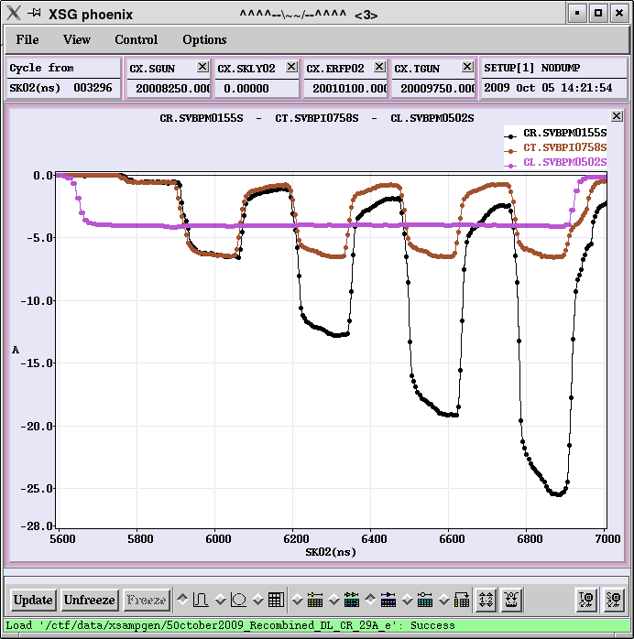
DB generation
Phase coding, satellite bunches,
R&D results and planning,
CTF3 measurements
Introduction
CTF3 experimental results
PHIN Photoinjector
Conclusion
Current from
Linac
Current after
Delay Loop
Current in the ring

Slide 2
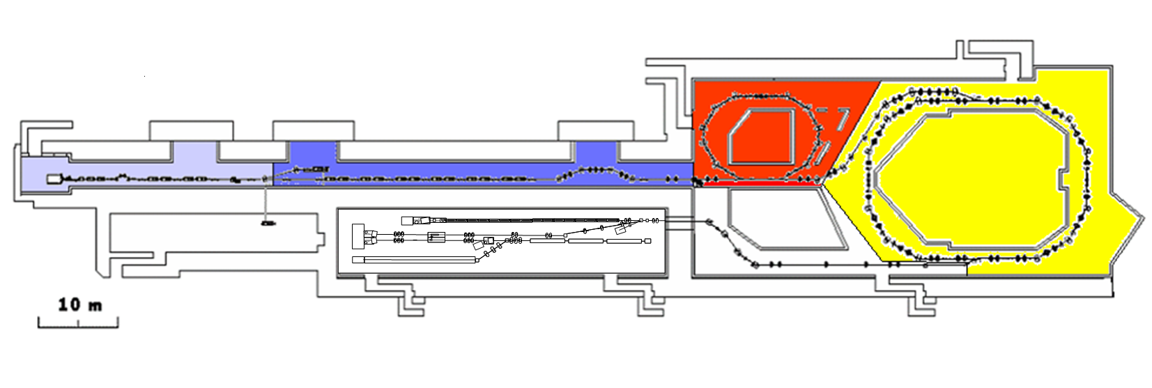
CTF 3 – CLIC Test Facility
demonstrate CLIC RF power source Drive Beam generation
(fully loaded acceleration, bunch frequency multiplication 8x)
Test CLIC accelerating structures
Test power production structures (PETS)aaaa
.
Delay Loop
42m
Combiner Ring – 84m
RF deflector
TL1
Injector
Linac
3.5A – 1.2µs
150 MeV
Laser
Test Beam Line - TBL
28A
140ns
150 MeV
TBTS
Califes
TL2
TBL
CLEX
Two Beam Test Stand - TBTS
Probe Beam - CALIFES

Slide 3
CTF3 base line programme
CTF3 – R&D Issues - where
recombination
x 4
recombination x 2
bunch length
control
bunch
compression
fully loaded
acceleration
PETS
on-off
structures
12 GHz
two-beam
acceleration
phase-coding
R1.1 – structures
R1.2 – DB generation
R1.3 – PETS on-off
R 2.1 – structure materials
R 2.2 – DB decelerator
R 2.3 – CLIC sub-unit
Deceleration
stability
structures
30 GHz
R.Corsini

Slide 4
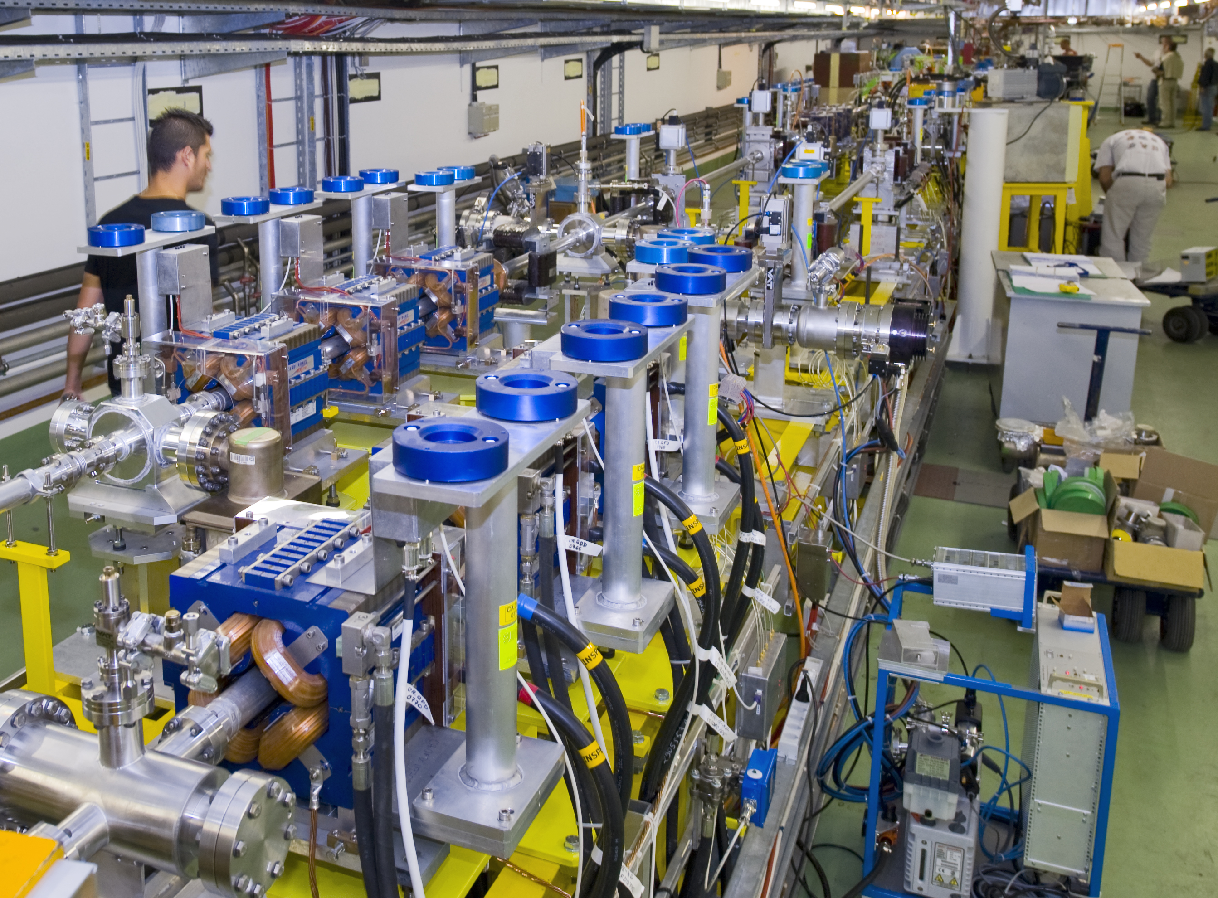

TBTS – Two beam test stand
Combined beam of Combiner Ring extracted
(up to 15A/28A), transported to CLEX
used for power production in TBTS and TBL
TBTS: Line for Two-beam acceleration studies
both Drive Beam and Probe Beam to the end
Optics and first breakdown kick measurements
170 MW (peak) RF power reached in
PETS power production structure
total pulse length ~200 ns
=> reached nominal CLIC power (135 MW)
acceleration structure is being installed now

Slide 5
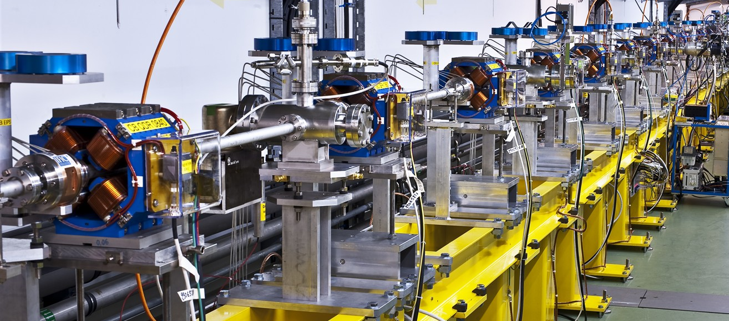
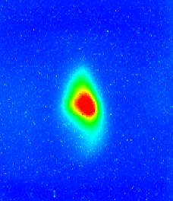

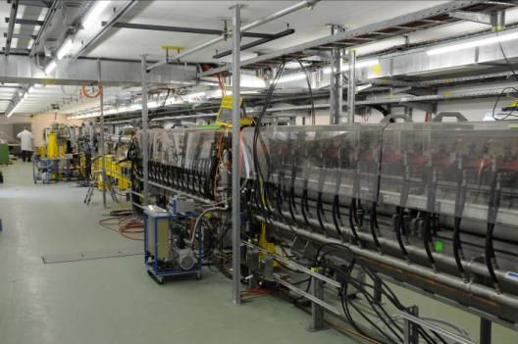
TBL - Test Beam Line / Califes
TBL: Line for deceleration studies
Installation of beam line with all magnets
and BPMs finished, 1st PETS prototype
installed (several more this year)
Beam transported to the end
10A beam generated 20 MW RF
power in the PETS structure,
follows expectation
Califes: Probe beam photo-injector
Laser performs well, nominal bunch charge reached, accelerated to 140 MeV
Beam transported to the end with ~100% transmission, reliable beam to TBTS
Detailed optics studies
CTF3/CLIC collaboration:
increased to 35 institutes

Slide 6
Comparison CLIC - CTF3
 | CTF3 | CLIC
Energy | 0.150 GeV | 2.4 GeV
Pulse length | 1.2 µs | 140 µs
Multiplication factor | 2 x 4 = 8 | 2 x 3 x 4 = 24
Linac current | 3.75 A | 4.2 A
Final current | 30 A | 100 A
RF frequency | 3 GHz | 1 GHz
Deceleration | to ~50% energy | to 10% energy
Repetition rate | up to 5 Hz | 50 Hz
Energy per beam pulse | 0.7 kJ | 1400 kJ
Average beam power | 3.4 kW | 70 MW
Still considerable extrapolation to CLIC parameters
Especially total beam power (loss management, machine protection)
Good understanding of CTF3 and benchmarking needed

Slide 7
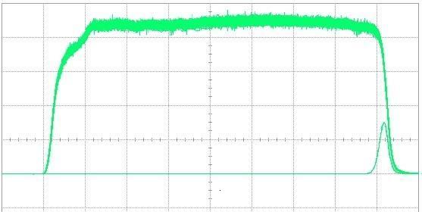
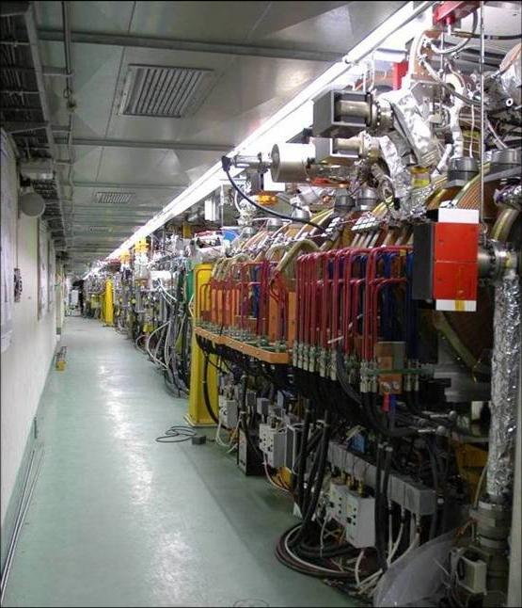
Full beam-loading acceleration in CTF3
high current routine operation demonstrated
RF pulse at structure input
1.5 µs beam pulse
RF pulse at structure output
analog signal
Measured RF-to-beam efficiency 95.3%
Theory 96%
(~ 4 % ohmic losses)
MKS03
MKS05
MKS06
MKS07
Spectrometer
4
Spectrometer
10

Slide 8
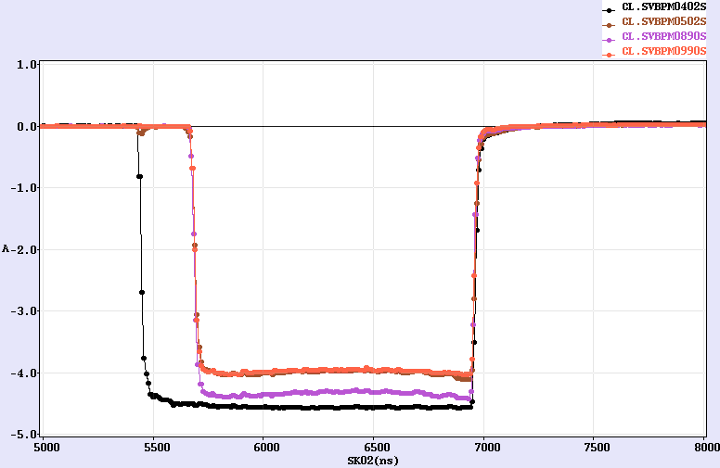
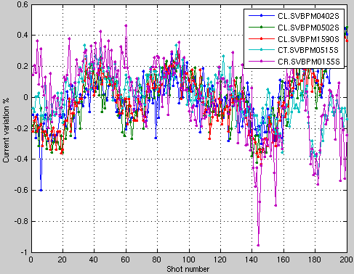
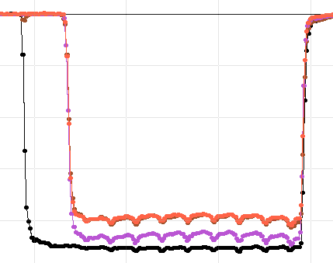
Beam current stability
operation sensitive to beam current variations
current stability ~ 0.15% end-of-linac, ~ 0.16% combiner ring
current variation over the pulse, also due to SHB phase switch
=> different energy
=> feed-forward will be implemented this run
badly
phased
SHB

Slide 9
RF / Beam energy stability
  RF phase stabilisation for klystrons put into operation
  => slow phase variation down to ~ 0.5 degree
  phase jitter ~ 0.1 – 0.2 degree (after compression)
  short term energy jitter from RF presently measured ~ 0.6 10⁻³
  slow power variation (from RF pulse compression) several %
  => temperature feed-back will be implemented this run
Klystron | PKI σ | PKI σ | PSI σ | PEI σ
 | MW | deg | deg | MW
MKS03 | 0.075 | 0.11 | 0.079 | 0.100
MKS05 | 0.115 | 0.16 | 0.074 | 0.089
MKS06 | 0.222 | 0.28 | 0.441 | 0.157
MKS07 | 0.080 | 0.41 | 0.083 | 0.187
MKS11 | 0.109 | 0.39 | 0.064 | 0.232
MKS12 | 0.154 | 0.28 | 0.069 | 0.154
MKS13 | 0.119 | 0.24 | 0.195 | 0.117
MKS15 | 0.080 | 0.19 | 0.215 | 0.066
Total |  |  |  | σ=0.59 µ=475
σ
Total RF power

Slide 10
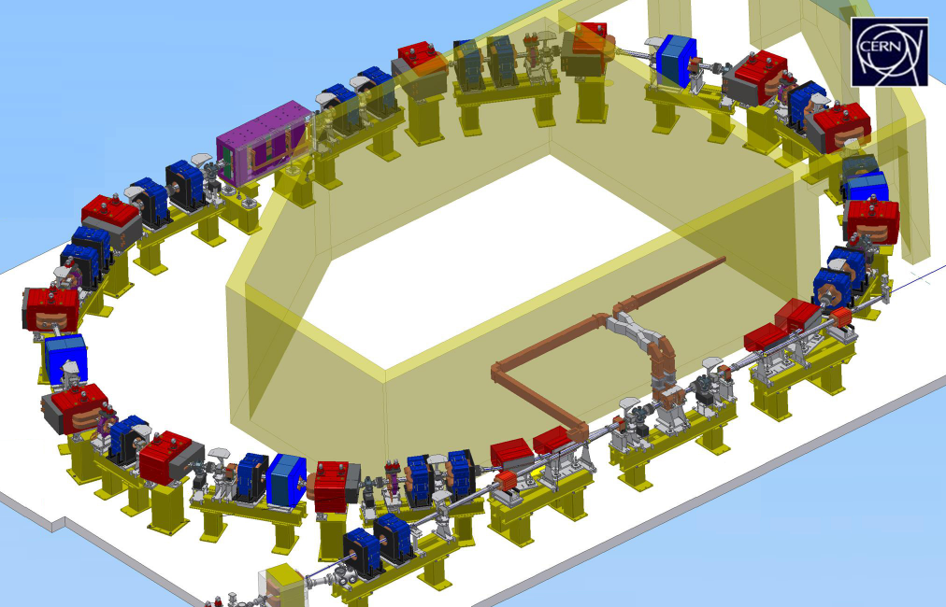

Delay Loop operation
TL1
SHB
2005
SHB
2004
gun
DL
CR
TL2
SHB
buncher
2 accelerating structures
CLEX
1.5 GHz sub-harm.
bunching system
1.5 GHz
RF deflector

Slide 11
SHB system – Phase coding
Key parameters for the SHB system: 1) time for phase switch < 10 ns (15 1.5 GHz periods)
2) satellite bunch population < 7 %
(particles captured in 3 GHz RF buckets)
phase switch:
satellite bunch population:
main bunch
satellite bunch
Phase switch is done within eight
1.5 GHz periods (<6 ns).
Satellite bunch population was
estimated to ~8 %.

Slide 12
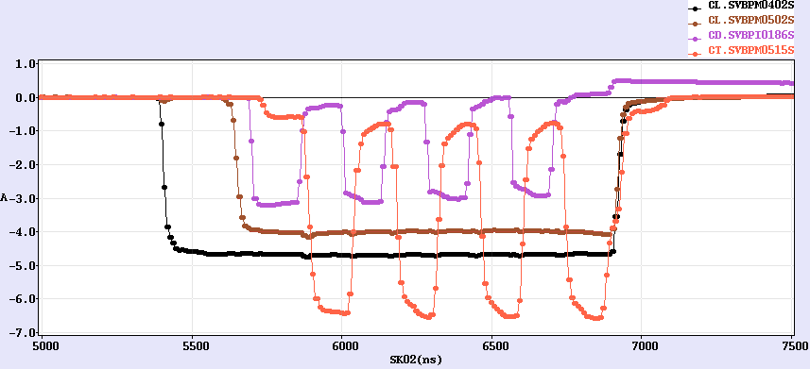
Delay loop status
DL
7A
CR
factor 2 combination re-established after 2 years
current about doubled, up to ~7 A (~0.5 A in satellites)
Current in the Delay Loop
Current after Delay Loop
Current from Linac

Slide 13
Demonstration of frequency multiplication

Slide 14
RF injection in combiner ring
combination factors up to 5 reachable in a ring
C_{ring} = (n + ¼) λ
1st turn
injection line
2nd
septum
1st deflector
2nd deflector
local
inner orbits
λ_{o}
RF deflector
field
3rd
4rd
λ_{o}/4

Slide 15
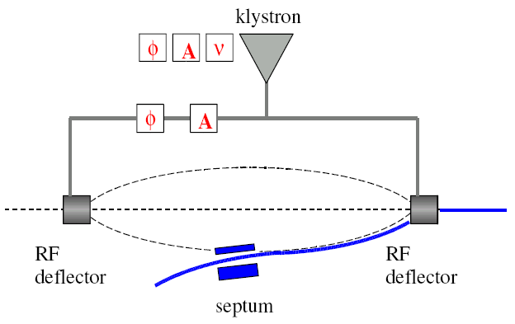
Combination setup procedure
Developed a setup procedure to optimize combination
5 parameters
  Amplitude and phase in each deflector
  Ring path length (wiggler for path length tuning)
Monitor trajectory differences over various turns
s

Slide 16
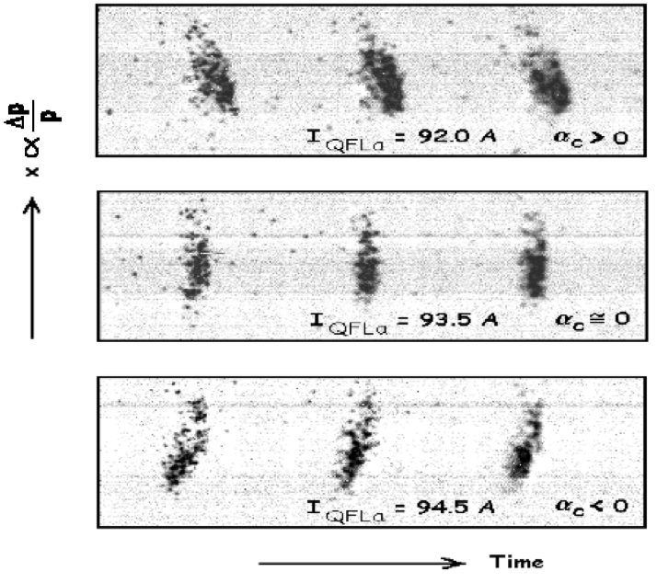
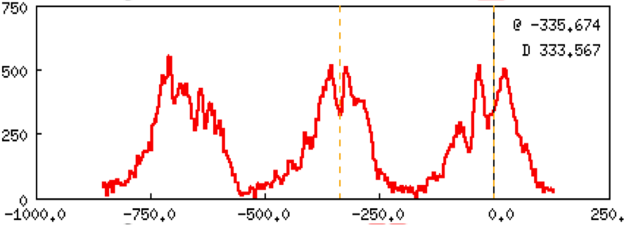
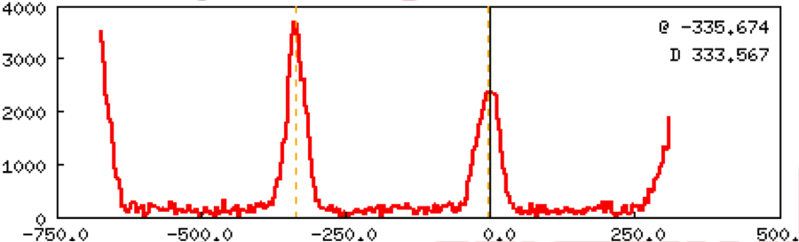
Isochronicity Tuning
ring optics needs to be isochronous to keep short bunch length
=> high power extraction efficiency
Streak Camera observations
non-isochronous – 2nd turn
isochronous – 60th turn
momentum compaction
α_{p} < 10⁻⁴

Slide 17
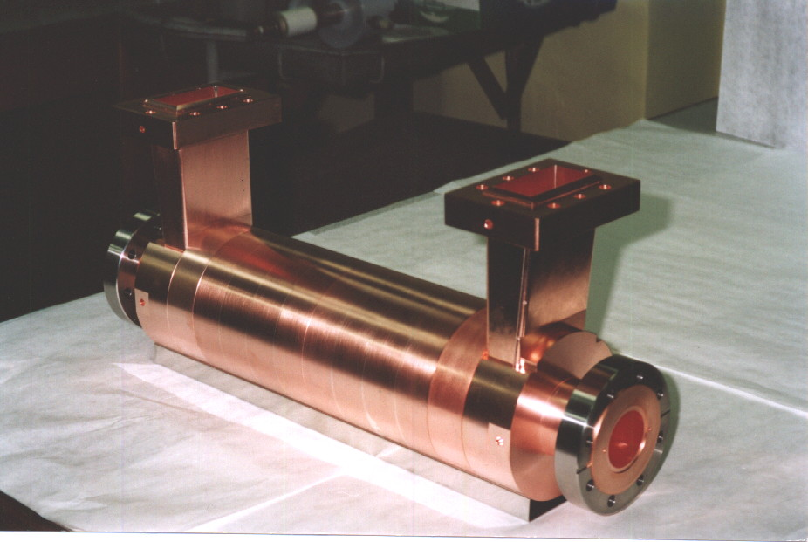
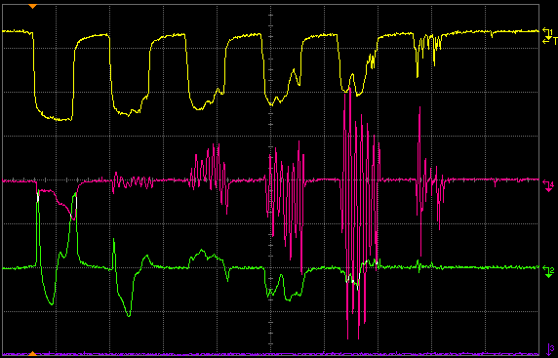
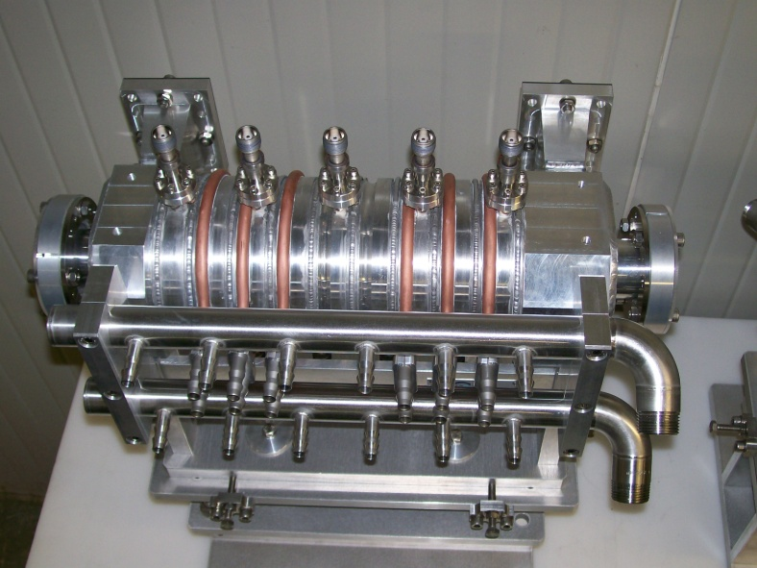
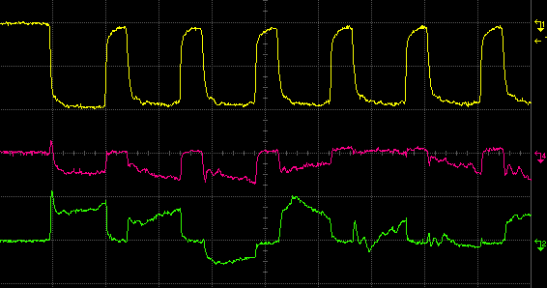
CR RF deflectors => Instability
RF deflectors had a vertical mode that deflected the beam
Could be minimized by proper phase advance – not done
effect perfectly understood, reproduced in simulation => not an issue
current
vertical
horizontal
Old deflectors, undamped
BPM signals shoving vertical instability
New deflectors, damped
damping loads
BPM signals, no instability

Slide 18
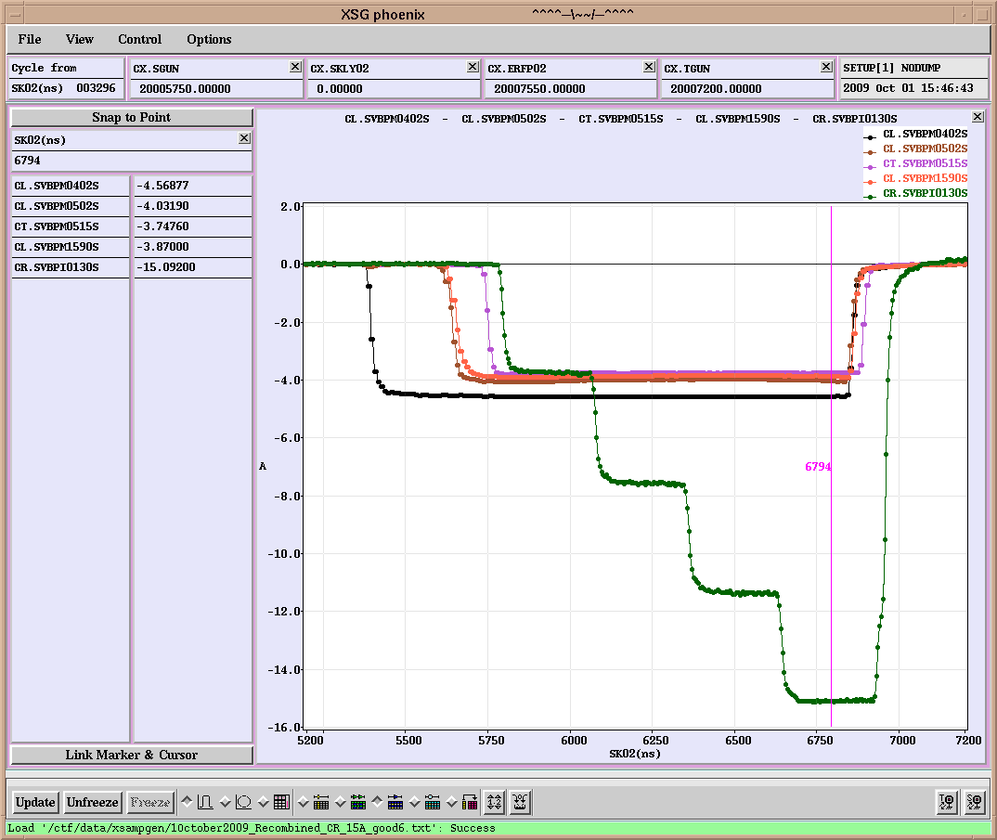
Combiner ring status
routinely factor 4 combination achieved with 15 A, 280 ns (without DL)
CR
15 A
280 ns
280 ns
Current from Linac
1st turn of 1st pulse
2nd turn of 1st pulse and
1st turn of 2nd pulse
3rd turn of 1st pulse,
2nd turn of 2nd pulse,
1st turn of 3rd pulse
Current in the ring
All 4 pulses

Slide 19
Factor 8 combination (DL+CR)
~28 A combined achieved, nominal 140 ns pulse
DL
CR
30A
Current from
Linac
Current after
Delay Loop
Current in the ring

Slide 20
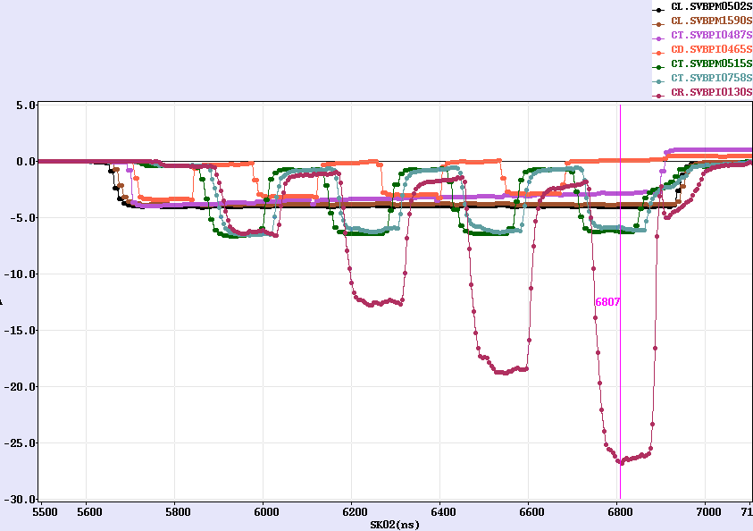
Factor 8 combination (DL+CR)
Current from
Linac
Current after
Delay Loop
Current in the ring

Slide 21
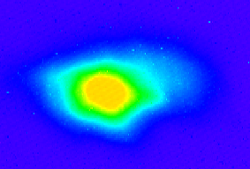
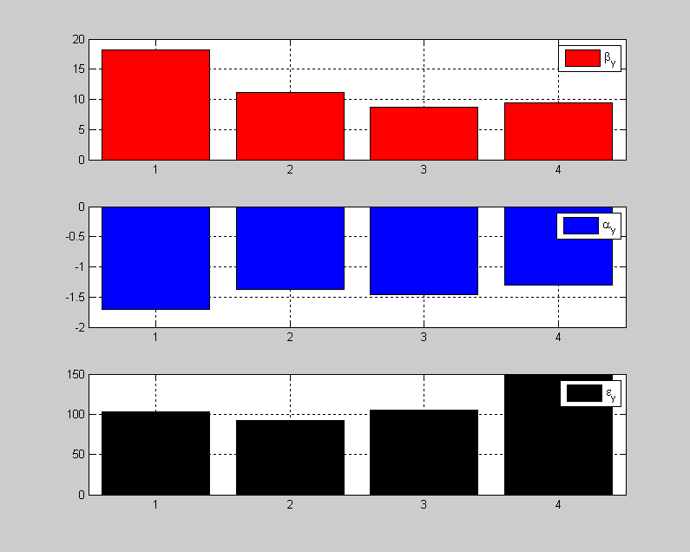
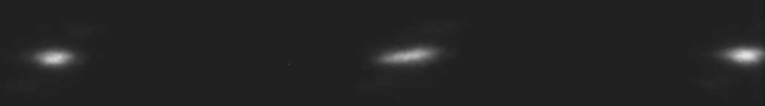
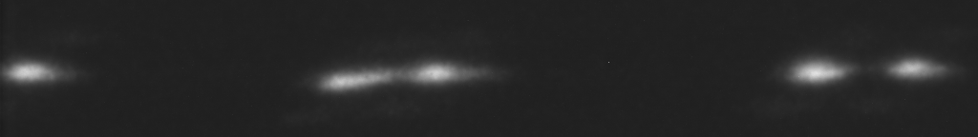
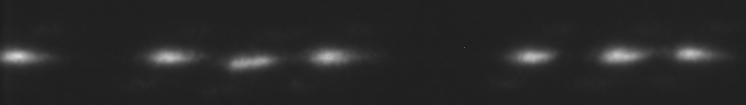
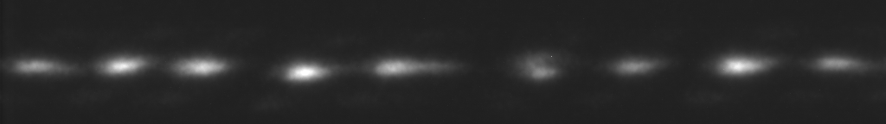
Recombination studies
emittance measurement (vertical plane)
combined 4x beam < 150 π mm mrad
streak camera measurements
orbit closure well controlled
combination to be optimized
dispersion/isochronicity
666 ps initial bunch spacing
Turn 1
from
DL
Turn 2
Turn 3
Turn 4
83 ps final bunch spacing

Slide 22
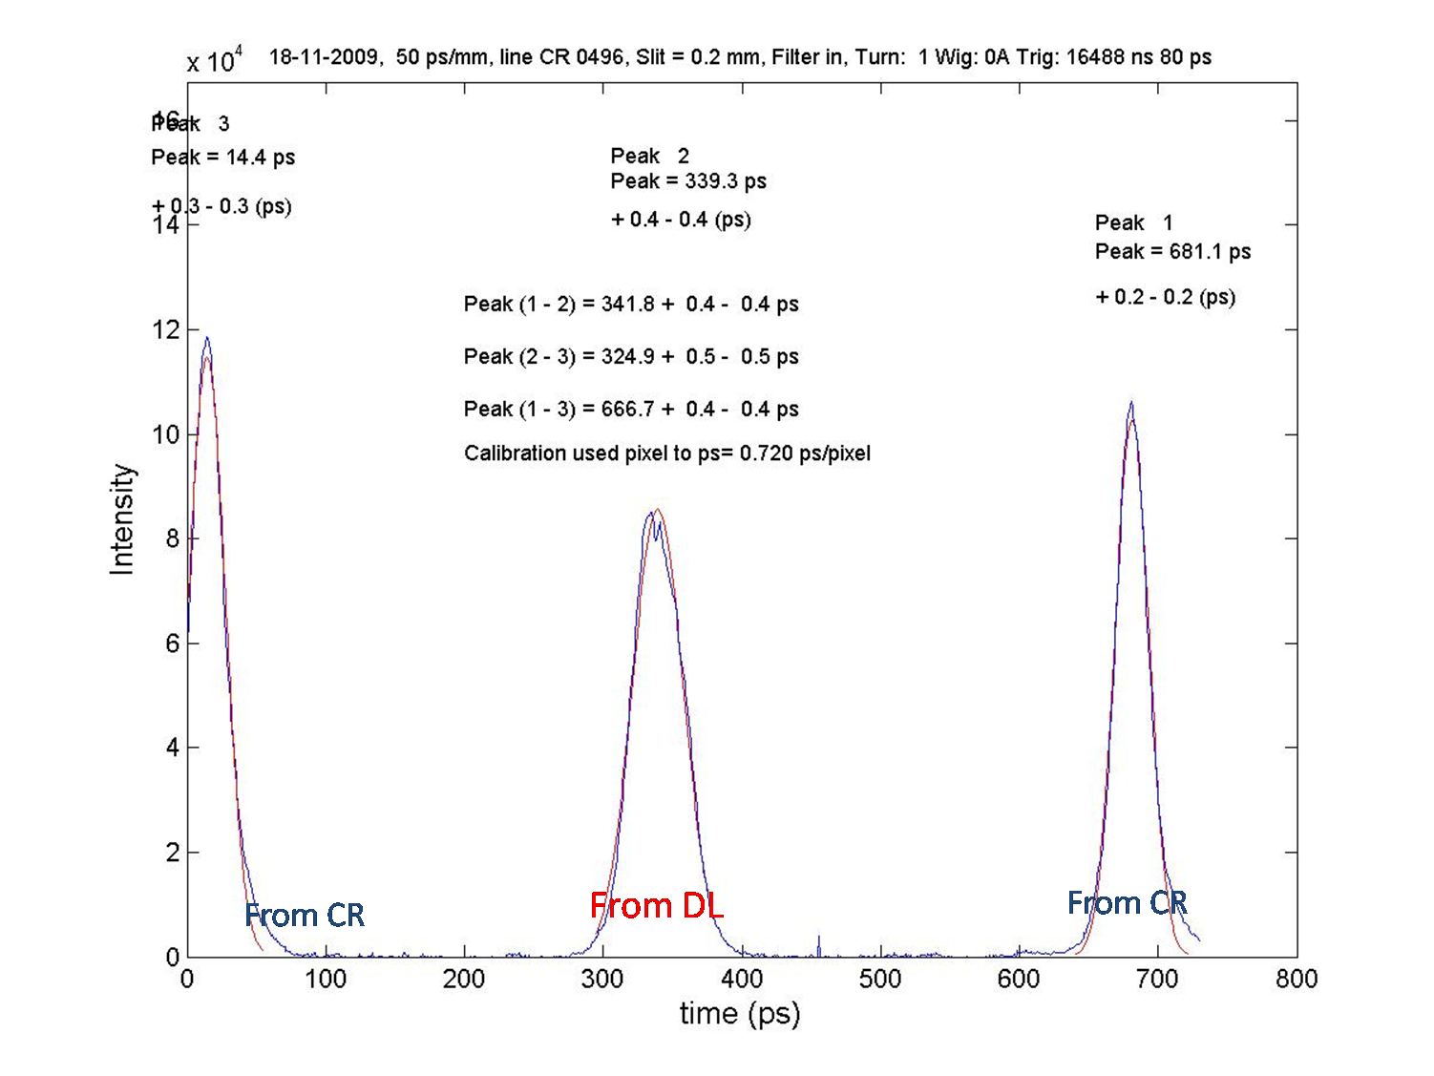
Adjustment of the path length
Wiggler behaviour as expected
CR: ~1.5 mm difference only
control to better than 0.5 mm
CF 5, - 1/5 λ_{RF}
About 1.5 mm
Expected ring length for nominal wiggler current
Measured Lfrac = - 1/CF λ_{RF}
CF 4, - 1/4 λ_{RF}
DL: correct length accessible =>

Slide 23
State of the art today
ongoing Drive Beam generation demonstration in CTF3.
  Full beam loading (95% transfer), high current (up to 5A) in DBA
  Sub-Harmonic bunching, phase coding (7% satellites)
  Bunch train recombination factor 2 in Delay Loop (up to ~7 A)
  Bunch train recombination factor 4 in Combiner Ring (3.8 to 15 A)
  Recombination 2x4 DL/CR achieved ~ 28 A
  Isochronous operation of ring, α_{p} < 10⁻⁴
  Transverse rms emittance 100 π mm mrad (end of linac only)
  150 π mm mrad (vert., 4x combination)
  Bunch length control to < 1 mm rms (end of linac only)
  Control of ring length to better than 0.5 mm
  Beam current stability ~ 0.15% end-of-linac, ~0.16% combiner ring

Slide 24
To be addressed …
Dispersion / isochronicity in DL/CR
Full bunch length manipulations in TL2 after combination
(we see from RF that the form factor is close to 1)
full beam (28 A) to users (new TL2/CLEX BPM readout)
RF power production in CLEX
Two-beam operation in TBTS (relevant CLIC sub-unit)
(we started with CCC operator supervision)
Deceleration stability
Loss management, machine protection system
Satellite bunches
Photo injector option
…

Slide 25
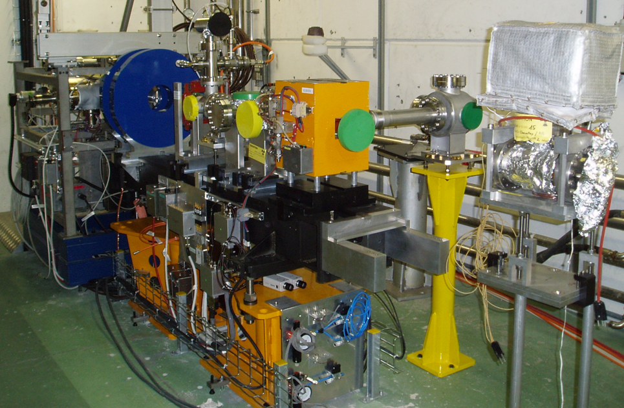
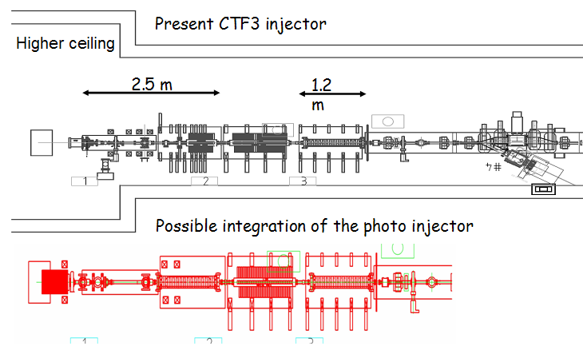
PHIN Photo-injector
Smaller transverse emittance, shorter bunches, no energy tails, no satellites
Bunch charge lower than present injector
shown up to 2.5 nC, above nominal!, also 2.3 nC for long train reached
Beam energy ~ 5-6 MeV
Emittance measured ~7 π mm mrad
Very good agreement with simulations
started to measure laser/beam stability:
better than requirements
Laser
size: x=0.74mm
E-beam
size: x=1.53mm
δ=0.15mm
δ=0.35mm

Slide 26
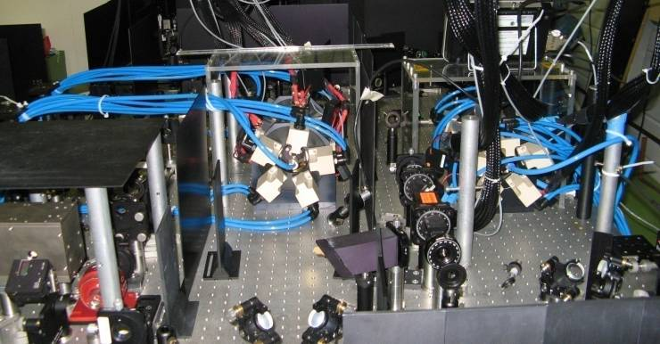
Laser system status
fulfilled PHIN photo injector requirements
micro bunches repetition rate | ns | 0.667
Synch to external rf @ 1.5GHz | ps | <1
micro bunch width (FWHH) | ps | <10
micro bunch energy (@ cathode) | nJ | 370
laser pointing stability std | mm | 0.5
setup significantly improved (beam path, optical crystal,…)
For PHIN all laser main target parameters fulfilled !!!
0.8% beam current stability (without feedback on the laser)
long term studies (cathode response, …) to be done
Laser phase coding to be demonstrated this year
  Booster amplifier needed (~ June)

Slide 27
Validation of DB scheme
Parameter | Unit | CLIC nominal | Present state | Objective 2010 | Objective 2012
I initial | A | 7 | 5 | 5 | 5
I final | A | 100 | 28 | 30 | 30
Q_{b} | nC | 8.4 | 4 | 2.5 | 2.5
Emittance, norm rms | π mm mrad | ≤ 150 | 100 (end of linac) ≤ 150 (y, comb. beam) | ≤ 150 (comb. beam) | ≤ 150 (comb. beam)
Bunch length | mm | ≤ 1 | ≤ 1 (end of linac) | ≤ 1 (comb. beam) | ≤ 1 (comb. beam)
E | MeV | 2400 | 120 | 120 | 150
T_{pulse} initial | μs | 140 | 1.4 | 1.4 | 1.4
T_{pulse} final | ns | 240 | 140 (240) | 140 (240) | 140 (240)
Beam Load. Eff. | % | 97 | 95 | 95 | 95
Deceleration | % | 90 | - | 30 | 50
Phase stability @ 12 GHz | degrees | 0.2 | - | ?
Intensity stability |  | 7.510⁻⁴ to few 10⁻⁵ | few 10⁻³ | 10⁻³

Slide 28
Conclusion
Drive Beam generation very well covered
  fully loaded operation demonstrated and routinely used
  full bunch train combination 2x4 shown (DL+CR)
  optimization procedures developed
  started to address performance and stability
next major steps:
  two beam tests in TBTS
  drive beam deceleration in TBL
CTF3 experimental program + plans for 2010
=> see Roberto’s talk
Many THANKS to all collaborators!

Slide 29
Reserve

Slide 30
2009 CTF3 experimental program
Goals
30 GHz: One structure test (TM02) + breakdown studies
PHIN Beam characterization, reach ½ of nominal bunch charge
CALIFES Beam characterization, beam to TBTS (most likely still reduced current)
Delay Loop Back in operation, retrieve combination x 2 (~ 7 A)
Combiner Ring Final optics checks, isochronicity, put together with DL (> 24 A)
TL2 Complete commissioning (tail clipper), bunch length control, > 20 A to users
TBTS PETS to nominal power/pulse length (15 A, recirculation)
Beam commissioning of probe beam line
First accelerating structure tests (one structure ? – CLIC G)
Two-beam studies (deceleration/acceleration), initial breakdown kicks studies
TBL PETS validation (100 MW, need > 20 A), beam line studies (2-3 PETS ?)
Others CDR studies in CRM, beam dynamics benchmarking, stability studies, control of beam losses…

