Slide 1
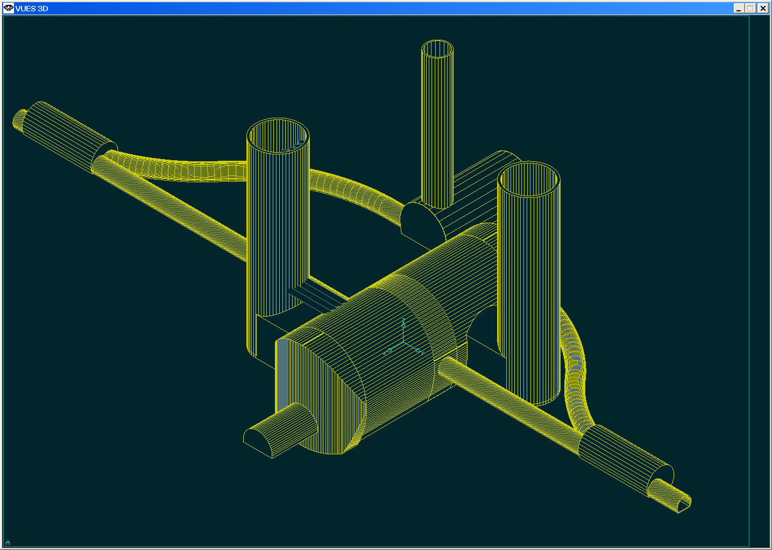
Machine Layout
ACE meeting 3-2-2010
Lau Gatignon / CERN-EN-MEF
For MDI and associated WG

Slide 2
Outline
Introduction
The QD0 magnet
Ground motion and QD0 support
QD0 stabilisation
Shortening the detector
L*
Intra-pulse feedback
Prealignment
New ideas
Conclusion

Slide 3
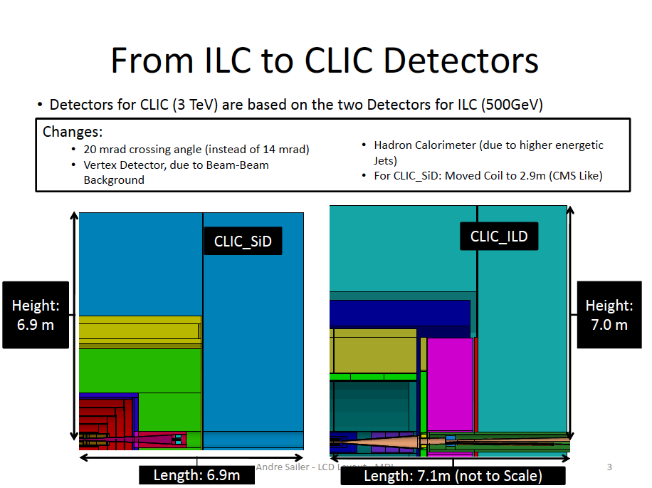
(R → 30 mm)
R

Slide 4
Final Focus Quadrupole (QD0): Parameters
Parameter | Value
Gradient [T/m] | 575
Length [m] | 2.73
Aperture radius [mm] | 3.83
Outer radius [mm] | < 50
Peak field [T] | 2.20
Tunability of gradient from nominal | [-10%, 0%]
– for spent beam

Slide 5
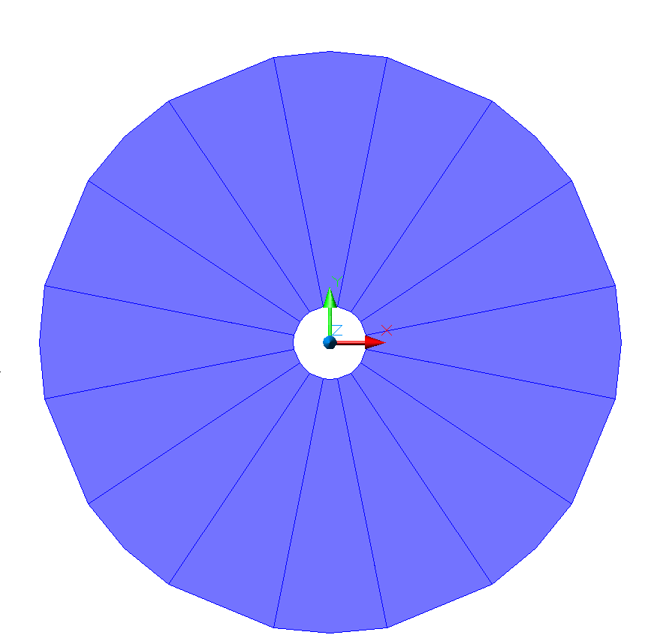
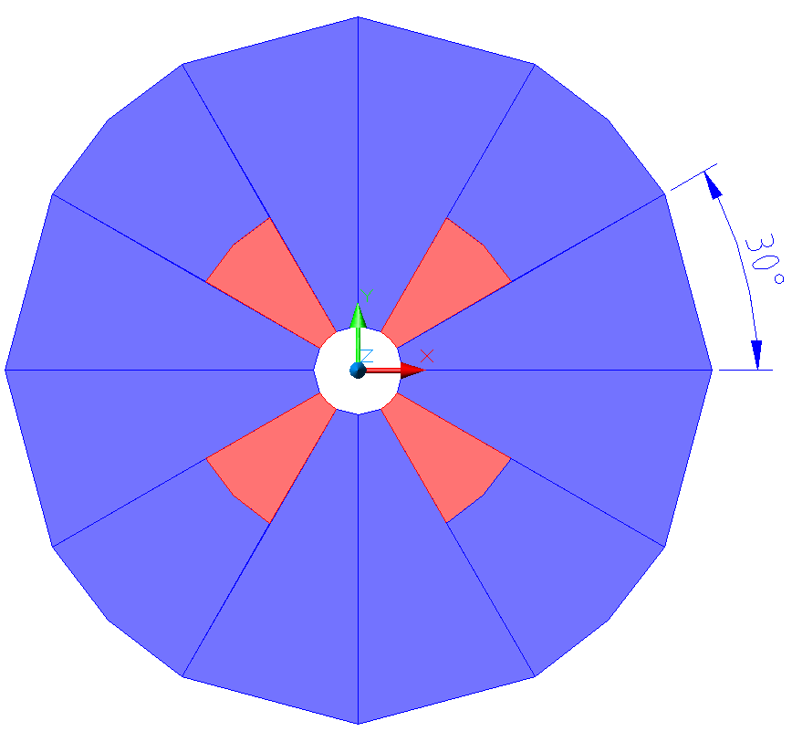
(Courtesy A. Vorozhtsov)
QD0 Design
“Halbach” vs. “Super Strong” performances:
G_{nom} = 575 T/m
R_{nom} = 3.8 mm
Permendur
PM
 | R=3.8 [mm] (no chamber) |  | R=4.125 [mm]
Material | Sm₂Co₁₇ | Nd₂Fe₁₄B | Sm₂Co₁₇ | Nd₂Fe₁₄B
Grad [T/m] “Halbach” | 450 | 593 | 409 | 540
Grad [T/m] “Super Strong” | 564 | 678 | 512 | 615
“CLIC09 Workshop” 12-16 October 2009 , M. Modena

Slide 6
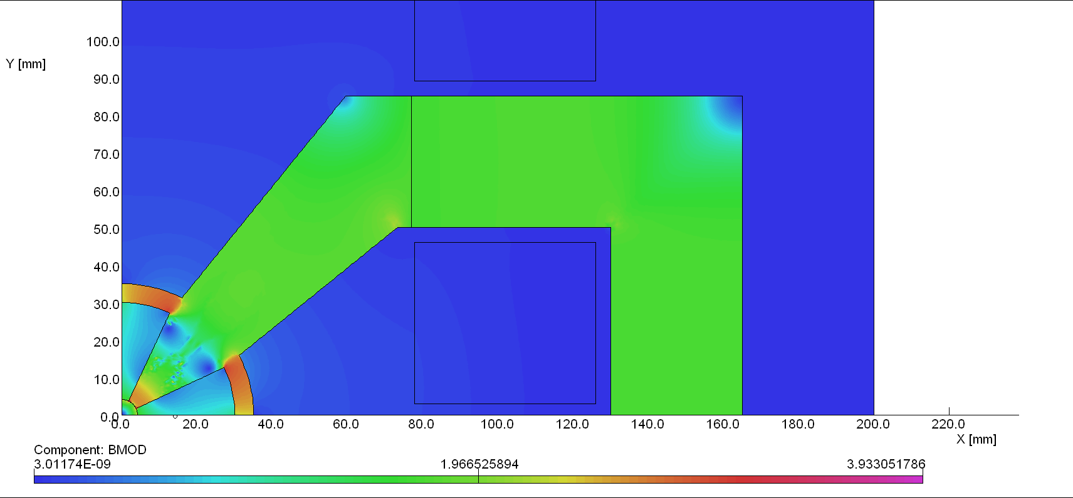
“Hybrid” approach, Version 2:
 | Iw=5000 [A]
Grad [T/m] Sm₂Co₁₇ | 531
Grad [T/m] Nd₂Fe₁₄B | 599
The presence of the “ring” decrease slightly the Gradient (by 15-20 T/m) but will assure a more precise and stiff assembly
EM Coils design will permit wide operation conditions (with or without water cooling) that can be critical for performances (ex. stabilization)
“CLIC09 Workshop” 12-16 October 2009 , M. Modena

Slide 7
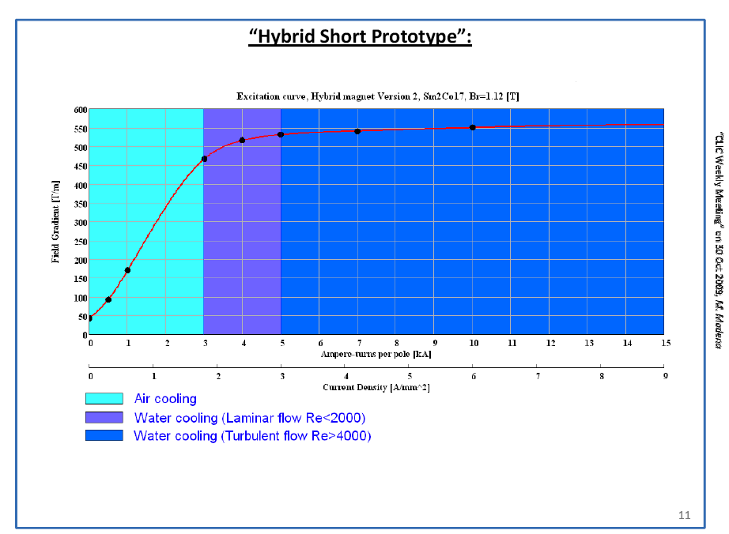

Slide 8
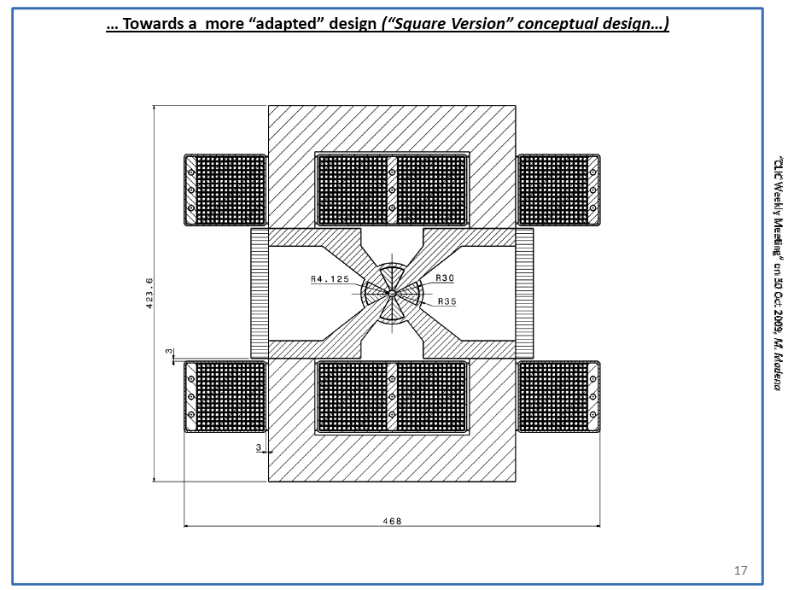

Slide 9
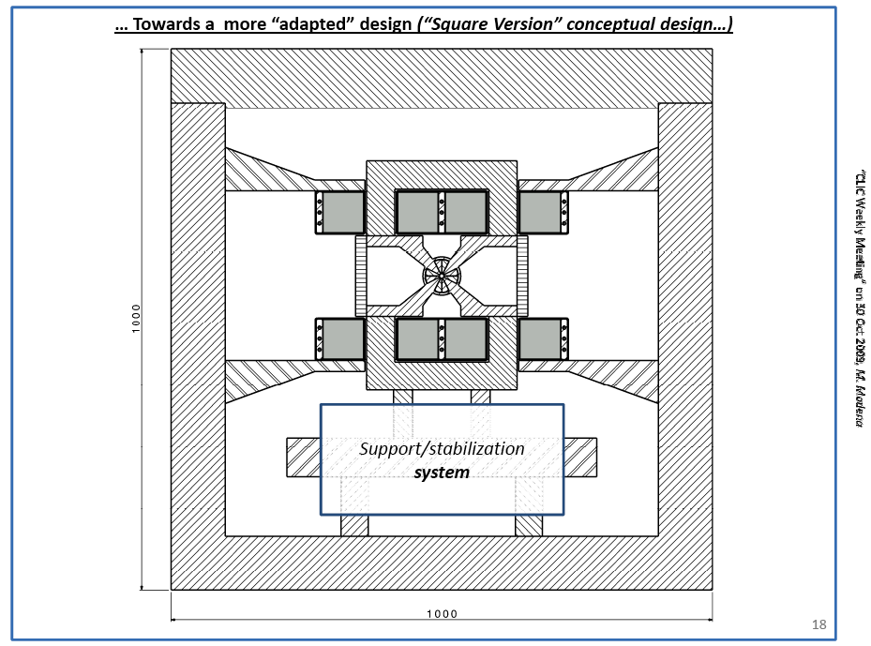

Slide 10
Slightly revised version of previous figure – M.Modena
“Hybrid” approach, Version 2:
 | Iw=5000 [A]
Grad [T/m] Sm₂Co₁₇ | 531
Grad [T/m] Nd₂Fe₁₄B | 599
The presence of the “ring” decrease slightly the Gradient (by 15-20 T/m) but will assure a more precise and stiff assembly
EM Coils design will permit wide operation conditions (with or without water cooling) that can be critical for performances (ex. stabilization)
“CLIC09 Workshop” 12-16 October 2009 , M. Modena

Slide 11
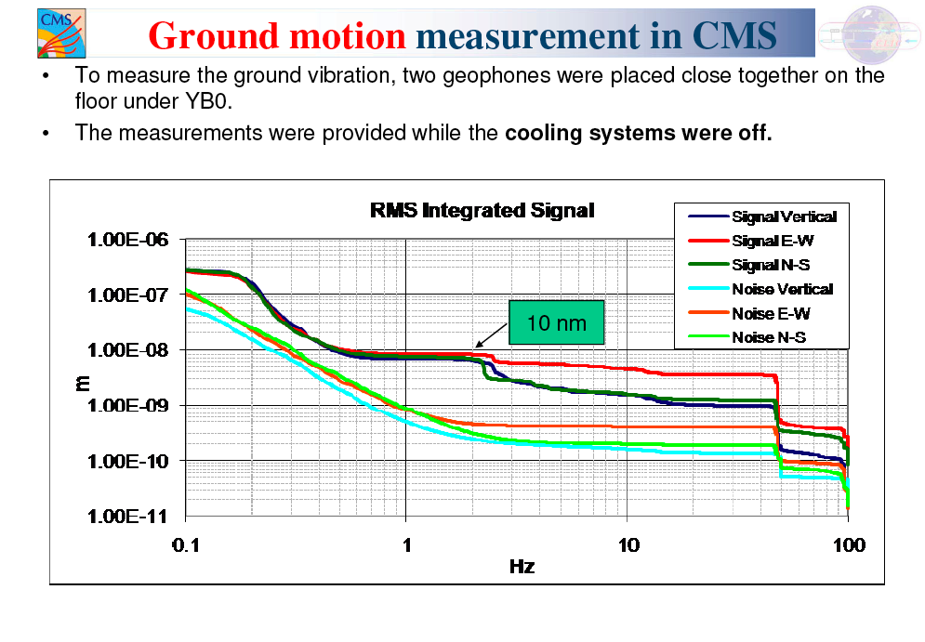

Slide 12
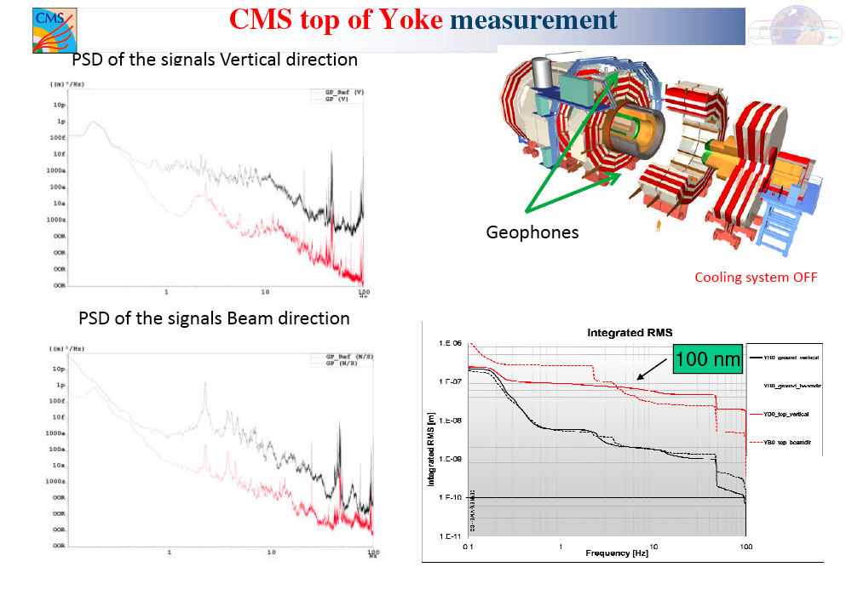

Slide 13
Supporting QD0 in CLIC
Measurements tend to confirm the idea that the QD0 support must be independent from the experiment.
However, to obtain the peak luminosity, the last focusing magnet must penetrate inside the experiment.
To get the best results, the QD0 support must be shortened and strengthened.
In addition the nearby machine and experimental areas must be designed to minimize (suppress) ground vibration.
A.Herve, H.Gerwig, …

Slide 14
Alternative scheme to support QD0
If CLIC experiments abandon the opening on IP (which is very limited and not so important if the push-pull movement is as quickly done as expected) then there are solutions.
One can move a solid supporting point way inside the experiment
Transport this (decoupled) heavy support/QD0 assembly to the Garage position with the Experiment,
Then extract it.
It may be necessary to segment QD0, one part in the detector,
one part in the tunnel
A.Herve, H.Gerwig, …

Slide 15
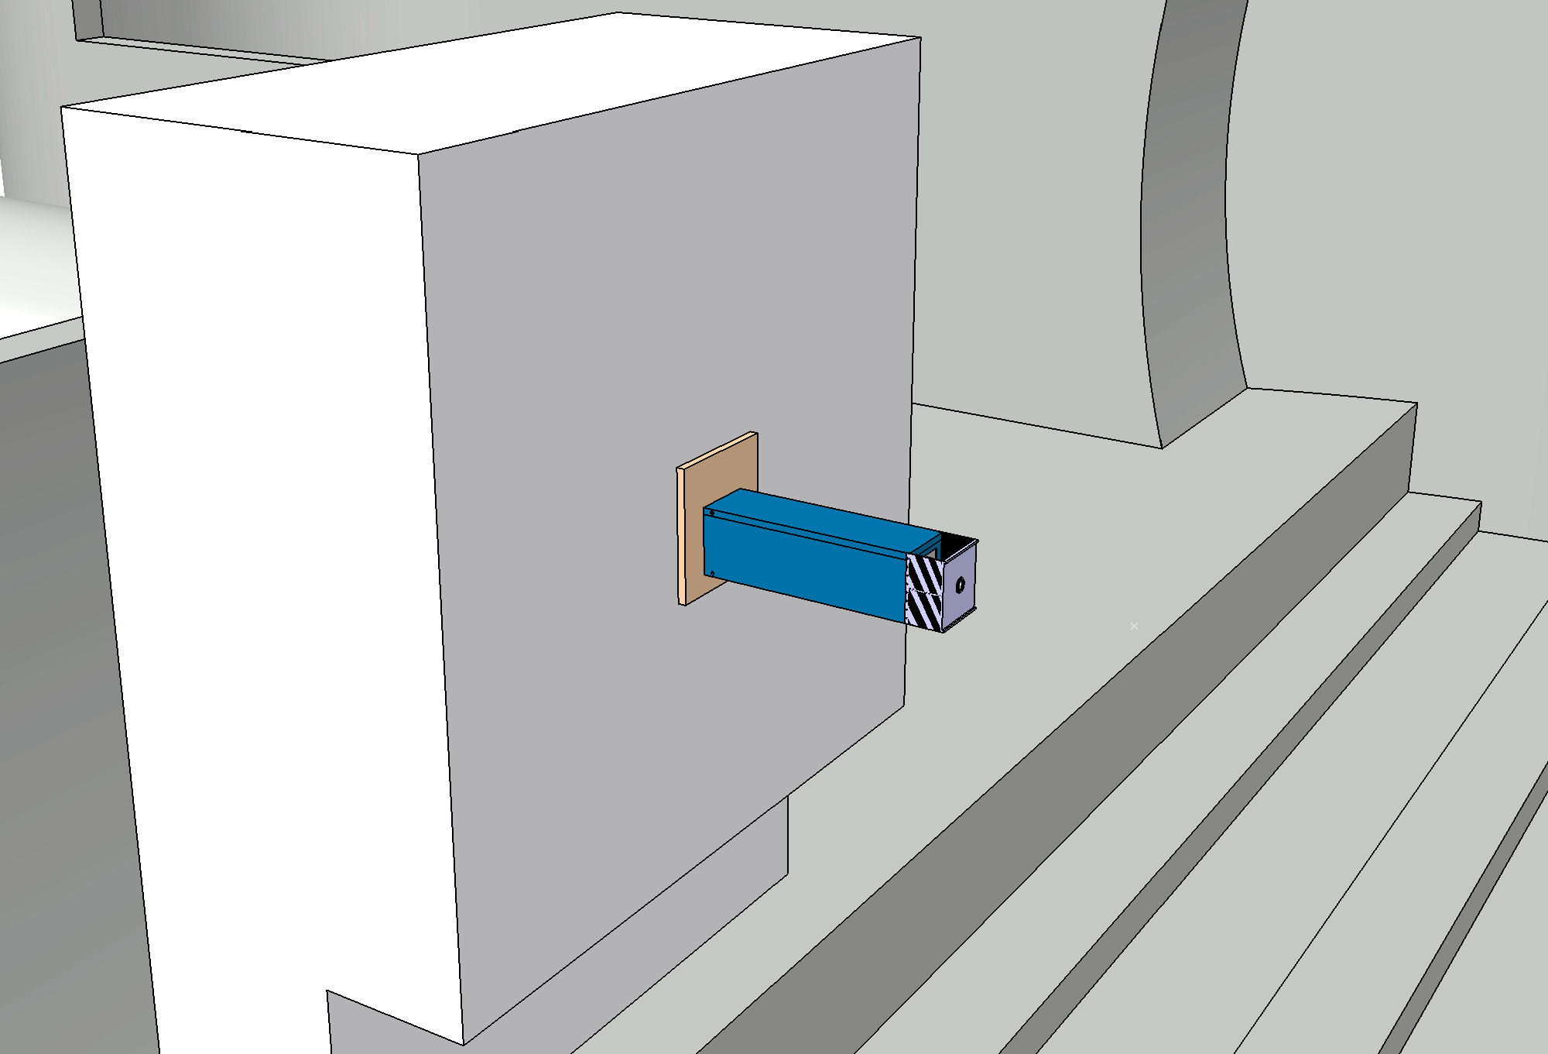
Alternative scheme to support in CLIC
At least 5m
concrete
for RP
Calculations under way for vibrations of such a report (H.Gerwig et al)

Slide 16

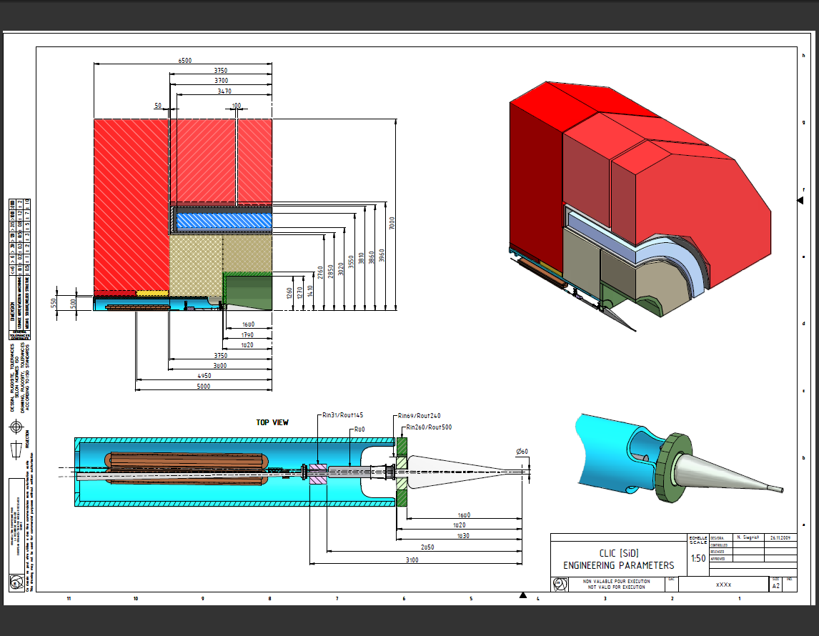
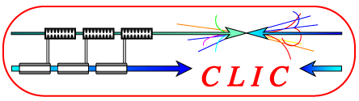
Baseline Detector Parameters for 5 T (‘SiD’) massive endcap, no endcap coils

Slide 17
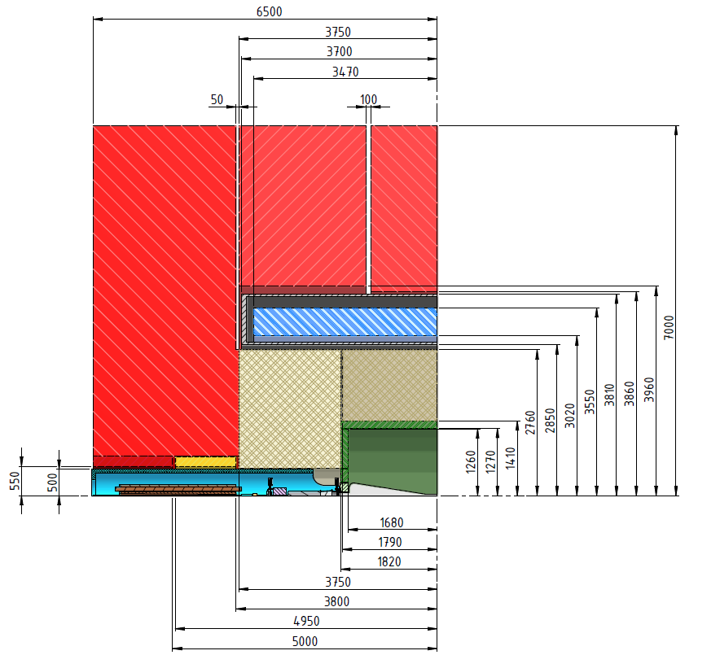
¼ Detector, details (SiD-ish)
Endcap yoke
+ muons
Barrel yoke
+ muons
Coil & vacuum tank
Endcap
HCAL
Barrel
HCAL
vertex
L* = 3800mm

Slide 18
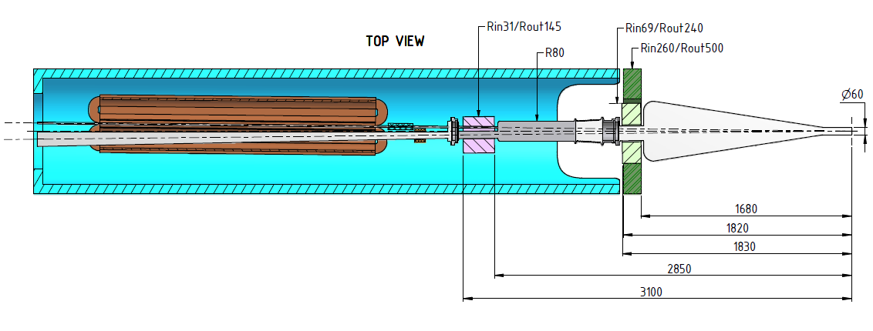
Support tube details (SiD-ish)
ECAL –ring
2nd valve
valve
Lumical
QD0,
max. length possible
= 2700 mm
BPM
Beamcal
Kicker

Slide 19
Some final remarks on detector layout
An engineering parameter drawing for the CLIC_SiD exists
L* of 3800 mm and a QD0 of 2700 mm for this detector are realistic
A parameter drawing will be created for the second detector, too
Then fine-tuning can be undertaken (endcoils, length of QD0…)
The support tube may be a 2 in 1 type (=separate tube for QD0)
In order to advance the position of the kicker inside the support tube, studies concerning Beamcal are under way
……..

Slide 20
QD0 Stabilisation
Any movement (vibration) of the QD0 quadrupole would lead to a deplacement
of the beam at the IP comparable to the movement of the magnet
As the vertical spot size is about 1 nm, the quadrupole position must be stabilised
to 0.15 nm in the vertical plane and 5 nm in the horizontal plane for frequencies > 4 Hz.
Beam-beam feedback will help.
A R&D program is under way for the stabilisation, based on passive and active
stabilisation and cantilever based stabilisation.
The integration in the experiment (push-pull) is still an open issue.
Studies are under way.
A review of stabilisation options is planned around the end of the year.
In case the L*≈3.5 m (2009 baseline) option seems unrealistic, larger L* values
may have to be considered for the CDR

Slide 21
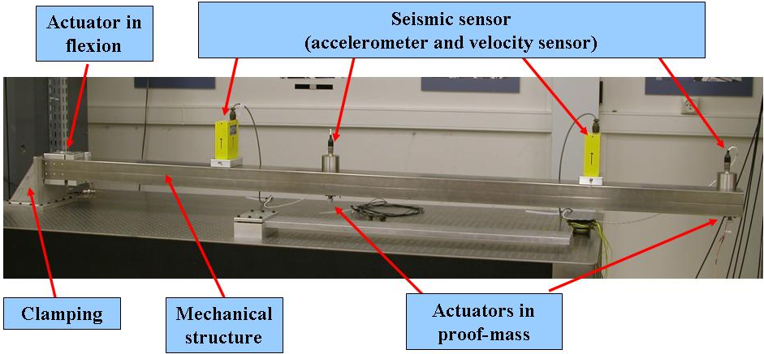
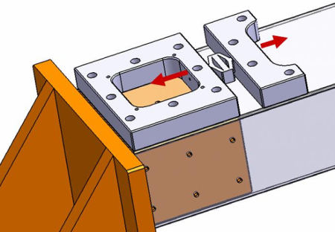
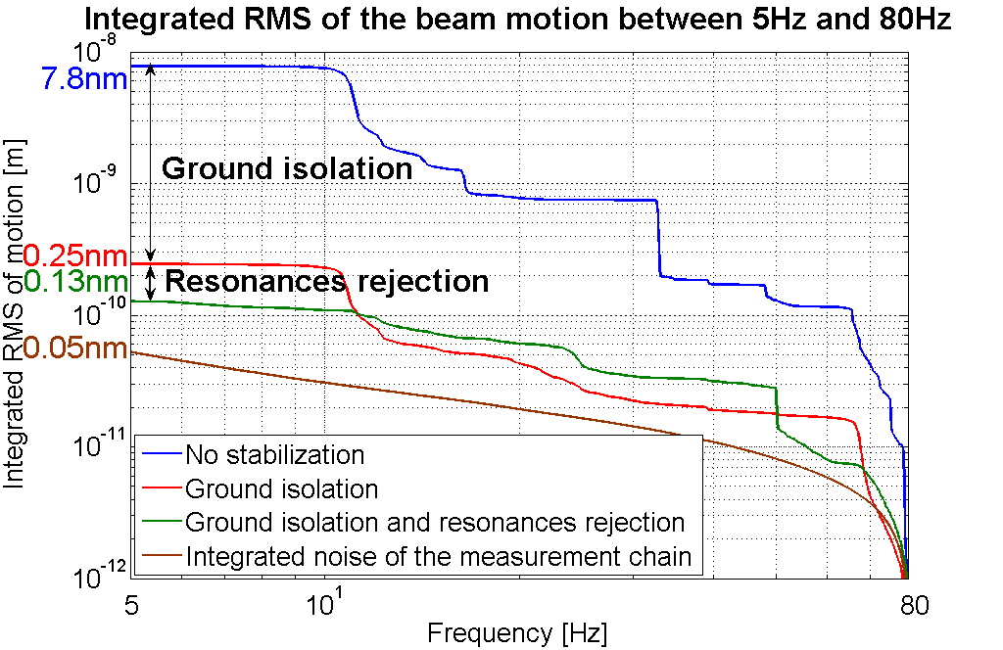
Achieved performance
L.Brunetti et al (EPAC/Genova 2008)
LAPP active system for resonance rejection
CERN TMC active table for isolation
The two first resonances entirely rejected
Achieved integrated rms of 0.13nm at 5Hz

Slide 22
Only if unsuccessful: consider larger L*
In the past some studies were made for L* = 8 m, however not fully optimised
If L* = 8 m: QD0 would be in the tunnel, i.e. have a much more stable support (in principle)
But some heavy prices to pay (Luminosity, prealignment, …)
Would prefer intermediate value (e.g. 6 m)?
Being followed up for ~6 m
Parameters | L* = 3.5 m | L* = 8 m
Luminosity | L_{o} | 0.72 L_{o}
QD0 support | Detector | Ground
QD0 gradient | 575 T/m | 323 T/m
QD0 grad tolerances | 5 10⁻⁶ | 3 10⁻⁶
Final focus length | 400 m | 800 m
QD0 length | 2.73 m | 4.2 m
QD0 aperture radius | 3.8 mm | 6 mm
QD0 jitter | 0.15 nm | 0.18 nm
Prealignment | 10 μm | 2 μm
From Rogelio Tomas

Slide 23
Thinner endcap + coils???
Warm coils type
LHCb / ALICE
but in Copper

Slide 24
Comparison of field quality
 | ILD | Air ‘endcap’ | Hybrid
IP | 4.050 T | 3.210 T | 3.875 T
1m | 3.925 T | 3.105 T | 3.775 T
2m | 3.800 T | 2.730 T | 3.550 T
3m | 3.375 T | 2.125 T | 3.125 T
Compar. | 100% | ~75% | ~95%

Slide 25
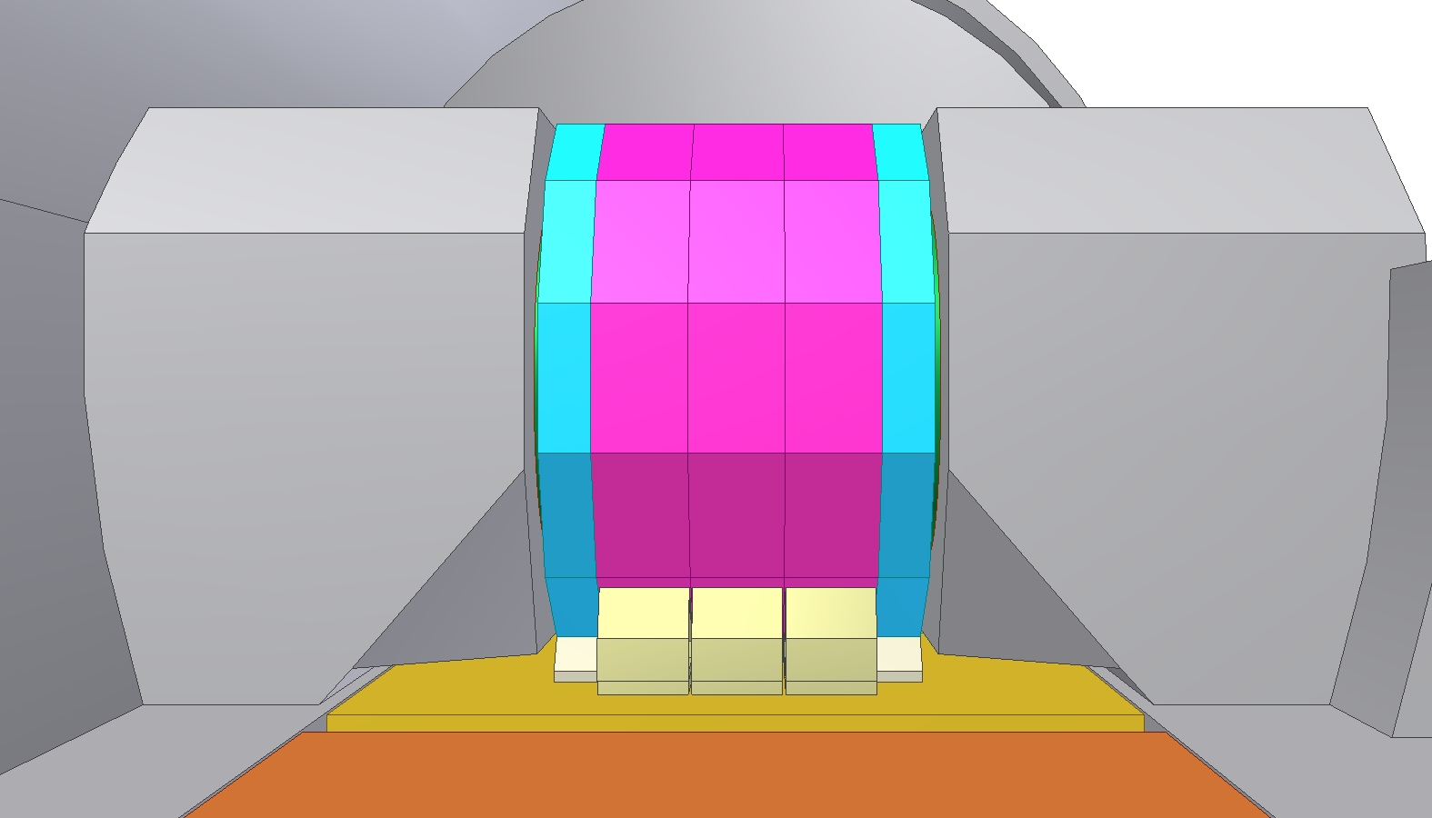
Side View
Thin endcaps
Tunnel part

Slide 26
Present choice of L*
A detailed drawing exists for a CLIC-SiD layout compatible with QD0, with L*=3.8 m
A similar drawing for CLIC-ILD in well advanced, but not yet ready.
But the L* for such a detector is known to be 4.6 m
Knowing that
- most of the work so far has been done on L*=3.5 m (close to 3.8 m) BDS, QD0, ….
- L* = 3.8 m gives the higher luminosity
the immediate efforts will concentrate on L*=3.8 m (for the CDR)
The L*=4.6 m is not discarded, however.
An alternative solution with QD0 installed in the tunnel will be considered as well.
The expected L* will be around L* = 6 m, assuming we shorten the end-caps.
This shall ease the stabilisation, but has an impact on the luminosity and
on the pre-alignment tolerance.
In that case L*=4.6 m is within the two extremes L* = 3.8 and 6 meters.

Slide 27
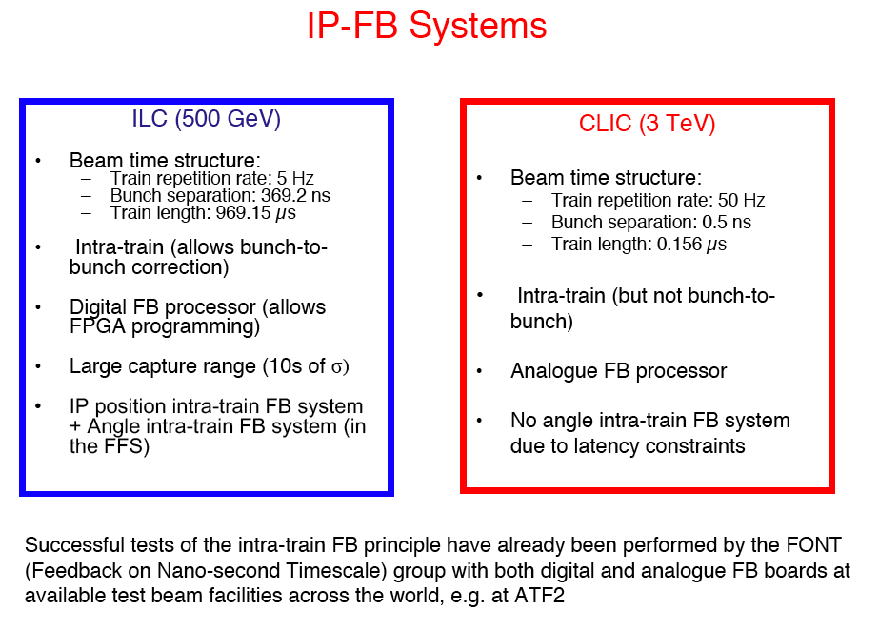
P.Burrows, J.Resta-Lopez

Slide 28
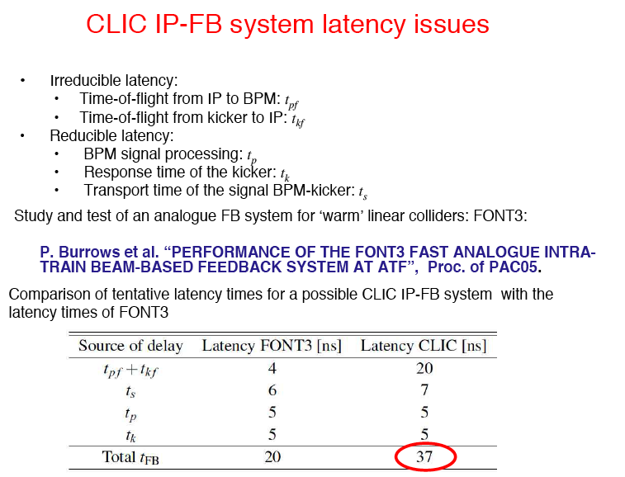
PRELIMINARY

Slide 29
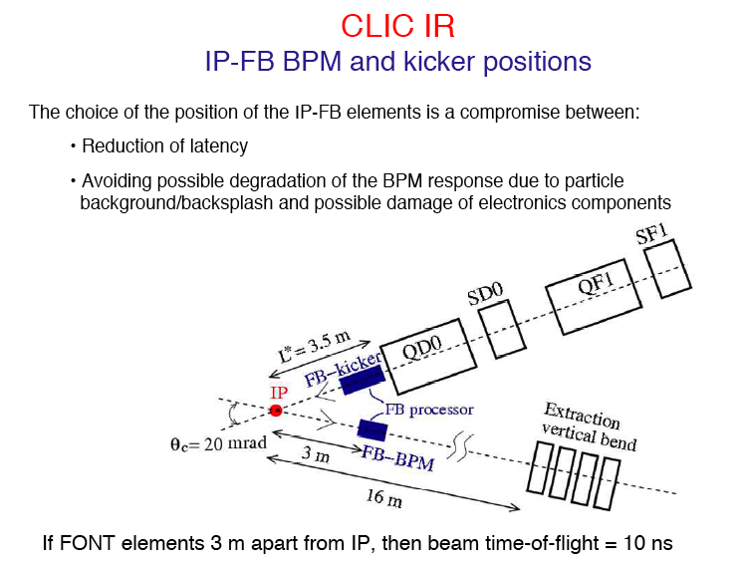
PRELIMINARY

Slide 30
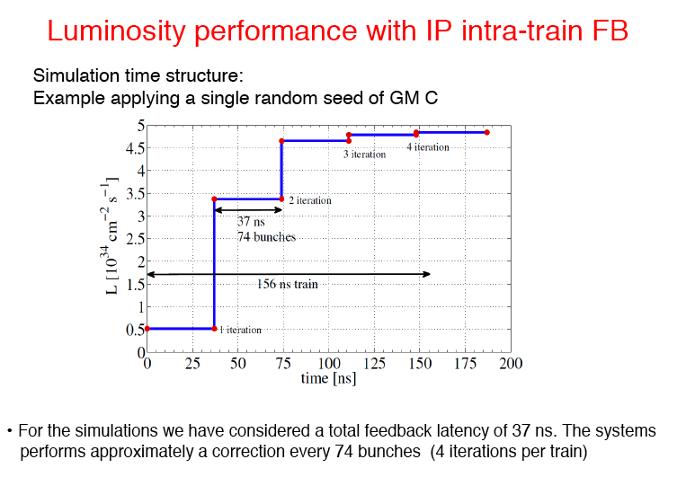

Slide 31
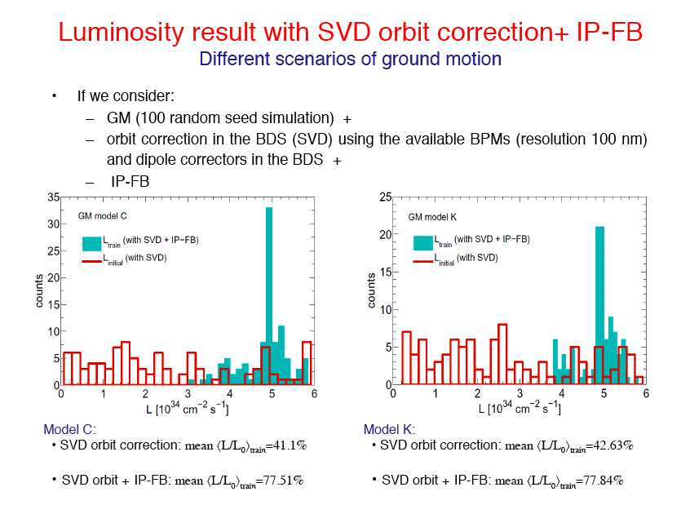
EXAMPLE:

Slide 32
COMBINED EFFECTS OF FEEDBACK, FEEDFORWARD AND STABILISATION
Combined calculations of all feedback systems, including QD0 suspension,
eventually complemented with a feedforward system based on ground
motion sensors, are being performed
By proper tuning of the QD0 support structures, the requirement on stabilisation
can be strongly reduced.
The results look quite promising.
See next presentation by Daniel Schulte

Slide 33
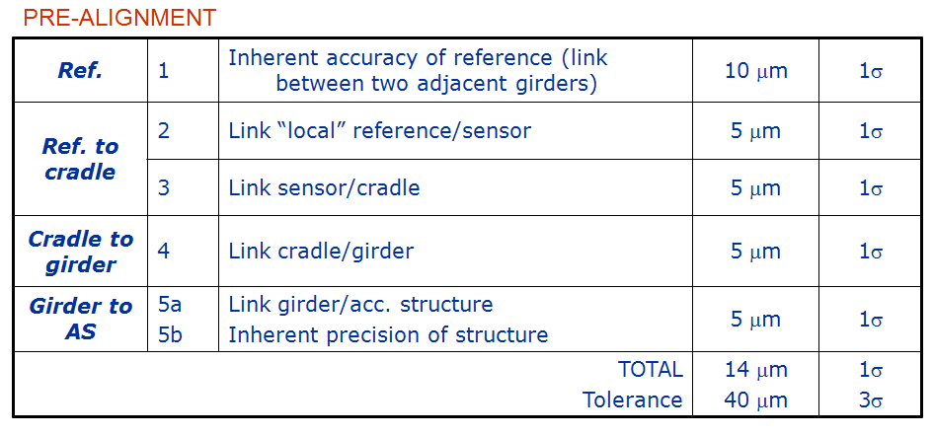
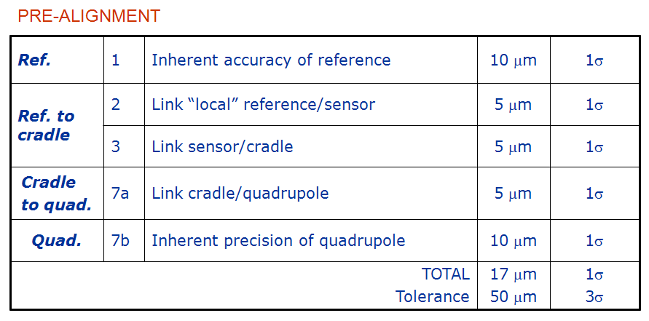
PRE-ALIGNMENT
Courtesy H.Mainaud
Case of the CLIC main linac
Some realistic data
Alignment model (input data for pre-alignment in beam dynamics simulations)
Case of girders
Case of MB quads
(2007)

Slide 34
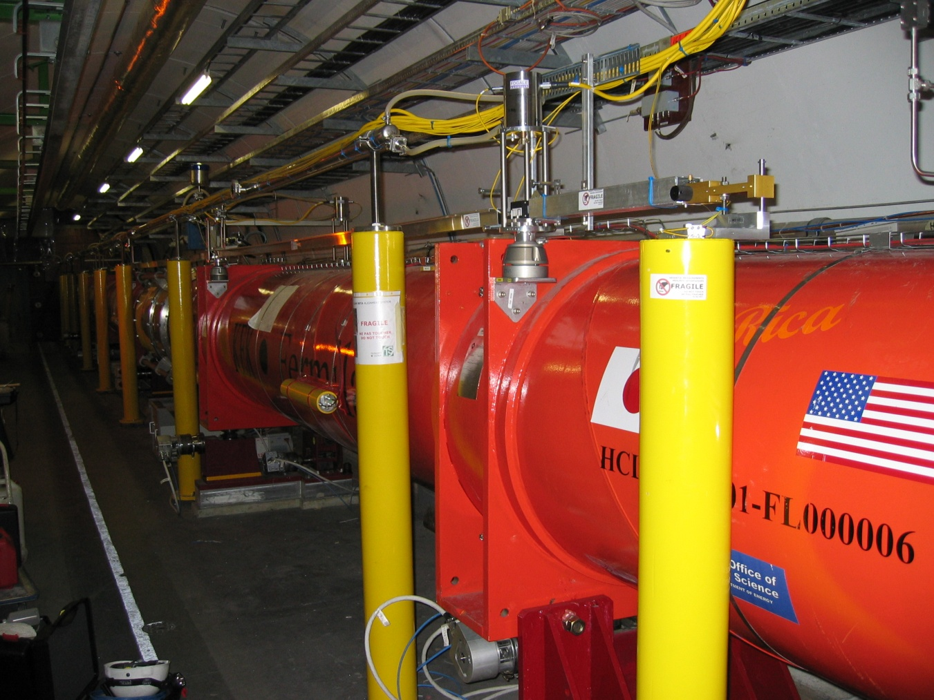
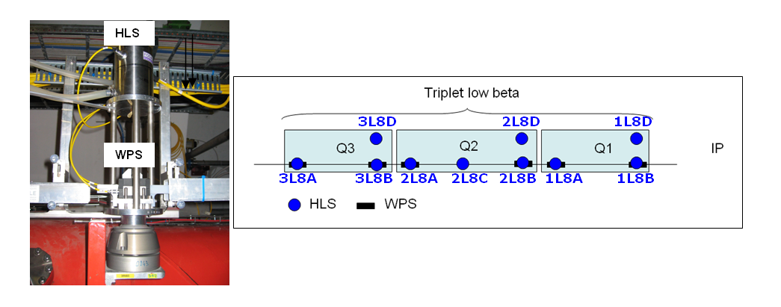
2 types of alignment systems:
Wire Positioning System WPS (reference of alignment : wire; sensors measuring the vertical and transverse offset w.r.t the wire (sub micrometric resolution)
Hydrostatic Levelling System HLS (reference of alignment is a water surface; sensors measuring the vertical distance w.r.t the reference)

Slide 35
CLIC pre-alignment in the MDI area
Measure of the position:
QD0 w.r.t. other components of the BDS:
  From the feasibility point of view, only « available » solution: stretched wire
  2 microns = impossible to achieve
  Seems difficult to have one wire over 500m
    sag ~ 0.5m
    Integration in the tunnel of one straight line as close as possible from the components to be aligned
  200m -> more realistic, but overlaps needed
  Solution to be integrated ASAP, with the other components of BDS
  The BDS are like 2 antennas: the « ideal straight lines » will have to meet at the IP. Some permanent monitoring systems giving the relative position of the two antennas will be needed (like in the LHC).
  One interesting point: the fact that the detector is push/pull will allow some measurements across the cavern from time to time, which is very important for the geometry of the machine.
Relative position of one QD0 w.r.t the opposite
    Only 15m between QD0 ➔ optical solution to be developped
    Some additional points needed as reference even if it is relative.

Slide 36
FE model
Anti-solenoid:
SCHEMATIC VIEW
To preserve luminosity
(coupling to solenoid field
in the presence of a
crossing angle)
To protect the QD0
permanent magnets
against excessive external
magnetic fields
Main Coil
1
2
3
4
5
D. Swoboda

Slide 37
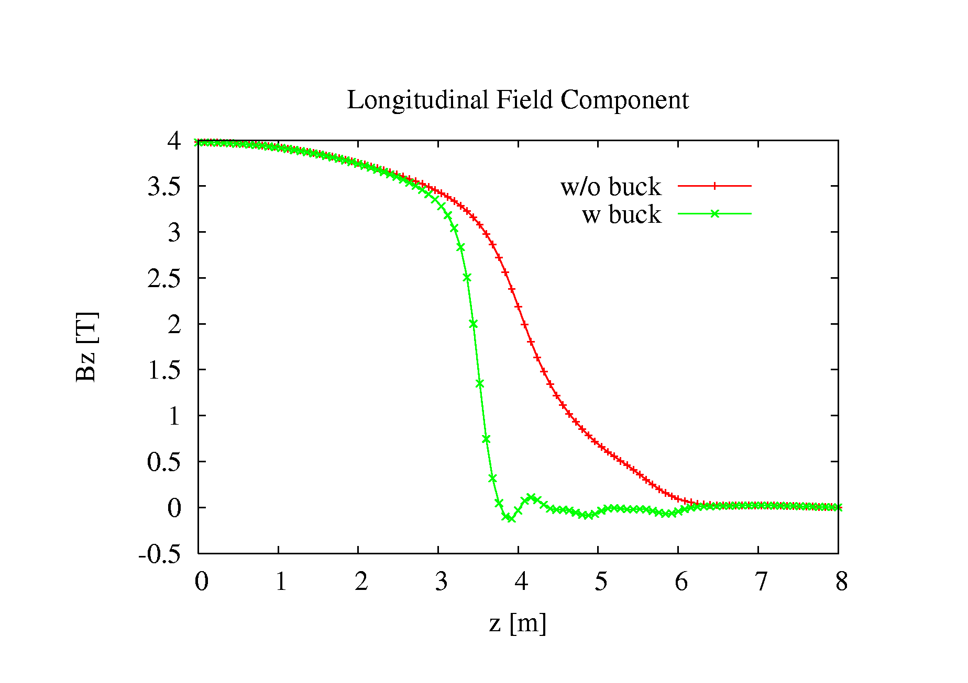
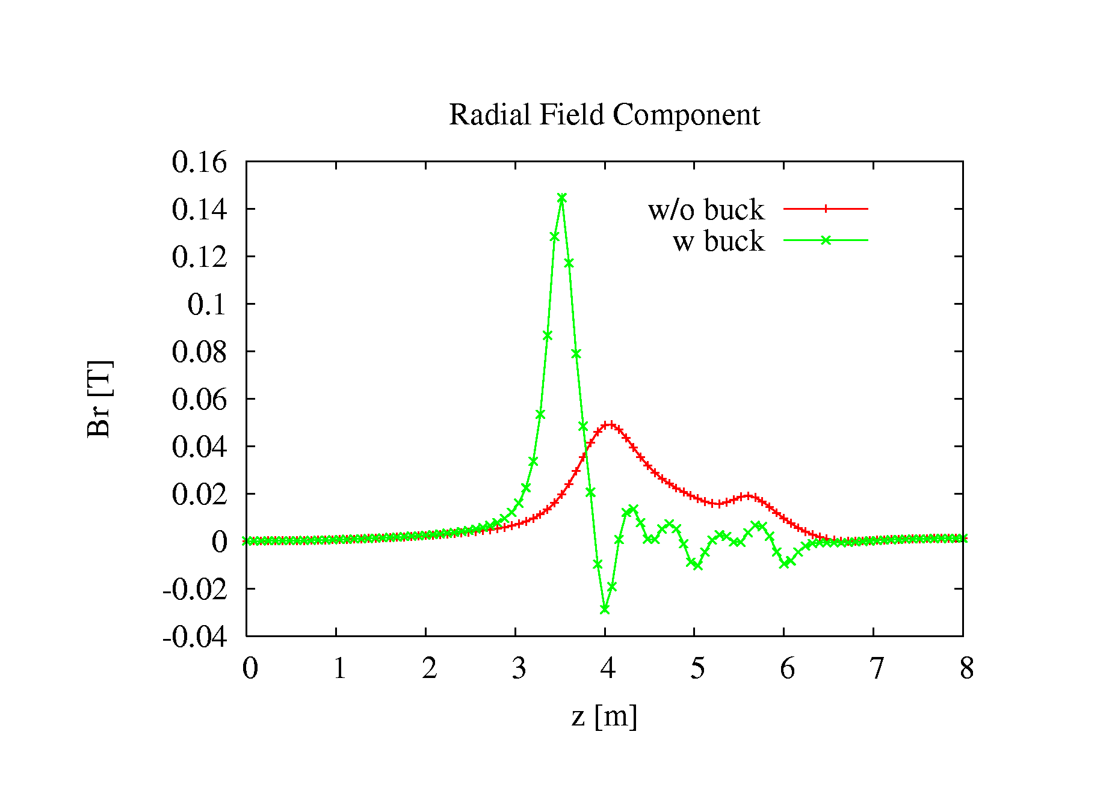
Longitudinal Field component
Radial Field Component

Slide 38
Additional ideas were proposed (very) recently for stabilizing
the QD0 support:
Mechanical coupling of the two QDO (+QF1) magnets – A.Gaddi
Pre-isolation of the QD0 (+QF1) magnets – F.Ramos
These are being worked out in more detail
Might be very attractive!
Very preliminary!

Slide 39
Summary and conclusions
A design for QD0 exists, a short prototype is in preparation
This QD0 can be integrated in the detector and will be surrounded by an anti-solenoid.
For maximum luminosity it must be suspended from the tunnel, detector motions are
too large according to measurements in CMS.
A realistic layout has been drawn for a SiD-like detector with L*=3.8 m
A similar drawing is under way for a ILD-like detector, with L*=4.6 m
Work is ongoing to reduce the length of both detectors to about 6 m by adding
compensating coils and shortening the endcaps.
The baseline for the CD will be based on L*=3.8 m, and a solution with L*=6 m
will be worked out as well as a fallback solution. This is easier for stabilisation, but
less advantageous in terms of luminosity and pre-alignment constraints.
This agreed between accelerator and physics teams.
The ILD-like solution is not abandoned but will be detailed afterward.
Significant progress has been made on integration issues and on the understanding of
vibrations in a cantilever solution.
Work is underway to work out the stabilisation performance. The present results
look encouraging, even for L* = 3.8 meters.

Slide 40
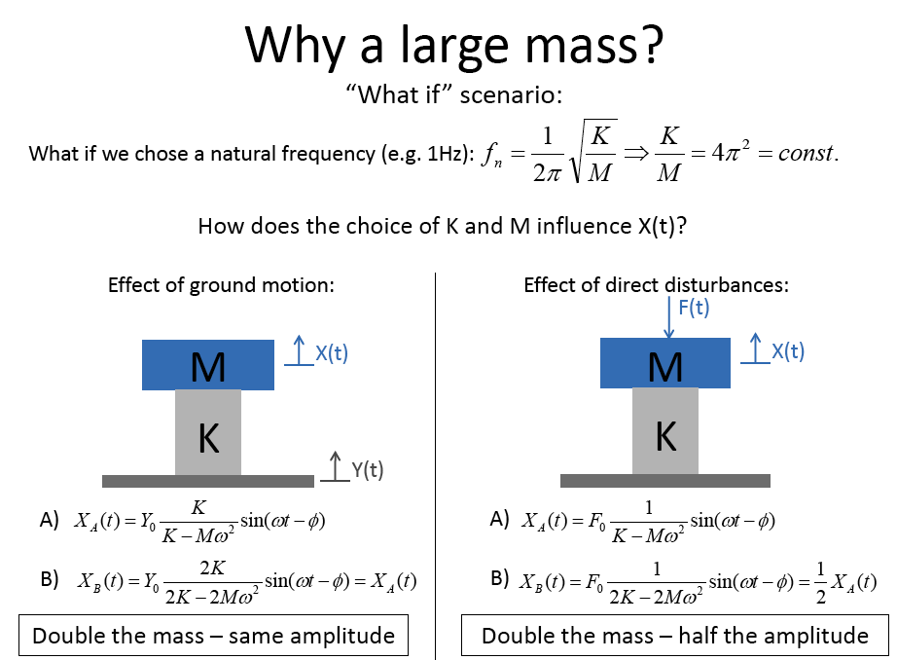
F.Ramos et al

Slide 41
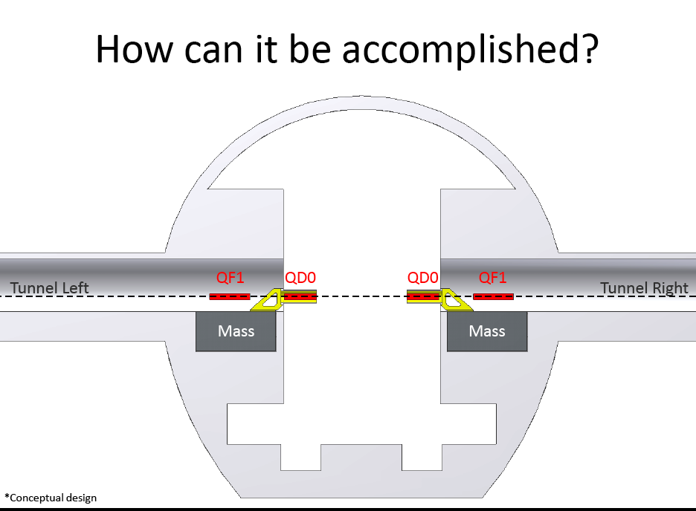

Slide 42
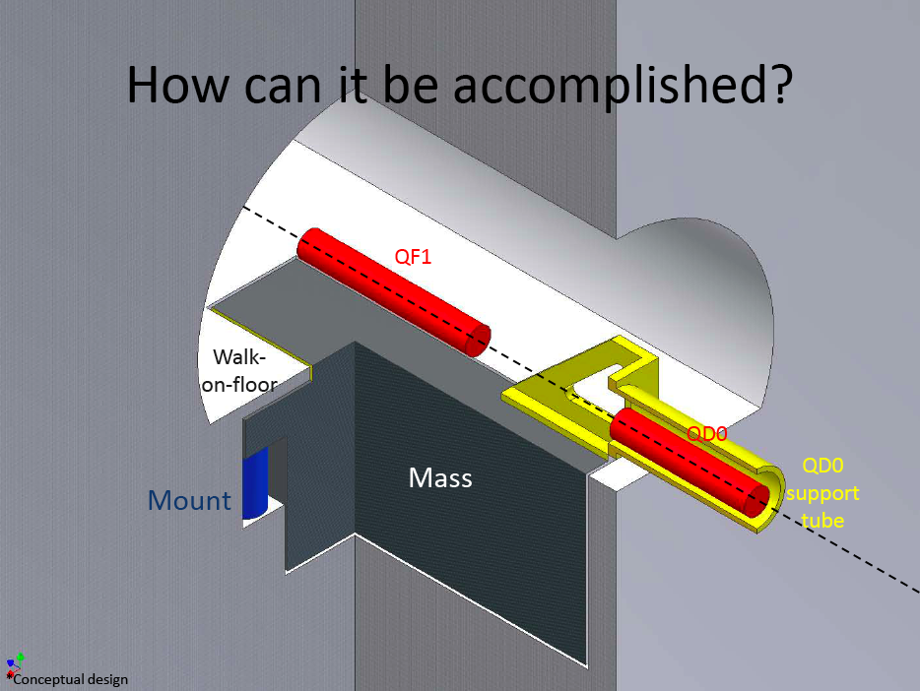

Slide 43
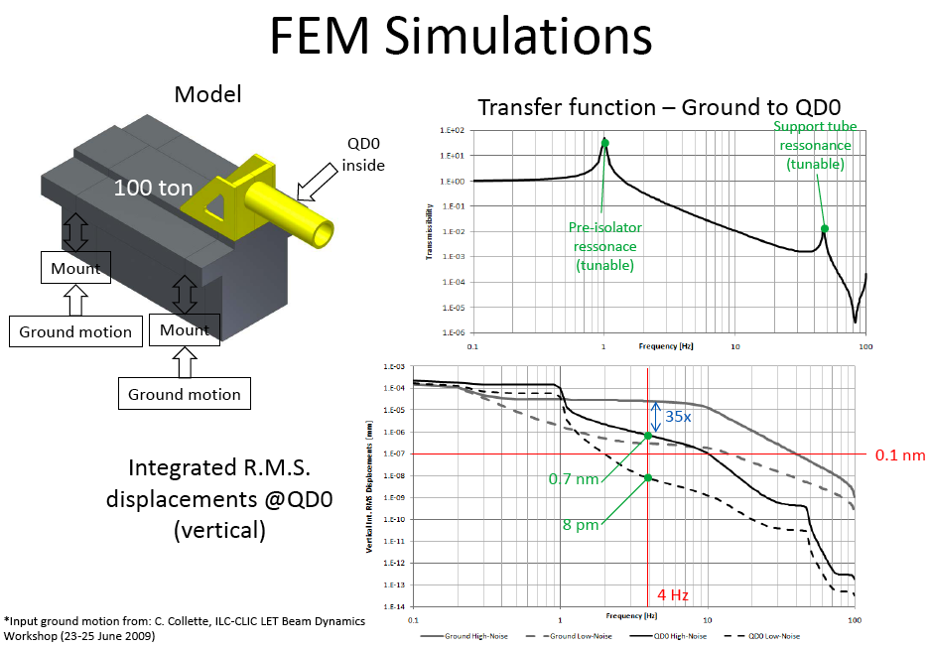

Slide 44
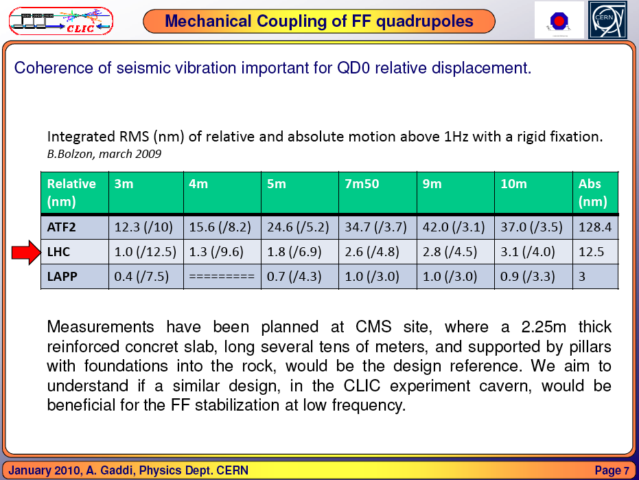

Slide 45
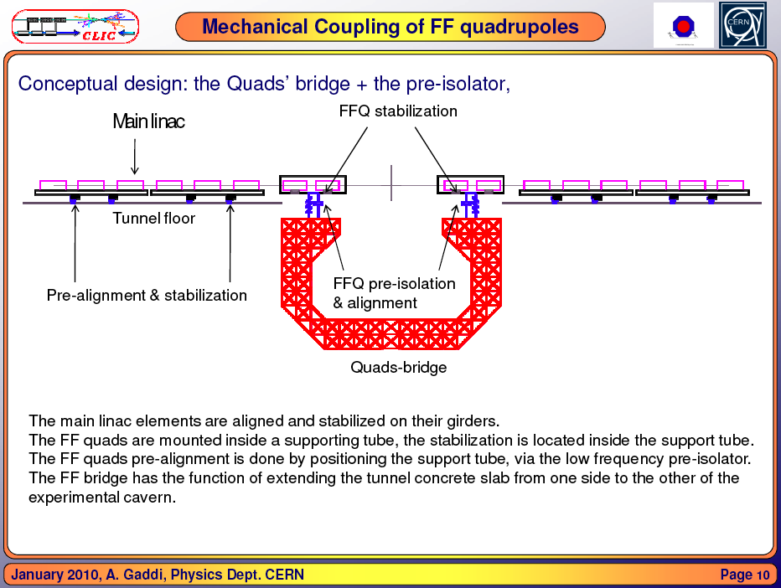

Slide 46
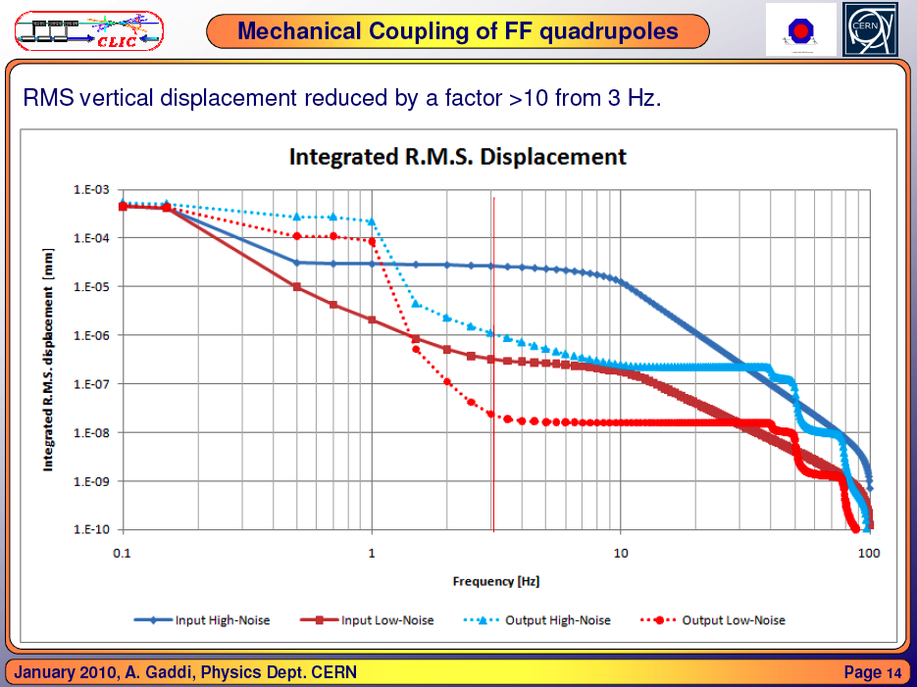

Slide 47
Spare slides

Slide 48
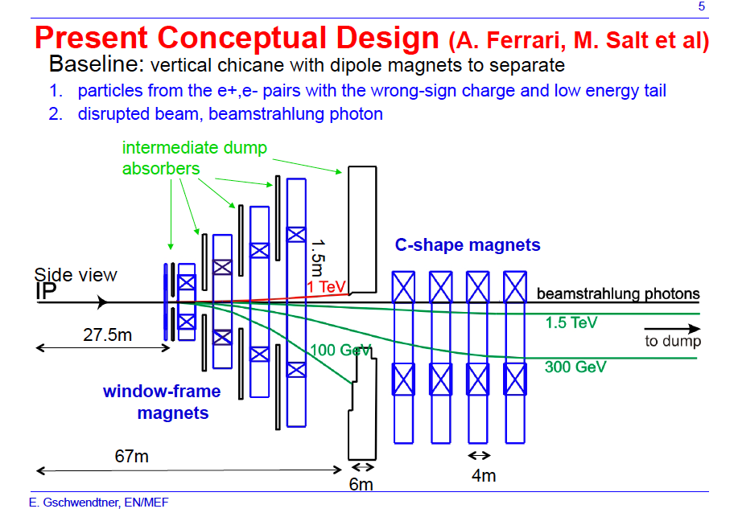
To be compatible with Post-Collision Line:

Slide 49
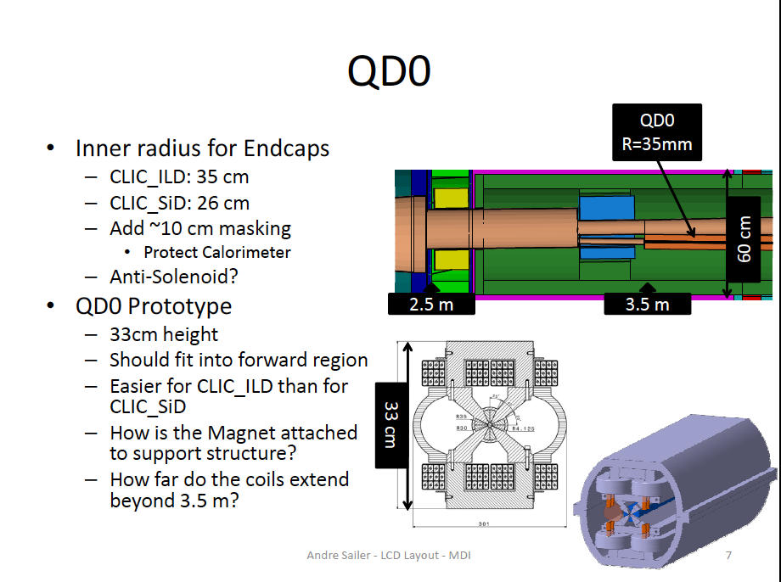
To be integrated and stabilised:

Slide 50
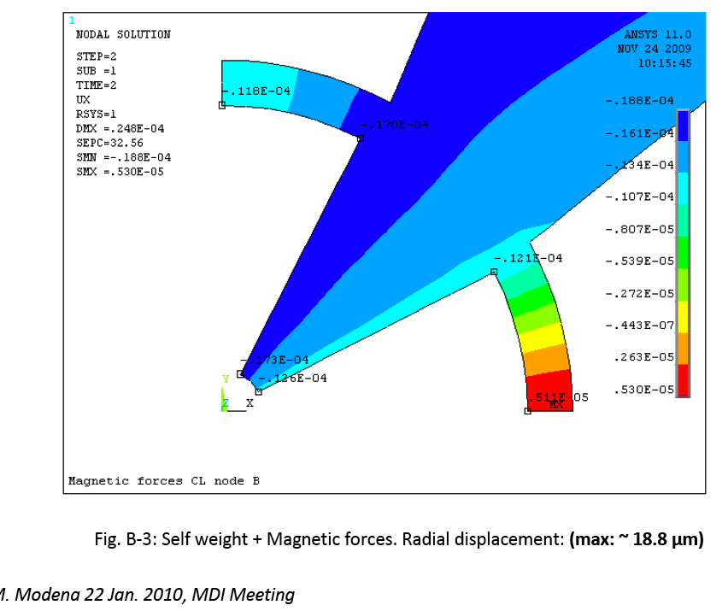
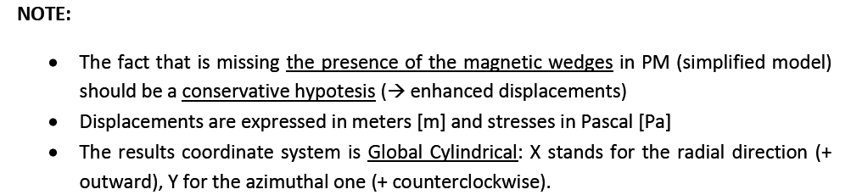
Structural calculations QD0
e.g.:

Slide 51
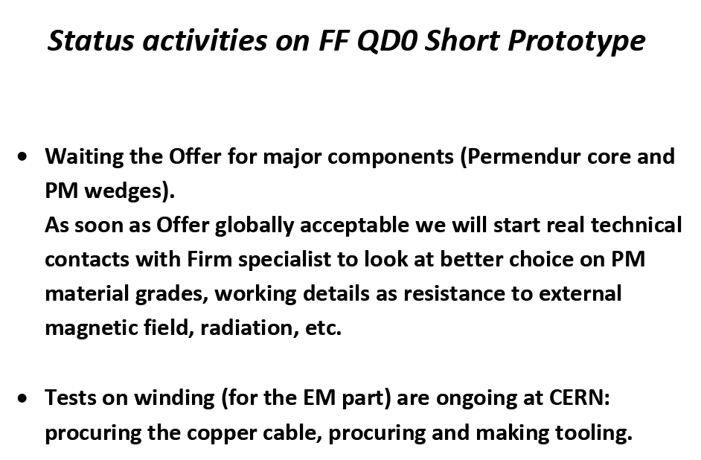
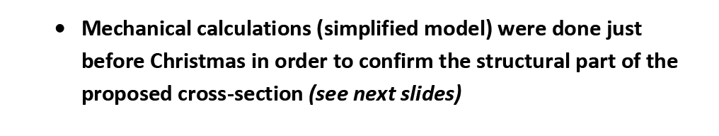
Courtesy M.Modena

Slide 52
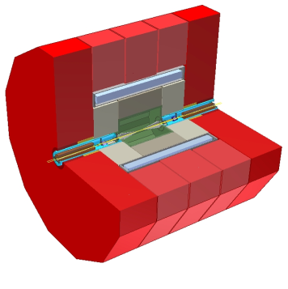
Closed Detector -> garage position

Slide 53
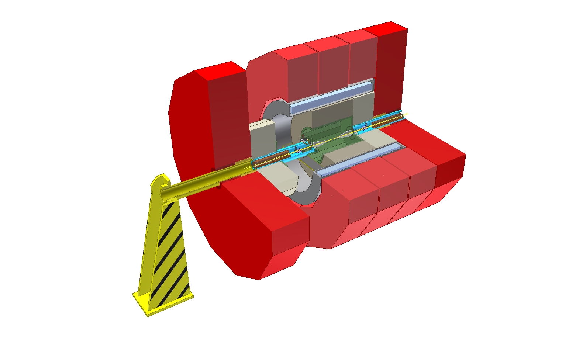
Step 2, Extraction tool, support tube does NOT move

Slide 54
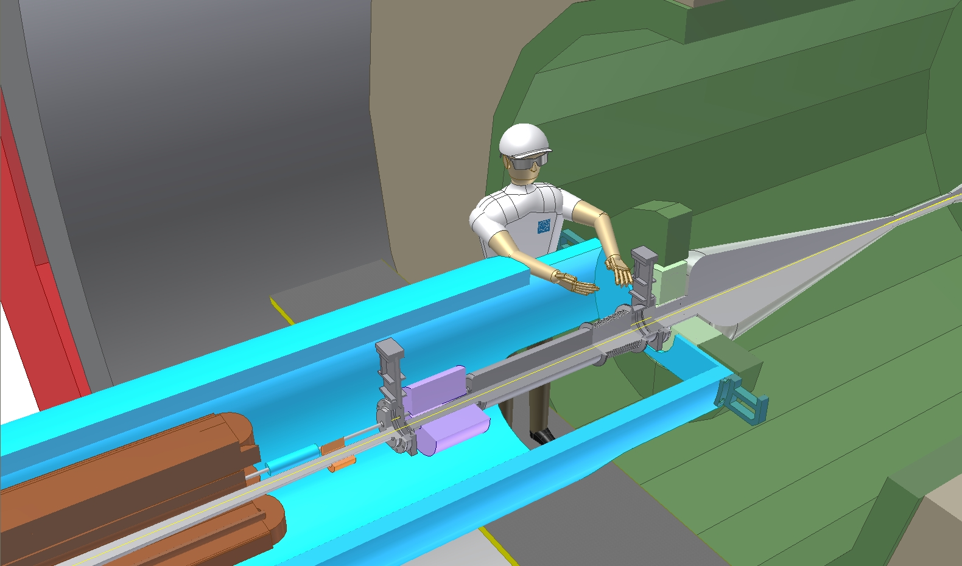
Step 3, Access to vacuum valve(s)

Slide 55

Step 4, disconnect and open Lumical

Slide 56
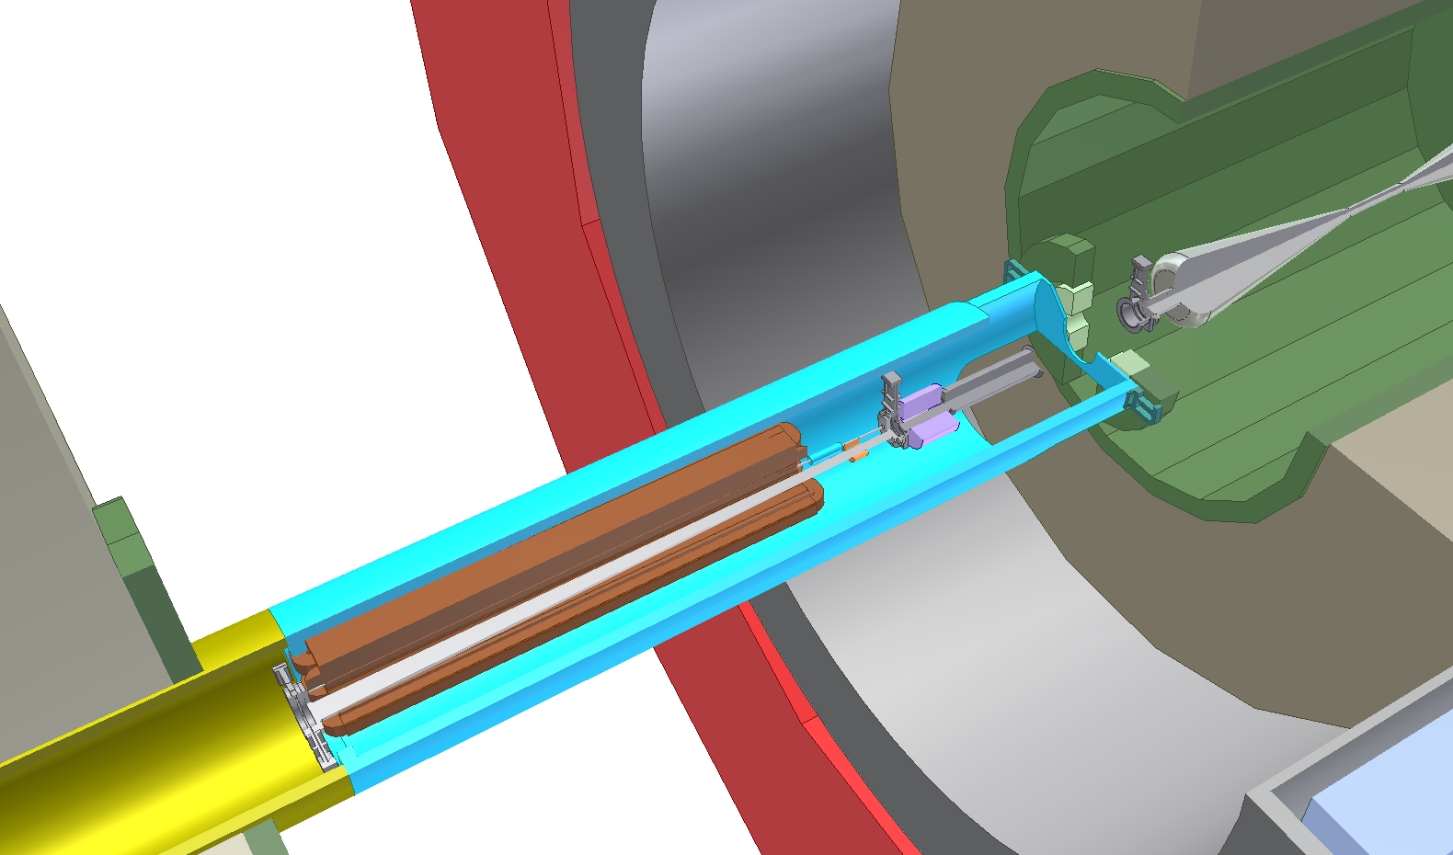
Step 5, slide back & prepare transport

Slide 57
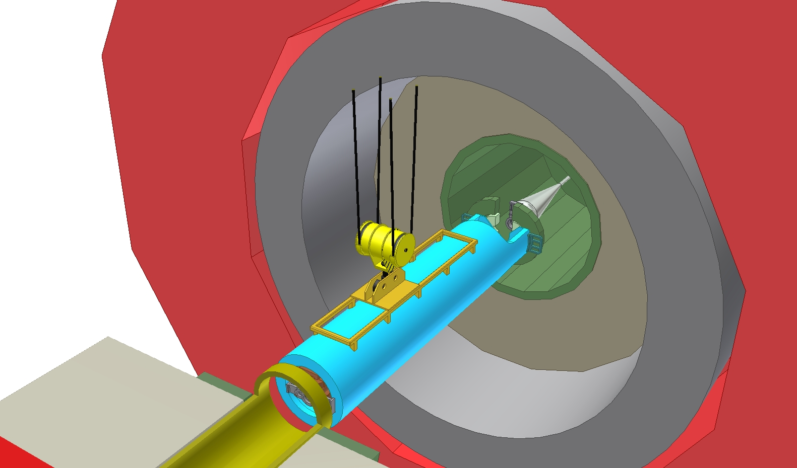
Step 6, Load transfer &disconnect from extension tool

Slide 58
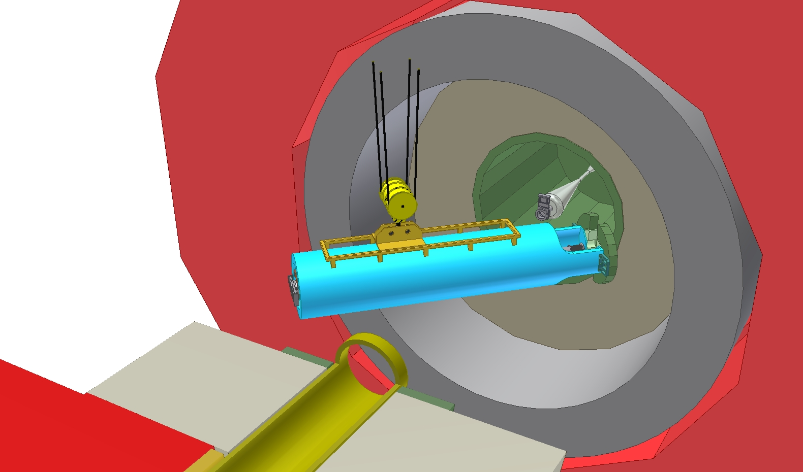
Step 7, Full Access, work can start

Slide 59
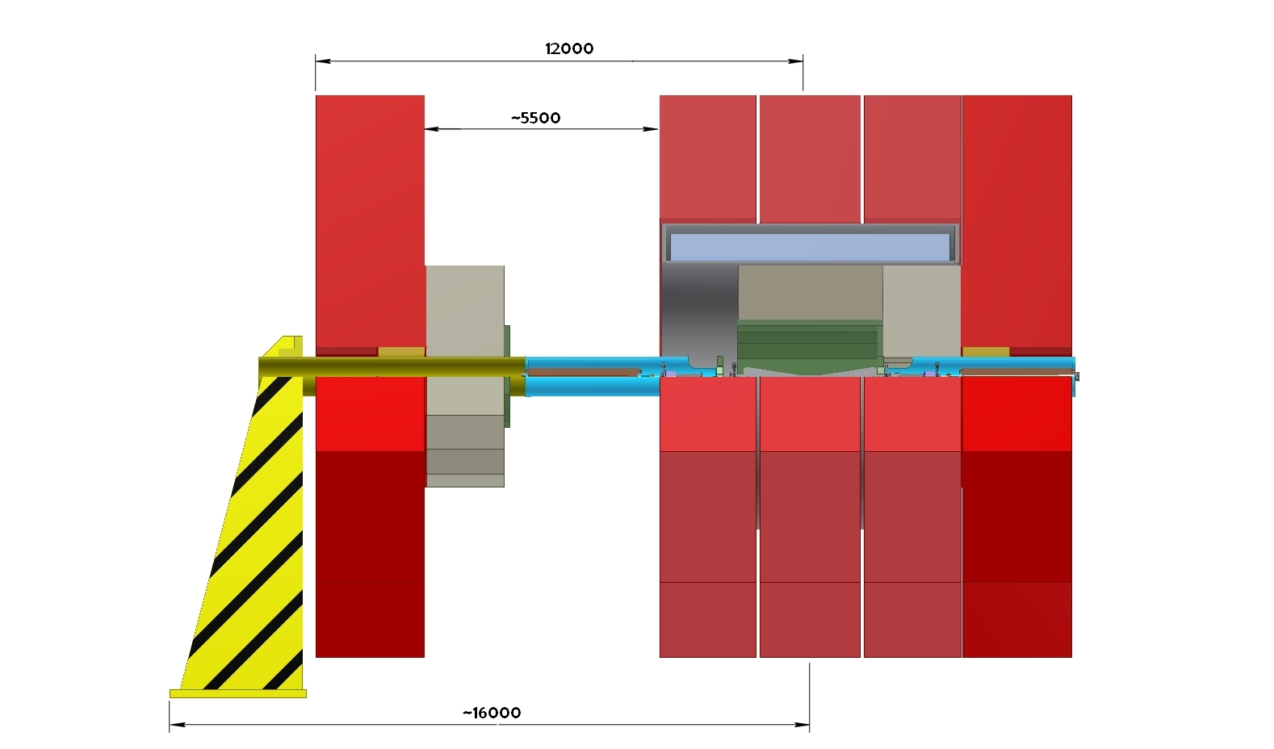
Distances Detector open

Slide 60

A.Hervė et al

Slide 61


Current work
Courtesy A.Jeremie
Replace big stabilisation table by a compact passive+active stabilisation system
Active system
Passive system
Instrumentation study (sensors and actuators)

Slide 62





Current work
Courtesy A.Jeremie
Simulations
Feedback development
Ex : force (actuator) applied to a point
Different strategies studied:
A knowledge only at strategic points
A local model for the disturbances amplified by eigenfrequencies.
A complete model
FF magnet design
Evgeny Solodko

Slide 63


Proposed parameters for implementation
External dimensions will be somewhat larger,
Details expected very soon

Slide 64

Very preliminary
To be checked
J.Resta Lopez

Slide 65


Slide 66


Slide 67


Slide 68


Slide 69


Slide 70
Proposed parameters for implementation
External dimensions will be somewhat larger,
Details expected very soon

Slide 71
Feasibility of the concept
STEPS
ISSUES
Stable alignment reference, known at the micron level
Determination of the propagation network
Determination of the position of each sensor w.r.t propagation network
Submicrometric sensors providing « absolute » measurements
Active pre-alignment
Fiducialisation: determination of the zero of each component w.r.t the sensor (external alignment reference)
Stable determination of 2m long objects within a few microns
Repositionning: displacement of the component supporting structure according to the sensor readings
Submicrometric displacements along 3/5 DOF
Other issues:
Compatibility with the general strategy of installation and operation
Compatibility with other accelerator equipment or services

Slide 72


Prealignment issues
Courtesy H.Mainaud
Favoured pre-alignment concept
straight reference = stretched wire
vertical & transverse position measured thanks to Wire Positioning Sensors (WPS)
Accelerating structures
PETS + DB quad
pre-aligned on independent girders
  DB and MB girders pre-aligned with 3+1 DOF (« snake system » / “articulation point”)
MB quad pre-aligned independently with 5+1 DOF

Slide 73


CLIC pre-alignment in the MDI area
The repositioning:
Some first considerations:
QD0 located in a confined area, and severe environment ➔ remote positioning needed
The tight tolerances require an active pre-alignment (repositioning of QD0 before the first beam)
The repositioning solution must be compatible with stabilization requirements.
    ➔ For the MB quad, a cam based repositioning system is being studied. First results expected in Spring.
(F. Lackner)

Slide 74


CLIC pre-alignment in the MDI area
Requirements (as far as I have understood!):
QD0 w.r.t. other components of the BDS:
    10 µm (for L*=3.5 m) : r.m.s value
    Position of the zero of the QD0 w.r.t the ideal straight line of the 500 last meters of BDS
Relative position of one QD0 w.r.t the opposite
    W.r.t to a common reference?
    Within a few microns?

Slide 75

Summary:
To book ASAP some space for pre-alignment references
  Pre-alignment sensor interface on QDO
  Reference (straight line) along QDO and other components of the BDS, close to QDO, to limit level arms effects
To book ASAP some space below QDO for the remote positioning. Same solution than for the main linac: cam based repositioning system (must be compatible with stabilization requirements)
To develop of a laser based pre-alignment solution for the relative position of QDO
To define the alignment functions around the IP:
F0 – Fiducialisation
F1 – The alignment of QDO w.r.t to the main elements of the corresponding BDS
F2 – The alignment of the detector w.r.t. FF geometry
F3 – The alignment of one FF w.r.t. the other FF (left/right side)
F4 – The alignment of each QDO w.r.t other components of the FF
During different periods of alignment :
- first or initial alignment
- monitoring beam on
- maintenance of the alignment beam off
- repositioning of the push/pull detector

Slide 76

Anti solenoid coil
A.Herve, H.Gerwig, …

Slide 77

Vertical dispersion and <x’,y> coupling
a
b
c
< x’,y > coupling and
vertical dispersion at IP
Tracking trough FFs and IP Solenoid
Tracking trough FFs and IP Solenoid + bucking coils covering QD0
Tracking trough FFs only
Residual <x’,y> coupling and dispersion can be compensated using the other FFs magnets

