Slide 1

CLIC-ACE5 3.02.2010
Main beam Quad Stabilisation:
Expected performance demonstration by end 2010
In continuity with ACE 4 presentation (May 2009)
K.Artoos
Contribution to slides by: C. Hauviller, Ch. Collette, S. Janssens,
M. Guinchard, A. Jeremie

Slide 2

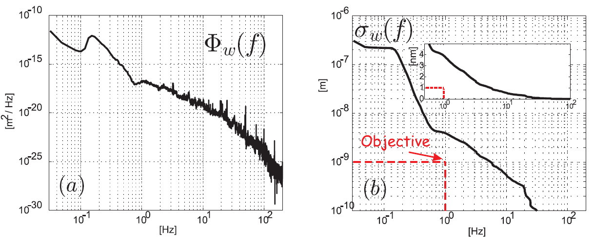
Requirements Stability
 | Final Focus quadrupoles | Main beam quadrupoles
Vertical | 0.1 nm > 4 Hz | 1 nm > 1 Hz
Lateral | 5 nm > 4 Hz | 5 nm > 1 Hz
Values in integrated r.m.s. displacement at 1 Hz
C. Collette
Notes:
Random vibrations (exact term) >> P.S.D. Observation: the level goes down with frequency
The summing from infinite frequency down to 1 Hz. Practically we see that from some upper limit the participation can be neglected

Slide 3
Contents / Approach
Organisation/ resources
Sensors
Ground motion measurements and modelling
Support, alignment and magnet
Choice stabilisation option: CERN option and LAPP option
Actuators
Prototypes to reach the performance
Implications on CLIC and module design

Slide 4






Organisation
CLIC Stabilisation Working Group (started 2008)
Collaboration and exchanged information with:
IRFU/SIS
MONALISA
Meetings every 3 months (Chairman: C.Hauviller)
Mandate:
Demonstrate 1 nm quadrupoles stability above 1 Hz (Linac), in an accelerator environment, with realistic equipment, verify with independent method
Demonstrate or provide evidence of 0.1 nm stability above 4 Hz (Final Focus)
Characterize vibrations/noise sources in an accelerator
Compatibility with pre-alignment
STABWG
MDI

Slide 5


CERN MB QUAD Stabilisation team
Claude Hauviller
Dr. Christophe Collette (fellow)
Stef Janssens (Phd student) supervisor Prof. A. Preumont
Kurt Artoos
Michael Guinchard (EN/MME Mechanical measurements lab)
Andrey Kuzmin
Ansten Slaathaug (Technical student 1 year) follows up Magnus Sylte
Raphael Leuxe
March 2010: Pablo Fernandez (fellow)
LAPP Lavista
LAPP: A. Jeremie, L. Brunetti, G. Deleglise,
L. Pacquet, G. Balik (CERN-CNRS white paper)
SYMME: J. Lottin, R. LeBreton (Phd student) A. Badel, B. Caron
CEA
F. Ardellier-Desages, M. Fontaine, N. Pedrol Margaley
IRFU/SIS
MONALISA
D. Urner, P. Coe, A. Reichold, M. Warden
MONALISA
Eucard funding

Slide 6
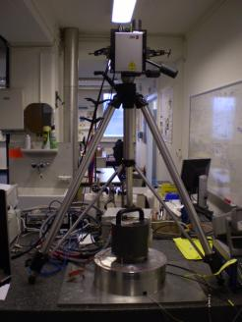
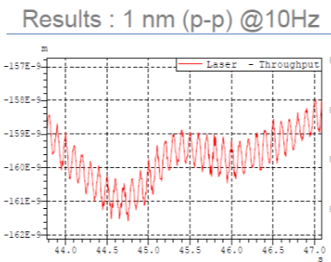
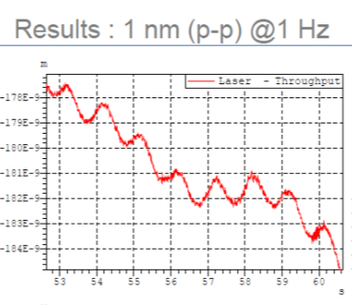
Sensors
How to measure nanometers and picometers ?
Overview: mainly catalogue products
Absolute velocity/acceleration:
Ref. Presentation C. Hauviller CLIC-ACE4
Seismometers and accelerometers
Relative displacement/velocity:
Capacitive gauges :Best resolution 10 pm (PI) , 0 Hz to several kHz
Evolving fast
(< 1 year):
Linear encoders best resolution 1 nm (Heidenhain)
Vibrometers (Polytec) ~1nm at 15 Hz
Interferometers (SIOS, Renishaw, Attocube) <1 nm at 1 Hz
IRFU/SIS
OXFORD MONALISA Optical distance meters
  Compact Straightness Monitors (target 1 nm at 1 Hz)

Slide 7
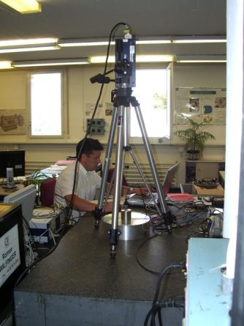
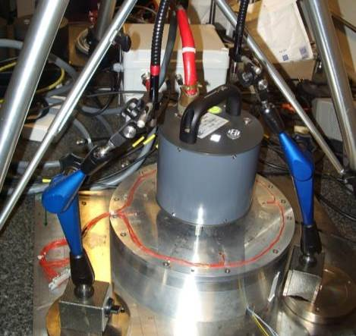
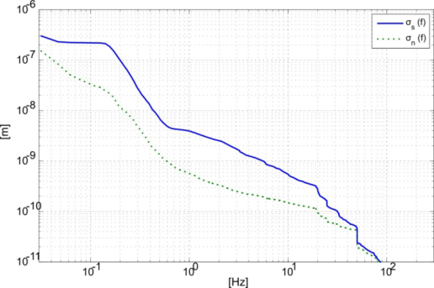
Sensors
Characterisation commercial devices
Reference test bench
Low technical noise lab
TT1 (< 2 nm rms 1Hz)
Instrument Noise determination
Sensitivity and resolution testing
Cross axis sensitivity
Model Seismometer: Transfer Function
C. Collette
Characterisation signal analysis (resolution, filtering, window, PSD, integration, coherence,...)
Ref. Talk C. Hauviller 4 th CLIC-ACE
+ STABILISATION WG

Slide 8

Sensors
Open issue
Validation and better knowledge of the instrumentation and signal analysis
SN ratio sufficient but to be improved
BUT:
Accelerator environment: Radiation + magnetic field + size of seismometers
Eentec SP500 electro chemical seismometer development : radiation and magnetic field hard. But not stable in time. (Followed up by LAPP)
No manpower dedicated to do R&D at the moment
Adapt existing device or develop new?
Some critical points:
Radiation and actuators :Less critical but also to be studied
Radiation and elastomers for passive damping
Shielded controller rack space in tunnel
Notes:
8

Slide 9
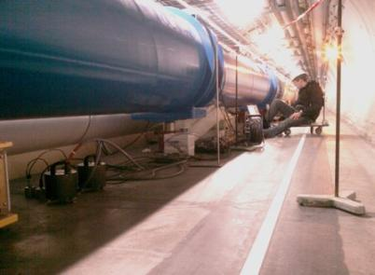
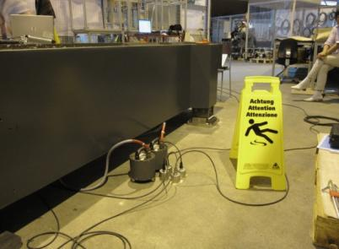
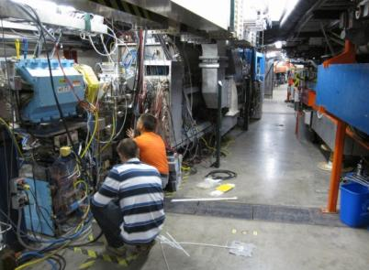
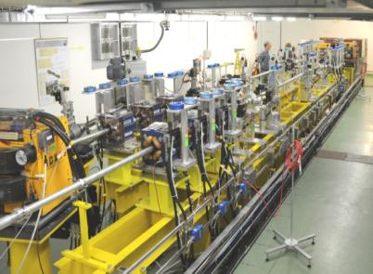
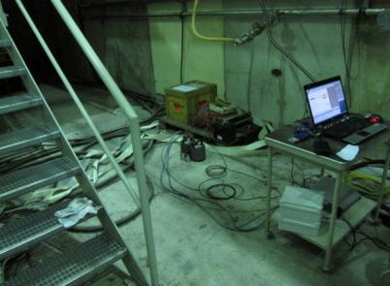
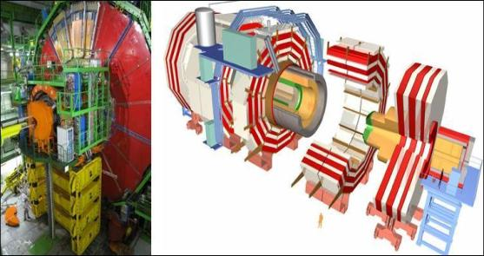
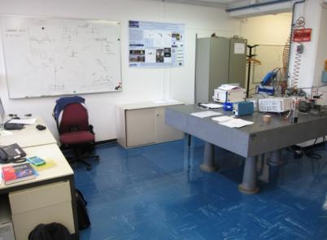
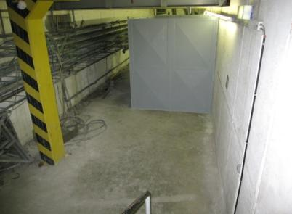
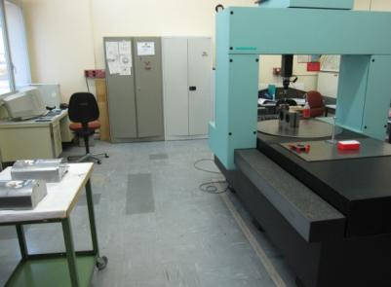
Characterisation vibration sources
What level of vibrations can be expected on the ground?
Several measurement campaigns: LAPP, DESY, CERN....
LHC
PSI
Effort continued by CERN in 2009
CesrTA
AEGIS
CLEX
CMS
Metrology Lab
2009
Lab
TT1
M. Sylte, M. Guinchard

Slide 10
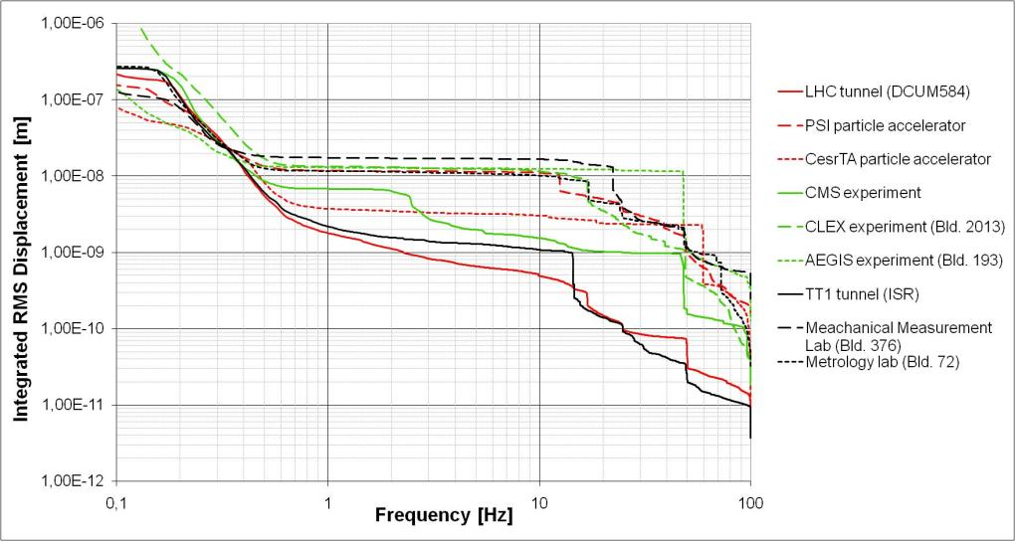
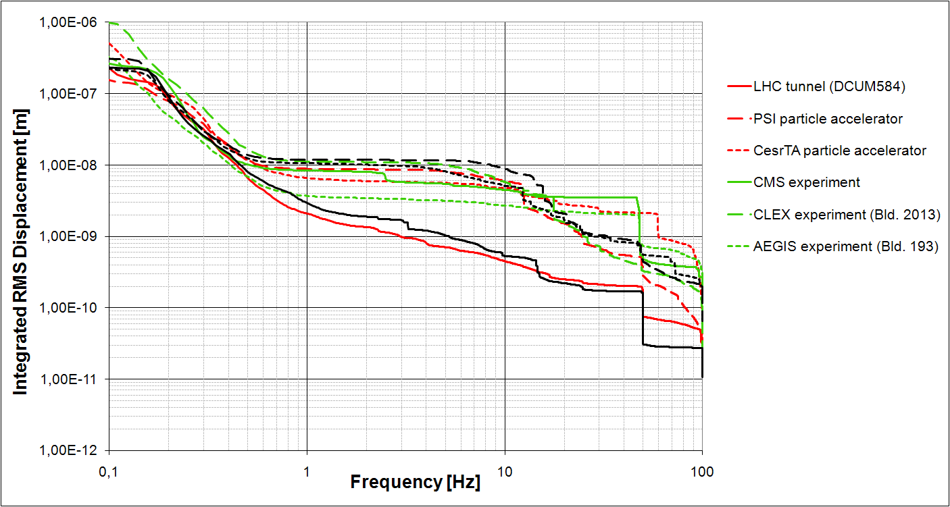
2 nm
1nm
Measured on FLOOR
Vertical
Lateral
5nm
M. Sylte, M. Guinchard

Slide 11
Characterisation vibration sources
Vibration measurements
Coherence measurements over long distances LHC ( Summer 2008)
Ground motion modelling
+ technical noise modelling
Former work A. Seryi, B. Bolzon
Update of 2D power spectral density for LHC tunnel in the vertical and lateral direction
Vertical and lateral models of the technical noise
Ref. C. Collette
“Description of ground motion”
ILC-CLIC LET Beam Dynamics WS 2009
Reference curves, technical noise
Well advanced
Models available integrated in models
for stabilisation and BBF

Slide 12
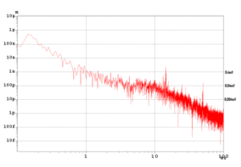
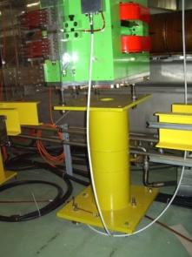
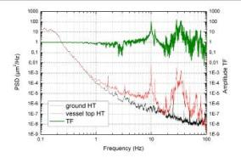
Dynamic analysis support, alignment and magnet
Vibrations on the ground
Result on magnet
Transmissibilty
Broadband excitation with decreasing amplitude with increasing frequency.
Amplification at resonances
Lessons learnt from light sources:
Increase natural frequencies ALL components
Alignment system as rigid as possible
+ optionally locking of alignment
Maximise rigidity
Minimise weight (opposed to thermal stability)
Minimise beam height
(frequency and Abbé error)
Optimise support positions
Increase damping
MB quad alignment with excentric cams

Slide 13
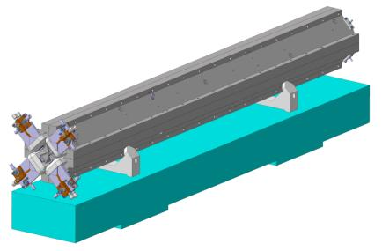
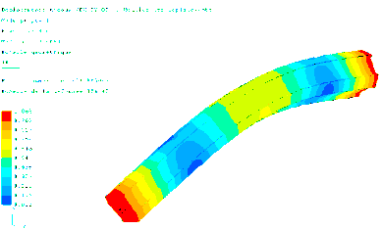
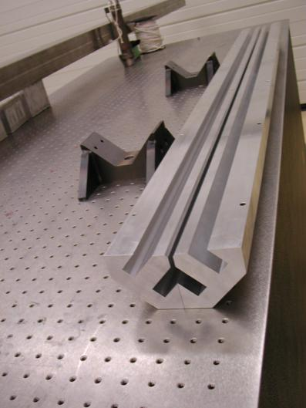
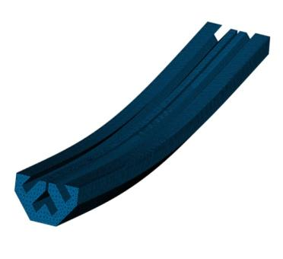
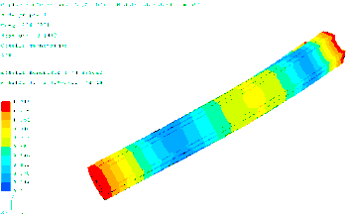
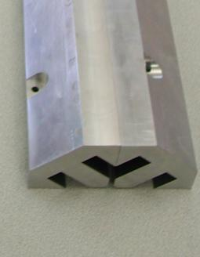
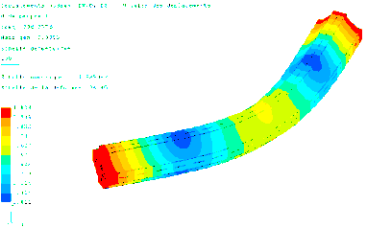
Dynamic analysis support, alignment and magnet
Type 1 + 4 quads
M. Modena
Delivery parts for assembly: February
Mounting and stiffness
Features to decrease vibrations from water cooling
Dynamic analysis LAPP
Prototype (aluminium) for modal testing + assembly
Guillaume Deleglise
Ongoing tests to validate model
307Hz
full length welding
249Hz
point welding
306Hz
local welding
Notes:
13

Slide 14
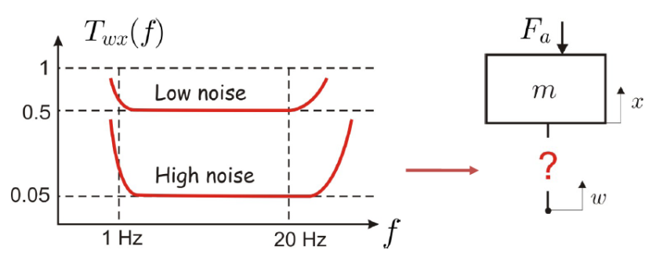
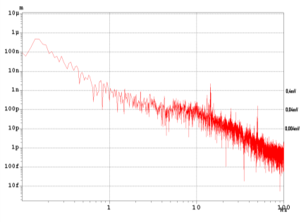
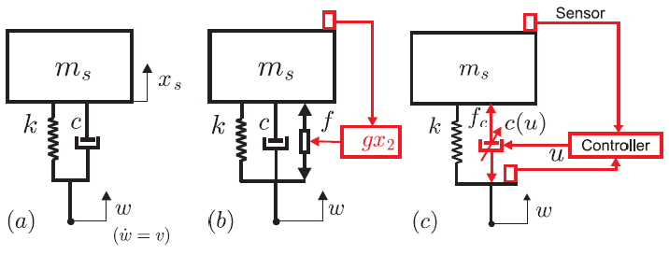
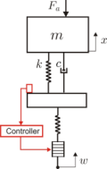
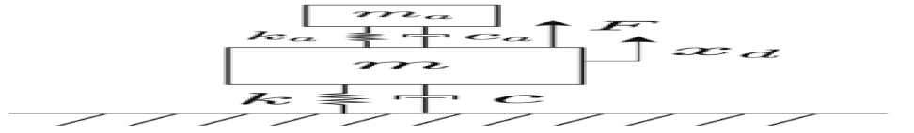
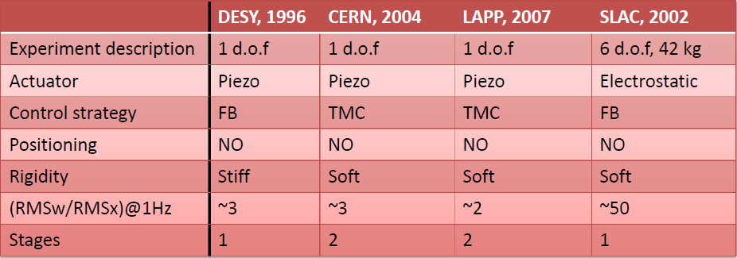
How to support the quadrupoles?
Comparison control laws and former stabilisation experiments
Ch. Collette
Stabilisation WG 7
…

Slide 15
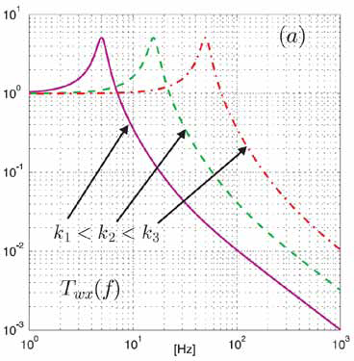
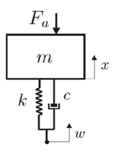
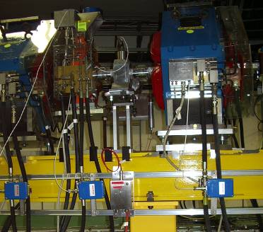
« Soft versus rigid ?»
C. Collette
Soft: + Isolation in large bandwidth
Rigid: - High resolution required actuators
Available in piezo catalogues
- But more sensitive to external forces Fa
+ Robust against external forces
- Elastomers and radiation
+ nano positioning
Example: 400 kg with resonant frequency
at 1 Hz: K= 0.016 N/μm
At 10 Hz k= 1.6 N/μm
Example TMC table:
Rigidity: 7 N/μm (value catalogue)
External forces: vacuum, power leads, cabling,
water cooling, interconnects,….
CLEX

Slide 16
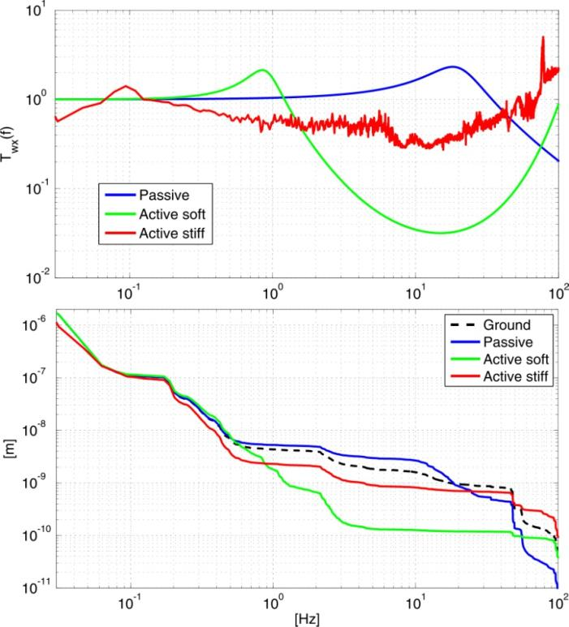
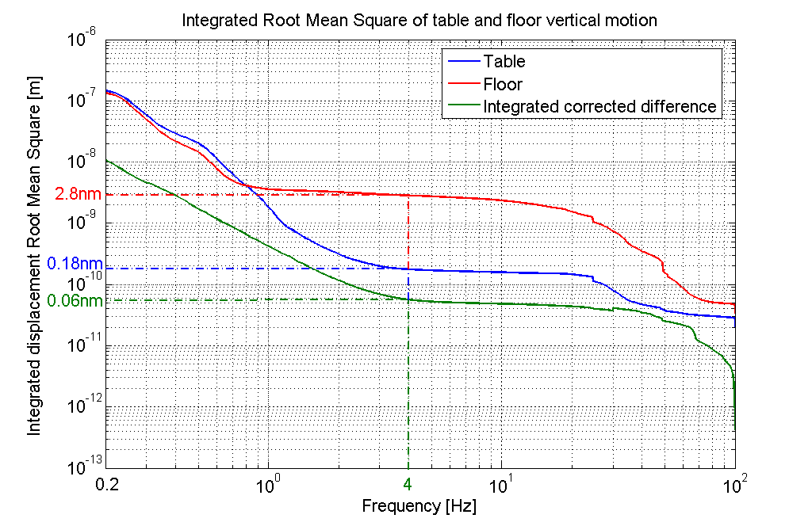
Reference for CLIC so far:
TMC STACIS table
Comparison:
S. Redaelli, CERN 2004
TMC table with CMS background
B. Bolzon, LAPP 2007
Prepared by Ch. Collette

Slide 17
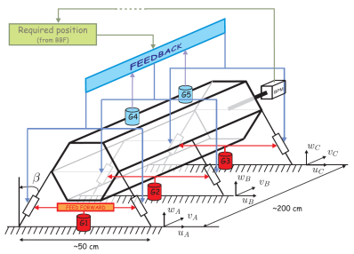
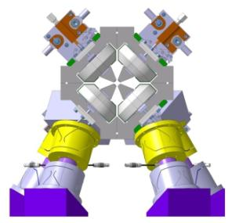
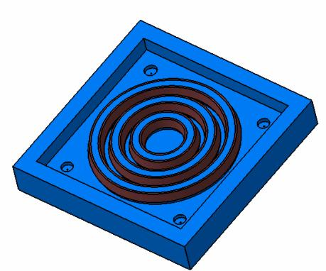
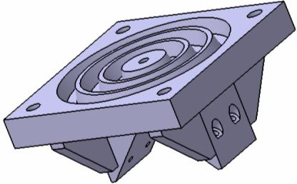
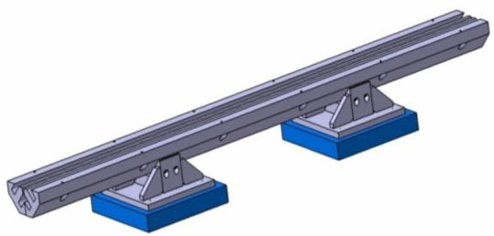

Option CERN: Rigid support and active vibration control
Approach: PARALLEL structure with inclined actuator legs with integrated length measurement (<1nm resolution) and flexural joints
Concept drawing
Up to 6 d.o.f.
Option LAPP: Soft support and active vibration control
3 d.o.f. :

Slide 18
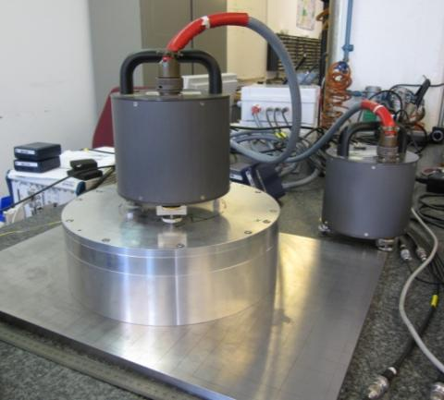
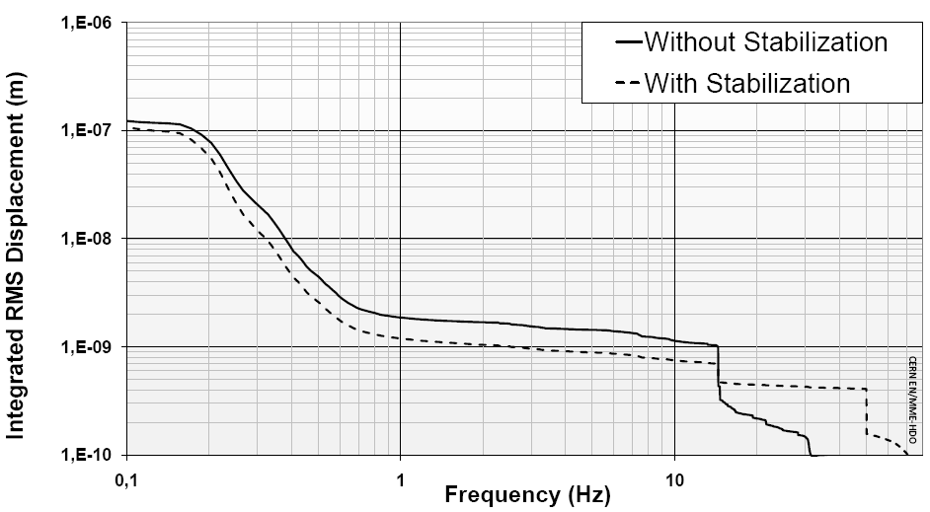
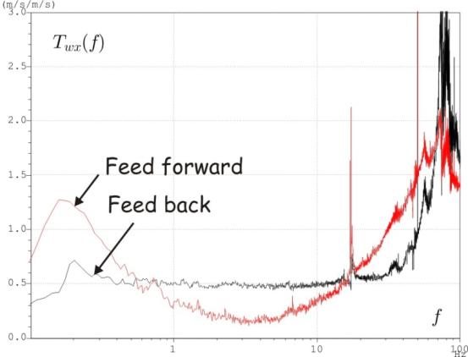
CERN option: Steps toward performance demonstration
1. Stabilisation single d.o.f. with small weight (“membrane”)
First result:
1.2 nm
This is not a TMC table...
Study and tests now ongoing for improvements:
Improve controllers, filters, resolution, mechanics...
Combinations of feedback and feedforward

Slide 19
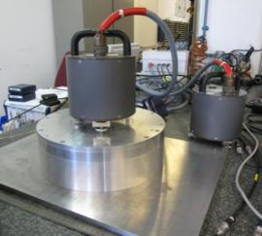
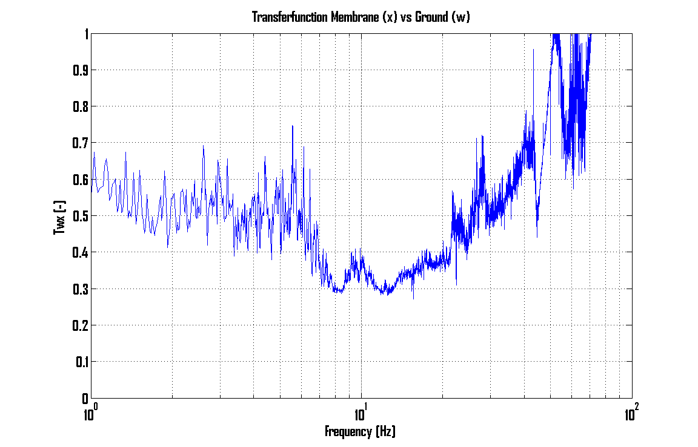
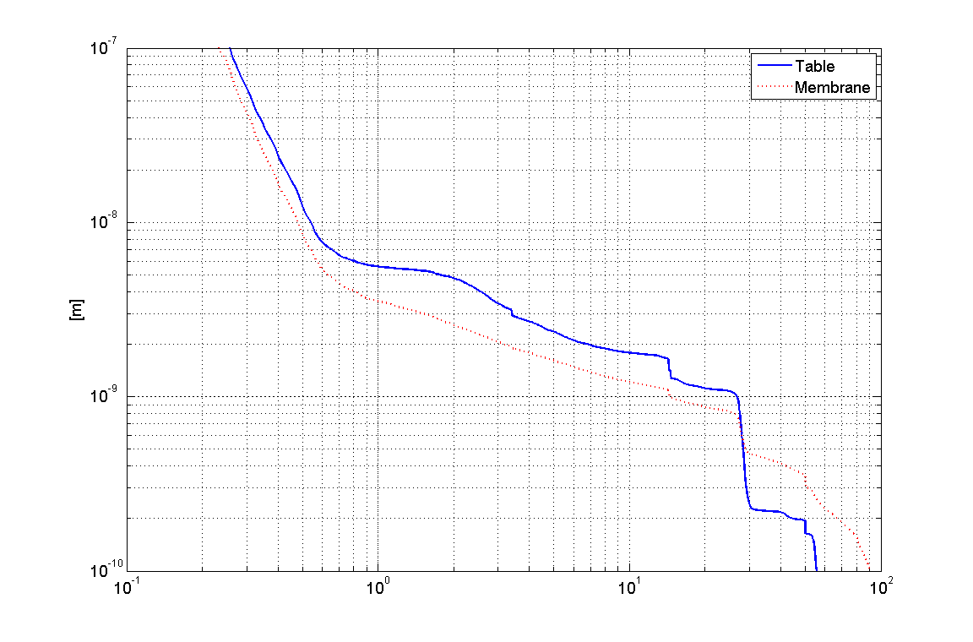

CERN option: Steps toward performance demonstration
1. Stabilisation single d.o.f. with small weight (“membrane”)
Feedback
Improvements controller
Preliminary results
S. Janssens
Feedback
Feedforward
5.5 nm down to 3.5 nm @ 1 Hz
6 nm down to 3 nm @ 1 Hz
Feed back

Slide 20


Option CERN: Rigid support and active vibration control
Bonus: possibility to nano position the Quadrupole
Ref. D. Schulte CLIC-ACE4 : “Fine quadrupole motion”
“Modify position quadrupole in between pulses (~ 5 ms) “
“Range 20 μm, precision 2nm »
Demonstration nano positioning :
S. Janssens
open loop
Measured with PI capacitive gauge
10 nm, 50 Hz
For FREE
Notes:
20

Slide 21



CERN option: Steps toward performance demonstration
2. Stabilisation single d.o.f. with type 1 weight (“tripod”)
2 passive feet
actuator
S. Janssens
Preliminary result
Will be improved :
Optimise controller design
(Tuning, Combine feedback with feedforward)
Expected
Improve resolution (actuator, DAQ)
Avoid low frequency resonances in structure and contacts
Noise budget on each step,
ADC and DAC noise

Slide 22





CERN option: Steps toward performance demonstration
3. Stabilisation two d.o.f. with type 1 quadrupole weight (“tripod”)
3a. Inclined leg with flexural joints
Status: Launch first prototype flexural hinges
Goal: start tests March 2010
3b. Two inclined legs with flexural joints
y
x
Status: Modelling
Goal: start tests May 2010
3c. Add a spring guidance
Load compensation
(Status: start design)
Precision guidance
Reduce degrees of freedom
Reduce stress on piezo
3d. Test equivalent load/leg

Slide 23

CERN option: Steps toward performance demonstration
4. Stabilisation of type 4 (and type 1)CLIC MB quadrupole proto type
Lessons learnt step 1 to 3
Results Tests 1 to 3
Cost analysis
(number of legs= cost driver)
Design for the 4 types
# degrees of freedom
Stress and dynamic analysis
Goal: start assembly and testing on type 4 prototype summer 2010
Range nano-positioning
Resolution
Results autumn 2010

Slide 24




Status: Construction + tests on elastomer

Slide 25


Implications on CLIC and module design
So far nothing can isolate 100 %
At 1 Hz, a factor two RMS ratio is demonstrated
2 nm integrated rms measured on LHC tunnel floor
Work now to increase the margin
1. The Main beam quadrupole stabilisation should be reflected in the complete CLIC module design including technical infrastructure and even tunnel design. A stabilisation system with the required precision requires a low back ground to start with.
2. For the integration of the MB quadrupole stabilisation system in the module an inventory of modal behaviour and rigidities of components should be made. An inventory of vibration sources will also be made.
3. Current module space reservation for stabilisation is feasible but very tight

Slide 26
Conclusions
Organisation/ resources
2010: key year with teams up and running
Sensors
Ground motion measurements and modelling
Validated, Well advanced
Issue: sensor accelerator environment
Support, alignment and magnet
Lessons learnt from light sources
Choice stabilisation option
Two options under study : soft and rigid
Actuators
Available
Prototype testing to reach the performance
Rigid 1 d.o.f. solution: 1.2 nm at 1 Hz
Program of improvements.
Results expected in the next weeks
Nano positioning demonstrated
Clear program with dates for demonstration
on full size mock up end 2010
Implications on CLIC
and module design
Very low background technical noise required

Slide 27
Spare slides

Slide 28
Actuators
Selection actuator type: comparative study in literature
First selection parameter: Sub nanometre resolution and precision
This excludes actuator mechanisms with moving parts and friction,
we need solid state mechanics
+ Well established
- Fragile (no tensile or shear forces), depolarisation
Piezo electric materials
High rigidity
Rare product, magnetic field, stiffness < piezo,
force density < piezo
+ No depolarisation, symmetric push-pull
Magneto Strictive materials
Electrostatic plates
Risk of break through, best results with μm gaps, small force density, complicated for multi d.o.f. not commercial
No rigidity, ideal for soft supports
Electro magnetic
(voice coils)
Heat generation, influence from stray magnetic fields for nm resolution
Shape Memory alloys
Slow, very non linear and high hysteresis, low rigidity, only traction
Electro active polymers
Slow, not commercial

Slide 29
Nano-positioning
Pro/con
Nano-positioning | Corrector coils
+ Larger radius of curvature | - Synchrotron radiation?
 | Extra required longitudinal space
Requires actuators with higher range Impact on resolution/number of providers Larger actuators/power
Requires stiff actuators and support HVPZT
Dynamics needs more attention ( High resonant frequencies components)
+- 5 μm

Slide 30
Nano-positioning
- “ Absolute position of quad in beam reference frame not known”
- “ BPM will move with quad”
>Ref. H. Mainaud Durand (9/11/2009 MWG): “Fiducialisation = determination of the zero of the MB quad (and BPM) w.r.t external pre-alignment references.Hypothesis : σ ~ 15 microns (?), What is the zero of the MB quad /BPM? Methods to measure that? Which uncertainty of measurement? »
The movement of the quadrupole should be measured with nm precision in a range of +- 5 μm with respect to alignment references: CHALLENGE. Measuring an incremental displacement of e.g. 50 nm with nm resolution « reasonable challenge »
- “ BPM better close to zero position, non linear effect”
Effect to be studied for 5 μm
- “ Quad goes down when piezos are unpowered”
Limit the range
Detect supply voltage drop and open leads to piezo.
To be studied

