Slide 1
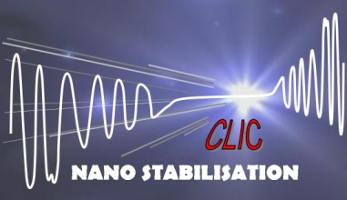
“something about ground vibration measurements”
K.Artoos
Slides from M.Guinchard, Ch. Collette, M. Sylte

Slide 2
Ground vibration measurements
Equipment
PSD
Integrated RMS displacement
Technical noise sources: model + some examples
Sensor noise
Coherence measurements

Slide 3
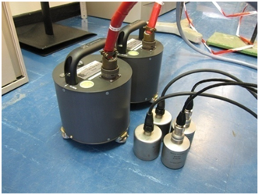
Equipment and settings
  Vibrations sensors
Type | Supplier | Type | Sensitivity | Freq. Range | Axes
Geophones | GURALP | CMG 6T | 2000 V/m/s | 30s to 100Hz | NS, EW, V
Seismic accelerometers | PCB | 393B31 | 10 V/g | 0.1 to 200Hz | V
 | ENDEVCO | 86 | 10 V/g | 0.1 to 200Hz | V
  Data acquisition system
  Spectrum analyser with 16 channels
  24 bits on 10mV for the lowest dynamic range
  Sampling frequency up to 200kHz
  Noise level DAC< 1 μV
  Software for signal treatment (FFT, PSD, Filtering, etc…)
Parameters:
Sampling rate | 1024Hz
Measurement Length | 1440s
Block length | 64s
Overlap | 66,7%
Window function | Hanning
Averaging | Linear
M. Guinchard, M. Sylte

Slide 4
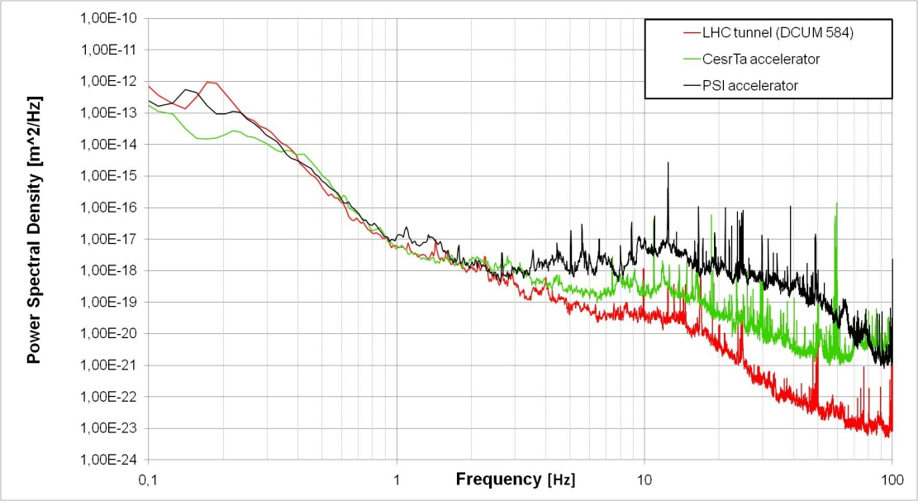
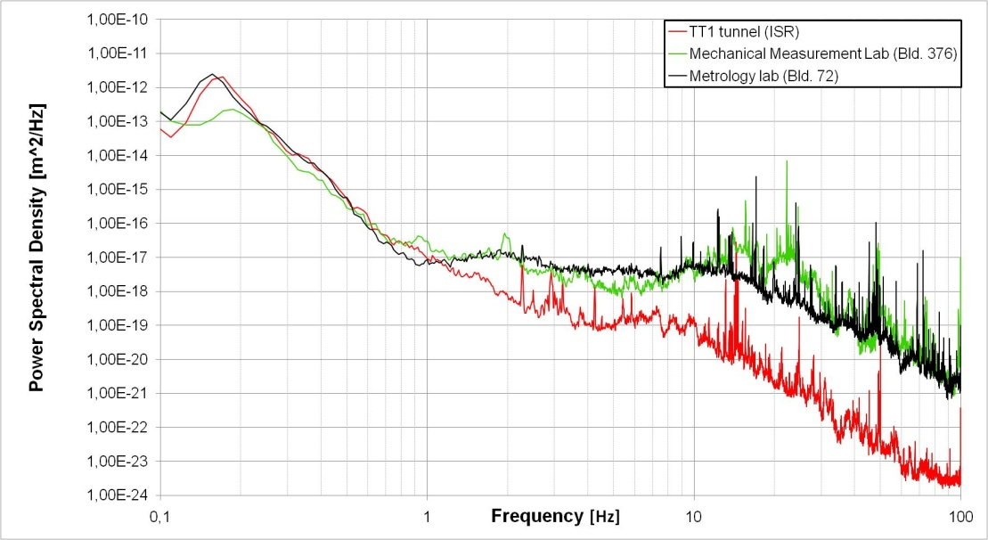
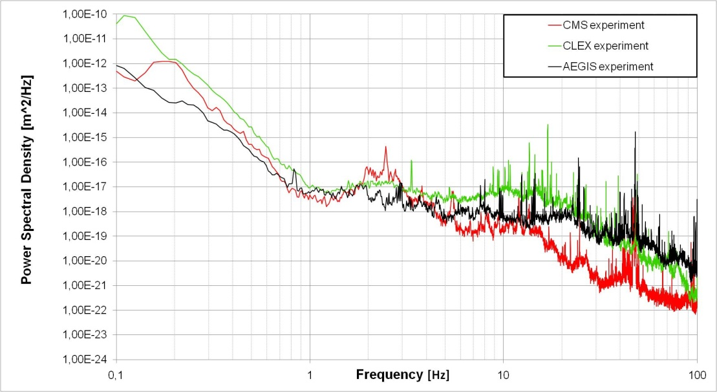
Power Spectral Density
M. Guinchard, M. Sylte

Slide 5
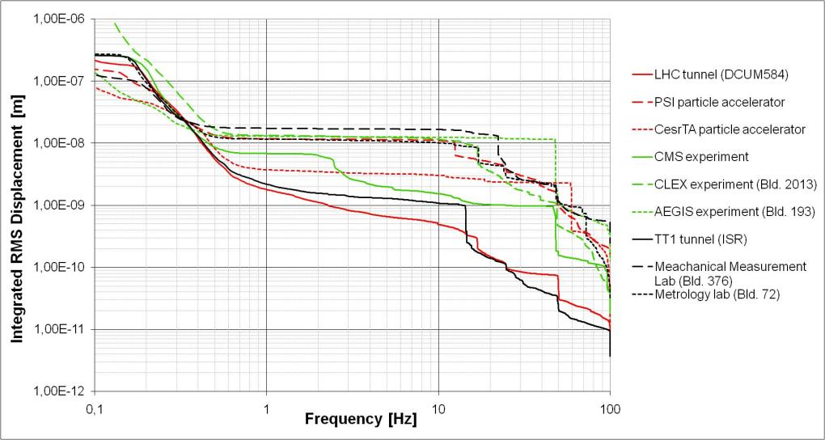

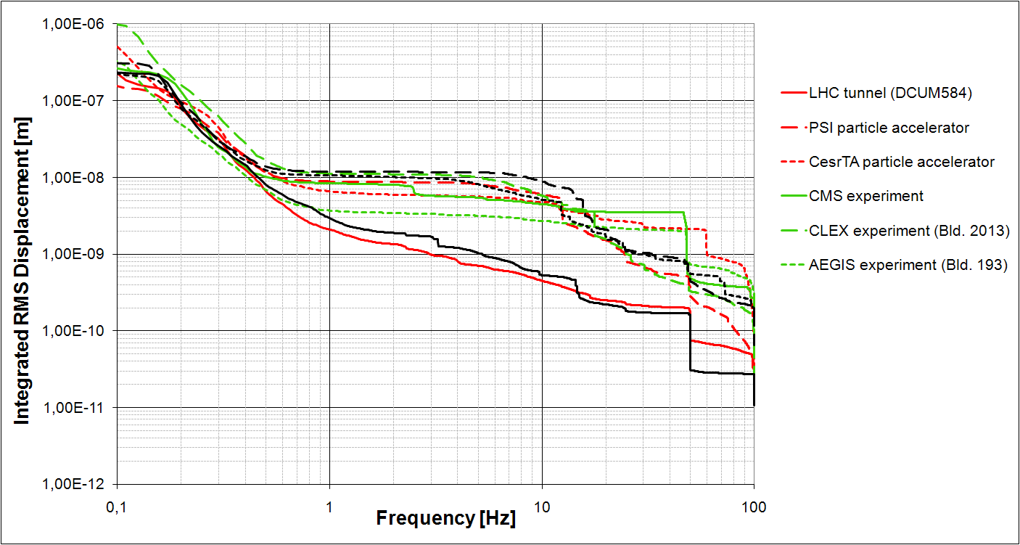

2 nm
1nm
Measured on FLOOR
Vertical
Lateral
5nm
M. Sylte, M. Guinchard

Slide 6
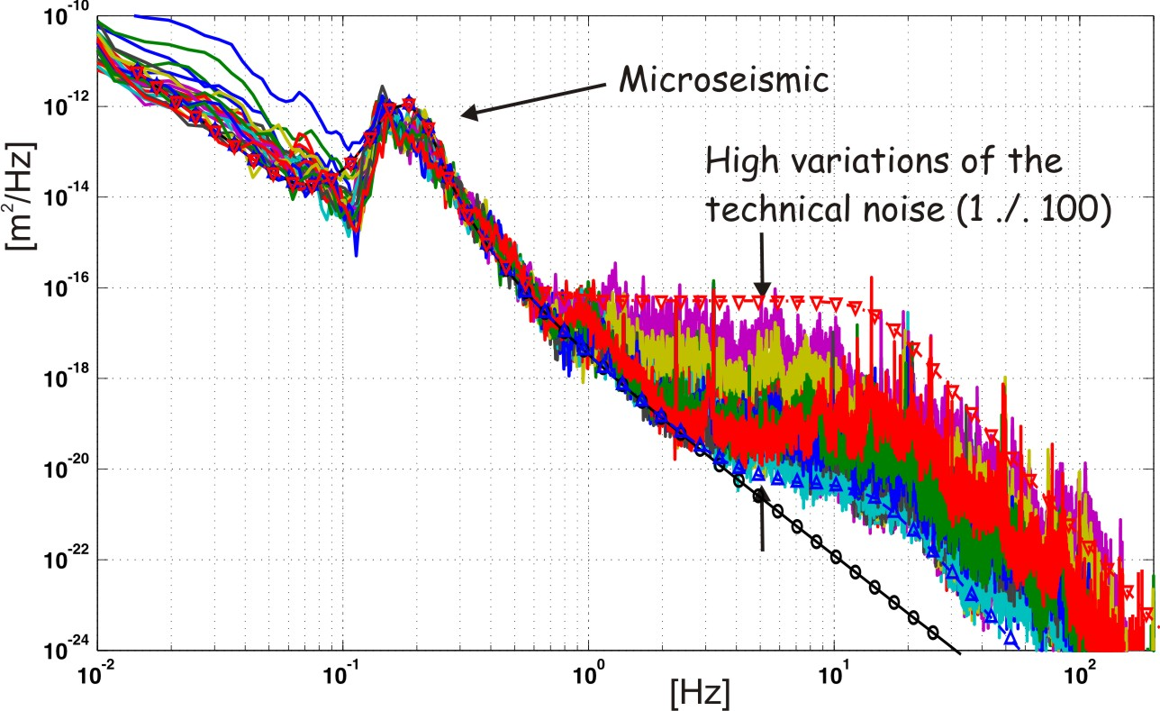
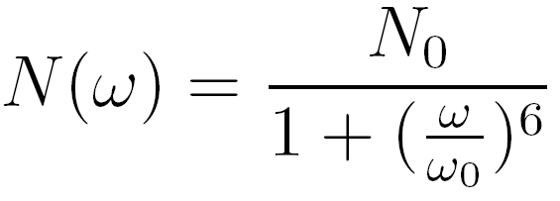

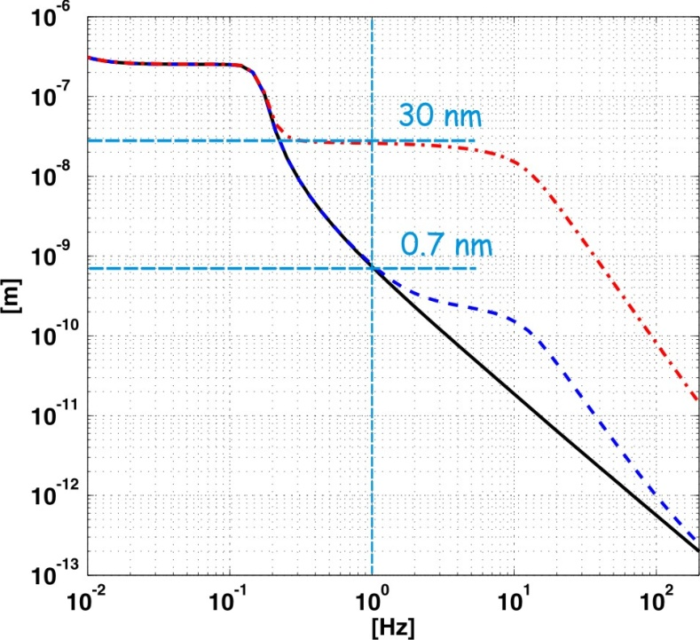
Local excitations: model
Vertical ground motion
Additional
technical noise:
Reference
Reference
Ch. Collette
6

Slide 7
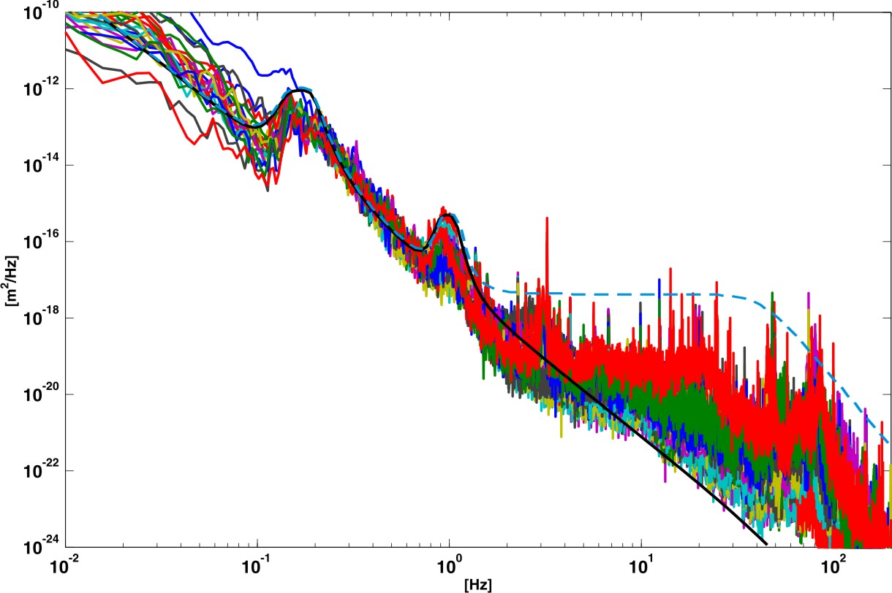


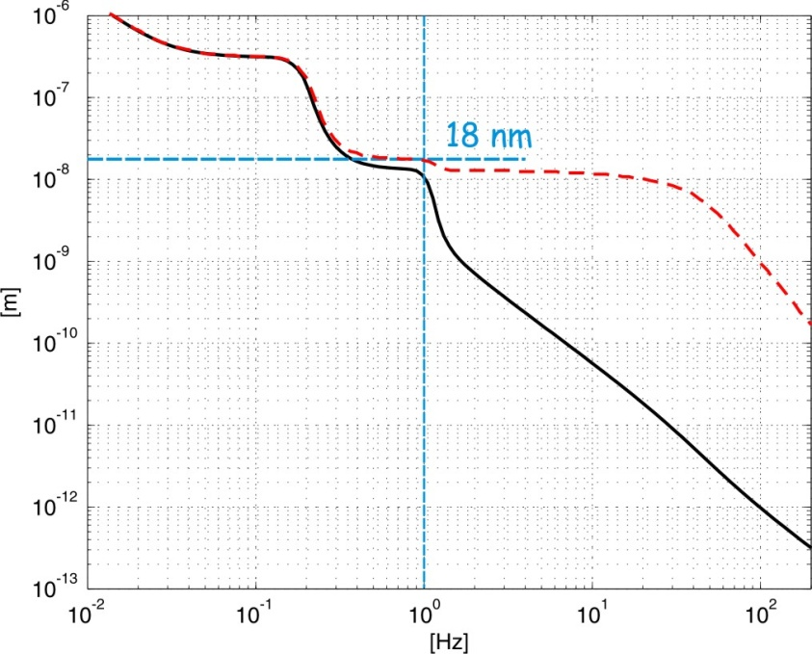
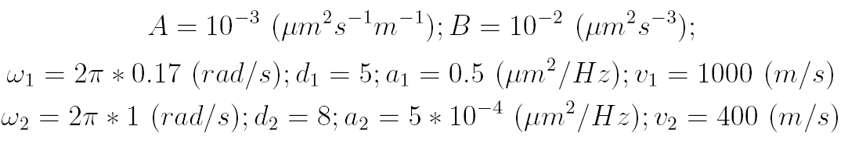
Local excitations
Lateral ground motion
Additional
technical noise:
Reference
Ref. :
Reference

Slide 8
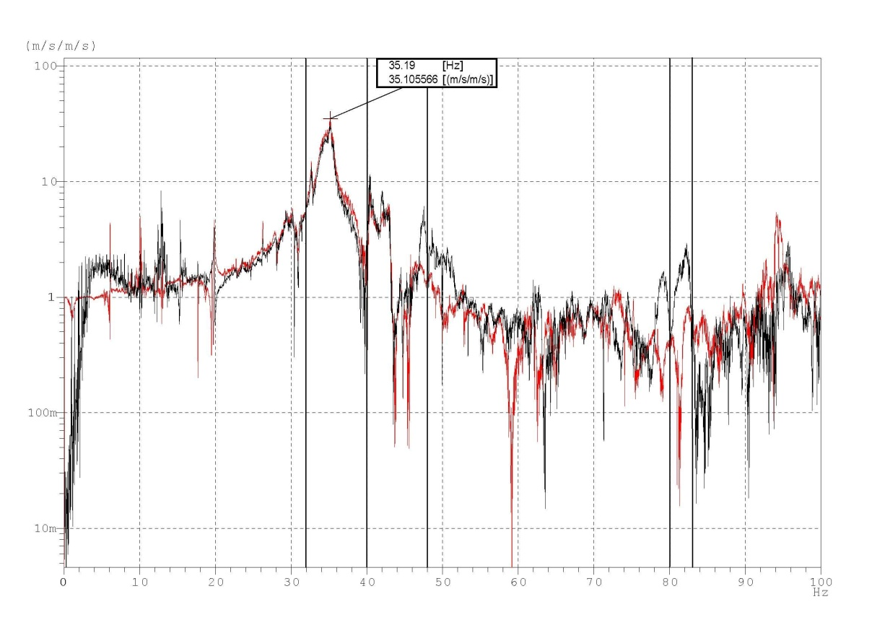
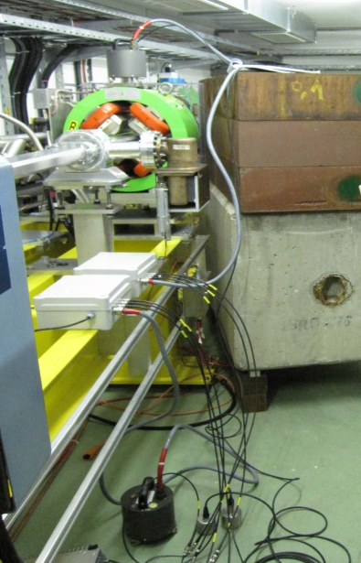
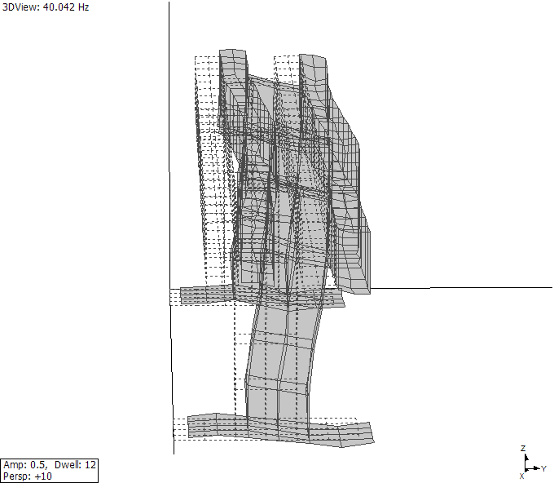
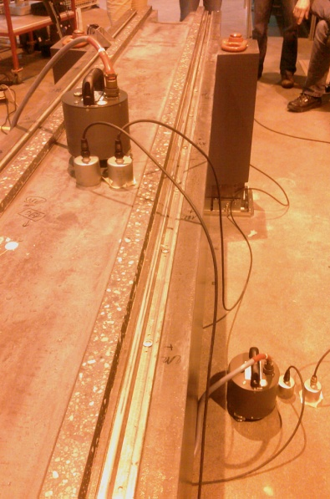
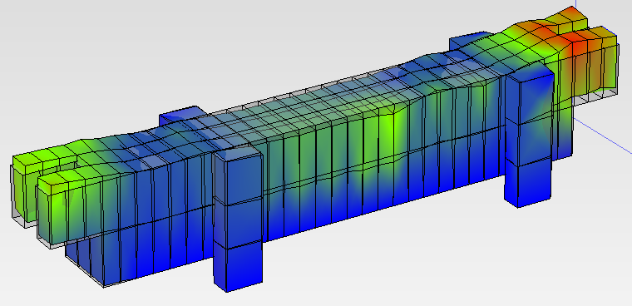
Support amplifications
CLEX girder
Mineral cast girder
(PSI)

Slide 9
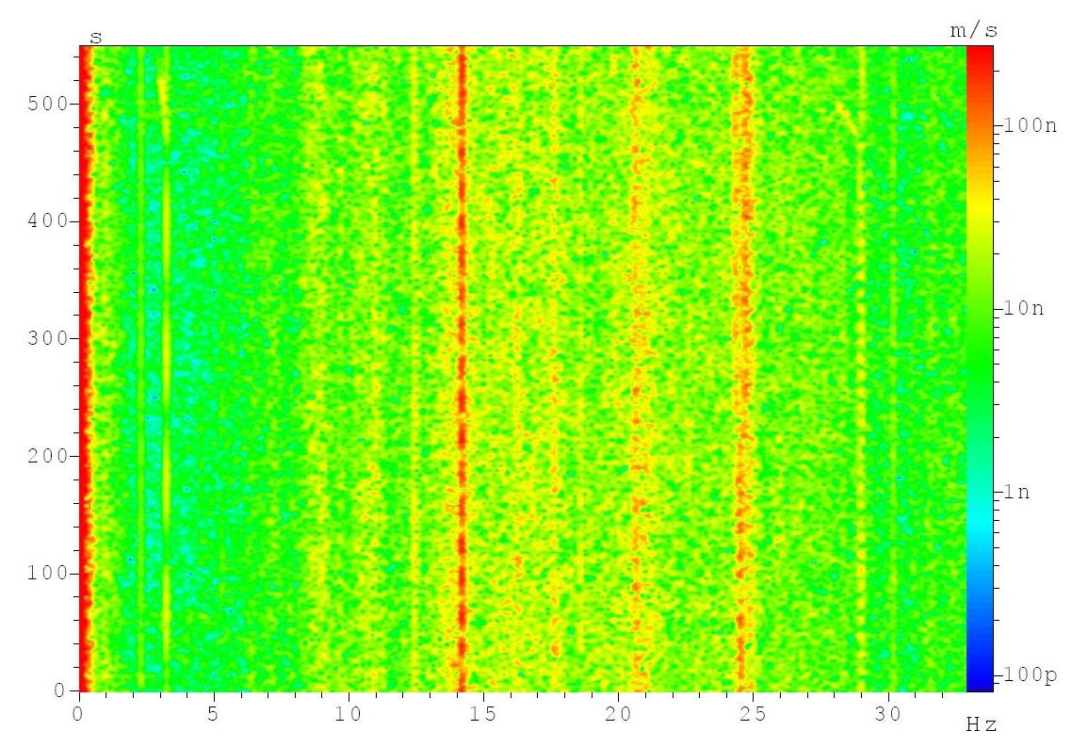
Color map LHC tunnel measurements

Slide 10
Color map LHC tunnel measurements

Slide 11
Example influence ventilation
CLEX

Slide 12
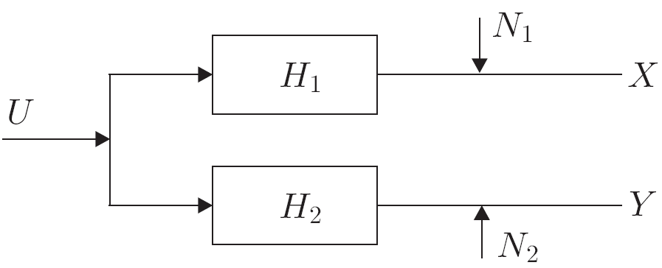


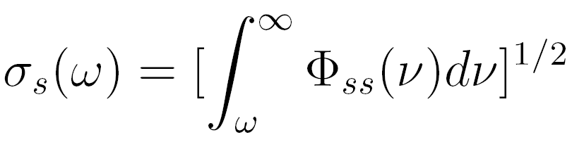
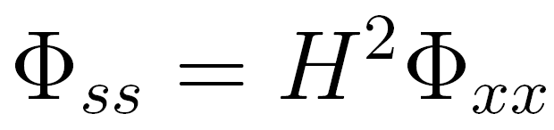
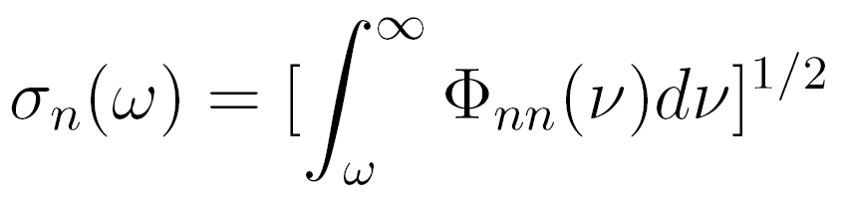
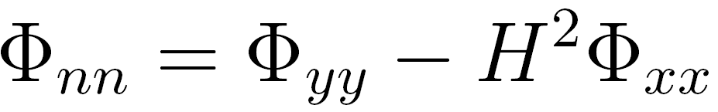
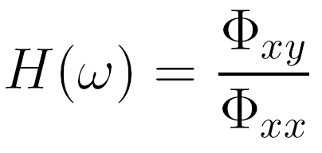
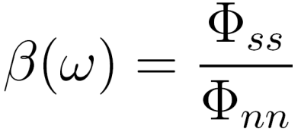
Sensor noise
Prepared by C. Collette
C. Montag. PhD thesis, Hamburg University, 1996.
Two geophones side by side:
where
Signal to noise spectrum ratio:

Slide 13
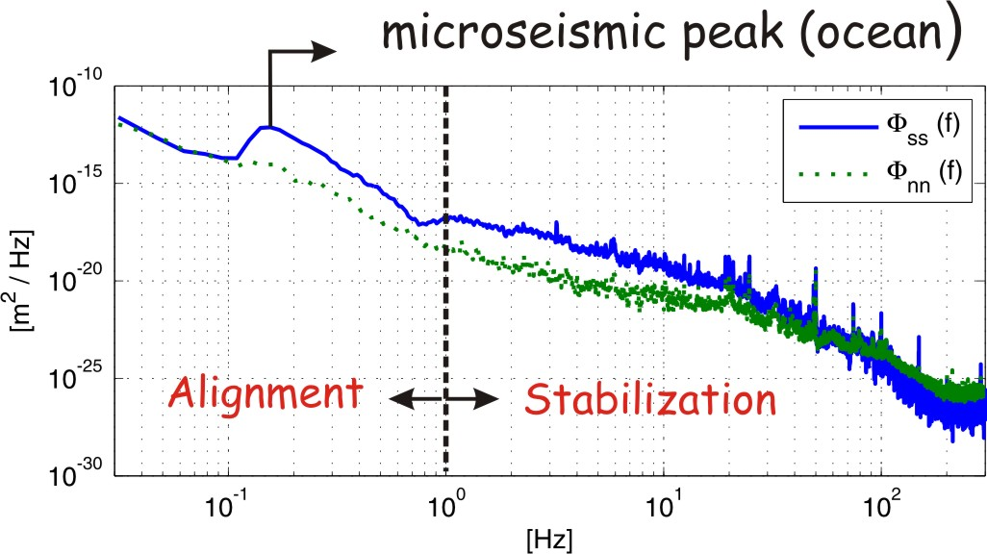
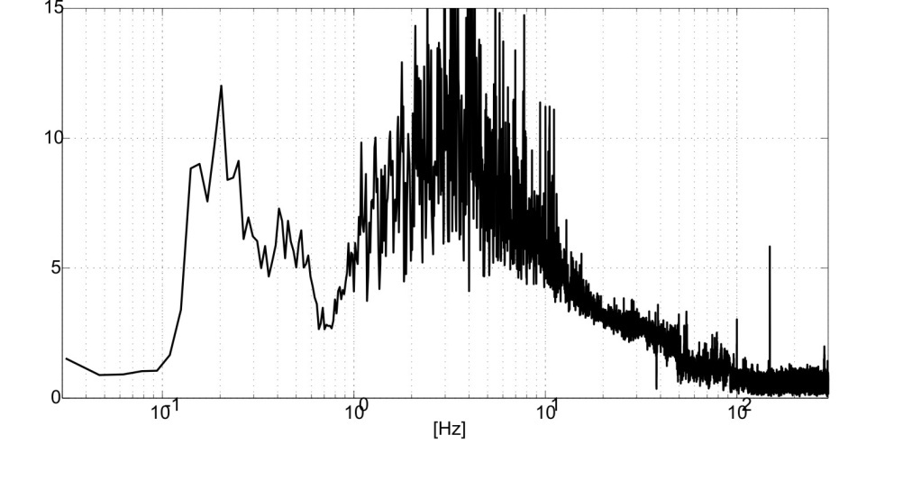

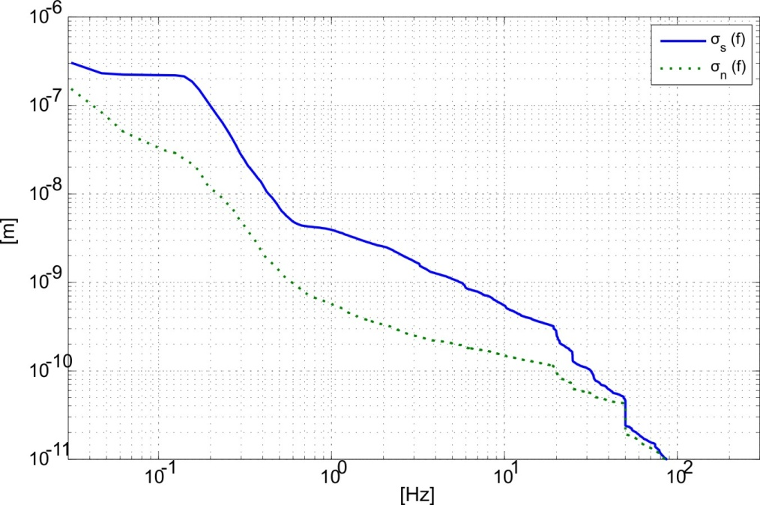
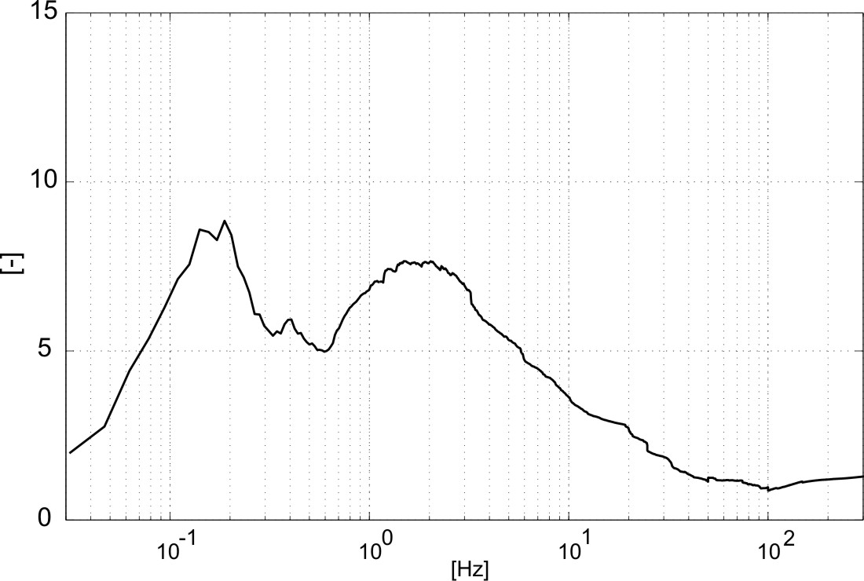

Sensor noise detection
Prepared by C. Collette

Slide 14
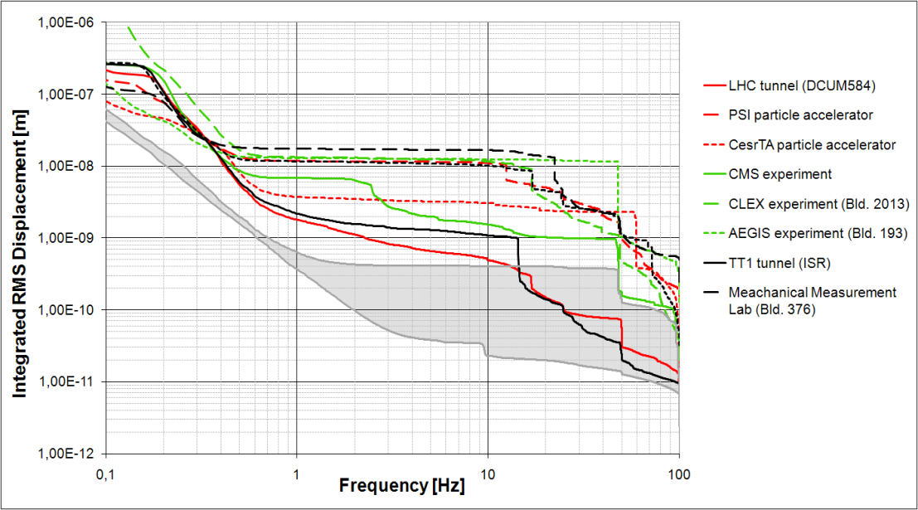
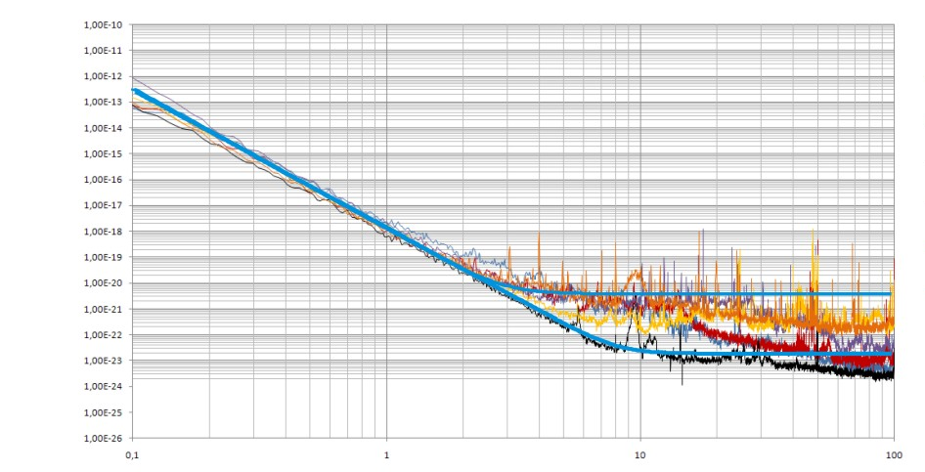


Sensor Noise
At high frequency, the sensor noise increases linearly with signal level
C. Collette, M. Sylte

Slide 15
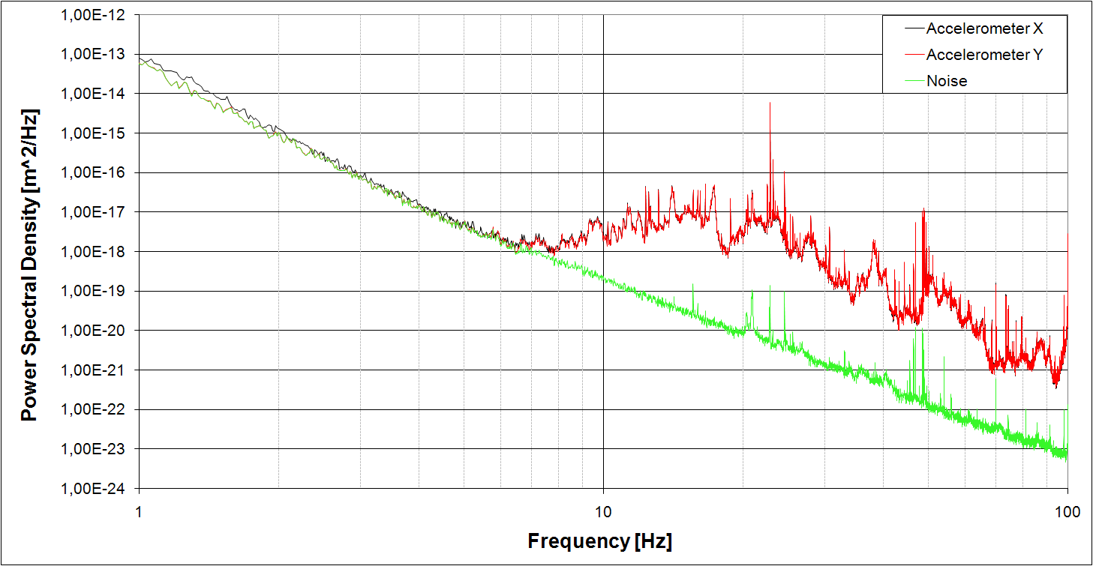
Sensor Noise
Seismic accelerometers
(Brüel & KjærTM type 8340)

Slide 16
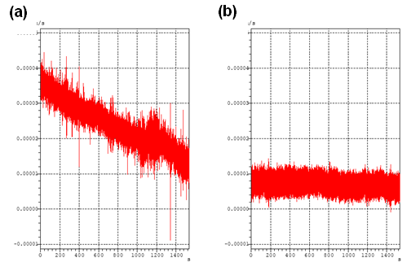
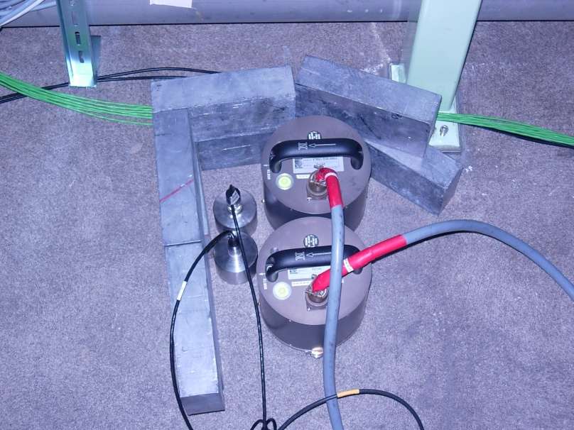
Use of the seismometers– CMG-6T Guralp seismometers
Influence from thermal conditions:
Long settling time
noise reduction
cover
PSI + Cesr TA: Influence from magnetic fields and radiation:
The sensors were placed about 2 m from the quadrupole. No effect was observed from the magnetic field. The effect from radiation needs more investigation.

Slide 17
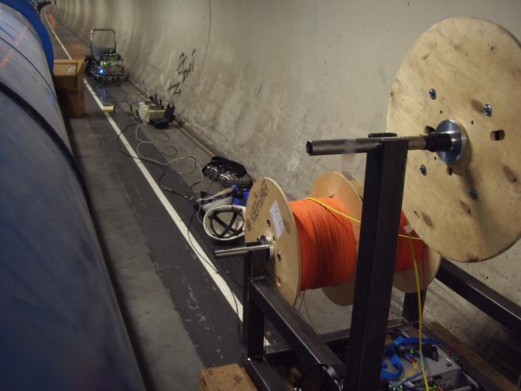
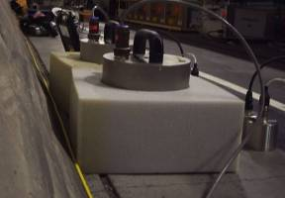
Ground motion measurements : Coherence length
1 km of optical fibre for synchronisation + timing
and Data Transfer
Parameters
Sampling rate
256 Hz
Block duration
64 s
Average
Lin – 50
Overlap
66.7 %
2 Muller-BBM
MKII Analyzers
Guralp
CMG 40T
x,y,z
2*800Vs/m
30 s -50 Hz
ENDEVCO 86
PCB 393B31

Slide 18
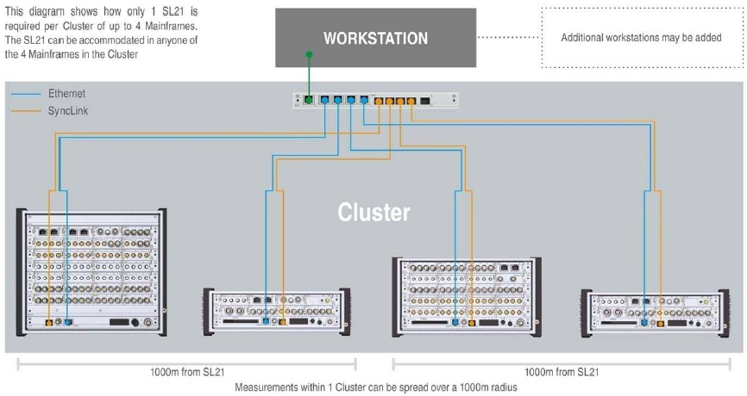
Ground motion measurements : Coherence length
Guralp
CMG 40T
2*800Vs/m
30 s -50 Hz
Specific features :
Synchronous measurements
Phase error < 0.01 deg on the frequency range

Slide 19
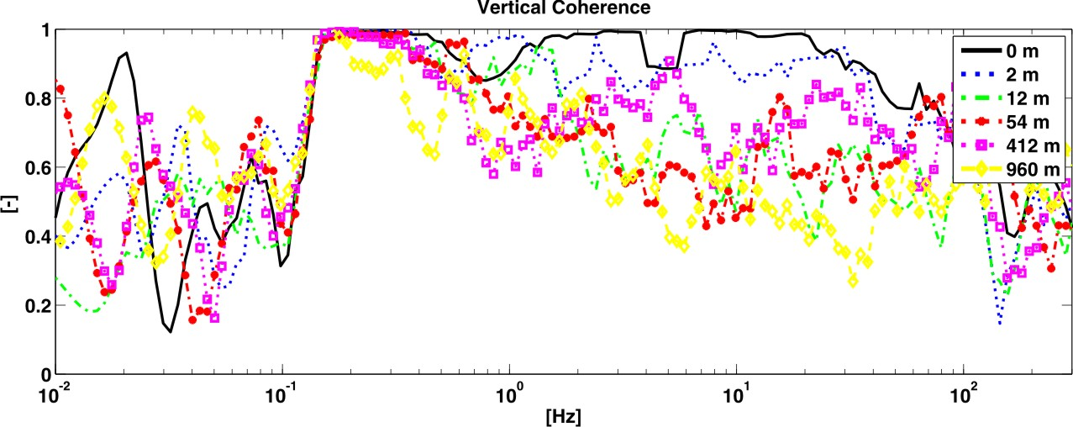
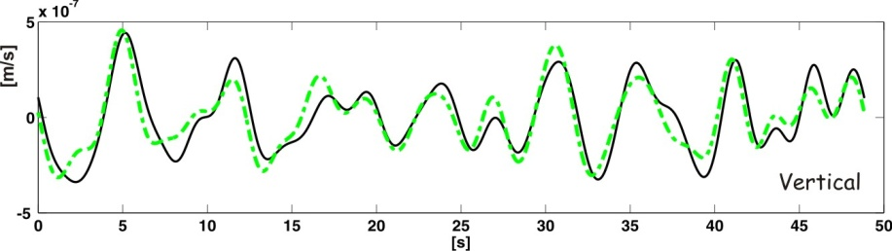
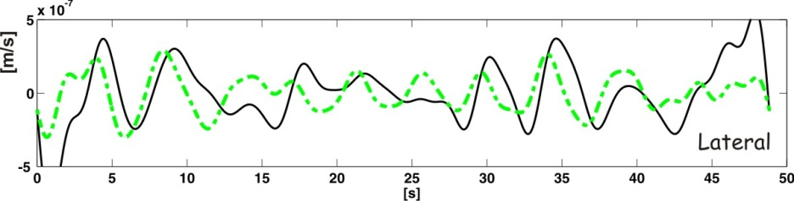
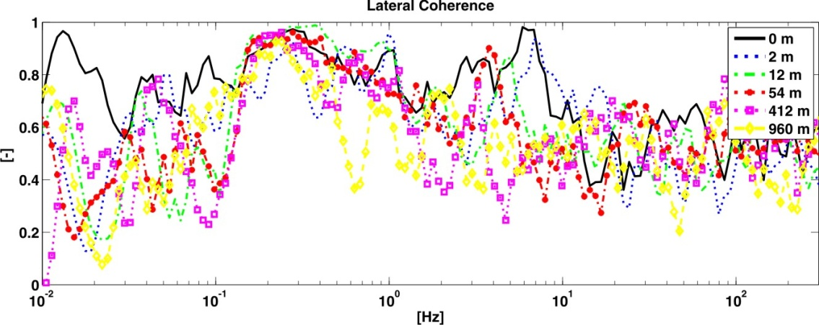
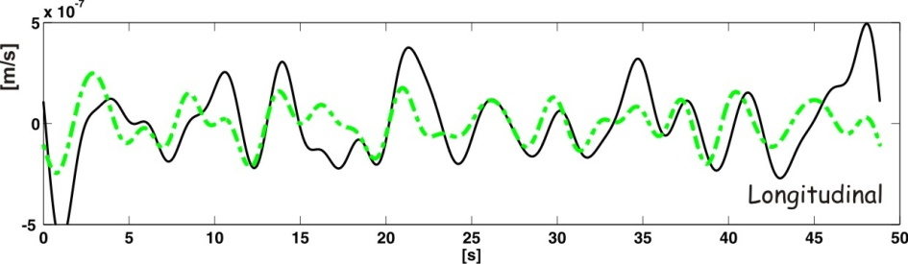
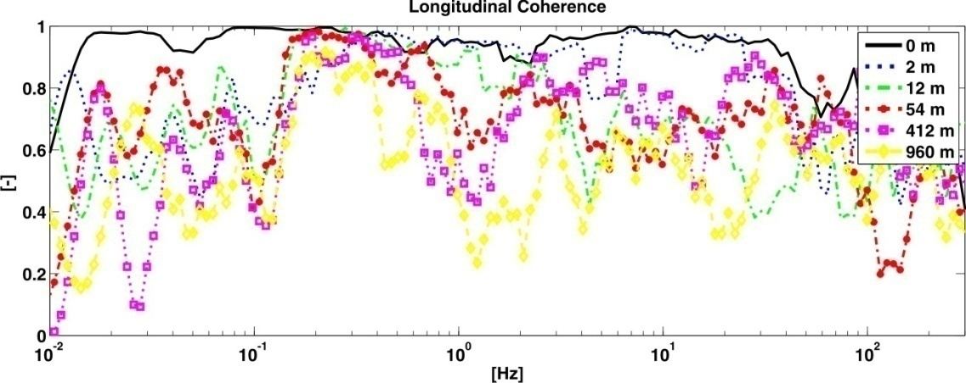
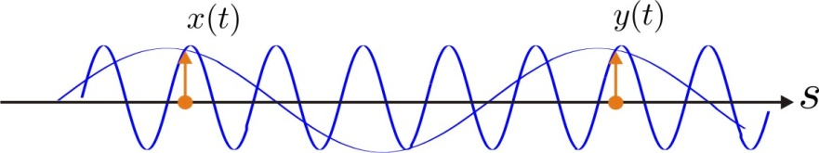
3D coherences
d=960 m; filtered between
0.08 Hz and 0.5 Hz
Correlation in the low frequency range
Similar amplitudes in all directions
or ?

Slide 20
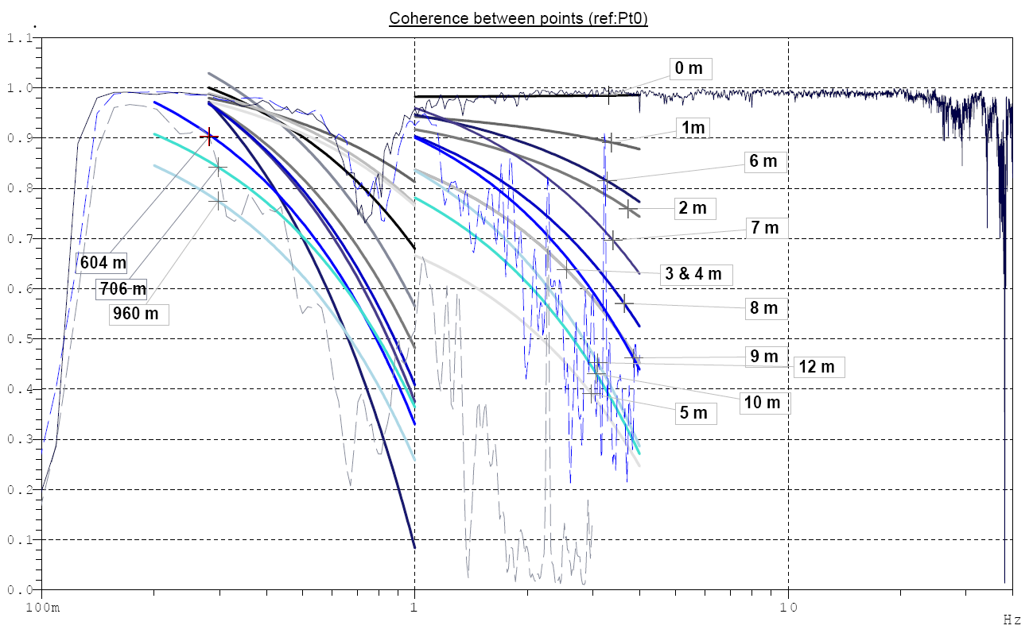
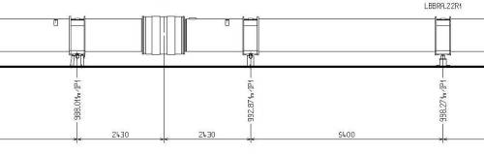
Coherence measurements LHC tunnel
10m
7m
6m
0

Slide 21
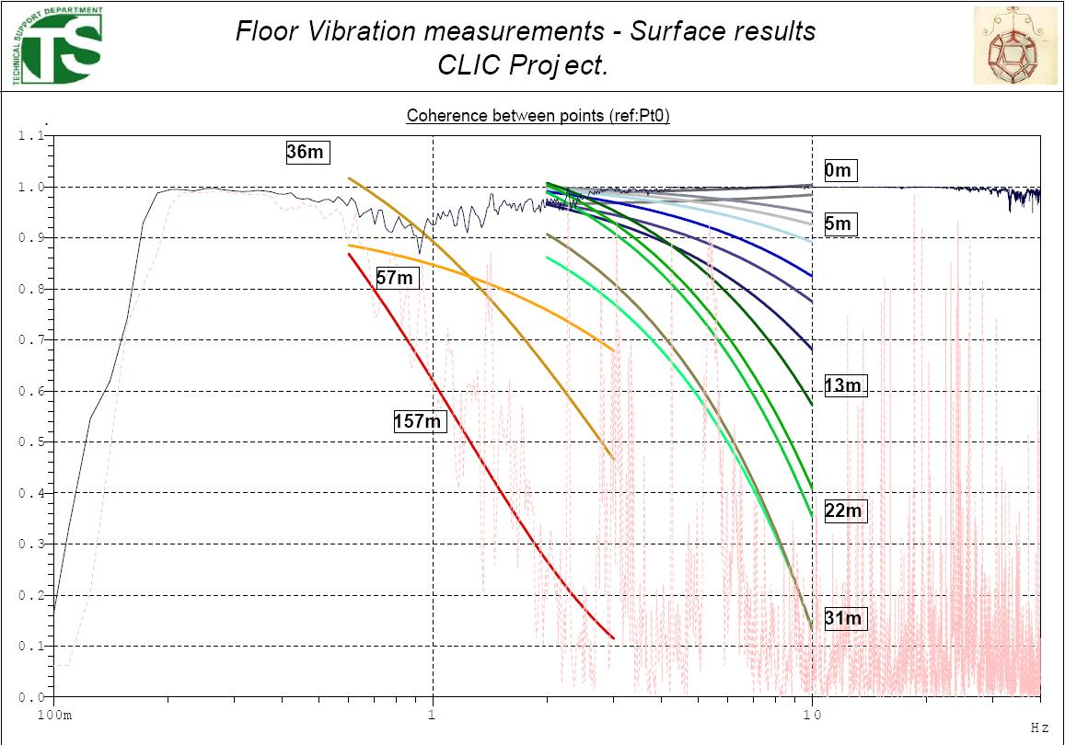
Coherence measurements Surface Building 180

