Slide 1
Summary of TDR task force recommendations

Slide 2
1 – Assumed TD phase from 2011 to 2016
Tentative long-term CLIC scenario
Shortest, Success Oriented, Technically Limited Schedule
Technology evaluation and Physics assessment based on LHC results
for a possible decision on Linear Collider with staged construction starting with the lowest energy required by Physics
?
?
Conceptual
Design Report
(CDR)
Technical
Design Report
(TDR)
Project
approval ?
First
Beam?

Slide 3
CLIC TDR phase preparation task force - Mandate
  Analysis of the issues still to be addressed:
    completion of the feasibility related issues if necessary
    performance and cost related issues
  Elaborate a proposal of the necessary tasks to be done from mid 2010 up to 2015/16.
  That should include in particular the motivation, description and expected results of:
    A possible upgrade of CTF3
    A possible new facility if necessary
    R&D on specific subjects
    Prototyping of critical items
    Industrialization of major components
    Finalization of design and cost
    Technical Design Report including consolidated performance and cost
  Estimate the (M&P) necessary resources and timescale
  Describe the proposal (concerning both accelerator and detector) in a document to be available by mid 2009 with a preliminary report of the main strategy by May 2009 for discussion at the ACE
  Members of the Task Force:
    for the Accelerator part: R.Corsini (chair), J.P.Delahaye, S.Doebert, G.Geschonke, A.Grudiev, H.Schmickler, D.Schulte, I.Syratchev, W.Wuensch
    for the Detector part: L.Linssen, D.Schlatter

Slide 4
What’s required for a TDR?
Should be enough to seek project approval and receive funding to build CLIC
  All major feasibility issues satisfactorily solved
  Technical design of all components which are critical for schedule
  Technical feasibility of all components shown
  Working prototypes for all critical technologies
  Detailed site consideration
  Detailed construction schedule
  Detailed material cost and manpower resource estimates and risk analysis

Slide 5
What hardware work is desirable for the TDR ?
Full technical design, prototypes and industrialization for all schedule critical items:
  Nominal two beam modules with all features this includes accelerating structures & PETS
  Drive beam accelerator units (modulator, klystron, RF network, accelerating structure)
  ...
Full technical design and prototypes (when applicable) for all critical components

Slide 6
Some issues to be considered
R&D on low emittance generation (ATF, SR sources, …)
R&D on low emittance transport (SLC heritage, Linac driven FEL’s, …)
R&D on CLIC final focus parameters and stability (ATF2, …)
R&D of injector parameters (polarised e⁻, unpolarised and polarised e⁺)
Integration of R&D program with other relevant facilities around the world
…
Future facilities should provide
Engineering test-bed for critical components and industrialization of mass produced components
Make a convincing case for project readiness
Provide X-band RF testing capabilities

Slide 7
CERN MTP
CLIC M+P Resources (MCHF) / year
CLIC M+P Resources (MCHF)
Expect additional resources from collaborators (from ½ to about the same level)

Slide 8
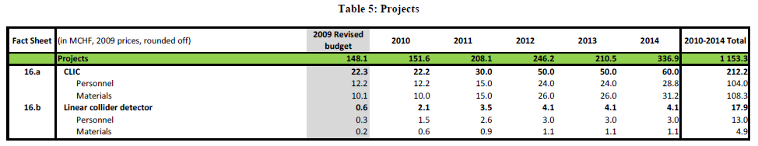

Slide 9
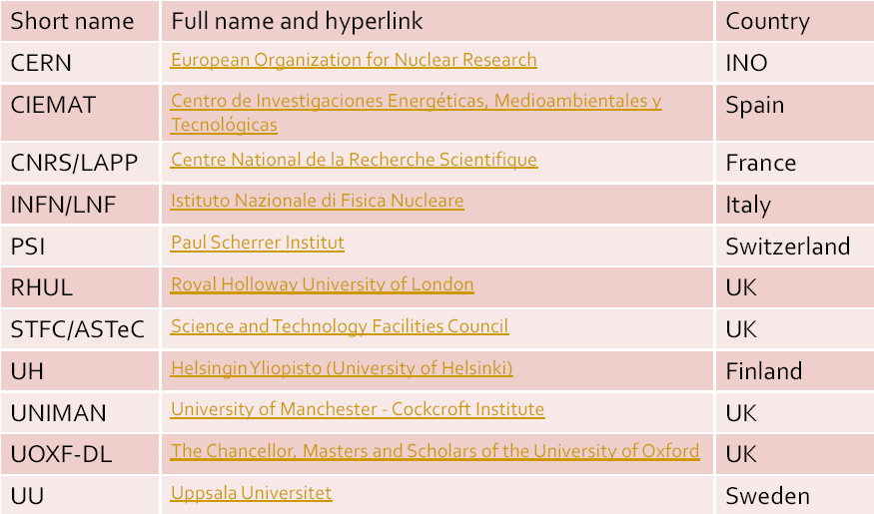
EuCARD - FP 7
NClinac (2009-2013) - beginning 1st April 2009
Total: 6,562,118 €, EC request: 2,001,478 €
Task 9.2: Normal Conducting High Gradient Cavities (G. Riddone/CERN)
Task 9.3: Linac and FF Stabilisation (A. Jeremie/LAPP)
Task 9.4: Beam Delivery System (G. Blair/RHUL)
Task 9.5: Drive Beam Phase Control (F. Marcellini/LNF)
11 Partners
+ EuCARD Task 10.3:Task “Crab cavities” in WP “SRF” and EuCARD Task 7.6: “Short period helical superconducting undulator” in WP “HFM”

Slide 10
5 – Integrate FP 7 in TD phase (including new initiatives)
EuCARD - FP 7, some comments
  Not really relevant financially (small final EU contribution)
  However, very important for CLIC:
    Network with collaborating partners
    Represents an engagement on R&D in the 2009-2013 period
  Note that the scope and size of the present program had been drastically reduced from the initial proposal
  Need to integrate FP7 in the TDR plan & use TDR resources to re-establish initial FP7 plans (when appropriate).

Slide 11
Task Force Strategy
  Don’t think in term of a single facility
  Start from needs and not from (potentially) available budget / resources
  Begin with list of activities and feasibility / critical items
  Determine where we will likely stand in 2010.
  Define a logical extension of R&D for each activity in the short term (2010-2012) - when needed - setting clear goals.
  Try to define additional R&D needed to arrive at a TDR in 2015 for each activity & identify schedule critical items.

Slide 12
Accelerating Structures
 | Projected Status in 2010 | Goals for 2012 | Goals for 2016
Structure development, high-gradient studies | Successful test of a few structures (TD18, CLIC_G), with nominal parameters (100MV/m 240 ns 3 10⁻⁷ m⁻¹ brkdown rate) operation for a few thousand hours Including HOM damping features (but possibly without damping material) | Test of at least five to ten structures (CLIC_G or current nominal structures) with nominal parameters for statistics. With damping material, compact coupler. Test of potential alternatives for cost & performance (10 - 20 structures) ? | About 200 structures tested Medium-series and long-term operation Need 10-20 testing stations (12 GHz klystrons or TBL+)
Precision manufacture | Evidence that final mechanical tolerances required by beam dynamics can be reached. Not yet fully implemented on prototypes. | Mechanical tolerances better than 5 µm | Cost optimization of procedures.
Integration, alignment | Design (or alternatives) for final solution including cooling, vacuum, alignment. Not yet implemented on prototypes. | All ancillary subsystems of prototypes (cooling, vacuum) compatible with module integration. Experimental verification in CTF3 modules (and elsewhere?) of inner and structure-structure alignment and resolution of the wake-field monitors | Cost optimization.
Facilities, Industrialization | Precision metrology at CERN. Precision assembly (brazing) at CERN. Full qualification capability at CERN and/or within the collaboration. List of qualified outside companies. | Start precision machining capability at CERN or elsewhere within the collaboration? | Cost optimization Pre-series production? Input needed from costing WG and TE dept.

Slide 13
PETS
 | Projected Status in 2010 | Goals for 2012 | Goals for 2016
PETS development, high-power tests | Operation (a few thousand hours) of a few PETS, in klystron-driven mode to nominal parameters (135 MW to 165 MW, 240 ns, breakdown rate a few 10⁻⁷ /m), eventually with damping. Beam-powered test of a single PETS with external recirculation in TBTS/CTF3, to nominal parameters (135 MW, 240 ns). Beam-powered test of 8 PETS in the TBL/CTF3, to nominal power (135 MW) and 140 ns. | Beam-powered operation of 8-16 PETS in the TBL/CTF3, to nominal power (135 MW) and 140 ns. Beam measurements to verify wake-field model. | Medium series, long term operation of nominal CLIC PETS (klystron-driven mode?). Possible use of TBL+ as power source
On/Off capability | Design of PETS with internal recirculation. Components: compact damped coupler. | Test of PETS with internal recirculation prototype (TBL). Fast on/off concept. | Full implementation, cost and reliability optimization.
Further optimizations, components | Waveguide components tested to full power (e.g., choke-mode flange). First test of wake monitoring in TBTS. | Full waveguide network prototype in CLIC modules in CTF3. Wake monitoring developments? | Final design of components.
Manufacture, industrialization & integration | Specified tolerances (~10 μm) achieved by several vendors (up to now ~ 6 companies qualified). Design of module integration. | Integration of special PETS in CLIC modules in CTF3 (no ON/OFF). Choice of damping material. | Cost optimization. Pre-series production?

Slide 14
8 – Absolutely need injector and “a few” DBA modules (part of CLIC 0)
Drive Beam
 | Projected Status in 2010 | Goals for 2012 | Goals for 2016
Drive beam injector | Thermionic option: scheme for satellites control, stability assessment in CTF3 Photoinjector option: meas. beam quality, stability and long test running of photo-injector in CTF2 | Comparison and choice between photo-injector and thermionic possible Photo-injector in CTF3 ? | Injector prototype at the right frequency and energy, possibly for both solution if choice is not made
DBA, Full Loading, efficiency | 95% efficiency RF-to-beam, SICA 3 GHz, 5 A Current stability ~ 10⁻³ Energy stability ~ 10⁻³ | Current stability < 10⁻³ Energy stability < 10⁻³ | First part of linac at right frequency, 200 MeV ? final stability Efficiency > 90% includ. WGs
Rings, combination scheme | ~ 30 A combined and transported, bunch length < 1 mm, emittance ~ 100 π mm mrad, current &energy stability a few 10⁻³ Phase stability ? CLIC DL & CR design | C & E stability below 10⁻³ Phase stability monitor (FP7), measurements | Eventually add final DL & ring(s) to injector/DBA ??
Sources (modulators & klystrons) | Parametric study of DBA power scheme, reference structure design, M&K specs | Design of M&K, start prototyping – possibly a few prototypes ready in 2012 | M&Ks with full specs, as needed for injector and DBA section.
Drive beam phase and amplitude feedback system | timing reference system conceptual feedback system | low impedance phase monitor, test in CTF3 | DB fast phase feed-back in CTF3 – experimental studies (Kickers, amplifiers, improved phase monitors) alternative timing reference (e.g. X-FEL)
9 – Klystrons could be on the critical path (easier with lower power, but…)

Slide 15
Power production and Two-beam issues
 | Projected Status in 2010 | Goals for 2012 | Goals for 2016
Power production from drive beam, Two-Beams | Beam-powered test of a single PETS with external recirculation in TBTS/CTF3, to nominal parameters (135 MW, 240 ns). Power, energy loss & gain measurements. First break-down kick measurement. | Complete break-down kick measurement. Break-down studies. | Possible use of TBL+ as power source
Deceleration, stability | Beam deceleration experiment in TBL 8 PETS, ~ 30 A & 30% energy extraction Lattice design including cost optimization options - study of decelerator stability, beam loss estimates, including beam based alignment | Beam deceleration experiment in TBL up to 16 PETS, ~ 30 A & 50% energy extraction | Eventually add test decelerator to final DL & ring(s) to injector/DBA ??
Beam loading compensation | Concept First experiment on beam loading control in CTF3/TBTS | Improved beam loading experiment in CTF3/TBTS – full charge | Drive beam bunch charge control Main beam current feed- forward? e.g. temperature effects
Manufacture, industrialization & integration | Design of CLIC module | Integration of accelerating structures, PETS & ancillary equipment in CLIC modules in CTF3. | Production of N modules (N>20) with combined alignment/stabilization system ?

Slide 16
12 – Many reasons to consolidate/upgrade CTF3
Next Steps in CTF3
TBL drive beam deceleration studies (string ofup to 16 PETS)
Study of two-beam issues
  RF breakdown kicks experiment
  Beam loading compensation of probe beam
Photo-injector option full implementation
Phase stability measurements & feed-forward tests
Full-fledged CLIC modules beam tests in CLEX
CTF3 upgraded to X-band power production & testing facility
Instrumentation development for LC – Instrumentation Test Beamline
2010
2012 +

Slide 17
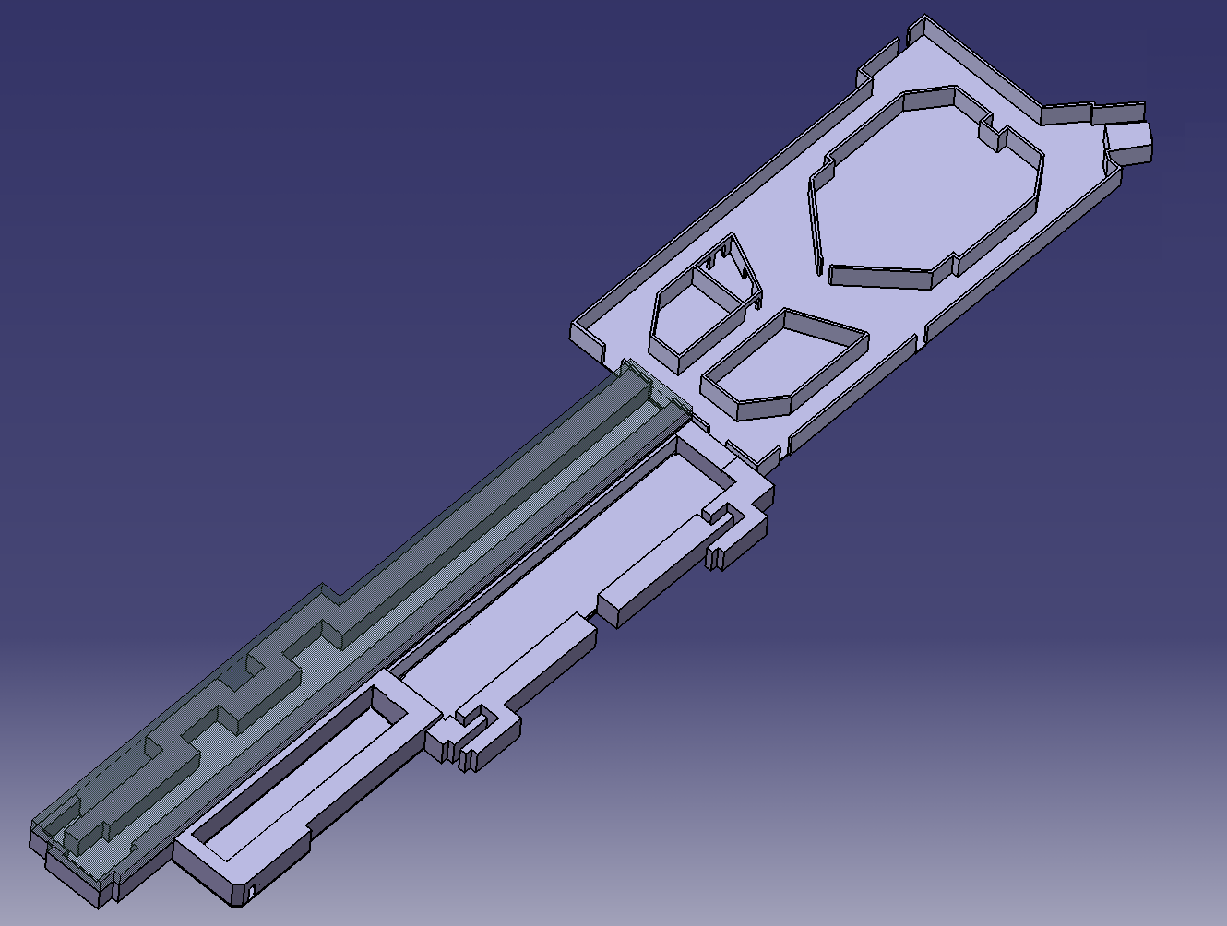
Phase stability measurements & feed-forward
DELAY
LOOP
Phase & energy measurement
COMBINER
RING
DRIVE BEAM
LINAC
Fast feed-forward kicker in final compression line
10 m
CLEX
CLIC Experimental Area

Slide 18
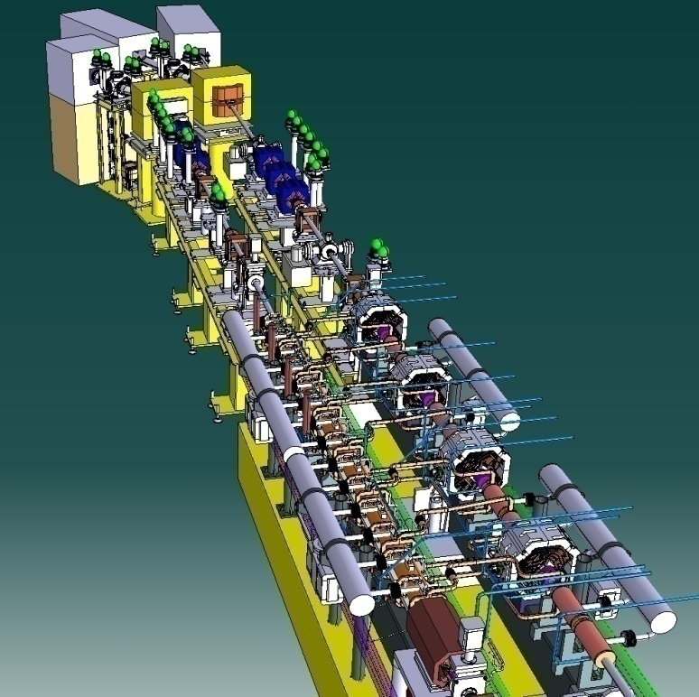
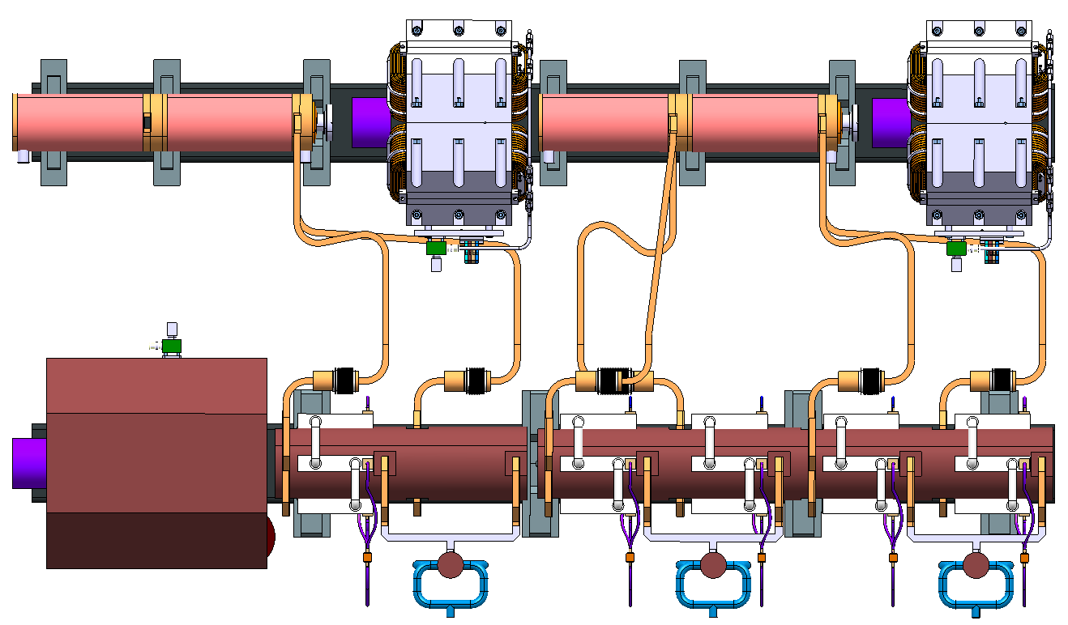
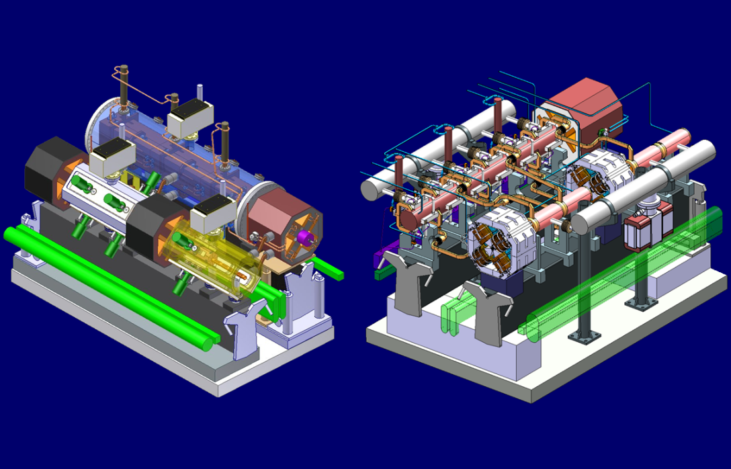
Two-beam modules in TBTS
Module design and integration have to be studied for different configurations.
Integration of the systems in terms of space reservation has been done. Detailed design started for the main systems, such vacuum, cooling, alignment, stabilisation …
Important aspects for cost and basic parameters provided for other areas of the study.
Goal: → test with beam of a few modules in CTF3/CLEX [includes FP7]: first module ready in 2011
Drive beam
MB: AS (quadrants) in vac. tank
DB: PETS in vac. tank
Quads: simplified 3D model
MB: AS (disks) sealed
DB: PETS with “mini-tank”
DB Quads: updated 3D model
Main beam
20760 modules (2 m long)
71460 power prod. structures PETS (drive beam)
143010 accelerating structures (main beam)
Tank Version
Sealed Version

Slide 19
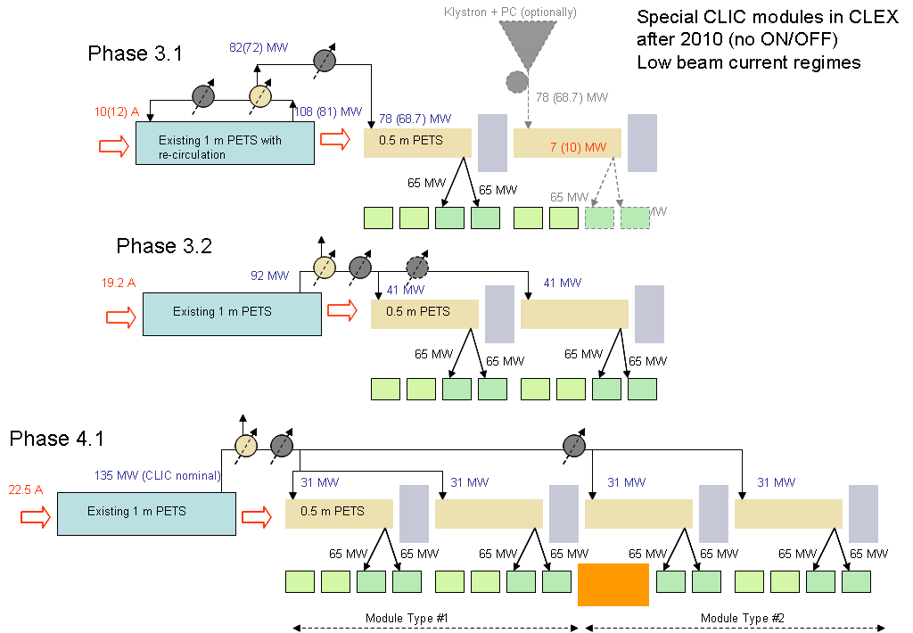
14 – Puzzle:
How to test with beam,
as close as possible to nominal

Slide 20
CTF3 klystron upgraded to X-band testing plant
Advantages
  Up to 16 RF ports with nominal power & pulse length
  Cheaper than several stand-alone X-band sources
  Gives incentive to consolidate drive beam operation towards large facility standards
Problems
  No individual pulse-length control of test slots
  (unless Igor has a smart idea)
  Pulse length obtained only sacrificing power – or need priming
  Increase of rep. rate up to 50 Hz desirable,
  but requires substantial increase of radiation shielding
But don’t say that you don’t believe in testing structures with a drive beam RF source.
If you don’t believe this, there is no point to continue to work on CLIC !
CLIC 3 TeV needs 144000 accelerating structures. If every structure needs four days of
RF processing before installation in the tunnel and we want to build CLIC over 7 years
we need
CTF3 with a drive beam linac upgraded as outlined before and a TBL extended to 43 PETS
could provide 86 RF slots !
17 – On top of stand-alone sources…
144000
×
2
=
113
RF slots
7
×
365

Slide 21
Stabilization
 | Projected Status in 2010 | Goals for 2012 | Goals for 2016
Main linac quads | Mechanical stability assessment of Main beam Quad in CTF3. Mechanics optimized for passive damping. Design of Alignment / stabilization system, within specs for: i) automatic mechanical pre-alignment ii) beam based correction +stabilization Test mockup in laboratory with first feedback loops. Gain of external feedback below 100. Meeting specification for MB Quad of 1nm rms above 1 Hz probable. | Integration into CLIC module (in CTF3/TBTS) Validation of magnet axis stability through a beam experiment at CESRTA or elsewhere Full implementation of feedback loops | Production of N modules (N>20) with combined alignment/stabilization system ? Assessment of performance Chose technical implementation of controller; global feedback versus distributed systems.
FF quads | Measurements of ground motion and environmental vibrations. Stabilization experiments at LAPP for a simple cantilever mockup of a FF magnet. Studies on options for FF magnet technology and options for FF magnet support structures. Simulations. | Mechanical stability of a superconducting FF magnet at ATF2. Mechanics optimized for passive damping. Gain of external feedback below 100. Meeting specification of 0.18 nm is challenging, if not unlikely. | CLIC prototype on chosen technology including alignment system and stabilization system. Assessment of performance
General | R&D on diagnostics; laser systems, interaction of lasers or other radiation with gas filled chambers (beyond geophones, i.e. laser interferometers, other) | Apply advanced diagnostics for assessment of performance | Apply advanced diagnostics for assessment of performance

Slide 22
Generation & preservation
of low emittances
18 – Tests elsewhere when possible – large possibilities for collaborations
Sources & Injectors
 | Projected Status in 2010 | Goals for 2012 | Goals for 2016
Polarized electron source | Scheme & alternatives solutions for 500 GeV. Test at SLAC ? | Test at SLAC, JLAB or elsewhere. | Full design, CLIC micro + macro pulse demonstration. Prototype ?
Positron source | Full simulation for yield to DR R&D on polarized positrons. | R&D on polarized positrons. | Full design, Positron target demonstration (KEK/SLAC)?
Main beam injectors | Simulation from DR to main linac, phase stability study, structure design |  | Full design, structure prototypes, 2,4 and 12 GHz Klystrons: 2, 4 and 12 GHz Laser specs

Slide 23
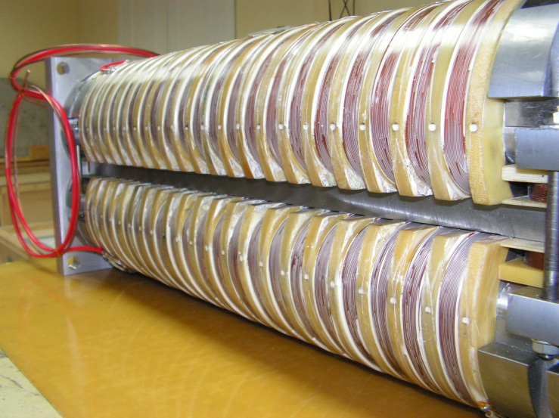
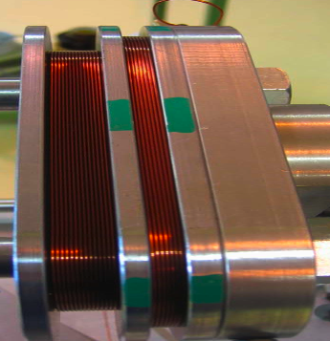
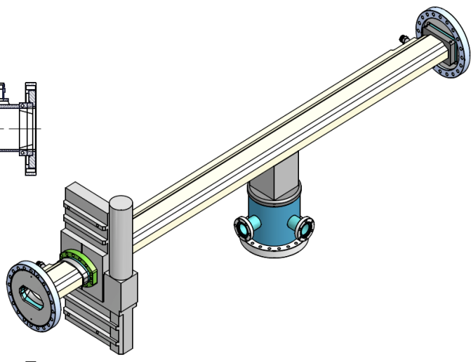
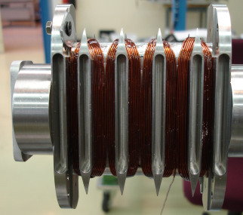
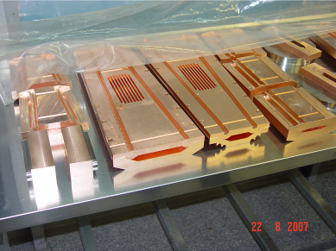
Generation & preservation of low emittances
Damping Rings
Status in 2010
Updated reference lattice designs for the damping ring and pre-damping rings at 3TeV and 500GeV.
Simulations confirming the damping ring performance with IBS.
Simulations defining the requirement beam pipe surface properties to suppress electron cloud. The results of the world-wide collaboration on electron cloud suppression.
Updated vacuum specifications to suppress fast beam-ion instability.
Prototype wigglers will be available.
Simulations showing that the heat load in the wigglers is acceptable.
A solution for the RF system including beam loading compensation.
19 – Wiggler tests with beam (recover FP7) and identify other critical hardware

Slide 24
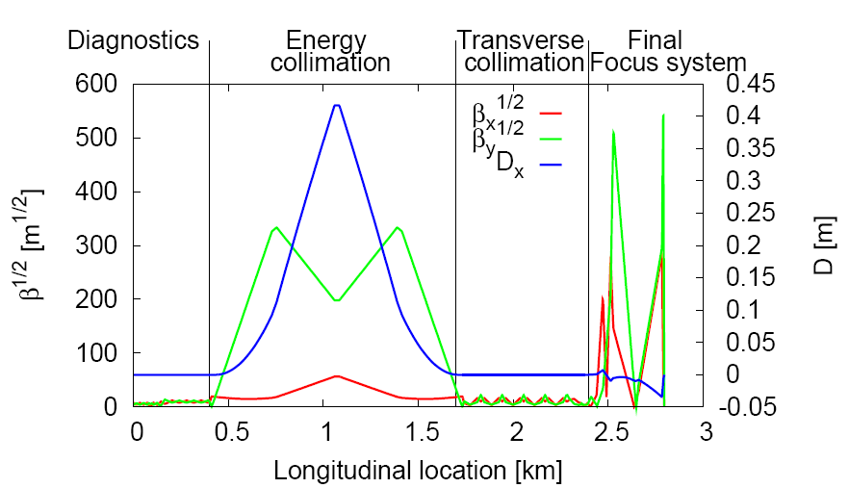
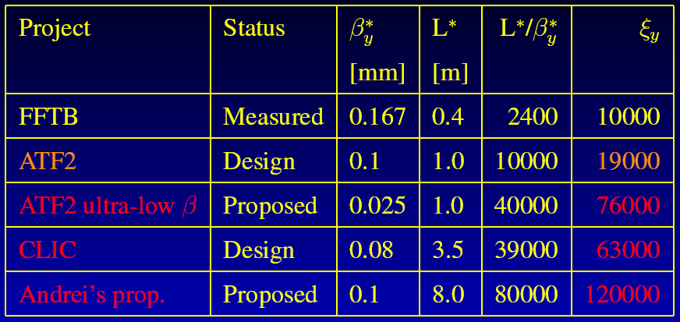
20 – More investment in ATF II
Generation & preservation of low emittances
Final Focus
Status in 2010
Updated reference lattice exists for CLIC at 3TeV.
A lattice at 500GeV needs to be optimised for performance and machine protection.
Studies establishing the performance of the collimation system.
Studies establishing that the detector solenoid and shielding are acceptable.
A tuning technique that removes the effect of static imperfections.
A conceptual orbit feedback.
A study of a tuning strategy that uses fast signals from the beam-beam collision.
Status in 2012
• Test of the CLIC beam-based alignment scheme at ATF2. While the beam size that can be reached in ATF2 is 20 nm, much larger than the 1 nm for CLIC, ATF2 will serve as a test bed for the chromaticity suppression and the system tuning algorithms.

Slide 25
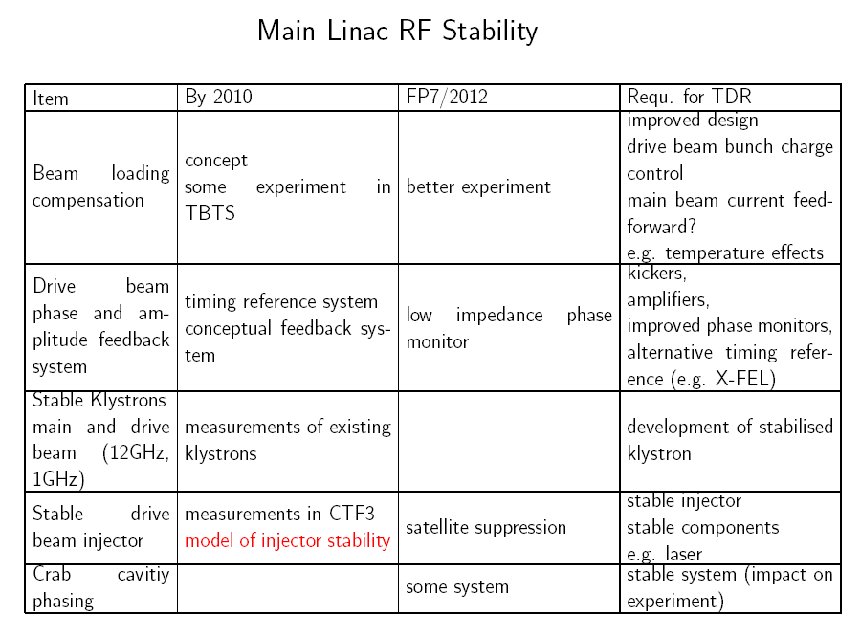
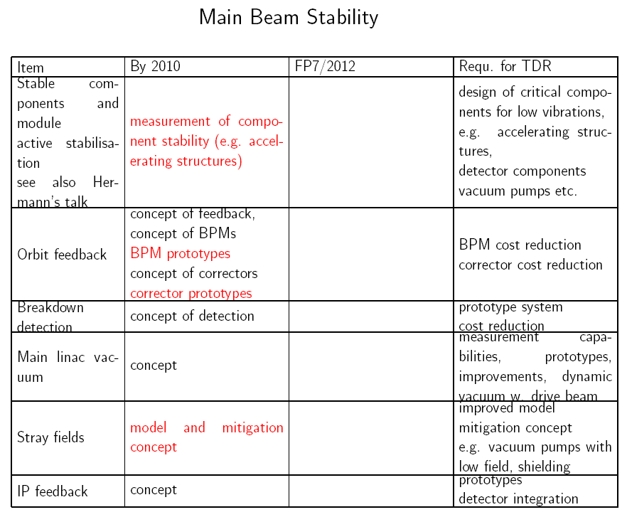
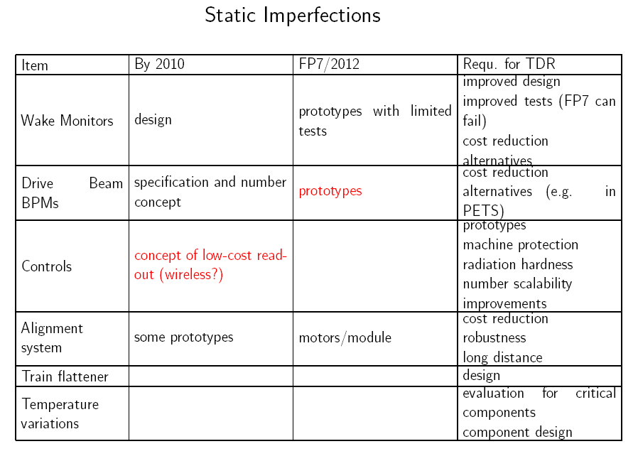
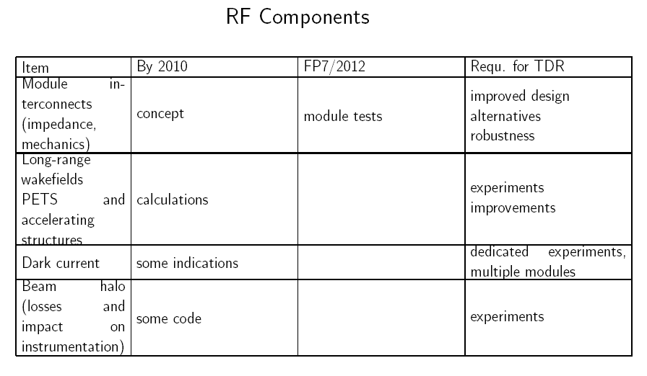

Slide 26
Operation and machine protection
What performances will realistically be achieved (Target Performances):
by end 2010
Full inventory of failure modes, simulation of their impacts on the accelerator structures
Detailed requirements for passive machine protection.
Evaluation of the requirements for beam observation systems to detect the onset of instabilities in drive and the main beam (i.e. beam loss, beam intensity loss, position and emittance).
Proof of feasibility for magnet power circuits with guaranteed tolerance for 2 ms after the onset of failure.
Required tolerance for all magnet circuits for safe operation with nominal beams.
Establish the procedure to reach nominal CLIC operation starting from a “cold” machine, based on successive beams of increasing intensity and brilliance.
Evaluate the unavailability of the machine for nominal operation due to various interlock conditions and equipment failures.
by end 2012 (including FP7)
Complete and validated design of passive protection system.
Detailed scenario for machine protection checks
Detailed design of “next beam permit” machine protection system for slow failures.

Slide 27
Schedule
 | 2010 |  |  |  | 2011 |  |  |  | 2012 |  |  |  | 2013 |  |  |  | 2014 |  |  |  | 2015 |  |  |  | 2016
 | 1 | 2 | 3 | 4 | 1 | 2 | 3 | 4 | 1 | 2 | 3 | 4 | 1 | 2 | 3 | 4 | 1 | 2 | 3 | 4 | 1 | 2 | 3 | 4 | 1 | 2 | 3 | 4
CTF3 TBTS operation | inst. | 1-2 structures, beam loading, breakdown kick
CTF3 TBL operation | inst. |  | Deceleration 8 PETS |  | final decelerator test (16 PETS, 50%)
Modules lab | initial tests, installation 2 modules |  |  |  | further tests, installation 4 modules |  |  |  | testing |  |  |  |  |  |  |  | pre-series production, industrialization
Modules CTF3 |  |  |  |  |  |  |  | 1 module inst. |  | testing 1 module |  | 3 modules inst. |  | testing 3 modules |  |  |  |  |  |  | > upgrades?
CTF3 phase feedback | design, hardware tests |  |  |  |  |  |  | installation |  | testing
CTF3 TBL+ |  |  |  |  |  |  |  | installation |  | commissio-ning |  | RF testing, potential upgrades
CLIC DB injector & linac | design & hardware construction |  |  |  |  |  |  |  | installation |  |  |  | commissioning |  |  |  | staged upgrade & testing
RF structures construction | precision metrology, fabr. procedures |  |  |  | up to 40 structures built, establish precision machining at CERN or elsewhere, 5 μm tolerances achieved |  |  |  |  |  |  |  |  |  |  |  | more than 200 structures built, final cost optimization, pre-series with industry
RF test infrastructure | CERN test stand inst. |  | CERN test stand testing and upgrades (at least two slots) |  |  |  |  |  | continue testing with increased capabilities, CERN or elsewhere, up to 10 slots |  |  |  |  |  |  |  | testing, up to 200 accelerating structures plus PETS and RF components
Prototypes of critical components | technical choices, design |  |  |  | construction, hardware tests |  |  |  |  |  |  |  |  |  |  |  | finalization, performance & cost optimization, industrialization for large scale components

Slide 28
(New) total cost profile
(CERN)
Integrated

Slide 29
Resources by activity

Slide 31
Conclusions
A single large facility, as initially envisaged, is not the best option to prepare the CLIC TDR.
The TDR phase preparation Task Force had identified milestones in the short (2012 / 2013) and longer (2015 / 2016) time scales, in all areas of the study.
The operation of CTF3 should be extended to at least 2012, to allow full exploitation of the present installation and extend it to include the construction and use of a series of full-fledged CLIC TBA modules and the implementation of a fast phase feed-back system to test the very tight phase stability requirements of the CLIC drive beam (0.2° at 12 GHz).
The extension of CTF3 to a power production facility for structure & RF component testing is highly desirable.
There is a large potential for experimental tests, that cannot be made in CTF3, in other facilities around the world – many are presently pursued (ATF2, CeSRTA, ANKA, …).
Need to prepare as soon as possible extensive prototyping of schedule critical items:
  Nominal two beam modules with all features this includes accelerating structures & PETS
  Drive beam accelerator units (modulator, klystron, RF network, accelerating structure)
A relevant fraction of resources will be taken by development and prototyping of performance-cost critical items (e.g. diagnostics, sc wigglers, kickers, vacuum chambers and equipment…). Whenever possible prototype testing should be done with beam at CTF3 or in other test facilities.

Slide 32
List of issues/options to be explored to get to the TDR
Completion of feasibility demonstration (basic information on feasibility should be already available, but...)
R&D on critical issues (performance + cost, e.g. stabilization & alignment)
Prototyping of critical components for performance (small number items, e.g. final doublet quads, sc wigglers)
Prototyping (and possibly pre-series) of critical components for cost (e.g. drive beam modulators/klystrons)
Start industrialization of mass produced components (e.g. RF structures, RF components...) ?
Integration of components in large number modular sub-systems (two-beam modules)
Test of full (small?) sub-systems, critical for performance (e.g. D.B. Injector, positron source...)
Tests at existing test facilities on specific issues (e.g. phase stability, electron cloud, IBS…)
R & D on diagnostics, machine protection ?
Need (larger) facilities for RF conditioning/testing ?

Slide 33
Reserve slides

Slide 34
Resources by activity

Slide 35
Material vs. manpower

Slide 36
CLIC DB Injector & Linac

Slide 37
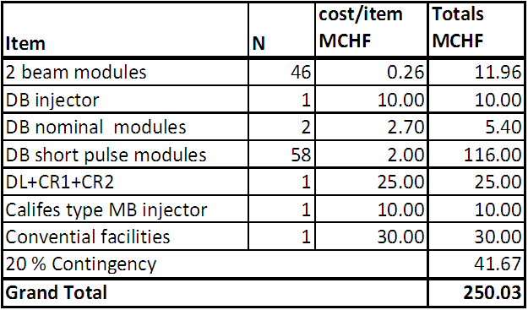
CLIC DB Injector & Linac

Slide 38
The ILC TDR
The Technical Design (TD) Phase of the ILC Global Design Effort will produce a technical design of the ILC in sufficient detail that project approval from all involved governments can be sought.
The TD phase will culminate with the publication of a Technical Design Report (TDR) at the end of 2012. The key elements of the TDR will be:
  A complete and updated technical description of the ILC in sufficient detail to justify the associated VALUE estimate.
  Results from critical R&D programmes and test facilities which either demonstrate or support the choice of key parameters in the machine design.
  One or more models for a Project Implementation Plan, including scenarios for globally distributed mass-production of high-technology components as “in-kind” contributions.
  An updated and robust VALUE estimate and construction schedule consistent with the scope of the machine and the proposed Project Implementation Plan.
The report will also indicate the scope and associated risk of the remaining engineering work that must be done before project construction can begin.

Slide 39
ILC TD phase 2

Slide 40
Initial proposal: A next facility towards CLIC
Presented & discussed at the CLIC workshop ‘08
“CLIC Zero” - Footprint
CALIFES type injector
0.2 GeV, 1.2 A
TBA
6.5 GeV, 1.2 A
0.2 GeV, 101 A
DB Turn around
0.48 GeV, 101 A
DBA
0.48 GeV, 4.2 A
DL
CR1
CR2
Compression
2 x 3 x 4
100 m

Slide 41
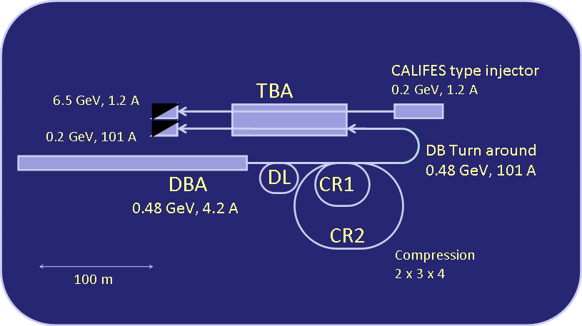
CLIC Zero – Pros & cons
  Demonstrates nominal DBA injector with all parameters
  Creates nominal drive beam train apart from energy (0.48 GeV instead of 2.4 GeV)
  Demonstrates nominal DBA module with klystron and modulator with all parameters
  Demonstrates two beam acceleration over significant distance with fully nominal modules
  Forces pre-series production of all mass produced components → Industrialization
  Well suited to create confidence in CLIC technology
  All hardware investment is re-usable for real CLIC
  Expensive – will absorb almost all planned budget
  Schedule too long – results with beam not before 2015
  No obvious use of 6.5 GeV main beam but for testing
  Drive beam dynamics more
  difficult than in real CLIC (like in CTF3)

Slide 42
CLIC 0 initial costing by Hans

Slide 43
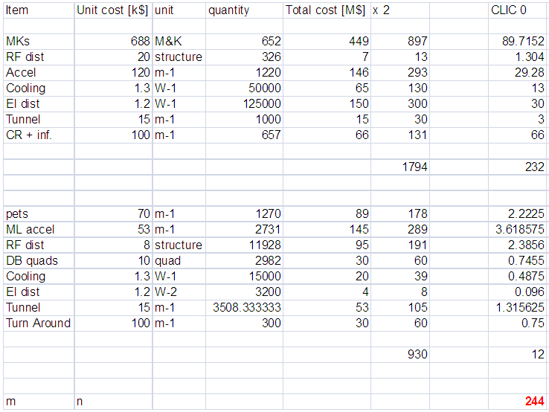
CLIC 0 by scaling CLIC costing by Chris Adolphsen

Slide 44
Tentative schedule for CLIC R&D 2010-2016

Slide 45
First estimate for structures
(Walter)

Slide 46
First estimate for injectors studies & structures testing
(Steffen)

Slide 47
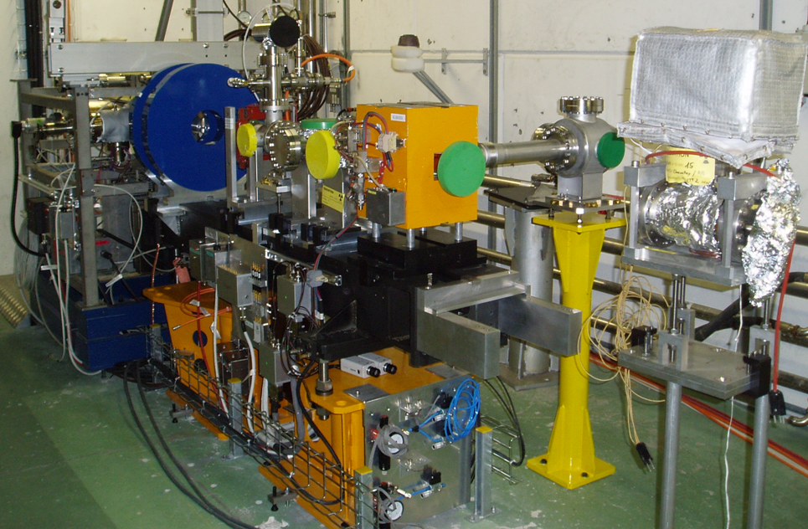
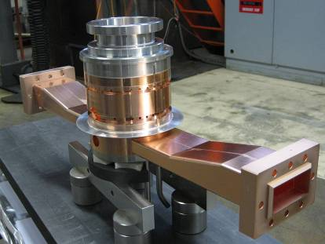
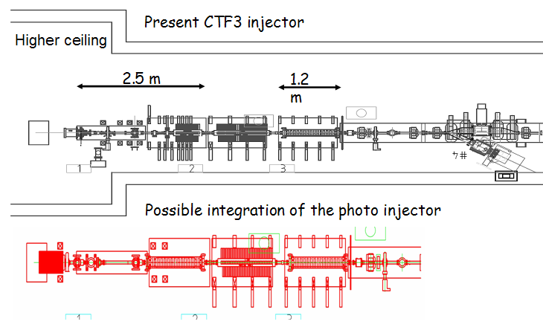
Photo-injector option full implementation
15 – Probably only dedicated tests in CTF2
Smaller transverse emittance
Shorter bunches, no energy tails
No satellites
Lower current
Single bunch option will allow
Check and correction of beam optics with high precision
CSR measurements with high precision in DL, CR and TL2 bunch compressor.
δ response of PETS and beam instrumentation
…

