Slide 1
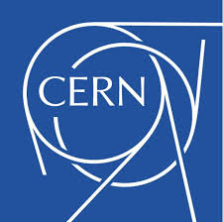

The proposed accelerator facility for SEEIIST
With contributions from U. Amaldi, E. Benedetto and M. Sapinski
Maurizio Vretenar (CERN)

Slide 2
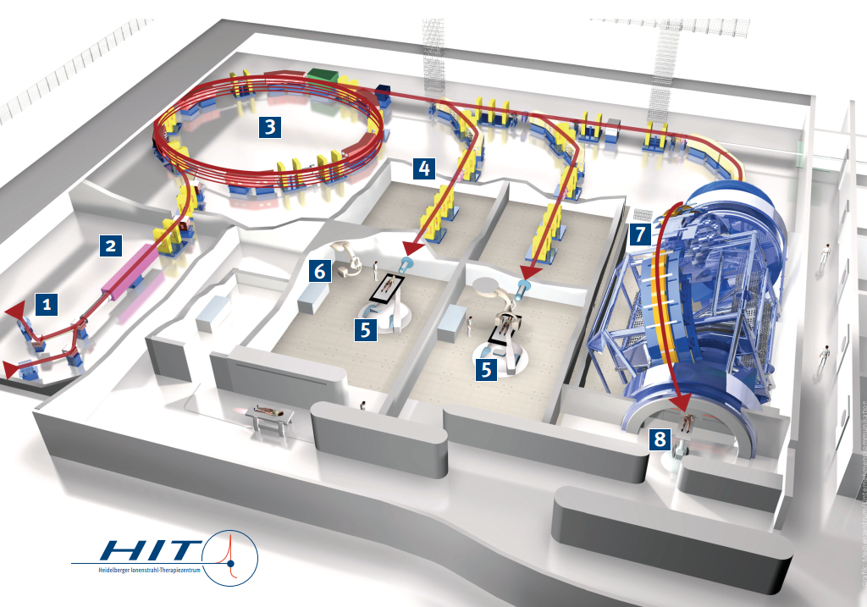
The key element: the accelerator
The new facility will place patients and science at its focal point - but the particle accelerator remains its key component in terms of cost and performance !
The accelerator system (ion source¹, injector², particle accelerator³, beam lines⁴ , gantry⁷) represents more than 75% of the construction and operation costs of the facility.
(from cost estimate in the SEEIIST 2018 report)
View of the accelerator system of the Heidelberg Ion Therapy center

Slide 3
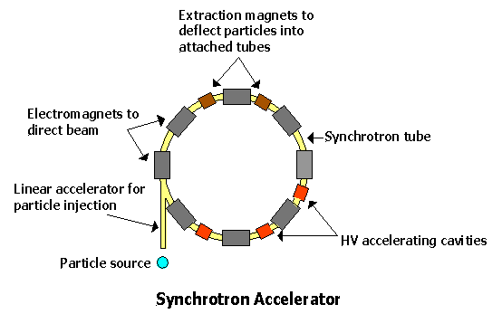
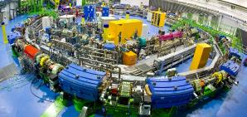
Small lexicon: synchrotrons and linear accelerators
In the following we will often make reference to synchrotrons, and sometimes to linear accelerators
magnets
The CNAO ion therapy synchrotron
http://webs.mn.catholic.edu.au/physics/emery/hsc_quanta_continued.htm

Slide 4

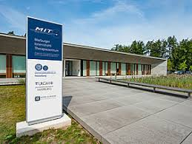
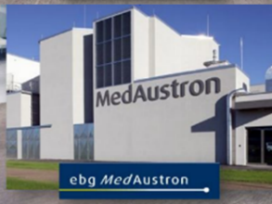
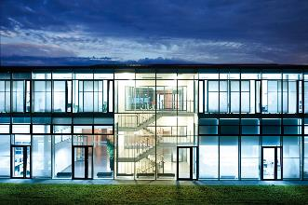
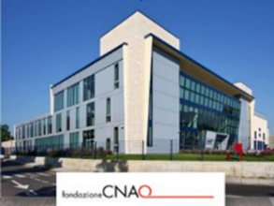
The present and the future of ion therapy accelerators
Europe has played a major role in the development of hadron therapy facilities
    4 ion therapy facilities operating in Europe (but 3 in China and 6 in Japan!)
2 based on the PIMMS design started at CERN in 1996. 1st patient at CNAO in 2011.
2 based on the GSI-Siemens design started at GSI in 1998 . 1st patient at HIT in 2009.
The new SEEIIST Facility – present design (2018) is based on PIMMS
Particle accelerator technology has made a huge progress in the last 20 years, and Japan is progressing fast in the development of new more compact and less expensive ion therapy accelerator designs.
Building on the combined experience accumulated over the last 20 years by the European facilities, can we imagine revising our standard accelerator designs to profit of the last advance in accelerator technologies ?
Notes:
Following the successful development of HIMAC in Japan (started in 1988, 1st patient 1994)

Slide 5
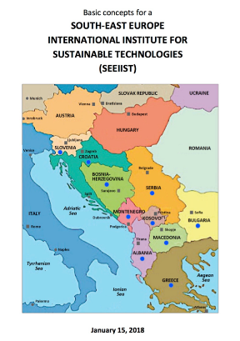
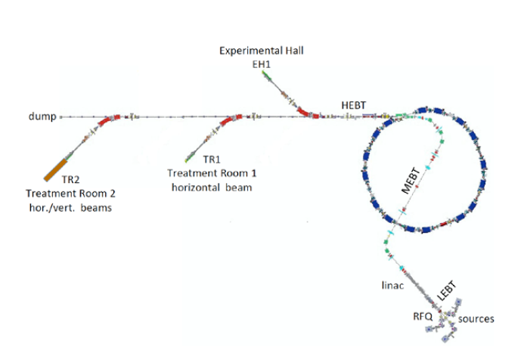
The reference accelerator layout
The SEEIIST report (2018) is based on a PIMMS-type accelerator design.
It can be considered as the most advanced version of the traditional ion therapy accelerator design, profiting of the experience and data from the CNAO and MedAustron facilities.
Construction cost 120 M€, footprint (all included) 15’000 m², operation costs 11 M€/year .
This design has the advantage of being immediately available but might suffer of similar limitations as the present generation: high construction and operation costs, reduced patient throughput, low level of industrialization.

Slide 6
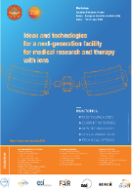
Requirements for a new accelerator design
Requirements of the ion therapy community, expressed at the Archamps Workshop, June 2018
A new ion therapy accelerator should have:
Lower cost, compared to present;
Reduced footprint;
Lower running costs;
Faster dose delivery with higher beam intensity or pulse rate;
A rotating ion gantry;
Multiple ions.
+ Specific requirements for SEEIIST:
Industrialization
Reliability
Easy operation
Reduced risk
Acceptable time to development
“Soft” advantages of a new innovative design:
Can attract a wide support from the scientific community (including CERN !)
Can increase the exchange SEE-WE and inside SEE thanks to stronger collaboration on scientific and technical issues;
Can bring modern high technology to the region, with new opportunities for local industry and scientific institutions.

Slide 7
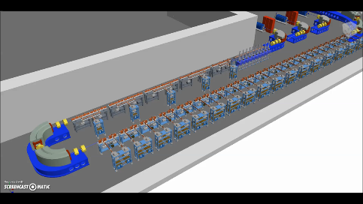
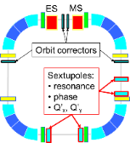
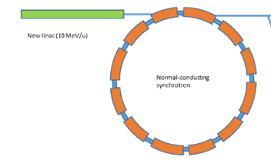
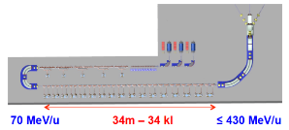
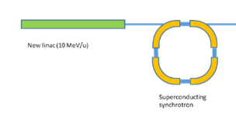
Accelerator design – the three options
Improved synchrotron (warm)
Equipped with several innovative features: multi-turn injection for higher beam intensity, new injector at higher gradient and energy, multiple extraction schemes, multi-ion.
Circumference ~ 75 m
Improved synchrotron (superconducting)
Equipped with the same innovative features as warm, but additionally 90⁰ superconducting magnets.
Circumference ~ 27 m
Linear accelerator
Linear sequence of accelerating cells, high pulse frequency.
Length ~ 53 m

Slide 8
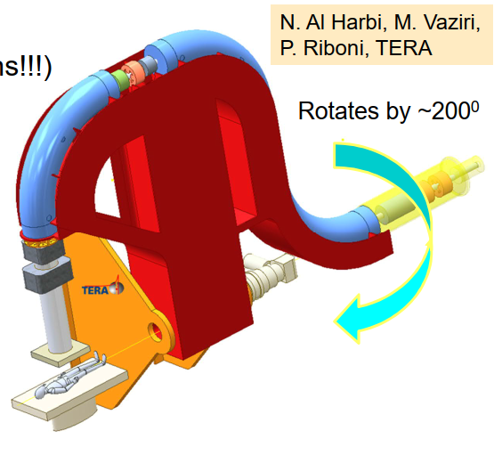
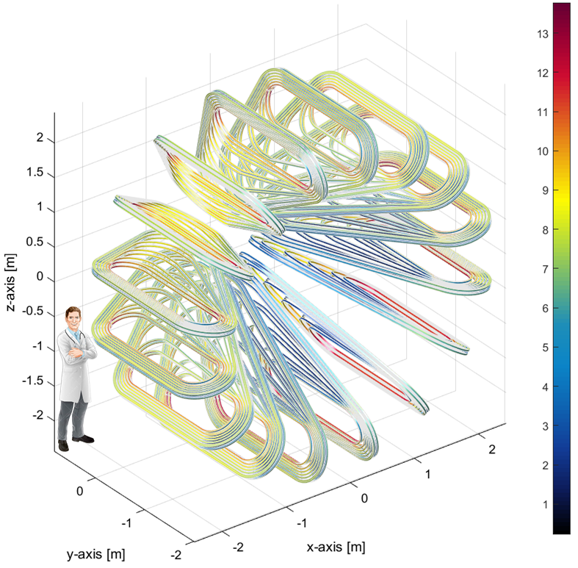
Alternative designs for the gantry
The medical community requires a gantry system to precisely align the beam on the patient
Rotational superconducting gantry
Equipped with CCT magnets similar to SC synchrotron, rotation by 200⁰.
Radius 5 m, weight ~ 40 tons
Toroidal gantry
Fixed superconducting toroidal magnet, no rotating parts (GaToroid, L. Bottura)
Radius 5 m, weight 50 tons

Slide 9
The three accelerator options - comparison
The comparison of the three accelerator options is the subject of the Service Contract with DLR that starts now. The table below summarises the data collected so far:
 | Construction Cost | Operation cost | Footprint | Performance | Time to development | Risk of development | Treatment protocols
Warm (new) synchrotron | Medium | Medium | Large | Good | Low | Low | Existing
Superconducting synchrotron | Lower | Lower | Small | Good | Medium | Medium | Existing
Linear accelerator | Lower | Lower | Small | Better | Long | Medium | To be developed
The linear accelerator has best performance, but needs longer time for development of technology and of the specific treatment protocols.
An improved warm synchrotron presents the lowest risk and the shortest development time.
A superconducting synchrotron has somehow longer time and risk, but offers lower costs and lower footprint.

Slide 10
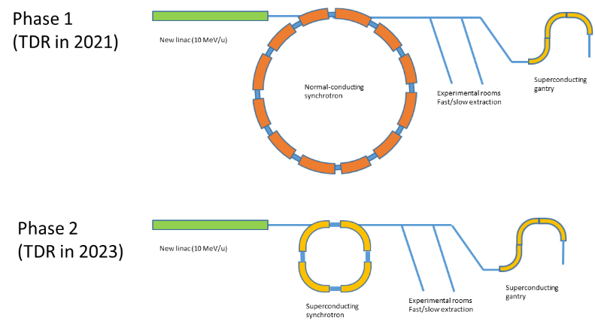
A Strategy for SEEIIST
A two-stage approach: develop an innovative synchrotron with warm magnets, which can be easily replaced by superconducting magnets
Additional features:
Upgradability
Flexibility
Industrialization
Innovations
10¹⁰ carbon ions per pulse
Fast / slow extraction
New linac at 10 MeV/u
Superconducting gantry
Multiple ion operation
As above, plus
Superconducting magnets for the synchrotron
With 10¹⁰ carbon ions per pulse, aim for the world record in beam current for a therapy facility

Slide 11
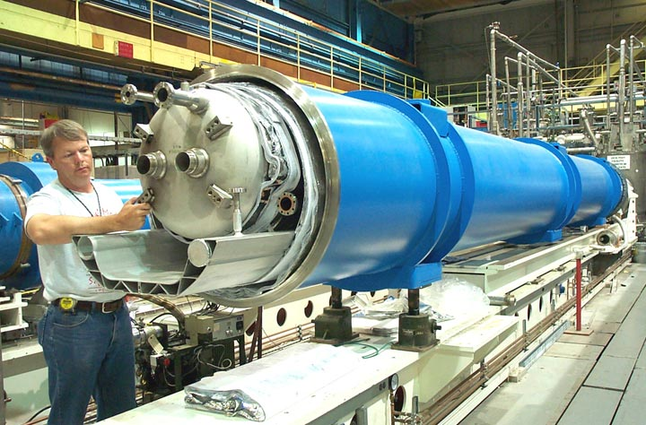
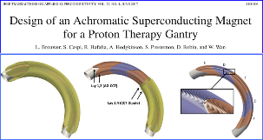
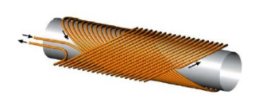
Superconducting magnets for accelerators
Superconductivity is the key to the progress of accelerators
Eliminates power loss and allows reaching higher fields and smaller dimensions.
Since the first tests 50 years ago is now a standard industrial technology with decreasing costs and low risk (1’400 superconducting magnets are operating in the CERN LHC accelerator!).
Canted Cosine Theta (CCT) type magnets, similar to those used in many laboratories, with nested quadrupoles.
The CERN LHC superconducting magnet

Slide 12
The accelerator development strategy
Phase 1: DLR Service Contract (July 2019 – December 2020)
Assess feasibility and define basic design for 3 accelerator options (Synchrotron with warm magnets, Synchrotron with superconducting magnets, High-frequency linear accelerator)
Goal: Advance the Conceptual Design of the 3 options, and perform a comparison of:
a) Technological Readiness; b) Construction and Operation costs; c) Risks.
Select options for beam transport and delivery to the patient.
Phase 2: Design Study for Research Infrastructures (September 2020 – August 2023)
Proposal to be submitted at the next Horizon2020 call for Research Infrastructures – very competitive call, results of evaluation should be known in summer 2020.

Slide 13
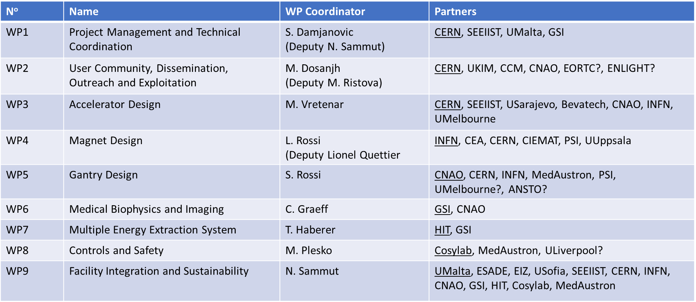
The HITRI Design Study proposal
HITRI = Heavy Ion Therapy and Research Infrastructure
INFRADEV-01-2019-2020 call for Design Studies (new Research Infrastructures), deadline 12 November 2019
Budget: €3m, duration 3 years
Working Group set up for preparing the proposal – Present structure of the project:
Coordinating institute CERN: management, administrative and financial aspects
Scientific coordination SEEIIST (S. Damjanovic): coordination, responsibility for reporting and reviews. Deputy coordinator N. Sammut (U. Malta)
13 participants from Central-West Europe
7 participants from SEE (including SEEIIST)
Focus on technical aspects and on building community and capacity in SEE
Political and organizational aspects specific to SEEIIST are left out (site selection is approached but in a general way)

Slide 14
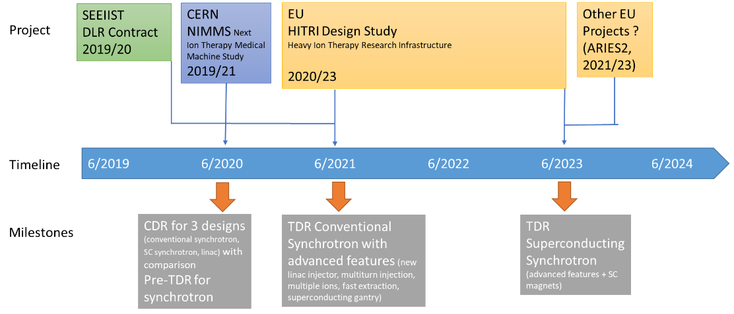
Accelerator Design Strategy – the timeline HITRI/SEEIIST

Slide 15
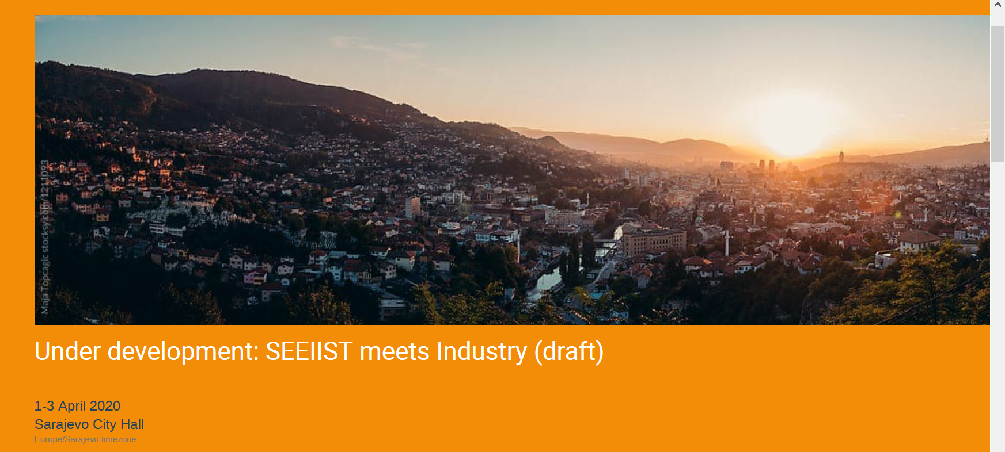
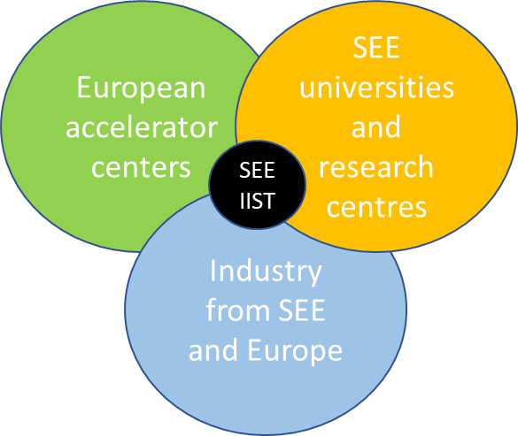
The role of CERN and other European institutions
Our goal is to create a community around/for SEEIIST, not only to design an accelerator Develop an ecosystem that will support SEEIIST construction and contribute to building in the SEE region the competencies required to construct and operate the facility
In HITRI, at least one partner from SEE region associated to each Workpackage
Involve local industry at the earliest possible stage (example: Sarajevo Workshop)
SEEIIST at the centre of the a cooperation network between European accelerator centers, universities and industry.
1-3 April 2020: SEEIIST meets industry Workshop in Sarajevo City Hall
Present project and the technology options to SEE industry, create interest and support for the project – open to CEI industry, if sponsoring available

Slide 16

Conclusions and Outlook
We should aim for creating a community and growing a culture, not only building an accelerator
We have to decide whether the SEEIIST accelerator is going to be the last one of the old generation or the first of a new generation.
Building something new at the forefront of technology in the SEE region is not a limitation but an opportunity: to involve local and international partners, and to attract interest from regional actors including industry.
But:
We need a flexible strategy to maximize the results and to minimize the risks for the project.
Out goal is not to plant a tree, but to grow a tree

