Slide 2
Ansys tutorial to run simulations on Linux resources at CERN
25th April 2019
Maria Alandes – IT/CDA
Pablo Llopis, Markus Tapani, Nils Høimyr – IT/CM

Slide 3
Outline
Practical information
  HPC Engineering Applications
  Documentation
  Incidents and Requests
  Infrastructure Basics
  Linux Resources at CERN
  Ansys Licenses
Tutorials
  Ansys RSM to HTCondor
  Ansys RSM to SLURM
  LXPLUS to HTCondor
  LXPLUS to SLURM

Slide 4
Practical Information

Slide 5
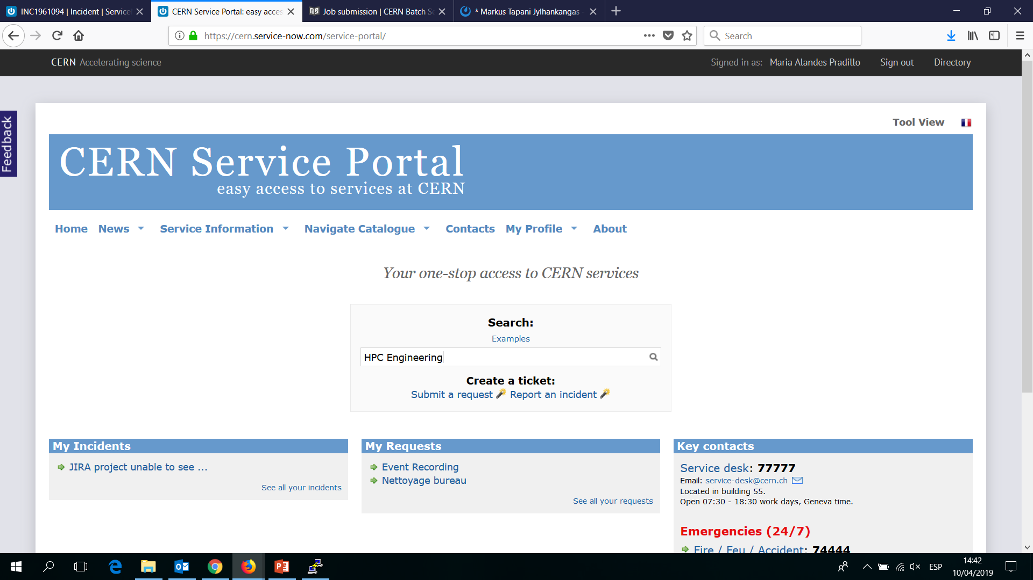
HPC Engineering Aplications

Slide 6
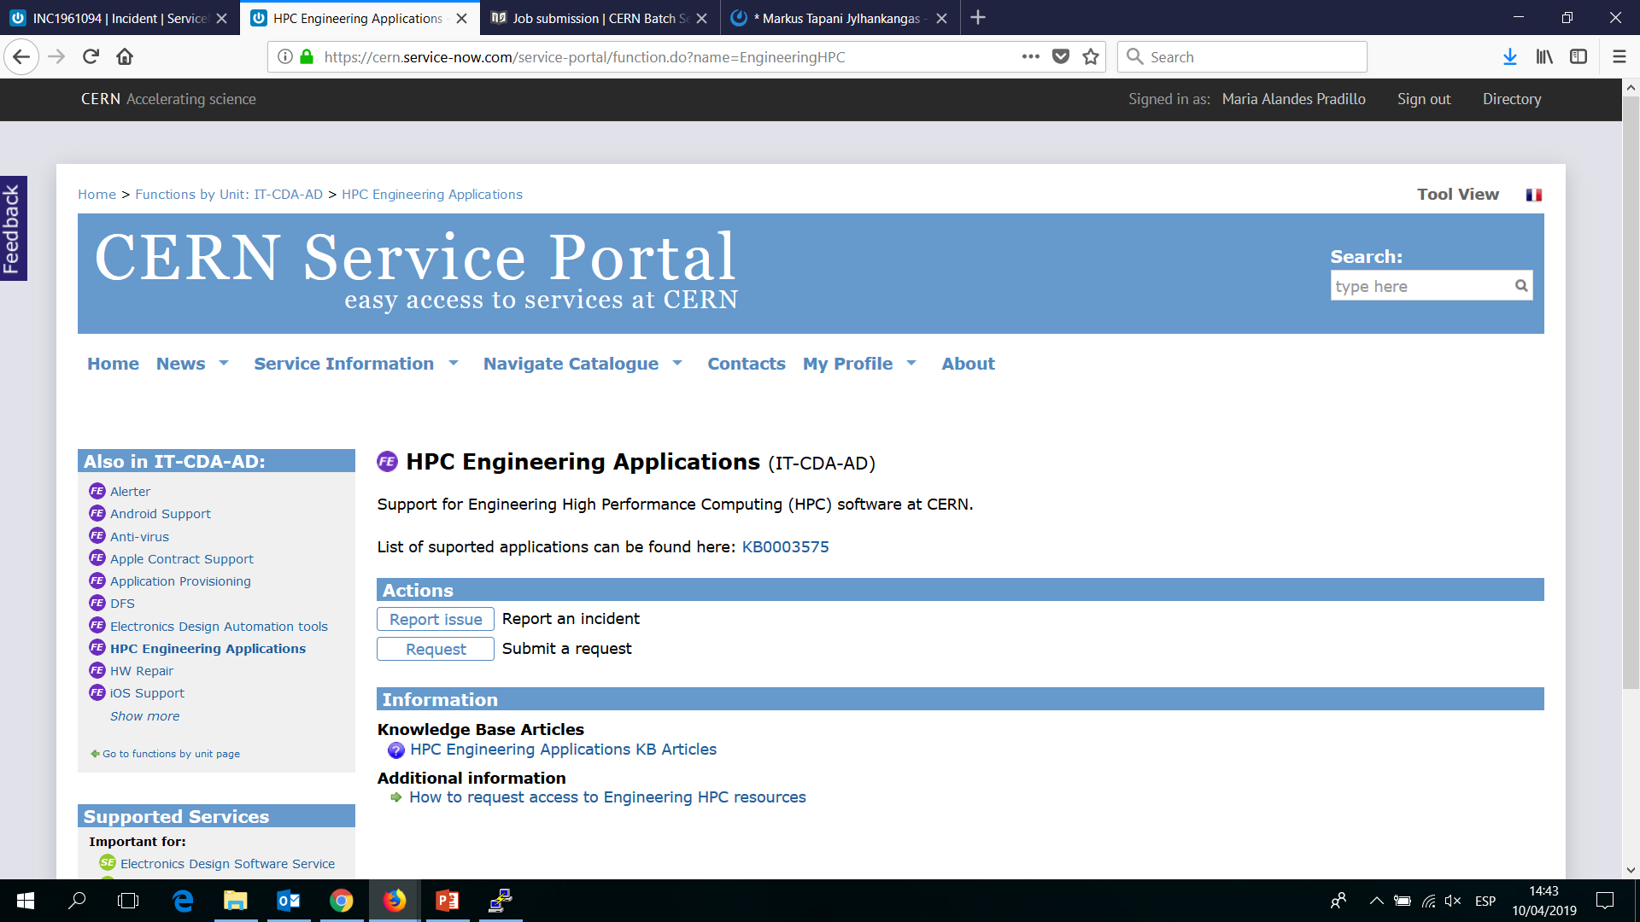
HPC Engineering Aplications

Slide 7
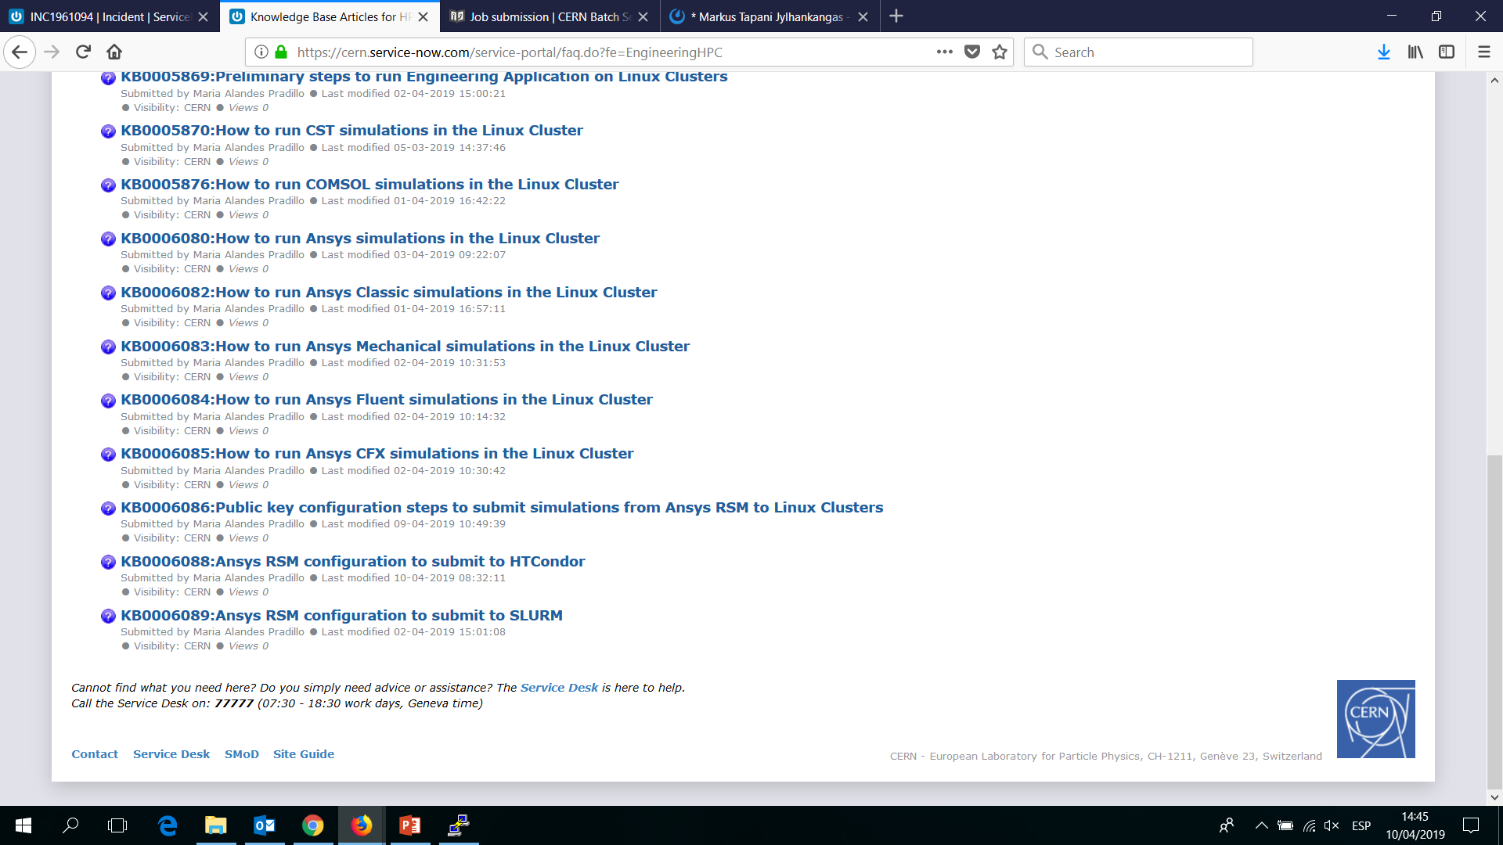
Documentation: SNOW KBs

Slide 8
We want good documentation
Please, complain if something is…
  NOT clear
  Obsolete
  Incomplete
We are happy to improve the existing KBs
Our lives will be easier with good documentation
  For us: less time spent in giving user support
  For you: less time to explain newcomers what to do
We count on you to have good documentation!

Slide 9
Reporting incidents or requests

Slide 10

Who can help you
2nd Line and 3 different groups in IT may be able to help you
Please, use SNOW so we can coordinate and learn!
HTCondor and SLURM expertise
Application related knowledge (i.e. Licenses)
will simply reassign the ticket
will help you based on existing KBs
IT-CM
Service Desk
2nd Line Support
IT-CDA
IT-ST
EOS and AFS

Slide 11


Infrastructure basics
AFS
script
submission file
Linux Cluster
WinSCP
User Windows PC Ansys / RSM
Putty
Local Disk
Prepare the simulation
Lxplus
CERNbox
Output file
Input file
Run the simulation
EOS
Input file

Slide 12
Linux resources at CERN
 | Cores | RAM | OS | Comments
HTCondor | 8 cores |  | CC7 | Open access 2GB/Core
 | 16 cores |  | CC7 | Open access 2GB/Core
 | 24 cores |  | CC7 (*) | Open access 5GB/Core
 | 24 cores | 1 TB | CC7 (*) | Big Memory nodes. Access needs to be granted
 | 48 cores | 500 GB | CC7
SLURM | 16 cores with HT | 128 GB | CC7 | Low-latency 10Gbit Ethernet
 | 20 cores | 128 GB |  | Infiniband. Access needs to be granted
(*) On going migration to CC7. See:
https://cern.service-now.com/service-portal/view-outage.do?n=OTG0047300

Slide 13
Recommended Clusters
We recommend to run Ansys applications in the following clusters:
  ANSYS Classic/Mechanical: HTCondor
  ANSYS CFX: HTCondor or SLURM
    It depends on the use case, but in general it will be HTCondor
  ANSYS Fluent: SLURM
Please, do not hesitate to get in touch with us if you have a special use case
  https://cern.service-now.com/service-portal/article.do?n=KB0003575

Slide 14
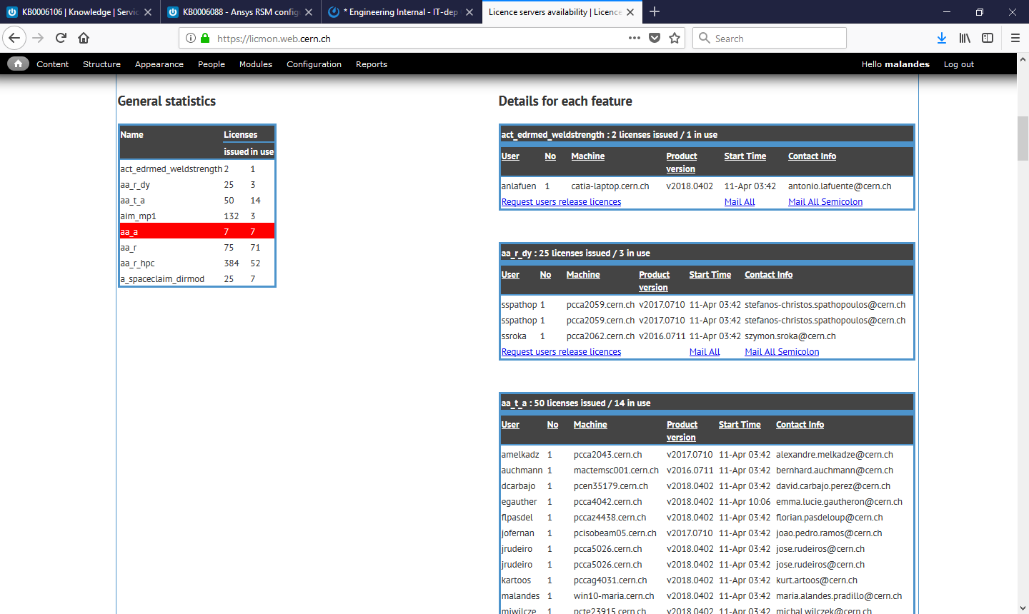
Ansys Licenses
Check the status of Ansys Licenses in
  https://licmon.web.cern.ch/

Slide 15
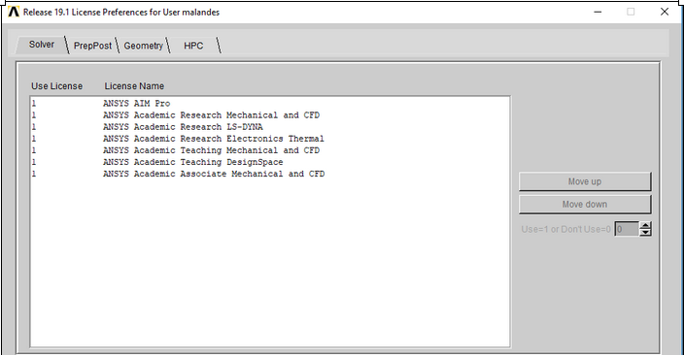
Ansys Licenses
In case your simulation fails, check the Ansys output and make sure it’s not related to lack of proper license
More information on Licenses here:
  https://cern.service-now.com/service-portal/article.do?n=KB0006080
License information also available in the User License Preferences application in Ansys

Slide 16
Ansys Licenses
In general
  Use Teaching Licenses for small or test simulations
  Use Research Licenses for real simulations
    By default, we recommend to use Ansys Mechanical Research Mechanical and CFD
License queuing
  Ansys is able to put the simulation on hold until a free license is available
  Be aware that you will wasting computing resources while queuing for a free license!
    We recommend to check licmon before launching a simulation, especially in scarce resources like bigmem nodes

