Slide 1

ELENA Phase2 Support System STATUS
28/3/2018
Antti Kolehmainen on behalf of WP2.1 Support system

Slide 2
OUTLINE
Schedule
Horizontal lines
Vertical lines

Slide 3
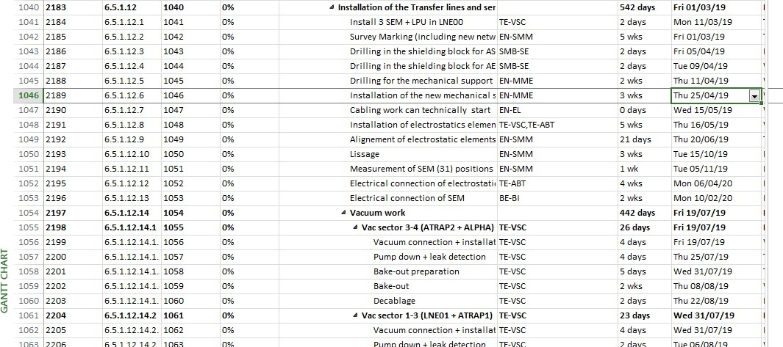
SCHEDULE
PREPARATION:
SURVEY TRACING – ON-GOING
DRILLING – START FROM APRIL 8
DEADLINES:
INSTALLATION OF ELECTROSTATIC EQUIPMENT
VACUUM WORK

Slide 4
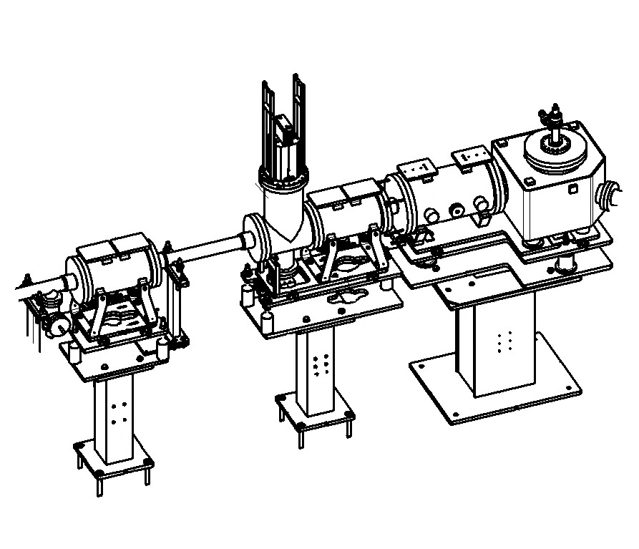
HORIZONTAL LINES
INSTALLATION 25/4 – 16/5/2019
SUPPLY OF COLUMNS AND ALIGNMENT TABLES W18 = 3/5/2019
SHIMS AND HARDWARE ORDERED FOR 25/4/2019
INSTALLATION 6/5 – 16/5/2019
  EN/HE REQUIRED FOR ZDS-RELATED SUPPORTS HANDLING
  ESTIMATION 1 WEEK OF WORK, EN/HE 2 DAYS
ZDS-SUPPORTS ORDERED FOR 31/3/2019
  TO BE DELIVERED TO TE/ABT FOR ASSEMBLY?
ZQNA – SEM SUPPORTS AVAILABLE @ b.133
ZQNA SUPPORTS ORDERED FOR 30/4/2019

Slide 5
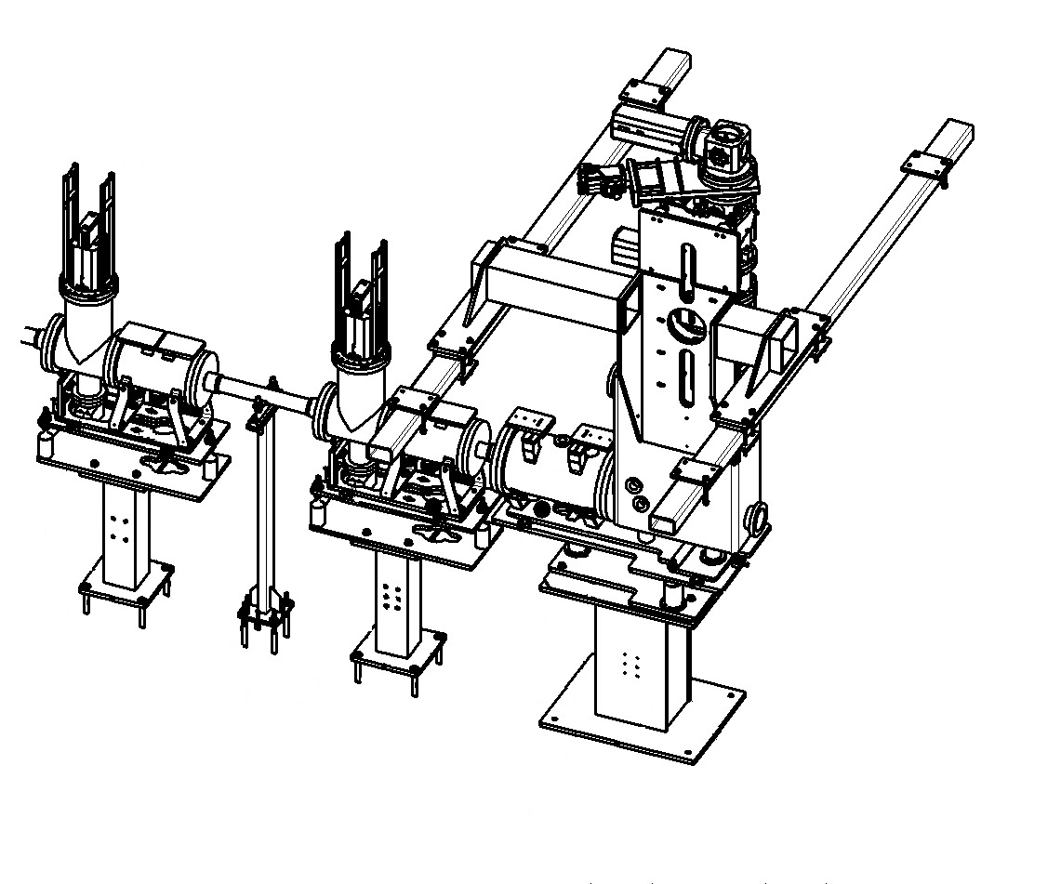
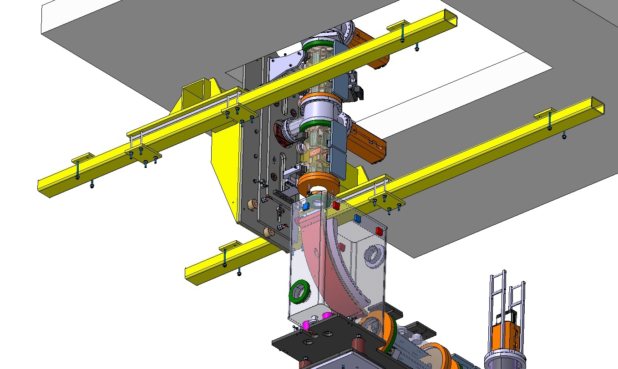
VERTICAL LINES
DESIGN OF THE LINE APPROVED THIS WEEK!
ORDER FOR RIGID SUPPORT COMPONENTS WITH 6 WEEKS LEAD TIME = 10/5/2019
ORDER FOR ALIGNMENT TABLES AND COMMON SUPPORTS WITH 8 WEEKS LEAD TIME = 24/5/2019 – FOLLOWS THE SEM TANK SCHEDULE
INSTALLATION TOOL REQUIRED!
  IS IN REVIEW WITH EN/HE
  VERY SHORT LEAD TIME REQUIRED!
LINE INSTALLATION REQUIRED BY THE START OF THE VACUUM WORK = 19/7/2019

Slide 6
CONCLUSION
HORIZONTAL LINE COMPONENTS IN ORDER WITH DELIVERY TO RESPECT THE SCHEDULE – NO MARGIN!
VERTICAL LINES COMPONENTS NEED SHORT LEAD TIMES TO KEEP THE SCHEDULE
CONTRACTS MUST BE FOLLOWED CLOSELY!

Slide 7
ELENA is on its way…
? / !
ANY QUESTIONS / REMARKS
THANK YOU FOR YOUR ATTENTION!

