Slide 1
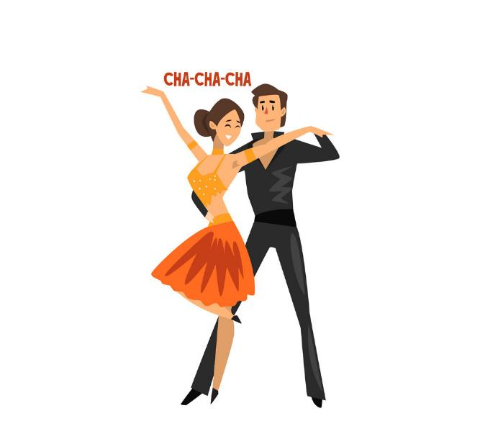
Cha-Cha-Cha: A fast course
Pablo G. Tello
EU Office/IdeaSquare
CERN

Slide 2
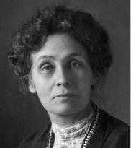
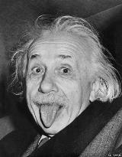
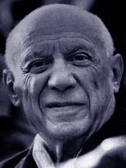
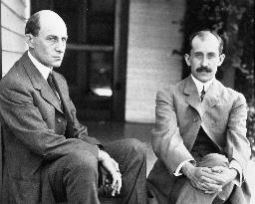
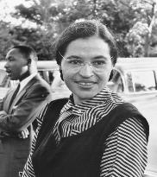
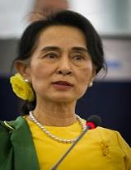
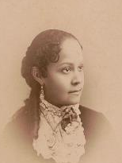
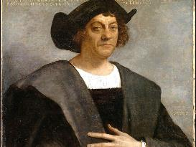
What do they all have in common?
E. Pankhurst
A. Einstein
P. Picasso
Wright brothers
R. Parks
A. S. Suu Kyi
F.B. Williams
C. Columbus

Slide 3
They all were excellent
Cha-Cha-Cha
dancers

Slide 4

How do you learn Cha-Cha-Cha?
Challenge
Change
Chart
Assumptions

Slide 5
Initiating yourselves…
Challenging what restaurants are and do…
Assumption
a) Restaurants have menus either written, verbal or implied.
b) Restaurants charge money for food.
Reverse
a’) Restaurants have no menus of any kind.
b’) Restaurants give food away for free.
c) Restaurants serve food.
c’) Restaurants do not serve food of any kind.
Come up with an idea for each one of the reversals

Slide 6
Example
Reverse
a’) Restaurants have no menus of any kind.
b’) Restaurants give food away for free.
c’) Restaurants do not serve food of any kind.
Idea
a’) The chief informs the client of what he bough that day. Asks the customers what ingredients appeal to them and cooks an exclusive dish. Recipe will be sent to them by email.
b’) An outdoor café where customers pay for time instead of food. Use a time stamp to charge by the minute. Selected food or beverages are sold for free.
c’) Create a restaurant with a unique décor in an exotic environment and rent out the location. People bring their own food and beverages and pay a service charge for the location.

Slide 7
Exercise
Form groups of among colleagues of the same unit and/or department.
Write down 3 daily tasks that that you believe can be improved in efficiency.
Reverse them (= imagine you do the opposite).
Think about how this reverse will improve efficiency.
Prepare a pitch of 3 min about every idea that you have generated and do it in a Cha-Cha-Cha spirit.

Slide 8
Template: Prison
Tasks
a)
b)
Reverses
a’)
b’)
c)
c’)
Idea/Pitches
a’’)
b’’)
c’’)

Slide 9

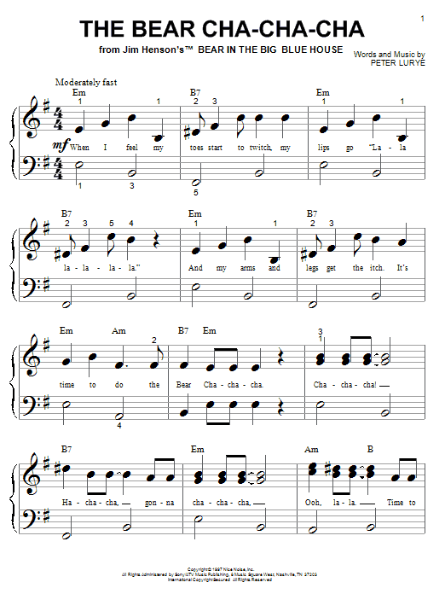
Thank you
Any questions?
https://www.youtube.com/watch?v=VzVSVNy-j98

