Slide 1

Validation, Screening and Reliability Tests for the new VFC-HD
S. Eitelbuß & V. Schramm
on behalf of
M. Gonzalez Berges, J. O. Robinson, M. Saccani, M. A. Stachon, W. Viganò, C. Zamantzas and all other involved
RAS WG 11.04.2019
10/04/2019

Slide 2
Introduction
Methodology & Objective
Test Setup
Test Results
  Validation Tests
  Temperature Cycling (ongoing)
  Run-In (ongoing)
Summary & Outlook
10/04/2019

Slide 3
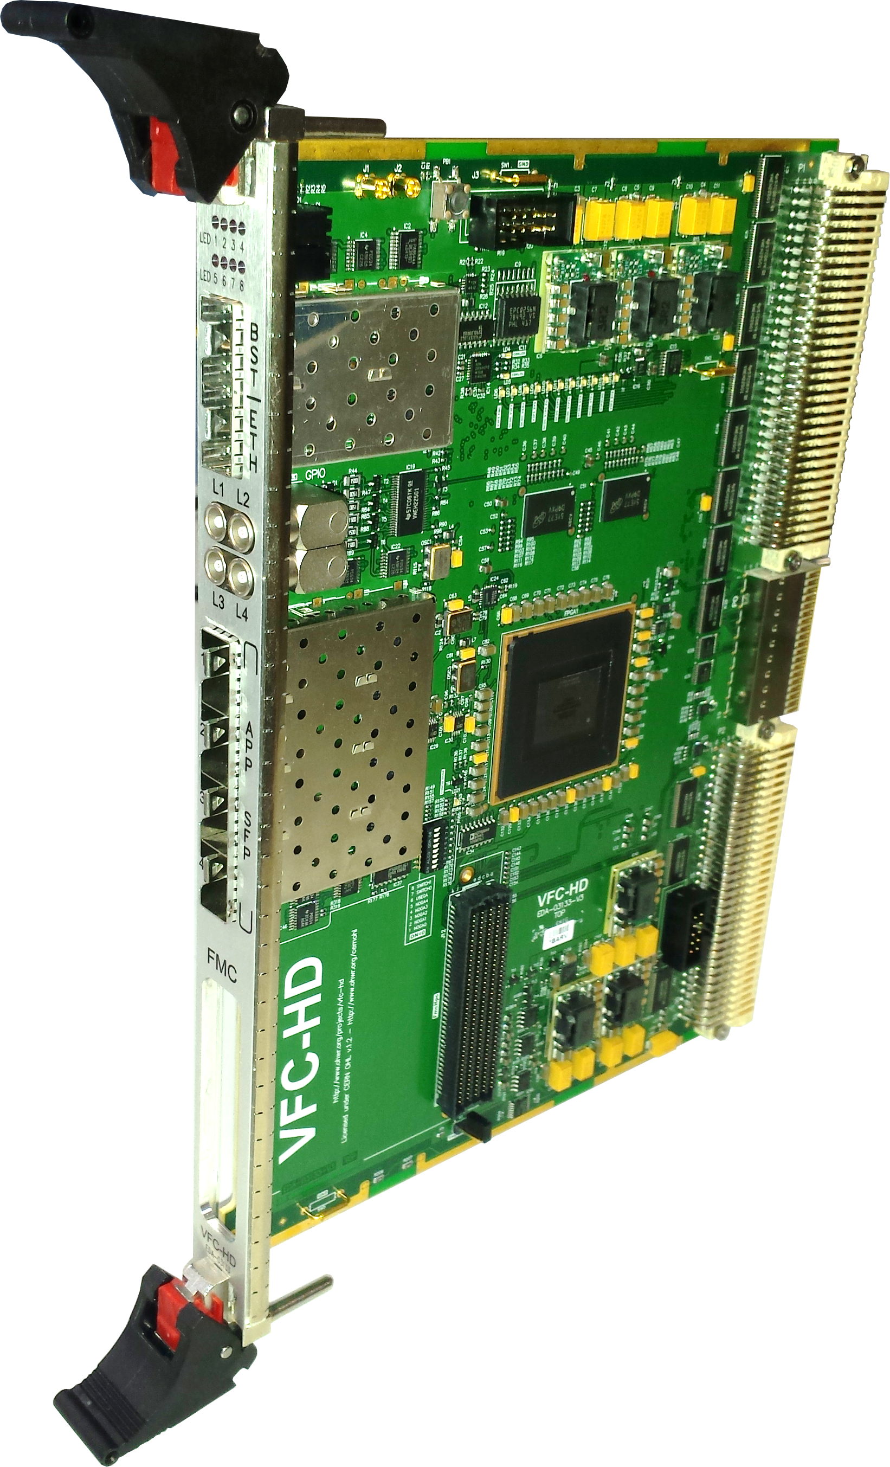
Introduction
The VFC-HD board is a new multi-purpose VME carrier board developed in BI
Main challenges:
  Complexity
    1200 mounted components, 12 layers
    VME, Arria V FPGA, DDR3, DCDC, FMC, SFPs, …
  Serves a variety of different users & applications
  Dependability and performance requirements
  Production of 1200 units
➔ To ensure a good and dependable performance upon installation, validation and reliability testing is put in place.
10/04/2019

Slide 4
Methodology & Objective
Design
✓
Dependability methodology applied upon planning and design through production, testing and installation to system operation
Specifications
Predecessor analysis
MTTF prediction
Failure Modes, Effects & Criticality Analysis
Design Review
Design
✓
✓
✓
✓
Production
(& Tests)
Addressing dependability during the full life cycle
Validation (functional, environmental, quality)
Reliability assessment & improvement
Risk reduction & risk assessment
Mitigation of (late) design changes
Methodological approach (re-useable; universal; evolving)
Reception Tests
Installation/
Commissioning
Operation
10/04/2019
Notes:
- Production approval

Slide 5
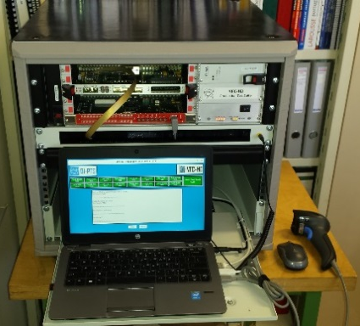
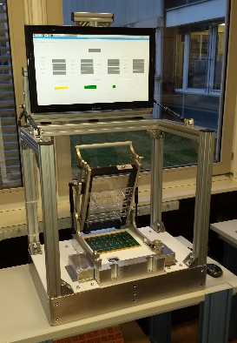

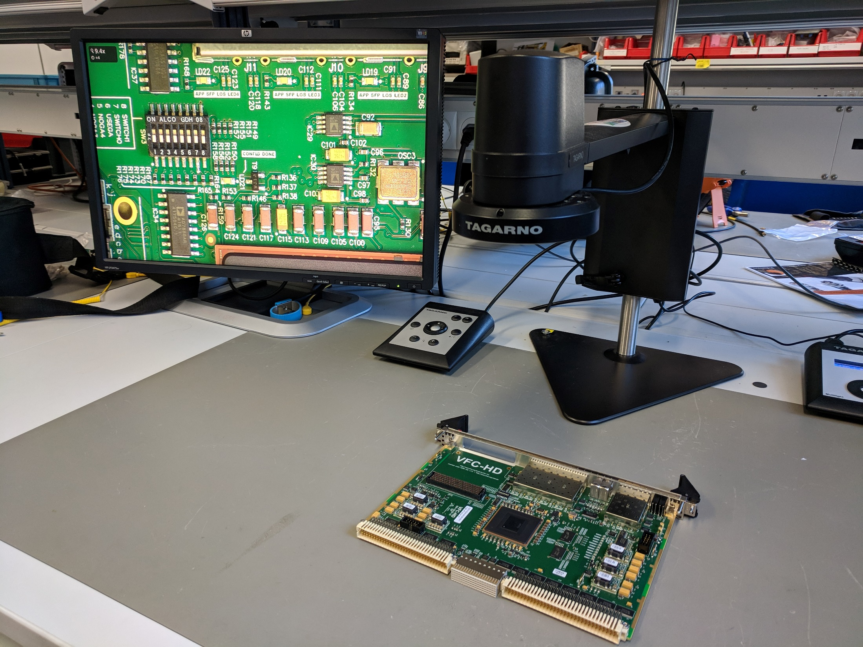



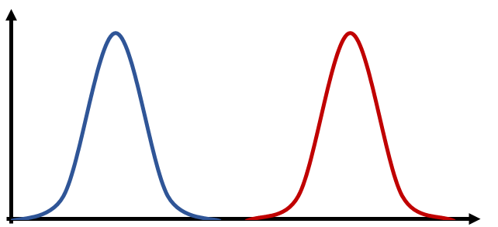

Methodology & Objective
Design
Various tests & checks implemented at the manufacturer:
Production & Tests
Component Test
Assembly & Production
Inspection
A-610 Class 3
Functional Test
Reception Tests
Test strategy after reception at CERN:
Visual Inspection
Validation Tests
Cycling Tests
High-Temp Test
Temperature Cycling
°C
°C
RH
Installation/
Commissioning
Run-In
Operation
10/04/2019

Slide 6
Introduction
Methodology & Objective
Test Setup
Test Results
  Validation Tests
  Temperature Cycling (ongoing)
  Run-In (ongoing)
Summary & Outlook
10/04/2019

Slide 7
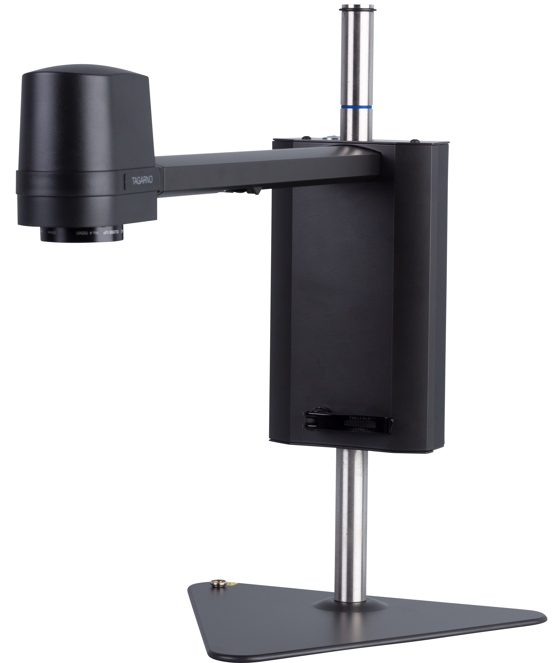
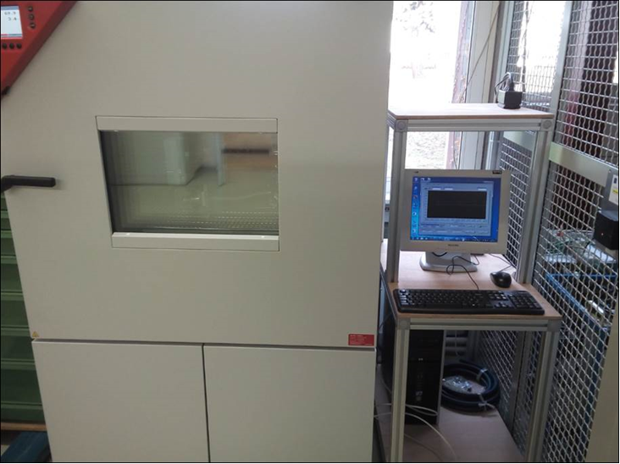
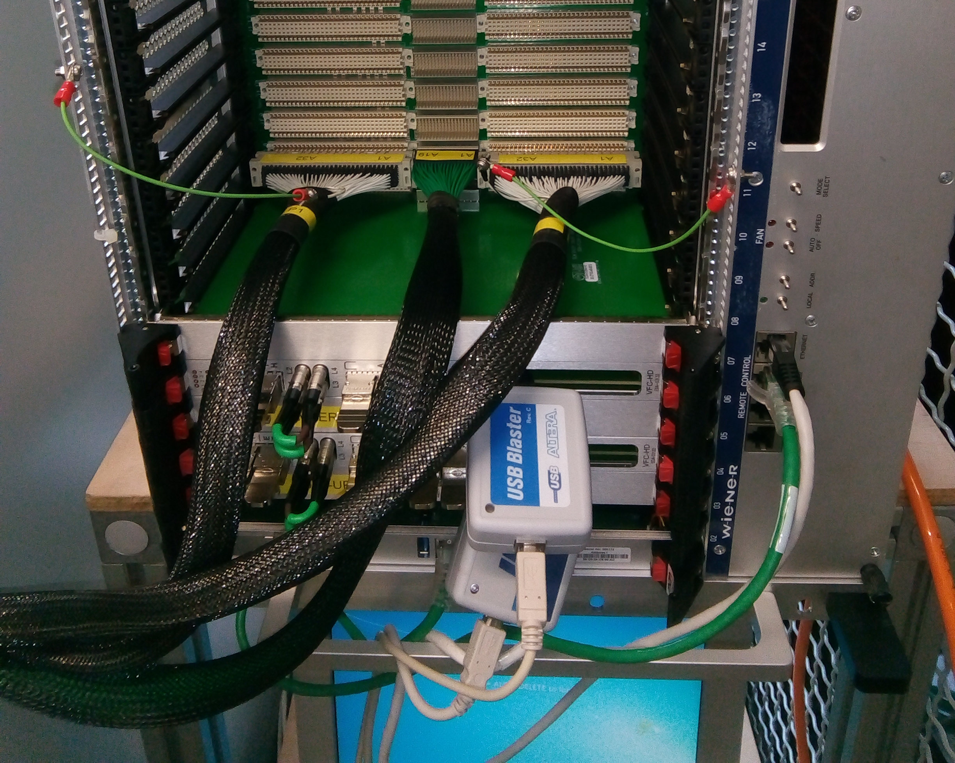
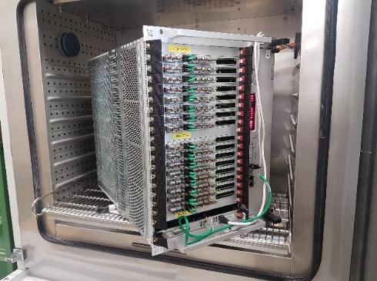
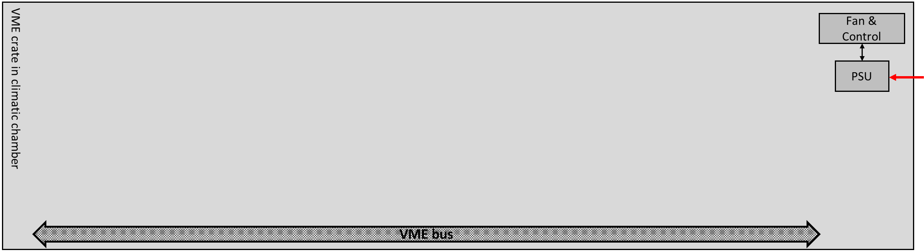
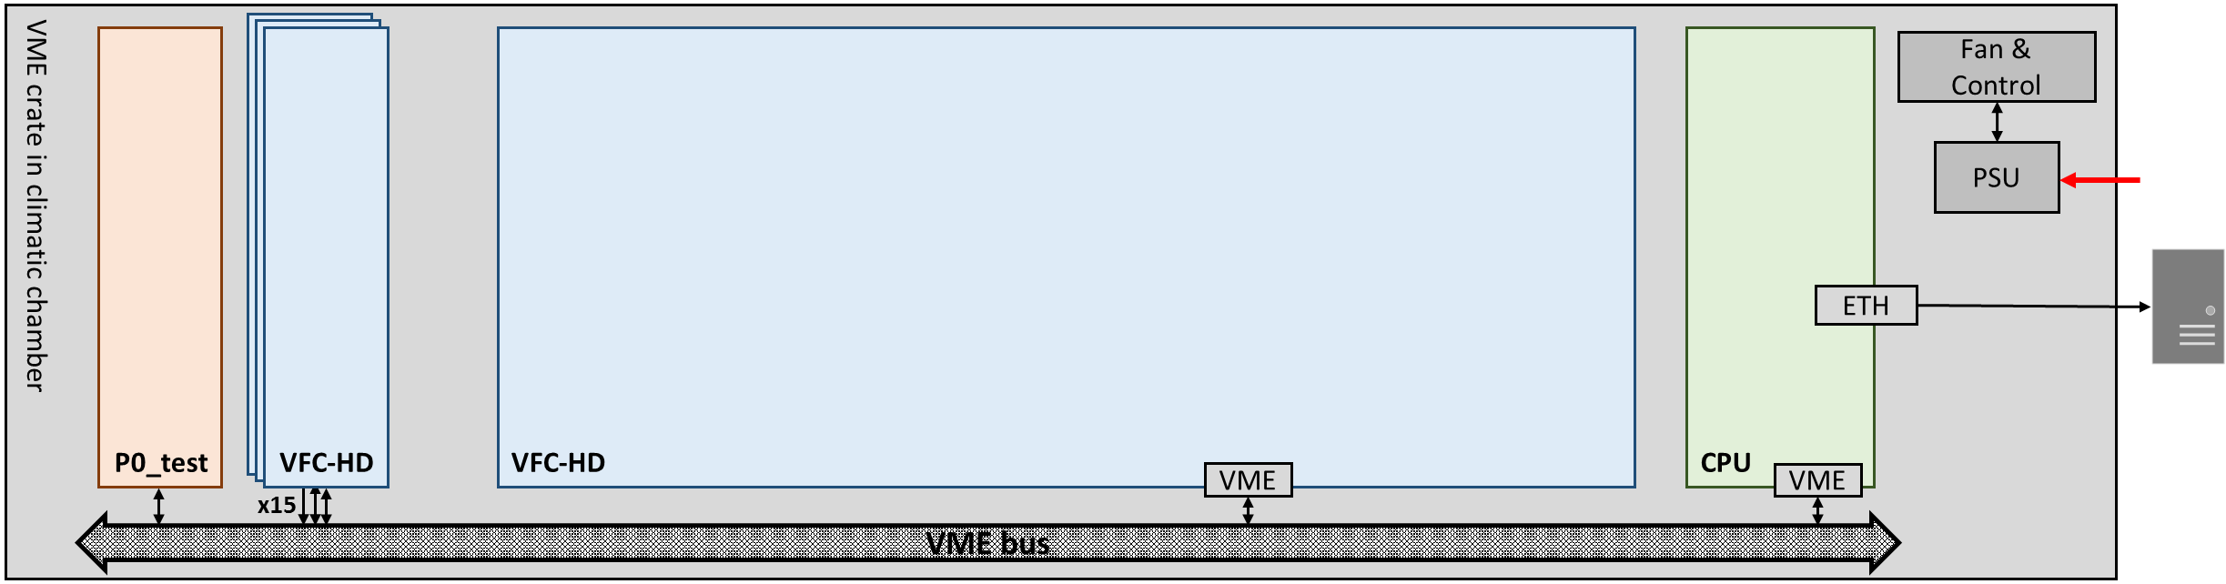
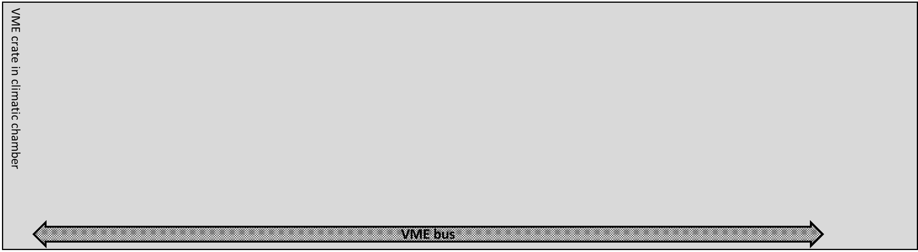
Test Setup
Hardware
Visual Inspection:
Validation & Cycling:
Run-In:
Digital microscope Tagarno FHD UNO (92x magnification)
Climatic chamber Binder MKF240 for temperature and humidity
Other procurements & modifications: Crate, FMC/SFP loopback modules, custom boards, cables, fibres, …
8 VME crates in 2 racks + PSUs, CPUs, cabling, …
10/04/2019

Slide 8
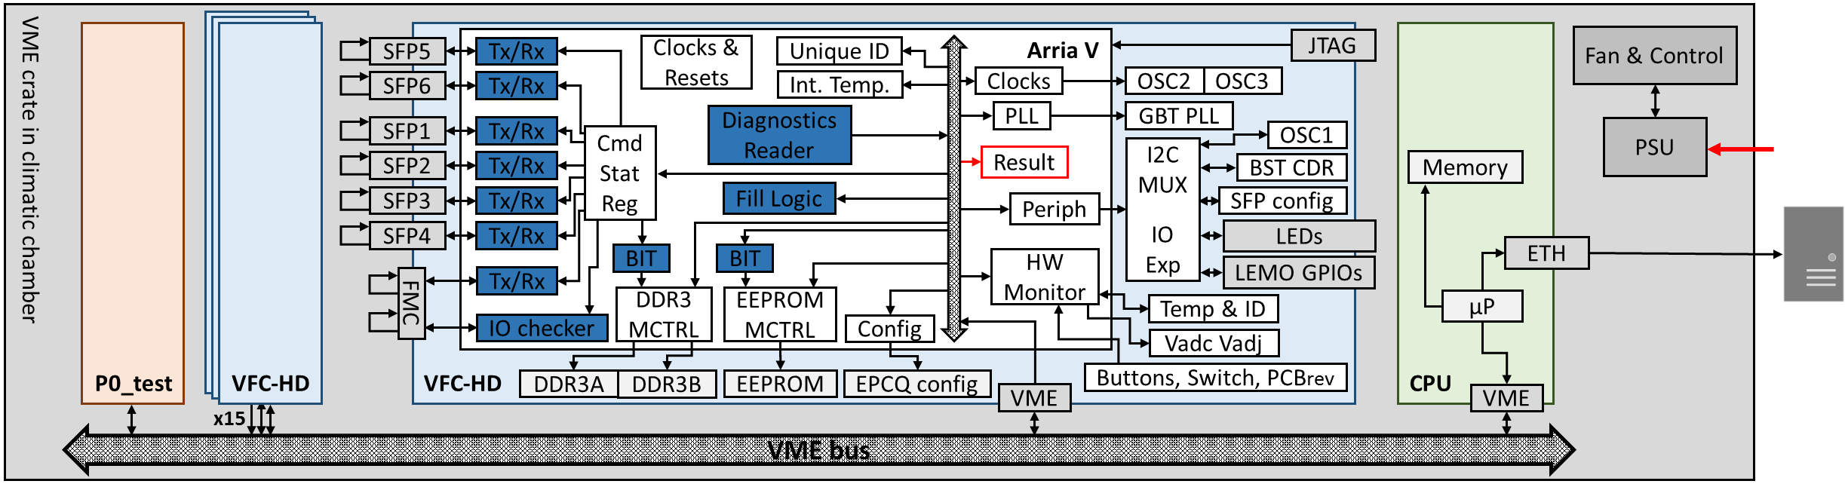
Test Setup
Software
Firmware
CPU card communicates the test results to the database:
  Data logged on NXCALS with Spark for queries
  Application developed
  Asset management integrated to register and follow up devices
Test firmware constantly checks all board functionalities in parallel & saves the results:
  Sends/writes & reads back
  Checks 220 different parameters
  FPGA self checking
10/04/2019
Notes:
- Thanks to Magdalena, James & Manuel

Slide 9
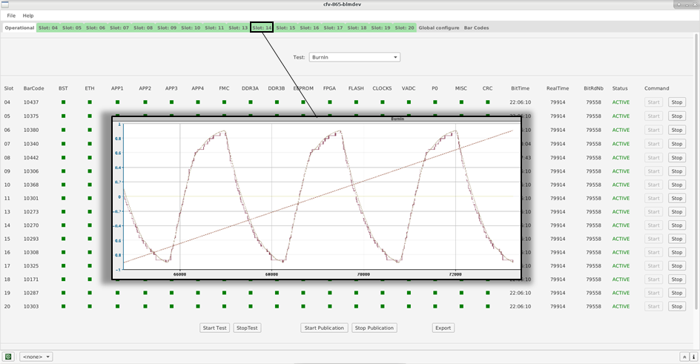
Test Setup
Graph configuration
Expert application
Global operational tab
16x DUTs
Bar code reading
Status LEDs
Test selection
Many thanks to:
M. Gonzalez Berges, J. O. Robinson & M. A. Stachon
10/04/2019

Slide 10
Introduction
Methodology & Objective
Test Setup
Test Results
  Validation Tests
  Temperature Cycling (ongoing)
  Run-In (ongoing)
Summary & Outlook
10/04/2019

Slide 11
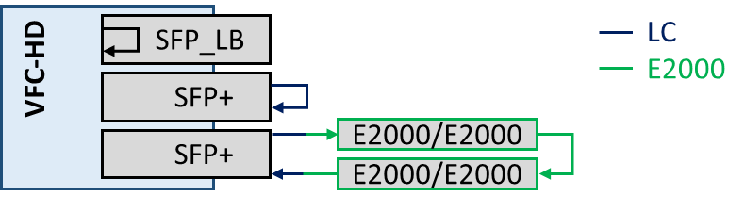
Validation Tests
1) Temperature/Humidity Cycling:
Functional & environmental validation + production approval
Sample size: 2x pre-series
Tests between 5-55°C & 10-90% RH
Various SFP transceiver (FT3A05D) + fibre configurations
Cycle tests in pyramid-shape or at constant conditions
In total 11 tests performed
10/04/2019

Slide 12
Validation Tests
# | T-range [°C] | RH-range [%] | Board A | Board B | Error A | Error B
1 | 5 | <35 | LB | LB | N | N
2 | 55 | <50 | LB | LB | N | N
3 | 25 | 80 | LC | LB | N | N
4 | 5-55 | 50 | LC | LB | Y | N
5 | 5-55 | 70 | LB | LC | N | Y
6 | 35-55 | 50 | LB | LC | N | Y
7 | 35-55 | 50 | Mix | LB | Y | N
8 | 35-55 | 50 | Mix | LC | Y | Y
9 | 30 | 50-90 | Mix | LC | N | N
10 | 30 | 80 | Mix | LC | N | N
11 | 40 | 80 | Mix | LC | Y | Y
1) Temperature/Humidity Cycling:
#1,2: Validation at temperature limits (low RH)
  No errors with SFP loopbacks
#3: Validation at 80% RH (25°C)
  No errors with SFP+ transceivers with fibre loopback (LC)
#4,5: 2h temperature cycling at 50/70% RH
  FMC loopback & SFP+ errors ≥50°C
✓
✓
10/04/2019

Slide 13
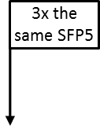
Validation Tests
# | T-range [°C] | RH-range [%] | Board A | Board B | Error A | Error B
1 | 5 | <35 | LB | LB | N | N
2 | 55 | <50 | LB | LB | N | N
3 | 25 | 80 | LC | LB | N | N
4 | 5-55 | 50 | LC | LB | Y | N
5 | 5-55 | 70 | LB | LC | N | Y
6 | 35-55 | 50 | LB | LC | N | Y
7 | 35-55 | 50 | Mix | LB | Y | N
8 | 35-55 | 50 | Mix | LC | Y | Y
9 | 30 | 50-90 | Mix | LC | N | N
10 | 30 | 80 | Mix | LC | N | N
11 | 40 | 80 | Mix | LC | Y | Y
1) Temperature/Humidity Cycling:
#6-8: Further temperature cycling at smaller
steps with different fibre setups
  Several SFP+ errors ≥ 40°C
  Wide spread of SFP+ quality
  Error rate ~ temperature
# | T_{min} [°C] | SFP slot 1 | SFP slot 2 | SFP slot 3 | SFP slot 4 | SFP slot 5 | SFP slot 6
4 | 57/54 |  |  | 40
5 | 53/45 | 3 |  | 200 |  |  | 30
6 | 46/45 | 8 |  | 700 |  | 1300 | 90
7 | 44/40 |  |  |  |  | 500 | 30
8^{Mix} | 42/40 |  |  | 1 |  | 350 | 16
8^{LC} | 46/45 |  |  | 1300 | 130
10/04/2019
Notes:
CHECKING OF 1 (later 2) SFP transceivers: difference in laser power
→ good, constant performance in injectors since XX
→ further checks planned

Slide 14
Validation Tests
# | T-range [°C] | RH-range [%] | Board A | Board B | Error A | Error B
1 | 5 | <35 | LB | LB | N | N
2 | 55 | <50 | LB | LB | N | N
3 | 25 | 80 | LC | LB | N | N
4 | 5-55 | 50 | LC | LB | Y | N
5 | 5-55 | 70 | LB | LC | N | Y
6 | 35-55 | 50 | LB | LC | N | Y
7 | 35-55 | 50 | Mix | LB | Y | N
8 | 35-55 | 50 | Mix | LC | Y | Y
9 | 30 | 50-90 | Mix | LC | N | N
10 | 30 | 80 | Mix | LC | N | N
11 | 40 | 80 | Mix | LC | Y | Y
1) Temperature/Humidity Cycling:
#9-11: Cycling and constant humidity tests
  Limitations when cycling with crate inside the chamber
  Not possible to control humidity reduction
  Validation for 80% RH at 30°C
  Errors at 80% RH and 40°C
✓
T_{max} (≤ 80% RH) = 30°C
T_{max} (≤ 50% RH) = 40°C
➔
x
Validation summary:
No VFC-HD board failures
FMC errors most likely a combined effect of temperature & firmware → solved with new FW
Further investigation for SFP+ errors above 40°C needed (possible RX saturation due to short fibre length)
10/04/2019
Notes:
- No board failures !

Slide 15
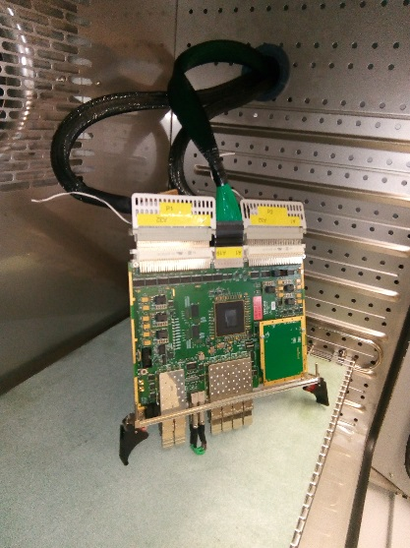
Validation Tests
2) High Temperature:
Trigger possible early failure mechanisms + production feedback
4 tested boards:
(SFP + FMC loopbacks)
Date | Production batch | T_{max_chamber} [°C]
26.07.2018 | Pre-series | 70
26.07.2018 | Pre-series | 70
31.08.2018 | Version 2 | 100
27.11.2018 | 1st production batch | 115
Error-free communication until 95°C
VME communication loss at 115°C → Test terminated
Crate current consumption increased by 5A
T_{max_FPGA_surface} = 161°C
T_{max_PCBsensor} = 128°C (in error)
saturation
T_ID loss
21x loss
DDR3A
DDR3B
VME loss
27.11.2018
10/04/2019
Notes:
1st failure FMC HSSL
Temperature sensors saturation: T_PCB @ 128°C [111°C chamber] & T_ArriaV @ 127°C [84°C chamber]
Linear extrapolation: 196.5°C ArriaV_junction
SFP APP1, SFP FMC HSSL9, Fill Logic DSP, SFP ETH, SFP APP2, SFP APP3, SFP APP4, SFP FMC HSSL1, SFP FMC HSSL2, SFP FMC HSSL3, SFP FMC HSSL4, SFP FMC HSSL5, SFP FMC HSSL8, SFP FMC HSSL10, GBT PLL Clock, OSC2 Clock, Clk FbA, Clk FbB, Clk FbC, Clk FbD, TempAndIdSensor

Slide 16
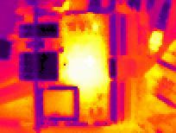
Validation Tests
2) High Temperature:
Tests summary:
Linear extrapolation: T_{j_max_FPGA} = 196°C
  Datasheet: T_{j_max} = 125°C
  T_{j_max_recommended} = 85°C
After cooling down full recovery of all functions
27.11.2018
Reliable board operation up to 95°C
No hardware failures up to 115°C → Successful
➔ Robust design & production
✓
10/04/2019
Notes:
Saturation: T_ArriaV @ 127°C [84°C chamber] → 158°C for 115°C chamber !impossible for 161°C surface measurement
However, as you try to lower the supply voltage (for reasons obvious from the above) the transistors no longer quite turn off all the way, and an ever larger static consumption appears. This is called subthreshold power leakage and increases with temperature. There is also gate oxide leakage.
the high temperature, the higher current leakage in the transistors

Slide 17
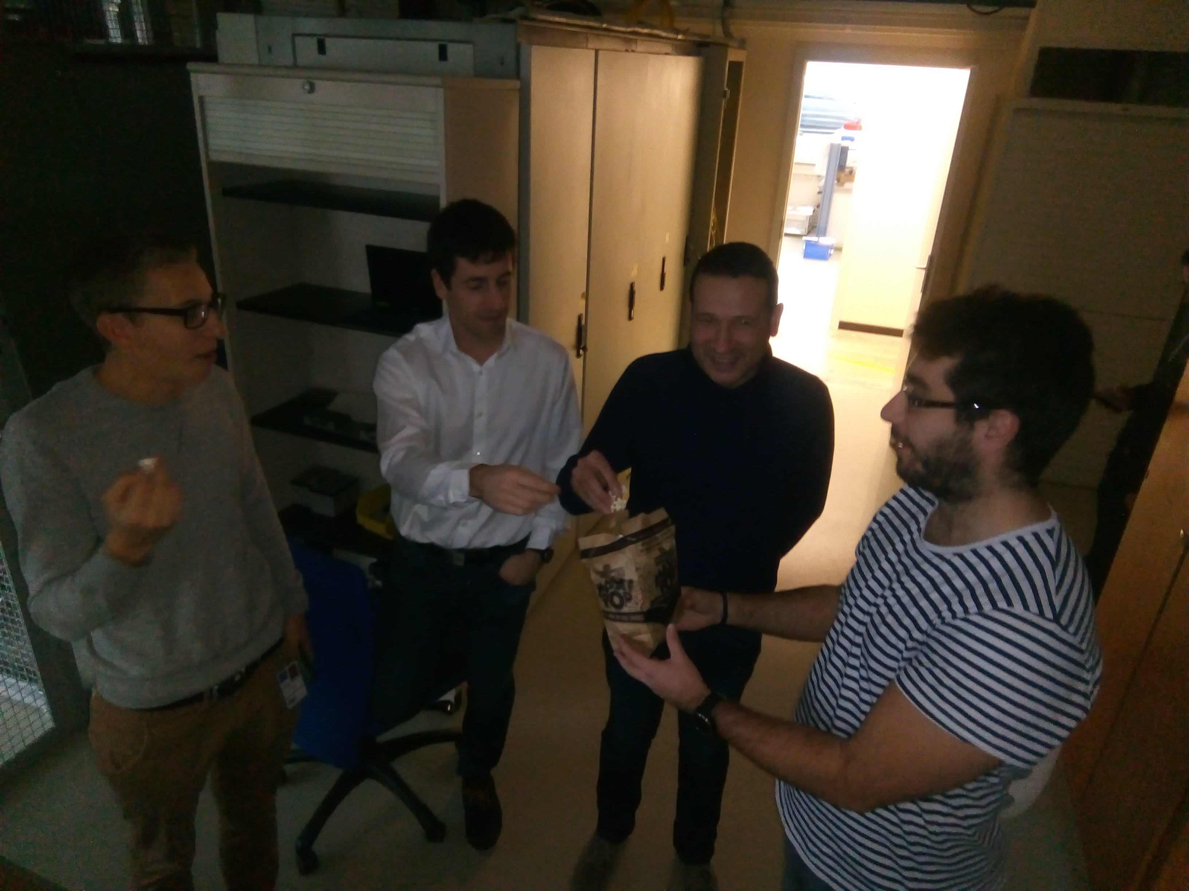
Introduction
Methodology & Objective
Test Setup
Test Results
  Validation Tests
  Temperature Cycling (ongoing)
  Run-In (ongoing)
Summary & Outlook
100°C: Raising tension with raising temperature in front of the climatic chamber ☺
10/04/2019
Notes:
- Only a few results to provide an insight. Full analysis and processing of data is to be followed up

Slide 18
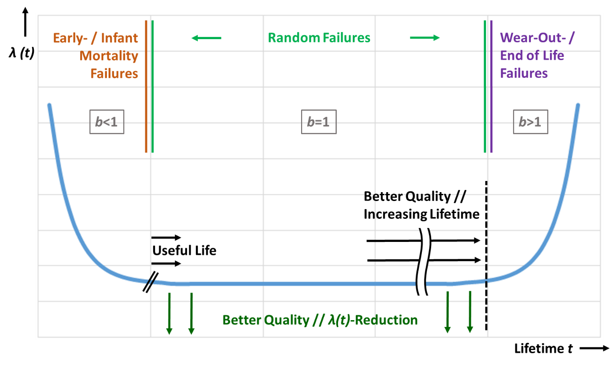
Screening & Reliability
The bathtub curve:
10/04/2019
Notes:
[bathtub] Decreasing constant T axis !!!!!!!
[MTTF requirement] LHCBLM 350 VFCs
Average X failures old system
<5(??) failures per year = MTTF Y
[w/o SFP → see ARW’17]

Slide 19

Screening & Reliability
Temperature cycling and Run-In to screen for early life failures and to assess the (minimum) reliability
Strategy comprises two steps:
  Temperature cycling to raise stress level
  Constant conditions to accumulate time & gain confidence
Temperature
Cycling
Run-In
at constant (operational) conditions
10/04/2019

Slide 20
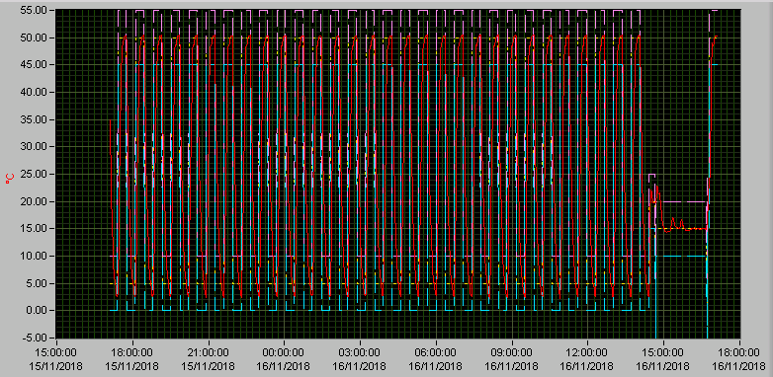
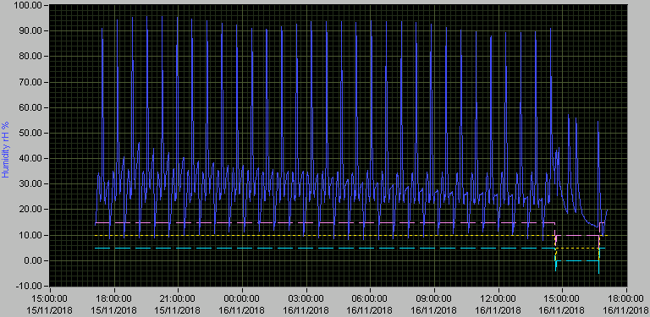
Temperature Cycling
Temperature cycling to raise stress:
  No. of cycles: 30
  Range: 5 to 50 °C
  Rate of change: 5°C/min
  Dwell: 12 min
  Rel. humidity: ~20% ! Short peaks of 90% RH, no condensation
  Total time: 22 h
10/04/2019
Notes:
Arria V max (no damage)
Humidity as additional stress; can’t be avoided due to chamber restrictions

Slide 21
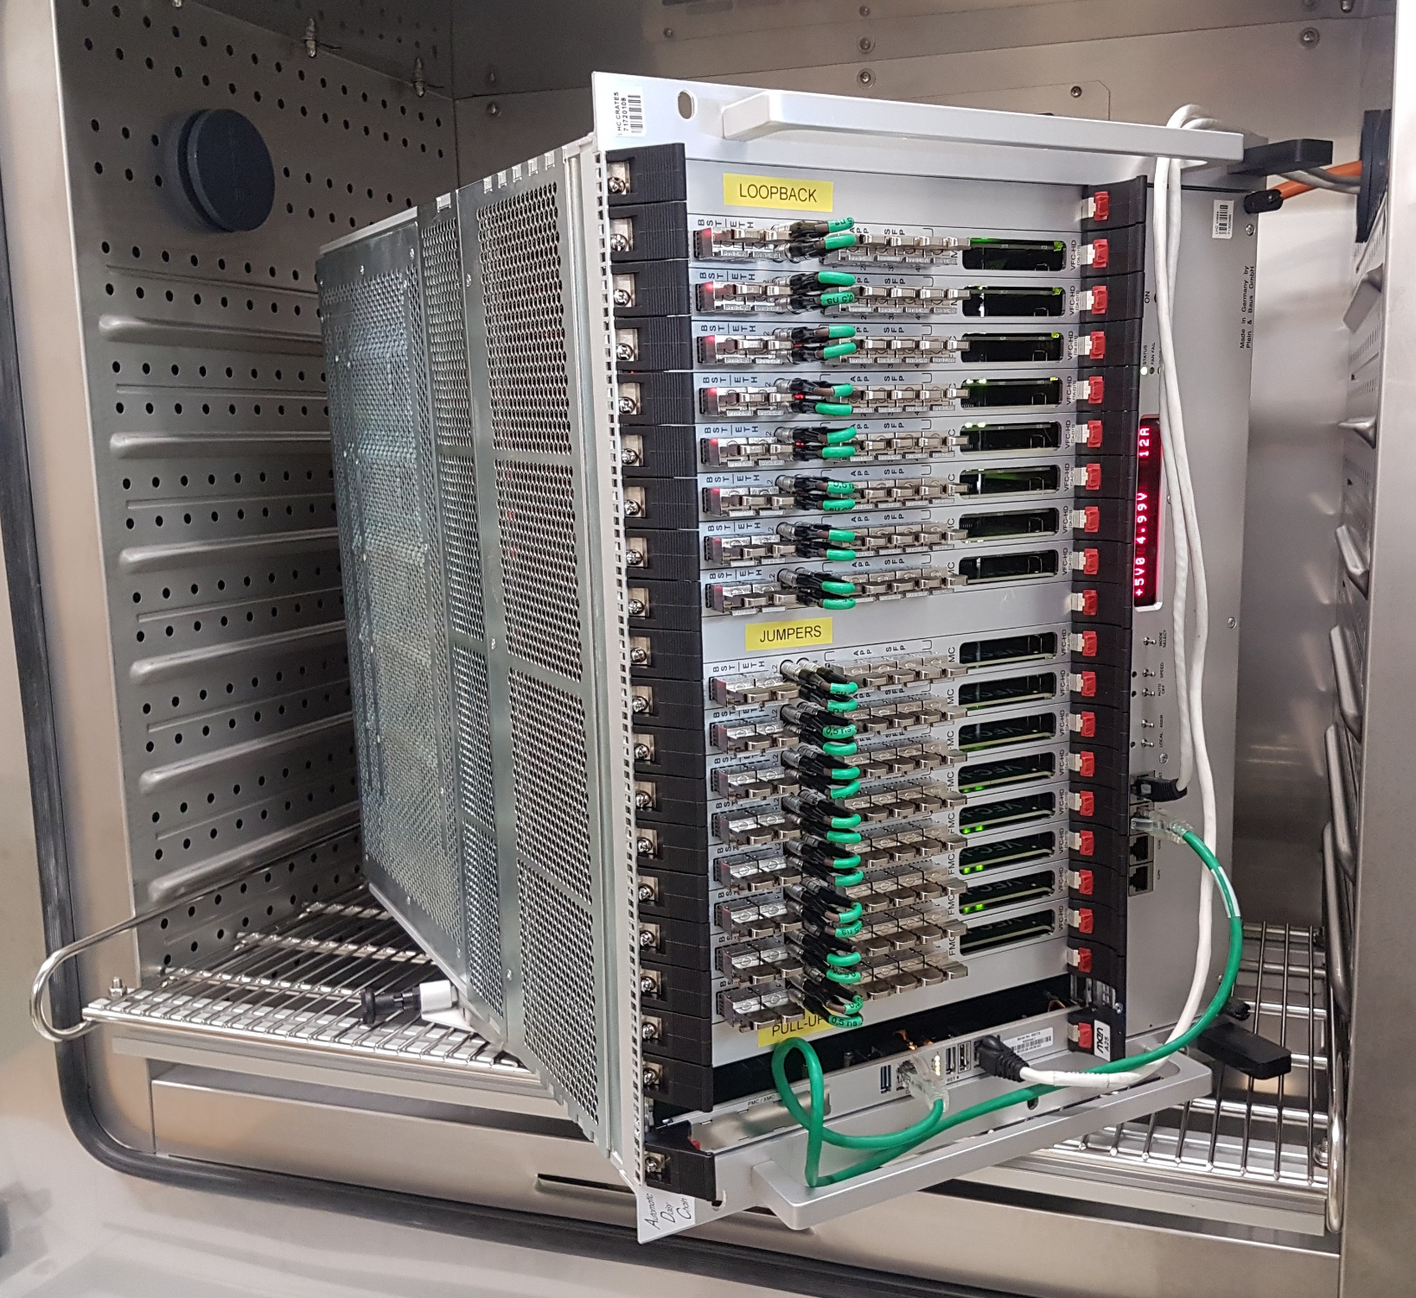
Temperature Cycling
Tests started on 01.11.2018:
50% of boards already tested; 597 out of 1200
10 boards failed the test
  Main cause of failure: Cleanliness of production
  Main circuit affected: Pushbutton with R1, C1
Most failures in batch 1 → Big efforts done to improve the situation:
  Intensive collaboration with the manufacturer
  Production process changes (handling, cleaning, inspection, documentation …)
Batch | No. of tested boards | Failure/ Error | Failure cause
1 | 147 | 8 | Cleanliness
2 | 156 | 1 | Manufacturing
3 | 116 | 1 | Unknown
4 | 139 | 0 | -
5 | 9 | 0 | -
6 | 25 | 0 | -
7 | 5 | 0 | -
TOTAL | 597 | 10 | -
10/04/2019
Notes:
IC2=
IC35=

Slide 22
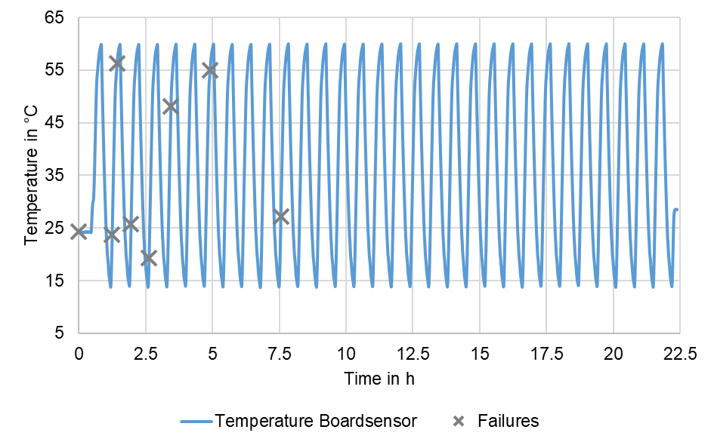
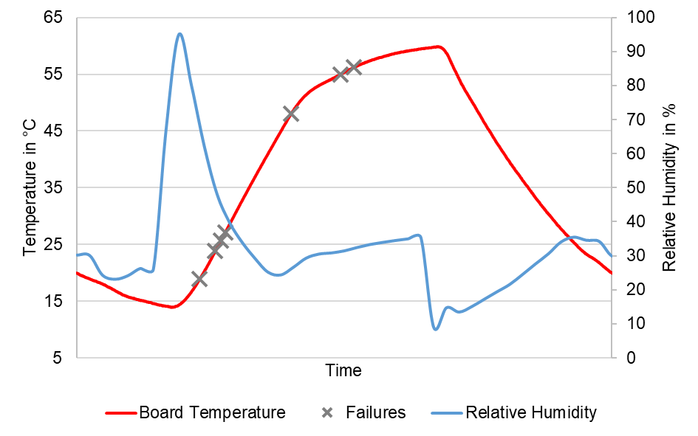
Temperature Cycling
All failures occur in first third of the cycling at low or high temperature
Applied cycles are sufficient for discovered failure mechanism
All failures at ascending temperature
Correlation with humidity peak
10/04/2019
Notes:
IC2=
IC35=

Slide 23
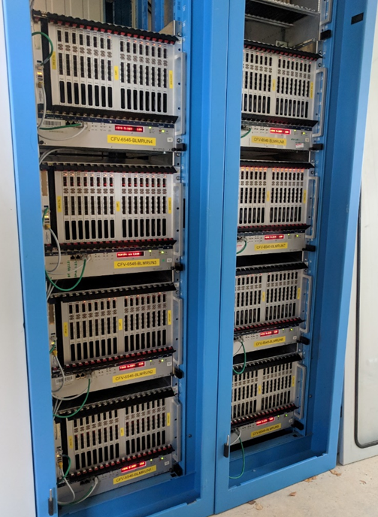
Run-In
Installation of 8 crates
Tests without FMC, SFP & LEMO loopbacks
Room temperature ≥ 30°C
No failures observed
Status as of 09.04.2019:
 | Lot 1 | Lot 2 | Lot 3 | Lot 4 | Total
Start date | 22.11.2018 | 22.12.2018 | 19.01.2019 | 26.03.2019
End date | 20.12.2018 | 18.01.2019 | 25.03.2019 | 09.04.2019
Number of days | 29 | 28 | 65 | 14 | 136
Number of DUTs | 128 | 128 | 128 | 128 | 512
Failures | 0 | 0 | 0 | 0 | 0
Device hrs | 89 000 | 86 000 | 200 000 | 43 000 | 418 000
10/04/2019
Notes:
- Electrical + internet connections, racks, crates, CPUs, PSUs, fans, cabling, …

Slide 24
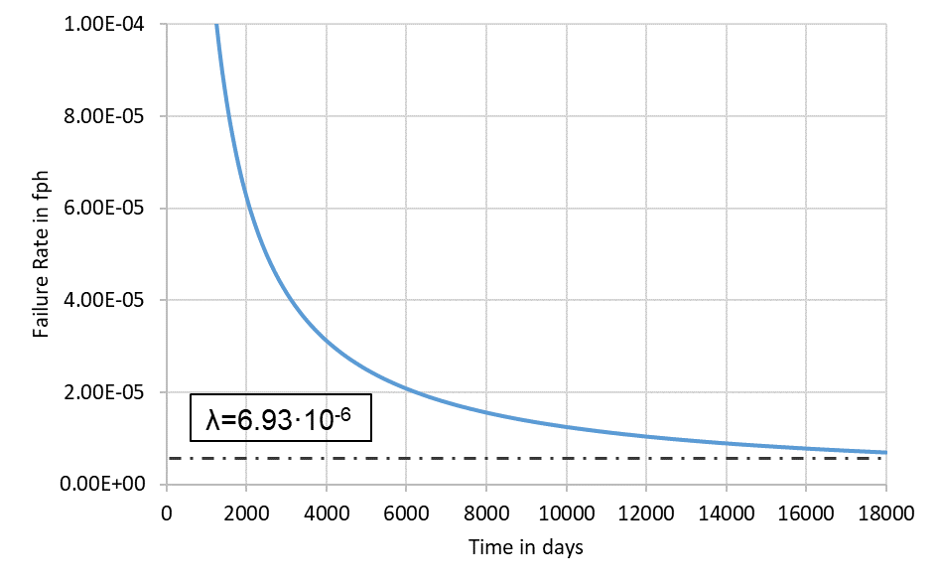
Run-In
MTTF assessment from Cycling and Run-In: status of 09.04.2019
Accumulated test time: 432 000 h
Confidence level: 95 %
Failure causes were solved → Censoring of the failures
Current minimal reliability: MTTF_{95%}= 144 000 h (Goal: ≥ 175 000 h)
10/04/2019
Notes:
Line DAB64x/Mezzanine 500k hrs
Goal? Better than 500k hrs ! Moreover improve complete OL
FR full OL: 129 failures/5 years (not BD)
- Acceleration factor 25°C = 1.56 (30°C); = 2.42 (35°C)

Slide 25
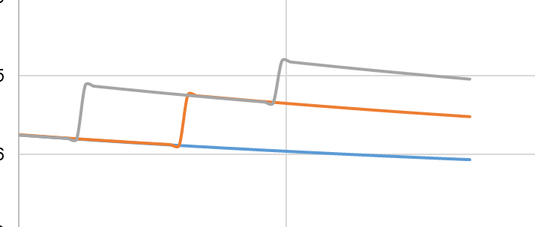
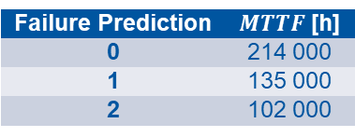
Run-In
Possible MTTF prediction for future tests (censored):
Assuming testing until 15.06.2019
Failure Prediction | $MTTF$ [h]
0 | 214 000
1 | 135 000
2 | 102 000
10/04/2019
Notes:
MTTF for 90%: 250k hrs
60%: 650k hrs
Accumulated hrs end of May: 590k

Slide 26
Summary & Outlook
Successful board validation at different humidity/temperature + at high temperature
  SFP+ transceiver as bottleneck → Further investigation
Screening (incl. inspection) turned out to be necessary
  Until now: Good, reliable design → No PCB/component failures, but:
  Production issues, mainly cleanliness, revealed during temperature cycling
    Efforts done to improve the situation for 2nd & 3rd batch
    Important to check production & to collaborate with manufacturer
  Run-In very important to accumulate failure free (low FR) time and to obtain MTTF_{min}
    09.04.2019: MTTF_{95%} = 144k hrs (HW failures; no stress acceleration)
    Final analysis and conclusions to be done after May
Dependable design methodology proved to be of use
  Might be used in a flexible way, but proper documentation necessary
10/04/2019
Notes:
Master thesis Simon
Not enough failures
Methodology proved to be of use; each step!
Dynamic use to be preferred (reduced FMECA; additional inspection step; iterative Run-In
To be assumed that most future (random) failures are not due to hardware issues, rather than due to other influences (production induced, environment, handling, …)

Slide 27
Thank you very much for your attention
And many thanks to all colleagues in BI-BP, BI-SW, BI-BL who contributed to this large project !

