Slide 1
CTA ATLAS deployment
10/4/2019
IT/ST

Slide 2
Overview
CTA migration strategy and open questions (Giuseppe and Michael)
eosctaatlas deployment status, commissioning tests (Julien)
Drive time efficiency and queueing latency (Germán)
ATLAS activities & intra-VO fairsharing / storage classes (Eric)

Slide 3
CASTOR to CTA Migration
ATLAS tape files in CASTOR
84,062,944 files in group zp
86,689,714 files in file classes atlas_raw, atlas_prod, atlas, atlas_user (and 7 others like *atlas* with under 2m files each)
Several thousand files with no tape copy (zero-length files; files in atlas_no_tape file class)
CASTOR Namespace
/castor/cern.ch/grid/atlas (70,716,745 files)
/castor/cern.ch/atlas (5,805,960 files)
/castor/cern.ch/user (10,209,365 files)
CASTOR Access Control
Directories have POSIX permission bits (95% are 755 or 775. 5% split over 50 combinations)
17% of directories also have Access Control Lists. Around 9,000 combinations.

Slide 4
CASTOR to CTA Migration
CASTOR has a single namespace. CTA will partition the namespace into five instances (one per LHC experiment and one for PUBLIC).
How to determine which instance a file belongs to? There are three hints:
  File class
  Directory branch in the namespace
  Group ID
The minimum granularity for migration is a single cassette

Slide 5
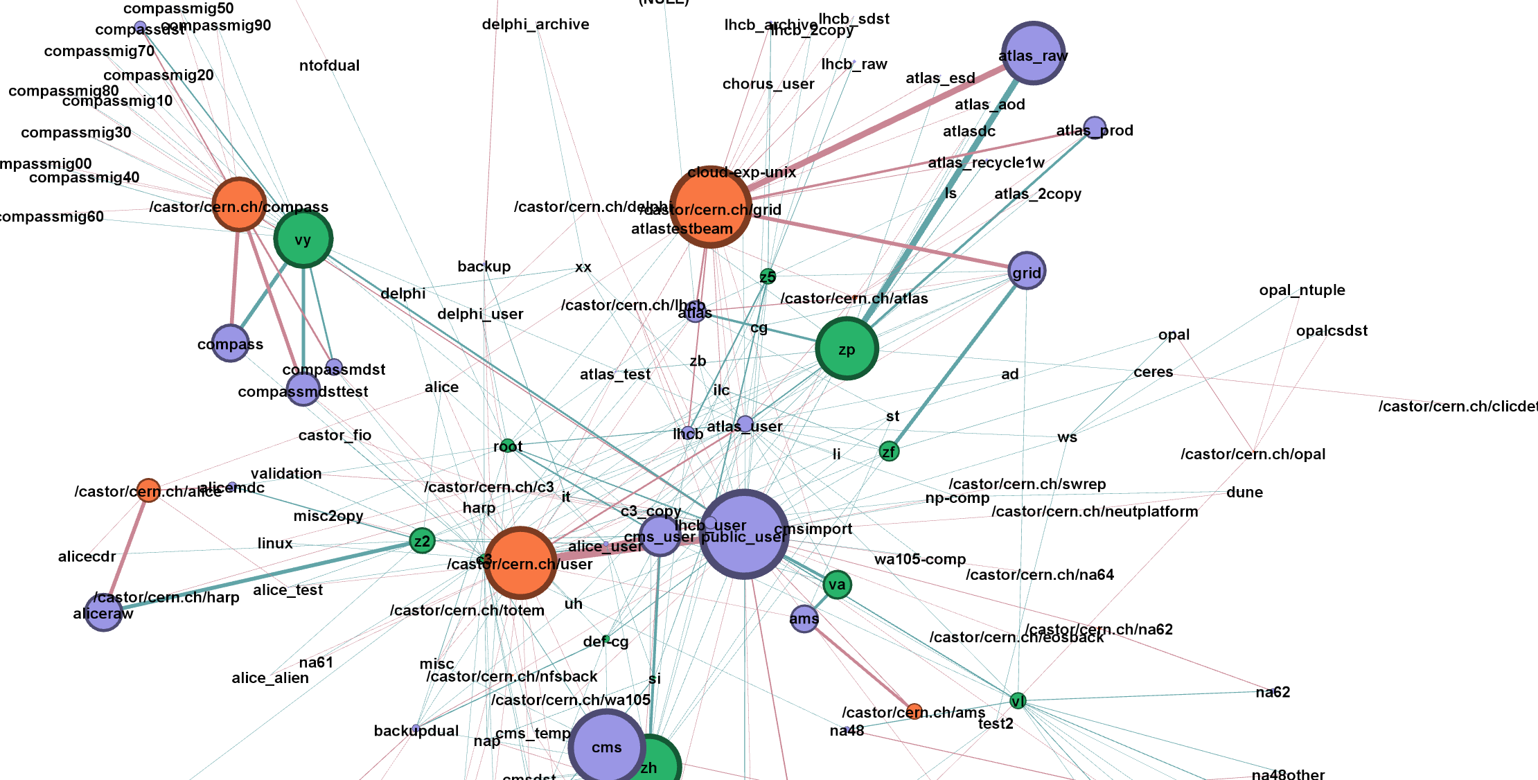
CASTOR to CTA Migration

Slide 6
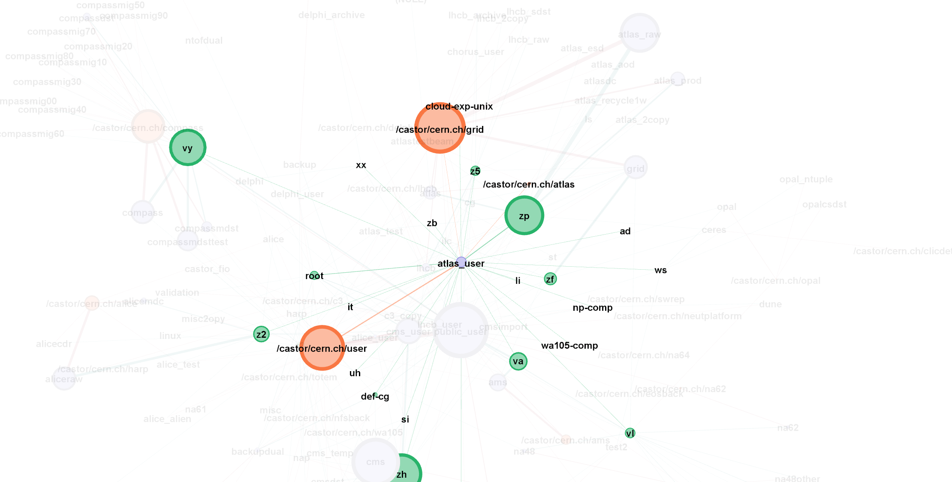
CASTOR to CTA Migration

Slide 7
Migration Questions (1)
Experiment and User file classes
atlas_user will be migrated to the ATLAS instance
  User data is mixed with legacy production data on the same tapes
We propose to NOT migrate the following metadata:
Zero-length files, files with no tape copy, deleted files. (This metadata will remain accessible in the CASTOR namespace).
Group IDs for individual files/directories. After the migration, all will be set to zp.
POSIX permissions and Access Control Lists. A new set of permissions will be created in EOS+CTA according to ATLAS use cases.

Slide 8
Migration Questions (2)
Where should migrated files appear in the EOS+CTA namespace?
We propose to have the new namespace under /eos/cta/atlas
Option 1: Keep migrated data and new data separate
  /castor/cern.ch/grid/atlas/ → /eos/cta/castor/grid/atlas/
  New data under /eos/cta/atlas/
Option 2: Keep migrated data and new data in the same branch
  /castor/cern.ch/grid/atlas/ → /eos/cta/atlas/
  New data under /eos/cta/atlas/
Same question for /castor/cern.ch/user/

Slide 9
Migration Milestones
Preparation
Agree how files (i.e., tapes) will be partitioned between EOSCTA ATLAS and EOSCTA PUBLIC_USER
Agree on access use cases : users, groups and permissions
Migrate metadata to test instance (files remain accessible only from CASTOR)
Live Migration
Select files to be migrated; disable the tapes in CASTOR
  Subsequent metadata operations on these files (delete, rename) are strongly discouraged!
Copy metadata to intermediate table in CTA database (DBLINK)
Inject directory metadata into EOS namespace
Inject file metadata into EOS namespace
Inject tape file metadata into CTA catalogue
Enable tapes in CTA
Disaster Recovery/Rollback
CTA will be prohibited from writing to tapes imported from CASTOR
To return a tape to CASTOR, disable the tape in the CTA catalogue and re-enable the tape in CASTOR

Slide 10
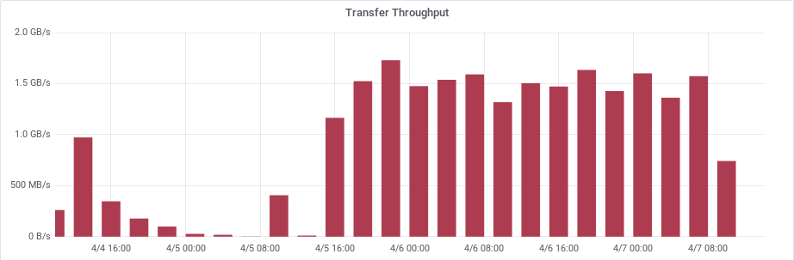
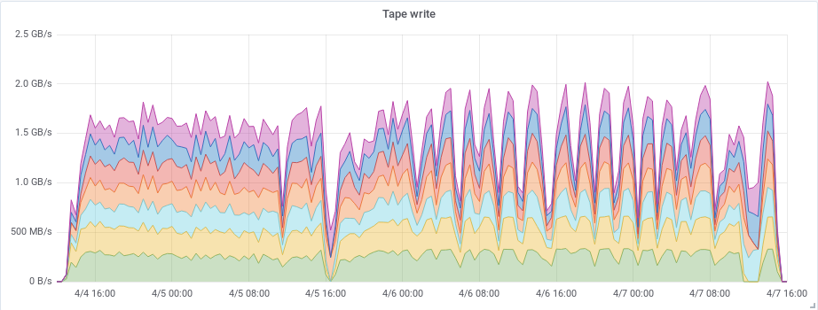
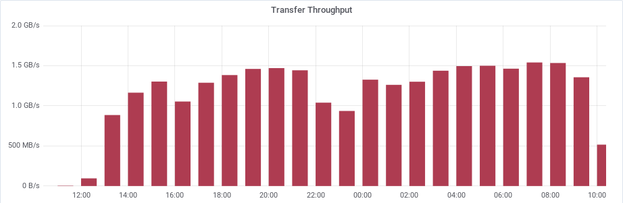
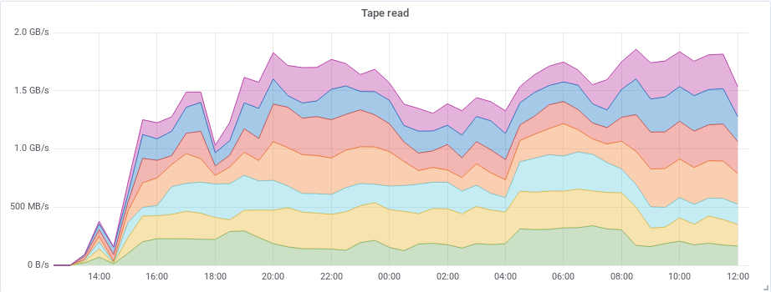
CTAATLASPPS transfers
First ATLAS data archival to CTA with SSDs
  16TB of SSD buffer, 7 tape drives
  250TB of data were written to tapes
  Average throughput 1.5 GB/s
  Transfer efficiency of 20% due to missing free space feedback (planned FTS feature)
First ATLAS data retrieval from CTA with SSDs
  250TB of data are currently being retrieved
  Average throughput 1.5 GB/s
  Transfer efficiency of 96%

Slide 11
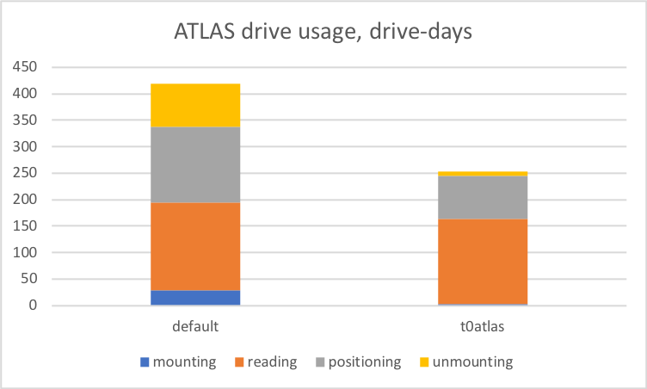
ATLAS and overall drive time efficiency
~2/3 of ATLAS drive utilisation adsorbed by “default” - despite only 45% of data
  Large impact of mount, unmounting and positioning (1st file)
With dataset-level reading, “default” drive usage would be ~50% less…
… liberating drive resources (less queueing/latency, more parallel reading)

Slide 12
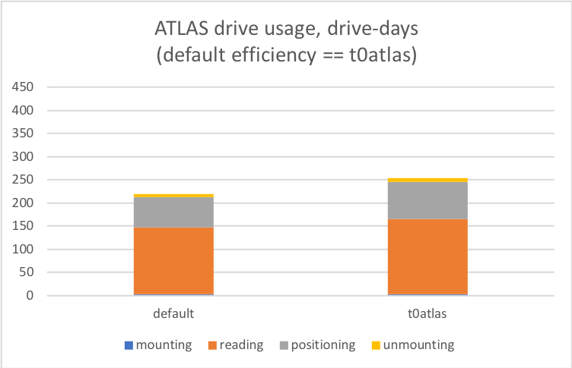
ATLAS and overall drive time efficiency
~2/3 of ATLAS drive utilisation adsorbed by “default” - despite only 45% of data
  Large impact of mount, unmounting and positioning (1st file)
With dataset-level reading, “default” drive usage would be ~50% less…
… liberating drive resources (less queueing/latency, more parallel reading)

Slide 13
ATLAS 2018 queueing latency
Latency (time to last bit of file):
default: median 0.41 d; mean 1.7 d
t0atlas: median 0.29 d; mean 0.64 d

Slide 14
ATLAS activities / intra-VO fairsharing / storage classes
FTS will propagate activity and CTA will honour it
  Activities configuration in FTS mirrored in CTA (map of tags to integer weights)
  Activity tag passed through Xrootd and EOS by FTS
  Mounts arbitrated between activities (weighted fair share)
CTA will then arbiter retrives using either FIFO or Bandwidth criteria
  All FIFO for Atlas, mixed case possible.
Cap of “parallel writes” for a given tape pool
  Parallel writing: how many tape do we simultaneously open for writing at the same time?
  But... creates an upper bound on the migration bandwidth (caps the number of parallel mounts)
  Tape dedicated to either repack or new data within a write mount.
Fail retrieves with more information, and faster (new possible idea)
  Fail requests earlier (and with more detail) when the data will not come in the foreseeable future
    Example: Tape sent to repair
  Discriminate with transient problems
    Example: disk buffer full
Storage class:
Number of copies (1 in our case)
Copy number to tape pool map (1 in our case)
Tape pool:
Owning VO
Max number of partial tapes (parallel writes)
Encryption
Mount Policy
Max archive and retrieve drives
Retrieve prioritisation: <Bandwidth|Latency> (to be added)
Activities (to be added)
Tag
Weight

Slide 15
CTA and tape read efficiency
The CTA project is looking at improving resource efficiency from several angles
  optimising tape and drive scheduling (integrated in CTA sw)
  read access ordering on LTO (“CERN RAO”) – WIP
  minimising disk contention and capacity waste (Julien’s SSD disk layer)
  Others
    larger file sizes – requires collaboration with experiments
    efficient pre-staging (complete data sets)
    collocation hints (Archival WG future output) for increasing contiguous file access

Slide 16
Why do we split data across tapes?
Operational reasons that require splitting of input streams during writes:
  ensure aggregated performance and time-to-tape latency SLA’s in writing (each Run-3 tape drive will only sustain 0.3-0.5 GB/s) (cf Julien’s slides at Rucio workshop)
  non-availability of tapes (eg. under repair, stuck in a drive)
  long library queueing wait times (busy drives, robotics)
  library (segment) downtime or maintenance
  potential impact of “holding back to collocate” on CTA buffer (and pit/T0 buffer)
Tape technology will be growing faster in capacity (~20% CAGR) than in throughput (10-15% CAGR)
Future evolution may require us to consider striped tape writing such as RAIT (cf as done in HPSS)

Slide 17
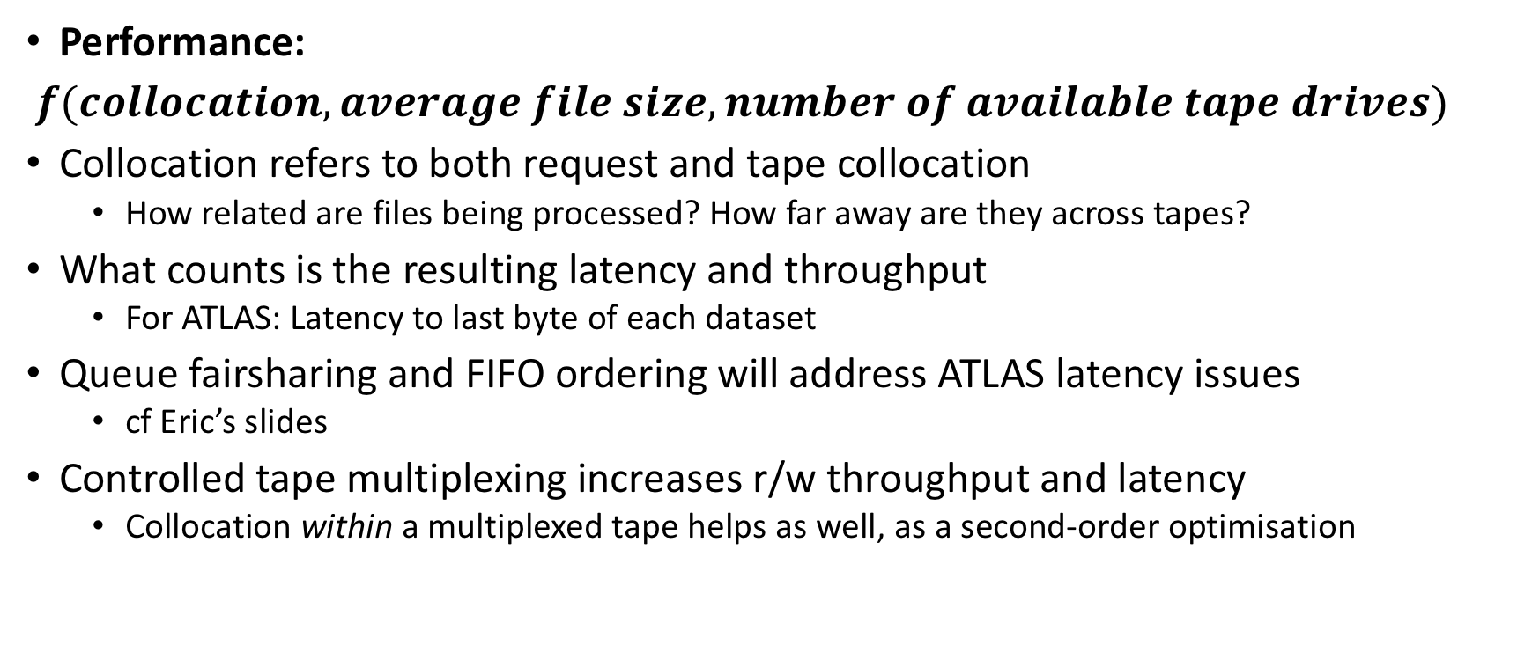
How does this splitting affect performance?
Performance:
$f(collocation, average file size, number of available tape drives)$
Collocation refers to both request and tape collocation
  How related are files being processed? How far away are they across tapes?
What counts is the resulting latency and throughput
  For ATLAS: Latency to last byte of each dataset
Queue fairsharing and FIFO ordering will address ATLAS latency issues
  cf Eric’s slides
Controlled tape multiplexing increases r/w throughput and latency
  Collocation within a multiplexed tape helps as well, as a second-order optimisation

Slide 18
Example
Assumption: ATLAS reading out, then processing complete (large) datasets
Dataset size: 10TB; nominal drive speed: 350MB/s; effective speed factor: 0.7 (0.3 for positioning) -> 245MB/s
Case a) fully collocated writing -> single tape @ factor 1
Case b) multiplexed writing -> N tapes in parallel @ factor 0.7
→ Multiplexing enables substantial latency and performance gains
NB: Tape drive cost is not part of ATLAS pledge but CERN/IT; operational overheads are borne by CERN/IT in any case (0.3 tape drive overhead, EOS disk overhead due to redundancy, switch/router network overheads, etc)
Fully collocated: | Read time (s) | Read speedup factor | Effective per-drive speed factor
1 drive | 2857.142857 | 1 | 1
2 drives | 2857.142857 |  | N/A
Multiplexed: | Read time (s) | Read speedup factor | Effective per-drive speed factor
1 drive | 4081.632653 | 0.7 | 0.7
2 drives: | 2040.816327 | 1.4 | 0.7
3 drives: | 1360.544218 | 2.1 | 0.7
5 drives: | 816.3265306 | 3.5 | 0.7

