Slide 1
NSLS-II Beamline EPS PLC
Chris Guerrero, Core Controls Group (Motion Controls and EPS)

Slide 2
Beamline EPS PLC System
BICS chassis (intelligent chassis)
1734 Remote IO
Gate Valve Control
Gate Valve Status
ArmorBlock Analog
water flow
EPICS Interface
Remote I/O
Beam Line Components
ArmorBlock
Vacuum Gauge Controller

Slide 3
Beamline EPS System Architecture

Slide 4
Workshop Topics
Requirements and Specifications
  Based on NSLS-II Beamline EPS Standards
Project Engineering
  Depends on components and engineering groups involved
Testing
  We perform test reports on all EPS components based on standardized procedures
Application Management
  All software is backed up and managed on gitlab.nsls2.bnl.gov/EPS
  Documentation is centralized on Gitlab/Sharepoint (internal) and Dropbox (external)

Slide 5
NSLS-II Accelerator Vacuum & Utilities PLC
Ibrahim Saleh, Accelerator Controls Group

Slide 6
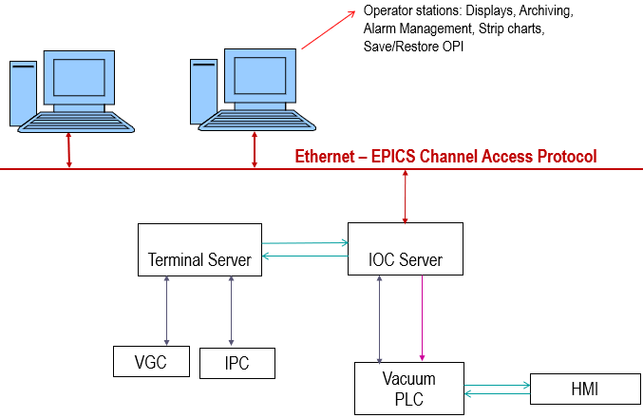
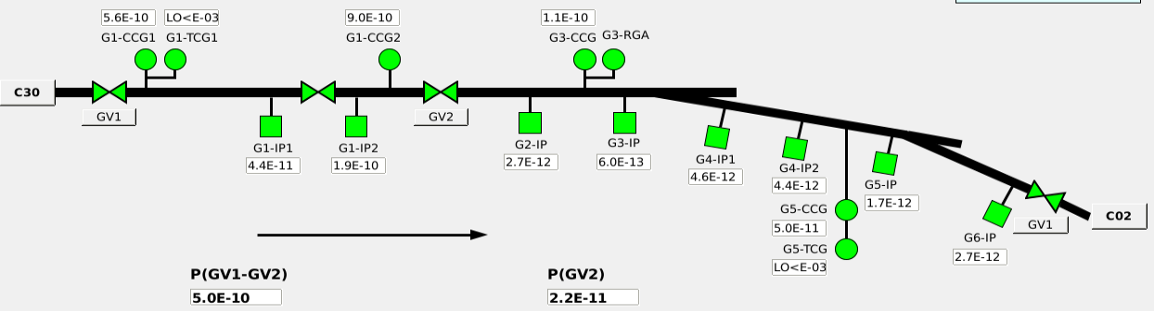
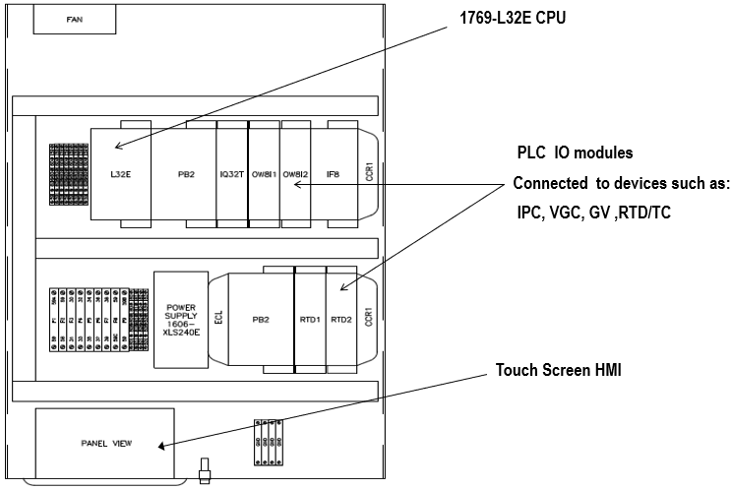
Accelerator Vacuum PLC
61 Allen Bradley CompactLogix PLCs
Injector: 6 PLCs (1769-L32E CPU)
Storage Ring: 30 PLCs (1769-L32E CPU)
Front Ends: 25 PLCs (1768-L43 CPU)
SR PLC Box
Vacuum Control Layout

Slide 7
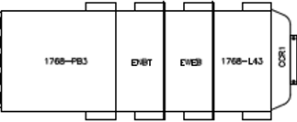
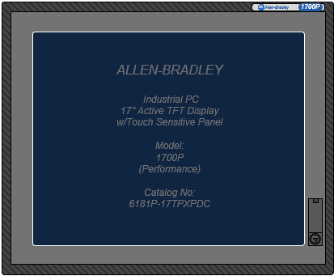
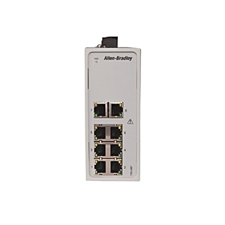
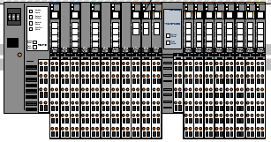

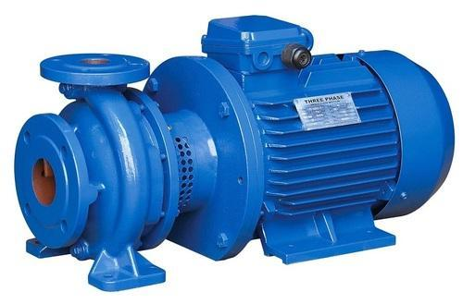
Accelerator Utilities PLC
7 Allen Bradley CompactLogix PLCs (1768-L43 CPU)
14 Remote IO Racks (1734)
29 Allen Bradley VFDs (PowerFlex 755)
Ethernet – EPICS CA
IOC Server
Temperature Sensors
Pressure Transmitters
Control Valves
Temperature Sensors
Pressure Transmitters
Control Valves
Utilities Water Pumps Control Layout

Slide 8
Workshop Topics
Requirements and Specifications
  Based on NSLS-II System Standards
Project Engineering
  Manage the project based on the available engineering resources
  Perform regular maintenance and checkups
  Put plans for system upgrades to replace obsolete hardware
Testing
  Perform test reports on all system components based on defined procedures.
  Perform testing and validation after any modification on the system (Hardware or Software)
Application Management
  Documentation is centralized on SharePoint (internal)
  All software is backed up and managed on SharePoint
  We are looking to have more Version Control options

