Slide 1
ESS control system
Emilio Asensi
Project Engineer
David Sánchez-Valdepeñas
Automation Engineer for Machine Protection
www.europeanspallationsource.se
2019-10-05

Slide 2
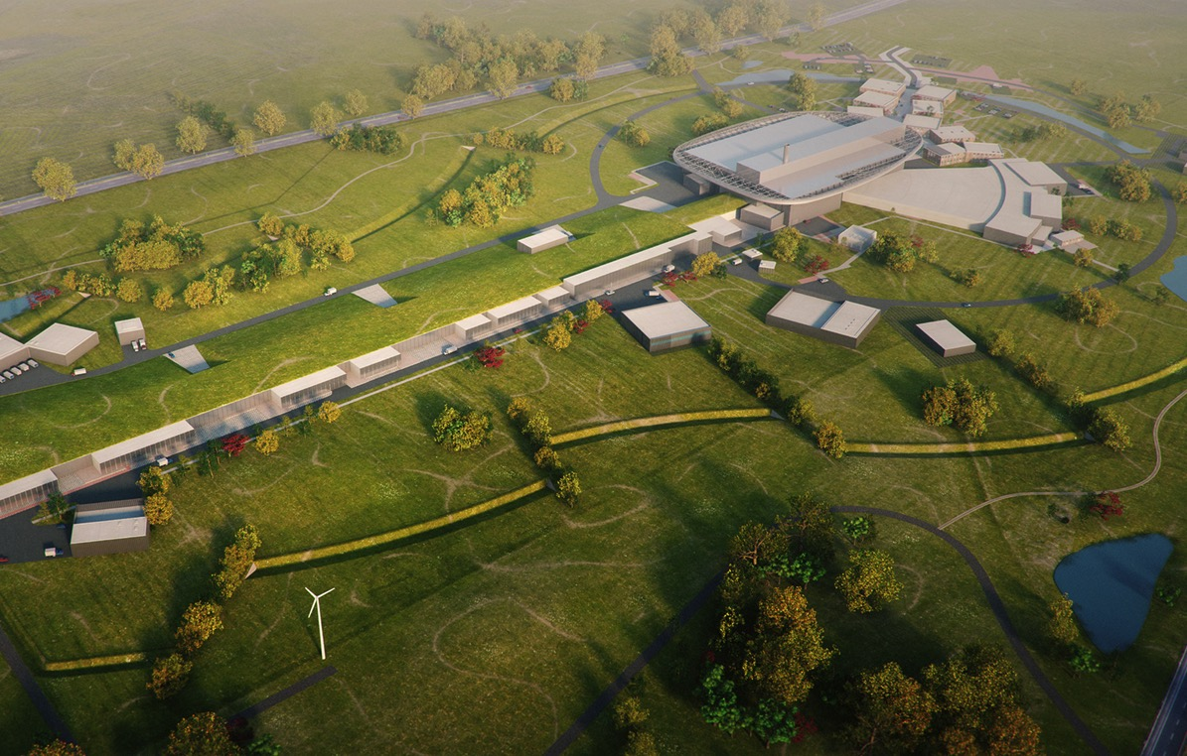

Road to realizing the world’s leading facility for research using neutrons
2025
ESS construction complete
February 2014
Construction partner selected: Skanska and ESS forms SEC
June 2014
Construction work starts on the site
2023
ESS starts
user program
2009
Decision: ESS will be built in Lund
2019
First trial operation of the facility
2012
ESS Design Update phase complete
2003
First European design effort of ESS completed

Slide 3
ICS In-kind partners
Agreement signed
Agreement waiting for signature
Collaboration/other agreement

Slide 4
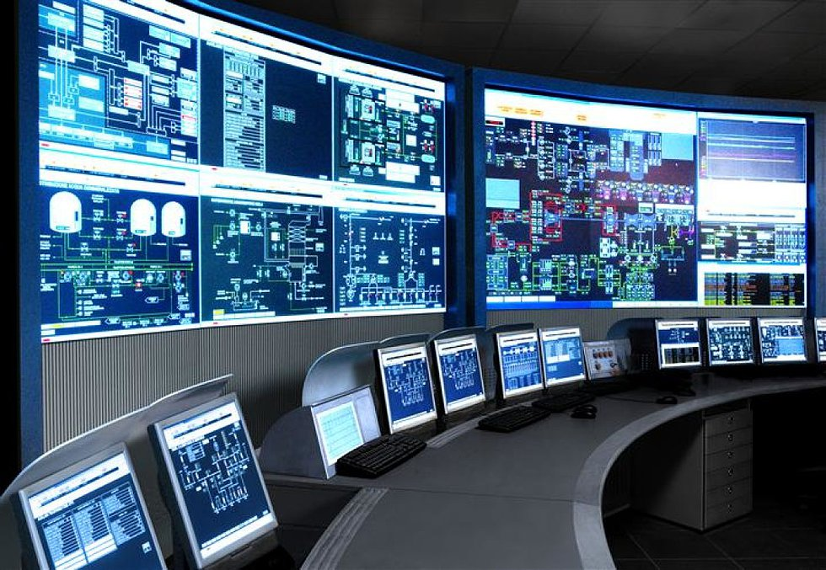
The ESS integrated control system
The ESS facility is a large and complex machine with very much and diverse equipment that needs to work in synchronization and with well-known configurations
The Integrated Control System Division (ICS division) is responsible for the control systems within the ESS facility including controls for
  Accelerator
  Target
  Neutron Scattering Systems
  Conventional Facilities
In addition, the control system
makes it suitable for
implementing
  Machine Protection System
  Personnel Safety System
To build a distributed control
system of this size is a major
undertaking

Slide 5


ESS/ICS challenges
The ESS control system complexity is very high
  About 1 600 000 “process values”
  Ambitious approach to automation of control system configuration
Facility availability goals are very high
  ICS plays a key role for the availability of the facility - 95% availability
  High performance and availability requirements on equipment used
Some new approaches will be implemented at ESS/ICS
  Full scale deployment of EPICS 7
    ESS is committed to contributing to the EPICS community
  Full scale deployment of MicroTCA.4
    ESS is involved in a public procurement for innovation initiative

Slide 6
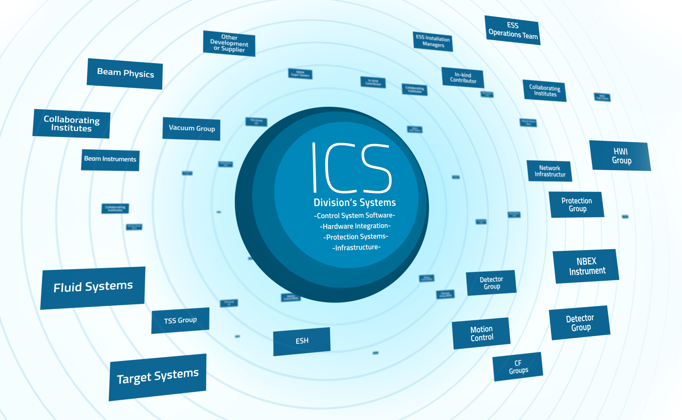
Working together

Slide 7

Layer Architecture of the ESS Control System
ESS Main Control Room
Experiment workstations
other human interfaces
System
GUIs
Equipment
GUIs
Physics
Apps
Config.
Tools
Data on
Demand
PSS
GUIs
NICOS
DMSC
High Performance
Data Network
EPICS
EPICS
IOC
EPICS
IOC
EPICS
IOC
EPICS
IOC
EPICS
IOC
Data on
Demand
EPICS
Archiver
Event
Generator
Timing System
Fast Beam
Interlock System
Machine Protection
MicroTCA
System
PSS
PLC
Personnel Safety Systems
PLC
PLC
Ether
CAT
MicroTCA
System
Fieldbus
Remote
I/O
Controller
Device
Electronics
Device
Electronics
Controller
Remote
I/O
Remote
I/O
Device signals
Pump
Flowmeter
Motor
Sensor
Chopper
Power Supply
Switch
Sensor
Sensor
H₂O Flow
He Flow
Mech. Movement
RF
Proton
Neutron
etc.
Temp
Electricity
Magnetic

Slide 9
ICS vision and mission statements
ICS vision statement
ESS operated efficiently, reliably and safely, with a control system that everyone loves
ICS mission
The ICS division shall provide and maintain world-class and cost-efficient control, protection and safety systems and services for the ESS facility.
The division shall develop competence and innovative solutions that can be shared in the community through open processes

