Slide 1
PLC Factory
PLC Based Control Systems workshop
ICALEPCS 2019
Emilio Asensi
Project Engineer
With slides of K. Vestin
and M. Boros
(both in this conference)
www.europeanspallationsource.se
05 October 2019

Slide 2
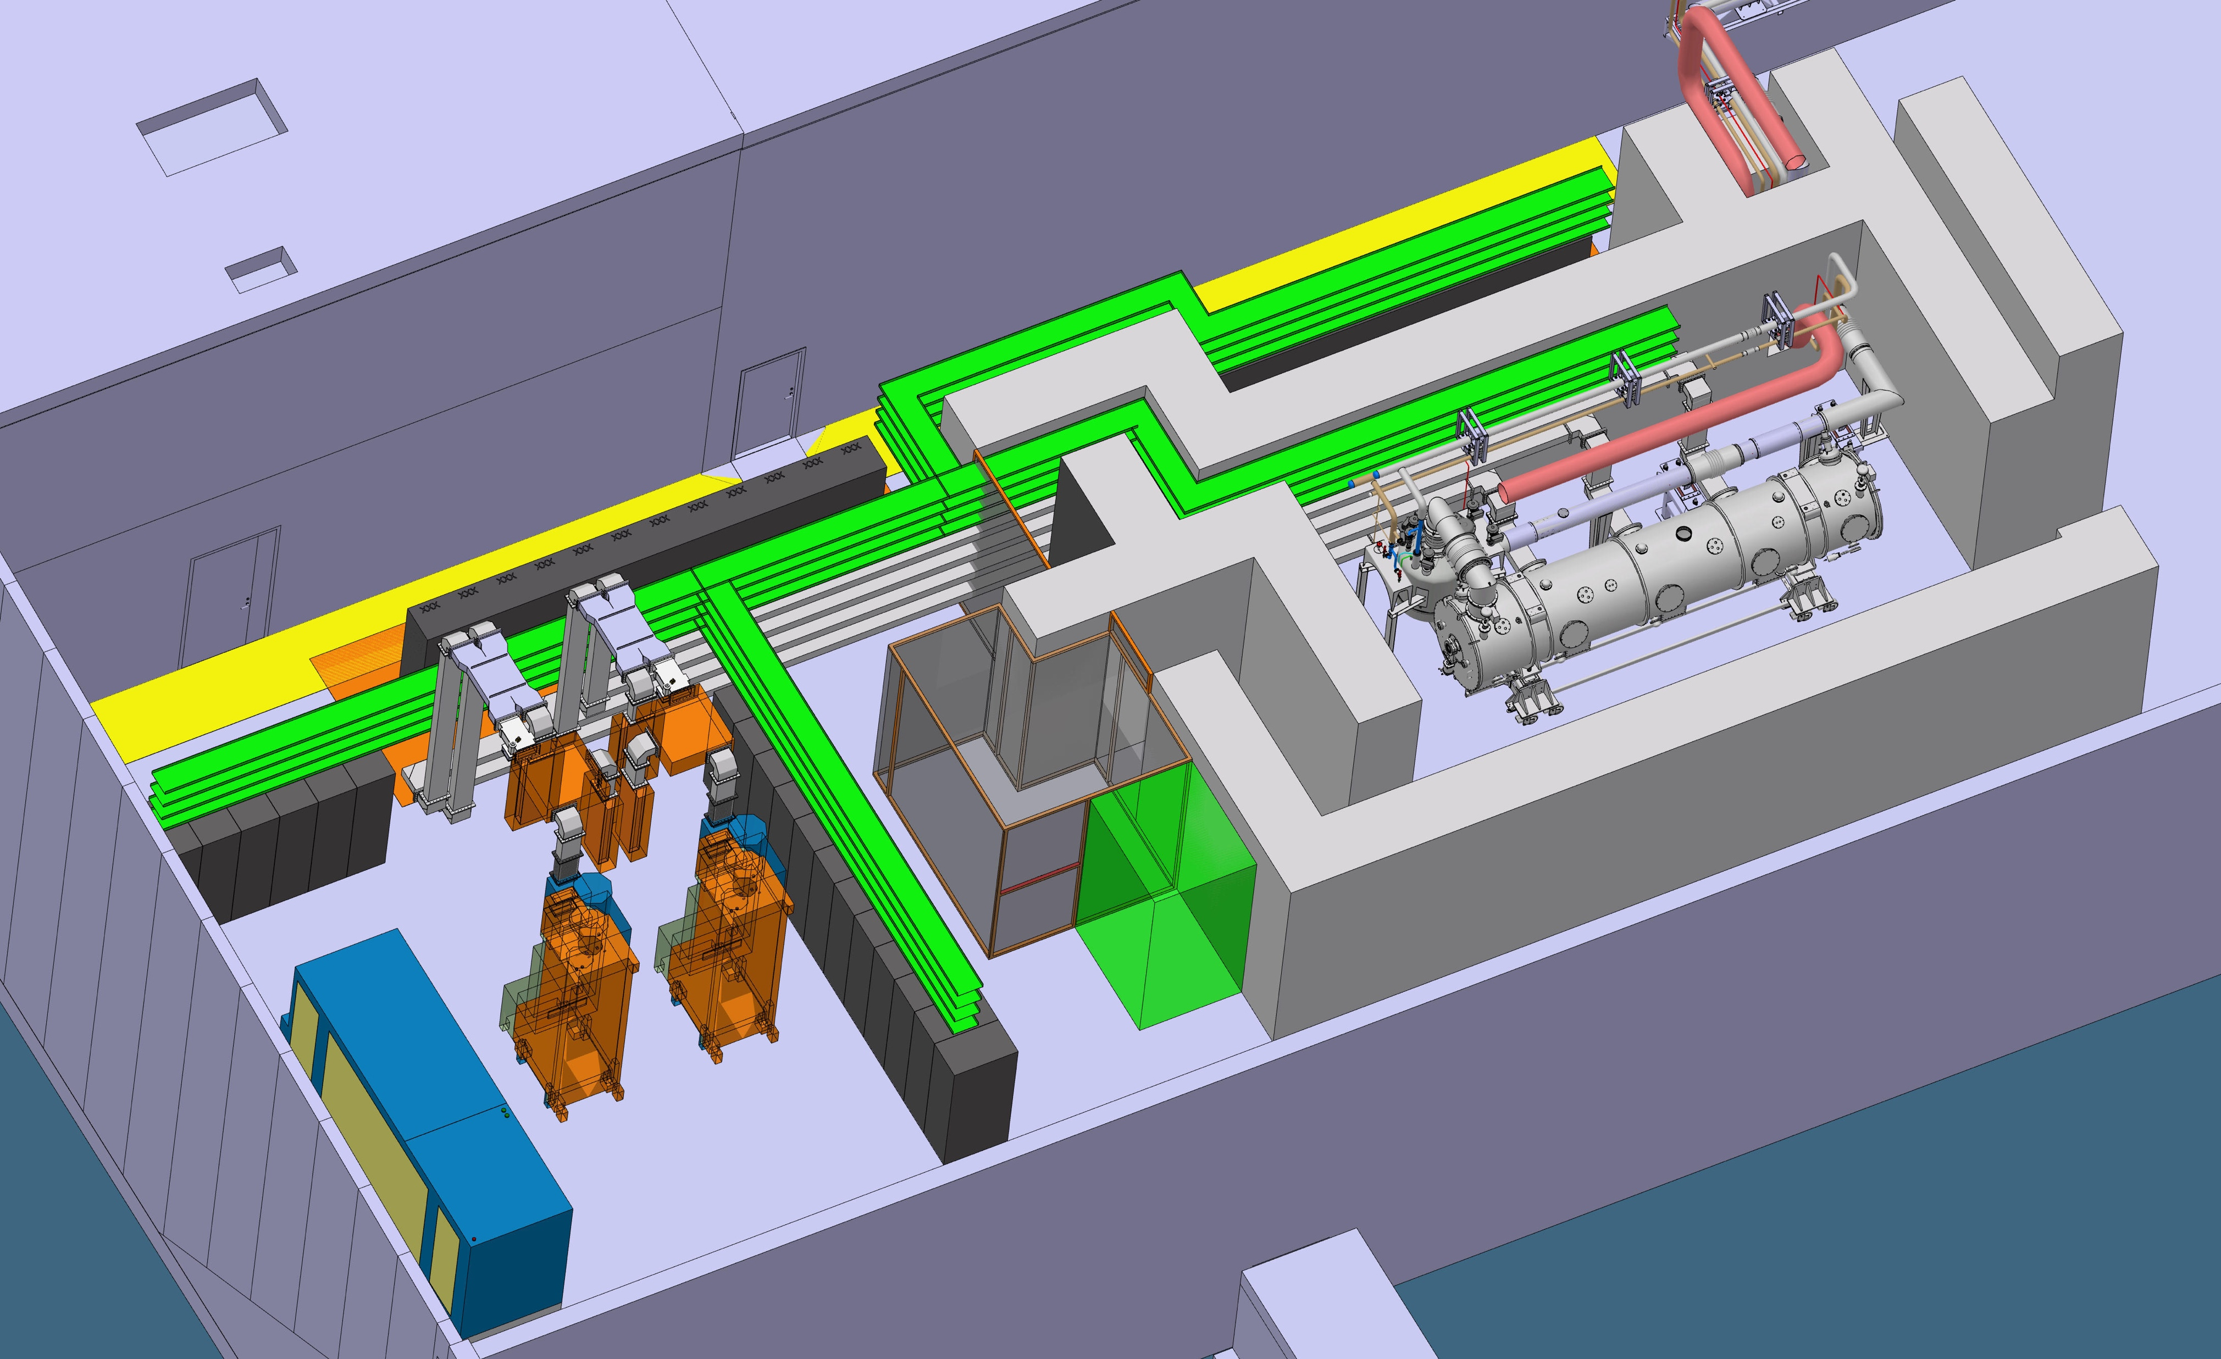
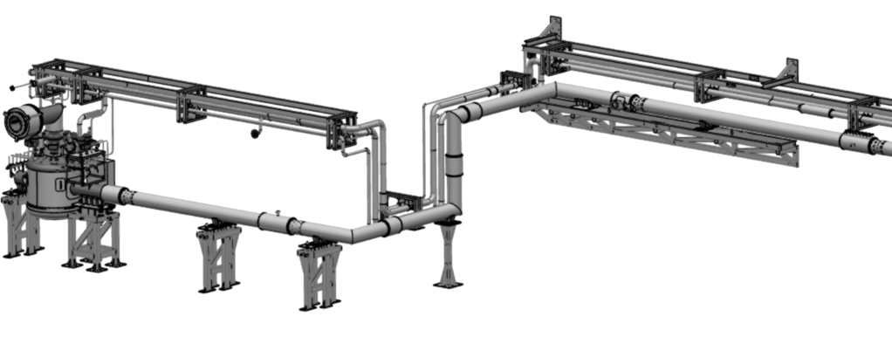
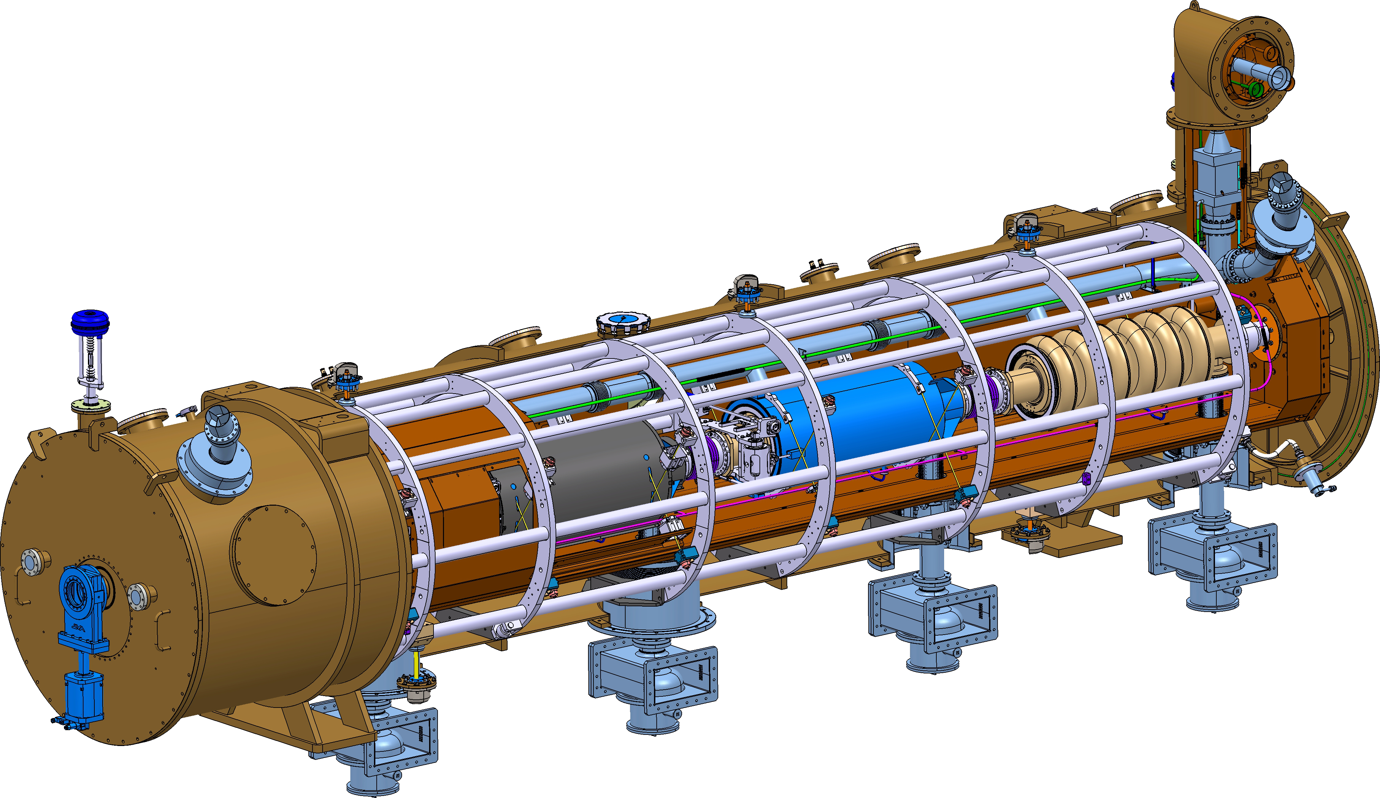
Context
Interface to
Cryomodule
Interface to TICP
50 m

Slide 3


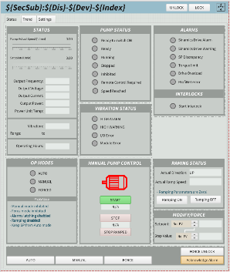
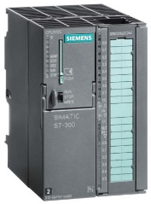
Overview of tool chain for automatic code and configuration at ESS
CS Entry
(Inventory management)
IOC Factory
(Java application)
E3
(ESS EPICS Environment)
CCDB
(Configuration database)
PLC Factory
(Python script)
Naming Service
(Device registry)
PLC Code
(TIA Portal)

Slide 4
PLC Factory - Workflow
Planning
Project plan
P&ID
Devices
Define DEVICE TYPES
Create DEVICE LIST
CCDB
Create ESS names
I/O List
PLC Factory
TIA Portal
EPICS
Run python script
Data pulled from CCDB
Import files generated by PLC Factory
Compile and test
Deploy in EPICS environment
Create CCDB types
Build project tree
Verify functionality

Slide 5
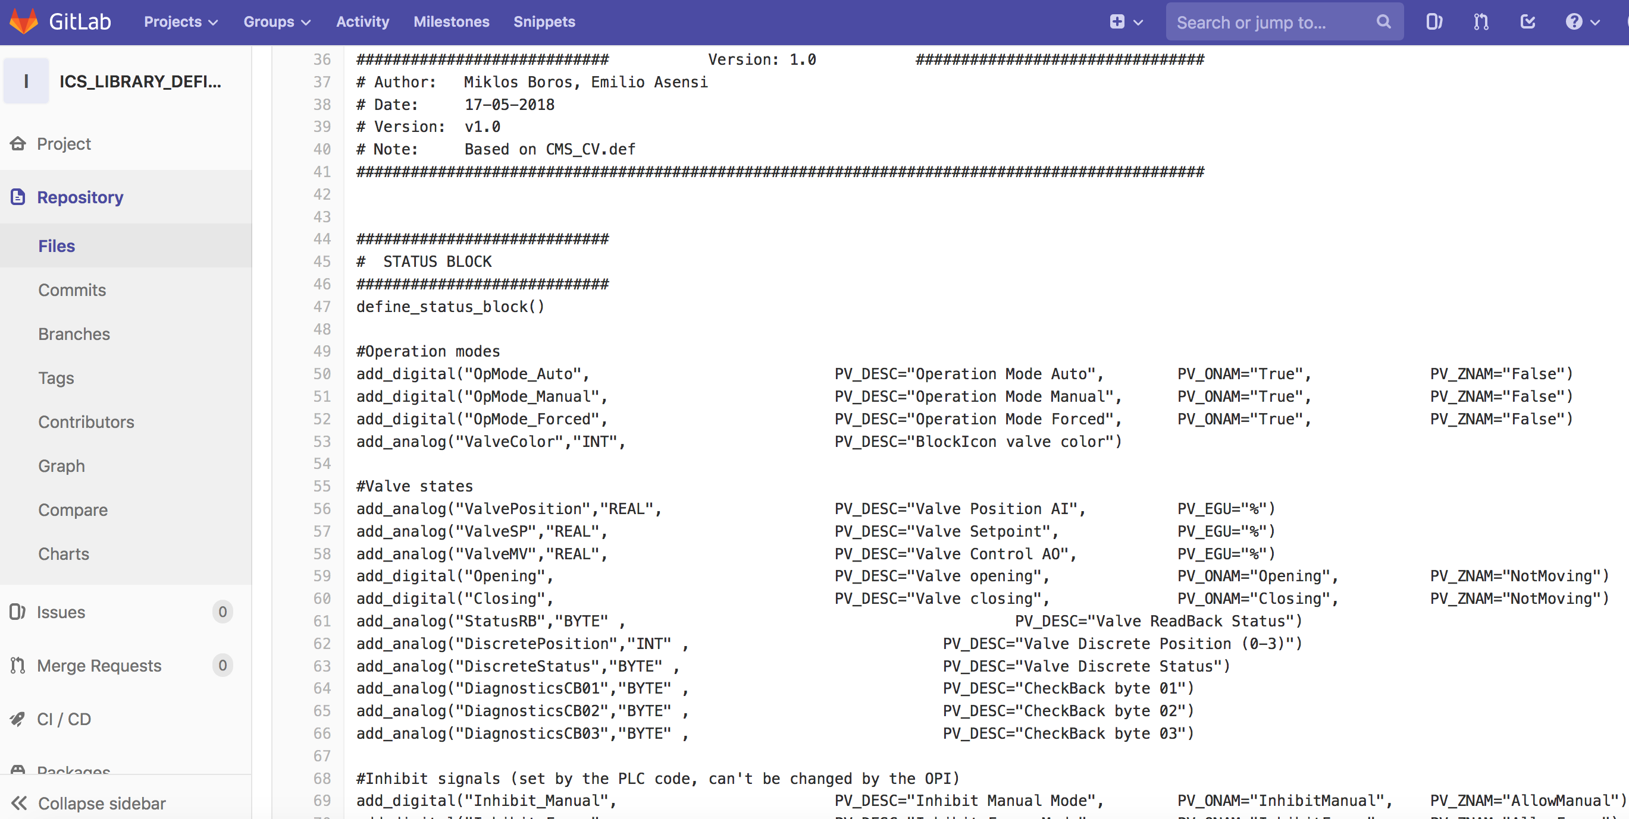
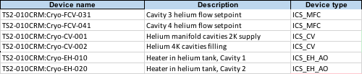
PLC Factory - Workflow
Planning
Project plan
P&ID
Devices
Define DEVICE TYPES
Create DEVICE LIST
CCDB
Create ESS names
I/O List
PLC Factory
TIA Portal
EPICS
Run python script
Data pulled from CCDB
Import files generated by PLC Factory
Compile and test
Deploy in EPICS environment
Create CCDB types
Build project tree
Verify functionality

Slide 6
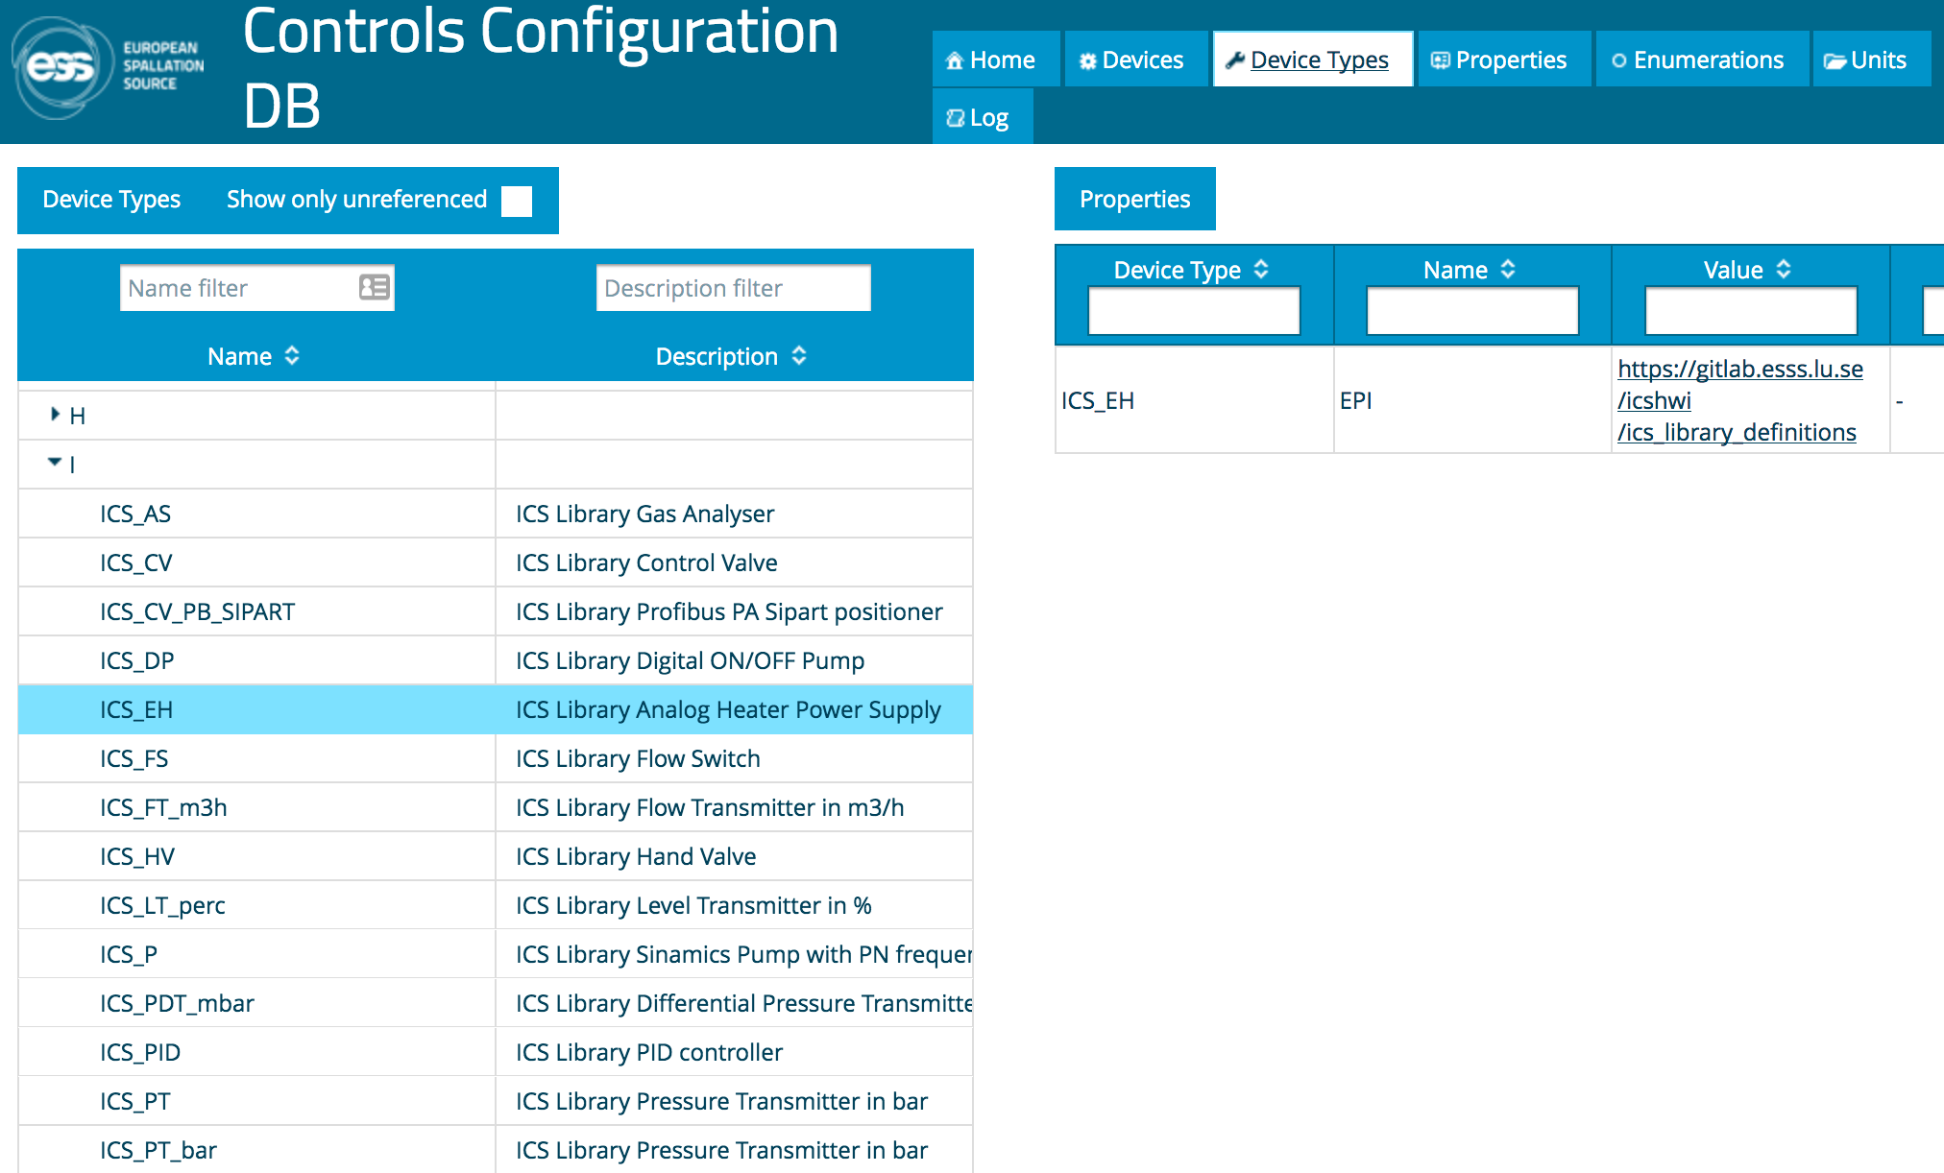
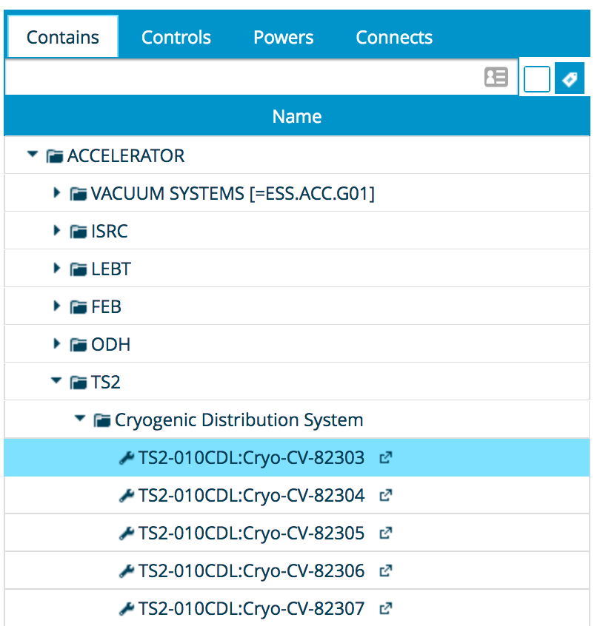
PLC Factory - Workflow
Planning
Project plan
P&ID
Devices
Define DEVICE TYPES
Create DEVICE LIST
CCDB
Build project tree
I/O List
PLC Factory
TIA Portal
EPICS
Run python script
Data pulled from CCDB
Import files generated by PLC Factory
Compile and test
Deploy in EPICS environment
Create ESS names
Create CCDB types
Verify functionality

Slide 7
PLC Factory - Workflow
Planning
Project plan
P&ID
Devices
Define DEVICE TYPES
Create DEVICE LIST
CCDB
Create ESS names
I/O List
PLC Factory
TIA Portal
EPICS
Run python script
Data pulled from CCDB
Import files generated by PLC Factory
Compile and test
Deploy in EPICS environment
Create CCDB types
Build project tree
Verify functionality
python plcfactory.py -d TS2-010CRM:Cryo-PLC-001 --plc-interface=14 --eee
Notes:
--plc-interface=14 indicates TIA portal version
--eee indicates to generate IOC code

Slide 8
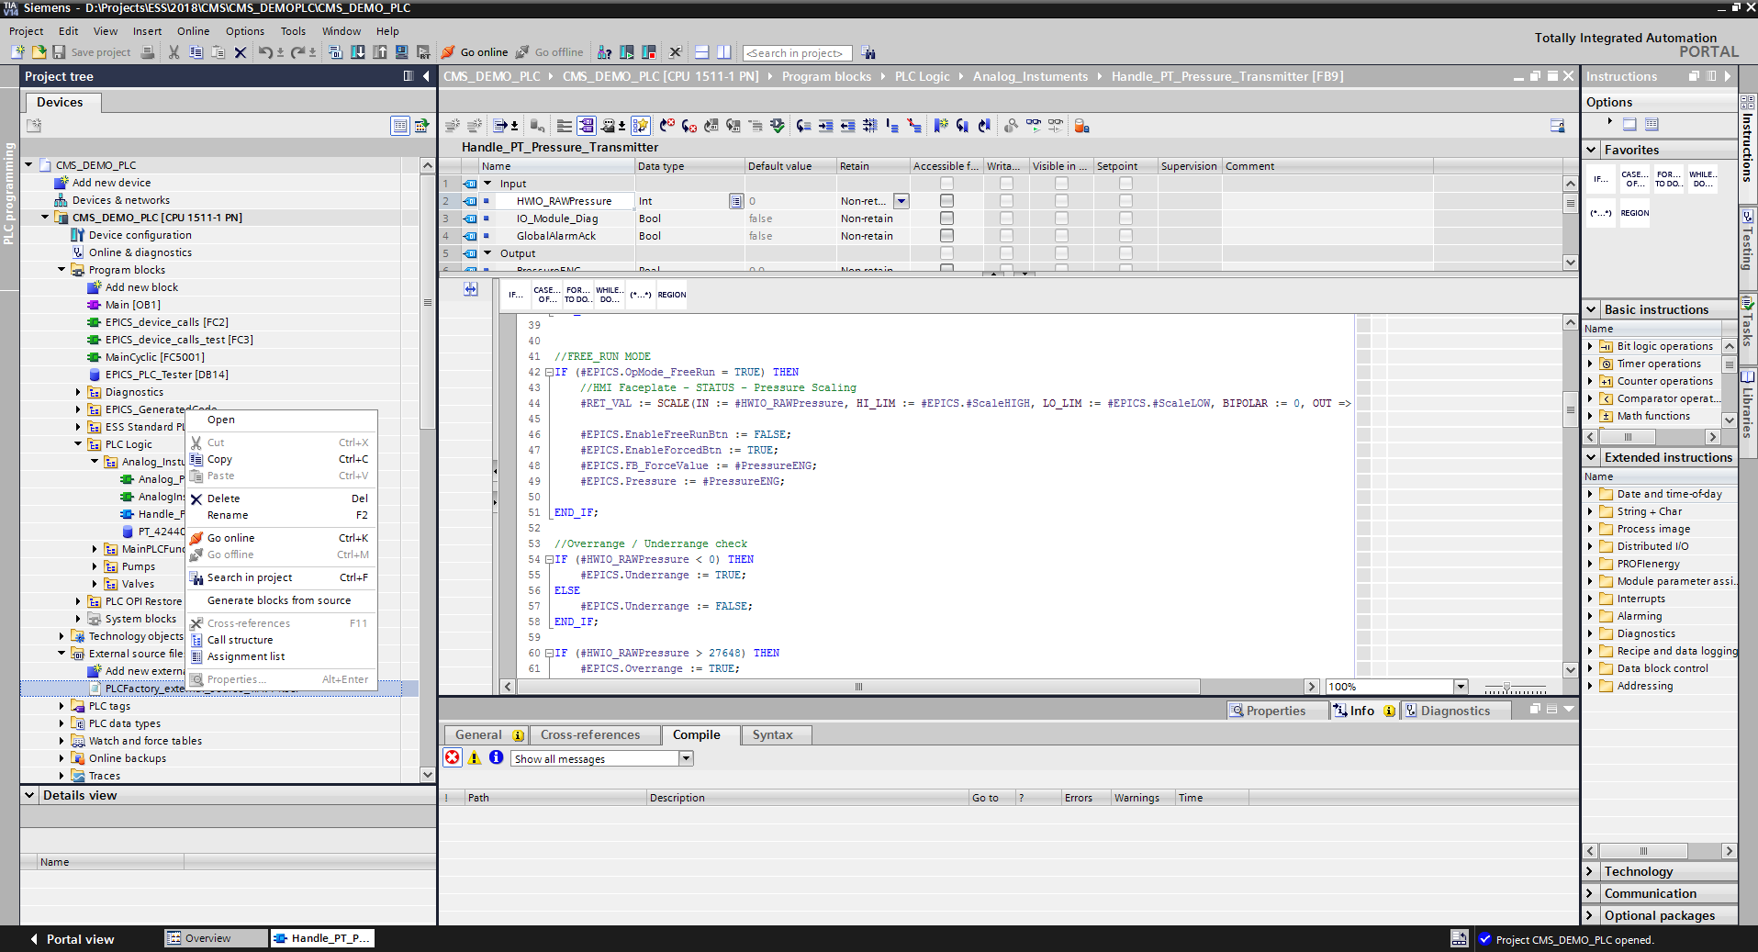
PLC Factory - Workflow
Planning
Project plan
P&ID
Devices
Define DEVICE TYPES
Create DEVICE LIST
CCDB
Create ESS names
I/O List
PLC Factory
TIA Portal
EPICS
Run python script
Data pulled from CCDB
Import files generated by PLC Factory
Compile and test
Deploy in EPICS environment
Create CCDB types
Build project tree
Verify functionality

Slide 9
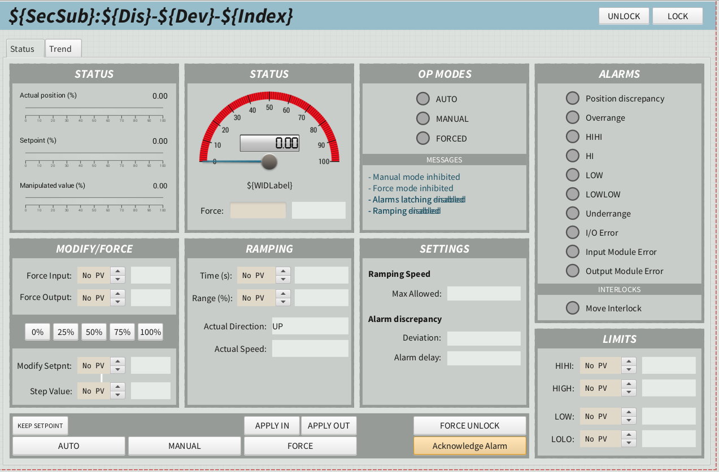
PLC Factory - Workflow
Planning
Project plan
P&ID
Devices
Define DEVICE TYPES
Create DEVICE LIST
CCDB
Create ESS names
I/O List
PLC Factory
TIA Portal
EPICS
Run python script
Data pulled from CCDB
Import files generated by PLC Factory
Compile and test
Deploy in EPICS environment
Verify functionality
Create CCDB types
Build project tree

Slide 10
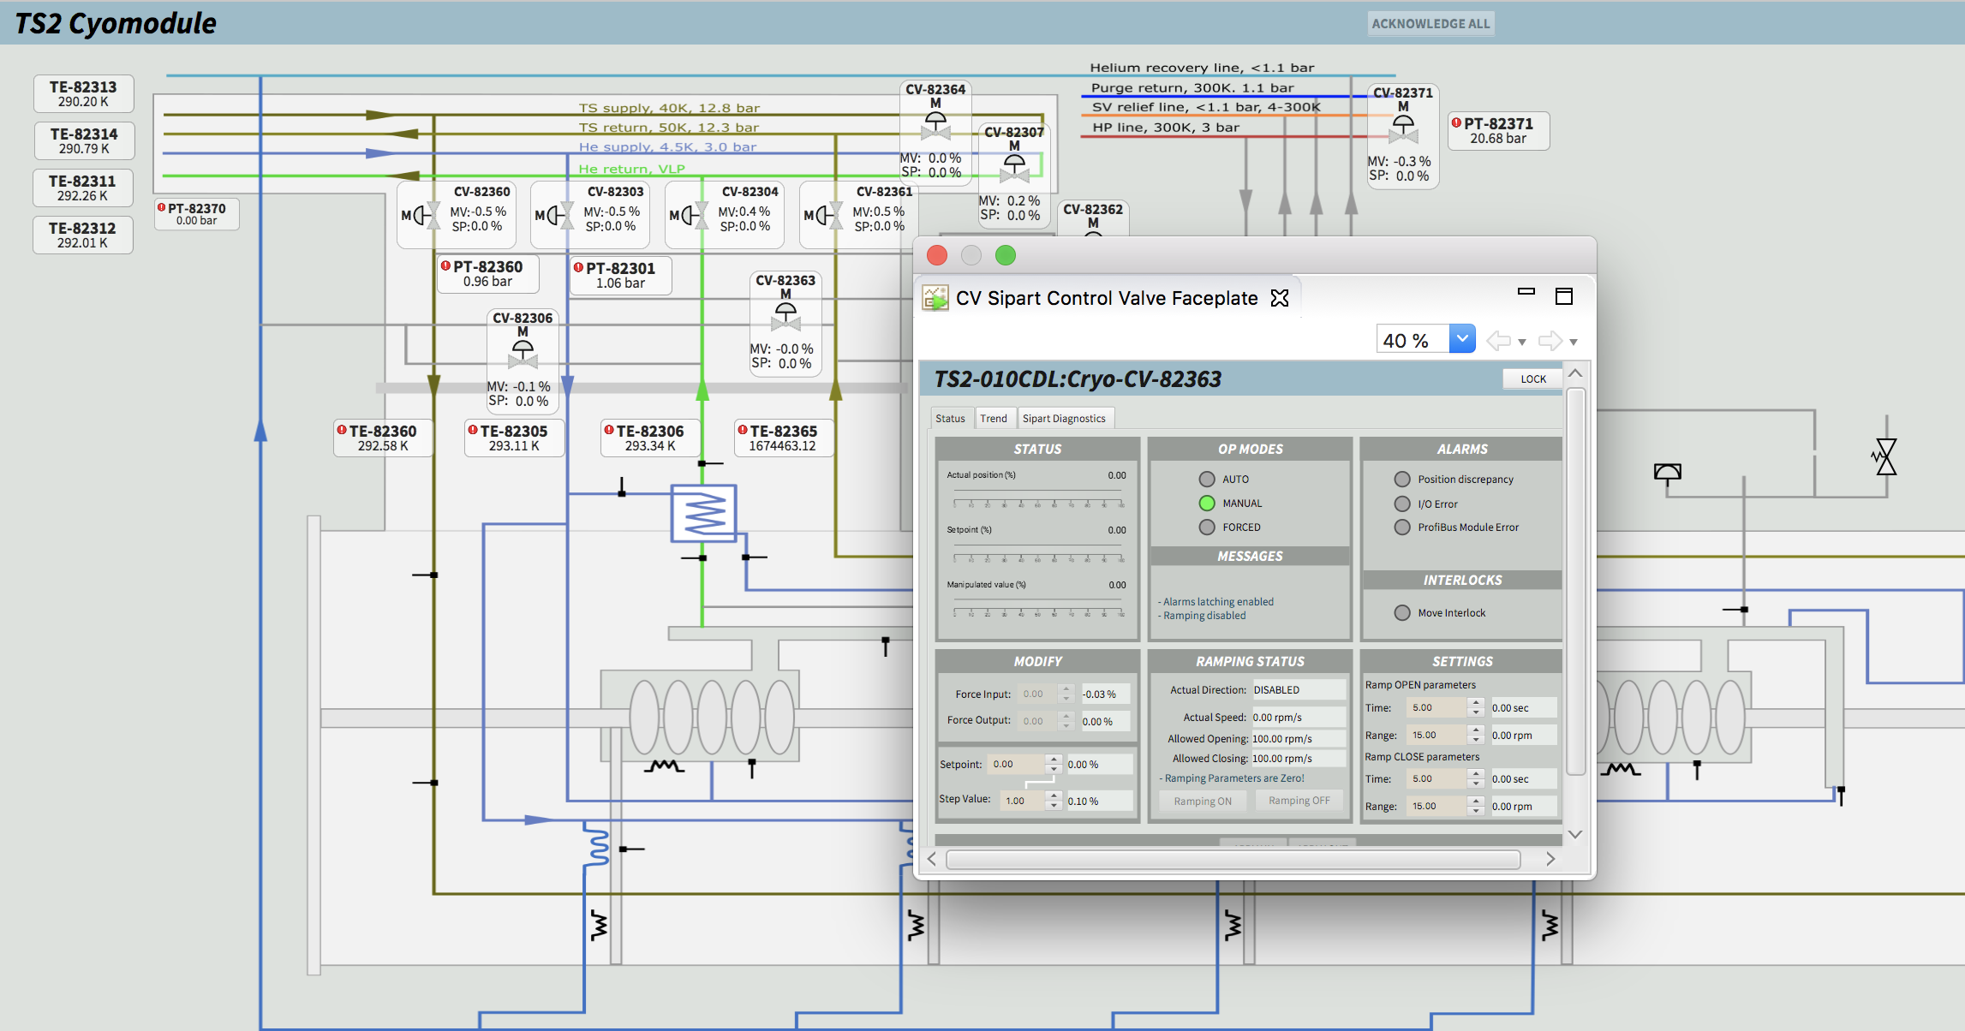
OPI

Slide 11
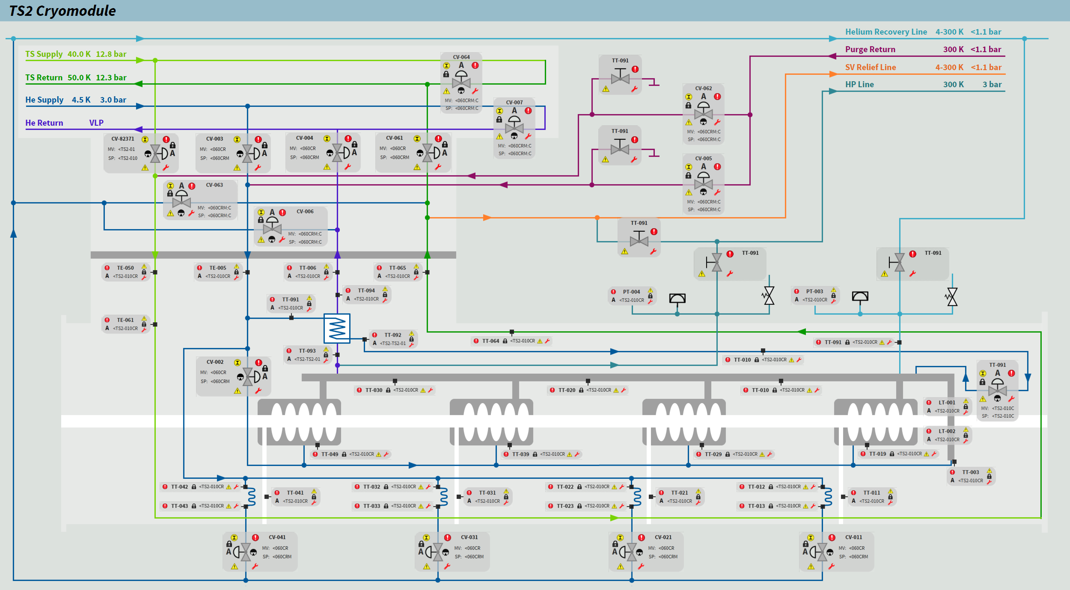
OPI

Slide 12


Slide 13
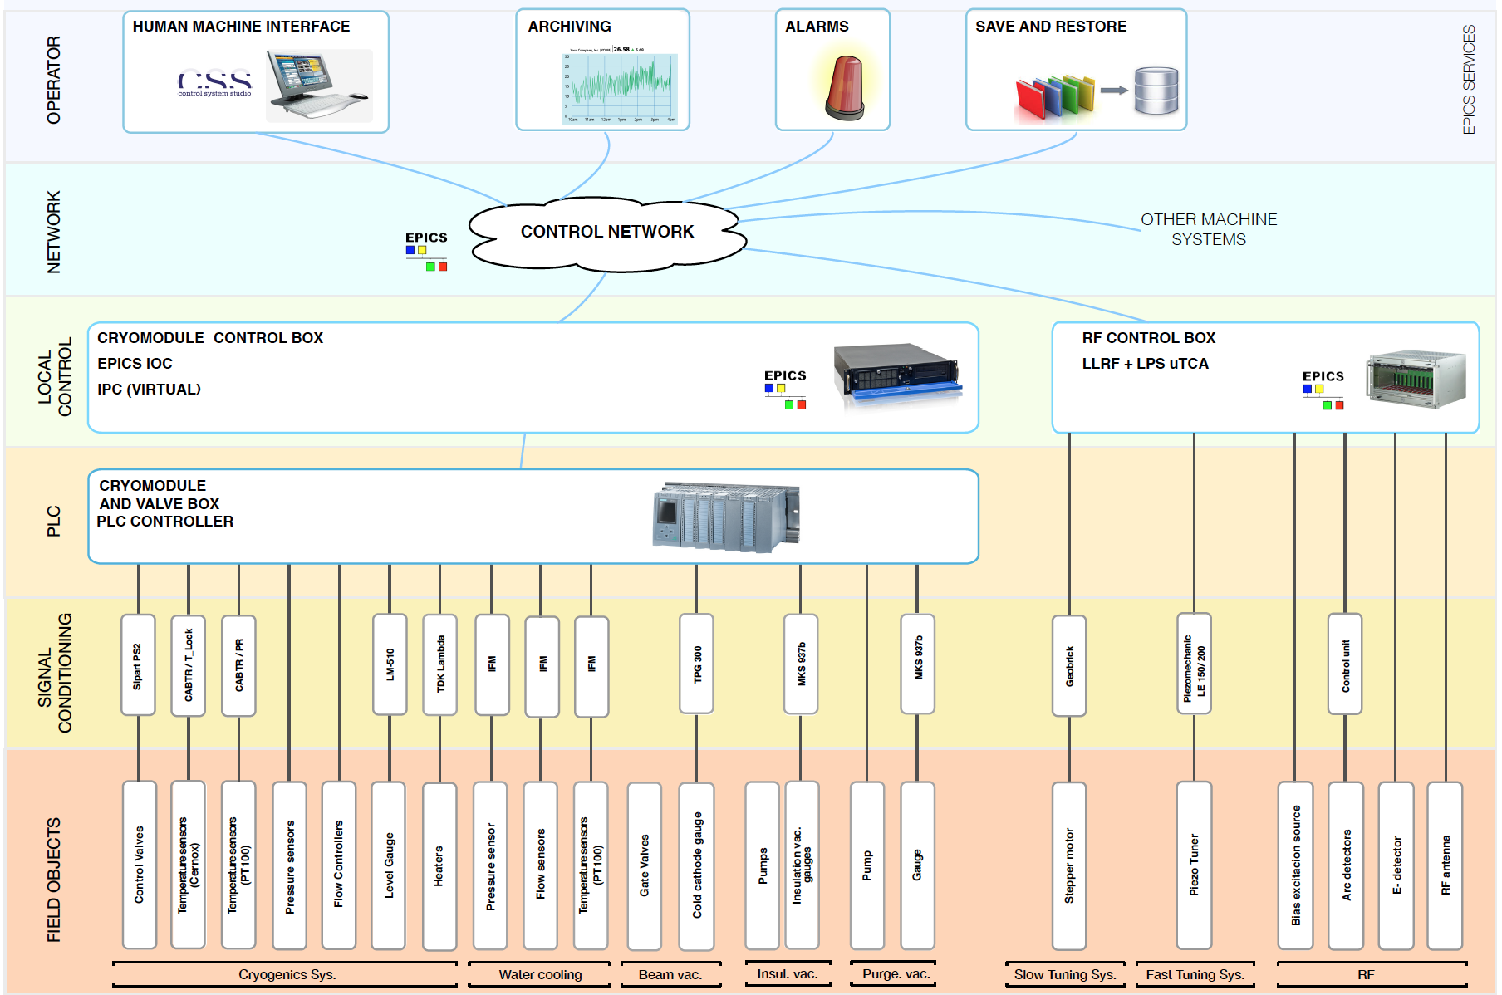
Architecture
Very similar to LINAC
N.Elias

Slide 14
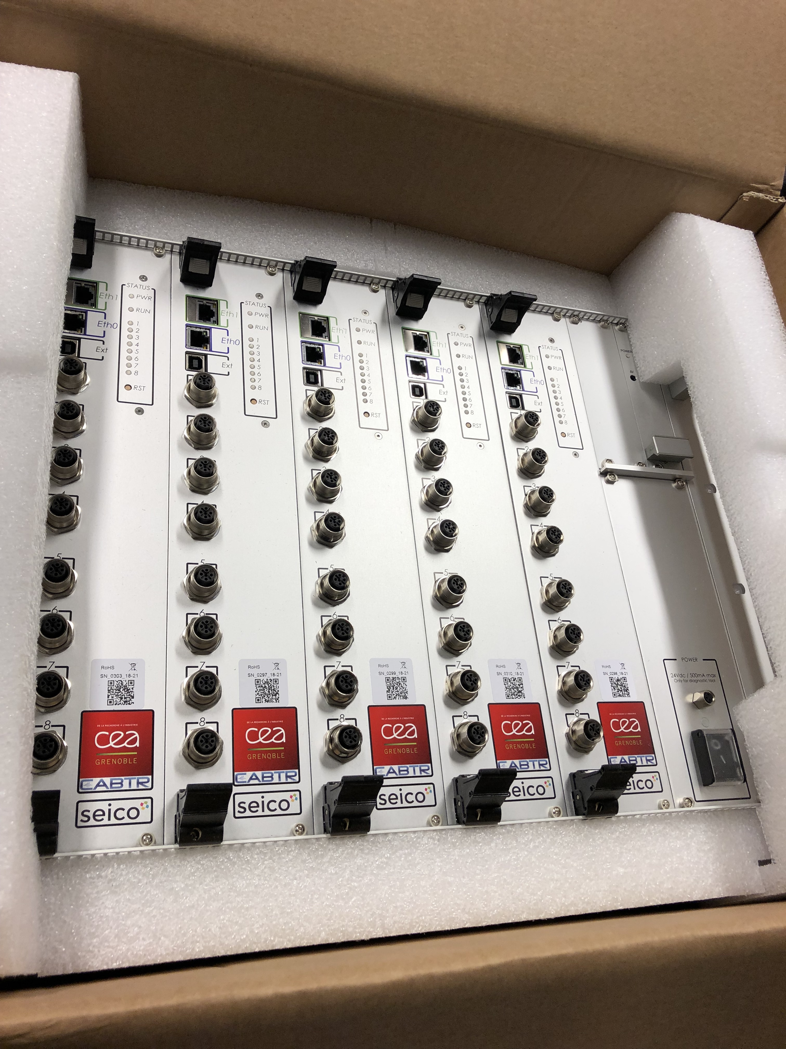
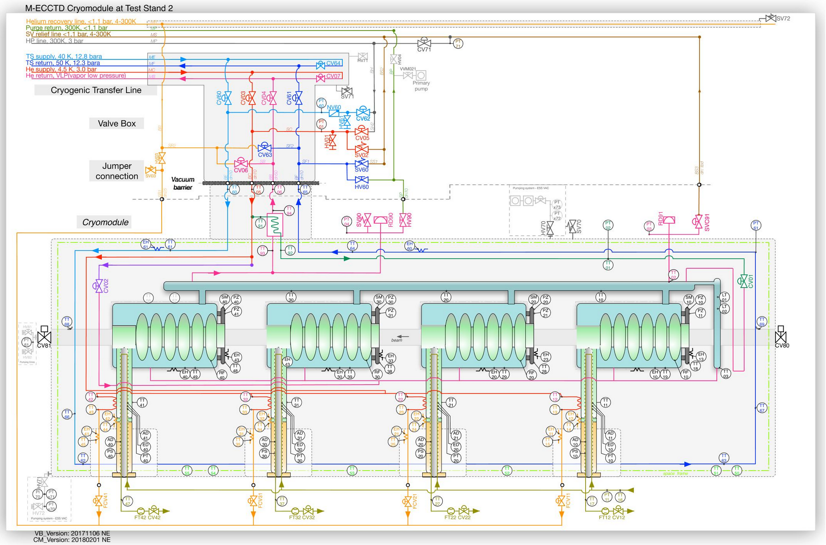
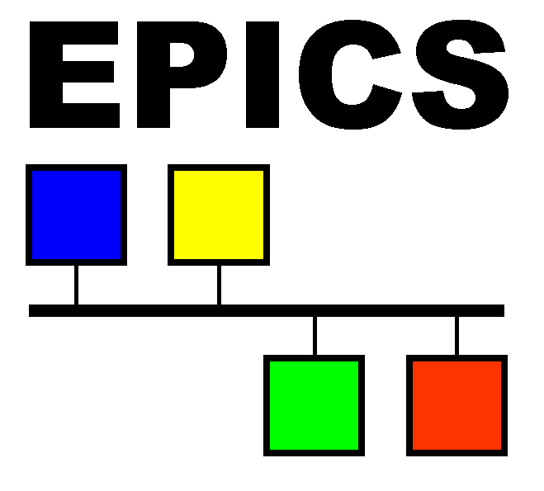

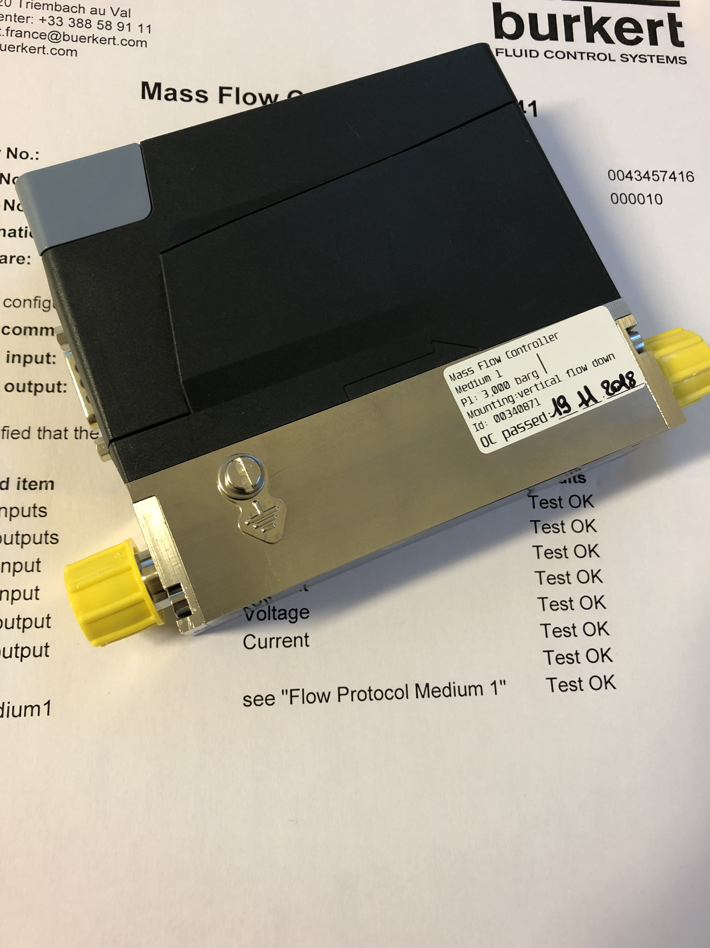
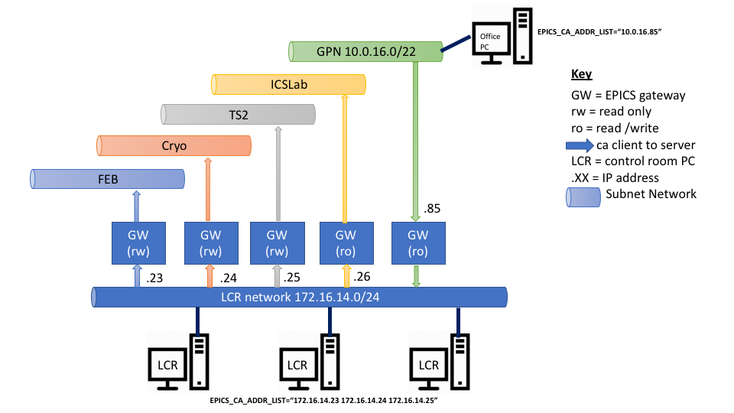
Methodology
P&I D
Field objects list
ESS names
Cable DB
FBS
Electrical Analysis
Device Selection
SC list
Procurement
Tests
FBS
ePlan objects
Diagrams
Installation
Cabling
PLC IO list
Procurement
CCDB
Definition Files
PLC Factory
HW Configuration
Read/Write
Tests
Process Logic Implementation
VersionDog
PLC Factory
IOC Factory
PV list
EPICS Implementation
CSEntry
Virtual IPC
Technical Network
CSStudio objects
Faceplates
OPI development
Alarms
Archive
Process Logic revision
Logbook
Operations
Initiation
Planning
Execution
Monitoring
Documentation

