Slide 1


ELENA Project
ELENA Commissioning
Conditions for 2019

Slide 2
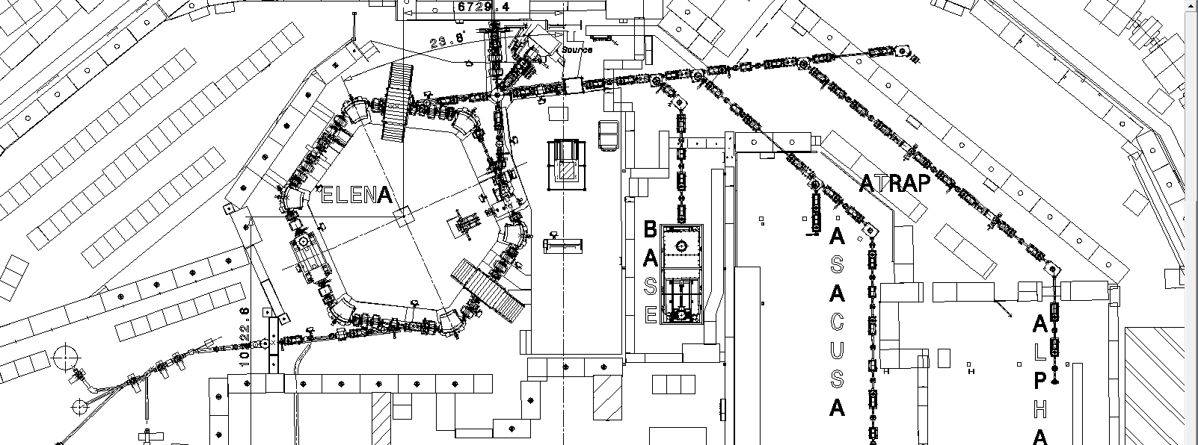
Background
Objectives for 2019:
-Restart the ion Source in May
-Circulate ions in ELENA ring June – September
-If possible use RF
-If possible eject ions to GBAR

Slide 3
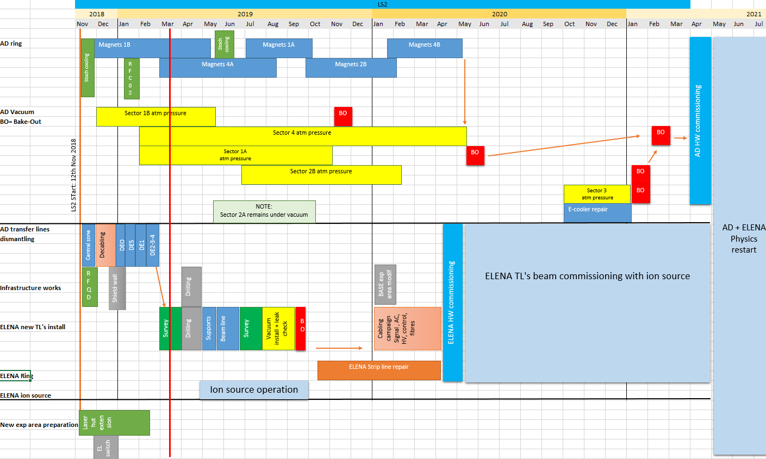
Master planning

Slide 4
Boundary Conditions
Operation with ions typically below 1 MeV, is considered safe for RP.
It is possible to “strap” the EISb (BTV) to allow injection in the ring with the access to ELENA open,
Needs adequate compensatory measures: if no measure is fail safe on its own: redundancy is acceptable
Already checked with main bending magnets: EPC can propose 2 levels of protection (limit current to 100 A)
What can be done at OP and RF level in order to “eliminate” this risk of accelerating ions beyond an energy of typically 700 keV.
Compatible with Btrain system ?
Once clear: propose scheme to PS CSAP / IEFC for a beam permit with strapped EISb

