Slide 1


Hybrid quantum systems of
ultracold atoms and ions
Elia Perego
ECCTI - Early Career Conference in Trapped Ions
14th January 2020

Slide 2
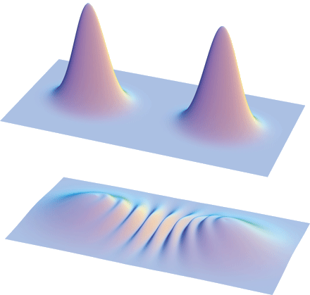
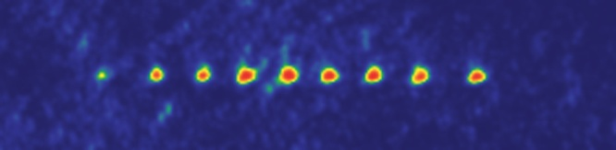
Ions & Atoms
Atoms and ions as separate systems
Ions
Atoms
Single particle detection and manipulation
Long coherence times
( secs. )
Macroscopic quantum system at nK temperature
Collective quantum states of 10⁶ particles
Source: Cambridge University
Source: Australian National University

Slide 3
Ions & Atoms
Atoms and ions as separate systems
Ions
Atoms
Single particle detection and manipulation
Long coherence times
( secs. )
Macroscopic quantum system at nK temperature
Collective quantum states of 10⁶ particles
Trapping systems
Paul trap
Penning trap
Source: Australian National University
Source: Cambridge University

Slide 4
Ions & Atoms
Atoms and ions as separate systems
Ions
Atoms
Single particle detection and manipulation
Long coherence times
( secs. )
Macroscopic quantum system at nK temperature
Collective quantum states of 10⁶ particles
Trapping systems
Paul trap
Penning trap
Source: Australian National University
Source: Cambridge University

Slide 5
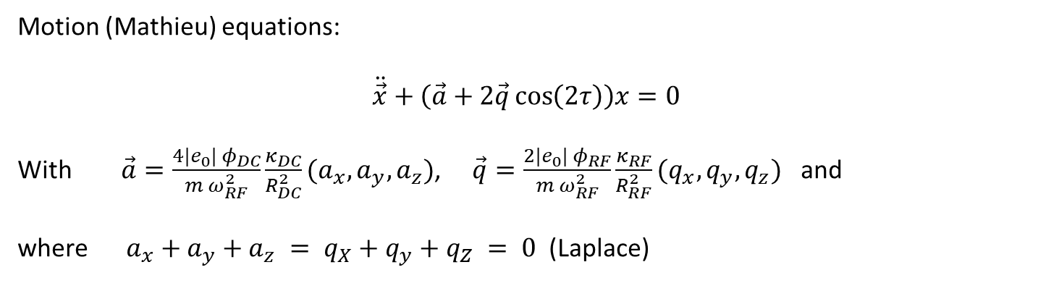

Ion trapping
Paul trap
+
Dynamic electric
potential (RF)
Static electric
potential (DC)
Motion (Mathieu) equations:
$$\ddot{\vec{x}}+\left(\vec{a}+2\vec{q}\cos\left(2τ\right)\right)x=0$$
With $\vec{a}=\frac{4{|e}_{0}| φ_{DC}}{m ω_{RF}^{2}}\frac{κ_{DC}}{R_{DC}^{2}}(a_{x},a_{y},a_{z})$, $\vec{q}=\frac{2{|e}_{0}| φ_{RF}}{m ω_{RF}^{2}}\frac{κ_{RF}}{R_{RF}^{2}}(q_{x},q_{y},q_{z})$ and
where $a_{x}+a_{y}+a_{z} = q_{X}+q_{y}+q_{Z} = 0$ (Laplace)
$$τ=\frac{1}{2}ω_{RF}t$$

Slide 6
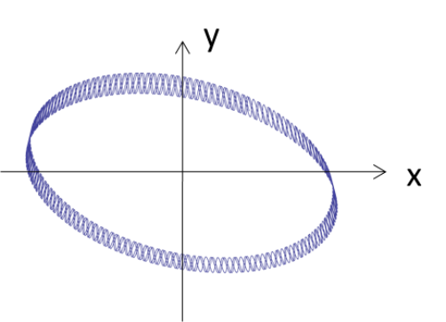
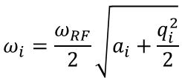

Ion trapping
Paul trap
+
Dynamic electric
potential (RF)
Static electric
potential (DC)
Motion (Mathieu) equations:
$$\ddot{\vec{x}}+\left(\vec{a}+2\vec{q}\cos\left(2τ\right)\right)x=0$$
With $\vec{a}=\frac{4{|e}_{0}| φ_{DC}}{m ω_{RF}^{2}}\frac{κ_{DC}}{R_{DC}^{2}}(a_{x},a_{y},a_{z})$, $\vec{q}=\frac{2{|e}_{0}| φ_{RF}}{m ω_{RF}^{2}}\frac{κ_{RF}}{R_{RF}^{2}}(q_{x},q_{y},q_{z})$ and
where $a_{x}+a_{y}+a_{z} = q_{X}+q_{y}+q_{Z} = 0$ (Laplace)
$$τ=\frac{1}{2}ω_{RF}t$$
Motion equations’ solutions (adiabatic approx):
$$x_{i}\left(t\right)≅x_{1,i}\cos\left(ω_{i} t+ φ_{i}\right)\left(1+ \frac{q_{i}}{2}cos⁡(ω_{RF} t)\right)$$
$$ω_{i}=\frac{ω_{RF}}{2}\sqrt{a_{i}+\frac{q_{i}^{2}}{2}}$$
Secular motion
Micromotion!

Slide 7
Ions & Atoms
Atoms and ions as separate systems
Ions
Atoms
Single particle detection and manipulation
Long coherence times
( secs. )
Macroscopic quantum system at nK temperature
Collective quantum states of 10⁶ particles
Trapping systems
Paul trap
Penning trap
Source: Australian National University
Source: Cambridge University

Slide 8
Ions & Atoms
Atoms and ions as separate systems
Ions
Atoms
Single particle detection and manipulation
Long coherence times
( secs. )
Macroscopic quantum system at nK temperature
Collective quantum states of 10⁶ particles
Trapping systems
Paul trap
Penning trap
Trapping systems
Magneto-optical trap
Optical trap
Magnetic trap
Source: Cambridge University
Source: Australian National University

Slide 9
Quantum hybrid systems
Atoms and ions together
Ions
+
Atoms
Single particle detection and manipulation
Long coherence times
( secs. )
Macroscopic quantum system at nK temperature
Collective quantum states of 10⁶ particles
Quantum hybrid
system
Trapping systems
Paul trap
Penning trap
Trapping systems
Magneto-optical trap
Optical trap
Magnetic trap
Source: Cambridge University
Source: Australian National University

Slide 10
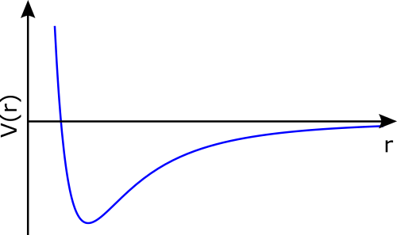

Quantum hybrid system
Atoms and ions together
Ions
+
Atoms
Single particle detection and manipulation
Long coherence times
( secs. )
Macroscopic quantum system at nK temperature
Collective quantum states of 10⁶ particles
Quantum hybrid
system
Trapping systems
Paul trap
Penning trap
Trapping systems
Magneto-optical trap
Optical trap
Magnetic trap
$$V\left(r\right) \sim r^{−4}$$
Long range
potential!
Source: Cambridge University
Source: Australian National University

Slide 11
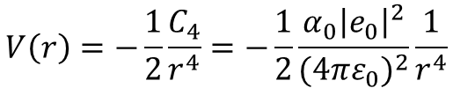
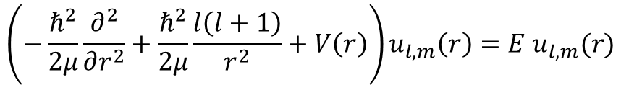
Quantum hybrid systems
Atom-ion interaction potential
Semiclassical theory:
Classical interaction potential:
$$\left(−\frac{ℏ^{2}}{2μ}\frac{∂^{2}}{∂r^{2}}+\frac{ℏ^{2}}{2μ}\frac{l\left(l+1\right)}{r^{2}}+V\left(r\right)\right)u_{l,m}\left(r\right)=E u_{l,m}(r)$$
$$V\left(r\right)=−\frac{1}{2}\frac{C_{4}}{r^{4}}=−\frac{1}{2}\frac{α_{0}{\left|e_{0}\right|}^{2}}{{(4πε_{0})}^{2}}\frac{1}{r^{4}}$$

Slide 12
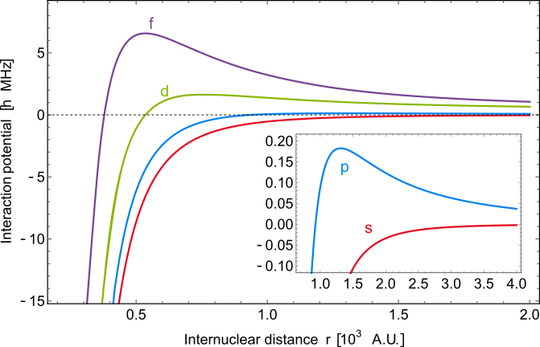
Quantum hybrid systems
Atom-ion interaction potential
Semiclassical theory:
Classical interaction potential:
$$\left(−\frac{ℏ^{2}}{2μ}\frac{∂^{2}}{∂r^{2}}+\frac{ℏ^{2}}{2μ}\frac{l\left(l+1\right)}{r^{2}}+V\left(r\right)\right)u_{l,m}\left(r\right)=E u_{l,m}(r)$$
$$V\left(r\right)=−\frac{1}{2}\frac{C_{4}}{r^{4}}=−\frac{1}{2}\frac{α_{0}{\left|e_{0}\right|}^{2}}{{(4πε_{0})}^{2}}\frac{1}{r^{4}}$$
Centrifugal barrier!

Slide 13
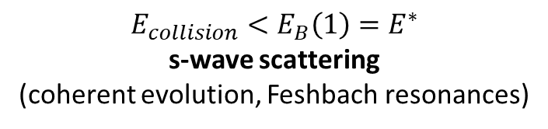


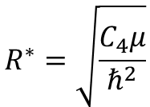

Quantum hybrid systems
Atom-ion interaction potential
$R_{B}\left(l\right)=\sqrt{\frac{2}{l(l+1)}}R^{∗}$
$$E_{B}\left(l\right)=\frac{1}{4}l^{2}{\left(l+1\right)}^{2 }E^{∗}$$
$$E_{collision}<E_{B}\left(1\right)=E^{∗}$$
s-wave scattering
(coherent evolution, Feshbach resonances)
$$R^{∗}=\sqrt{\frac{C_{4}μ}{ℏ^{2}}}$$
$$E^{∗}=\frac{ℏ^{2}}{2μ R^{∗2}}$$
Centrifugal barrier!

Slide 14
Quantum hybrid systems
Atom-ion collisions
Elastic collisions
Inelastic collisions

Slide 15
Quantum hybrid systems
Atom-ion collisions
Elastic collisions
Inelastic collisions
Aims
Sympathetic cooling, s-wave scattering regime, atom-ion Feshbach resonances
Control of ion – atom chemistry,
creation of cold molecular ions

Slide 16
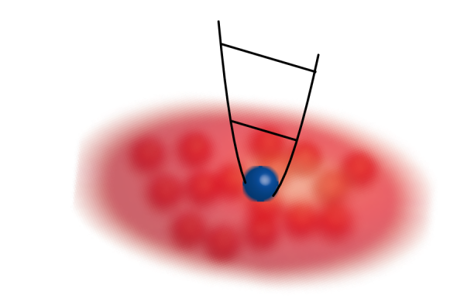

Quantum hybrid systems
Atom-ion collisions
Elastic collisions
Inelastic collisions
Aims
Sympathetic cooling, s-wave scattering regime, atom-ion Feshbach resonances
Control of ion – atom chemistry,
creation of cold molecular ions
Applications
Quantum computation
e.g., atomic ultracold bath for
ion-based quantum hardware
Quantum simulation
Condensed matter emulation with long-range interactions.
e.g., linear chain of ions creating a periodical potential that induces a band structure in the atoms’ cloud
Singly resolved ions
10 µm
Quantum (astro-)chemistry
Possibility of studying chemical reactions in a controlled way starting from cold reactants
Metrology
e.g., estimation of the frequency shift due to the background collisions
Quantum gas experiments - exploring many-body states, chap. 12, C. Sias, M. Kohl (2016).

Slide 17
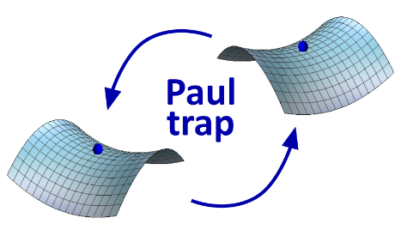
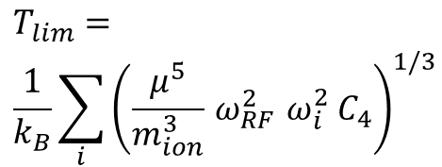
Quantum hybrid systems
Atom-ion collisions
Elastic collisions
Inelastic collisions
Aims
Sympathetic cooling, s-wave scattering regime, atom-ion Feshbach resonances
Control of ion – atom chemistry,
creation of cold molecular ions
Applications
Quantum computation, quantum simulation, quantum chemistry and astro-chemistry, metrology
Towards s-wave scattering regime: problems
$$T_{lim}= \\ \frac{1}{k_{B}}\sum_{i}{{\left(\frac{μ^{5}}{m_{ion}^{3}}{ ω}_{RF}^{2} ω_{i}^{2} C_{4}\right)}^{1/3}}$$
Micromotion:
heating mechanism!

Slide 18
Quantum hybrid systems
Atom-ion collisions
Elastic collisions
Inelastic collisions
Aims
Sympathetic cooling, s-wave scattering regime, atom-ion Feshbach resonances
Control of ion – atom chemistry,
creation of cold molecular ions
Applications
Quantum computation, quantum simulation, quantum chemistry and astro-chemistry, metrology
Towards s-wave scattering regime: problems
+
$$T_{lim}= \\ \frac{1}{k_{B}}\sum_{i}{{\left(\frac{μ^{5}}{m_{ion}^{3}}{ ω}_{RF}^{2} ω_{i}^{2} C_{4}\right)}^{1/3}}$$
+
POW!
+
+
Micromotion:
heating mechanism!
Loss of control!

Slide 19
Quantum hybrid systems
Atom-ion collisions
Elastic collisions
Inelastic collisions
Aims
Sympathetic cooling, s-wave scattering regime, atom-ion Feshbach resonances
Control of ion – atom chemistry,
creation of cold molecular ions
Applications
Quantum computation, quantum simulation, quantum chemistry and astro-chemistry, metrology
Towards s-wave scattering regime: problems
+
$$T_{lim}= \\ \frac{1}{k_{B}}\sum_{i}{{\left(\frac{μ^{5}}{m_{ion}^{3}}{ ω}_{RF}^{2} ω_{i}^{2} C_{4}\right)}^{1/3}}$$
+
POW!
+
+
Micromotion:
heating mechanism!
Solutions
Loss of control!
Trap design
Atomic species choice

Slide 20
Quantum hybrid systems
Atom-ion collisions
Elastic collisions
Inelastic collisions
Aims
Sympathetic cooling, s-wave scattering regime, atom-ion Feshbach resonances
Control of ion – atom chemistry,
creation of cold molecular ions
Applications
Quantum computation, quantum simulation, quantum chemistry and astro-chemistry, metrology
Towards s-wave scattering regime: problems
+
$$T_{lim}= \\ \frac{1}{k_{B}}\sum_{i}{{\left(\frac{μ^{5}}{m_{ion}^{3}}{ ω}_{RF}^{2} ω_{i}^{2} C_{4}\right)}^{1/3}}$$
+
POW!
+
+
Micromotion:
heating mechanism!
Solutions
Loss of control!
Trap design
Atomic species choice

Slide 21
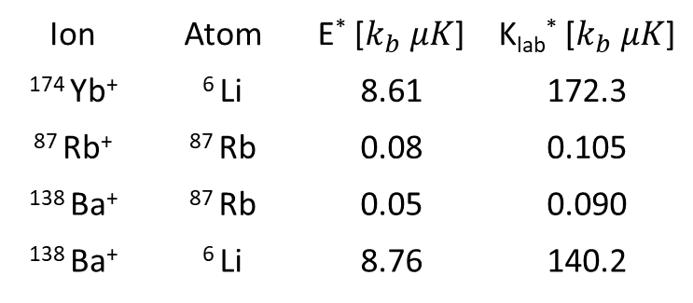
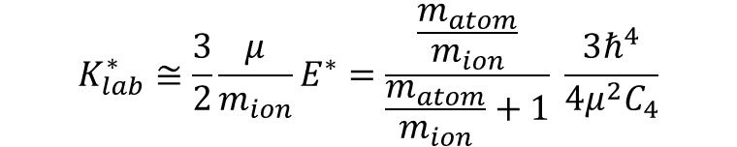

Barium ions & Lithium atoms
Atomic species choice
Ion | Atom | E* [$k_{b} μK$] | K_{lab}* [$k_{b} μK$]
¹⁷⁴ Yb⁺ | ⁶ Li | 8.61 | 172.3
⁸⁷ Rb⁺ | ⁸⁷ Rb | 0.08 | 0.105
¹³⁸ Ba⁺ | ⁸⁷ Rb | 0.05 | 0.090
¹³⁸ Ba⁺ | ⁶ Li | 8.76 | 140.2
$$E^{∗}=\frac{ℏ^{4}}{2μ^{2}C_{4}}$$
$$K_{lab}^{∗}≅\frac{3}{2}\frac{μ}{m_{ion}}E^{∗}=\frac{\frac{m_{atom}}{m_{ion}}}{\frac{m_{atom}}{m_{ion}}+1} \frac{3ℏ^{4}}{4μ^{2}C_{4}}$$

Slide 22
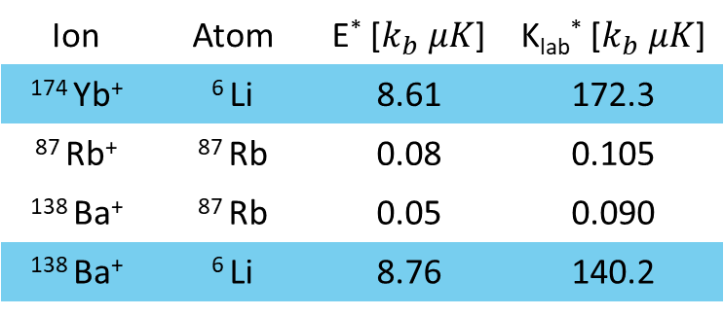
Barium ions & Lithium atoms
Atomic species choice
Ion | Atom | E* [$k_{b} μK$] | K_{lab}* [$k_{b} μK$]
¹⁷⁴ Yb⁺ | ⁶ Li | 8.61 | 172.3
⁸⁷ Rb⁺ | ⁸⁷ Rb | 0.08 | 0.105
¹³⁸ Ba⁺ | ⁸⁷ Rb | 0.05 | 0.090
¹³⁸ Ba⁺ | ⁶ Li | 8.76 | 140.2
$$E^{∗}=\frac{ℏ^{4}}{2μ^{2}C_{4}}$$
1,2)
$$K_{lab}^{∗}≅\frac{3}{2}\frac{μ}{m_{ion}}E^{∗}=\frac{\frac{m_{atom}}{m_{ion}}}{\frac{m_{atom}}{m_{ion}}+1} \frac{3ℏ^{4}}{4μ^{2}C_{4}}$$
2)
1) Cetina et al. PRL 109, 253201 (2012) ; 2) Krych et al. PRA 91, 023430 (2015)

Slide 23
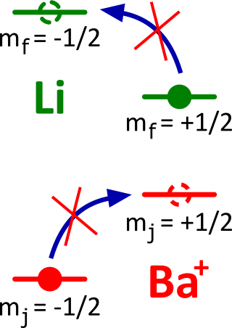
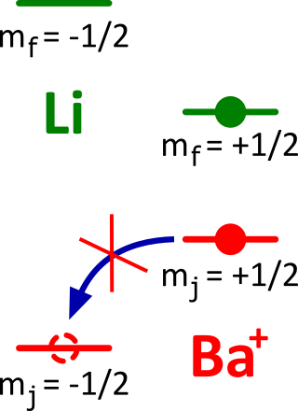
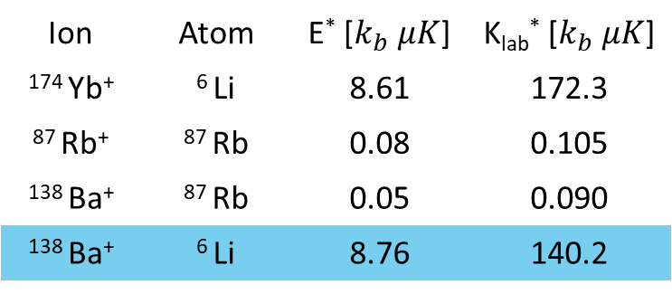
Barium ions & Lithium atoms
Atomic species choice
Ion | Atom | E* [$k_{b} μK$] | K_{lab}* [$k_{b} μK$]
¹⁷⁴ Yb⁺ | ⁶ Li | 8.61 | 172.3
⁸⁷ Rb⁺ | ⁸⁷ Rb | 0.08 | 0.105
¹³⁸ Ba⁺ | ⁸⁷ Rb | 0.05 | 0.090
¹³⁸ Ba⁺ | ⁶ Li | 8.76 | 140.2
$$E^{∗}=\frac{ℏ^{4}}{2μ^{2}C_{4}}$$
1,2)
$$K_{lab}^{∗}≅\frac{3}{2}\frac{μ}{m_{ion}}E^{∗}=\frac{\frac{m_{atom}}{m_{ion}}}{\frac{m_{atom}}{m_{ion}}+1} \frac{3ℏ^{4}}{4μ^{2}C_{4}}$$
2)
Control over inelastic collisions!
Ba⁺ in the ground state & spin-polarized Li gas:
Decoherence-free ultracold buffer gas
No three body recombinations
Ba⁺ & Li in the ground state:
Lowest energy molecular potential
No charge-exchange
Energy conservation!
Momentum conservation!
1) Cetina et al. PRL 109, 253201 (2012) ; 2) Krych et al. PRA 91, 023430 (2015)

Slide 24
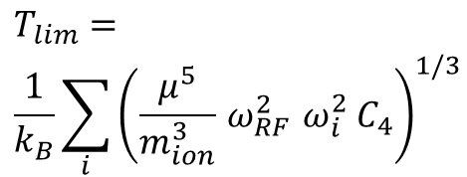
Quantum hybrid systems
Atom-ion collisions
Elastic collisions
Inelastic collisions
Aims
Sympathetic cooling, s-wave scattering regime, atom-ion Feshbach resonances
Control of ion – atom chemistry,
creation of cold molecular ions
Applications
Quantum computation, quantum simulation, quantum chemistry and astro-chemistry, metrology
Towards s-wave scattering regime: problems
+
$$T_{lim}= \\ \frac{1}{k_{B}}\sum_{i}{{\left(\frac{μ^{5}}{m_{ion}^{3}}{ ω}_{RF}^{2} ω_{i}^{2} C_{4}\right)}^{1/3}}$$
+
POW!
+
+
Micromotion:
heating mechanism!
Solutions
Loss of control!
Trap design
Atomic species choice

Slide 25
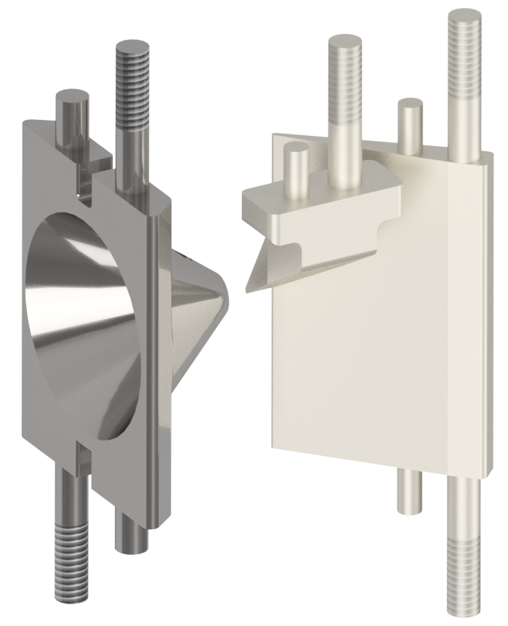

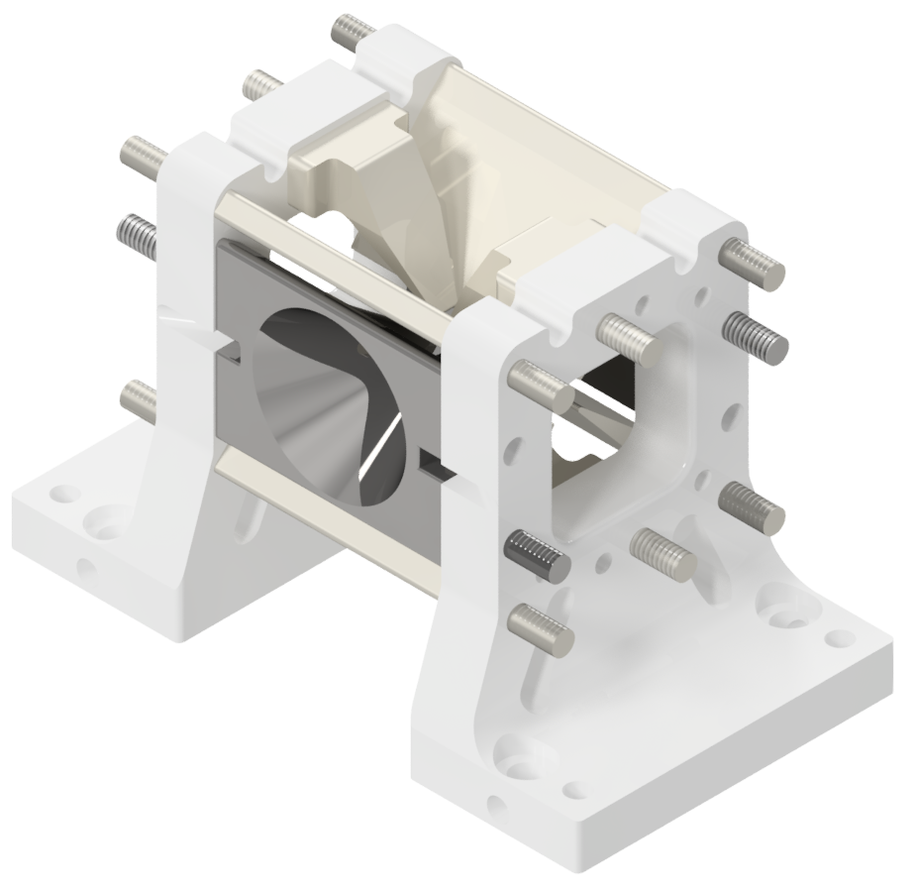
Trap design
Ion trapping and micromotion compensation
‘Blade’ electrodes
Endcaps
Cones electrodes
2.1 mm
3 mm
3.6 mm
Design guidelines:
Micromotion compensation
Optical access for lasers
Access for atoms’ optical transport
Optical access for high NA objective in vacuum
- Lateral supports
in Shapal High-M Soft
- Electrodes in titanium (degree 5)

Slide 26
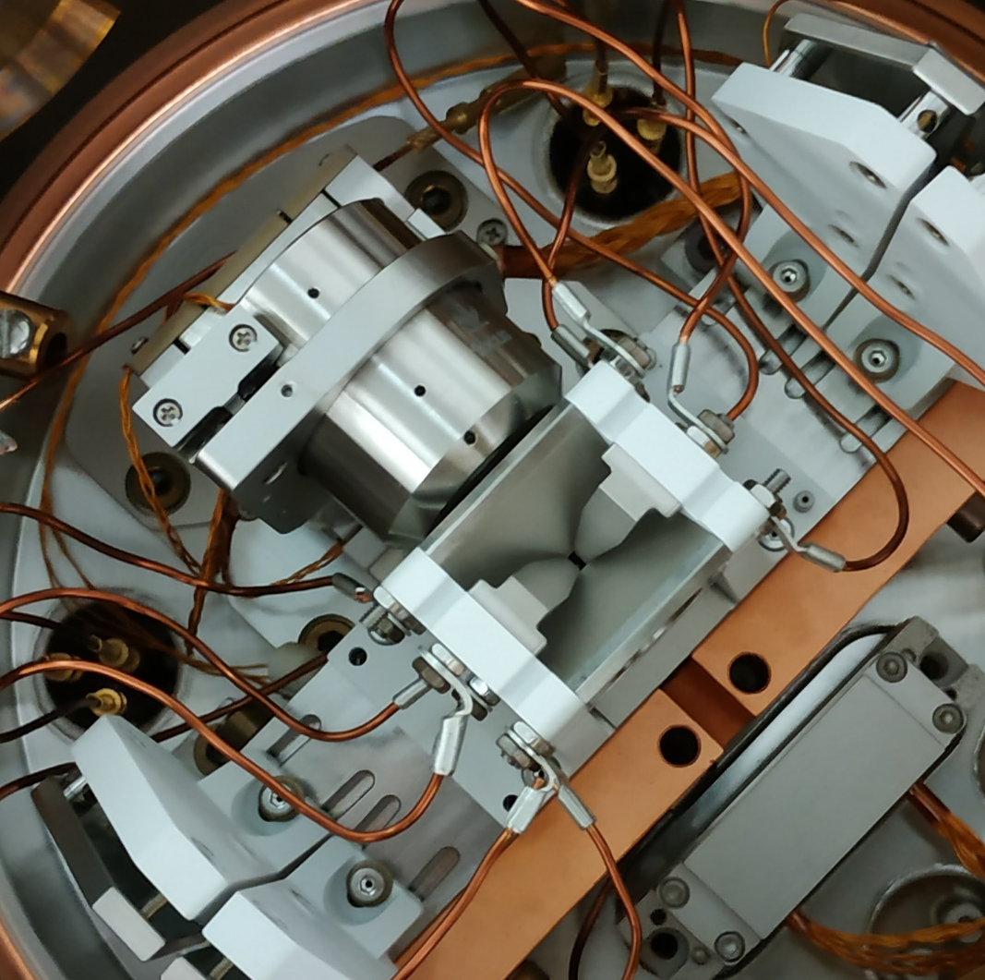
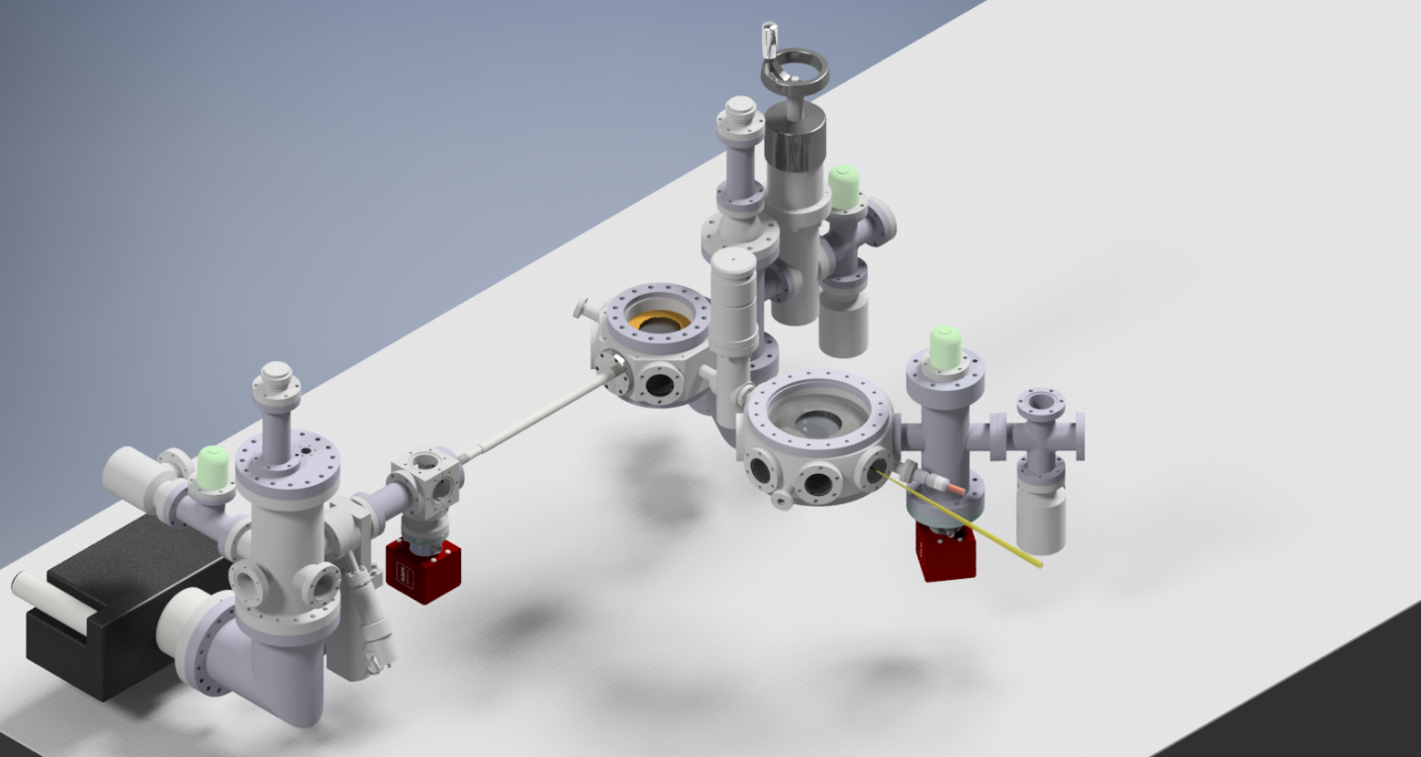
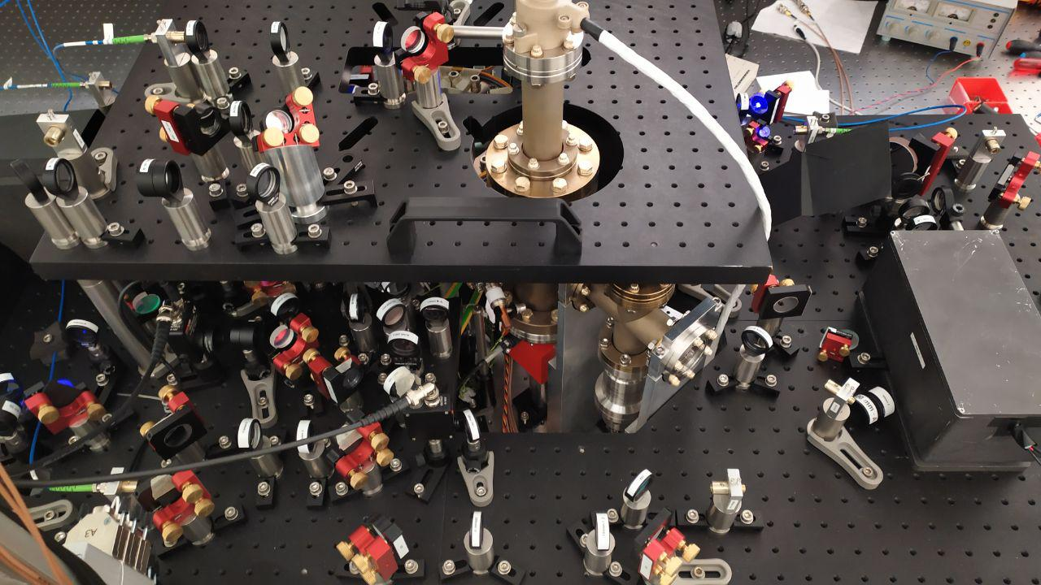
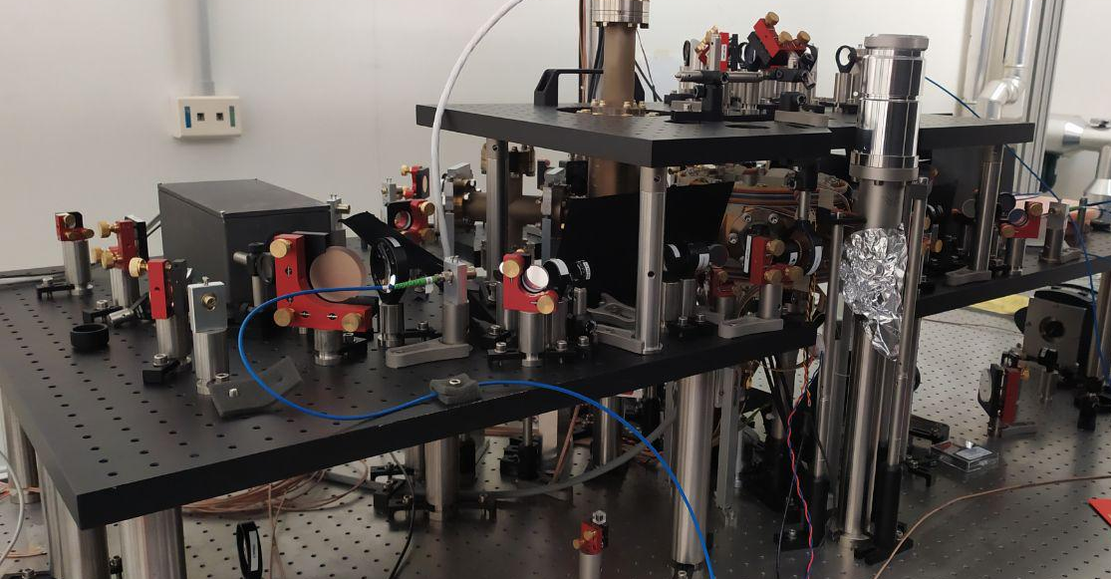
State-of-the-art
Atoms’
chamber
Optical
transport
Ions’
chamber

Slide 27
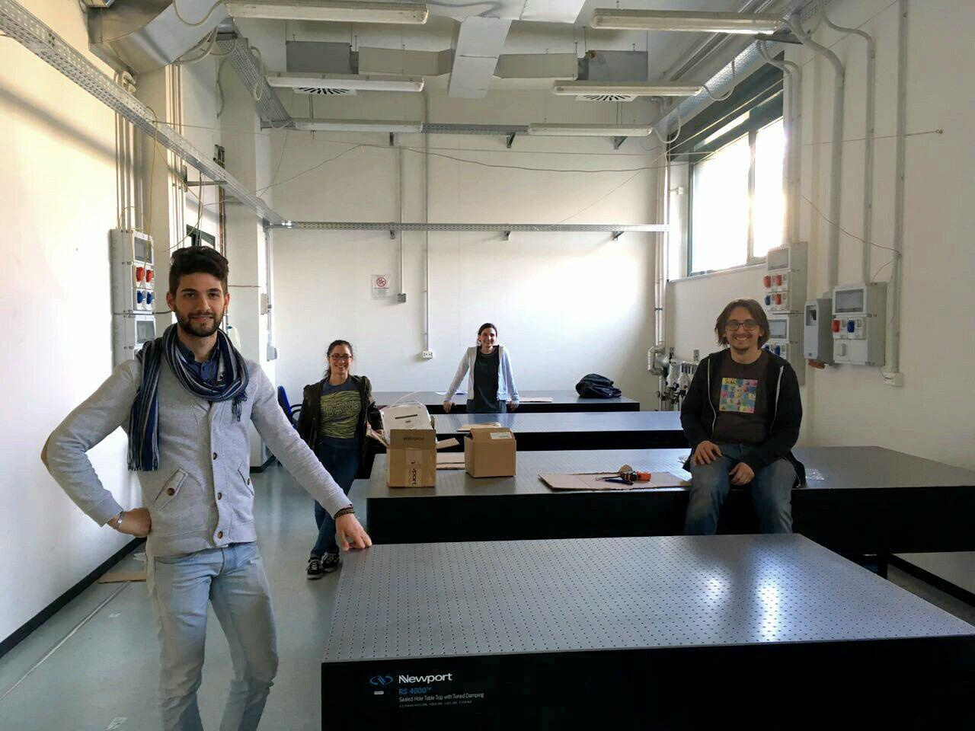
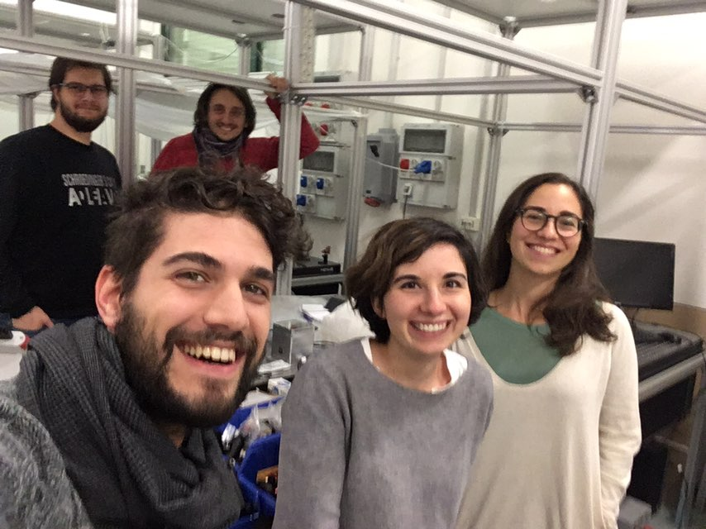

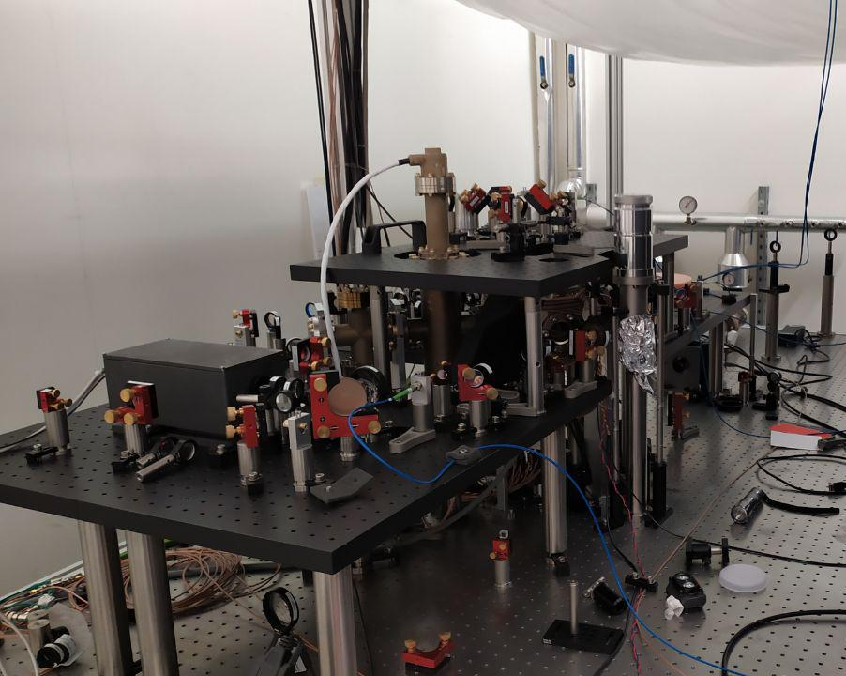




Ba⁺ Li group
Federico Berto
Carlo Sias
Massimo Inguscio
E.P.
Amelia Detti
Lucia Duca

Slide 28
Thank you for your attention!
Federico Berto
Carlo Sias
Massimo Inguscio
PhD and PostDoc positions available!
E.P.
Amelia Detti
Lucia Duca

