Slide 1
ALICE USA Computing Project Report
R. Jeff Porter
ALICE-USA Computing Resource Review
April 11, 2019

Slide 2
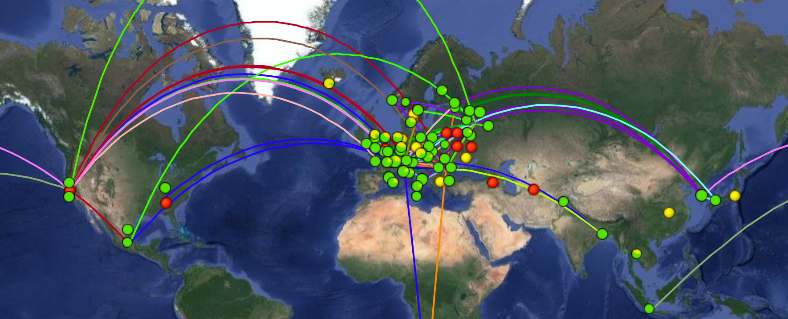
ALICE-USA Computing Project
Initiated in 2009
Objective: to meet US/DOE obligations to ALICE for Grid-enabled compute & storage
Organization to procure resources & operate facilities at 2 DOE labs
In operation since 2010
DOE project for ALICE-USA
Project Exec. & Acquisition Plan (PEAP)
Updated annually & submitted to DOE
Procurement plans from ALICE targets
Organization w/ operational milestones
Quarterly reports to DOE
Subject to periodic multi-year reviews
Current Effort
ALICE: J. Porter, Project management, ALICE Computing board, AliEn site services
ORNL: P. Eby, ORNL::EOS storage, M. Galloway, cluster management
LBNL: J. White, LBNL_HPCS::EOS storage, K. Fernsler, cluster management
ALICE Grid
~1.2 FTE

Slide 3
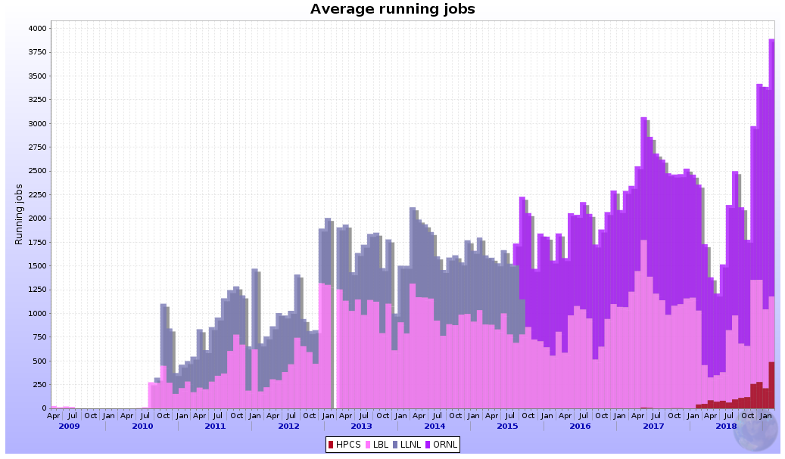
Project History
Original facility: NERSC/PDSF @ LBNL and Livermore Computing @ LLNL
Proposal approved in Jan 2010, in operation by July
External review in the following year, 2011
Project change in 2014
LLNL withdraws from ALICE-USA
Replace LLNL/LC with ORNL/CADES
New proposal to DOE, review in June 2014
ORNL T2 fully operational July 2015
LLNL shut down October 2015
Project change again in 2017-2019
NERSC to decommission PDSF
Suggest PDSF groups can instead use its High Performance Computing (HPC) systems
Our approach is to leverage new LBNL/IT cluster (LBNL/HPCS), with modest use of NERSC HPC
Project expects new multi-year proposal and external review in the next ~year
concurrent jobs: 2010-2018
20% annual growth
ORNL
LLNL
LBNL/PDSF
LBNL/HPCS

Slide 4
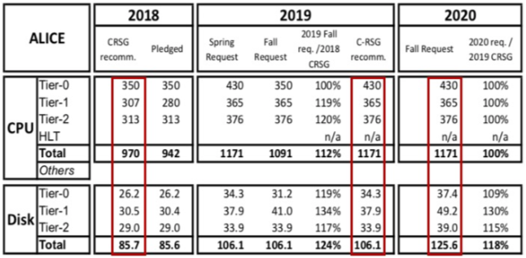
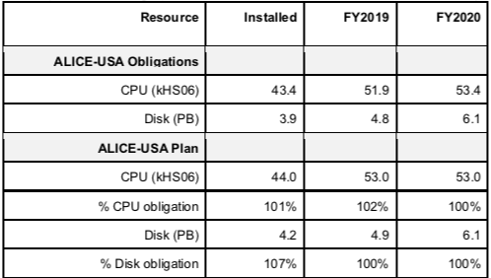
Resource Requirements & Procurement Planning
ALICE Computing Requirements
vetted by the WLCG
% ALICE-USA participation
ALICE-USA Resource Deployment Plan ➔
In annual PEAP update
DOE requests we don’t overprovision

Slide 5
ALICE Grid Site Topology
WAN
Other ALICE
Grid sites
Central Services
@ CERN
Global Task queue
File Catalog
Job Catalog
LAN
EOS/XRootD
Grid-enabled Storage
MonaLisa
site monitor
CVMFS Stratum 1
Software Repo
CM monitors global queue
OSG CE
CE manages jobs/local queue
VObox site services
Compute
cluster
cvmfs
local
squids
software deployment via cvmfs

Slide 6
Site Operations
Sites must meet some basic requirements
VOBox for AliEn services with selected external ports opened
Grid-enabled disk-based storage, XRootD or EOS – (preferably EOS)
Compute cluster supports:
serial jobs, with 2-3GB mem + 10GB scratch disk per job
outgoing network connections
Software delivery via CVMFS
Sites do not have a clear view of what is run on their systems.
This makes identifying site-level problems very difficult
ALICE-USA used to provide some effort (B. Nilsen) to help connect cluster performance to ALICE jobs.
The project holds bi-annual meetings with CERN Offline team
Consult on configurations
Evaluate our site operations and performance

Slide 7
US Site configurations
LLNL/LC: 2010-2015
Stand-alone ALICE cluster within institutional computing facility
1 continuous facility manager
Batch: PBS/Torque + OSG gateway
Gb Ethernet
CVMFS via NFS gateway
VObox on physical node
In-house Linux OS
XRootD, PB scale, hardware raid system
NERSC/PDSF: 2010-2019
Shared facility at NERSC for HEP/NP exp.
4 different facility managers over lifetime
Batch: SGE, SLURM both + OSG gateway
Mix 10 Gbit Ethernet & 40Gb InfiniBand
CHOS virtualization
VOBox on physical node, then in VM
XRootD & EOS, PB scale hardware raid
ORNL/CADES: 2014-present
Stand-alone ALICE cluster within institutional computing facility
Two continuous facility support staff
Batch: PBS/Torque, no OSG
10Gbit Ethernet, 40Gb uplink
Connected to LHCOne virtual network
VObox in VM
EOS, PB+ scale:
Initially software raid (ZFS)
Migrate to single disk FS
LBNL/HPCS: 2018-present
Shared cluster within Institutional computing facility
Two continuous facility support staff
Batch: SLURM, no OSG
Mix 10Gbit Ethernet & 40Gb InfiniBand
VObox in VM
EOS, PB+ scale, single disk FS

Slide 8
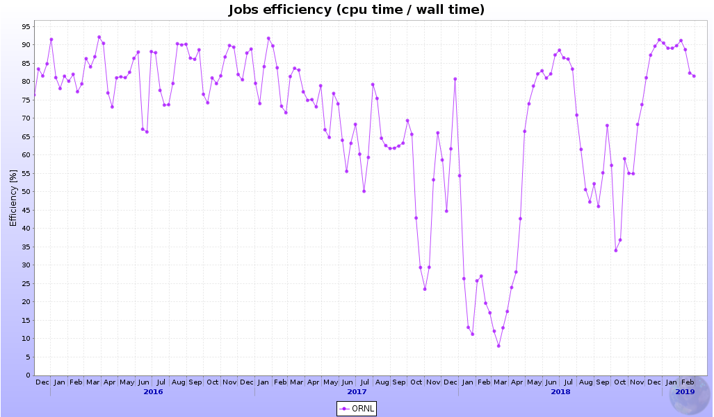
ORNL CPU Efficiency degradation from
ORNL::EOS configuration/performance
ALICE RW test failures begin after 1.5 PB system at 95% capacity
CPU efficiency drop noticed
Report to ALICE & search for cause/remedy
Found block size mismatched wrt workload
test draining data & reconfigure
Drains stall due to high system load
Meet w/ EOS, ORNL, LBNL, vender engineers
Confirmed block size mismatch
Developed new reconfigure strategy
Reconfigure entire SE
Take ~20% of system offline at a time
Slow & w/ low cpu eff while in progress
Lose a filesystem → overall cpu eff degradation
2nd reconfiguration
Remove large raid file systems
Slow & w/ low cpu eff while in progress
3 year CPU efficiency: Apr 2016– Mar 2019
eff = 85%
eff = 70%
ORNL
eff = 60%
a.
d.
eff = 50%
b.
eff =25%
e.
c.
Similar ALICE T2 = 80%
2016
2017
2018
2019

Slide 9
ORNL CPU Efficiency degradation summary
ORNL was an early EOS adopter by request of ALICE Offline
No EOS best practices existed: file-system size, concurrency/TB, OS or filesystem tuning
Nor reproducible test suites or expectations beyond some global features, e.g. GB/s
Problem found to be from two issues related to the ORNL::EOS storage:
Default block size used did not match well to ALICE access patterns
Unresponsive 30-60TB ZFS raid file systems @ near capacity (with even native-EOS draining)
Fix was slow:
Copy all resident data to new, restructured disks at ORNL
Resource remained in production → copies were slow
Many steps required by-hand manipulations on live system → error prone
Multiple passes: to optimize block size & to move to non-raid single disk file systems
Lessons … ?
See sub-bullets of top one here !! Can we fix this? -- particularly going into Run 3

Slide 10
2018 Project Operations

Slide 11
2018 PEAP Plan – Hardware
2018 Plan Relative to Obligations:
CPU : 43.5 kHS06 = 100%
Disk : 3.85 PB = 99%
2018 Actual Relative to Obligations:
CPU : 41.5 kHS06 = 95%
Disk : 4.5 PB = 116%
Notes of interest
Assumed added CADES nodes which came in Jan
No real NERSC HPC contrib.
Disk capacity at ORNL was used to reconfigure disks
Resource | 2017 Installed | FY2018 plan | FY2018 (actual)
LBNL HW
HPCS CPU +/- kHS06 |  | 0.0 | +3.5
CPU NERSC HPC |  | 1.5⁺ | 0.0
CPU installed | 14.0 | 14.0 | 17.5
HPCS Disk +/- |  | 0.44 | 1.2
Disk installed | 1.06 | 1.6 | 2.25
ORNL HW
CPU +/- kHS06 |  | +10.0 | +6.0
CPU installed | 18 | 28.0 | 24.0
Disk +/- (PB) |  | 0.0 | 0.0
Disk installed | 2.25 | 2.25 | 2.25
⁺1M MPP hrs ~ 0.9 kHS06
2018 Allocation = 5M MPP hrs

Slide 12
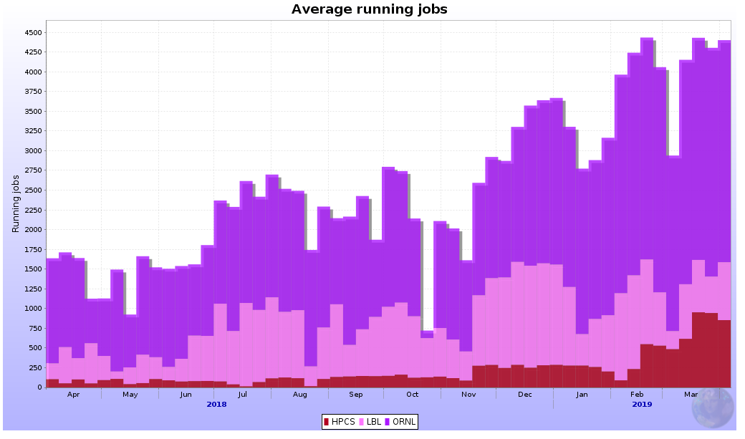
2018 Job Occupancy
Extra nodes from CADES
Stabilize ORNL batch system
2019
target
depends on
node-type mix
~ave #-jobs 2018 target
ave #-jobs
ORNL
ORNL batch issues
significant periods with~70% slot occupancy
PDSF ramp down
PDSF config problem
PDSF
HPCS ramp up
HPCS
ORNL
New nodes in Sept & Jan
Batch issues lowered rates
LBL PDSF
Early config problem lowered rates
Node removal began in Dec
Final shutdown on Apr 1st 2019
LBL HPCS
New nodes: Nov, Feb, Mar
Will take PDSF nodes in Apr/May

Slide 13
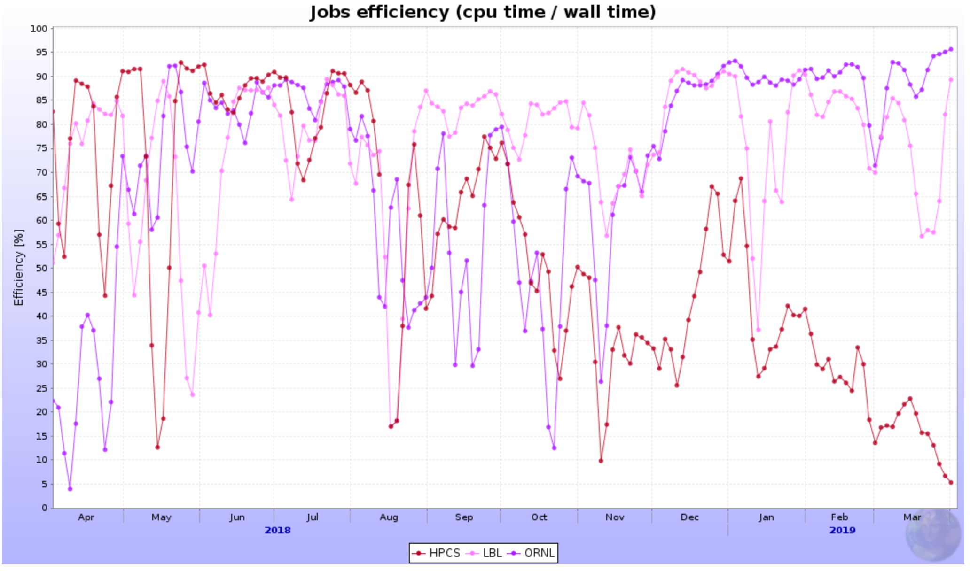
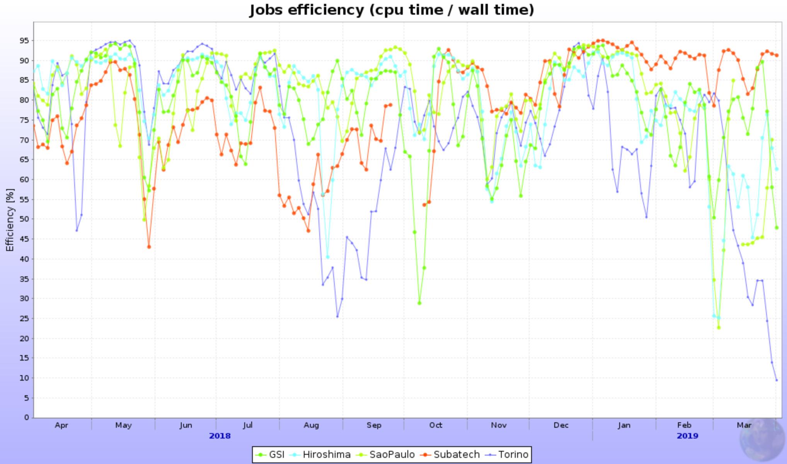
CPU Efficiency
ORNL
Periods of low eff. correlate with restructuring SE
LBNL
Eff. is similar to other T2s.
HPCS
Early results track LBNL
Extreme low efficiency since summer correlated to very high rate of analysis jobs
PDSF = 75%
ORNL = 70%
HPCS = 55%
HPCS trend line?
Similar ALICE T2 = 77%

Slide 14
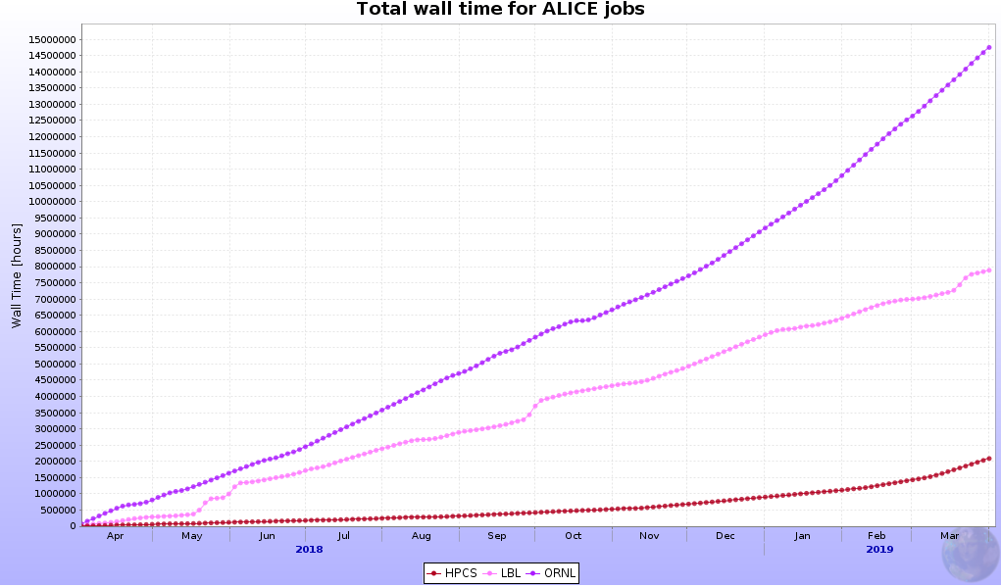

2018 CPU Delivery Relative to Obligations
Relative to 2018 Project Plan
CPU Obligations | kHS06
ALICE-USA | 43.5
LBNL T2 | 21.5
ORNL T2 | 22.0*
*ORNL cannot pledge w/o MoU
Walltime delivered RRB-2018
USA T2 Site | Per/core CPU (HS06/slot) | Wall-time delivered (MHS06-hrs) | ALICE-USA obligation* (MHS06-hrs) | % obligation delivered
LBNL:PDSF+HPCS | 18.8+16.9 | 148.2+35.2=183.4 | 178.9 | 102%
ORNL | 12.0 | 177.0 | 183.0 | 97%
Total |  | 360.4 | 361.9 | 99.6%
Issue: CPU deployment & utilization was not as planned, thus we underperformed early and overperformed late
* includes 95% uptime

Slide 15
2019 Project Planning

Slide 16
Resource Requirements & Procurement Planning
ALICE Computing Requirements
vetted by the WLCG
Note:
Does not include obligations for US/NSF funded Scientists ~10%
% ALICE-USA participation
ALICE-USA Resource Deployment Plan ➔
In annual PEAP update
DOE requests we don’t overprovision

Slide 17
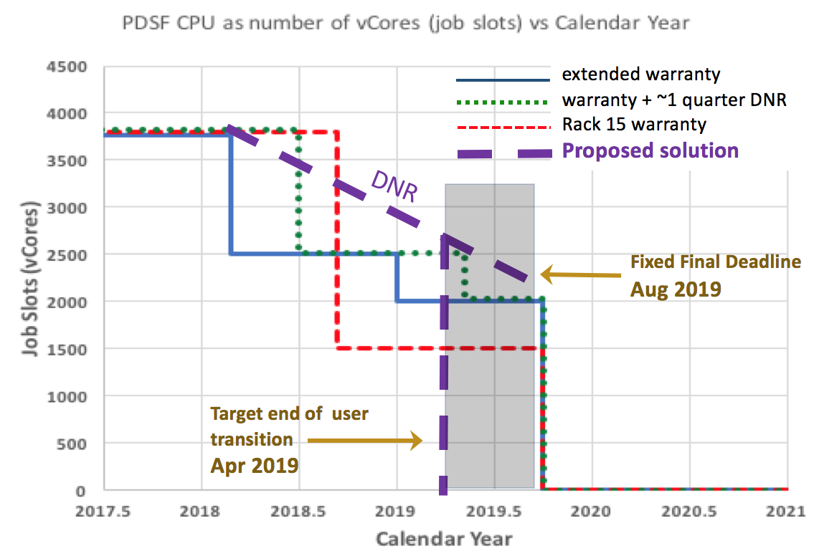
Site Change at LBNL
NERSC makes decision to decommission PDSF
Future power & space needs, Operating costs
NERSC desire to support workflows on HPC
Decommissioning schedule:
Operate existing hardware to April 2019
Allow grace period as needed until Aug 2019
Project plan:
Replacement storage at HPCS
Copy data from LBL::EOS to LBL_HPCS::EOS
New CPU only on HPCS
Move ~30 nodes from PDSF to HPCS
PDSF was shutdown April 1st 2019
PDSF Decommissioning Schedule
✓
✓
✓
← we need to schedule!
And here we are

Slide 18
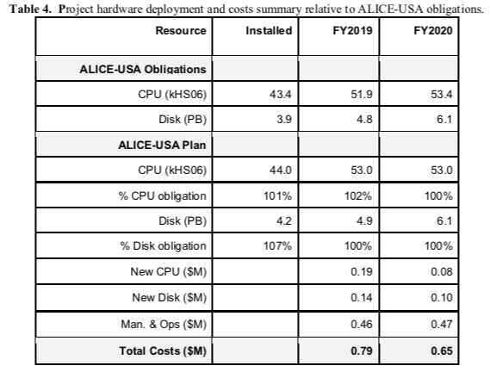
Overview of 2019 PEAP Update
2019 PEAP Update
Maintain facility at ORNL/CADES
CPU slots & 2.x PB Storage
Extra CPU gives us great safety margin!!
Expand new LBNL/HPCS Facility
300 CPU slots → 1000 CPU slots
1000 CPU slots from PDSF
1.2PB → 2.5 PB storage
Modest use of NERSC HPC
~150 CPU slots
Ready for next system: 2020
Submitted to DOE, Nov 9
Reviewed at quarterly DOE call
Expect Multi-year Project Review in late 2019 or summer 2020
Will cover the early Run 3 resource needs & operations

Slide 19
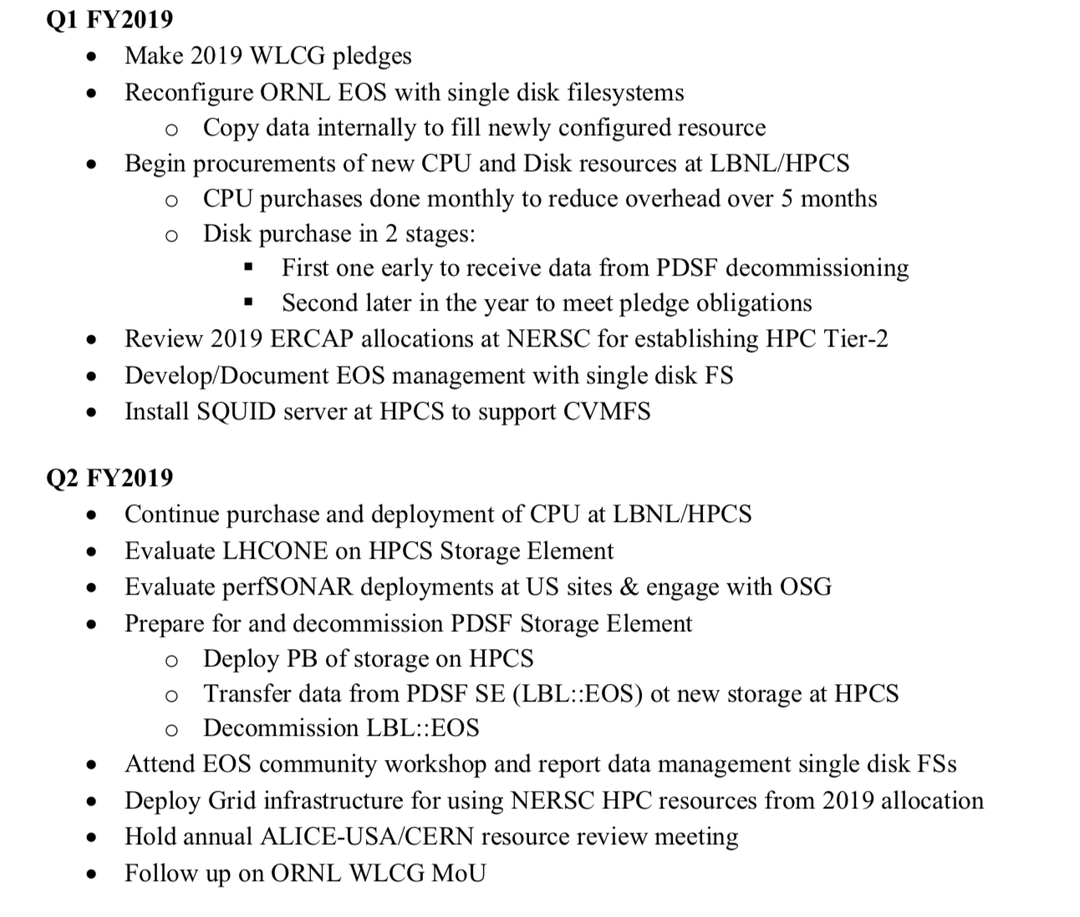
2019 Project Tasks
Oct-Dec 2018
✓ - ORNL still cannot pledge
✓
✓
✓
✓
We have quotes -->
✓
Do we need to document? -->
✓
Jan-Mar 2019
✓
✓
✓
✓
✓
We couldn’t this year -->
Students this summer -->
✓
New program manager -->
We couldn’t this year -->

Slide 20
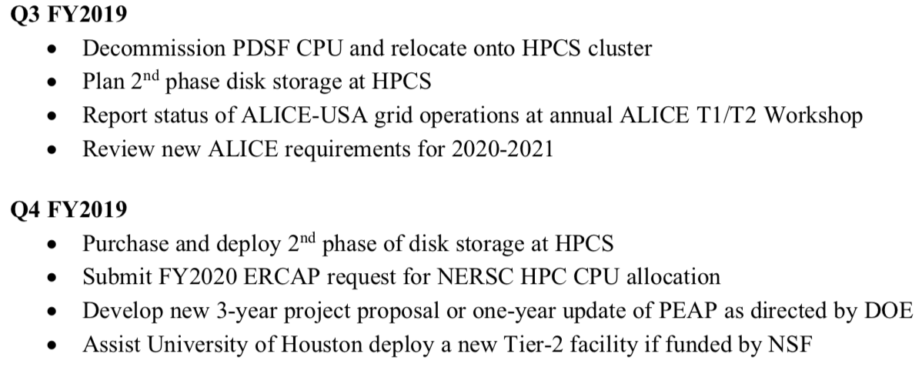
2019 Project Tasks continues
Apr-June 2019
June-Sept 2019
Proposal not funded!!

Slide 21
Project Effort - Issues & Opportunities
PDSF support staff are no longer part of the project
In truth, this has been so since Iwona & Lisa left in 2015
ALICE-USA used to provide ~1/3rd FTE as community service
Last effort ended in 2013
LDRD funds still remain, but no one to take up the tasks
Funds go away Sept 30, 2019
I have funds to support:
2 Romanian Student for summer 2019
1/2 Post-Doc for 2 years, can be paired up with NP/OSG funds for CS-type PD or project scientist/engineer. Note, tasks are more engineering than PD research
Current support items:
Michael is on retirement slope
Jeff may be on retirement slope in the next year+

Slide 22
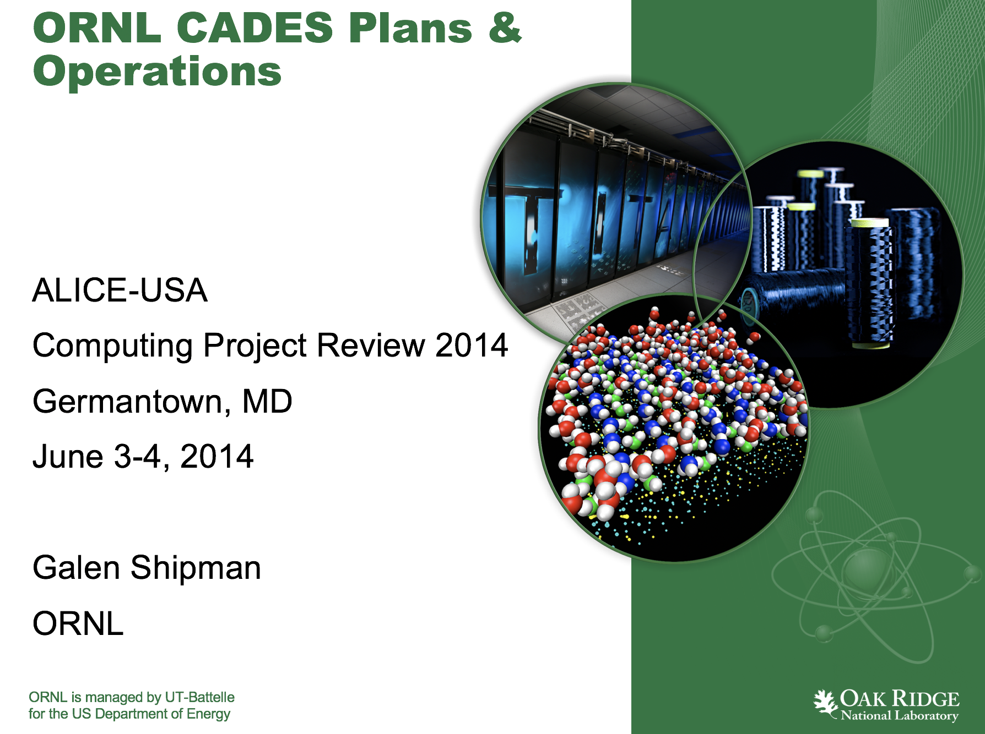
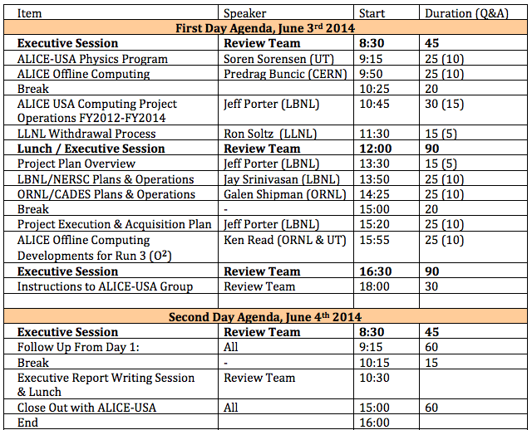
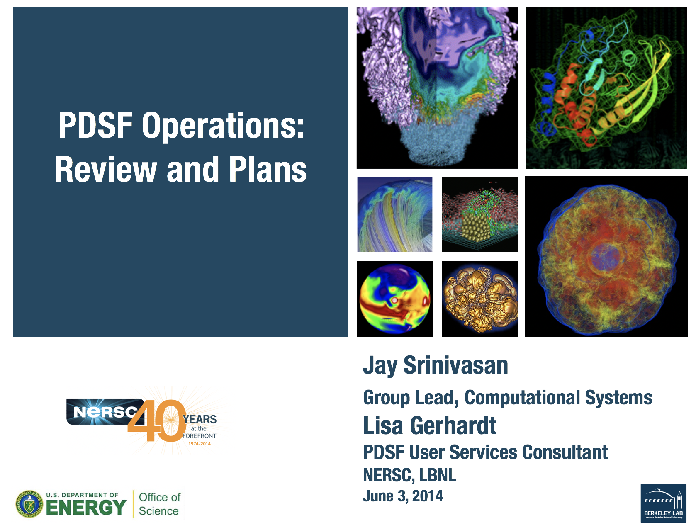
2014 Proposal Review:
ALICE USA T2 Sites

