Slide 1
ALICE-USA Computing Project Annual Review
Purpose:
  Evaluate how the project is meeting or failing to meet goal
  Prepare US team for upcoming year of tasks
Some focus for this meeting:
  Site layout discussions
  Monitoring tasks & toolkits
  CPU efficiency issues, now and into Run 3
Helpful links:
  Group Document folder: https://drive.google.com/drive/folders/0B_axg5dG4OVVMUJQNTZXb0pFSFk
    Contains folders: ‘Annual PEAPS, Quarterly Reports, Hardware docs, Meetings’
    Folder for this meeting: https://drive.google.com/drive/folders/1nUflZKluFefFBOZ-1R6YtfCo_2NwZSo6
  Annual US meeting
    2019 https://indico.cern.ch/event/812485/
    2018 https://indico.cern.ch/event/718770/
    2017 https://indico.cern.ch/event/622907/
    2016 https://indico.cern.ch/event/507381/
    2015 https://indico.cern.ch/event/366989/
    2014 https://indico.cern.ch/event/310399/
  Annual T1/T2 workshops
    2019 https://indico.cern.ch/event/778465 - Bucharest
    2018 https://indico.cern.ch/event/690294/ - Derby
    2017 https://indico.cern.ch/event/595536/ - Strasbourg
    2016 https://indico.cern.ch/event/485835/ - Bergen
    2015 https://indico.cern.ch/event/354209/ - Torino
    2014 https://indico.cern.ch/event/274974/ - Tsukuba
    2013 https://indico.in2p3.fr/event/8114/ - Lyon
Be proactive & shape
the meeting for your needs

Slide 2
ALICE-USA Computing Workshop
Session | Time | Location | Focus
Thursday Morning | 9:15-12:15 | Bld 70 - 191 | Project Status & ALICE Operations
Thursday Afternoon | 13:45-17:00 | Bld 70 -191 | Site layouts, Test infrastructure, ESNet Review prep
Friday Morning | 9:30-12:15 | Bld 2 -100 | WAN Monitoring, EOS operations, Analysis Efficiencies
Friday Afternoon | 1:45-17:30 | Bld 2 -100 | Site Efficiencies & Run 3 Configurations
Monday Morning | 9:30-12:30 | 54-130B | WP-15 discussion and overflow topics

Slide 3
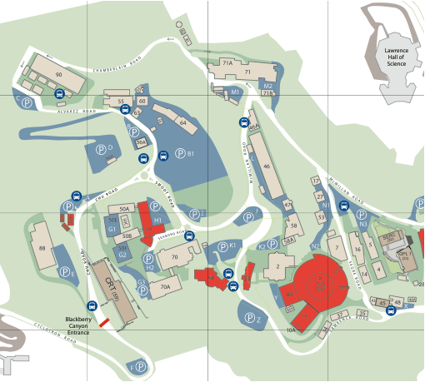
Jeff & Lady offices:
Bld 70, rm 310 & 319A
Bld 2 - 100
Friday
70-191
Thursday
Cafeteria
Bldg 54
54-130B
Monday

Slide 4
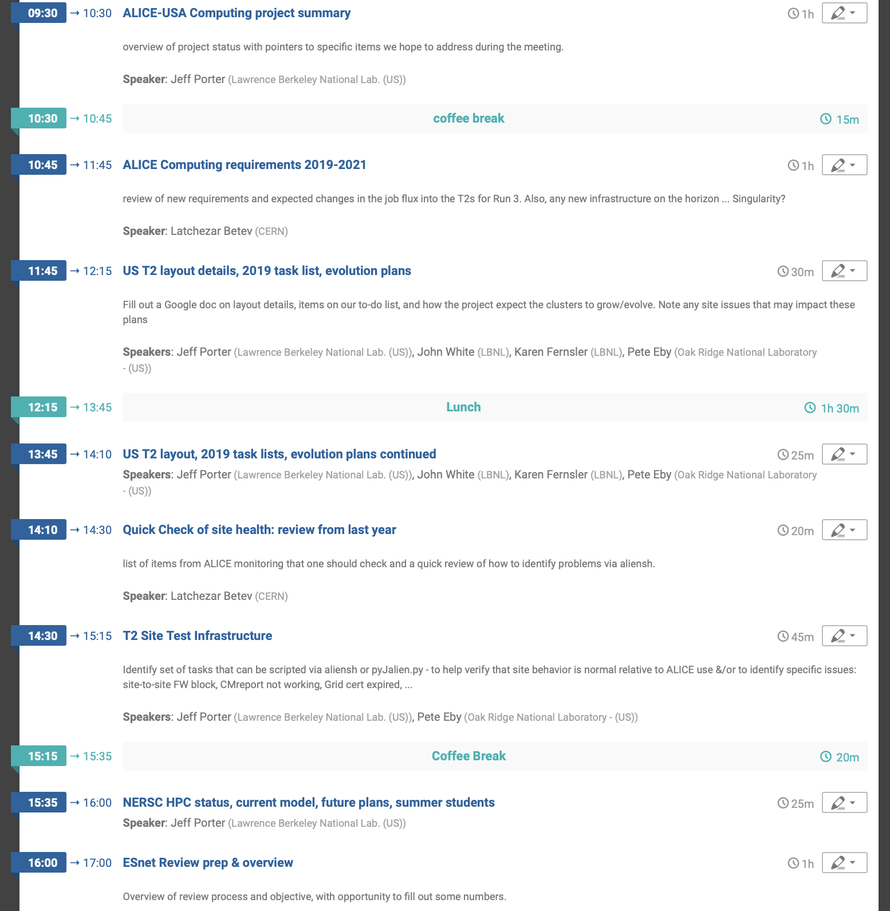
Thurday

Slide 5
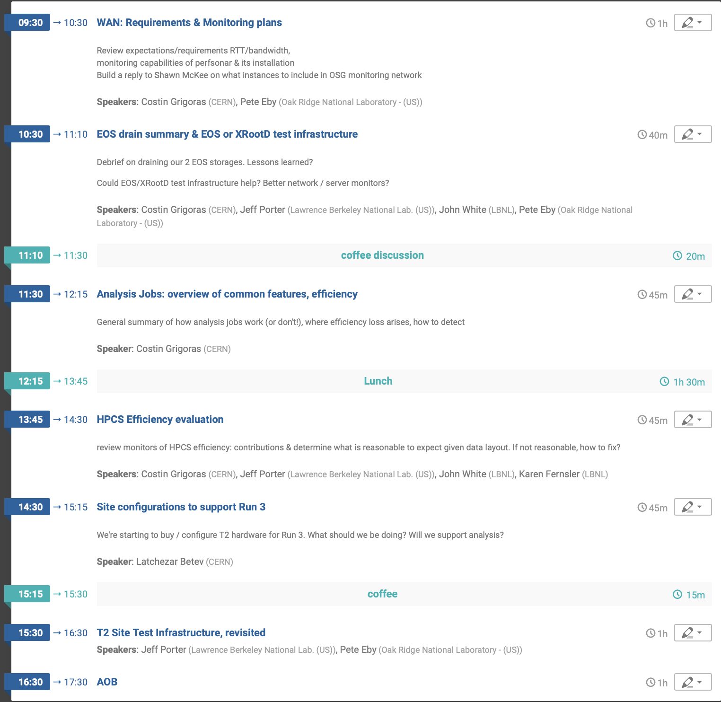

Friday & Monday
Monday

