Slide 1
Synthesizing ML Models for Use in FPGAs
Sheila Sagear

Slide 2
What have we done?
  Optimized ML models for jet tagging
What do we need to do?
  Synthesize models for use in FPGAs

Slide 3
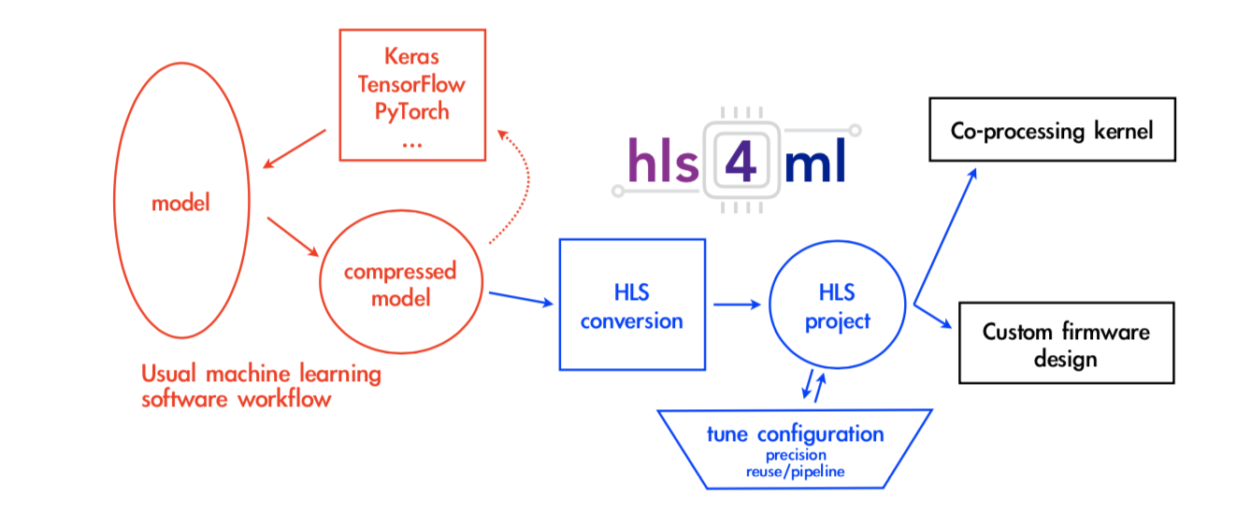
hls4ml:
hls4ml is a tool that translates high level models for use in FPGAs.
Duarte et al. 2018

Slide 4
hls4ml:
hls4ml is a tool that translates high level models for use in FPGAs.
Model
Creation
✅
Duarte et al. 2018

Slide 5
hls4ml:
hls4ml is a tool that translates high level models for use in FPGAs.
Model
Creation
Conversion
to FPGA
✅
Duarte et al. 2018

Slide 6
Conversion to FPGA:
hls4ml creates a firmware implementation of our ML models using high level synthesis language (HLS)
High level synthesis: converts models created using high level languages (python) into something that can program an FPGA
hls4ml outputs total latency (how long it takes to perform the inference – higher for bigger models). We want to minimize latency.

Slide 7
Issues:
Theano gives more accurate models than Keras – why?
hls4ml can’t handle models bigger than a certain size

