Slide 1
Project Update 6
By: Ryan McCarthy

Slide 2

Scientific Linux to Centos
Dear All,
The decision was that we can't make numpy, which was built on SLC6, work on CC7. We just can't. With numpy you must use a binary that was built specifically for your OS.
CERN
My code

Slide 3
Scientific Linux to Centos
lsetup "root 6.16.00-x86_64-centos7-gcc8-opt“
Allows us to use numpy on centos7 despite CERN’s best efforts
Sets up version of root which was compiled with centos7 and work with numpy

Slide 4
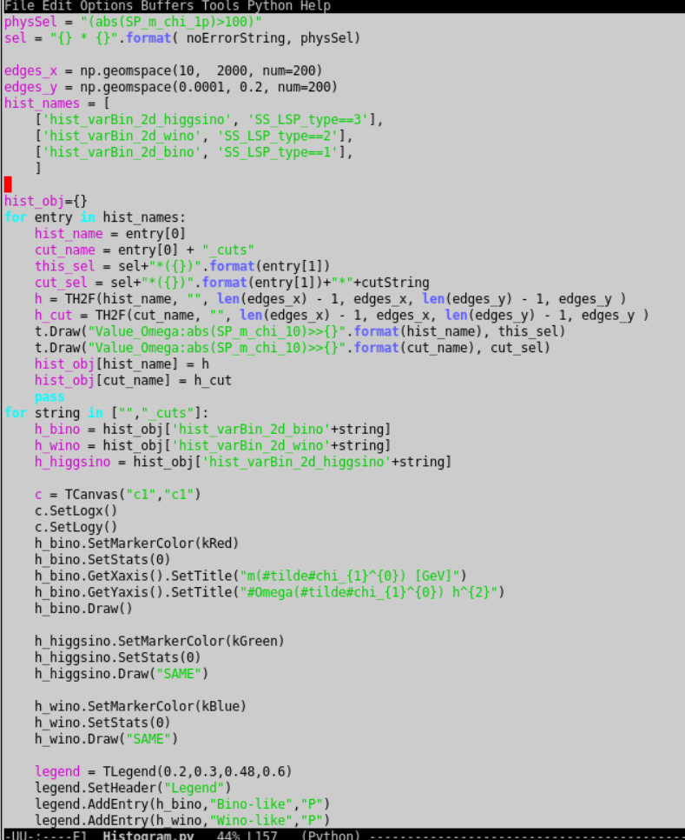
New Plotting Script
Using lists and formatting strings allowed me to compress about 800 lines of code to 400!
Makes all of the plots I made before plus some new ones

Slide 5
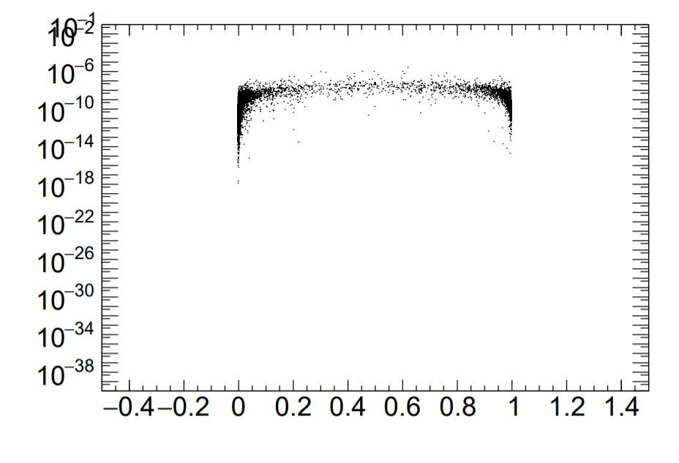
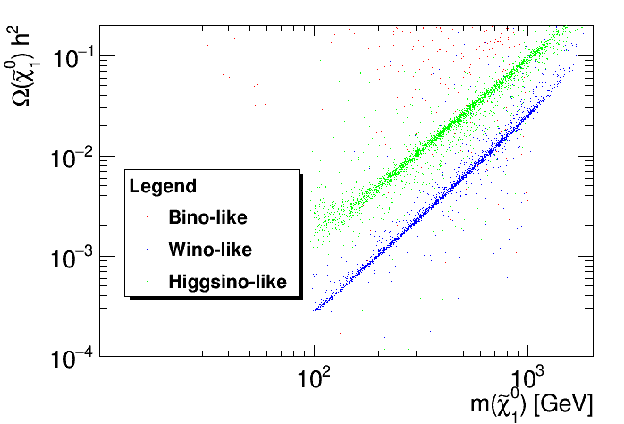
New Histograms
Expect cross section to drop significantly when neutralino is entirely higgsino-like or not higgsino-like at all
Remade older plots to look nicer
SI Neutron Cross Section
N₁₃²+ N₁₄²

Slide 6
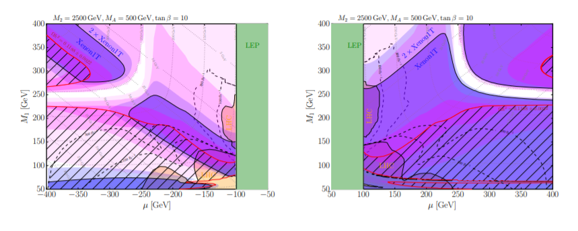
Future Plans
Make same plots as “Well-Tempered Neutralino” paper
More ways of showing excluded model points

