Slide 1
Applying the Generalized Scattering Matrix Concatenation Method to the SPS 200 MHz Cavities
Alex Angus

Slide 2
Overview
Goals:
To implement a more efficient method of calculating S-parameters
  Current method is brute force simulation which is computationally expensive and time consuming
Use it on the 200 MHz cavities
  Possibly to find an optimal arrangement for the HOM couplers
Method:
Generalized Scattering Matrix Concatenation facilitated through a Python program

Slide 3
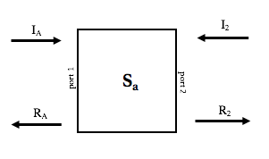
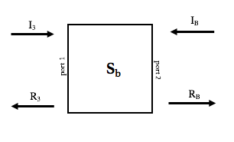
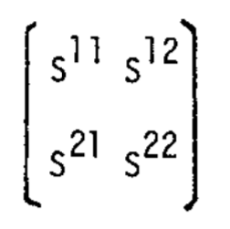
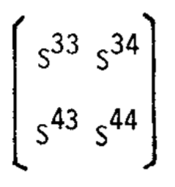
Generalized S-matrix Concatenation
+
c
S_{AA}
S_{AB}
+
S_{BA}
S_{BB}

Slide 4
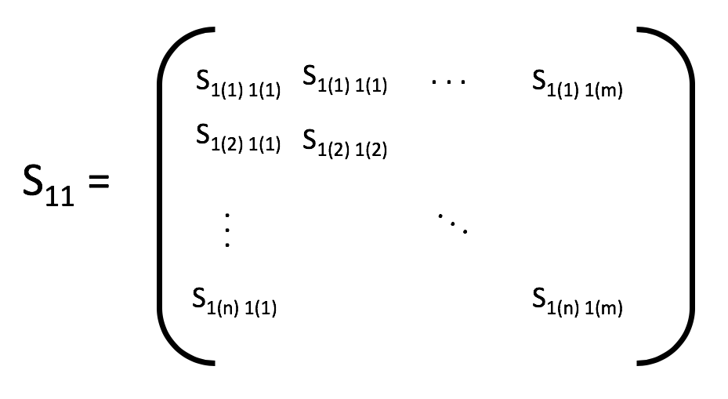
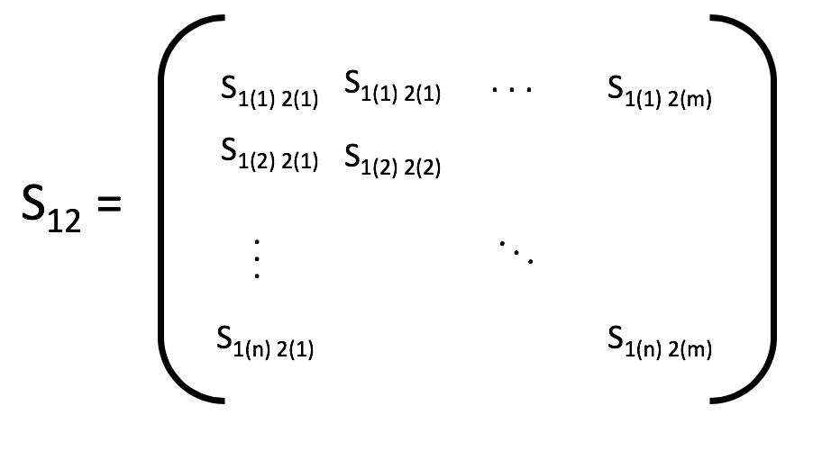
Multi-modal S-parameters --> block matrices
. . .
S₂₁= …
S₂₂= …
. . .
. . .

Slide 5
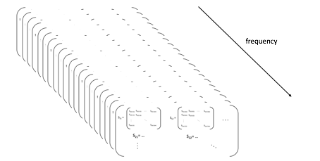
Generalized S-matrix Concatenation
Take 2 S-matrices, combine them for a single S-matrix that represents the entire network
There is an S-matrix for each frequency, so this must be done for each frequency.

Slide 6
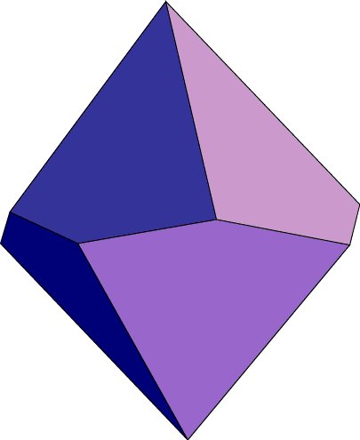
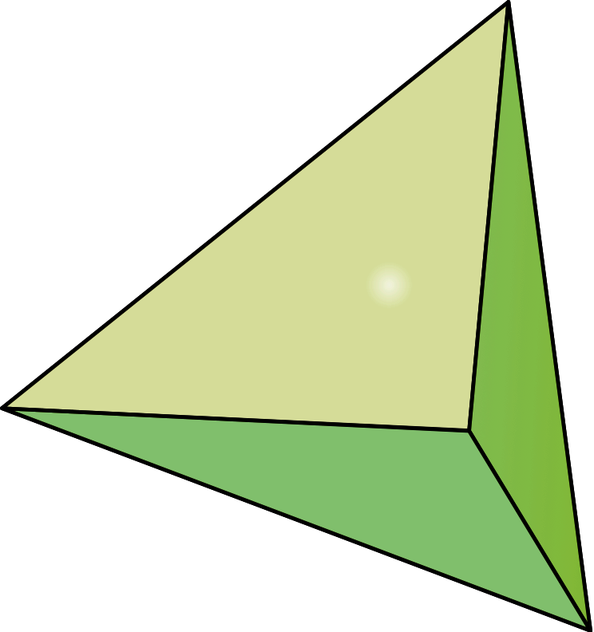
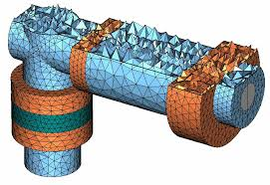
Meshing
CST uses a process called meshing to model 3 dimensional physical objects, or 2 dimensional surfaces
Types of meshing:
Hexahedral
Tetrahedral
Hybrid Triangular
Quadrilateral
Volume meshes
Surface meshes
Finite integration technique

Slide 7
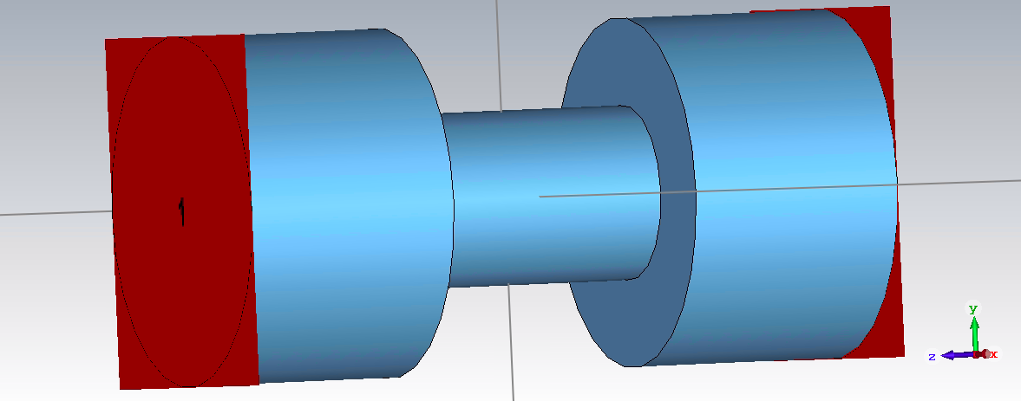
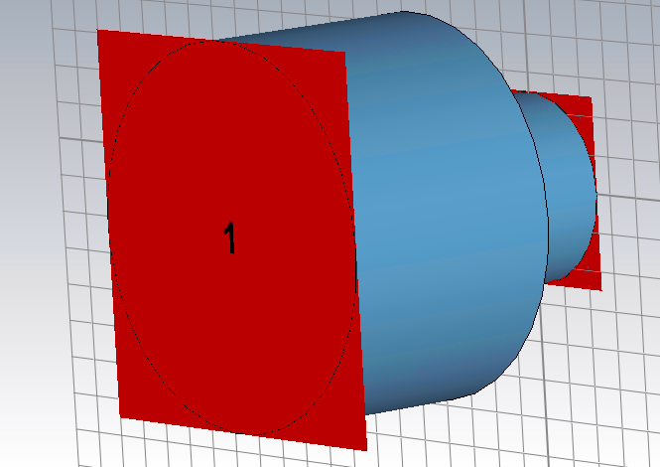
To start
Test theory and begin building a concatenation algorithm
First try to replicate a full waveguide’s S-parameters with two concatenated halves

Slide 8
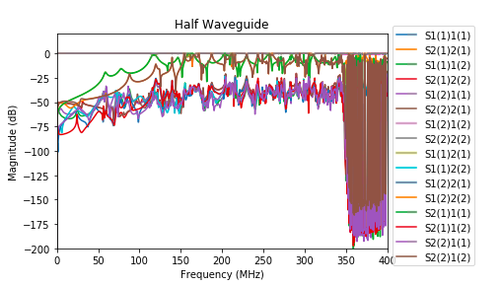
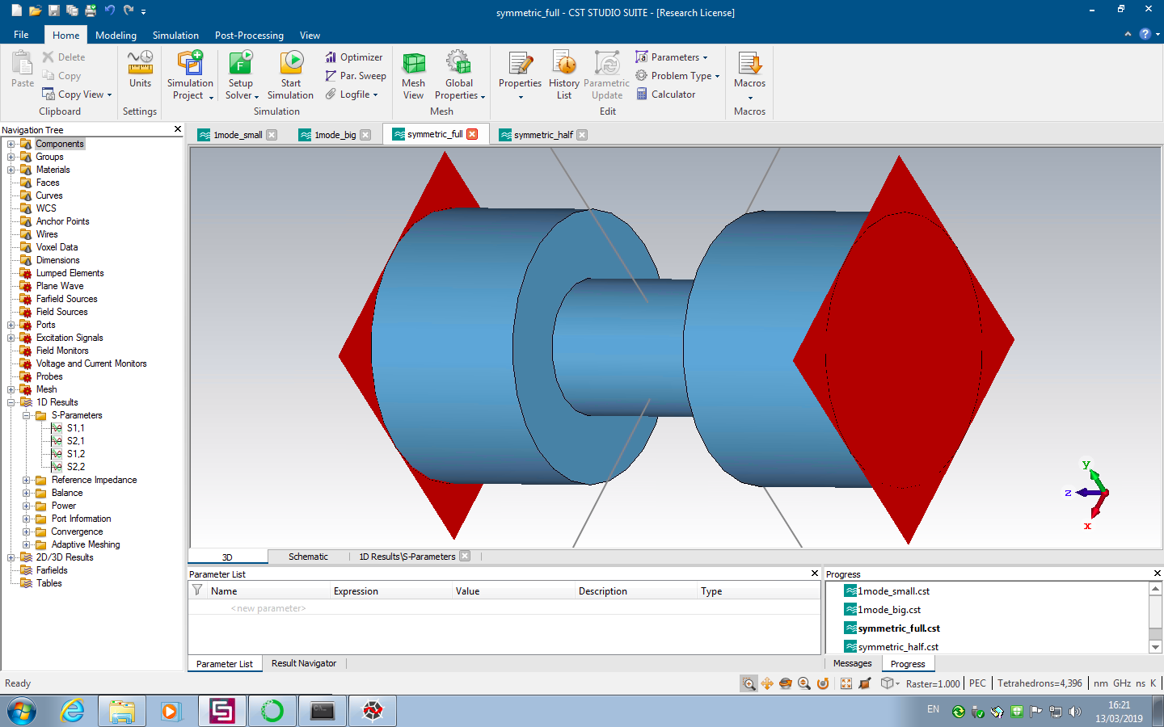
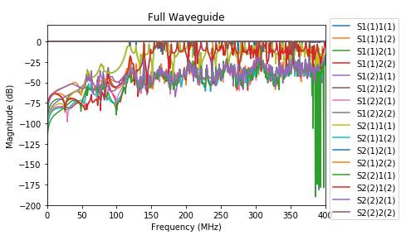
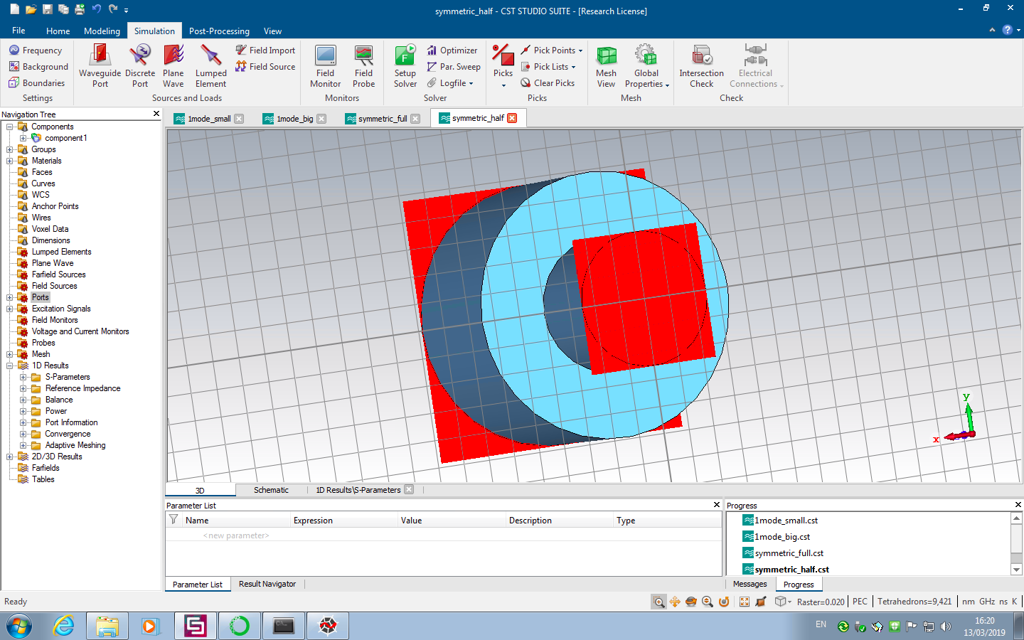
Considering only 2 possible modes

Slide 9
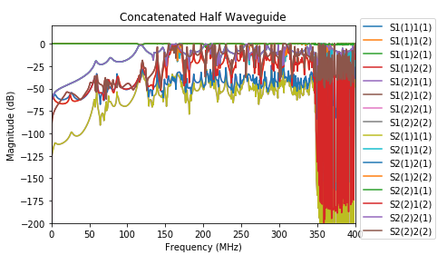
Results of Concatenated Symmetric Half Waveguide Algorithm
Modal S-parameters of the Concatenated Symmetric Half Waveguide compared to the Full Waveguide

Slide 10
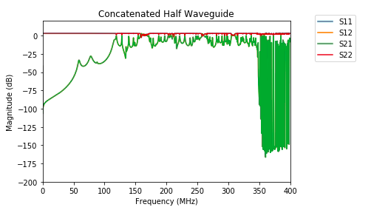
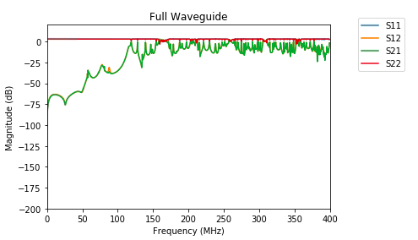
Non-modal S-parameter results

Slide 11
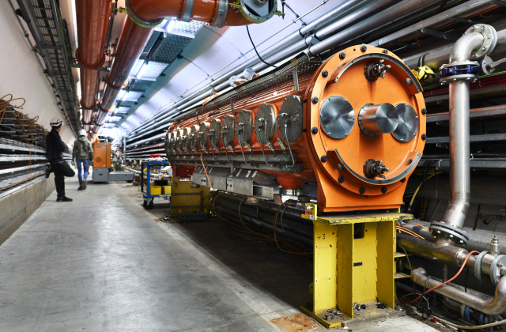
Moving Forward
Expand concatenation algorithm to include:
Any number of modes → more accuracy
3 port networks → more versatility
Apply to the 200 MHz cavities to reduce S-parameter calculation time
(200 MHz cavity diagram, Patrick Kramer, 2019)

Slide 12



Applying the Generalized S-matrix Concatenation method to the 200 MHz cavities
Split 200 MHz cavity into repetitive segments
Simulate each segment type only once
Use concatenation method to get S-parameters of entire cavity
+
+

