Slide 1
Cold diodes for HL IT circuit: implications on cryostat design
TCC meeting: 11 Apr. 2019
Y.Leclercq, D.Ramos, V.Parma, E.Todesco for WP3

Slide 2
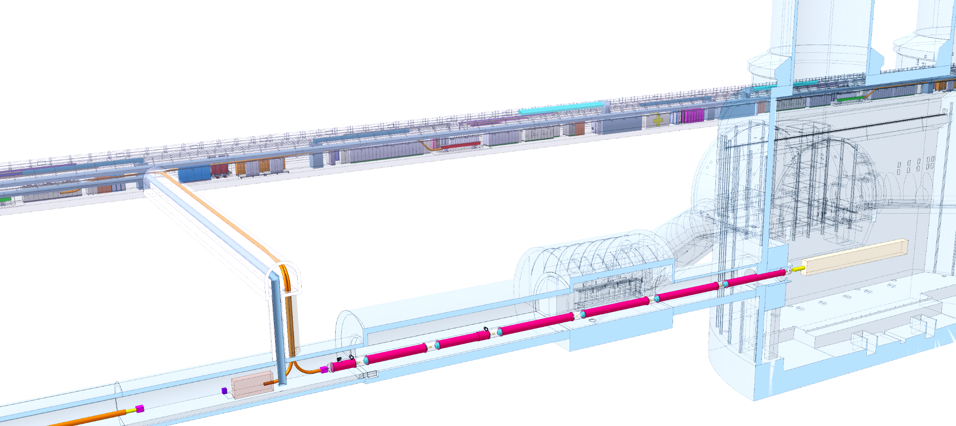
Context
For illustration
Courtesy S. Yammine
Objective : integrate 4 diodes at cold, connected to:
  Q1 to Q3 main circuit (2 connections)
  Trims circuits (3 connections)
2018: Preliminary studies
  Interfaces between WP3 and WP6a, WP3-WP6a joint meeting 23.01.18 Indico693807
  Cold diodes module : Conceptual integration proposal, HL-MCF meeting 7.08.18 Indico745287
  Cold diodes module : Conceptual Integration studies, 8th HL-LHC collaboration meeting, 17.10.18 Indico742082
DFHX
Power converters area
Service tunnel
SCLink
Transverse tunnel
≈50m
IP
≈8m
wp3
wp6a
Q2a
Q1
Q2b
DFX
Q3
D1
CP
≈80m
LHC tunnel
Courtesy S.Maridor

Slide 3
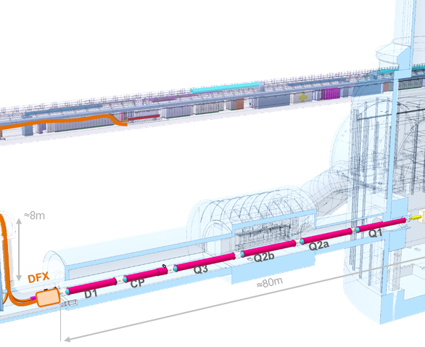
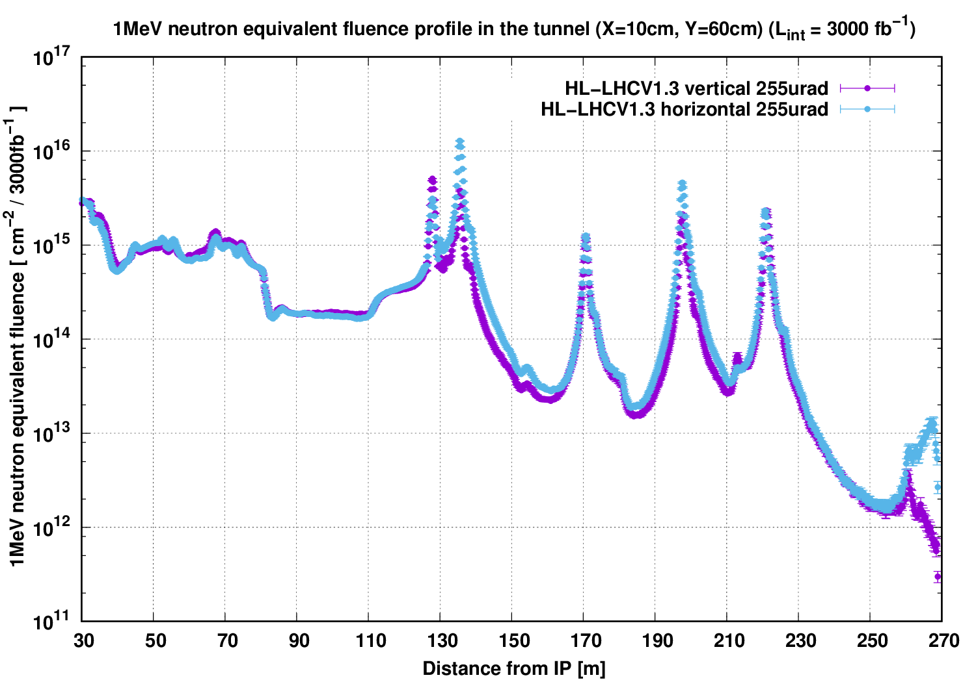
Location of diodes in the tunnel
Diode must be as close as possible to the circuits (minimize additional bus bars)
→ after D1 to allow access to the 5 cable
Diodes must be compatible with radiation levels and available space:
  → Location between D1 and DFX :
    Lowest Neutron Fluence level
    Cables accessibility
    Integration space availability
Diodes must be accessible for replacement
Access location
to the 5 cables
D1
Courtesy R.Garcia, G.Lerner
Courtesy S.Maridor

Slide 4
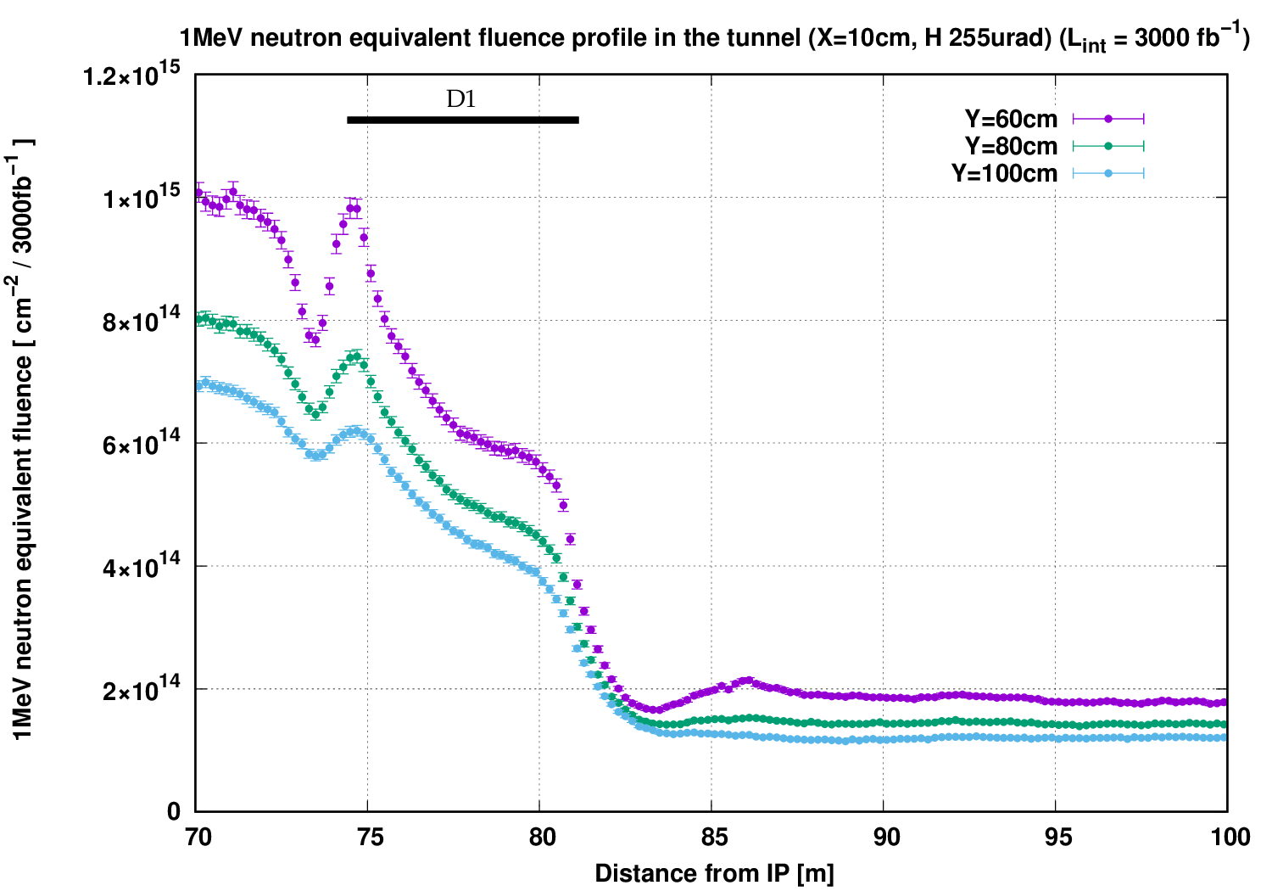
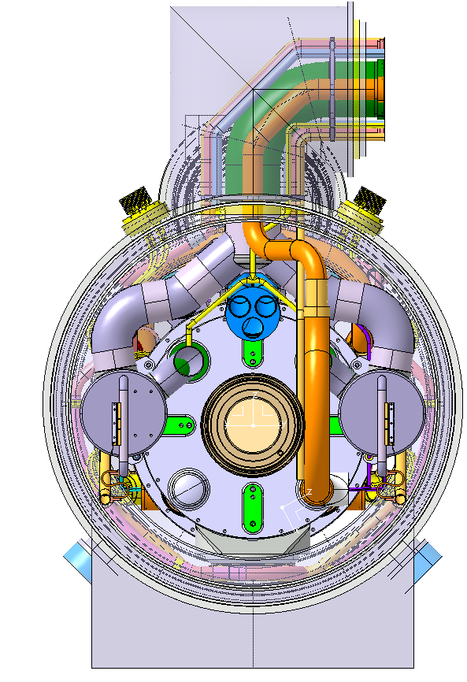
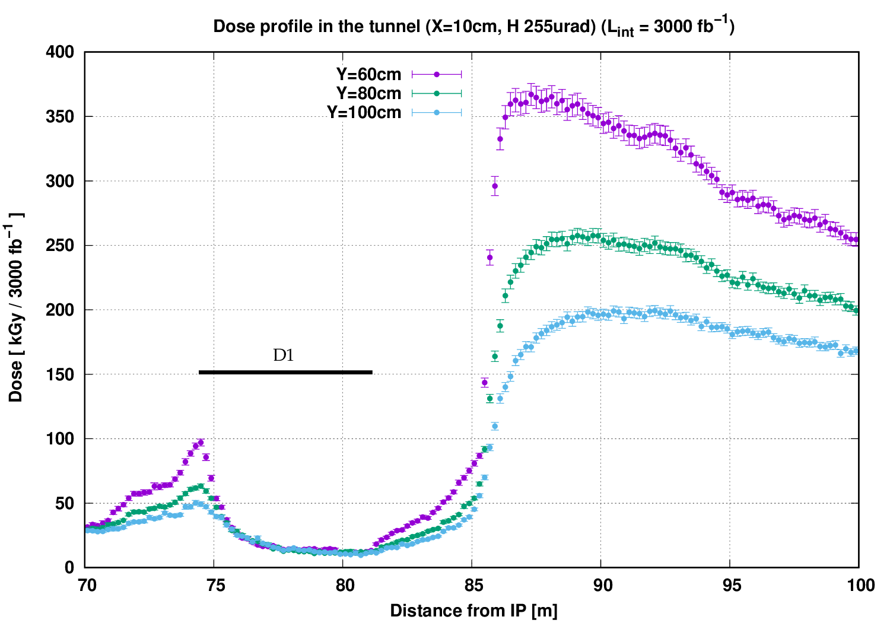
Diodes ideal location in D1-DFX zone
Courtesy Ruben Garcia Alia
Autumn 2018 values
Radiation levels and large gradients (future FLUKA simulations will provide more accurate results):
  → Diodes location has to be outside cryostat envelope
Integration space constraints
  Cables accessibility only above the beam
  Transport & Survey reservations exclude passage side
  → ideal location identified
CP
D1
MBXF
Transport & survey reservations
Ideal location
Accessibility
Ideal location
Cables to connect
to the diodes
High radiation area
60 cm
80 cm
D1
100 cm
MBXF
D1
28 cm
MBXF
CP
Beam
83 m
Courtesy C.Eymin

Slide 5
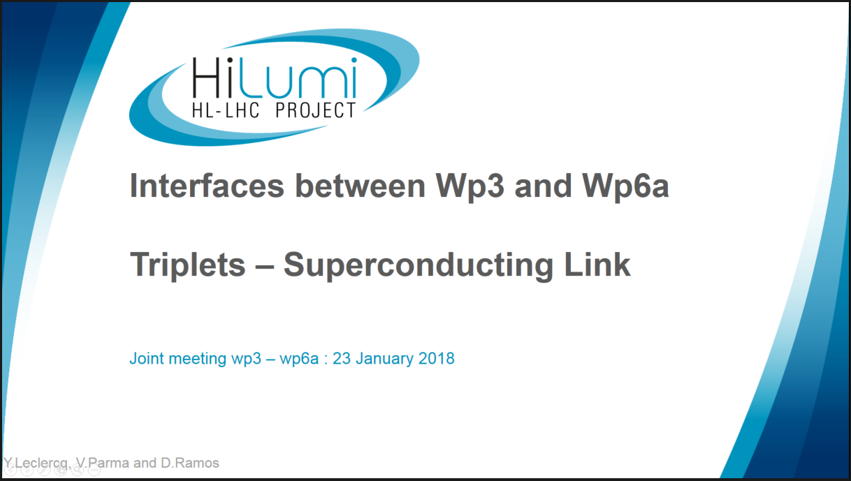
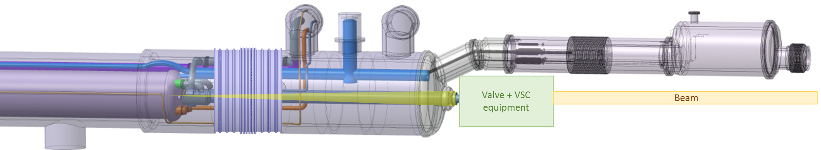
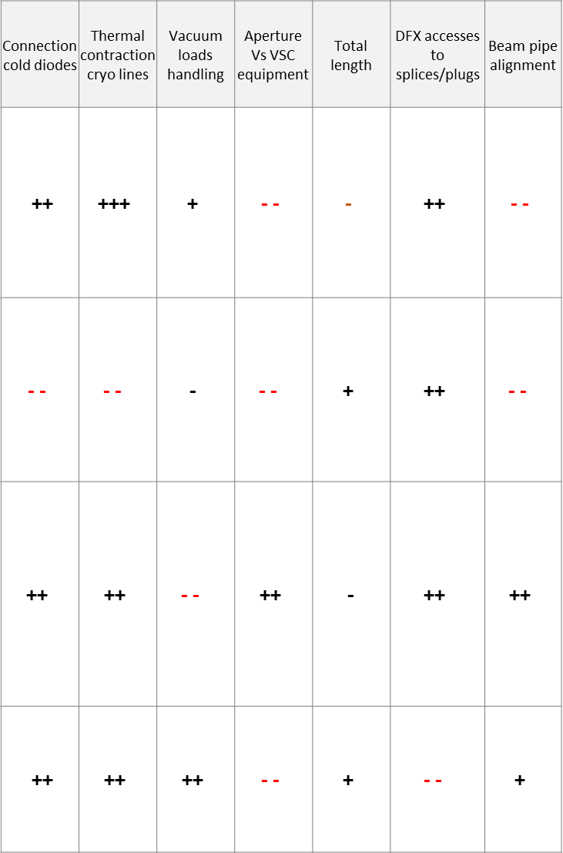
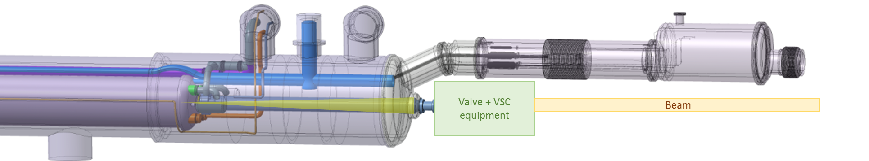
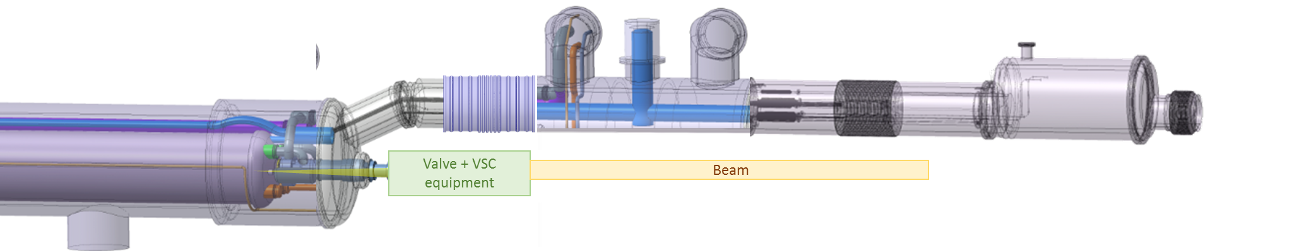
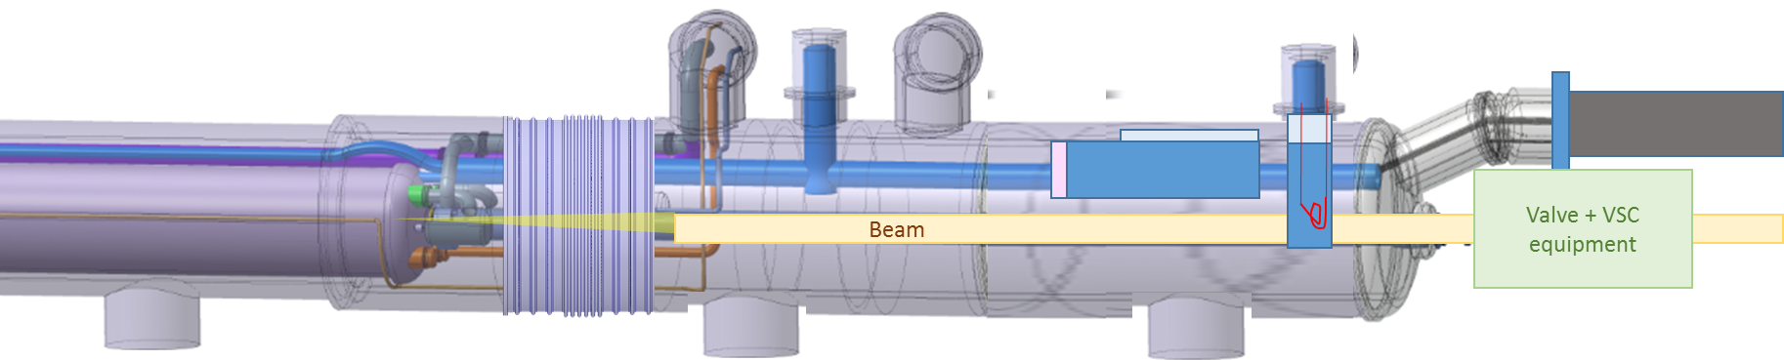
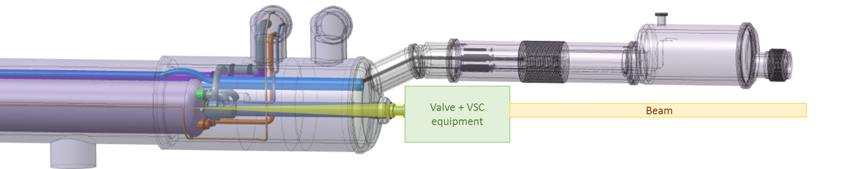
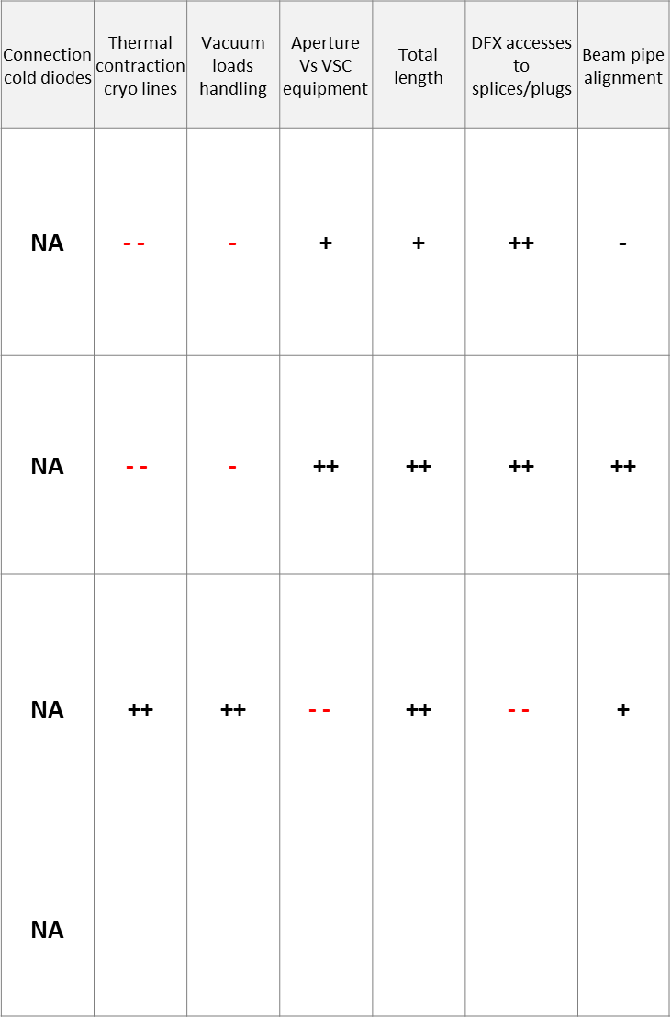
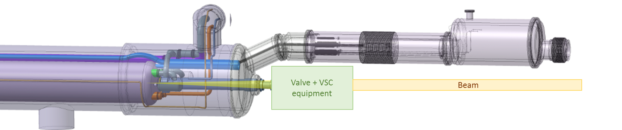
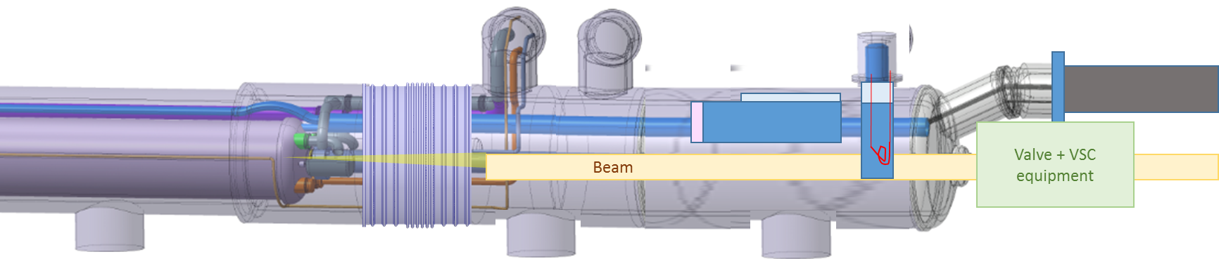
Technical systems constraints and implications on conceptual design
→ proposal of a Cold Diode Module (CDM)
D1 cryostat interface complexity:
  Beam tubes and associated equipment (BPM, CWT, etc.)
  Cryogenic lines routing and connections
  Bus bars interconnection
  Vacuum and pressure loads
Several options studied
We propose a dedicated cryostats for the cold diodes → Cold Diodes Module (CDM)
  Indico693807
Beam alignment + Sector valve
No access for bus bars connection
Ideal location
Cryo pipe integration
Plug
Beam alignment + sector valve
To
SCLink
D1
MBXF
Vacuum equipment
Beam alignment + sector valve
Beam
Splice access + radial integration
Beam alignment + sector valve
<3m
83 m

Slide 6
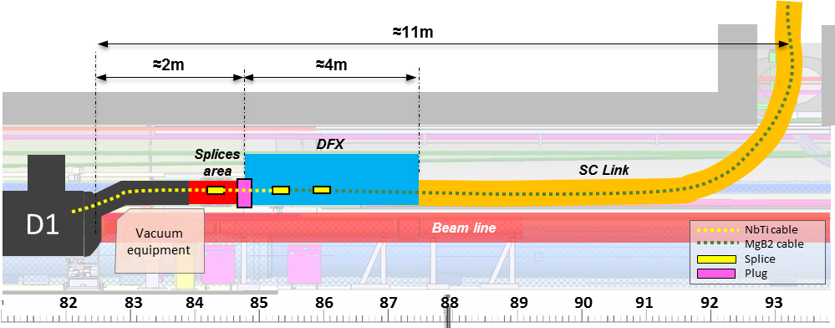
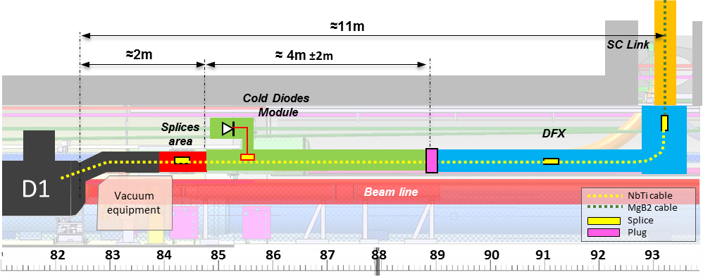
Layout evolution towards a CDM unit
Cold Diodes Module starting point:
60 kGy as boundary with today’s simulations
Design focuses on optimising position
Quick replacement feasible
CDM interfaces with splices and plug
Layout 2018
D1
Working layout 2019
MBXF
CP
Courtesy R.Garcia, G.Lerner

Slide 7
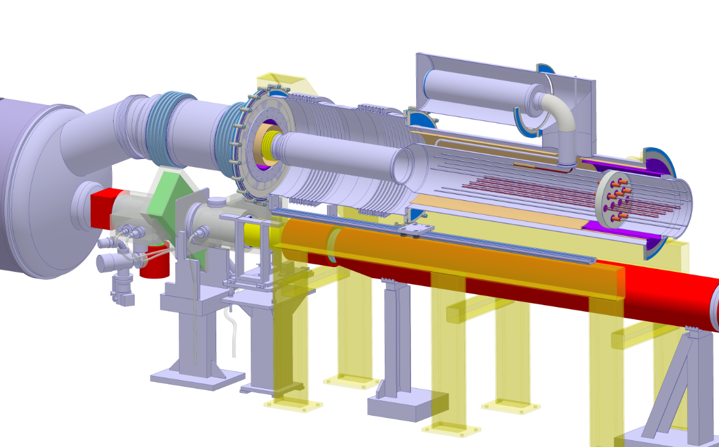
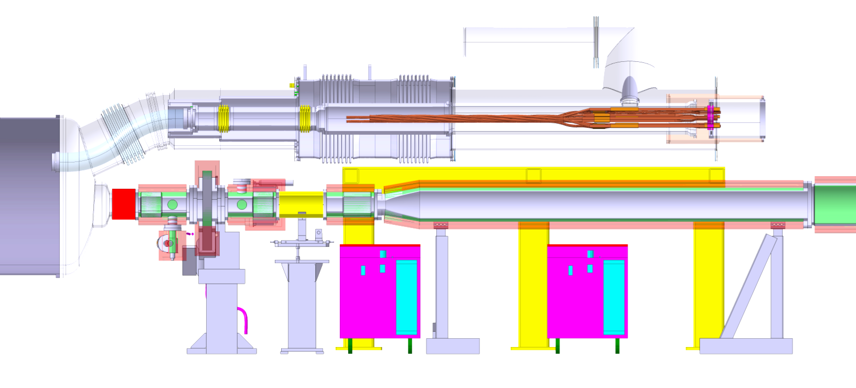
Conceptual design of the CDM
19 NbTi-NbTi
splices
Replaceable
Cold Diodes
CDM preassembled with diode pack, bus bars with plug and qualified before tunnel installation
Some technical features
  In superfluid helium, common volume with magnets
  Same insulation vacuum as triplets cryostats
  Actively cooled thermal shield
  Diodes replaceable (aimed at being done with a YETS)
➔ study led to a 1st concept as an acceptable compromise
Further iteration will be necessary with various work-packages
D1
Plug
Vacuum
equipment
19 Bus bars
Supports
Diodes
KhFh
Jumper
DFX
Splices
Plug
Superfluid vol.
4.5K LHE
NbTi leads
Cu Leads TBC
Splices
Actively cooled th. shield
Vacuum envelope
D1

Slide 8
How to proceed and plans
Cost estimate of CDM unit prepared and being discussed within WP03
Contribution to the ECR with the required information (technical, resources and schedule)
Proceed from conceptual study to engineering design
Detailed design by end of 2019 (build-to-print)
Construction and qualification of a full prototype for the String (could be used as spare)
Supply of components in industry
Assembly at CERN (service contract)
Equipping with diode pack and qualification testing (but no cold testing) before installation
4 units + 1 spare to be produced in 2021-2023

Slide 9
Summary
Layout considerations require integration of the cold diodes in individual cryostat units (CDM) equipped with dedicated bus bars and a diode package
The CDM are located between the D1 and the DFX, with an accessibility for replacement of the diode package, aimed at allowing replacement within a YETS
The positioning of the CDM is constrained longitudinally and transversally by technical systems and integration considerations, a proposed solution has been found as a compromise with radiation resistance
A cost estimate has been done and is being discussed within WP03
An ECR will have to validate the proposal
Further iterations with other WPs will have to accompany the evolution of the conceptual design towards a final design by the end of 2019
It is proposed to build and qualify a prototype for the String
4 units + 1 spare to be produced in 2021-2023

Slide 10
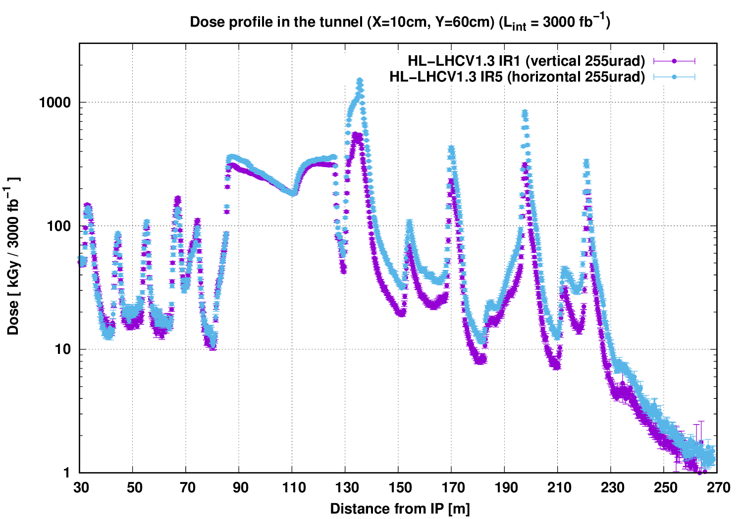
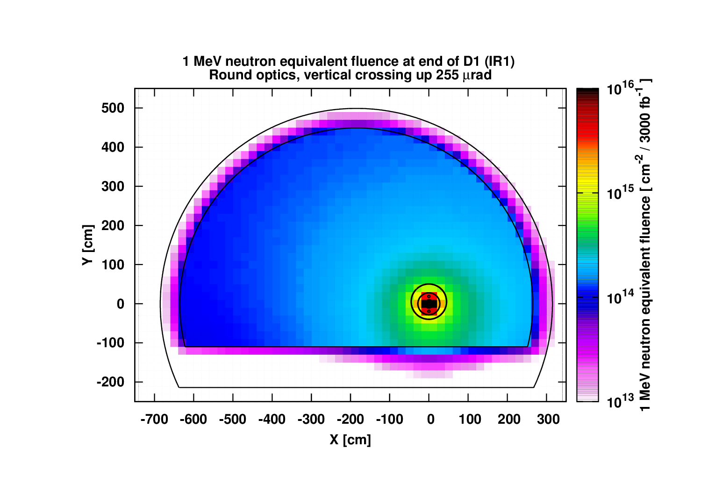
Spare slides

Slide 11
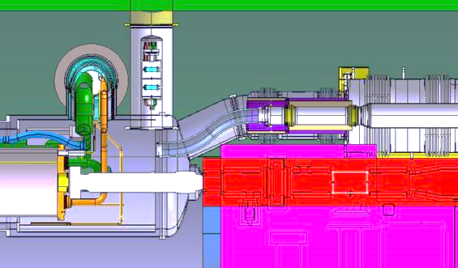
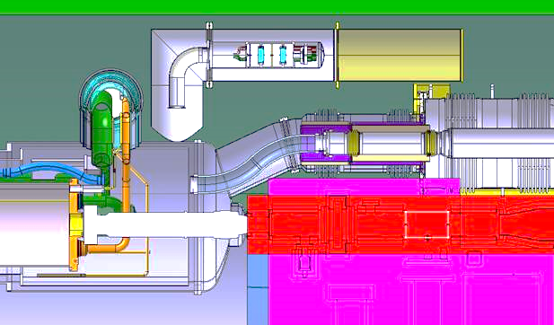
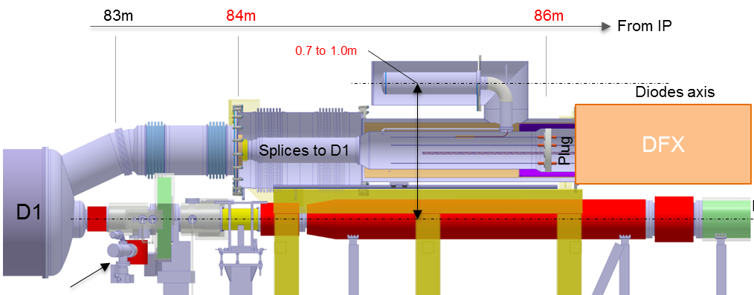
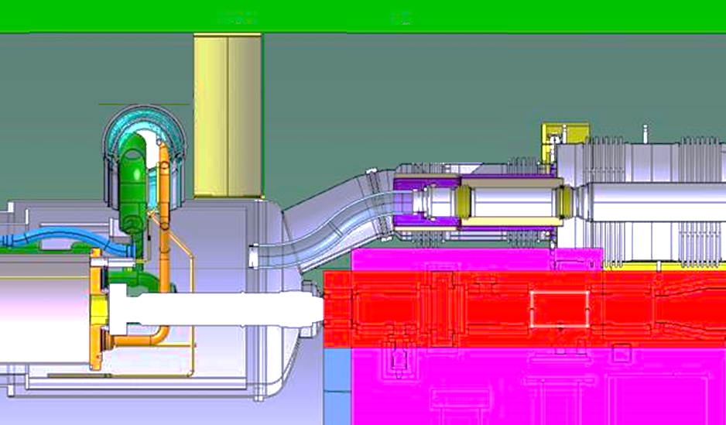
Iterations
Courtesy Ruben Garcia Alia
Diodes assembly assumptions:
  Volume Ø175 x 600 mm
Preliminary Concept :
  1Mev neutron fluence ≈1.4x10¹⁴ cm⁻²
  Dose:≈60 kGy
Request to review position of cold diodes toward D1 to minimise dose
Other concepts being analysed
Iterative work in progress
Concept | 1 Mev neutron fluence | Dose
 | [cm⁻²] | [kGy]
#1 | ≈ 1.4 x 10¹⁴ | ≈ 60
#2 | ≈ 1.5 x 10¹⁴ | ≈ 30
#3 | ≈ 1.4 x 10¹⁴ | ≈ 35
#4 | . | .
D1
MBXF
D1
MBXF
Concept #2
Replacement issues
D1
MBXF
D1
MBXF
Concept #3
Assembly issues
D1
MBXF
Concept #4
High dose level

Slide 12
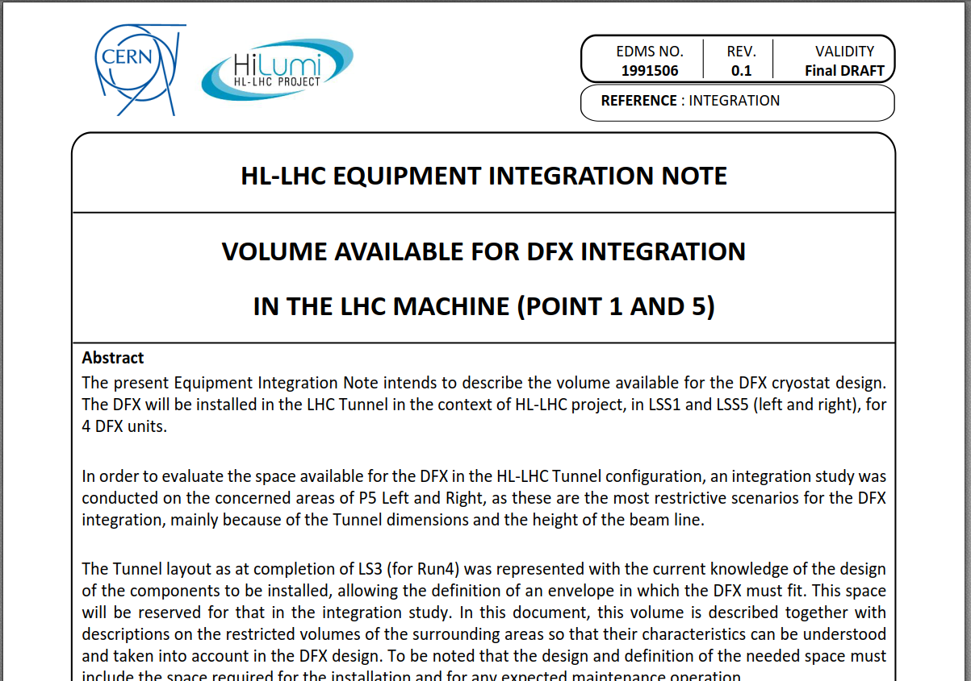
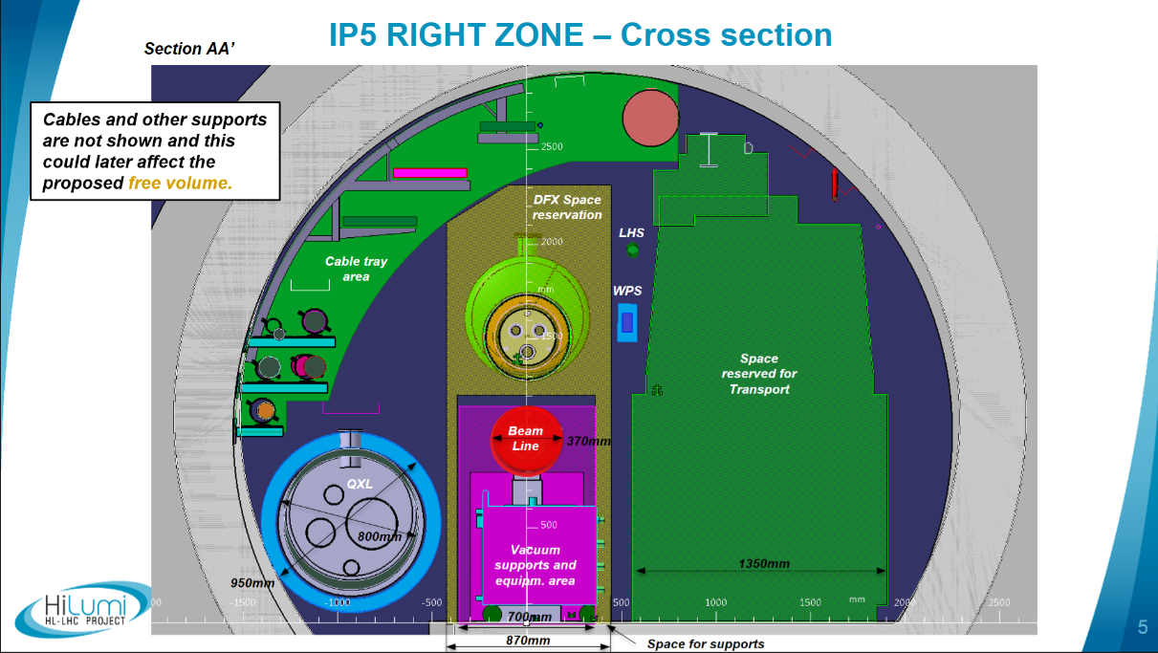
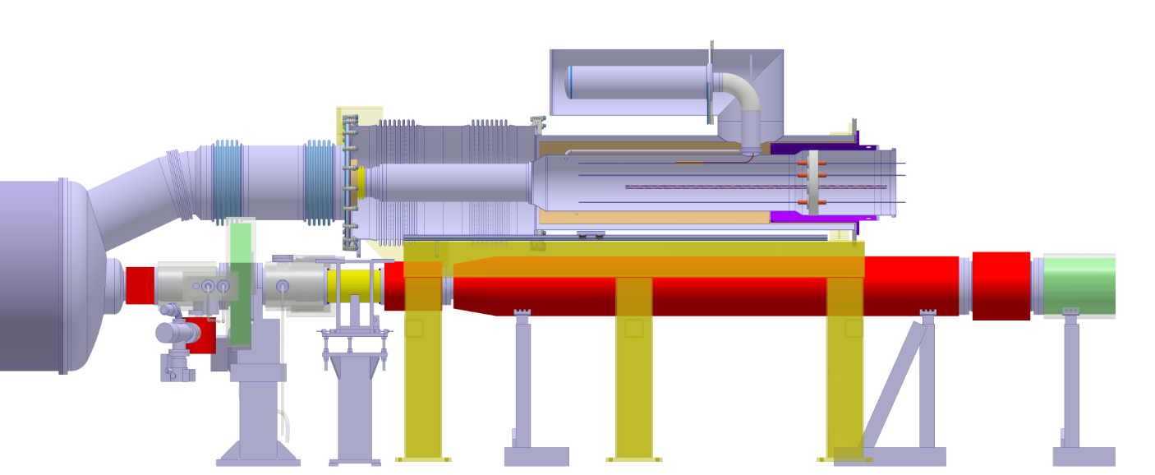
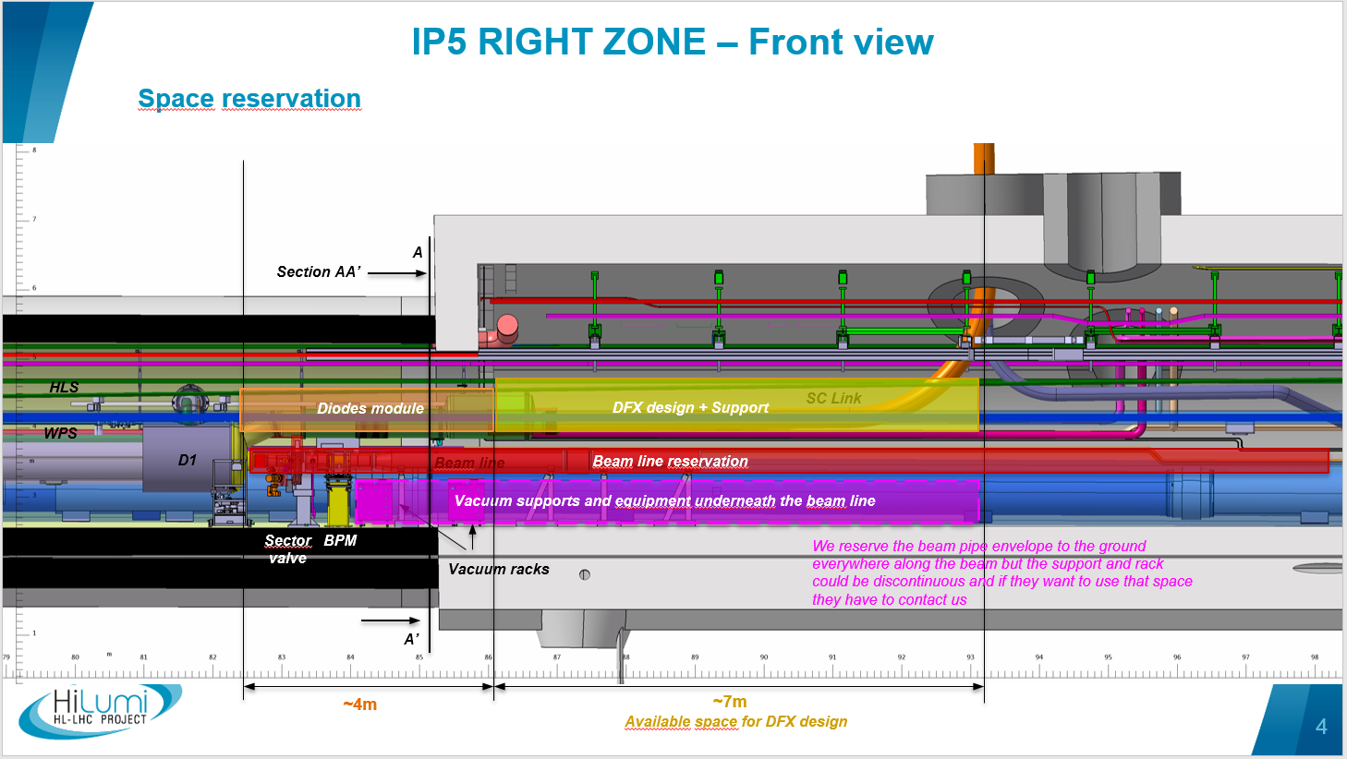
Cold Diodes Module integration
EDMS1991506 WP15
M.Mendes, M.Gonzalez
Integration boundaries extrapolated from EDMS 1991506
Cold diodes preliminary location:
  84-86 m from IP
  Radially : ≈0.7m to 1.0 m from beam axis
83m
84m
86m
From IP
0.7 to 1.0m
Courtesy M.Gonzalez
Indico 683600
Diodes axis
DFX
Splices to D1
Plug
D1
Beam axis
Vacuum & beam equipment
BPM

