Slide 1

High performant smart computations for graph analysis
Richard Forster

Slide 2
Agenda
Community Detection
Communities with Deep Q-learning
ForceAtlas
Barnes-Hut Tree with RNN

Slide 3
Community detection

Slide 4
Community detection
Used to reveal groups in real world data
Louvain method
Parallel heuristics

Slide 5
Louvain Method
Multi-phase, iterative, greedy algorithm
Monotonically increasing modularity
Inherently sequential

Slide 6
Results
(Community Detection)
Database: 4x
Silicon: 4x
3D: 11x
CT: 12x
      Database Silicon 3D CT
      Nodes 17832 24923 35763 53039
      Edges 113622 185594 192336 325490

Slide 7
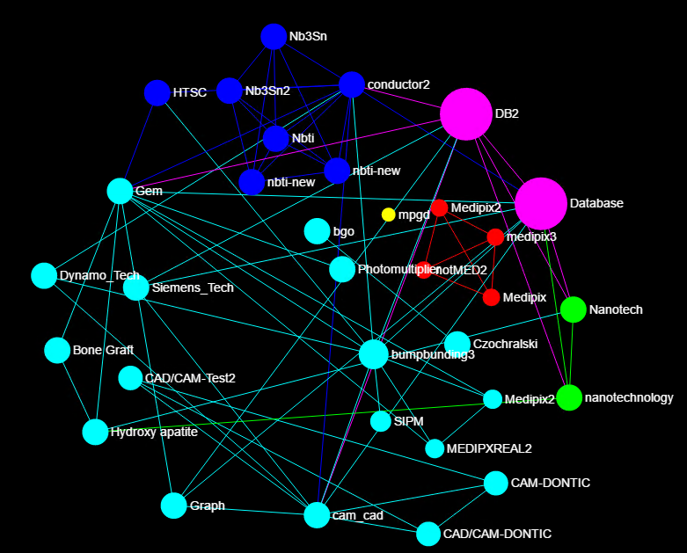

Slide 8
Communities with deep q-learning

Slide 9
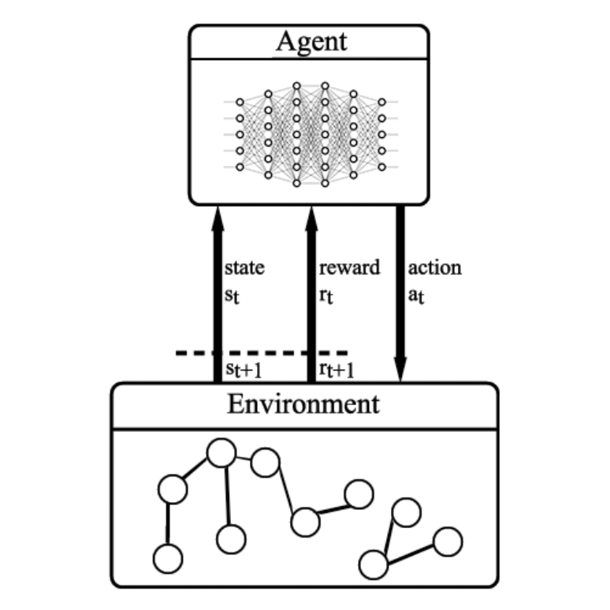
Communities with deep q-learning
Reinforcement learning problem:
Interactions between the environment and agent
  Action-reward
Goal is to maximize the reward, find appropriate π policy
Finite action space in every timestep

Slide 10
Communities with deep q-learning
Extensions for deep Q-learning:
Calculate Q for all possible actions in state st,
Make prediction for Q in st+1, get action at+1 = maxa a ϵ A(st+1),
Q[a] = r+γQ(st+1,at+1),
Update the network
Current limitations:
Maximum 4 neighbors are explored
Processing:
Training data contains graphs with various size and structure.
The environment computes the real Louvain modularity to get the next community. Reward for correct prediction 10000, for wrong -1000
The agent makes a prediction for every node

Slide 11
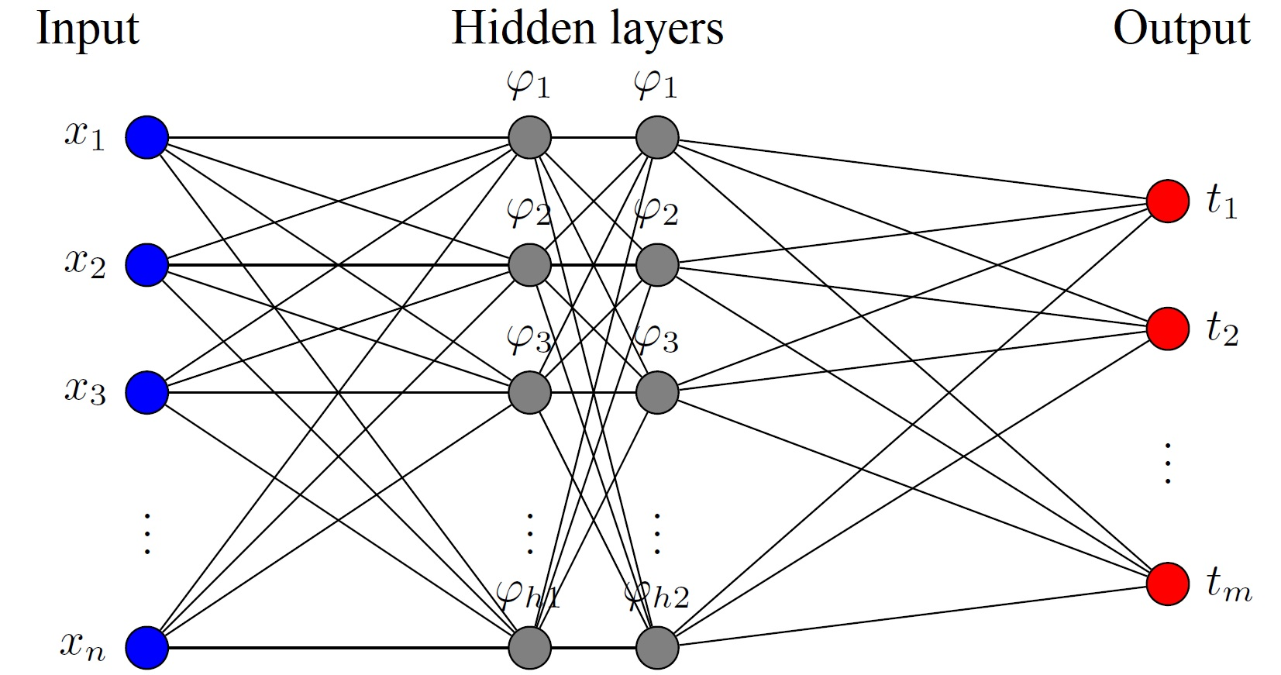
Communities with deep q-learning
The agent:
n: input size
h1: size of hidden layer 1
h2: size of hidden layer 2
m: size of the action space
Input size is state_size*action_size
h1 = h2 = 128
m = 4
To prevent overfitting:
50% dropout on both hidden layers
Multiple independent representation
83% precision with early model after 70 epochs

Slide 12
forceatlas

Slide 13
Forceatlas
Force-directed layout based on n-body simulation
Repulsion-attraction
Makes visual interpretation easier
Result depends on starting state

Slide 14
Results
(ForceAtlas)
Database: 4,31x
Silicon: 6,65x
3D: 9x
CT: 9,8x
      Database Silicon 3D CT
      Nodes 17832 24923 35763 53039
      Edges 113622 185594 192336 325490

Slide 15
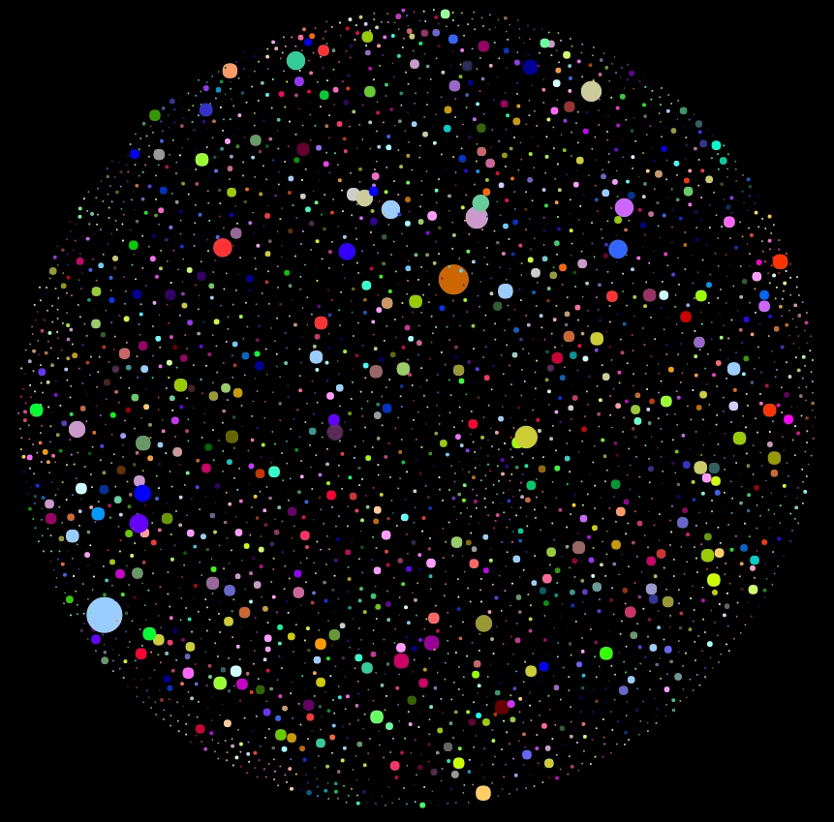
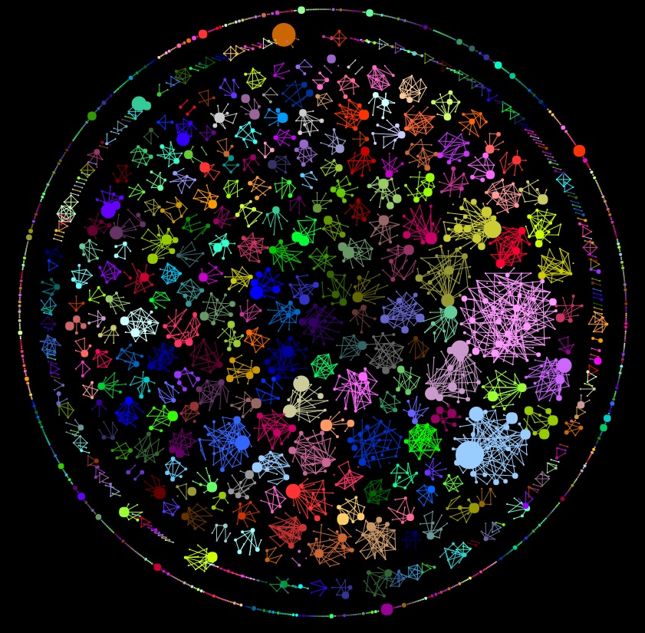
ForceAtlas Layout types
Original layout
Community based layout

Slide 16
Barnes-Hut Tree with RNN

Slide 17
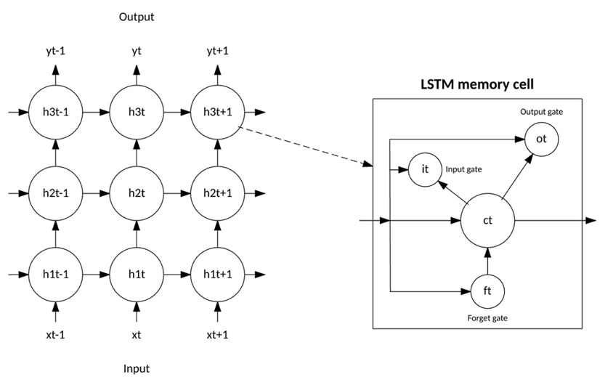
Barnes-Hut Tree with RNN
h_{t} : hidden state in timestep t
x_{t} : input in timestep t
h_{t-1} : hidden state in timestep t-1
U: transformation matrix
Ф: activation function(logistic sigmoid, tanh)

Slide 18
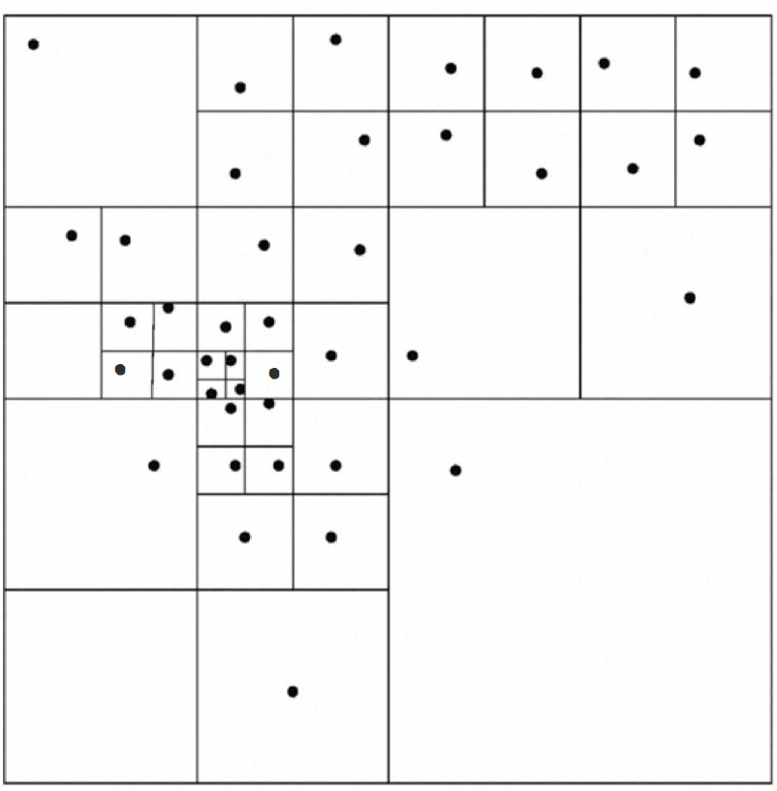
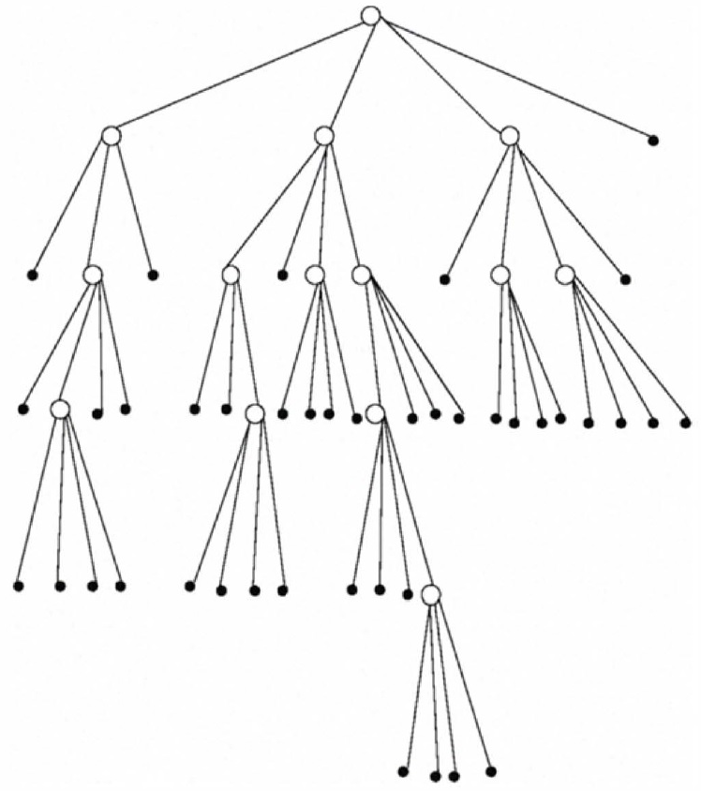
Barnes-Hut Tree with RNN
Generation provides a quadratic tree
Plane is halved until only 1 node remains in a region.
For RNN system is provided as a time series

Slide 19
Barnes-Hut Tree with RNN
t, x, y, old_n_1, old_n_2, old_n_3, …, old_n_N, new_n_1, new_n_2, …, new_n_N
t: timestep
x, y: coordinates of node in timestep t
old_n_N: state generated in timestep t-1 (initially -1)
new_n_N: state generated in timestep t (no -1 at the end)
N: number of nodes
Model trained for graphs with 1000 nodes: 94% accuracy.

Slide 20
Barnes-Hut Tree with RNN
How to use this approach to increase the visual experience?

Slide 21
Barnes-Hut Tree with RNN

Slide 22
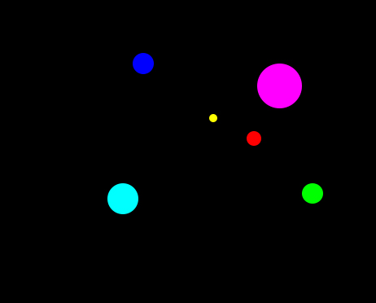
Barnes-Hut Tree with RNN

Slide 23
Barnes-Hut Tree with RNN

Slide 24
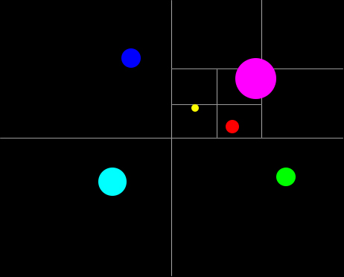
Barnes-Hut Tree with RNN

Slide 25
Barnes-Hut Tree with RNN
We would like to analyse Medipix (red node)
This time the top right corner is the hot zone

Slide 26
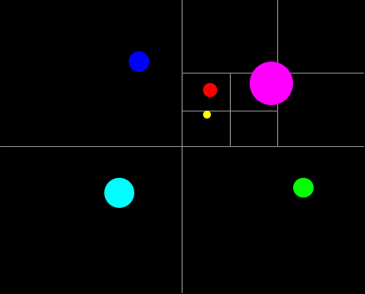
Barnes-Hut Tree with RNN
We move the red node, recompute the tree and store the state for future training

Slide 27
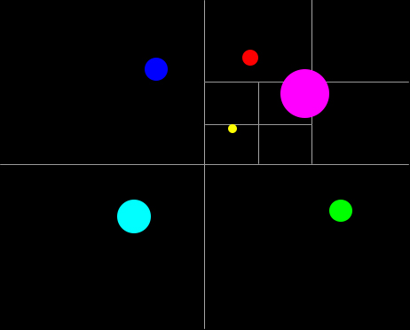
Barnes-Hut Tree with RNN
Red node advancing

Slide 28
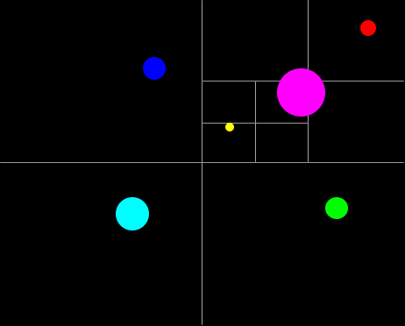
Barnes-Hut Tree with RNN
Red node advancing to final position

Slide 29
Barnes-Hut Tree with RNN
States stored for one node (Medipix)
Train a model for Medipix
The model will move the node through the regions

Slide 30
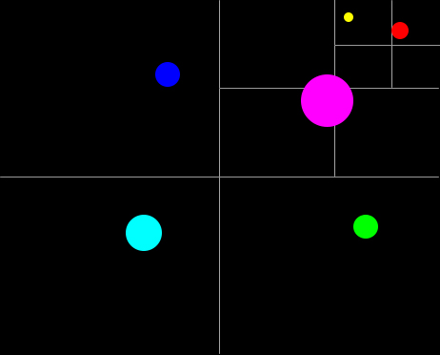
Barnes-Hut Tree with RNN
Graph preprocessed based on Medipix (red) and mpgd (yellow)

Slide 31
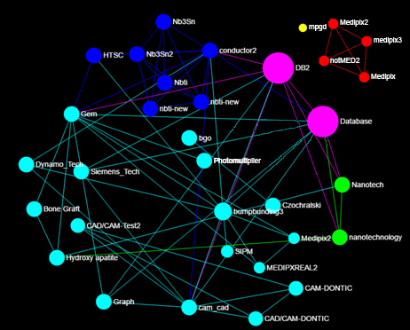
Barnes-Hut Tree with RNN

Slide 32
Thank you

