Slide 1
WP3: C-BAND INJECTOR
D. Alesini
on behalf of the WP3 C-band injector working team*
* F. Cardelli, M. Diomede, G. Castorina, B. Spataro, M. Croia, M. Ferrario, C. Kourkoutis, N. Gazis, C. Vaccarezza, A. Vannozzi, A. Giribono, A. Gallo

Slide 2
ORGANIZATION OF THE ACTIVITY ON C-BAND INJECTOR
1) C-Band gun design to reach the 240 MV/m peak field level
      1a) Optimum 2D profile to minimize mod. Poy. Vector, peak field etc… and to increase the gun mode separation for short RF pulses (F. Cardelli, D. Alesini, G. Castorina)
      1b) Powering schemes with RF pulse compressors and optimum coupling coefficient (D. Alesini, F. Cardelli)
      1c) Coupler design options:
      magnetic (F. Cardelli, D. Alesini)
      mode launcher (G. Castorina, B. Spataro)
      alternative schemes (F. Cardelli, D. Alesini)
2) C-Band TW accelerating structures design for the velocity bunching and acceleration: optimum irises tapering, structure length,… (M. Diomede, D. Alesini)
3) Beam dynamics simulations of the injector to reach the XLS requirements: gun gradient, TW structures accelerating field, solenoids strength, half cell length optimization…(M. Croia, M. Ferrario,…)
4) Solenoids design (C. Kourkoutis, N. Gazis)
5) Mechanical drawings of the injector module (N. Gazis)

Slide 3
ORGANIZATION OF THE ACTIVITY ON C-BAND INJECTOR
1) C-Band gun design to reach the 240 MV/m peak field level
      1a) Optimum 2D profile to minimize mod. Poy. Vector, peak field etc… and to increase the gun mode separation for short RF pulses (F. Cardelli, D. Alesini, G. Castorina)
      1b) Powering schemes with RF pulse compressors and optimum coupling coefficient (D. Alesini, F. Cardelli)
      1c) Coupler design options:
      magnetic (F. Cardelli, D. Alesini)
      mode launcher (G. Castorina, B. Spataro)
      alternative schemes (F. Cardelli, D. Alesini)
2) C-Band TW accelerating structures design for the velocity bunching and acceleration: optimum irises tapering, structure length,… (M. Diomede, D. Alesini)
3) Beam dynamics simulations of the injector to reach the XLS requirements: gun gradient, TW structures accelerating field, solenoids strength, half cell length optimization…(M. Croia, M. Ferrario,…)
4) Solenoids design (C. Kourkoutis, N. Gazis)
5) Mechanical drawings of the injector module (N. Gazis)

Slide 4
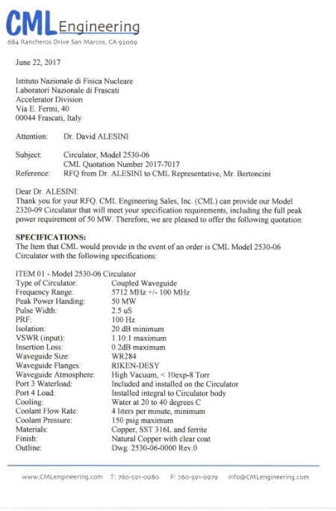
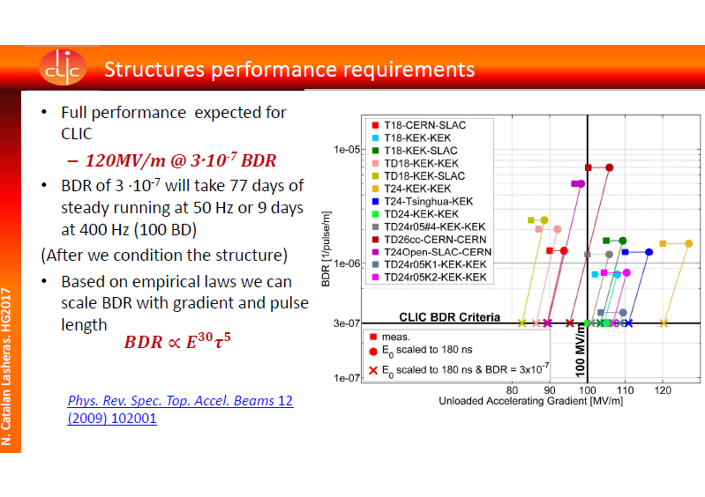
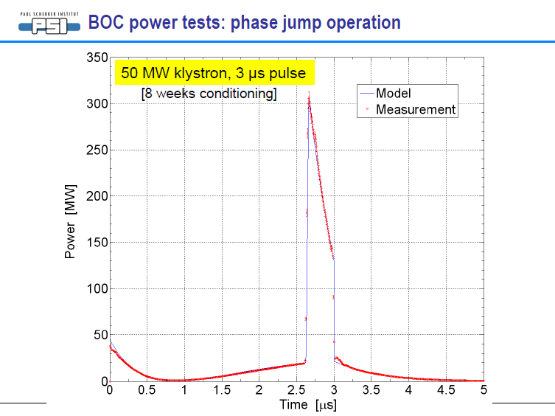
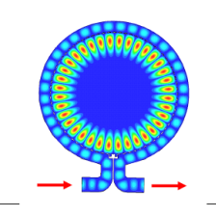
C-band gun design: general considerations
State of the art:
in X band (CERN/SLAC) with τ_{p}≅180 ns input pulse E_{surf}≅240 MV/m S_{c}≅4 W/µm² BDR∼10⁻⁶ bpp/m
C Band klystrons with solid state modulators (Toshiba+Scandinova) are working up to 100 Hz with 2.5 μs, 50 MW peak power available
Circulator (CML) available: 50 MW, 2.5 μs, 100 Hz
SLED/BOC C-band compressors available (PSI) with amplification factors >4 @ 200 ns flat top pulses
Consequences:
A C-Band gun filled in 180 ns and working at 240 MV/m with BDR∼10⁻⁶ can work, if properly designed;
Circulator can be used up to the 50 MW peak power level
SLED/BOC C-band compressors can be used (if necessary)
ULTRA FAST GUN

Slide 5
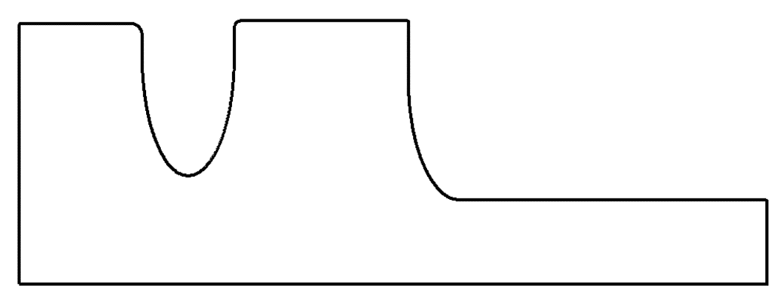
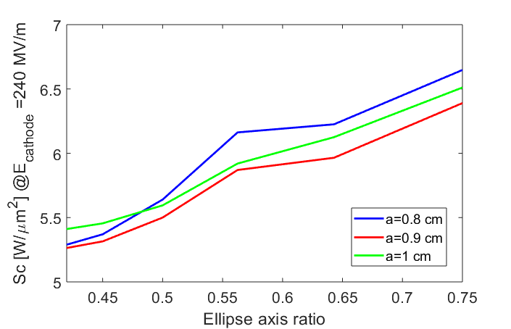
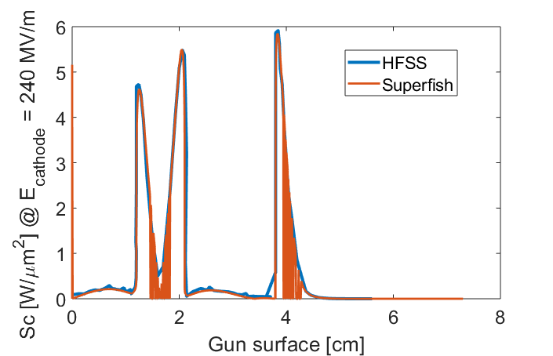
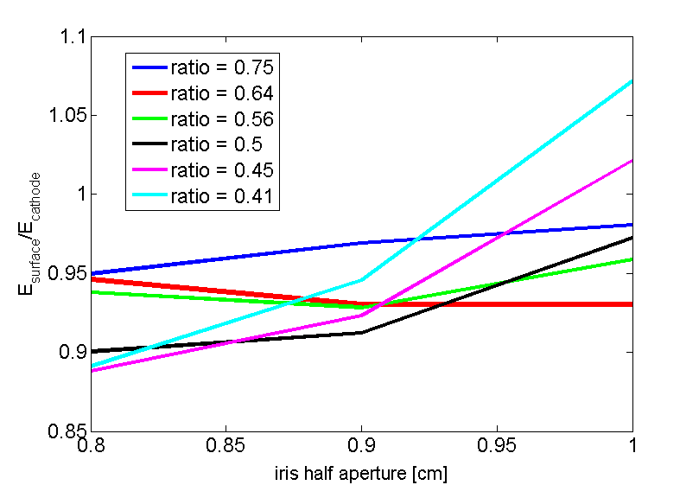
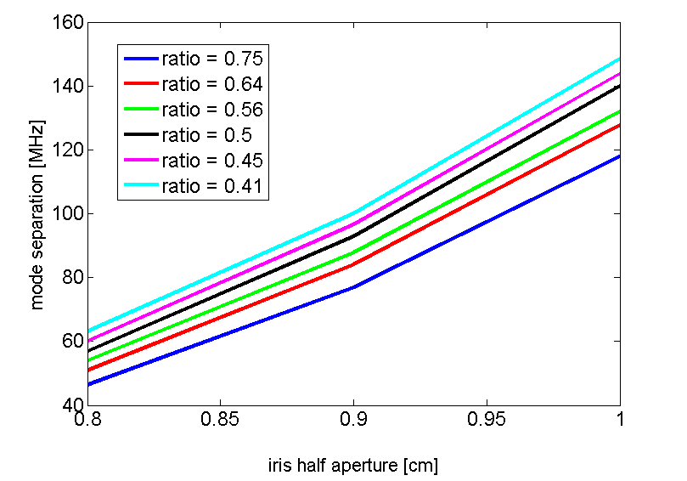
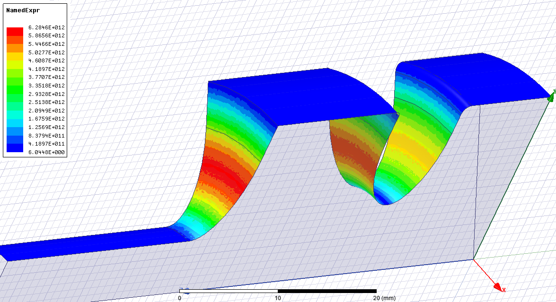
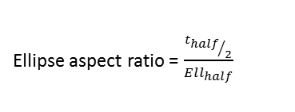
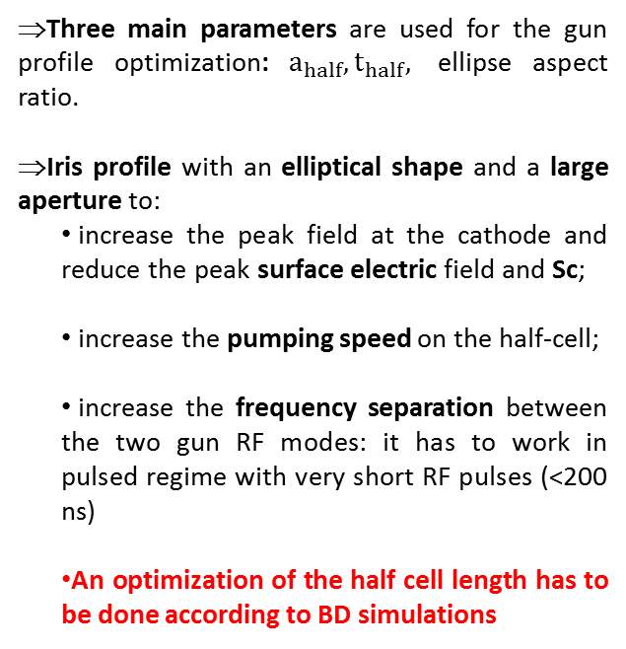
C-Band gun 2D DESIGN: mode separation, MODIFIED POYNTING VECTOR
⇒Three main parameters are used for the gun profile optimization: $a_{half}, t_{half},$ ellipse aspect ratio.
⇒Iris profile with an elliptical shape and a large aperture to:
      increase the peak field at the cathode and reduce the peak surface electric field and Sc;
      increase the pumping speed on the half-cell;
      increase the frequency separation between the two gun RF modes: it has to work in pulsed regime with very short RF pulses (<200 ns)
      An optimization of the half cell length has to be done according to BD simulations
Ellipse aspect ratio = $\frac{{t_{half}}/2}{Ell_{half}}$
a_{half}
Assuming 150 ns input pulse we have an expected BDR of 10⁻⁵ bpp/m that means, on the 4 cm RF gun a BDR >10⁻⁶ bpp

Slide 6
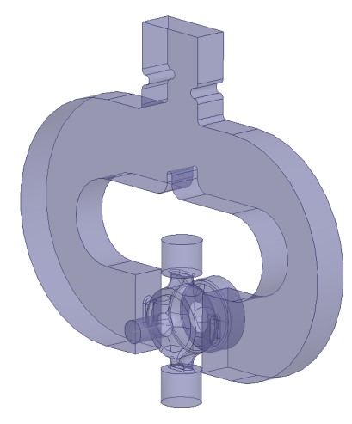
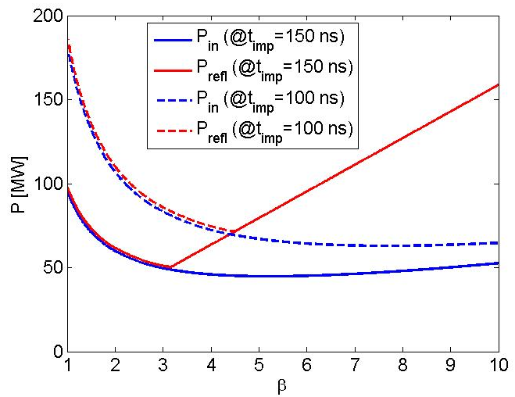
C-Band gun design: optimum coupling coefficient CALCULATION
We calculated the required input power (and reflected power) to reach 240 MV/m cathode peak field
P_{refl}
P_{in}
Considered C-Band gun parameters (2D and preliminary 3D calculations)
f_{π} | 5.712 GHz
Q₀ | 10450
τ_{F} | 140 ns
E_{cath} | 240 MV/m
P_{diss} @E_{cath}=240MV/m | 15.5 MW
Av. P_{diss} @100Hz, 200ns | <300 W
⇒A coupling coefficient equal to 3 allows keeping under control the required input power necessary to reach the 240MV/m on the cathode.
⇒With β=3 we can also keep at a reasonable value the reflected power
P_{diss}

Slide 7
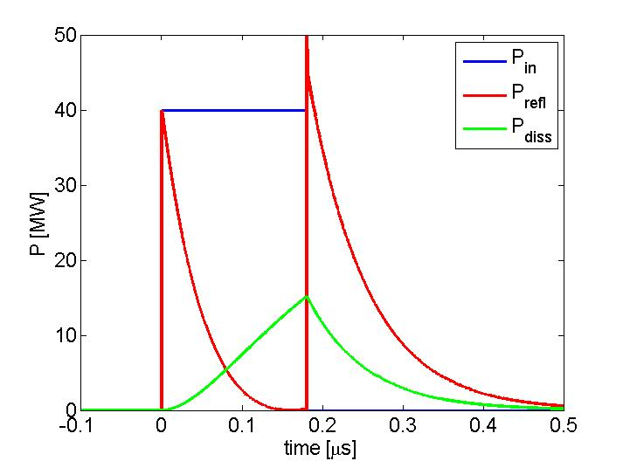
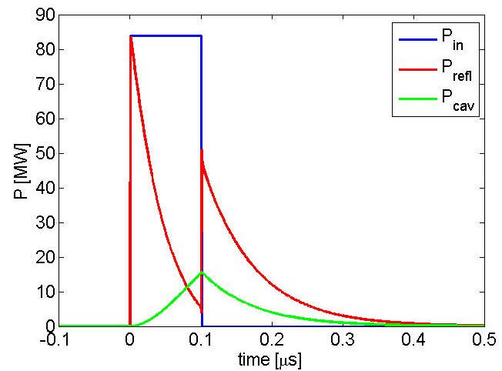
C-Band gun design: POWERING SCHEMES
CASE 1
-Klystron connected to the cavity through one circulator
-RF pulse length 180 ns
0.180 μs 40 MW
β=3
KLY
circ
GUN
CASE 2
-Klystron connected to the cavity through one RF compressor (P.C.) and two circulators
-RF pulse length 100 ns
100 ns, 85 MW
P.C.
X2.1
circ
β=3
KLY
circ
GUN
1-1.5 μs, 40 MW
This second scheme is more flexible (we can detune the P.C. and go to the case 1) and allows exploring RF pulses even shorter than 100 ns

Slide 8
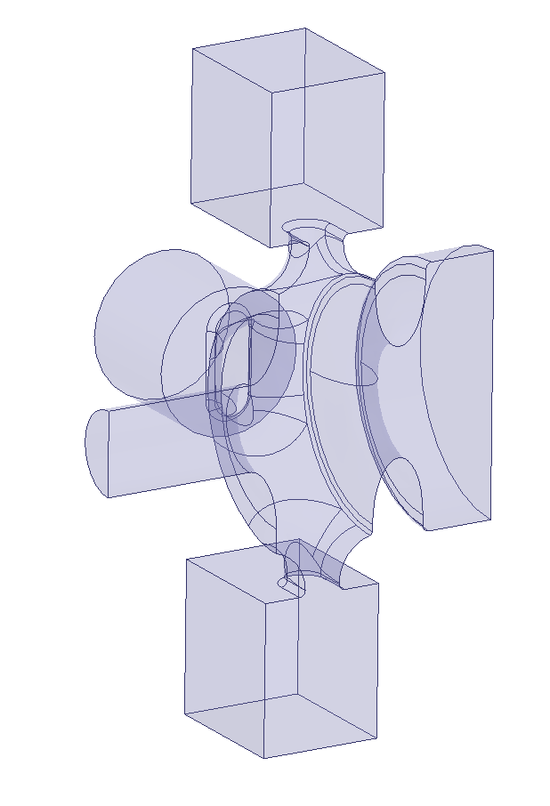
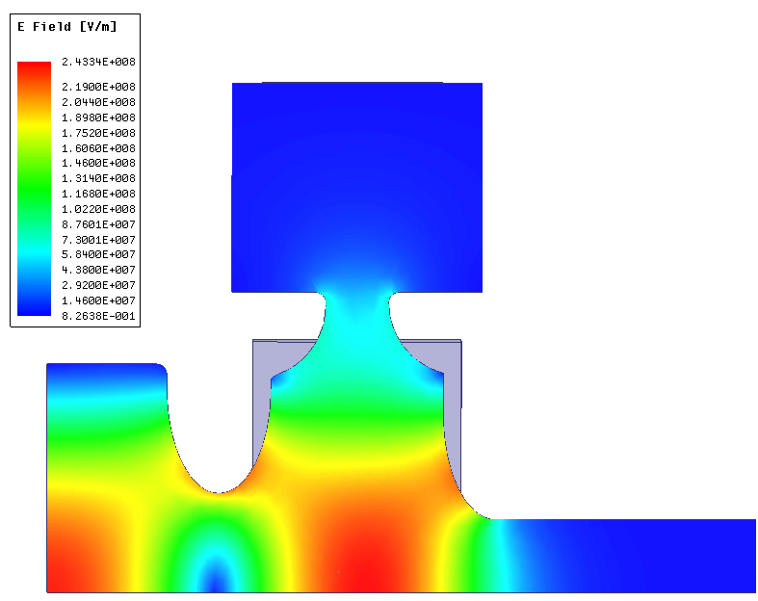
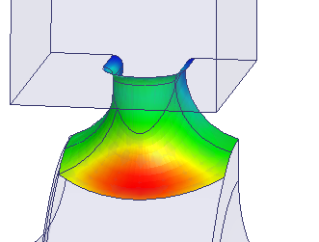
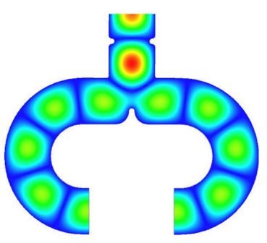
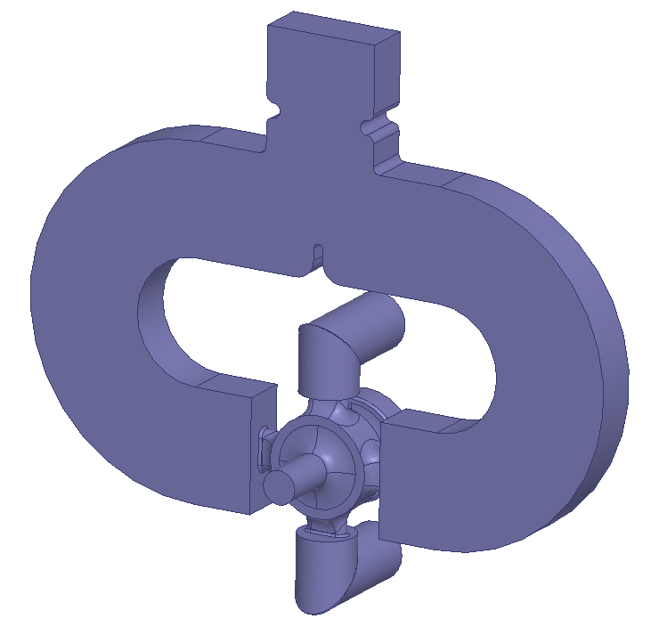
gun COUPLER: MAGNETIC COUPLING
Input waveguide
Quadrupole field compensating hole and pumping port
Input waveguide
Magnetic Field Distorsion compensation:
Symmetric feeding with two input waveguides and two symmetric holes for quadrupole field compensation
cathode
solenoid
Pulsed heating:
The coupling window strongly rounded to reduce the peak surface magnetic field and, as a consequence, the pulsed heating.
Coupling apertures
Input waveguide
Power splitter
Pumping ports:
The holes for quadrupole compensation can be used for pumping
f_{π} | 5.712 GHz
Δf_{0-π} | ≈ 100 MHz
Q₀ | 10450
β | 3
τ_{F} | 143 ns
E_{cath} | 240 MV/m
P_{in} @240MV/m | 20.8 MW
Av.P_{diss} @100Hz, 200ns | 300 W
T_{pulsed} @ 200 ns | 66°C
Laser injection:
On axis
Solenoid:
Can be put immediately after the gun and installed separately. Bore of the solenoid relatively small (no cathode compensation solenoids required, in principle)
Vacuum pumping port

Slide 9
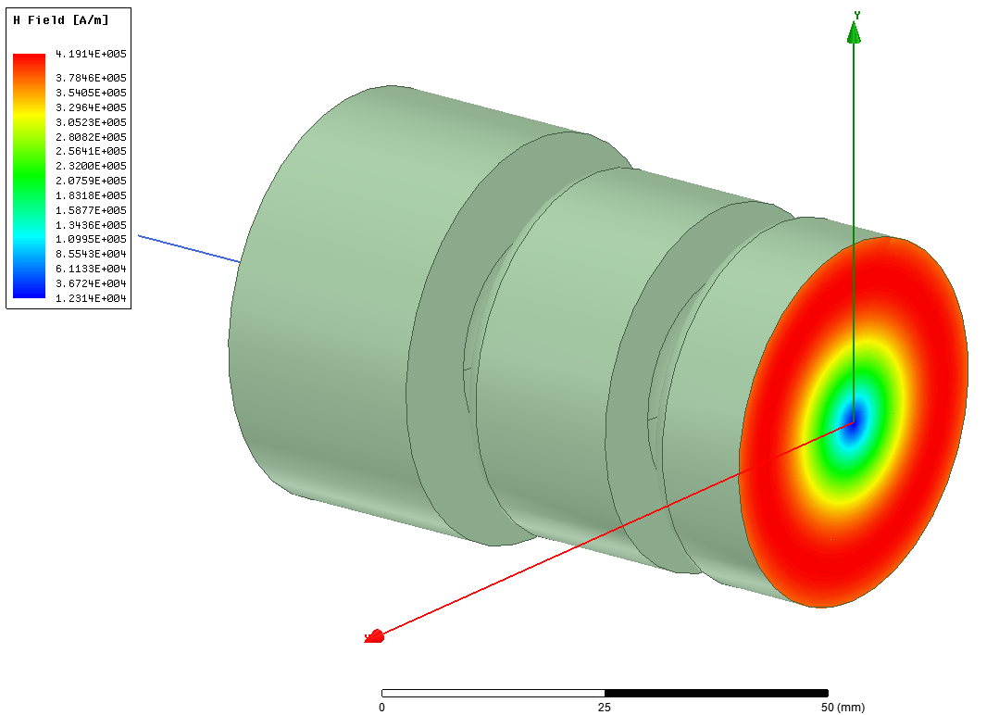
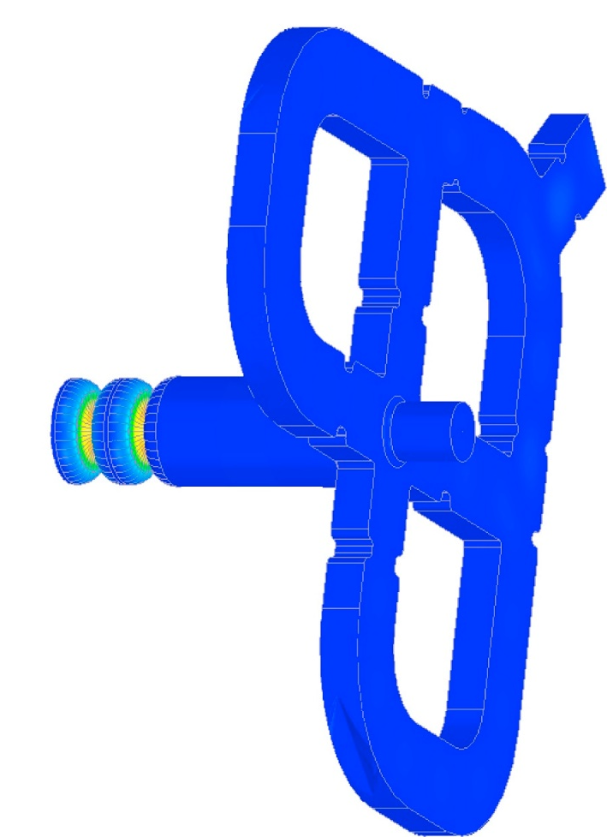
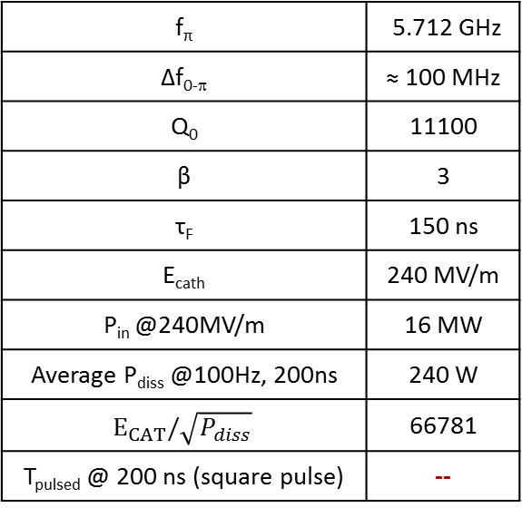
gun COUPLER: MODE LAUNCHER
Magnetic Field Distorsion compensation:
Perfect 2D profile: no multipole components
Input waveguide
Pulsed heating:
No pulsed heating on the input coupler
Pumping ports:
To be studied. Pumping from waveguides could be too far form the accelerating cells
Gun
f_{π} | 5.712 GHz
Δf_{0-π} | ≈ 100 MHz
Q₀ | 11100
β | 3
τ_{F} | 150 ns
E_{cath} | 240 MV/m
P_{in} @240MV/m | 16 MW
Average P_{diss} @100Hz, 200ns | 240 W
$$E_{CAT}/\sqrt{P_{diss}}$$ | 66781
T_{pulsed} @ 200 ns (square pulse) | --
Mode launcher
Laser injection:
To be studied. On axis injection after the mode launcher is probably too far from the cathode
Input waveguide
Solenoid:
To be studied. The solenoid bore has to be increased with respect to the other cases and a compensating solenoid for the reduction of the magnetic field on the cathode has to be designed
solenoid

Slide 10
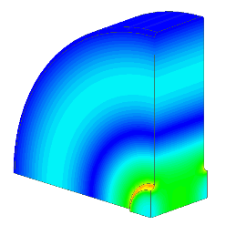
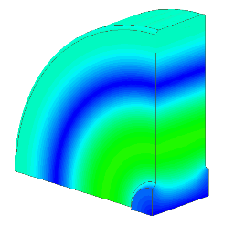
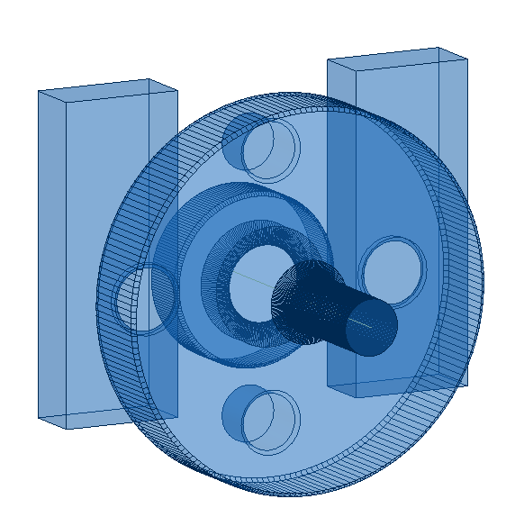
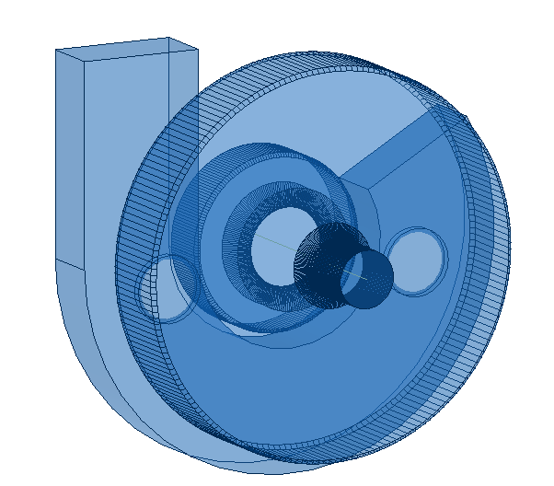
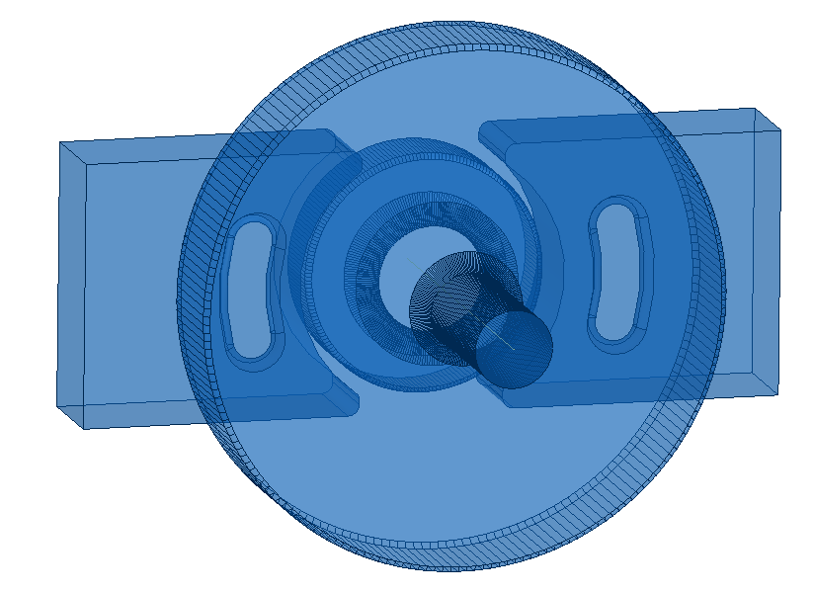
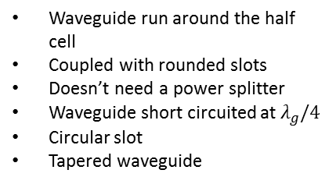
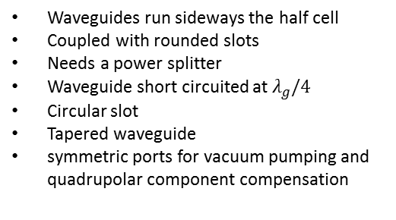
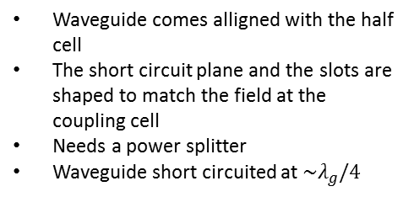
gun COUPLER: TM₀₂₀ ELECTRIC COUPLING
We need to have a compact gun to have the possibility to place the solenoid immediately after the full cell (no mode launcher type) and low surface fields and pulsed heating.
Proposed coupler: Electric coupling (EC) coupler based on TM₀₂₀ mode on the full cell.
Different kind of geometries have been investigated:
H field
E field
Type A
P_{in}
P_{in}
P_{in}
Type B
Type C
P_{in}
P_{in}
Waveguide comes alligned with the half cell
The short circuit plane and the slots are shaped to match the field at the coupling cell
Needs a power splitter
Waveguide short circuited at $\sim λ_{g}/4$
Waveguides run sideways the half cell
Coupled with rounded slots
Needs a power splitter
Waveguide short circuited at $λ_{g}/4$
Circular slot
Tapered waveguide
symmetric ports for vacuum pumping and quadrupolar component compensation
Waveguide run around the half cell
Coupled with rounded slots
Doesn’t need a power splitter
Waveguide short circuited at $λ_{g}/4$
Circular slot
Tapered waveguide

Slide 11
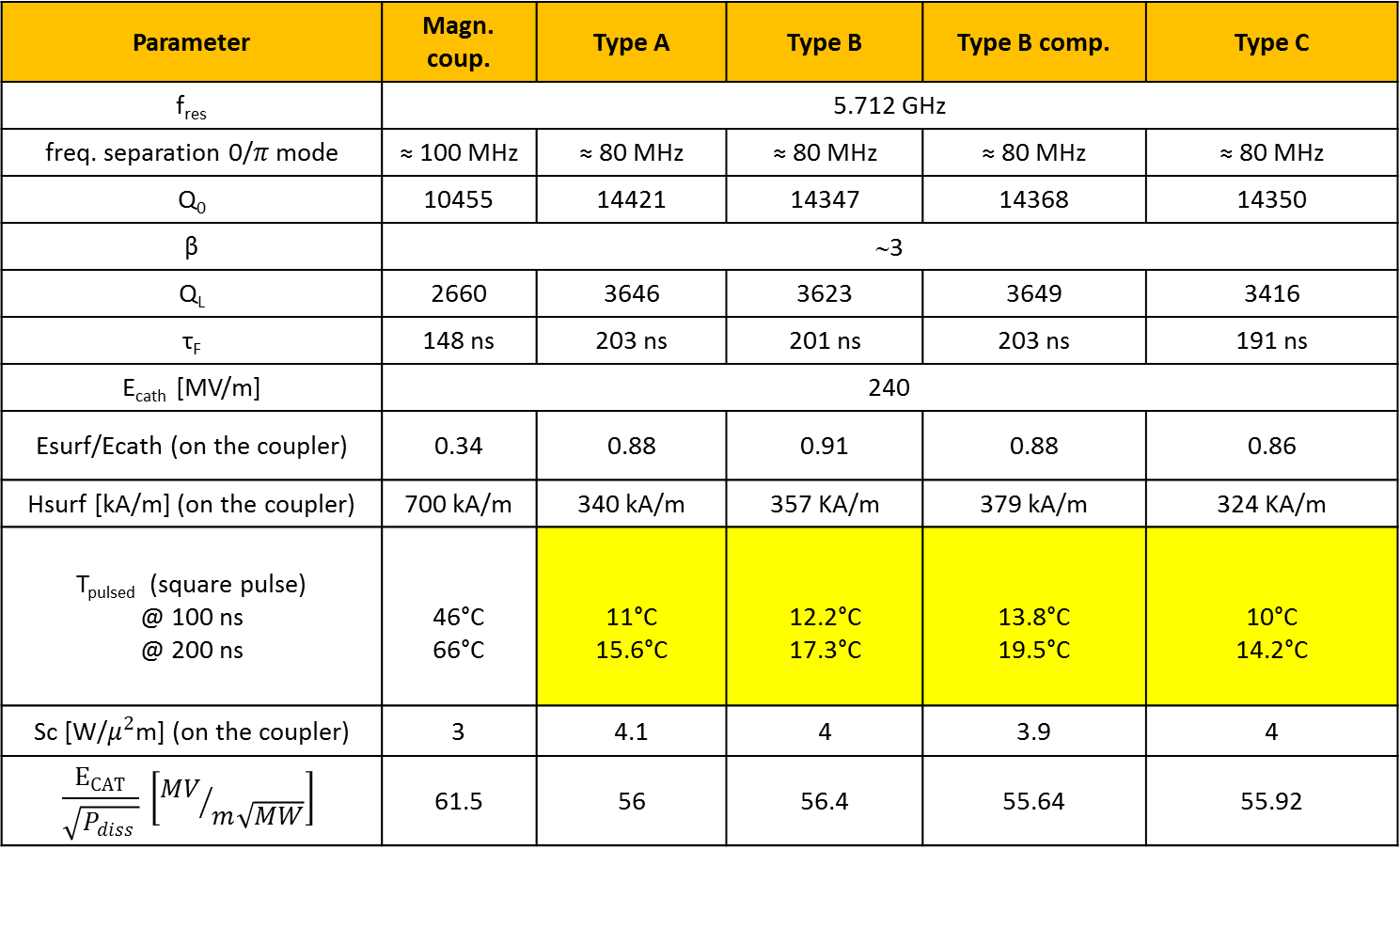
gun COUPLER: TM₀₂₀ ELECTRIC COUPLING
Parameter | Magn. coup. | Type A | Type B | Type B comp. | Type C
f_{res} | 5.712 GHz
freq. separation 0/$π$mode | ≈ 100 MHz | ≈ 80 MHz | ≈ 80 MHz | ≈ 80 MHz | ≈ 80 MHz
Q₀ | 10455 | 14421 | 14347 | 14368 | 14350
β | ∼3
Q_{L} | 2660 | 3646 | 3623 | 3649 | 3416
τ_{F} | 148 ns | 203 ns | 201 ns | 203 ns | 191 ns
E_{cath} [MV/m] | 240
Esurf/Ecath (on the coupler) | 0.34 | 0.88 | 0.91 | 0.88 | 0.86
Hsurf [kA/m] (on the coupler) | 700 kA/m | 340 kA/m | 357 KA/m | 379 kA/m | 324 KA/m
T_{pulsed} (square pulse) @ 100 ns @ 200 ns | 46°C 66°C | 11°C 15.6°C | 12.2°C 17.3°C | 13.8°C 19.5°C | 10°C 14.2°C
Sc [W/$μ^{2}$m] (on the coupler) | 3 | 4.1 | 4 | 3.9 | 4
$$\frac{E_{CAT}}{\sqrt{P_{diss }}} \left[{MV}/{m\sqrt{MW}}\right]$$ | 61.5 | 56 | 56.4 | 55.64 | 55.92

Slide 12
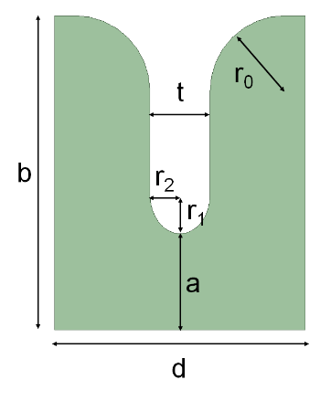
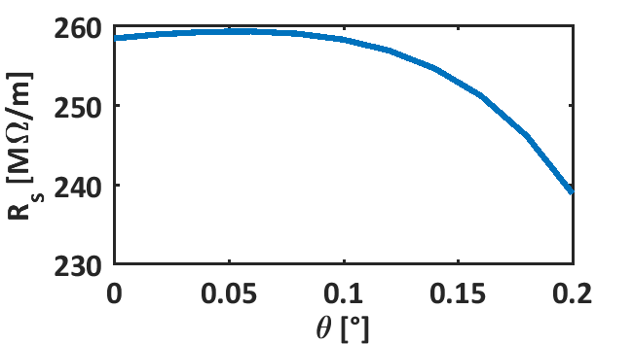
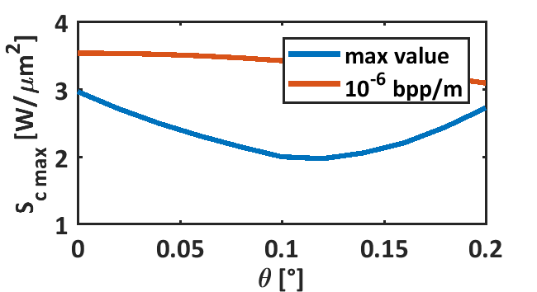
C-BAND TW STRUCTURES FOR VELOCITY BUNCHING
BD simulations have to be done
In the meanwhile a scan of possible C-band structures geometries (irises apertures, tapering, powering schemes…) is under investigation
Effective shunt impedance
f | 5.712 GHz
d cell | 17.496 mm
t_F | 320 ns
Q₀ of BOC | 210000
Ls | 1.2 m
<a> | 6.3 mm
P_{in}=11 MW per structure for 60 MV/m average acc. gradient
Referred to 65 MV/m

Slide 13
ORGANIZATION OF THE ACTIVITY ON C-BAND INJECTOR
1) C-Band gun design to reach the 240 MV/m peak field level
      1a) Optimum 2D profile to minimize mod. Poy. Vector, peak field etc… and to increase the gun mode separation for short RF pulses (F. Cardelli, D. Alesini, G. Castorina)
      1b) Powering schemes with RF pulse compressors and optimum coupling coefficient (D. Alesini, F. Cardelli)
      1c) Coupler design options:
      magnetic (F. Cardelli, D. Alesini)
      mode launcher (G. Castorina, B. Spataro)
      alternative schemes (F. Cardelli, D. Alesini)
2) C-Band TW accelerating structures design for the velocity bunching and acceleration: optimum irises tapering, structure length,… (M. Diomede, D. Alesini)
3) Beam dynamics simulations of the injector to reach the XLS requirements: gun gradient, TW structures accelerating field, solenoids strength, half cell length optimization…(M. Croia, M. Ferrario,…)
4) Solenoids design (C. Kourkoutis, N. Gazis)
5) Mechanical drawings of the injector module (N. Gazis)

Slide 14
BEAM DYNAMICS SIMULATIONS OF A C-BAND INJECTOR: CONSIDERED LAYOUT
(M. Croia, M. Ferrario, A. Giribono, C. Vaccarezza)
Considered layout (not in scale)
TW structures solenoids
2 C-band TW structures, with solenoid around, operating at 40 MV/m average accelerating gradient (as example, PSI-like structures with 1 klystron every 2 sections)
Gun solenoid
2 m
X-band accelerating module
1.6 cell RF gun operating at 240 MV/m cathode peak field
Drift 0.7 m for pumping, diagnostics and emittance control
Drift 0.5 m for pumping and diagnostics

Slide 15
BEAM DYNAMICS SIMULATIONS OF A C-BAND INJECTOR: RESULTS
(M. Croia, M. Ferrario, A. Giribono, C. Vaccarezza)
Laser radius 300μm (uniform), L≅4ps (rise time ∼0.5 ps)
ε_{INT}=118 nm
Q=75 pC
M. Croia

Slide 16
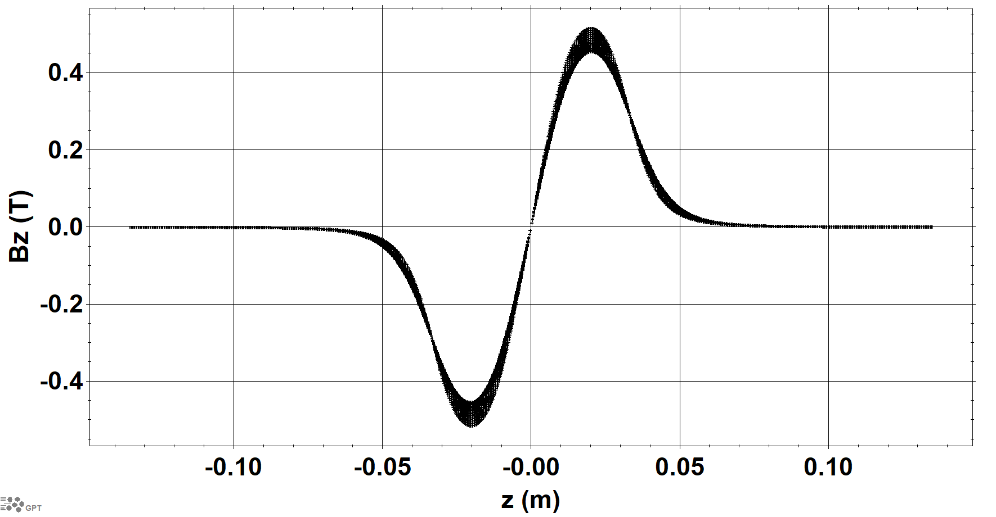
PRELIMINARY REQUIREMENTS FOR THE SOLENOIDS
Two coils solenoid in order to have the possibility to power it in the two configurations ++ and +-
Bore of the solenoid >40 mm (diameter)
Bmax in ++ config ∼0.75 T
Bmax in +- config ∼0.5 T
Integratde field in ++ config ∼0.06 Tm
Good field region radius 15 mm
Cathode position with respect to the center of the solenoid ∼100 mm
Solenoid length ∼ 90-100 mm
Field at the cathode position ∼10⁻⁴ gauss
Coils of ∼0.5 m powered independently
Internal radius of the coil >200 mm
Maximum field in the center >0.65 T

Slide 17
ORGANIZATION OF THE ACTIVITY ON C-BAND INJECTOR
1) C-Band gun design to reach the 240 MV/m peak field level
      1a) Optimum 2D profile to minimize mod. Poy. Vector, peak field etc… and to increase the gun mode separation for short RF pulses (F. Cardelli, D. Alesini, G. Castorina)
      1b) Powering schemes with RF pulse compressors and optimum coupling coefficient (D. Alesini, F. Cardelli)
      1c) Coupler design options:
      magnetic (F. Cardelli, D. Alesini)
      mode launcher (G. Castorina, B. Spataro)
      alternative schemes (F. Cardelli, D. Alesini)
2) C-Band TW accelerating structures design for the velocity bunching and acceleration: optimum irises tapering, structure length,… (M. Diomede, D. Alesini)
3) Beam dynamics simulations of the injector to reach the XLS requirements: gun gradient, TW structures accelerating field, solenoids strength, half cell length optimization…(M. Croia, M. Ferrario,…)
4) Solenoids design (A. Vannozzi)
5) Mechanical drawings of the injector module (N. Gazis)

Slide 18
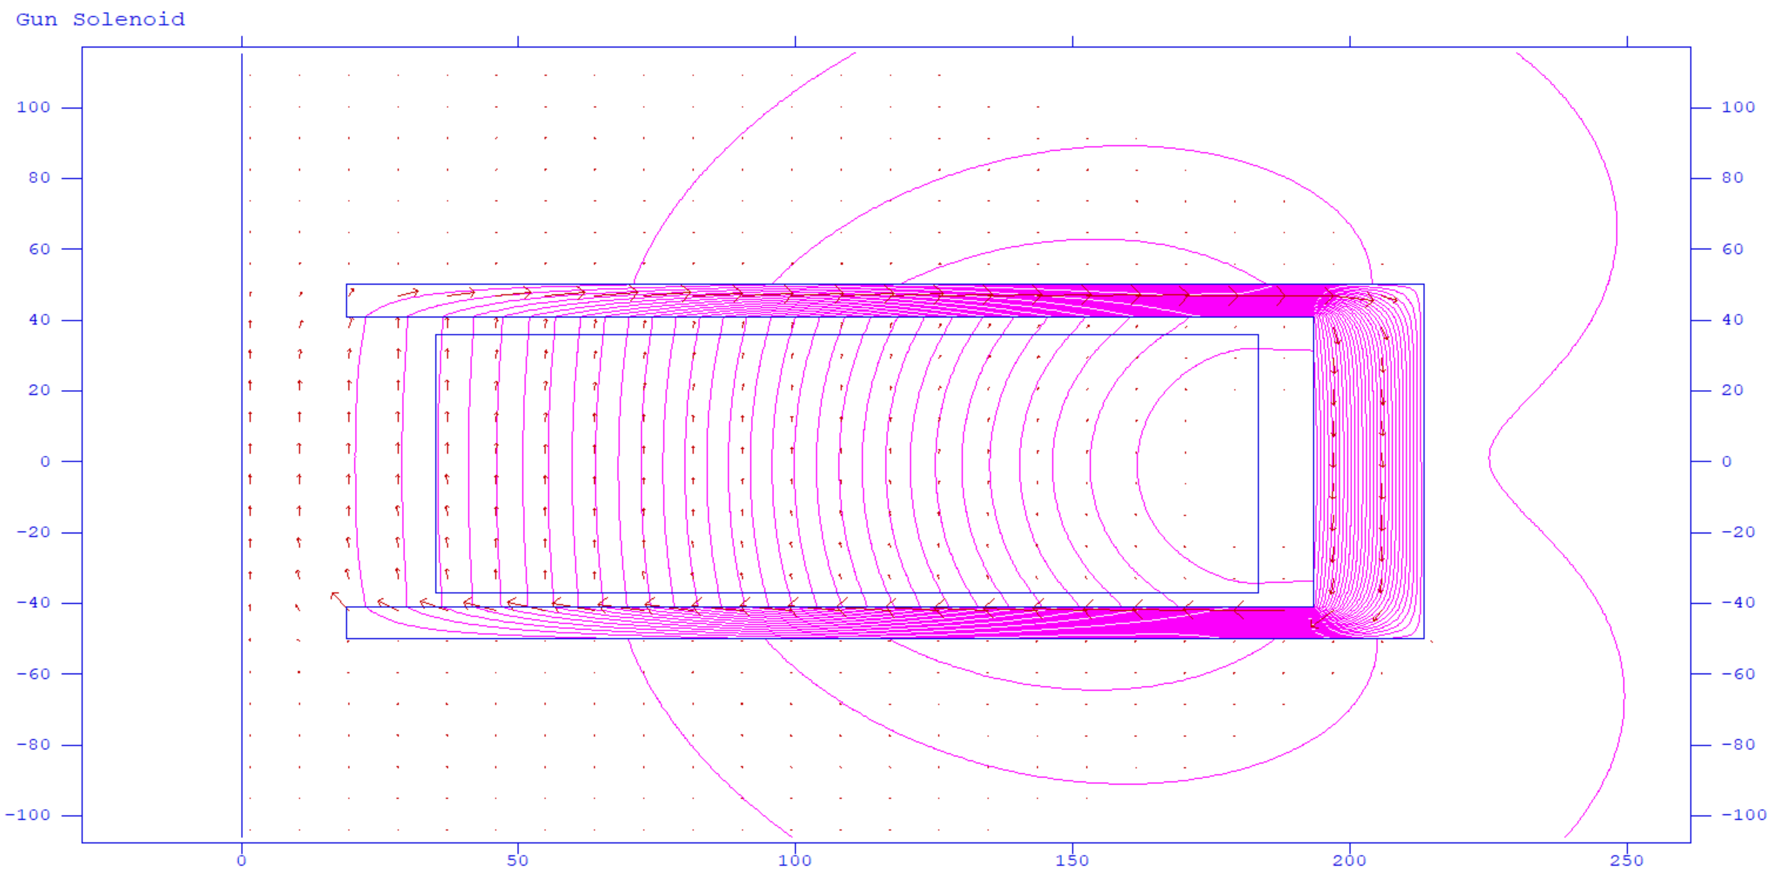
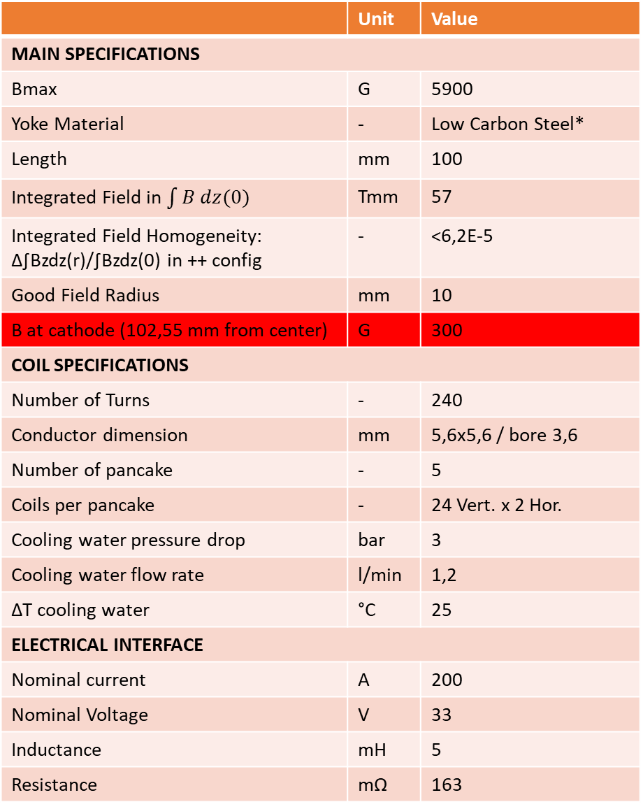
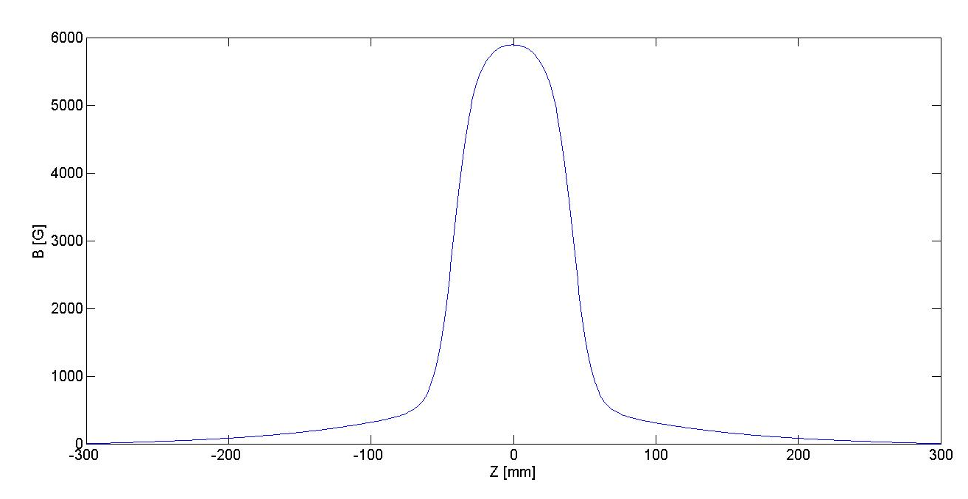
C Band Gun Solenoid 2D Simulation
50
200
35
19
A. Vannozzi

Slide 19
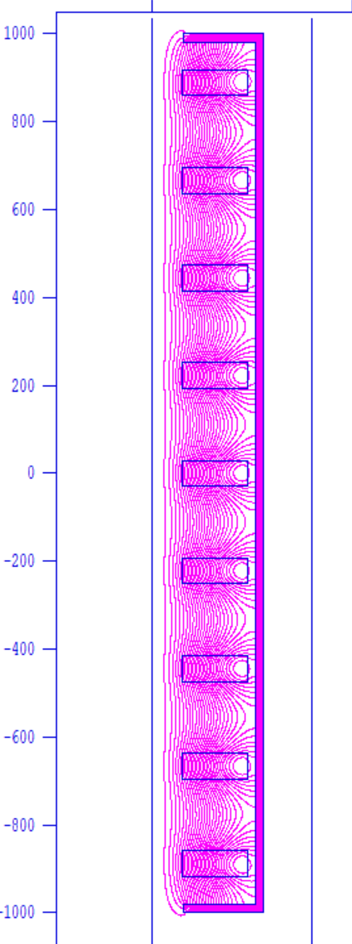
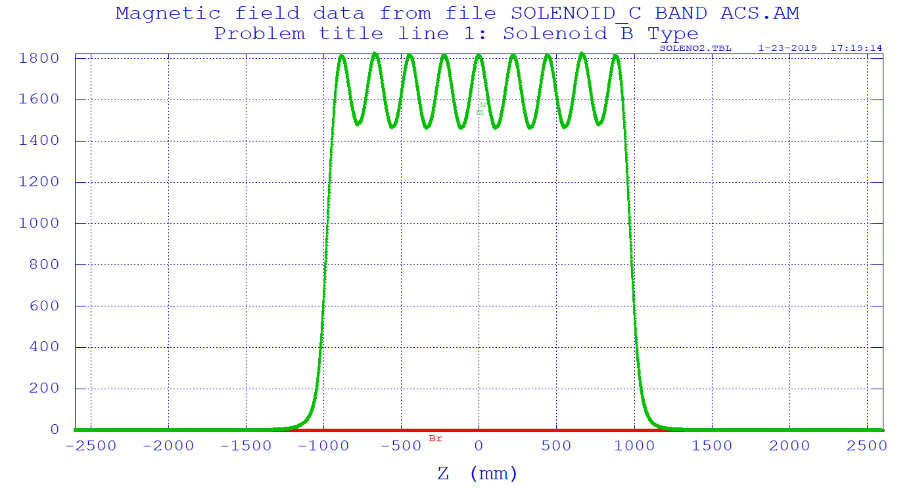
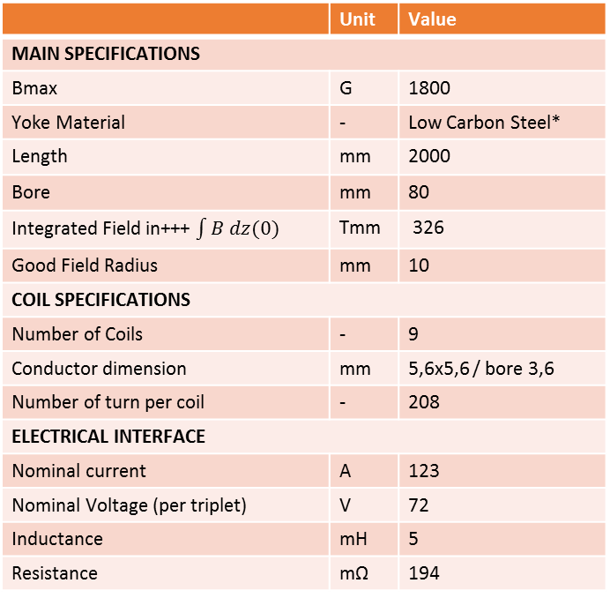
Solenoid on C-Band accelerating structure 2D Simulation
 | Unit | Value
MAIN SPECIFICATIONS
Bmax | G | 1800
Yoke Material | - | Low Carbon Steel*
Length | mm | 2000
Bore | mm | 80
Integrated Field in+++ $\int{B dz(0)}$ | Tmm | 326
Good Field Radius | mm | 10
COIL SPECIFICATIONS
Number of Coils | - | 9
Conductor dimension | mm | 5,6x5,6 / bore 3,6
Number of turn per coil | - | 208
ELECTRICAL INTERFACE
Nominal current | A | 123
Nominal Voltage (per triplet) | V | 72
Inductance | mH | 5
Resistance | mΩ | 194
A. Vannozzi

Slide 20

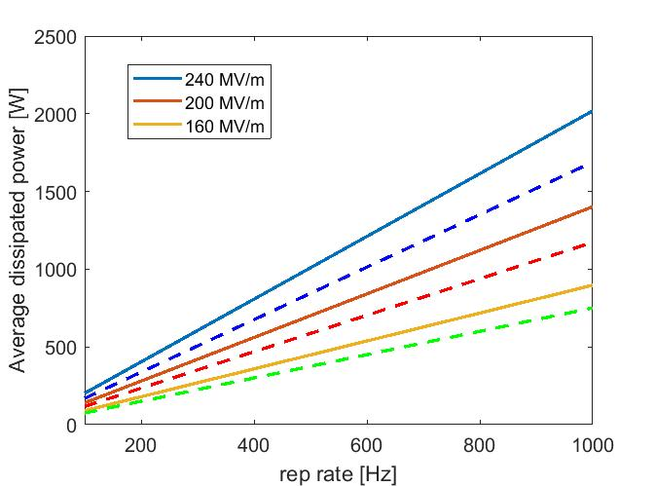
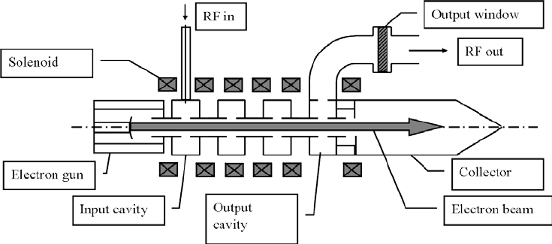
kHz REPETITION RATE OPERATION
The high repetition rate operation is limited by two effects:
The average dissipate power in the structure. This power because of the short pulses can be managed, in principle, even at extremely high gradients of 240 MV/m
The klystron power available at high rep. Rate. This is the real limitation and it is due to the maximum power can be released on the collector
Cont. Line: t_{p}=200 ns
Dashed Line: t_{p}=100 ns

Slide 21
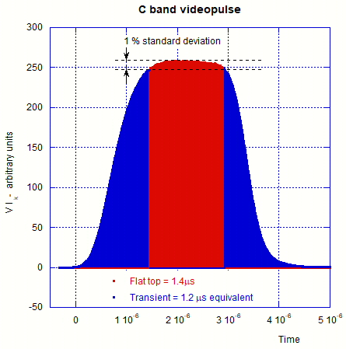
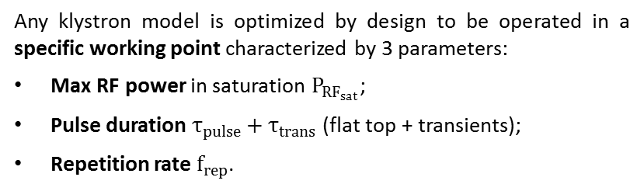
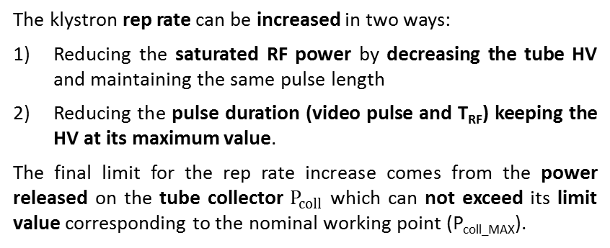
Towards higher rep rate operation of RF power sources (KLYSTRONS)
Any klystron model is optimized by design to be operated in a specific working point characterized by 3 parameters:
Max RF power in saturation $P_{{RF}_{sat}}$;
Pulse duration $τ_{pulse}+τ_{trans}$ (flat top + transients);
Repetition rate $f_{rep}$.
Video pulse measured at SPARC C-band klystron
The klystron rep rate can be increased in two ways:
Reducing the saturated RF power by decreasing the tube HV and maintaining the same pulse length
Reducing the pulse duration (video pulse and T_{RF}) keeping the HV at its maximum value.
The final limit for the rep rate increase comes from the power released on the tube collector $P_{coll}$ which can not exceed its limit value corresponding to the nominal working point (P_{coll_MAX}).
Contribution due to transients that is strongly dependent from the modulator characteristics (solid state are better)
Contribution due to the flat top
14/20

Slide 22
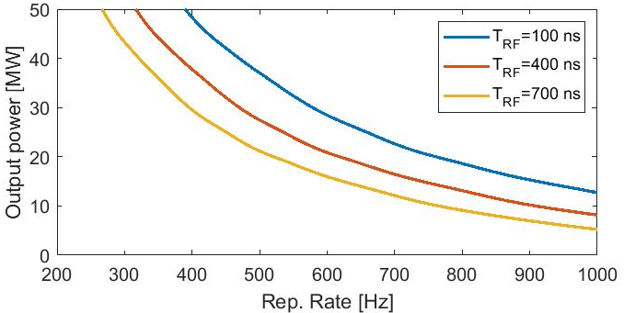
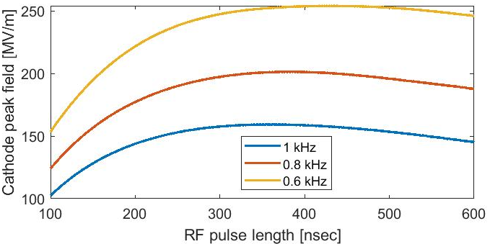


Rep rate increase REDUCING THE RF pulse duration
In this case we reduce the RF pulse but we are dominated by the modulator transients. Looking at the values of the high power C-band klystron Canon (Toshiba) E37212 that are specified for 100 Hz, 50 MW, t_{RF_MAX}=2.5 μs, t_{trans}=2.5 μs, we obtain P_{coll_MAX}≅58kW.
Assuming equivalent transients given by solid state modulators similar to that measured on SPARC C-band klystrons (t_{trans}∼1.2 μs) we obtain:
Mode launcher case

