Slide 1
Injector Simulations
X-Band injector
Avni Aksoy

Slide 2
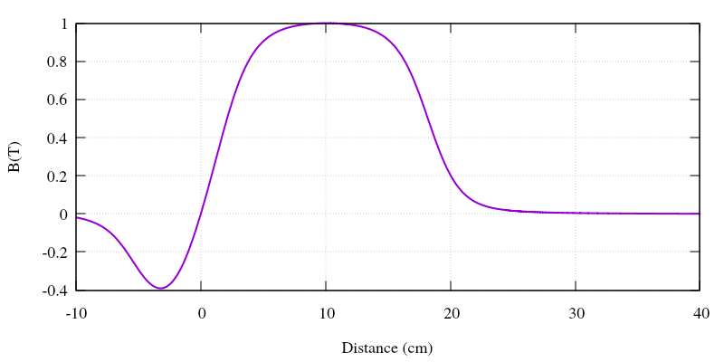
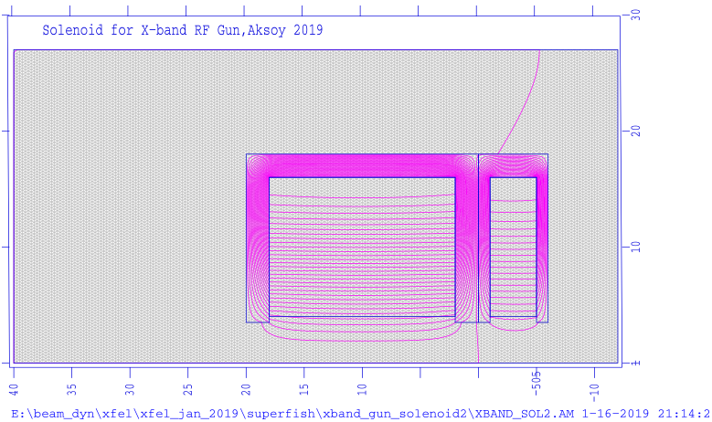
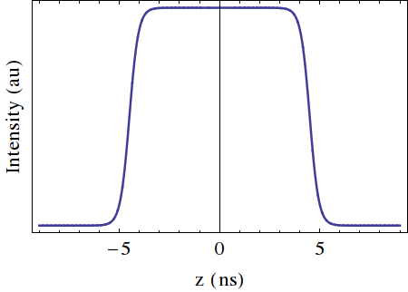
X-band based Injector
Laser
12 GHz RF Gun
5.6 Cell, 200 MV/m
12 GHz Traveling wave structures
108 cell, ~0.9 m, 65MV/m, 120 degree
σ_{z} = 2 ps (FWHM)
σ_{x,y} = 0.25 mm

Slide 3
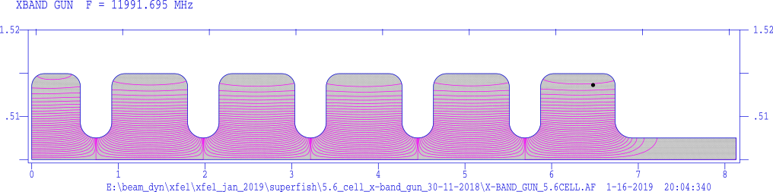
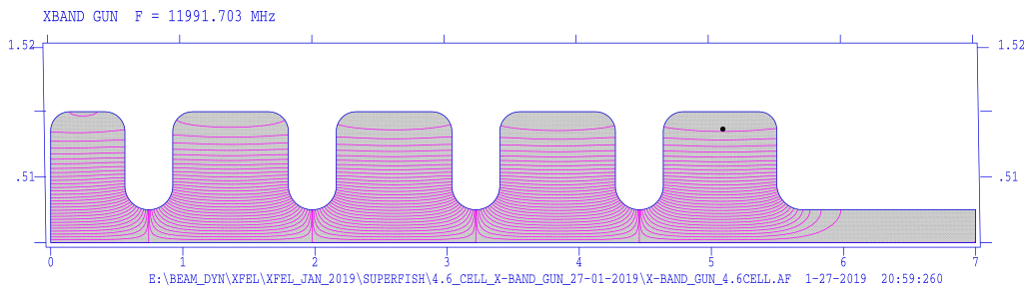
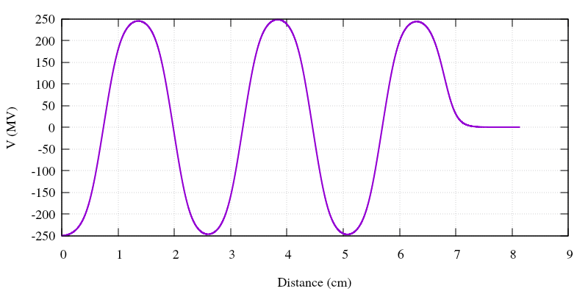
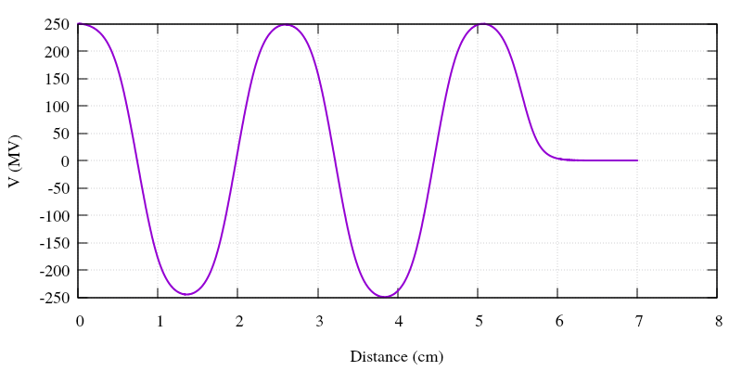
X-band based Injector
Laser
12 GHz RF Gun
5.6 Cell, 200 MV/m
12 GHz Traveling wave structures
108 cell, ~0.9 m, 65MV/m, 120 degree
Parameter | Value | Unit
Frequency | 12 | GHz
Gradient | 200 | MV/m
Cell number | 5.6 | #
Parameter | Value | Unit
Frequency | 12 | GHz
Gradient | 250 | MV/m
Cell number | 4.6 | #

Slide 4
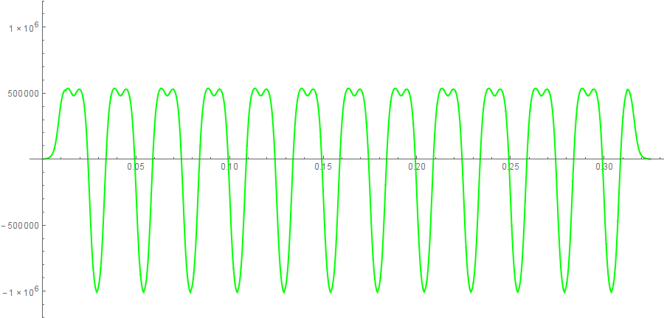
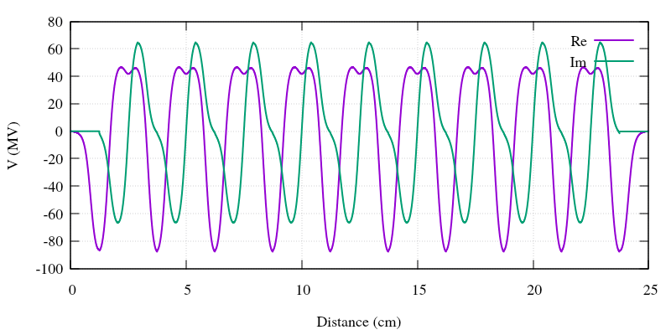
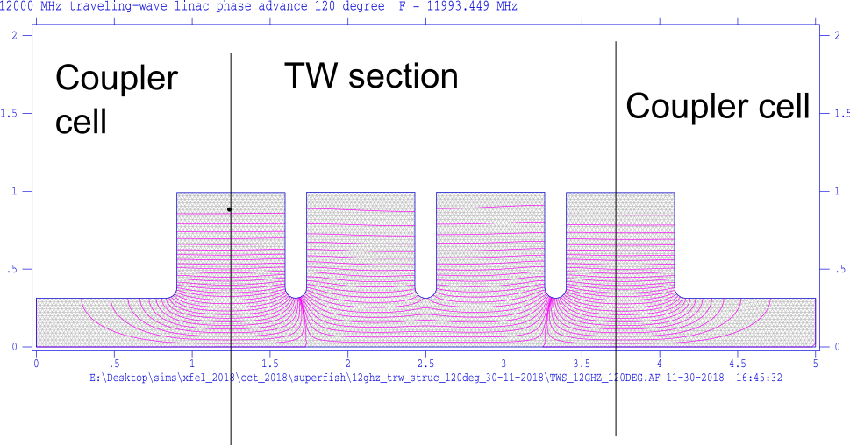
X-band based Injector
Parameter | Value | Unit
Frequency | 12 | GHz
Gradient | 65 | MV/m
Total lengt | ~1 | m
Cell number | 108 | #
Laser
12 GHz RF Gun
5.6 Cell, 200 MV/m
12 GHz Traveling wave structures
108 cell, ~0.9 m, 65MV/m, 120 degree

Slide 5
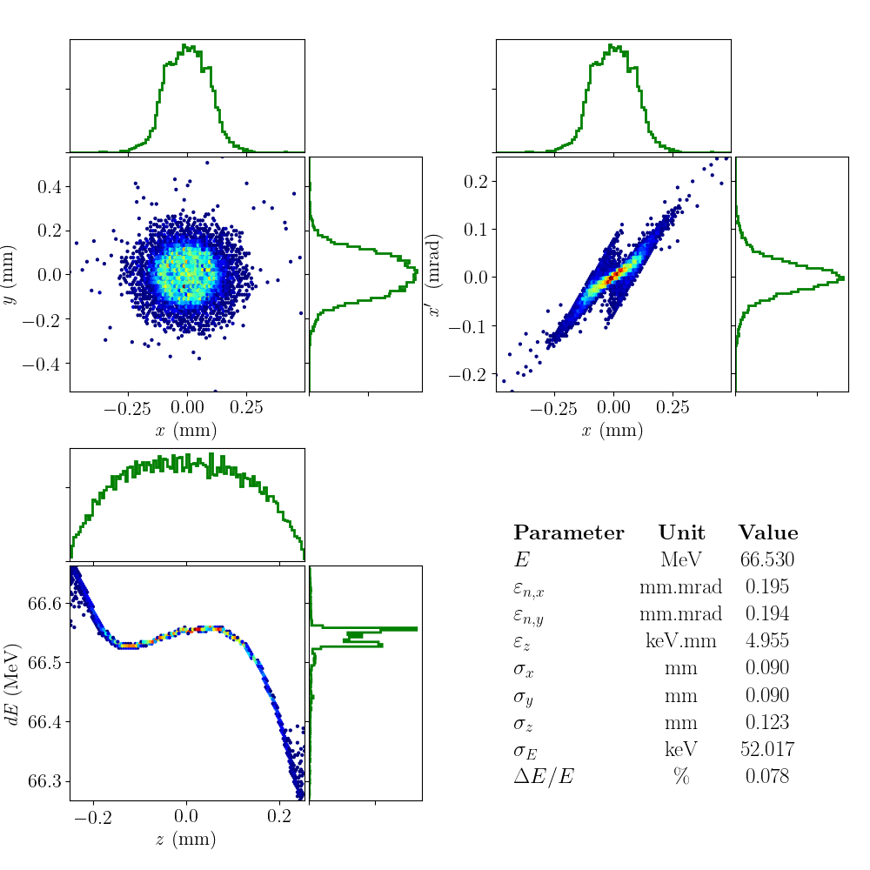
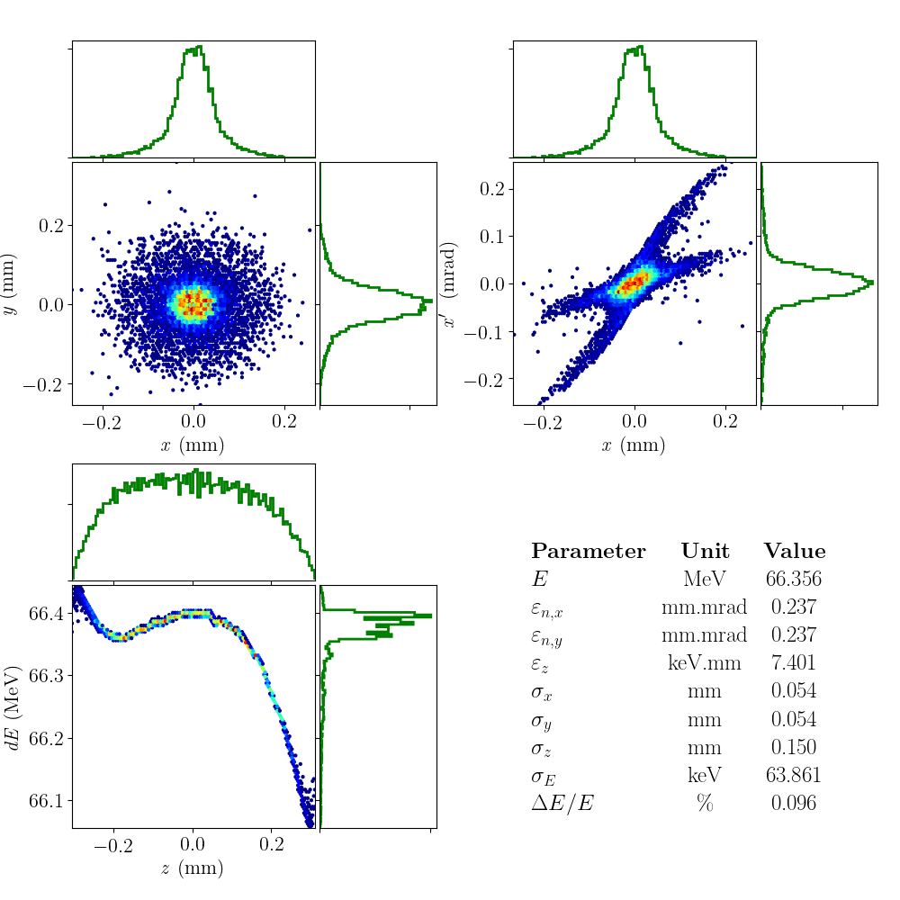
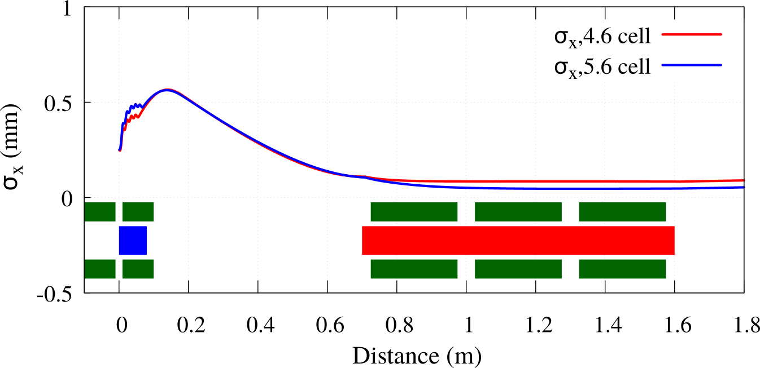
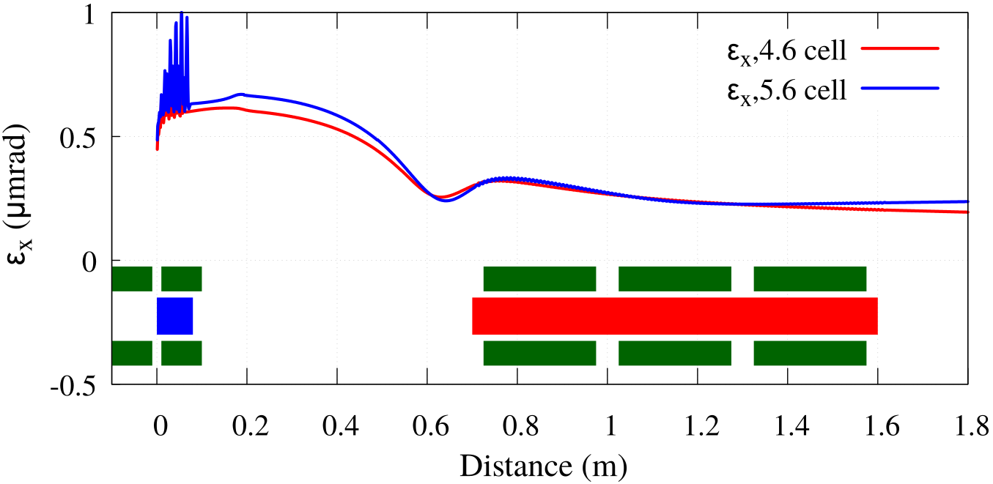
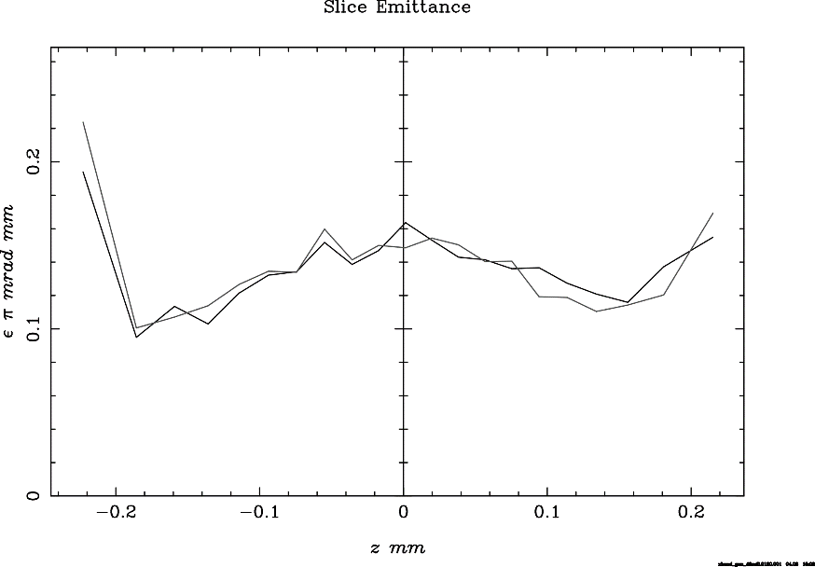
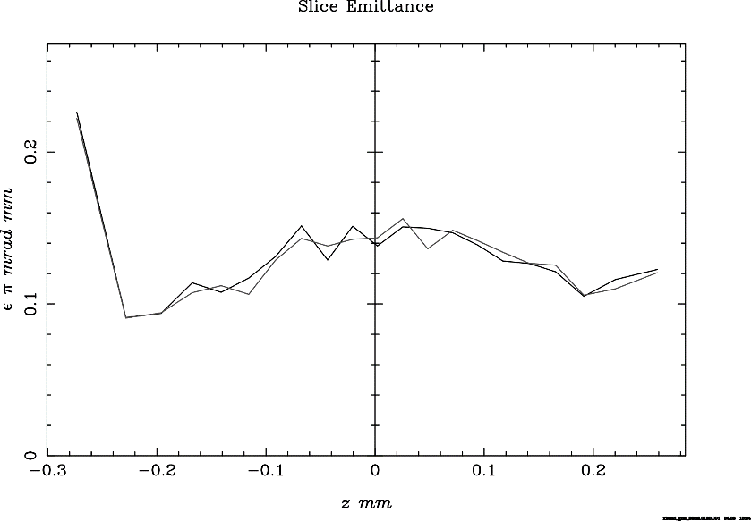
X-band Injector Optimization
4.6 cell
5.6 cell
4.6 cell
5.6 cell

Slide 6
Benchmarking of codes
ASTRA-GPT

Slide 7
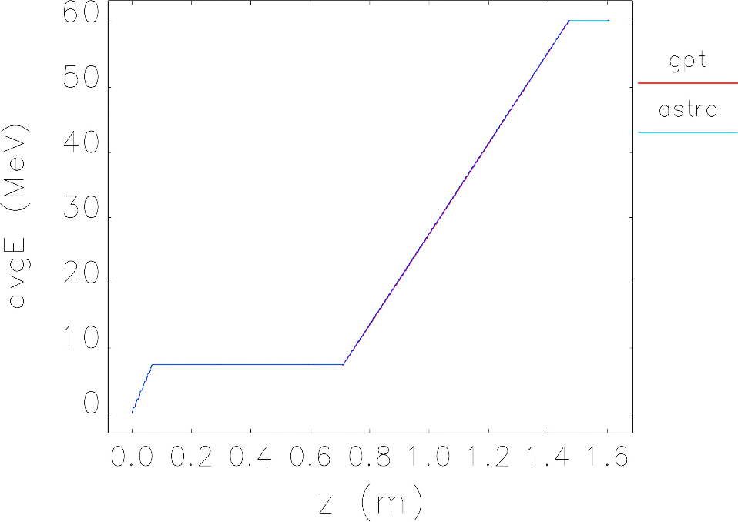
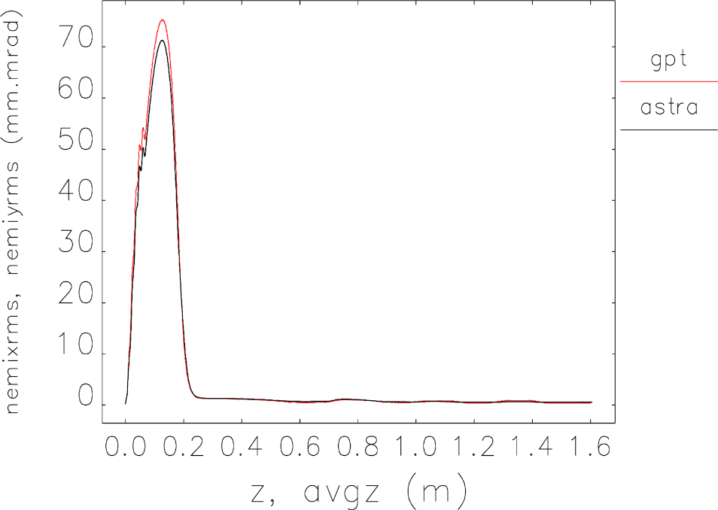
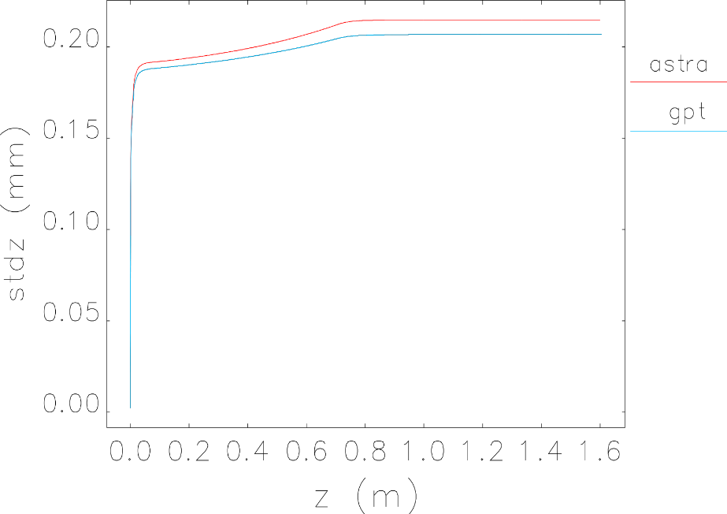
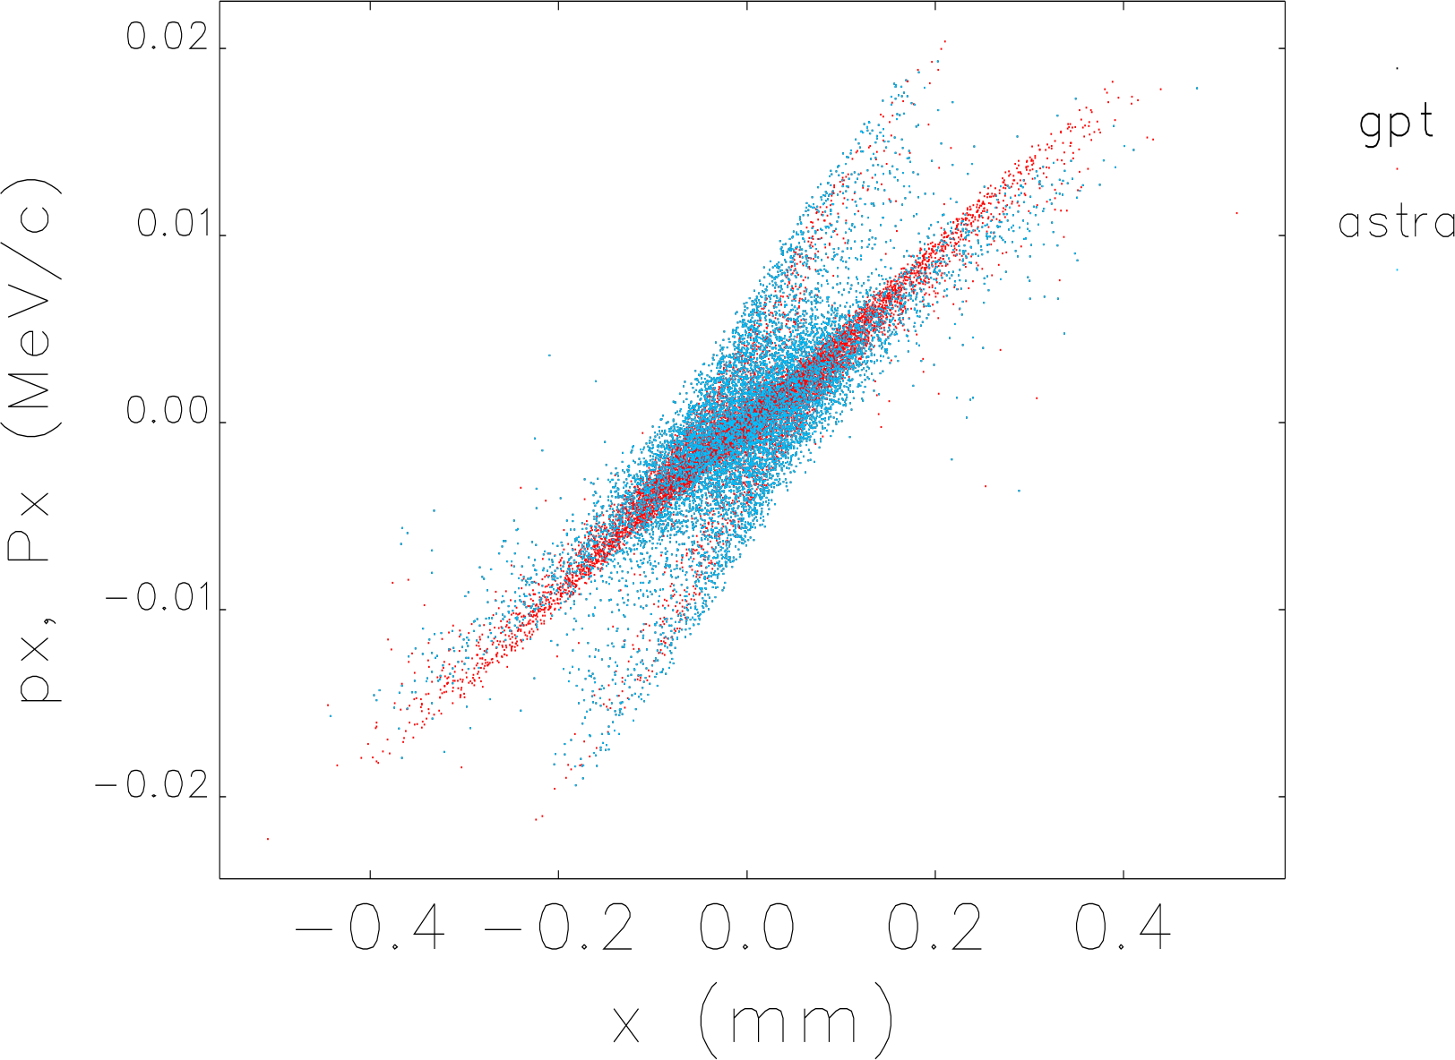
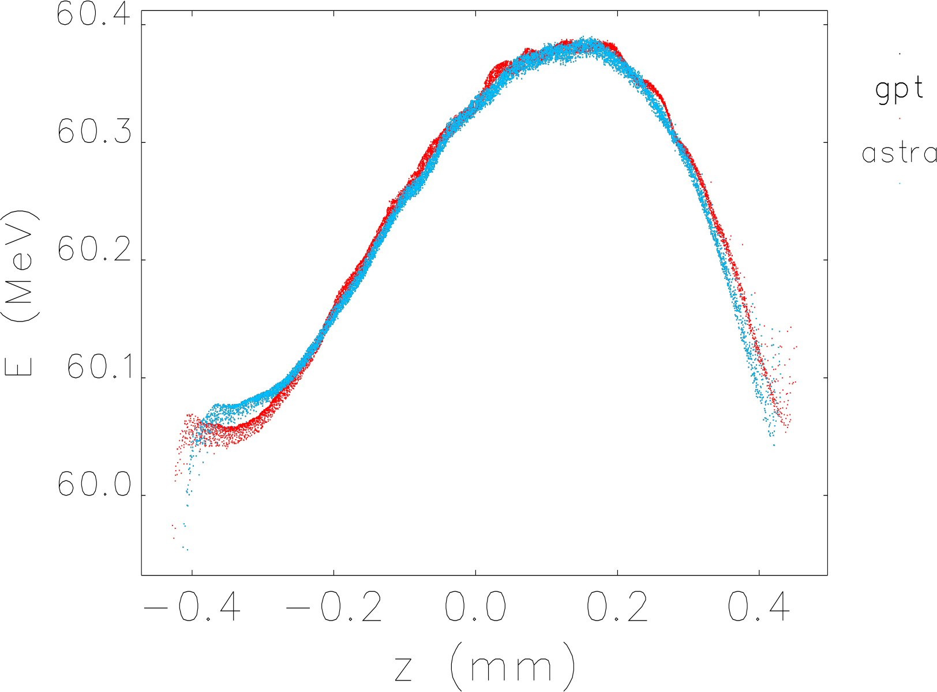
4.6 Cell X-Band Gun + X-Band structure

