Slide 1



WP3 Meeting 16 April 2019
Laser & Photocathode study for e-gun
Nikolaos Gazis^{c}, Eugene Tanke^{c}, Emmanuel Trachanas^{c},
Irini Telali^{b}, Katerina Tzanetou^{b}, ENG^{a,b}
a) Institute of Accelerating Systems & Applications
b) National Technical University of Athens
c) European Spallation Source
EN Gazis/IASA
Laser/Photocathode
1

Slide 2
Outline - Literature
The photocathode material/Laser study to fit for the S-, X- band structure
The 3D design for the e-gun and the Solenoid(s) electric & mechanical design
Radio-frequency (RF) photoinjectors [1] are the most effective way to generate intense bright electron beams.
They are proposed as drivers for high-brightness electron injectors for X-ray Free-Electron Laser (XFEL) facilities; where a well-defined pulse structure is required.
Electrons are produced via the photoelectric effect by a suitable laser [2] impinging on a photocathode mounted inside an RF gun.
The photocathode material in an RF photoinjector is of vital importance since it determines the intrinsic emittance and the quantum efficiency (QE) of the electron source.
Semiconductor materials like cesium telluride (Cs₂Te) provide a Q.E. orders of magnitude larger than metal photocathodes like copper (Cu), while the expected intrinsic emittance for both types of material is similar.
[1] J. S. Fraser, et al., IEEETrans.Nucl.Sci. 32, 1791 (1985); C. Hernandez-Garcia, et al.,Phys.Today 61,44 (2008)
[2] Ultraviolet laser transverse profile shaping for improving x-ray free electron laser performance, S. Li, et al., PHYS. REV. ACC.&BEAMS 20, 080704 (2017)
EN Gazis/IASA
Laser/Photocathode
2

Slide 3
Types and Criteria of Photocathodes
Metals – low efficiency, good time response (prompt), resistant to contamination, need UV laser (Cu, Mg)
Semi-conductors – high efficiency, slower time response, sensitive to contamination, visible/IR lasers (GaAs, Cs₂Te, K₂CsSb,GaN)
SELECTION CRITERIA
High Quantum efficiency
Fast response time
High Robustness
Low intrinsic emittance
Low surface roughness
Long lifetime
New ideas are welcomed!
EN Gazis/IASA
Laser/Photocathode
4

Slide 4
Properties of the current Photocathodes
Metal Semiconductor
Comparable work function Comparable work function
Low Q.E. High Q.E.
Long lifetime Short lifetime
Relatively tolerant to poor vacuum Easy contamination
Fast response time Longer response time
Laser wavelengths in UV Laser wavelengths in visual/UV
Intrinsic Emittence measurements with the same injector have been obtained by changing the phocathode Cu vs Cs₂Te, at SWISS FEL Injector Test Facility [1].
Similar ASTRA simulations have been obtained by our team for the two cathodes.
[1] PHYSICAL REVIEW SPECIAL TOPICS - ACCELERATORS AND BEAMS 18, 043401 (2015)
EN Gazis/IASA
Laser/Photocathode
3

Slide 5
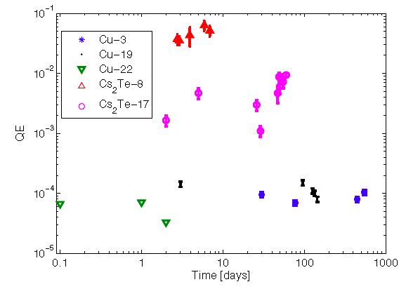
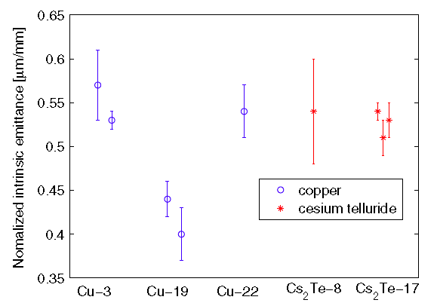
Properties of the current Photocathodes
Quantum efficiency evolution of the five photocathodes tested at the Swiss FEL Injector Test Facility.
Measured normalized intrinsic emittances for the five cathodes studied at the Swiss FEL Injector Test Facility.
EN Gazis/IASA
Laser/Photocathode
3

Slide 6
Properties of the current Photocathodes
The measured normalized intrinsic emittances for the same cathode do not differ significantly between measurement efforts, indicating that the uncertainty introduced by the overall stability of accelerator and laser system is comparable to the errors of individual measurements.
The normalized intrinsic emittance approximately ranges:
Cu 0.37 - 0.61 μm/mm ➔➔ 0.49±0.12 μm/mm
Cs₂Te 0.48 - 0.60 μm/mm ➔➔ 0.54±0.06 μm/mm
EN Gazis/IASA
Laser/Photocathode
3

Slide 7
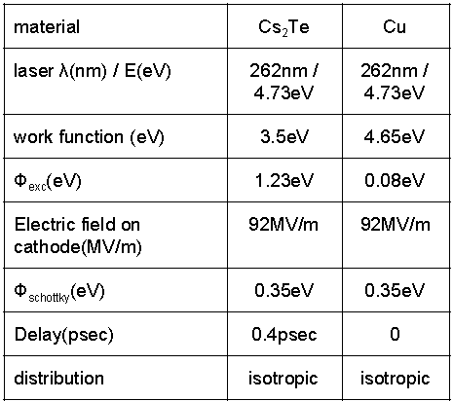
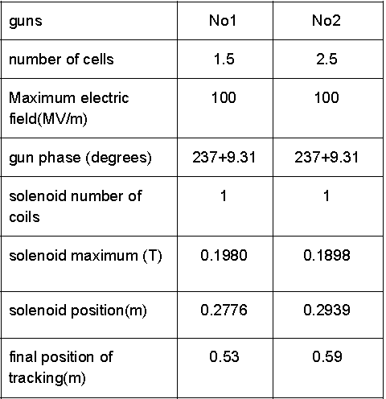
Photocathodes Simulations for Cs₂Te/Cu (I.T.)
Various parameters have been scanned through to obtain optimal layouts for
the e-gun. Using these layouts and a distribution created by a copper (Cu) cathode, the following results:
Similar simulations with 5.6 cells under way
EN Gazis/IASA
Laser/Photocathode
3

Slide 8
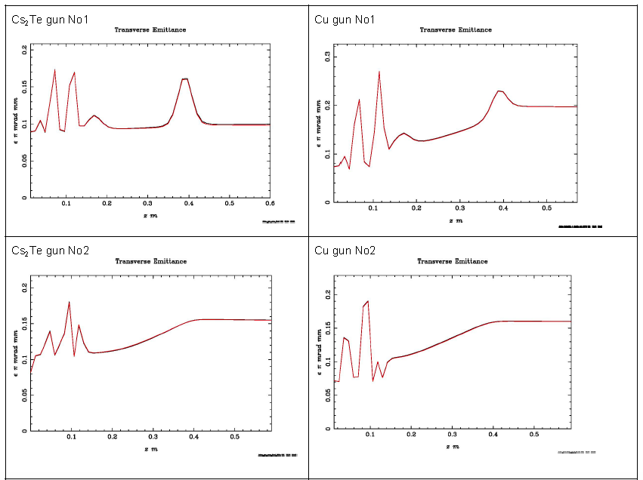
Photocathodes Simulations for Cs₂Te/Cu (I.T.)
EN Gazis/IASA
Laser/Photocathode
3

Slide 9
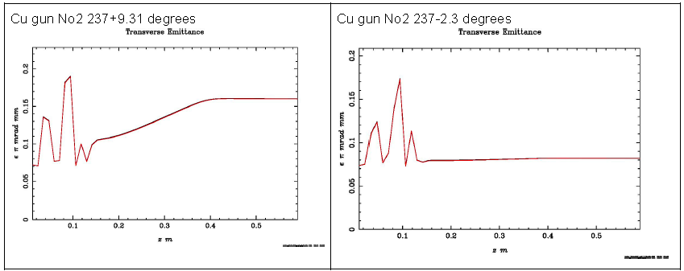
Photocathodes Simulations for Cs₂Te/Cu (I.T.)
Optimization to our simulations are still needed, as i.e. for the Cu cathode by changing the phase of the 2.5 cells from 237+9.31 degrees to 237+2.35 degrees; then better results are obtained:
EN Gazis/IASA
Laser/Photocathode
3

Slide 10
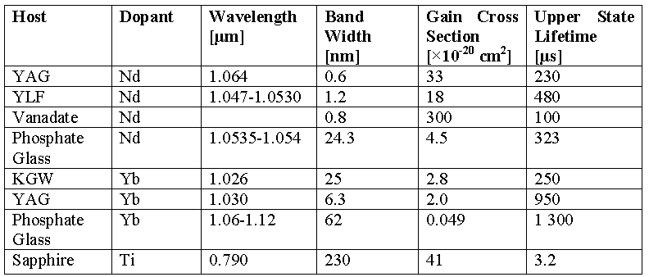
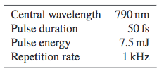
Lasers (K.T.)
It is needed a fs pulse laser to irradiate a metallic or semiconductor cathode and the following parameters to be defined:
Laser wavelength
Pulse duration
Pulse energy
Repetition Rate, plus other parameters with pulse structure and time accuracy
The lasers in red squares provide a 262 nm pulses for the current XFEL systems; getting the 4th harmonic: Nd: YLF (Yttrium Lithium Fluoride), Yb:CaF₂, Ti: Saphire
MAXIV laser→
Ti: Sapphire
with specifications
EN Gazis/IASA
Laser/Photocathode
9

Slide 11
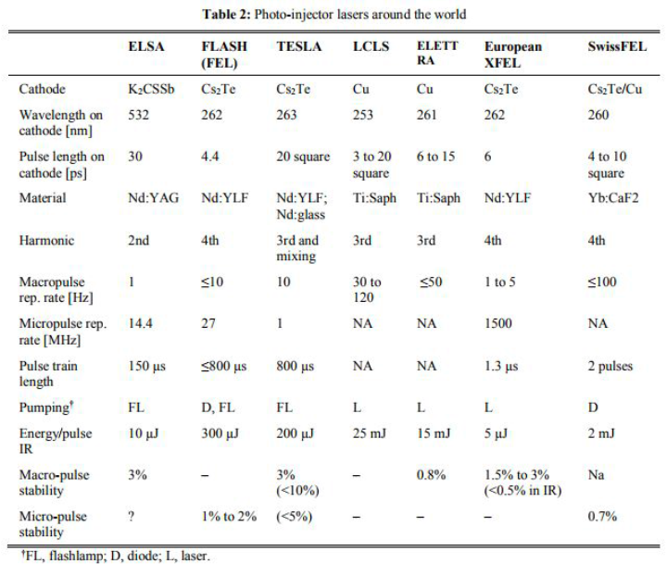
Lasers (K.T.)
EN Gazis/IASA
Laser/Photocathode
9

Slide 12
The Greek TEAM participation – ESS (NG, EuT, EmT)
Methodology to electrical & mechanical
design of the injector solenoid
Field Strength/Gradient
Mechanical Length
Integrated Field Strength/ Gradient
Aperture and Good Field Region
Field Quality (Field Homogeneity, Maximum allowed Multipoles- error and Tolerances, Time Constant)
Operation Mode
Supporting & transportation systems design
General mechanical tolerances
Electrical Parameters: Ampere Turns, Current
Magnet Topology Βucking Coil, Steerer Coil
Coil Design : Number of Coils and Cross Section, Material, Cross Section, Insulation Epoxy Impregnation,
Cooling Circuit and Sensors, Hydraulic Connections, Integration to accelerator cooling system
Temperature and Sensors
Power Distribution : Power Supply, Cabling , Protection
Integration of Sensors to Control System
Alignment targets Adjustment tables Support jacks
Magnetic measurement devices: Pick-up, hall probes
Magnet
Survey and Alignment
Transportation
Safety
Vacuum
Integration
Cooling
Certification
Power
Controls and Sensors
Beam Optics

Slide 13
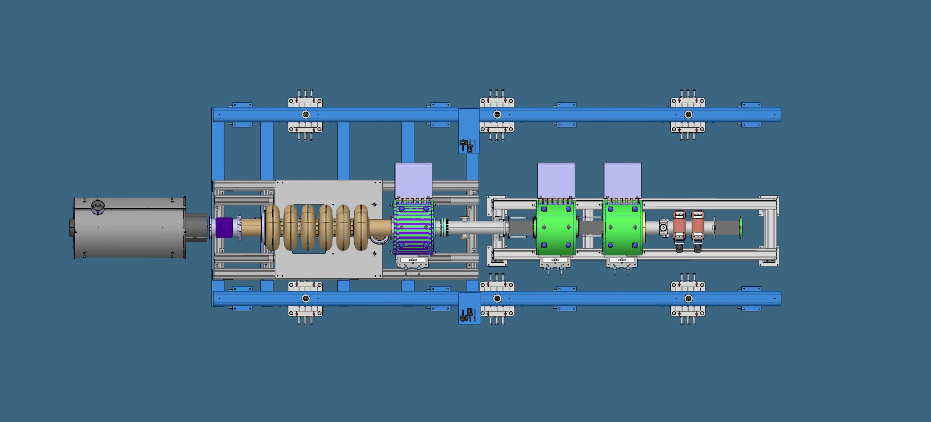
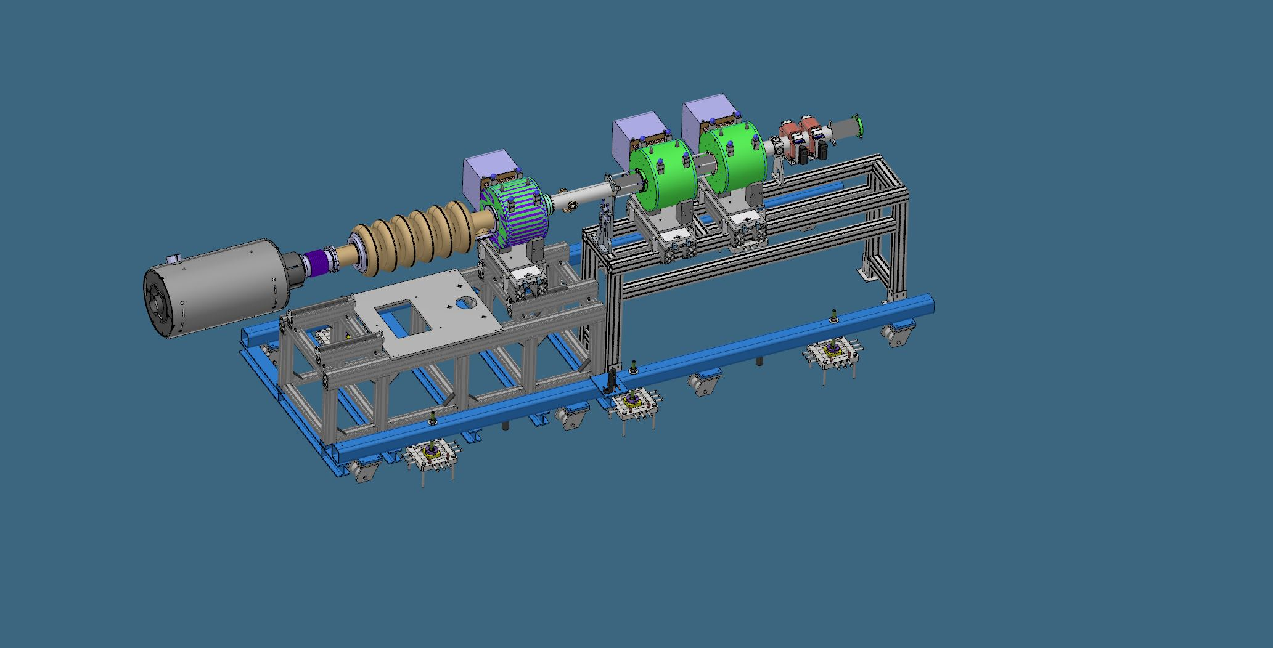
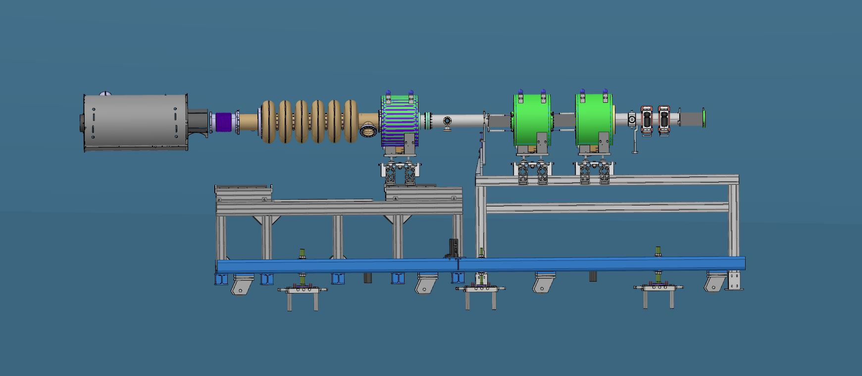
The Greek TEAM participation – ESS (NG & ET)
Photocathode/e-gun, RF-cavity, Solenoids, BPM, Steerers

Slide 14
Conclusions
Various modes and types of the photocathodes have been investigated, finalizing among the Cs₂Te and the Cu cathodes
The choice of the photocathode is dictated by the requirements on the average current in relation to the available laser
Reliable cathode and laser systems exist for average current of 10 mA
The current can be increased to 100 mA, by a small improvement in both the cathode and the laser system
The limited lifetime of the cathodes is an IMPORTANT issue
An important study of the the degradation of the cathode performance, so to improve the lifetime of these cathodes at least by an order of magnitude is necessary
A very very preliminary proposal could be :
    a cathode Cs₂Te, with QE ~0.1-0.2 %, Nd: YLF laser; High repetition rate
Our Simulations and the Measurements (SWISS FEL) seem to have similar results in Emittence with the two Cathodes
The 3D model design of the injector and the electro-mechanical work for the solenoids is under way
EN Gazis/IASA
Laser/Photocathode
14

Slide 15
BACKUP SLIDES

Slide 16
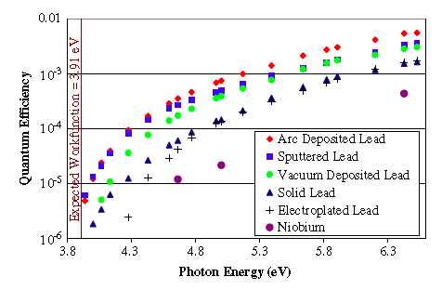
Metal Photocathodes
Normal conducting injectors
Room temperature
Insensitivity to contamination → easy handling
Longtime operational lifetime, i.e. Mg, Cu are running for years
High work function, ~1mA current :
              UV laser for driving
              High accelerating gradient
              Very little dark current
              QE quite law
QE of Pb deposited on Nb photo-cathodes.
The QE > 0.2% at 6.3 eV (196.3 nm) photon energy
It is proposed:
  Mg → Normal conducting
  Pb/Nb → Super-conducting
EN Gazis/IASA
Laser/Photocathode
5

Slide 17
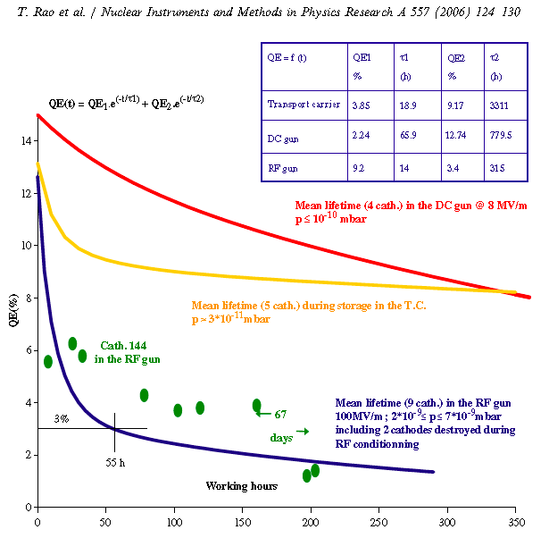
Cs₂Te Photocathodes, 10% QE at 266nm
High QE in UV
NC RF-injector
High Acc. Gradient
4 nC/pulse delivered, ~1mA current
High work function ➔ UV laser
Sensitive to contaminants
Quick QE decay from 12% to 3% in 55 h
Load-lock system for cathode transfer/exchange
Evaporation CsBr on Cs₂Te improves the lifetime
EN Gazis/IASA
Laser/Photocathode
6

Slide 18
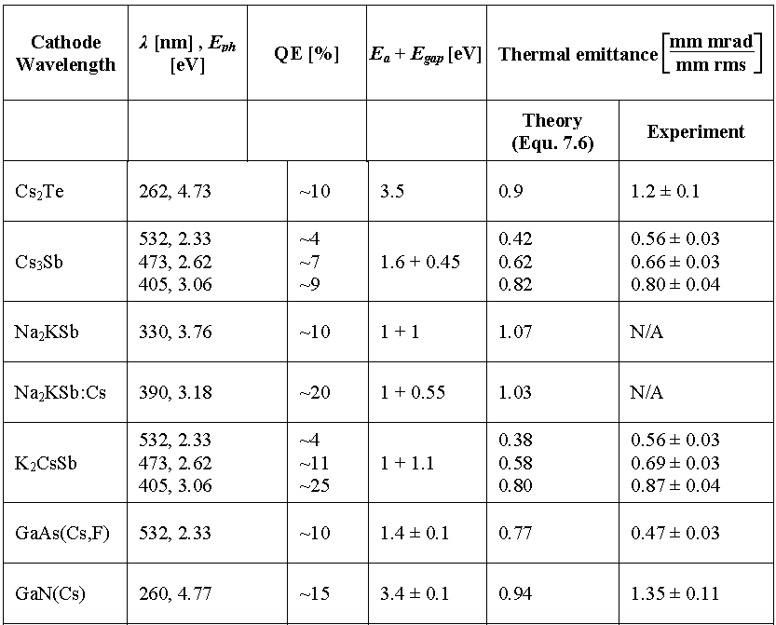
Photocathodes
EN Gazis/IASA
Laser/Photocathode
7

