Slide 1
CI update
Hao & Amir

Slide 2
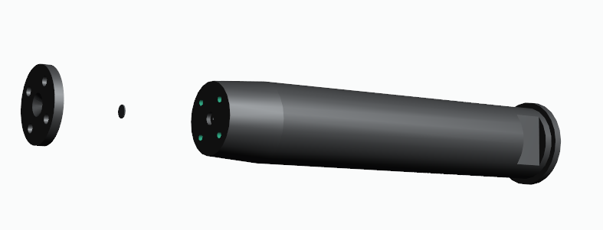
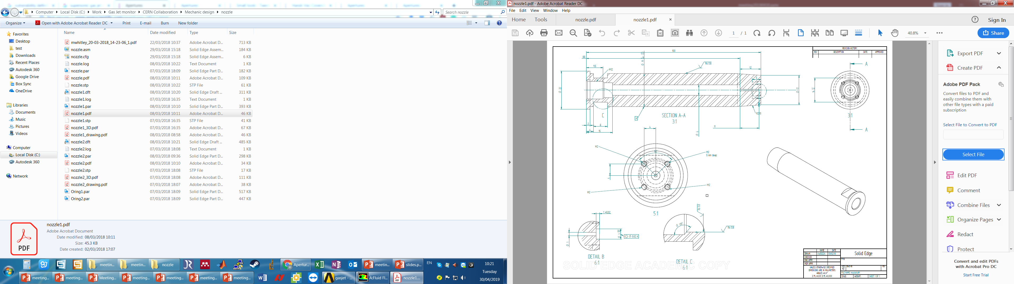
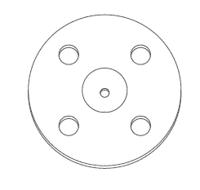
CI nozzle
2mm
100mm
Aperture

Slide 3
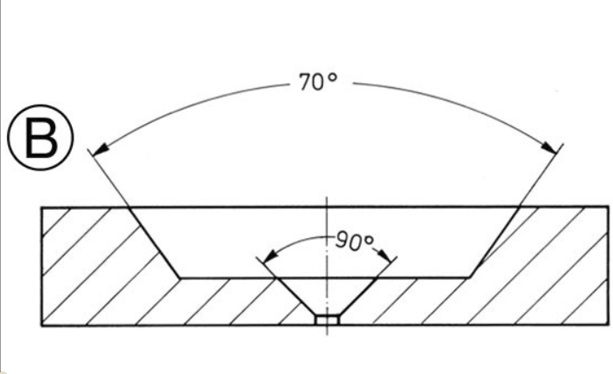
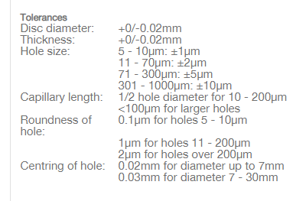
Aperture from agar scientific
0.25 mm
3.04 mm
Capillary length = 0.5 hole diameter

Slide 4
Pressure test with 50 um aperture
Nozzle | Nozzle Chamber (mbar) | Skimmer Chamber(1) (mbar) | Skimmer Chamber(2) (mbar) | Interaction Chamber (mbar) | Dump Chamber (mbar)
Normal Conditions | 3.80E-03 | 3.90E-06 | 3.80E-07 | 7.68E-09 | 2.21E-09
50 um | 8.6E-03 | 3.5E-04 | 2.4E-05 | 2.9E-08 | 7.7E-09
No jet was found for 50 um currently.

Slide 5
Conclusion
No conclusion yet.
Need more analysis of current data.
Try 20 um as well.

