Slide 1
Cockcroft Update
Amir and Hao

Slide 2
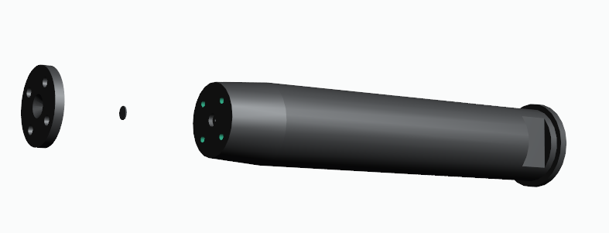
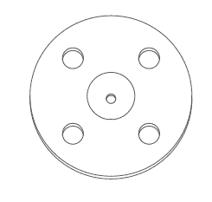
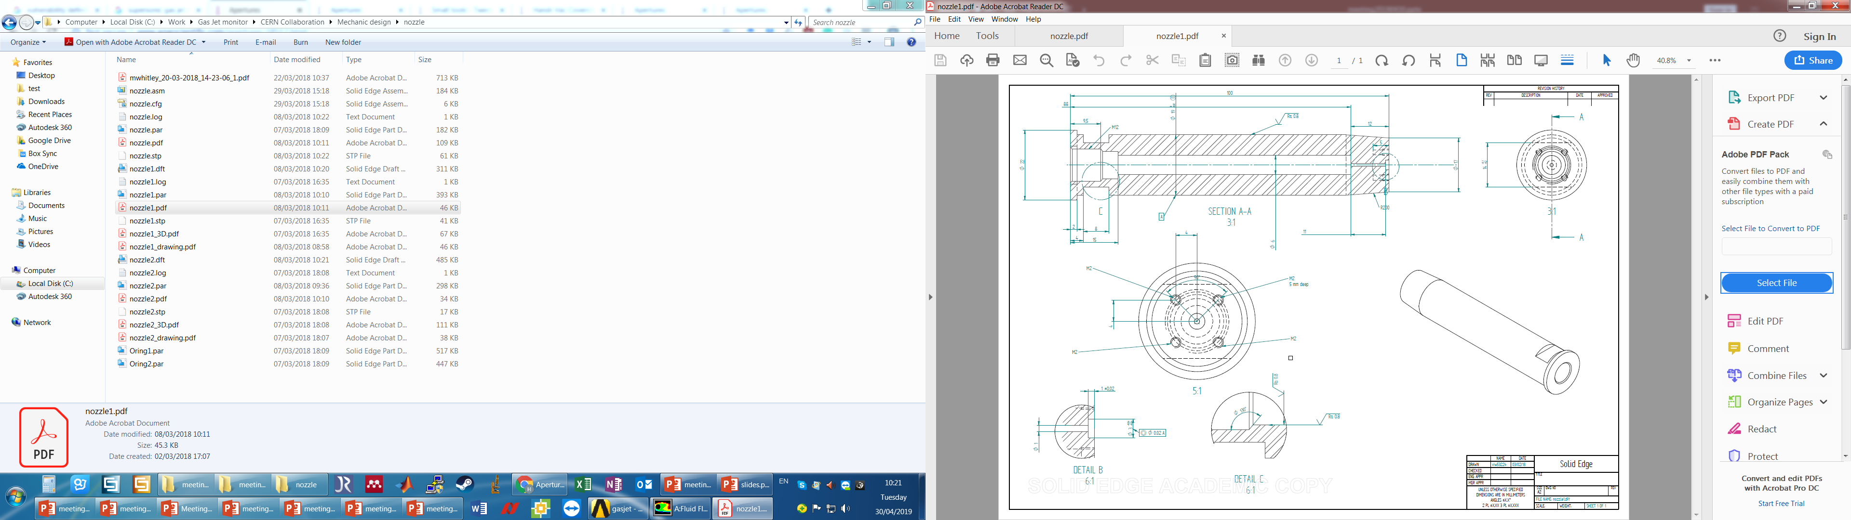
Recap
2mm
100mm
Aperture

Slide 3
Pressure Test with 50micron nozzle
Nozzle | Nozzle Chamber (mbar) | Skimmer Chamber(1) (mbar) | Skimmer Chamber(2) (mbar) | Interaction Chamber (mbar) | Dump Chamber (mbar)
Normal Conditions | 3.80E-03 | 3.90E-06 | 3.80E-07 | 7.68E-09 | 2.21E-09
50 um | 8.6E-03 | 3.5E-04 | 2.4E-05 | 2.9E-08 | 7.7E-09
No jet was found for 50 um currently.

Slide 4
Continued tests with the nozzle
The nozzle and skimmer chamber were opened and the skimmer assembly was realigned with the 50 micron nozzle.
Two missing screws were the reason behind higher pressure in the skimmer chamber.

Slide 5
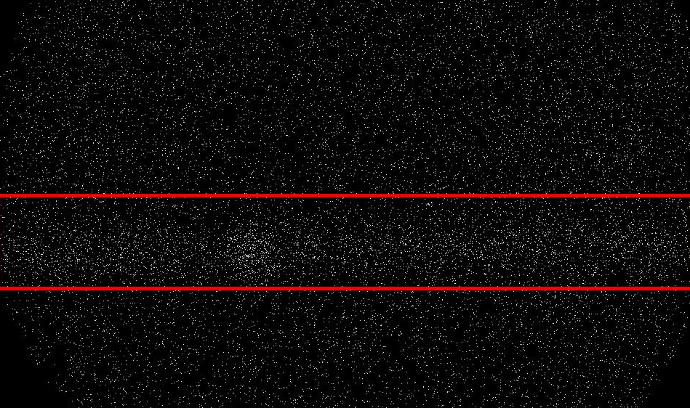
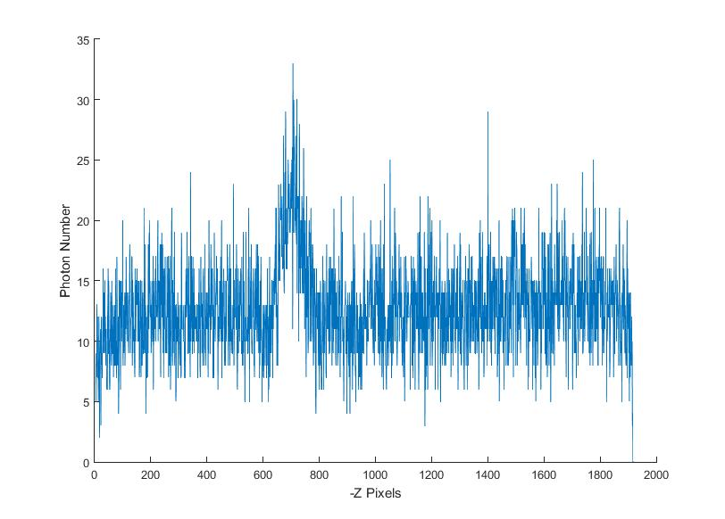
First Image
Integration time = 400s
Electron gun : 0.66mA and 5KeV
Inlet Pressure : 5 bar Nitrogen
Nozzle to Skimmer distance : 7mm
Gas-jet
Electron Beam

Slide 6
Third Skimmer
The position of the third skimmer was optimised with respect to the new alignment using the previous procedure.
A set of measurements were taken with the new 50micron nozzle by varying the nozzle to skimmer distance and pressure.

Slide 7
Nozzle-skimmer distance study for 50micron nozzle
Integration Time : 400s
Electron Beam : 0.65mA , 5KeV
Inlet Gas : Nitrogen
Distance (mm)
For an Inlet pressure of 5bar, the optimum nozzle-skimmer distance is 10.7mm (Compared to the 30micron nozzle which was 3.76).
At distances below 7mm, gas jet density decreases as the Inlet pressure is increased.

Slide 8
Comparison Between the two
The density of the jet at the optimum distance for the 50micron nozzle is 6 -7 times lower than that of the 30micron nozzle at its optimum distance. This was also confirmed with the moving gauge.
Nozzle | Nozzle Chamber (mbar) | Skimmer Chamber(1) (mbar) | Skimmer Chamber(2) (mbar) | Interaction Chamber (mbar) | Dump Chamber (mbar)
30 um | 3.80E-03 | 3.90E-06 | 3.80E-07 | 7.68E-09 | 2.21E-09
50 um | 8.2E-03 | 5.2E-05 | 4.8E-06 | 1.8E-08 | 5.25E-09

Slide 9
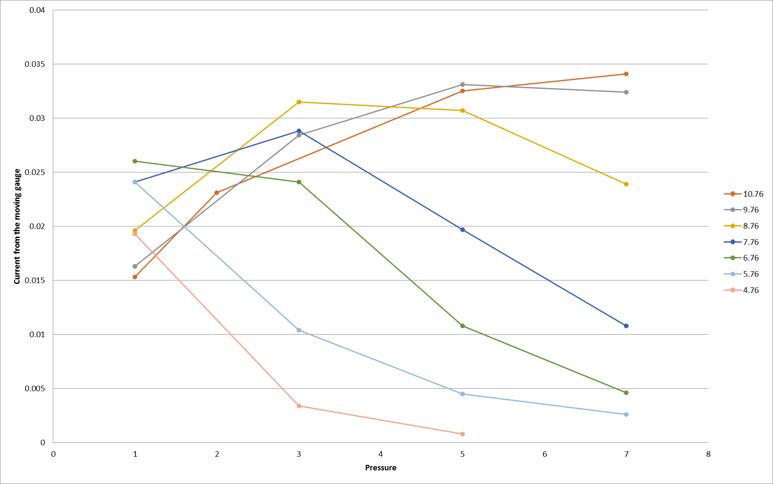
Moving Gauge
A rough horizontal scan was conducted at the most dense part of the jet using the moving gauge.
Analysis is still ongoing.

Slide 10
Conclusion
The optimum nozzle-skimmer distance for the 50micron nozzle was measured to be 10.7mm.
The density of the jet for the 50micron nozzle is 7 times lower than the 30micron nozzle.
Analysis of the pressure gauge and experiments with the 20micron nozzle will take place in the coming weeks.

Slide 12
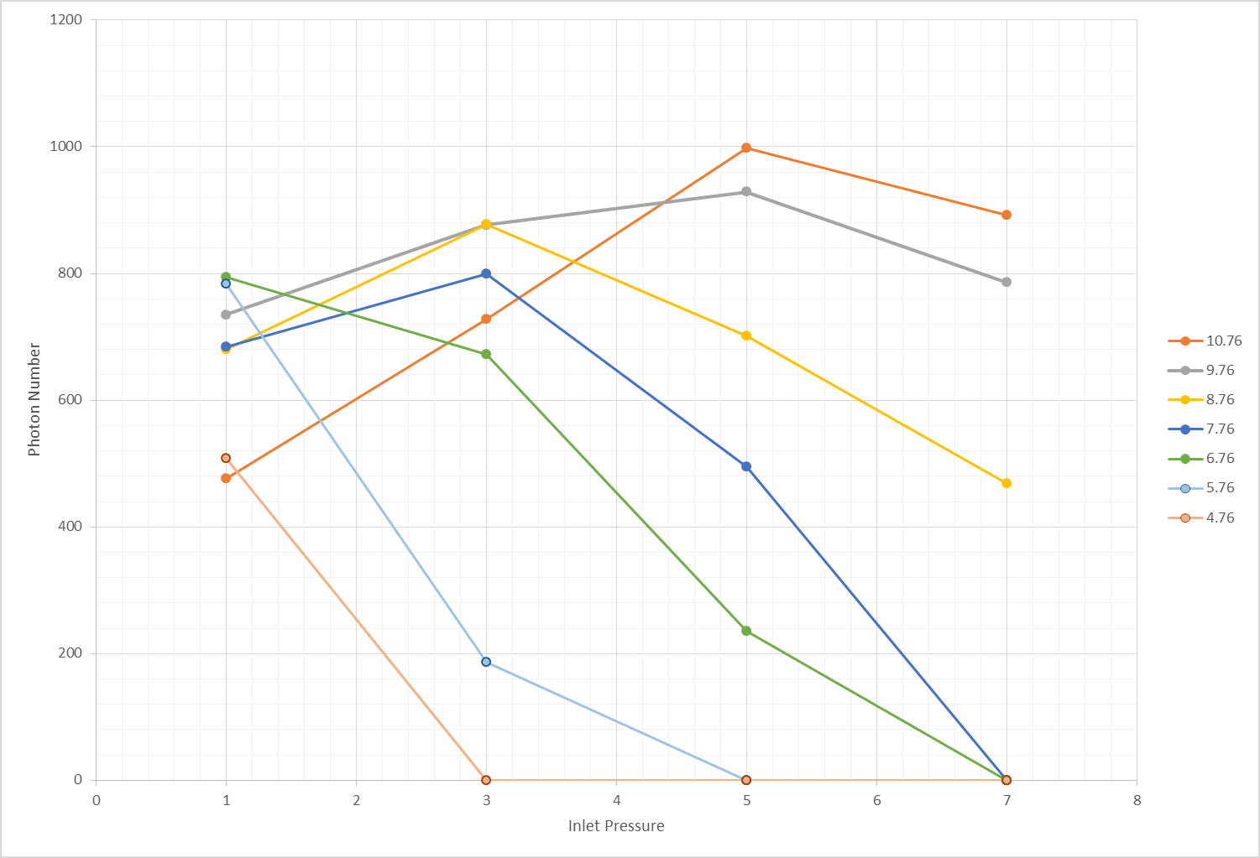
Moving Gauge
Electron Gun

Slide 13
30Micron data

