Slide 1

HEPiX IPv6 Working Group
- update
David Kelsey (STFC UKRI)
WLCG GDB, CERN, 12 Feb 2020

Slide 2
On behalf of all in the
HEPiX IPv6 working group
Active in HEPiX IPv6 Working Group – last 12 months
M Babik (CERN), M Bly (RAL), T Chown (Jisc), D Christidis
(U Texas/ATLAS), J Chudoba (Prague), C Condurache (RAL/EGI.eu),
T Finnern (DESY), C Grigoras (CERN/ALICE), B Hoeft (KIT), D P Kelsey (RAL), R Lopes (Brunel), F López Muñoz (PIC), E Martelli (CERN),
A Manzi (CERN), R Nandakumar (RAL/LHCb), K Ohrenberg (DESY),
F Prelz (INFN), D Rand (Imperial), A Sciabà (CERN/CMS)
Many more in the past, and others join from time to time
and thanks also to WLCG operations, WLCG sites, LHC experiments, networking teams, monitoring groups, storage developers…

Slide 3
Outline
Recent WG meeting at CERN – 16/17 Jan 2020
  Part of the week of networking meetings at CERN
  https://indico.cern.ch/event/855123/
Phase 3: IPv6-only networking
Summary & recommendations

Slide 4
Agenda of IPv6 WG 16/17 Jan 2020
Day 1 – a more general overview and history – more suitable for all the “visitors”
History, status & plans (D Kelsey)
IPv4 & IPv6 status in RIRs (R Evans, Jisc, UK)
Tier 0/1, LHCOPN and LHCONE (B Hoeft)
Tier 2 (A Sciaba)
IPv6 at CERN (E Martelli)
Monitoring (M Babik)
Day 2 – routine working group business
Roundtable updates, future plans, CHEP2019 paper, next meetings

Slide 5
Preparatory work during Phase 1
2011-2016

Slide 6
Problems & lessons learned
Many blocking issues outside of our own control
  Both software and site networking teams
Developers claim that software is fully IPv6-compliant!
Software/protocols fixed-size storage for IP addresses
Software/protocols assume single address (as in IPv4)
Performance differences between IPv4 & IPv6
  IPv6 must perform at least as well
Have to understand cases where fraction of IPv6 is smaller than expected
  Preference for IPv6 over IPv4 must be established
Can be lots of development effort and testing is not easy when no other positive change re functionality
Sys admins, operations staff, security team, developers
  All need TRAINING and experience

Slide 7
The transition Phase 2
2016-2020

Slide 8
FTS traffic (IPv6) – 15 Jan 2020 (62%)
(average of last 30 days before each point)

Slide 9

LHC[OPN/ONE] → IPv6 → history + status
Bruno Hoeft / DE-KIT

Slide 10

PerfSONAR of Tier-1s
IPv6 Status 2019

Slide 11
Still issues
Some solved:
  DNS + DHCP + site dependend IPv6 enabling
  Early dCache versions needed special configuration
  EOS had caveats
  dCache does not support IPv6 dual-home
  redesign of network deployment
      Francesco Prelz enabled dCache code to support dual-home
      code not jet commited by dCache developers
  Network equipment does not support …
Some still pending:
  FNAL → FTS server is still not dual-stack enabled
  RRC-KI-T1 → dual-stack is not enabled

Slide 12
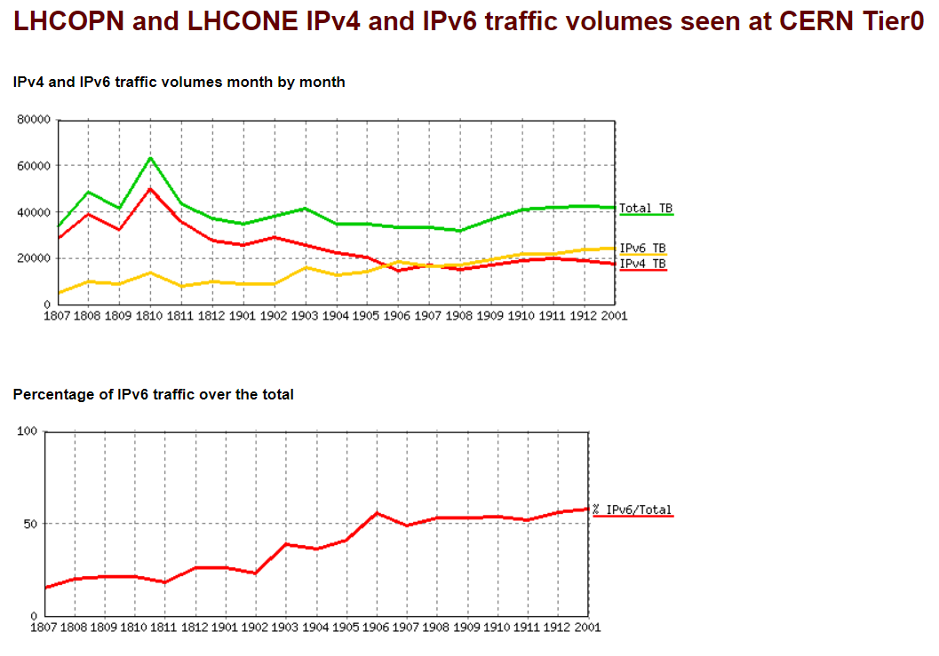
IPv6 traffic on LHCOPN & LHCONE at CERN
Edoardo Martelli
IPv6 traffic on LHCOPN & LHCONE as seen at CERN
~55% of all traffic is IPv6
From June 2019 onwards
LINK to these plots

Slide 13
IPv6 on FTS and at Tier-1s
FTS servers at BNL, CERN and RAL work in dual stack, while FNAL has still problems
GridFTP transfers happen also via IPv6 at most Tier-1s
IPv6 transfers do not happen at
  RRC-KI
  FNAL FTS IPv6 transfers are still problematic, but should be fixed soon
Fraction of Tier-1 disk storage on IPv6:
  ALICE: 78%
  ATLAS: 96%
  CMS: 100%
  LHCb: 94%
  All VOs: 96%

Slide 14
Tier-2 IPv6 deployment update
Andrea Sciabà
HEPiX IPv6 working group meeting
16 January 2020

Slide 15
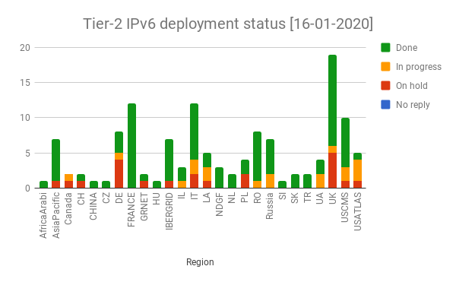
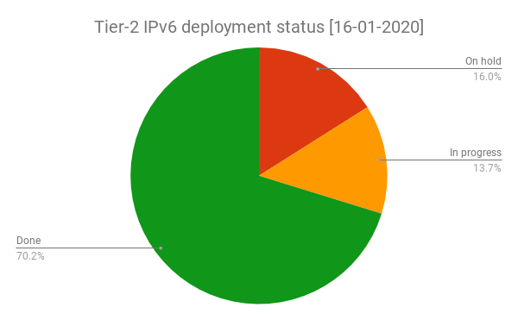
IPv6 at Tier-2 sites today
The deployment campaign was launched in November 2017
  GGUS tickets sent to all non-US sites
  Deployment at US sites was delegated to OSG ops and USCMS/USATLAS
Steady progress (status)
  About 70% of T2 sites have storage on dual stack
Experiment | Fraction of T2 storage accessible via IPv6
ALICE | 85%
ATLAS | 59%
CMS | 89%
LHCb | 75%
Overall | 73%

Slide 16
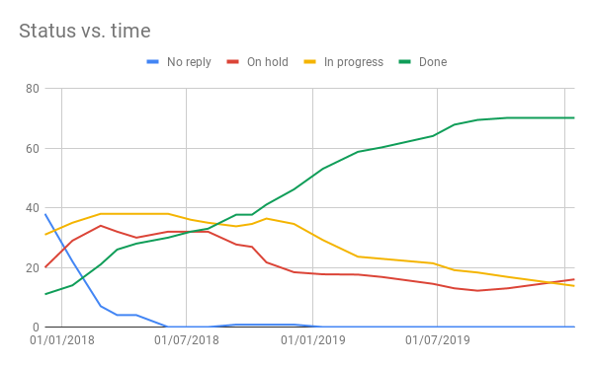
Progress and trends
We did not meet the (very ambitious) goal of 100% of sites with IPv6 by the end of Run2
  Still, 7x increase in the number of sites with IPv6 achieved thanks to the campaign
Official deadline

Slide 17
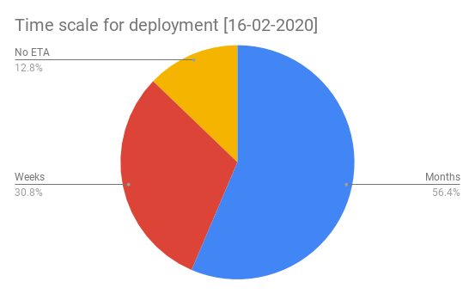
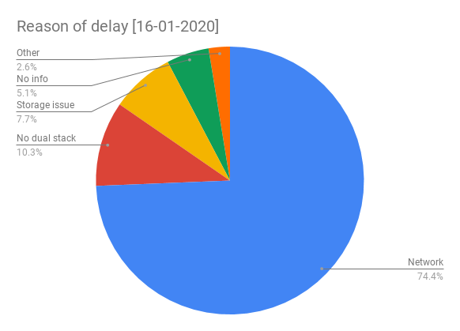
Reasons of no deployment
Checked why sites are late in their IPv6 deployment and the expected ETA
  Network: waiting for interventions on the site infrastructure or network issues to be fixed
  No dual stack: infrastructure network is fine but IPv6 needs enabling on storage or perfSONAR
  pS/storage issues: encountered problems that need fixing
  Other: other types of problems (e.g. the site needs relocating)
  No info: no meaningful information given by the site on their plans

Slide 18
Conclusions
Deployment Tier-2 is proceeding, but it has slowed down
  It was sort of expected: the remaining sites are those having the most difficulties in deploying IPv6
  Still, many of the remaining sites are clearly committed to it
  A couple of VOs have ~90% of their T2 storage on IPv6, so they can almost declare success
    Note: the IPv6 TF does not treat sites differently for different VOs!
We are now one year past the official deadline
  We (as IPv6 TF) can only keep the pressure
  Experiments may, if they wish so, implement their own “incentives” to sites
Deployment tracking
  https://twiki.cern.ch/twiki/bin/view/LCG/WlcgIpv6

Slide 19
WLCG Experiments Test Framework (ETF)
Marian Babik, CERN
HEPiX IPv6 WG meeting

Slide 20
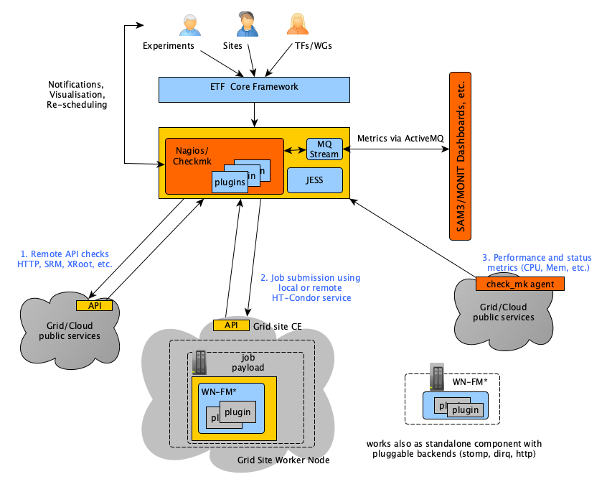
Architecture
ETF Core Framework
Frontend API, configuration, scheduling, alerts
Plugins (probes/tests)
Range of available plugins to test broad
range of services
Contributed by experiments, PTs, TFs and
open source projects (Checkmk), etc.
Python library to help write plugins (python-nap)
MQ Stream for publishing results
Job Submission Framework (JESS)
Framework to write job submission plugins
(submit/manage jobs, retrieve worker node
results, etc.)
Worker Node Framework (WN-FM)
Micro-scheduler to run tests on the WNs
(configure and execute WN tests,
collect results)

Slide 21
Deployment and Operations
Experiment instances @CERN (IPv4-only/IPv6-only in QA, IPv4-only in PROD)
perfSONAR infrastructure monitoring @OSG
ETF now runs in containers and is integrated with gitlab CI
Each experiment has its own container/image and gitlab repository
  Full control over packages and versions to be deployed
ETF can be deployed in the experiment-specific environment if needed
Faster development cycle - changes propagated to QA upon each commit
  Each commit triggers container rebuild and deployment to QA, one-click deploy to prod
Simplified deployment - auto-deployed directly from gitlab
  Easy to rollback

Slide 22
Summary
ETF is a container-based application combining open source software with a set of frameworks and APIs to provide flexible testing suite
Easy to extend, re-locate and support new experiments and technologies
Supported as part of the CERN IT Monitoring Stack
Currently deployed at CERN for all four experiments
  Supporting IPv4-only and IPv6-only monitoring
  Experiments contacts have access in case they need to debug and/or follow up on issues
  Central instance provides a site-level view (one place to see results from all experiments)
Additional deployment at OSG for perfSONAR infrastructure monitoring
  Strong interest from other communities to have this available as a generic tool
SAM reporting ready for IPv6
  We’re able to aggregate IPv6 results and compute either IPv6-only profiles or IPv6/IPv4
  Experiments need to add IPv6 metrics to the A/R profile

Slide 23








WLCG Networks: Update on Monitoring and Analytics
perfSONAR Update
S. McKee¹, B. Bockelman², R. Gardner³,
I. Vukotic³, M. Babik⁴, D. Weitzel⁵, M. Zvada⁵, E. F. Hernandez⁶,
¹ University of Michigan, ² Morgridge Institute of Research, ³ University of Chicago, ⁴ CERN,
⁵ University of Nebraska, ⁶ UCSD

Slide 24
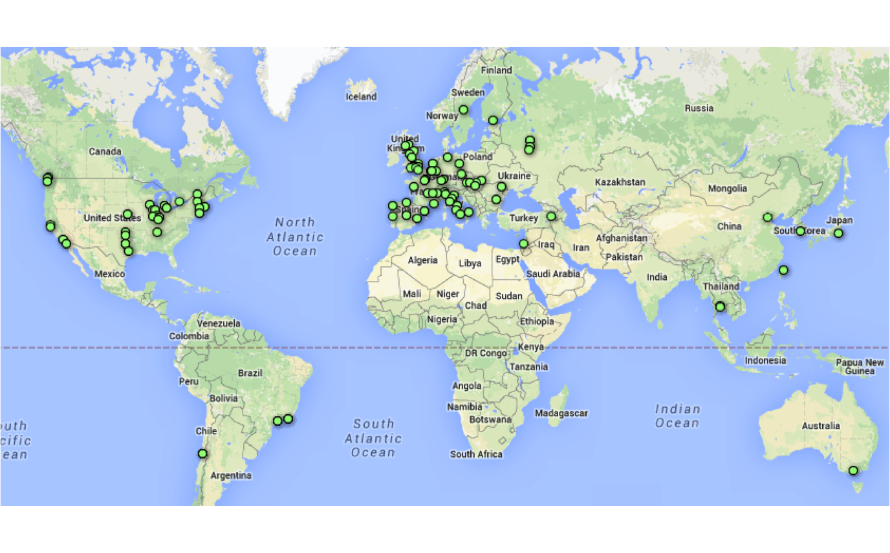
perfSONAR deployment
261 Active perfSONAR instances
- 207 production endpoints
- 173 running 4.2; 138 on 4.2.1 (latest)
- T1/T2 coverage
- Continuously testing over 5000 links
- Testing coordinated and managed from central place
- Dedicated latency and bandwidth nodes at each site
- Open platform - tests can be scheduled by anyone who participates in our network and runs perfSONAR

Slide 25
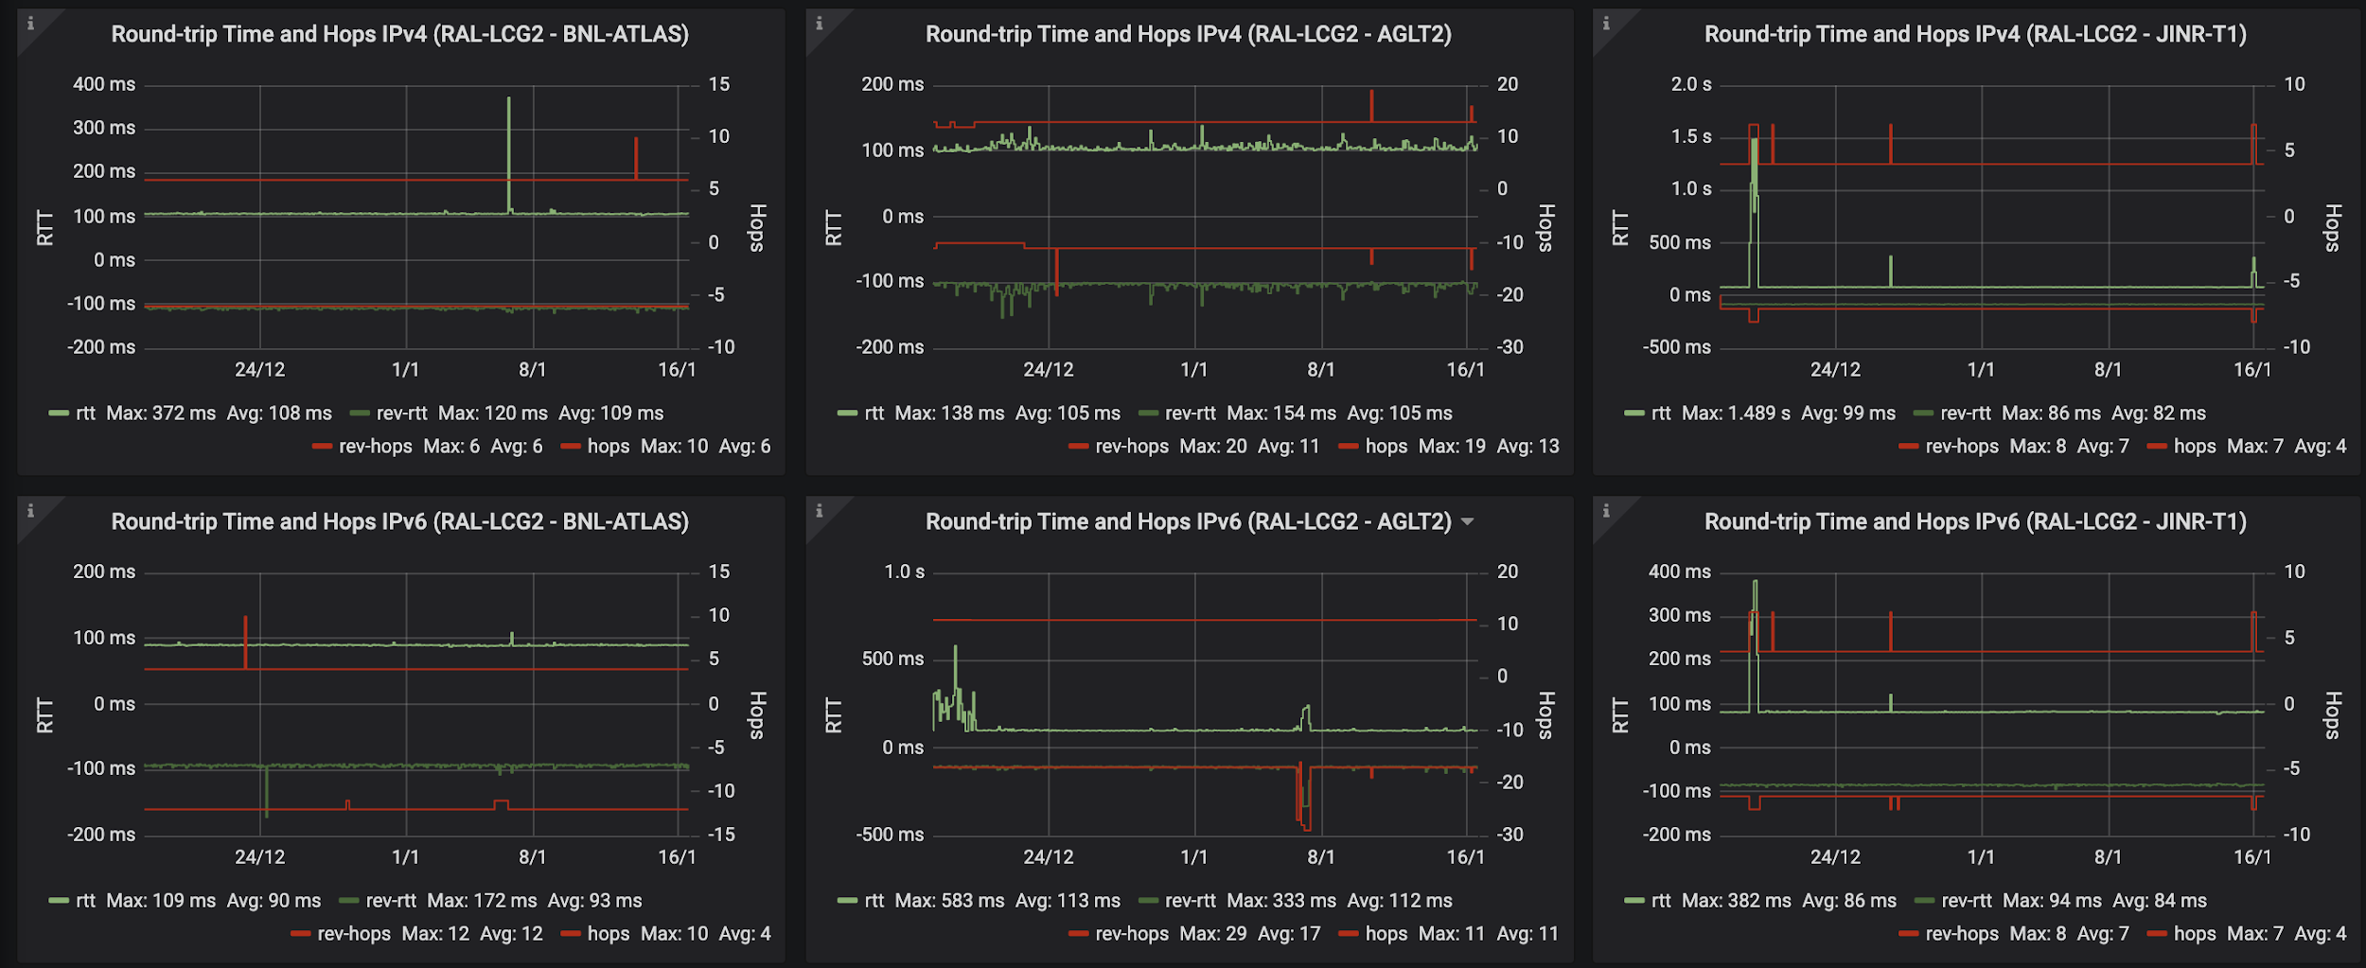
MONIT perfSONAR IPv6 dashboard

Slide 26
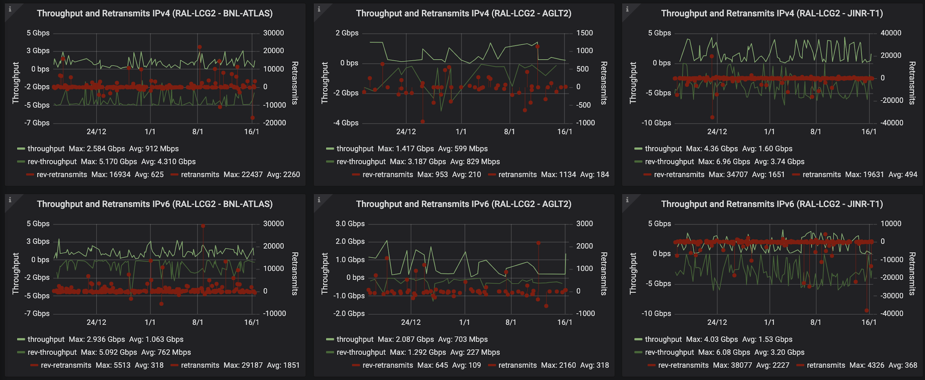
MONIT perfSONAR IPv6 dashboard

Slide 27
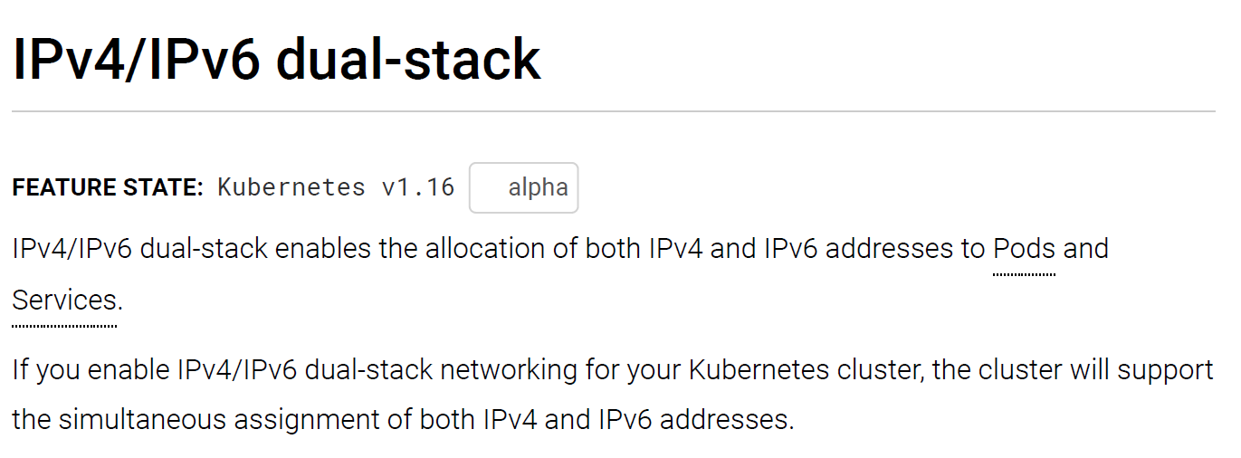
A new issue - Kubernetes & IPv6/IPv4
IPv6-only cluster available earlier in 2019
The dual-stack alpha was only released in ~Jan 2020

Slide 28
Now for Phase 3
2020-?
(move to IPv6-only networking)

Slide 29
IPv6-only networking
Running a dual-stack IPv4/IPv6 infrastructure is complex
  It was never our desired end-point!
Large companies (e.g. Facebook, EE/BT) use IPv6-only internally
  Then use tools like NAT64/DNS64/464XLAT for legacy world
CERN EOS infrastructure also uses IPv6-only internally
When/how do we simplify and move to IPv6-only in WLCG?
  IPv6 working group Phase 3

Slide 30
IPv6-only networking (2)
The LHCOPN data transfers on IPv6 continue to grow (>50%)
When the amount of IPv4 traffic on LHCOPN is close to zero
  Turn off IPv4 entirely on LHCOPN?
  simplify routing tables and tracking problems is easier
  IPv4 traffic will continue to flow over the general Internet links
Our main use case - ready for use of (opportunistic) IPv6-only CPU
BUT there are other drivers for IPv6-only, including
  new CERN machine room and lack of public IPv4 addresses
    Use only IPv6 addresses for external public networking?

Slide 31
IPv6-only networking (3)
Ongoing work:
Fixing dual-stack endpoints that prefer to use IPv4 and not IPv6
Include experience of sites already doing IPv6-only CPU
  UKI-LT2-Brunel - successful IPv6-only cluster for ATLAS, CMS & LSST
  Also SiGNET, T2_US_Nebraska, UKI-T2-QMUL, …
More testing is essential
Transition tools such as NAT64 can be used once core is IPv6-only
Turning off IPv4 at a Site is clearly their own decision
  they may have many other needs (not WLCG) for IPv4
We may define a date for “end of support” for IPv4-only clients
  e.g. start of LHC Run4?

Slide 32
Summary & recommendations
WLCG is ready to support use of IPv6-only CPU resources
  Good steady progress towards this goal!
Tier-1s should all have production storage accessible over IPv6
  96% of Tier-1 storage is available via IPv6
Tier-2s 70% sites done
  73% of Tier-2 storage is dual-stack
~62% of FTS transfers today over IPv6
~55% LHCOPN+LHCONE traffic observed at CERN is IPv6
WG Phase 3 - we are planning for move to IPv6-only services
RECOMMENDATION – deploy dual-stack on all services and WNs

Slide 33
Questions?

