Slide 1

Update from the HEPiX
IPv6 working group
David Kelsey (STFC, UK Research and Innovation)
on behalf of the HEPiX IPv6 Working Group
WLCG GDB
14 Oct 2020

Slide 2
On behalf of all members of the HEPiX IPv6 working group
Recently active in the HEPiX IPv6 Working Group
M Babik (CERN), M Bly (RAL), T Chown (Jisc), D Christidis
(U Texas/ATLAS), J Chudoba (Prague), C Condurache (EGI.eu),
C Grigoras (CERN/ALICE), B Hoeft (KIT), D P Kelsey (RAL),
E Martelli (CERN), S McKee (U Mich), R Nandakumar (RAL/LHCb),
K Ohrenberg (DESY), F Prelz (INFN), D Rand (Imperial), A Sciabà (CERN/CMS), D Stockland (Imperial)
Many more in the past and others join from time to time
and thanks also to WLCG operations, WLCG sites, LHC experiments, networking teams, monitoring groups, storage developers…

Slide 3
Outline
WLCG transition to dual-stack IPv4/IPv6 storage
  Tier-1/Tier-2 status
FTS data transfers – fraction over IPv6
Monitoring (ETF and perfSONAR)
IPv6-only networking
  Why? How?
Summary
For Working Group meetings see
https://indico.cern.ch/category/3538/
Meetings of working group (2020):
16-17 Jan (CERN – F2F)
3 June (half-day virtual meeting)
29-30 Sep (two half-days)
One-hour update meetings:
10 Mar, 30 Apr, 2 Jul, 3 Sep
Upcoming virtual meetings:
19-20 Jan 2021 (2 half-days - assumed virtual)
One-hour updates: 22 Oct, 26 Nov 2020

Slide 4
IPv6 and Tier-1 storage
FTS servers at BNL, CERN and RAL work in dual stack, while Fermilab is still IPv4-only
  But Fermilab T1 storage is dual-stack
GridFTP transfers happen also via IPv6 at most Tier-1s
IPv6 transfers do not happen at
  RRC-KI
  Fermilab FTS IPv6 transfers are still not happening
Fraction of Tier-1 disk storage on IPv6 (not recently updated)
  ALICE: 78%
  ATLAS: 96%
  CMS: 100%
  LHCb: 94%
  All VOs: 96%

Slide 5
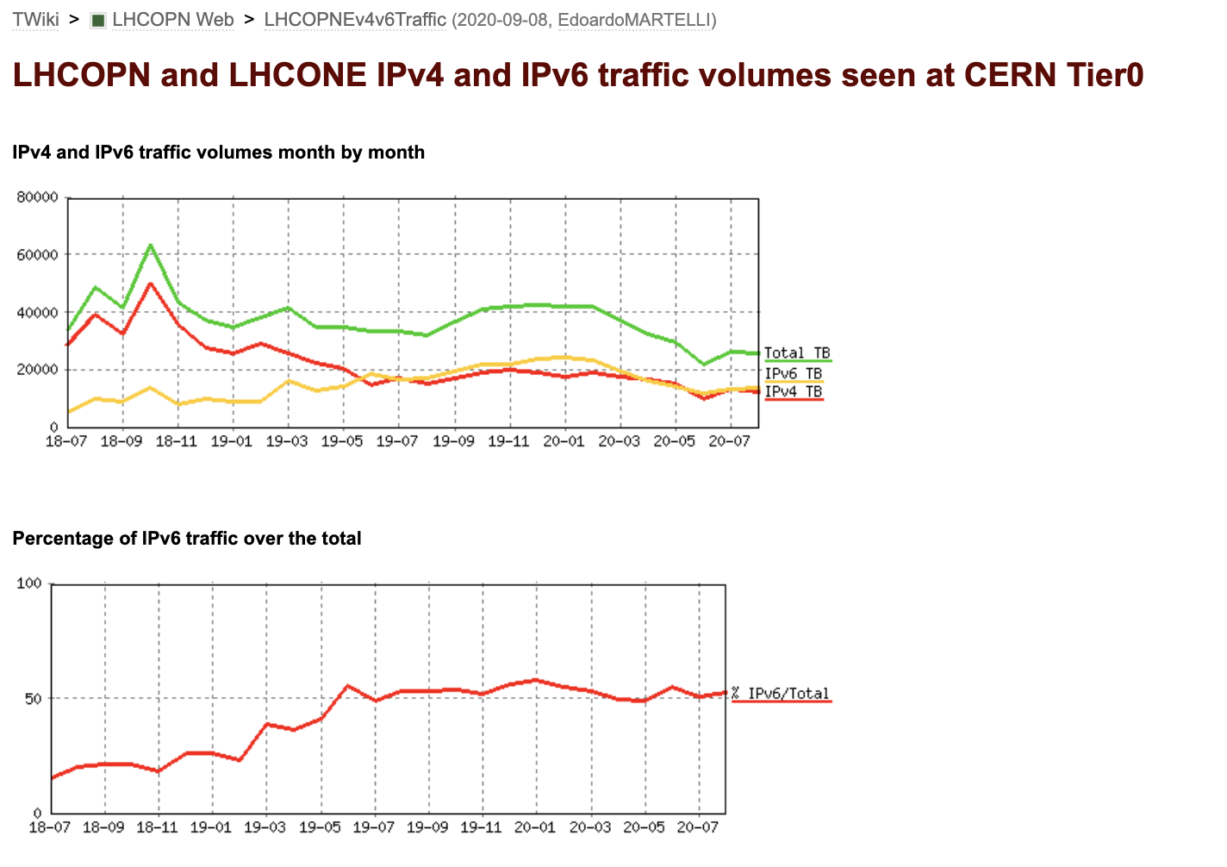
IPv6 traffic on LHCOPN & LHCONE at CERN
IPv6 traffic on LHCOPN & LHCONE as seen at CERN
~50% of all traffic is IPv6
From June 2019 onwards
LINK to these plots

Slide 6
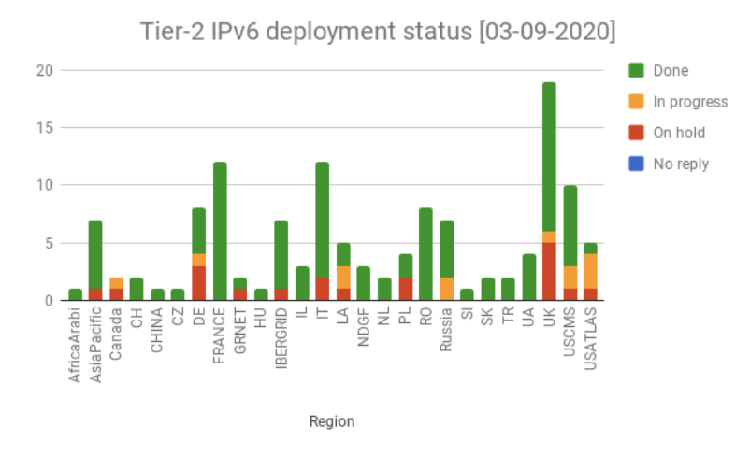
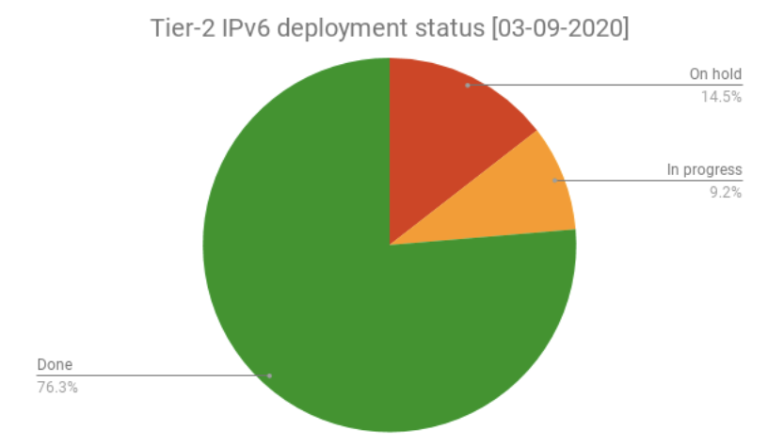
Tier-2s: GGUS tickets to all Tier-2 sites
The deployment campaign was launched in November 2017
Steady progress (status)
  About 76% of Tier-2 sites have storage on dual stack

Slide 7
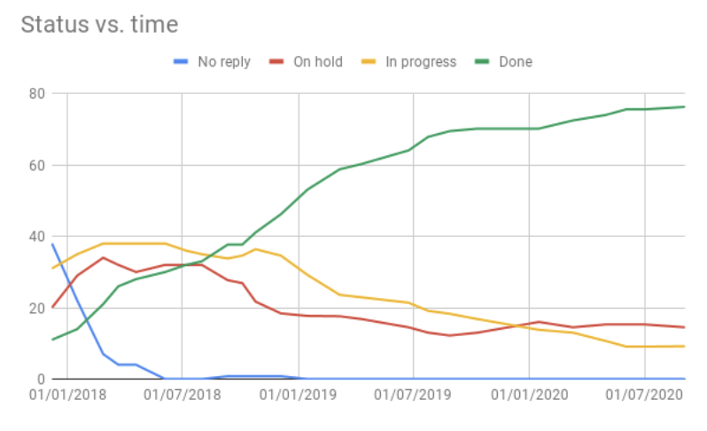
Tier-2 status (cont’d)
Experiment | Fraction of T2 storage accessible via IPv6
ALICE | 86%
ATLAS | 62%
CMS | 93%
LHCb | 75%
Overall | 76%

Slide 8
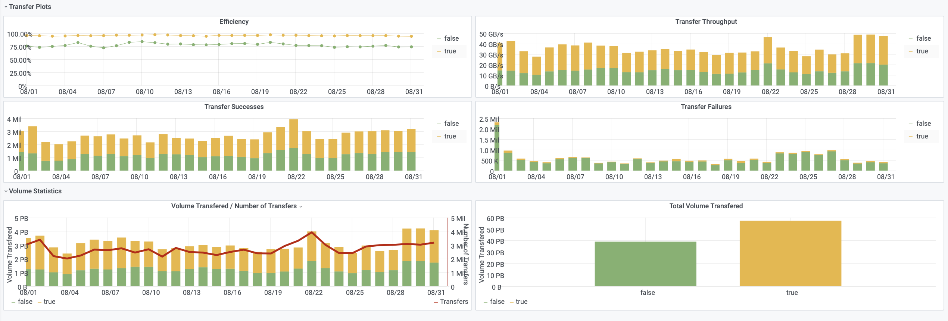
Data Transfers - FTS transfer monitoring - August 2020
Approximately 59% of data transferred via FTS in Aug 2020 went over IPv6
IPv4 IPv6
https://monit-grafana.cern.ch/

Slide 9
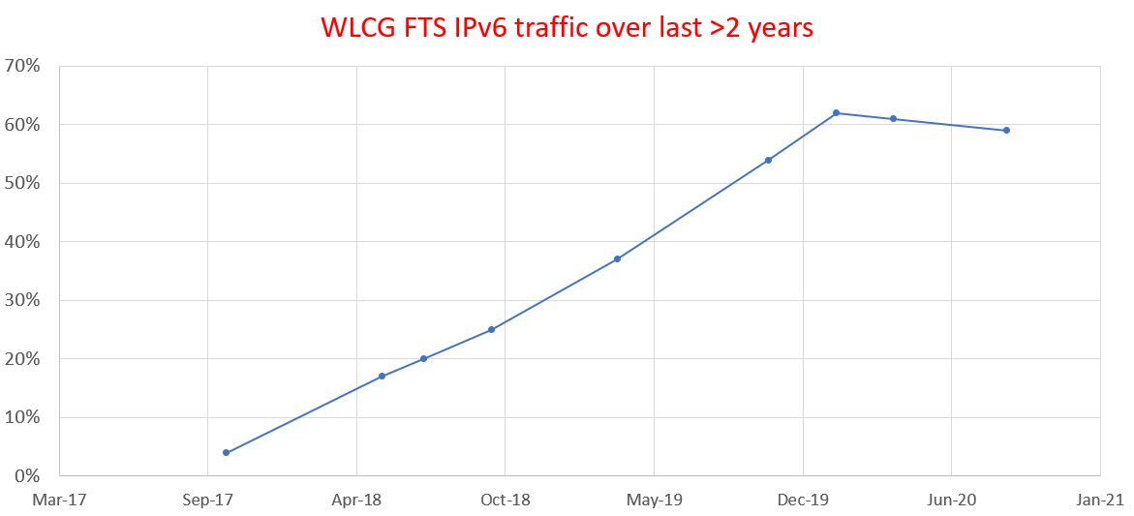
% of FTS traffic over IPv6 - last >2 years
IPv6 %traffic no longer increasing during 2020
Since April 2020, total traffic reduced and mix of CMS to ATLAS traffic changed
          all contribute to small downward trend in 2020

Slide 10
Monitoring & IPv6
Important tools for tracking/troubleshooting IPv6
See presentations by Marian Babik at IPv6 WG 30 Sep 20
Experiment Test Framework ATLAS, CMS and LHCb now have IPv6-only ETF instances
  running both IPv4-only and IPv6-only instances
  Able to generate WLCG reports with IPv4/IPv6 results
perfSONAR
  IPv6 measurements included in all meshes

Slide 11
IPv6-only networking
Our main use case for dual-stack storage was and still is:
  Be ready for use of (opportunistic) IPv6-only CPU
BUT there is a new requirement for data transfers over IPv6
  Talk by Shawn McKee on 29th Sep 20 (IPv6 working group meeting)
Research Networking Technical Working Group (RNTWG)
  The ability to understand WAN network flows is too limited
    Preparing for HL-LHC
  Need new methods to mark and monitor network use
  label traffic at the packet level to indicate experiment and activity
    better understand use of the network – data in flight, not just end points
  Packet Marking sub-group started work
  Decided to focus on IPv6 marking (and backport to IPv4 if possible)

Slide 12
IPv6-only networking (2)
Important driver for IPv6-only
Running a dual-stack IPv4/IPv6 infrastructure is complex
Dual-stack everywhere – not desirable as the “end of transition”
Large companies (e.g. Facebook, EE/BT) use IPv6-only internally
  Then use tools like NAT64/DNS64/464XLAT for legacy world
CERN EOS infrastructure uses IPv6-only internally
Our proposed plan is to simplify and move to IPv6-only in the majority of WLCG services and clients
  Ongoing support for IPv4-only clients where needed (via use of NAT64?)

Slide 13
Work to achieve IPv6-only networking on WLCG
Fix dual-stack endpoints that prefer to use IPv4 rather than IPv6
More testing of IPv6-only clusters
Encourage more sites to use dual-stack CPU
  Many sites have successfully moved to dual-stack worker nodes
  IPv6 CPU will more naturally transfer data over IPv6
WLCG may need to agree a date for “end of full support” of
IPv4-only clients
  e.g. before the start of LHC Run4?
  Transition tools such as NAT64/DNS64 can be used once core is IPv6-only

Slide 14
Summary
WLCG is ready to support use of IPv6-only CPU resources
  Tier-1: 96% of storage is available via IPv6
  Tier-2: 76% sites & storage are now dual-stack
~60% of FTS transfers today over IPv6
~50% LHCOPN+LHCONE traffic observed at CERN is IPv6
But growth currently “on hold”
IPv6 WG is working on the move to IPv6-only services
  Much simpler to manage
  IPv6 data transfers to help netflow packet marking
Many thanks to all who contribute to this work – volunteers to join the working group are always welcome!

Slide 15
Questions?

