Slide 1
WLCG SAM3 Migration
(Final Report)
MONIT Team

Slide 2
Overview
Migration of WLCG Site Monitoring from SAM3 to SiteMon
No major changes for Management and Site Admins
  Same ETF tests and Alice tests
  Same profiles (the aggregation logic)
  Same output of PDF monthly reports
Just a different infrastructure handling the data

Slide 3
Reports
Exact same look and feel as before
Provided in most used formats: PDF and JSON
Improved handling of UNKNOWN status
    In the old infrastructure missing data was replaced by OK
    Results can be “fixed” in new infrastructure with a recomputation
    Or by improving ETF and/or site configuration
Question: should the reports be reviewed at some point?

Slide 4
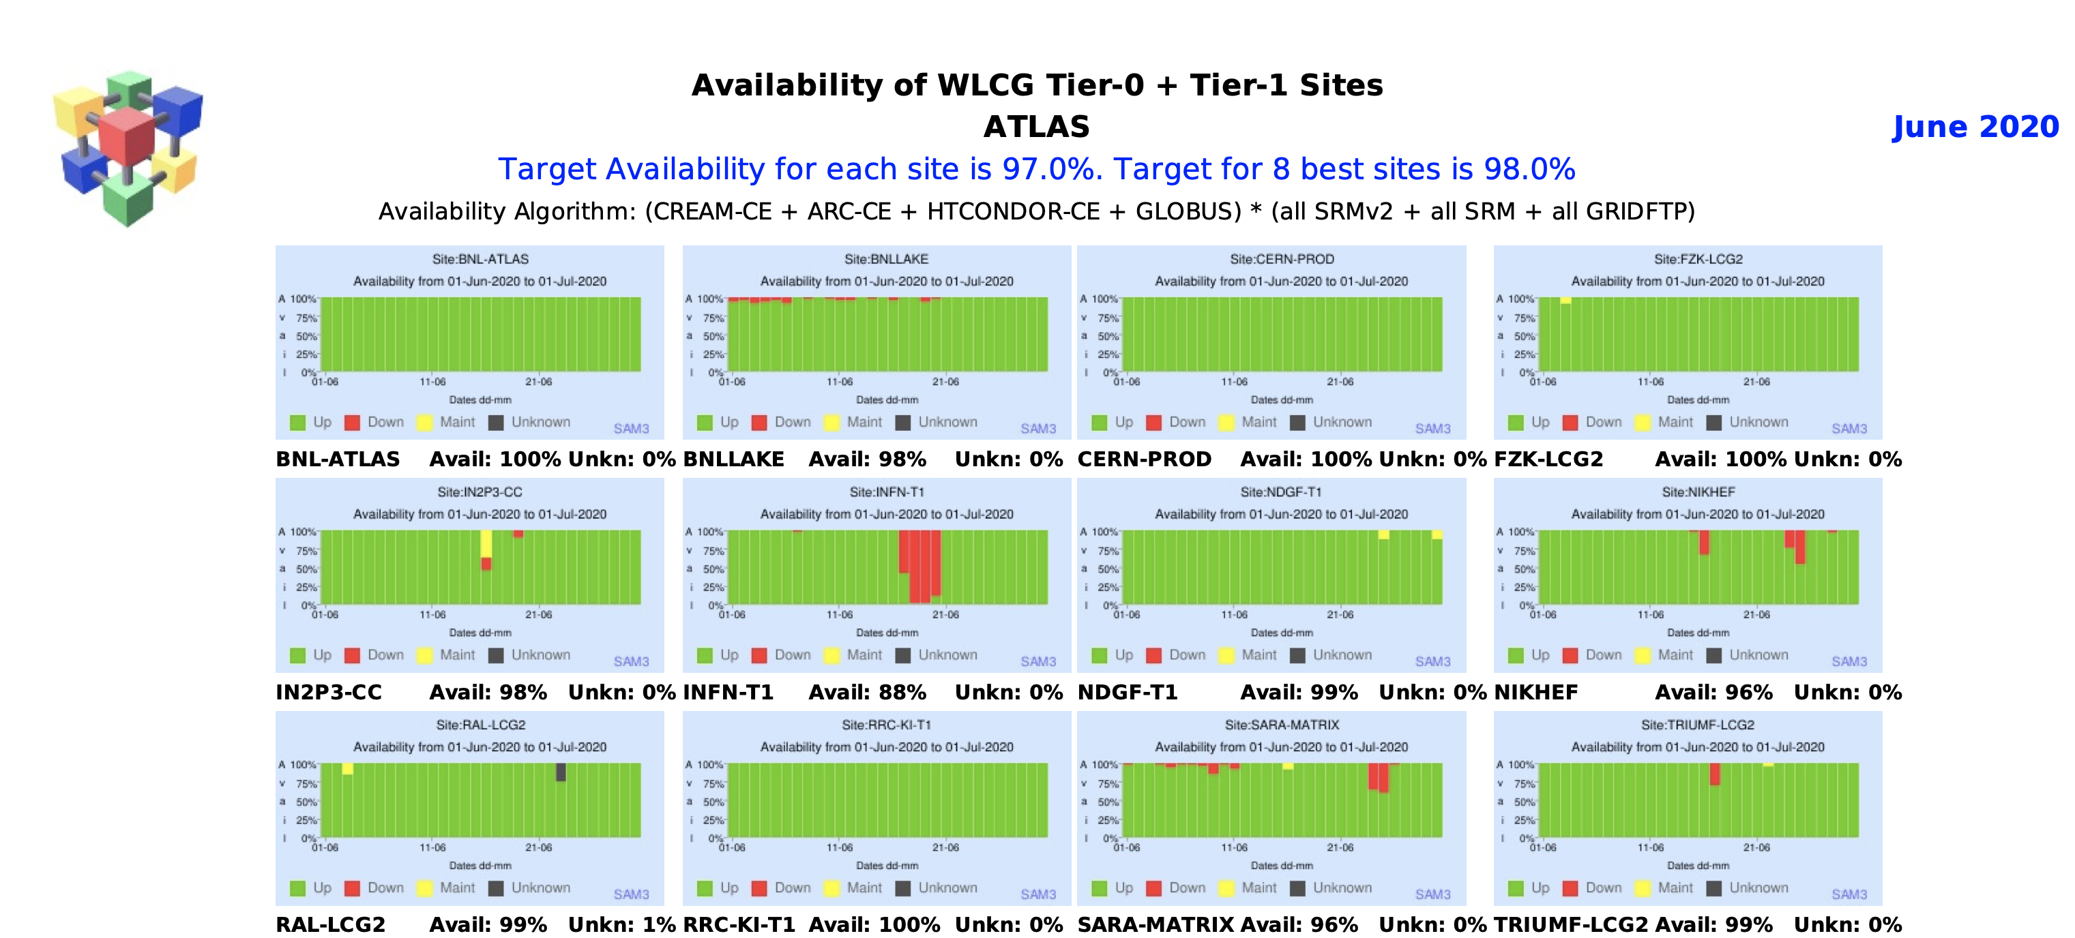
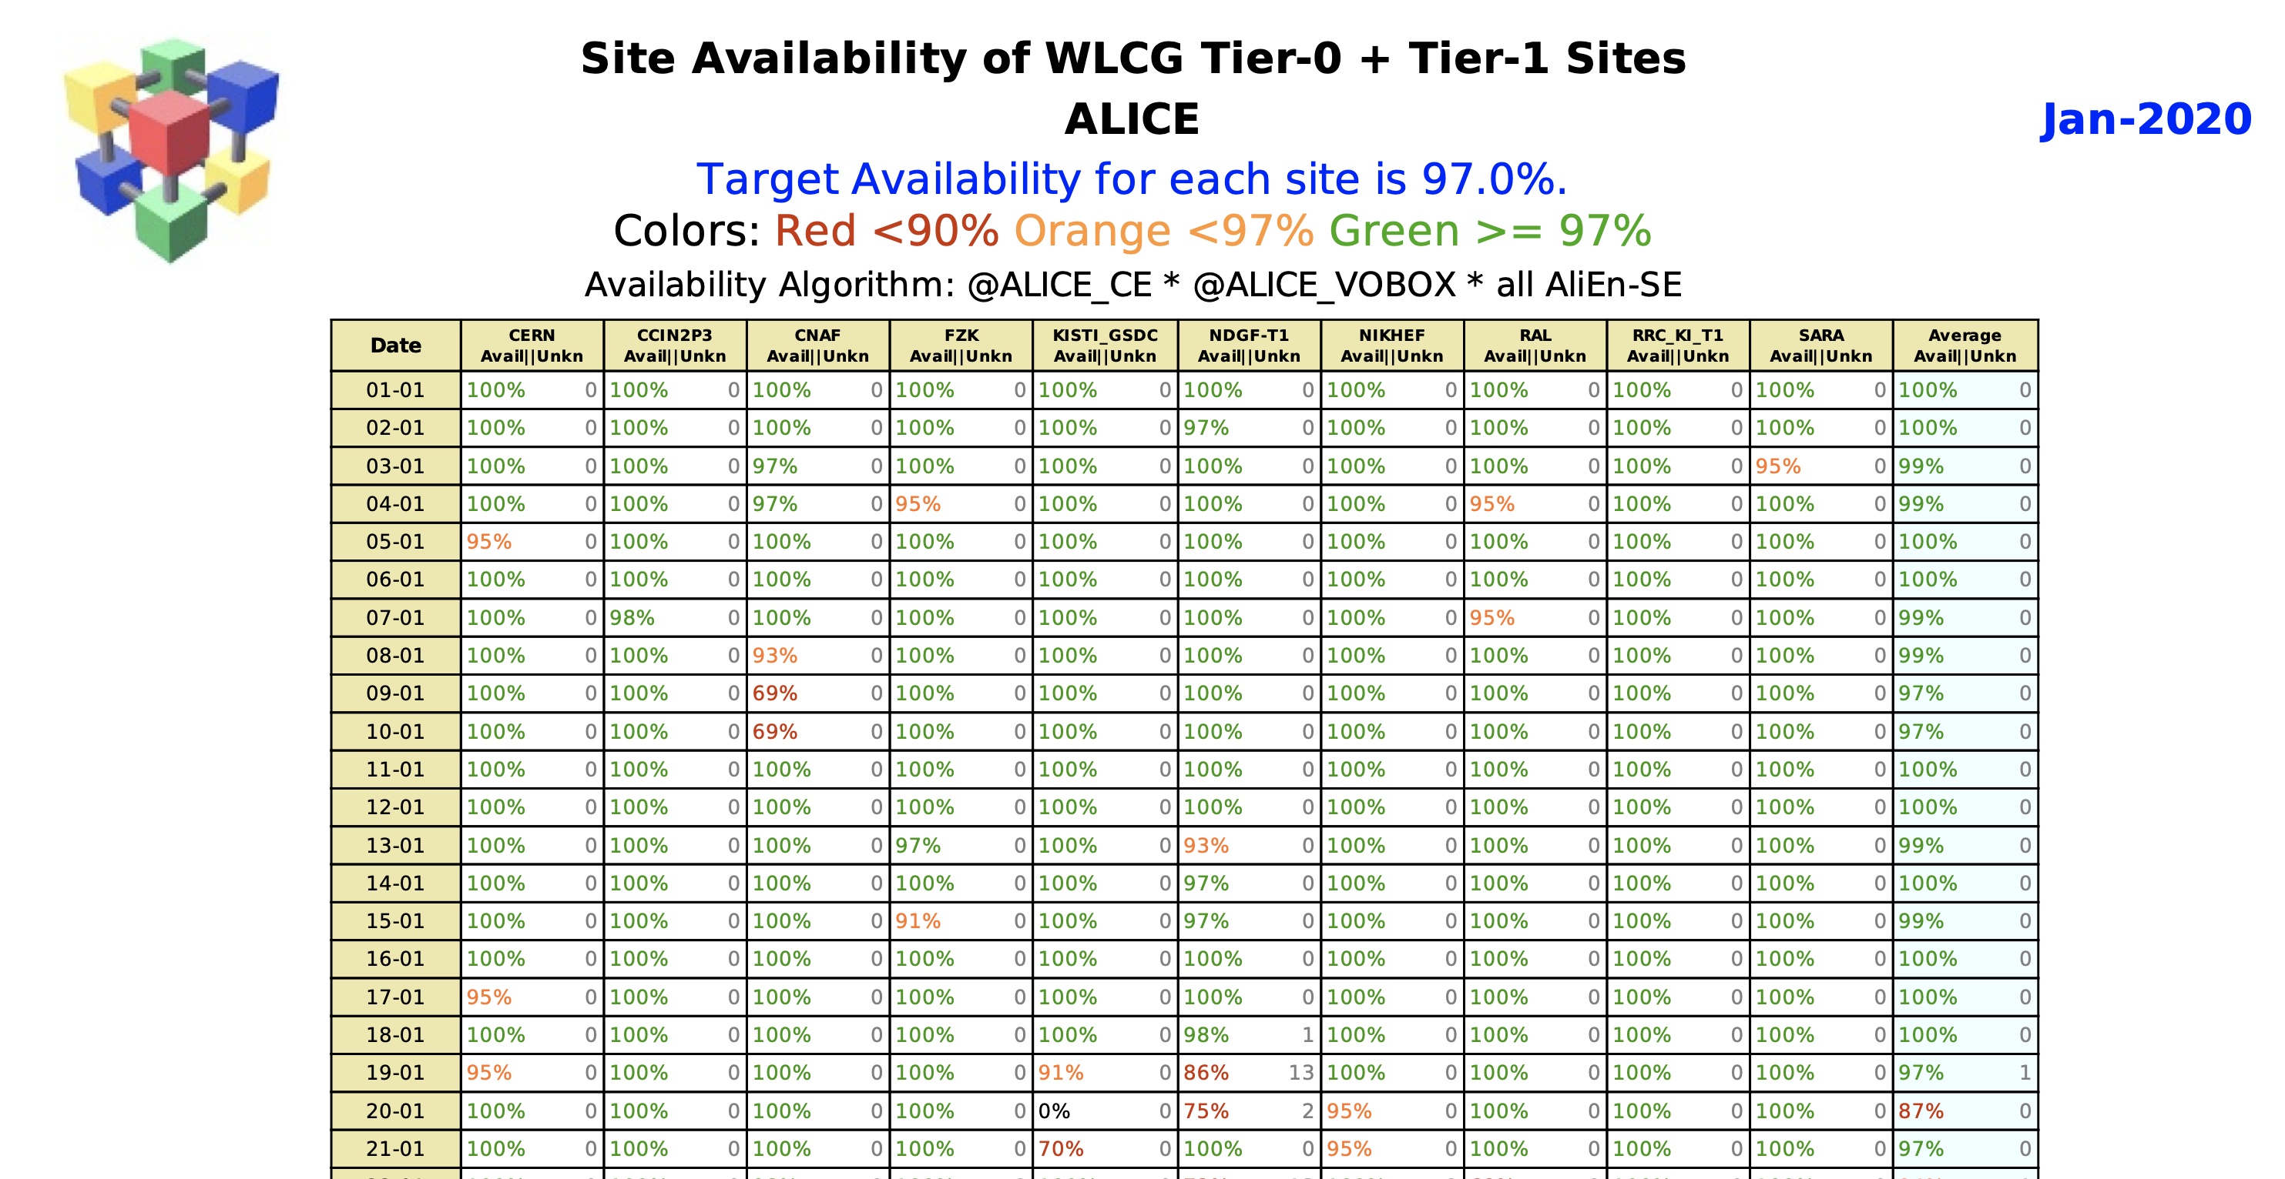
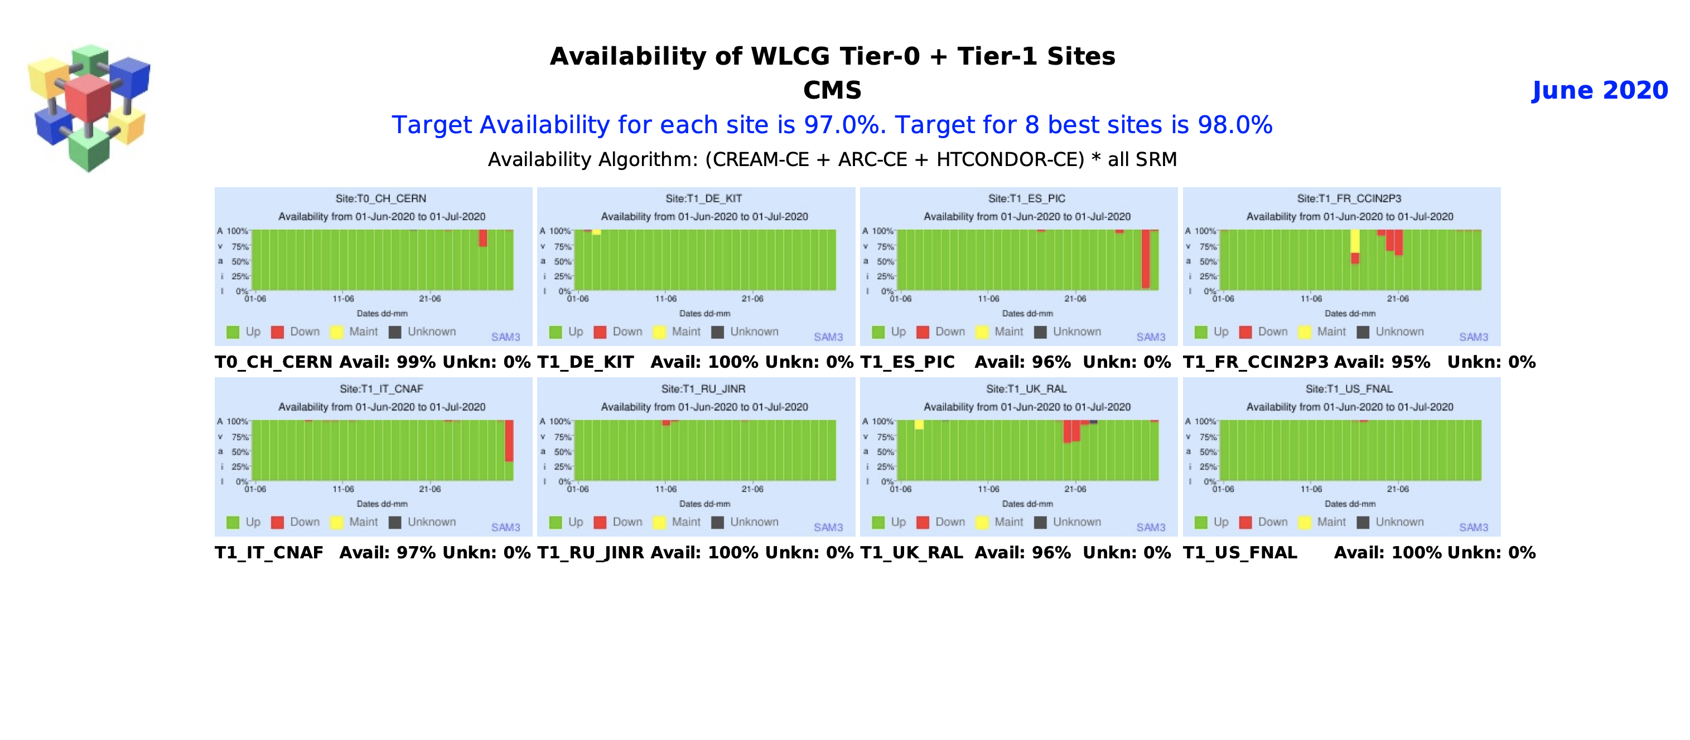
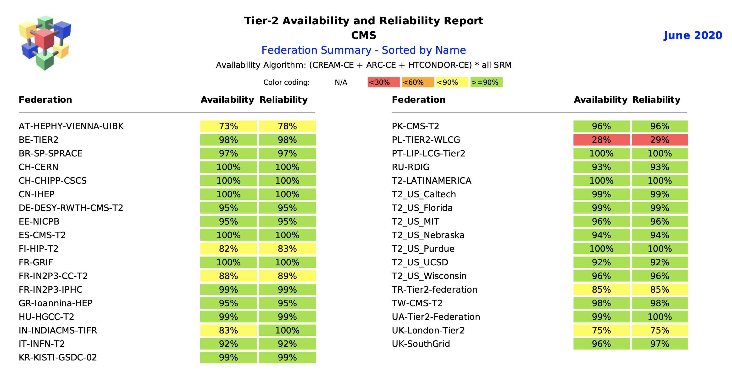
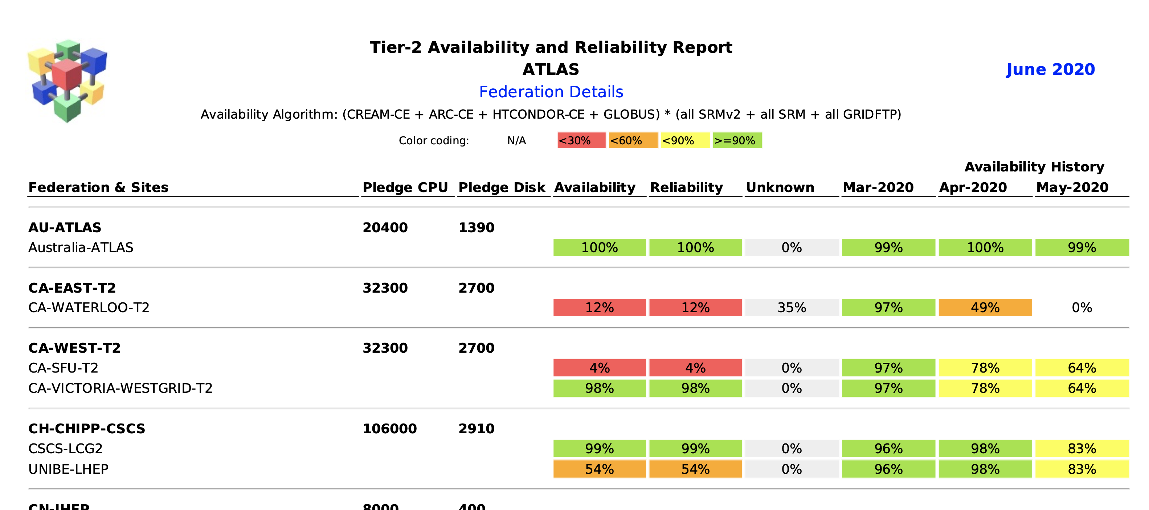
SiteMon
Reports

Slide 5
Dashboards
Available from Grafana WLCG org
Historical Profiles dashboard
  Availability/reliability plots
  Status information for each site/endpoint/test
  Selector for raw data vs corrected data
Historical Tests dashboard
  All raw test results from ETF and Alice
Latest Tests dashboard
  The latest test results from ETF and Alice
Computed availability/reliability (% per hour) kept forever
Computed status (ok, critical, etc) kept for 1 year
Raw test results kept for 1 year

Slide 6
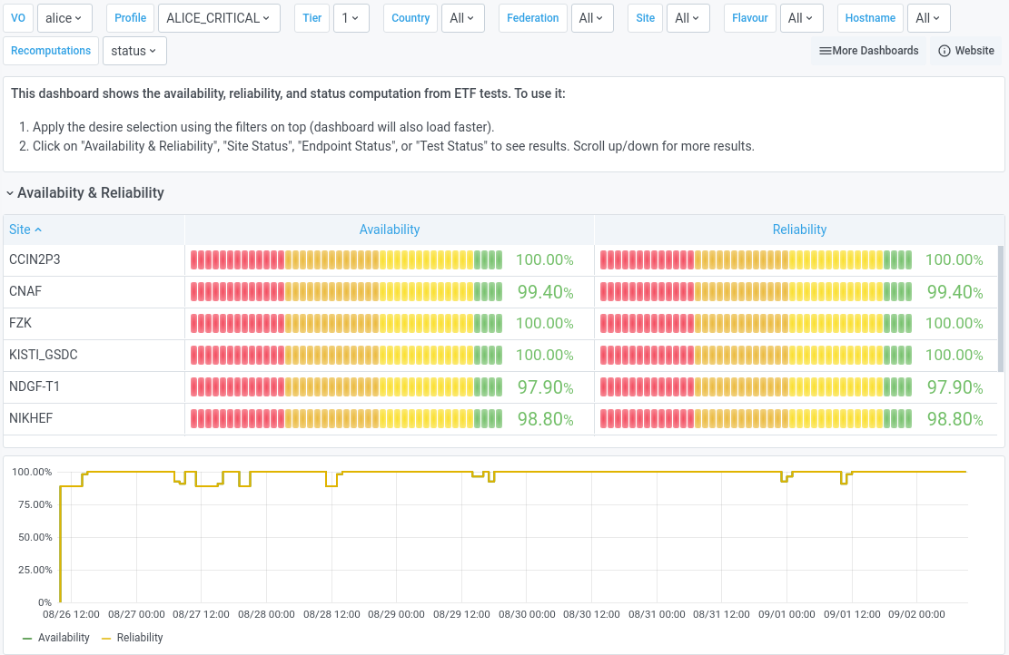
SiteMon
Historical Profiles

Slide 7
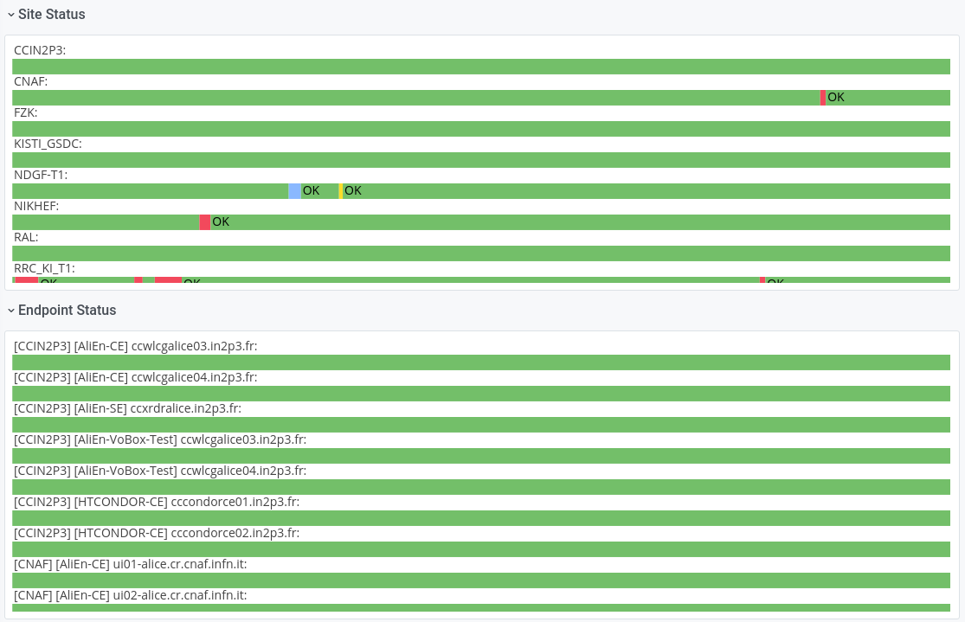
SiteMon
Historical Profiles

Slide 8
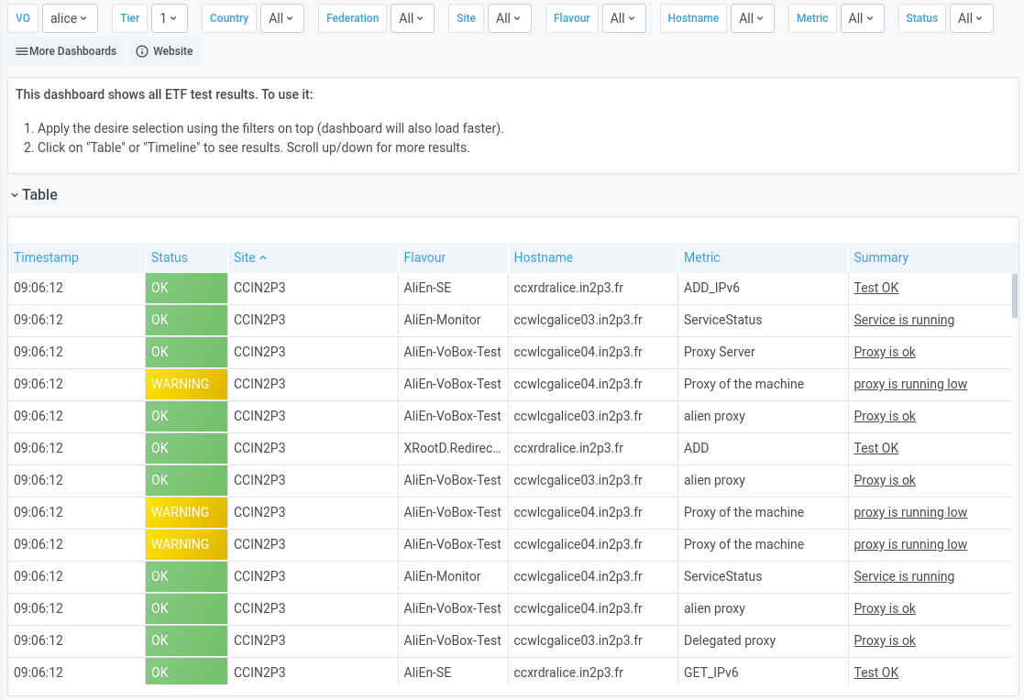
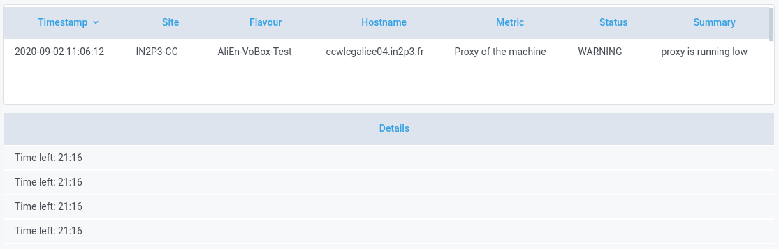
SiteMon
Historical Tests

Slide 9
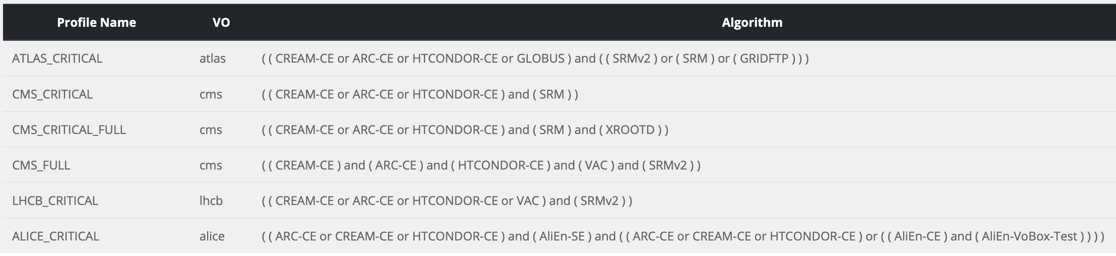
Profiles
Managed internally by the MONIT team
All VO critical profiles initially added by MONIT
Other profiles added later as requested by VOs
Please open a SNOW ticket for further missing profiles

Slide 10
Recomputations
Managed by Experiment representatives
Based on Gitlab with one json doc per request
  Added new option to create VO-wide requests
  Built-in tracking of requests history
  Detailed documentation provided in the repository
{
"vo": "atlas",
"dst_experiment_site": "IN2P3-LAPP",
"periods": [
{ "start_time": "2019-12-01 12:00:00",
"end_time": "2019-12-01 12:13:00",
"status": "DOWNTIME" }
]
}

Slide 11
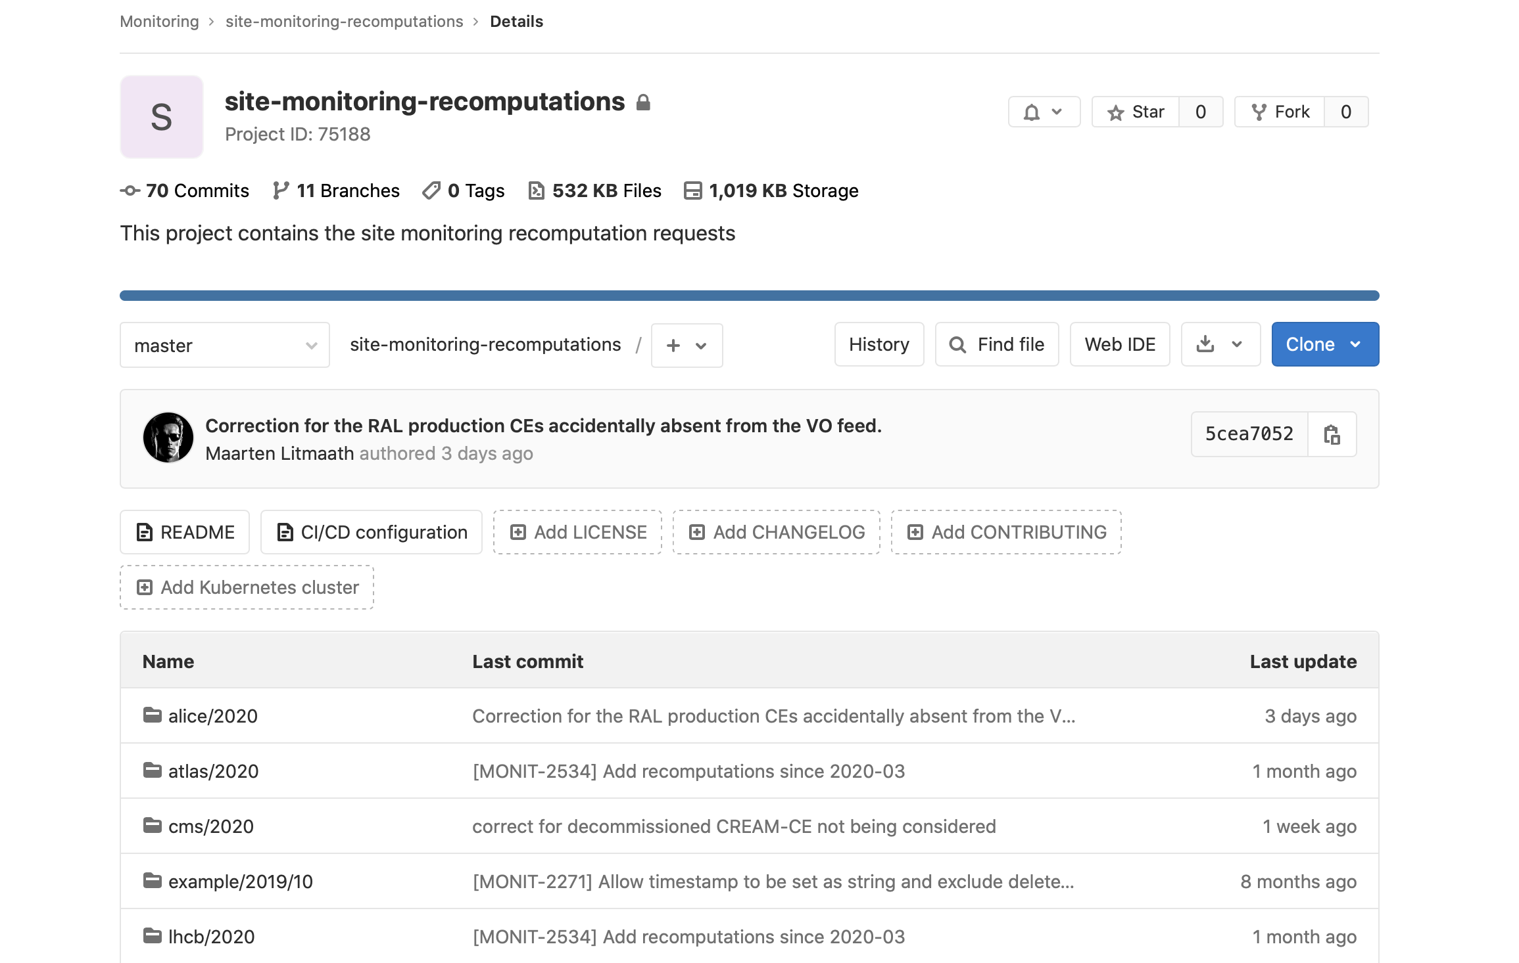
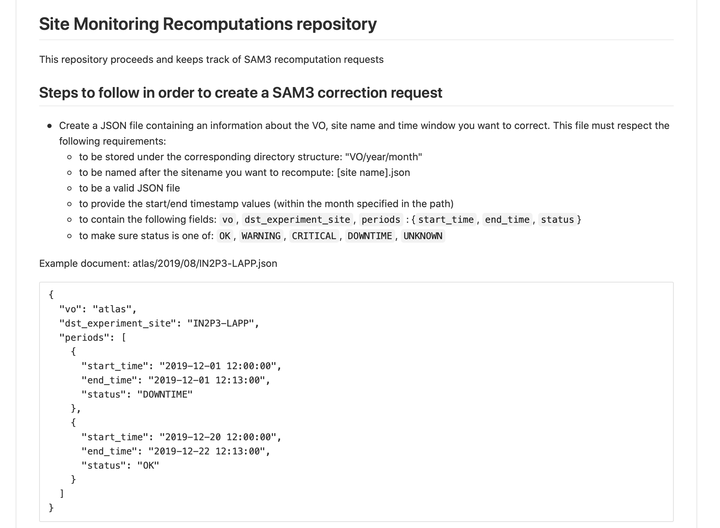
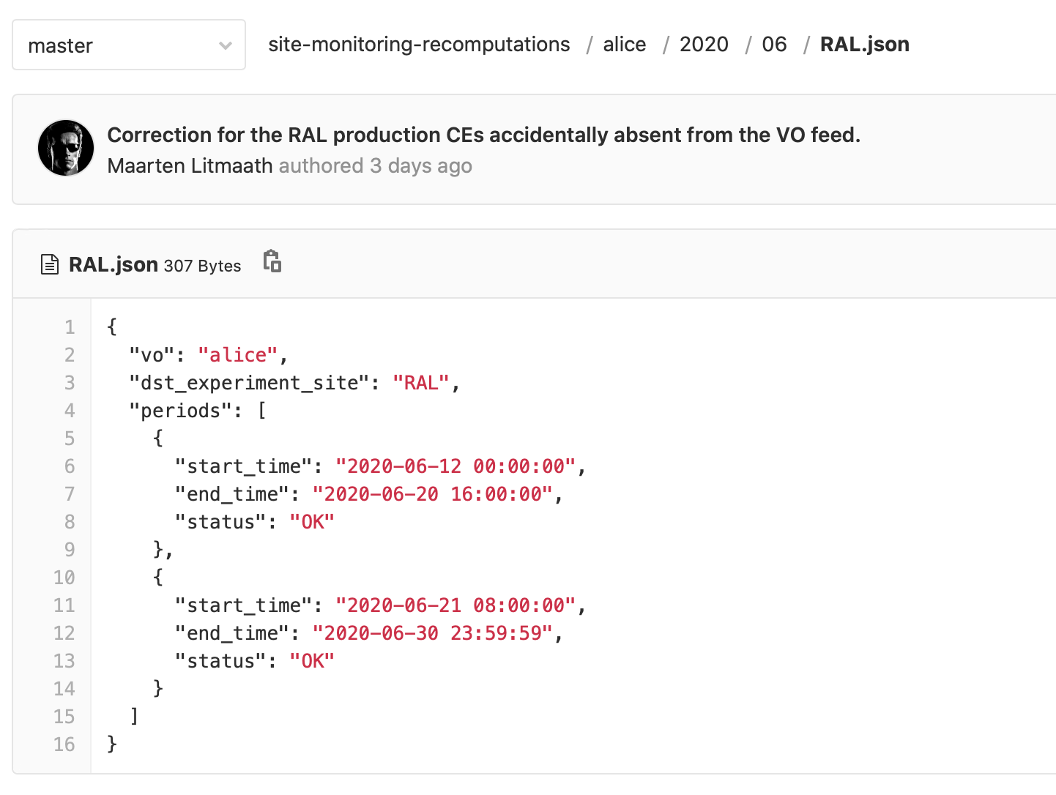
SiteMon
Repo

Slide 12
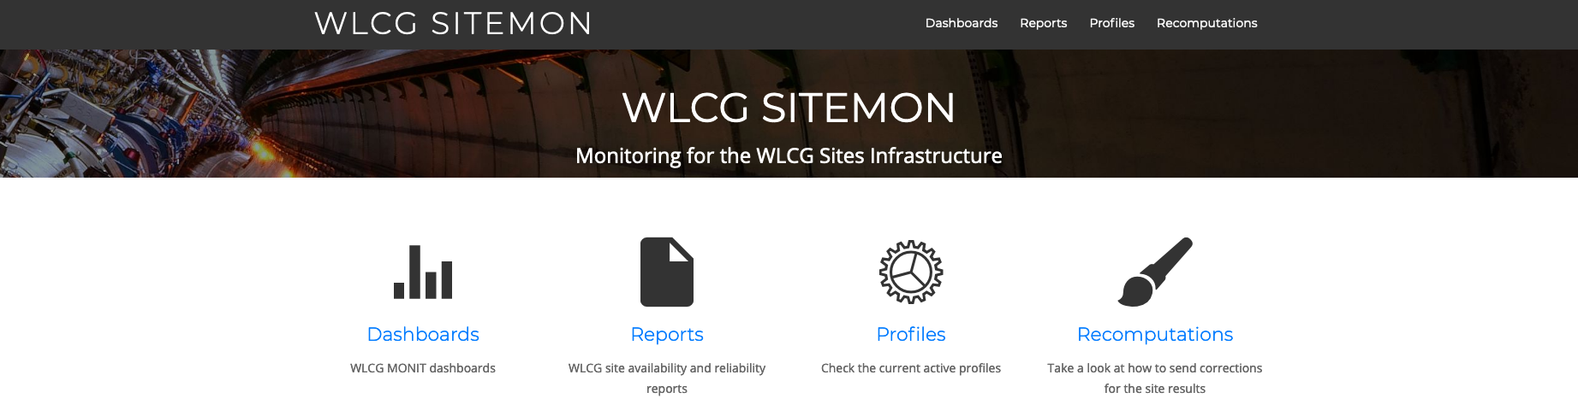
Homepage
http://cern.ch/monit-wlcg-sitemon

Slide 13

Status
Presented the migration in multiple WLCG meetings
    07 May: WLCG Operations Coordination
    02 Jul: WLCG Operations Coordination
    08 Jul: WLCG GDB
    03 Sep: WLCG Operations Coordination
    14 Oct: WLCG GDB
Completed the implementation and deployment of SiteMon
    Imported historical data for availability and reliability
    Collected feedback and provided solutions
New SiteMon fully replaced SAM3
    Old dashboards and infrastructure shutdown
    Reports official since July (~3 months)
    Dashboards official since mid September (~1 month)

Slide 14
Further Improvements
Test validity per profile (now is 24h for all profiles)
Migrate topology enrichment from VOFeeds to CRIC
Improve freshness of profile computations (now is 1h)
Manage profile definition as time-series

Slide 15
Thank you !
In particular to all VO representatives for the feedback provided and the validation of the new tools together with Site Managers.
http://cern.ch/monit-support

