Slide 1
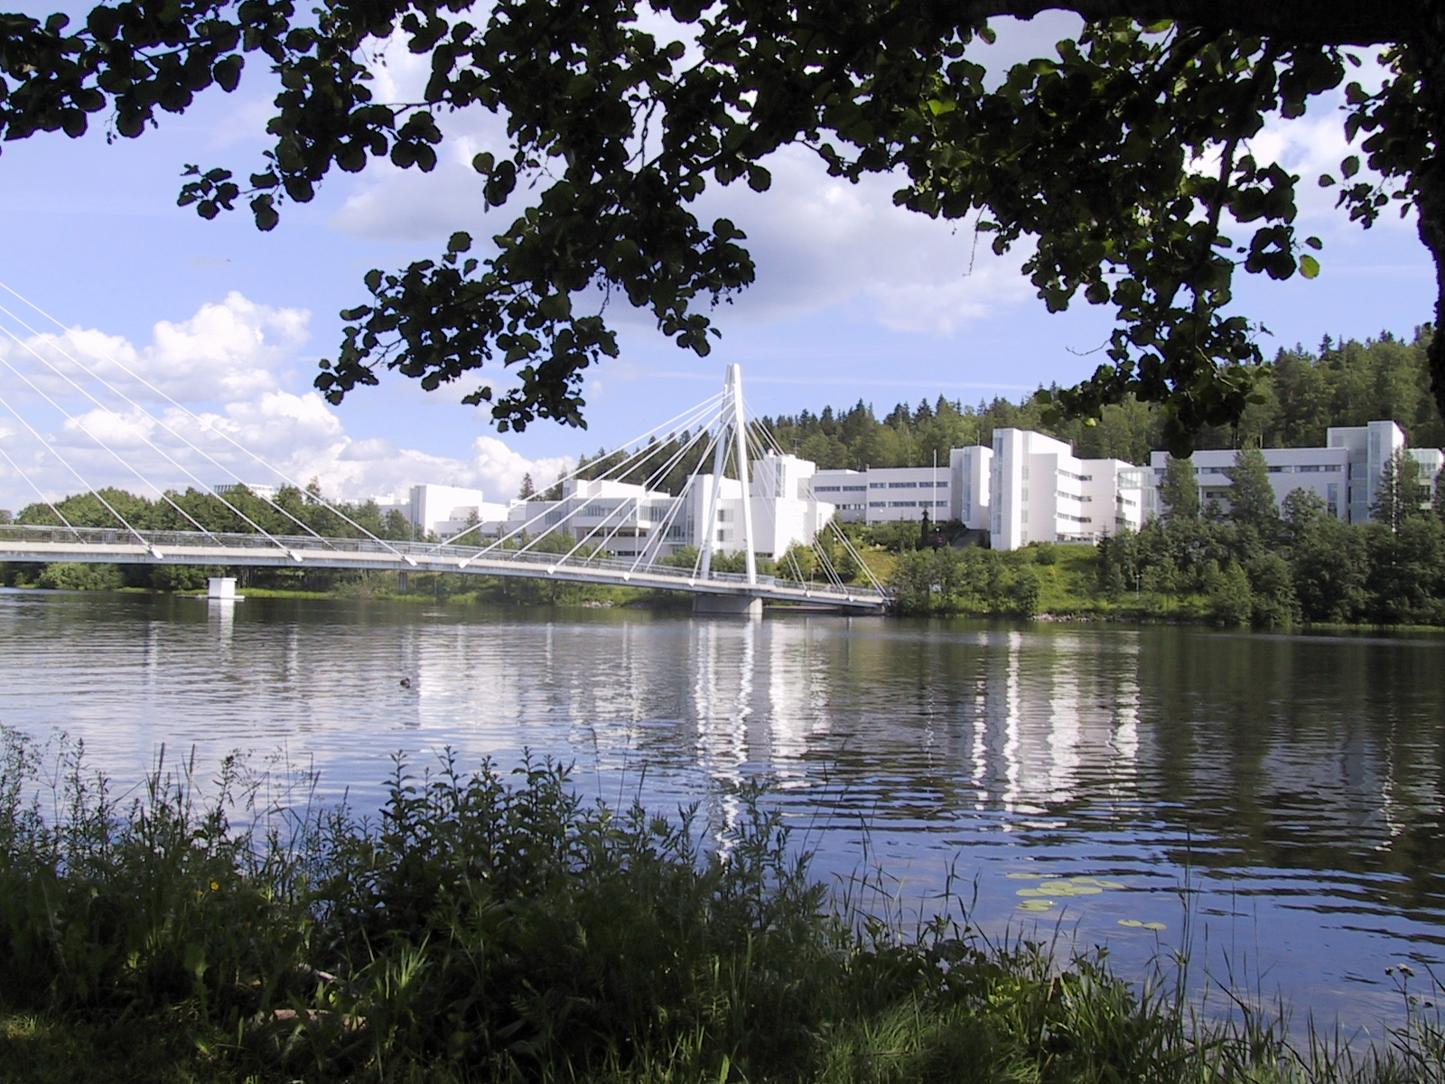
IoP Half Day Meeting
Recoil separators, present and future design concepts
Liverpool, April 29th , 2019
Juha Uusitalo
Department of Physics
University of Jyväskylä (JYFL)
Finland

Slide 2
Nuclear reactions induced by exotic nuclei allow the exploration of nuclear structure at its extremes, the dynamics of stellar evolution and the limits of nuclear existence. Reaccelerated radioactive beams are currently available with energies up to around ~ 10 MeV/u from ISOL ion sources, where the beam is produced by the bombardment of thick targets by a primary particle accelerator.
High-resolution recoil separators are used to identify the reaction products, separating the primary beam from the products of interest. The singular properties of ISOL beams and the variety of physics programs impose specific design requirements.
This meeting will provide an opportunity to reinforce present collaborations and research activities across interdisciplinary lines, and to coordinate synergies and efforts for the development of a new instrument for HIE-ISOLDE.
High-resolution recoil separation is a combination of a separator itself and various detector setups at the target position and the focal plane.

Slide 3
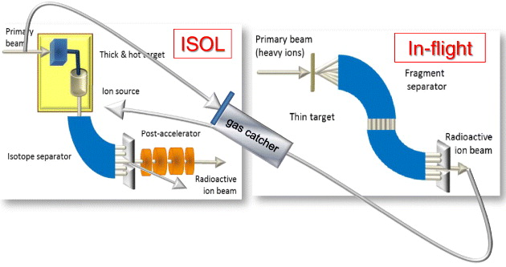

Slide 4
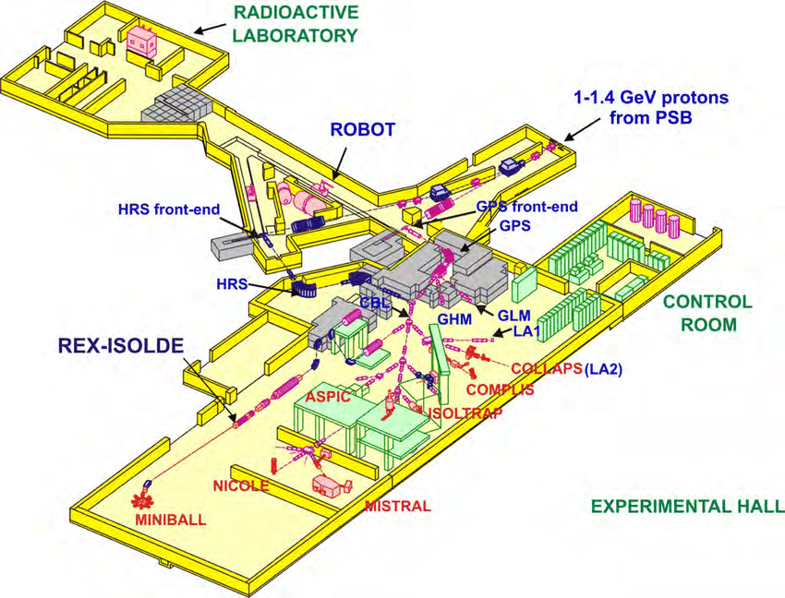
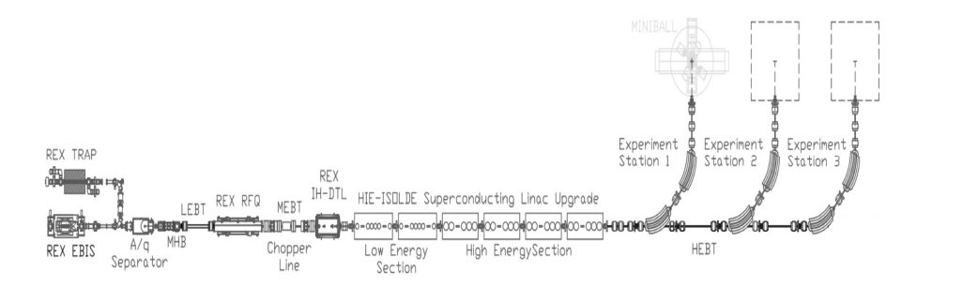

Slide 5
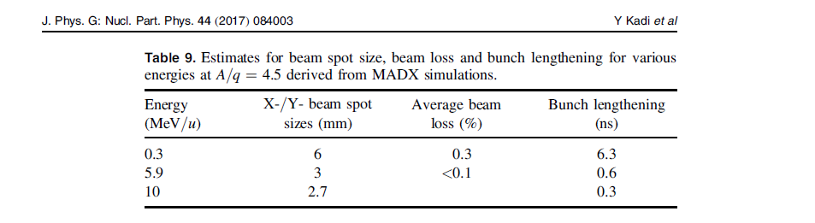
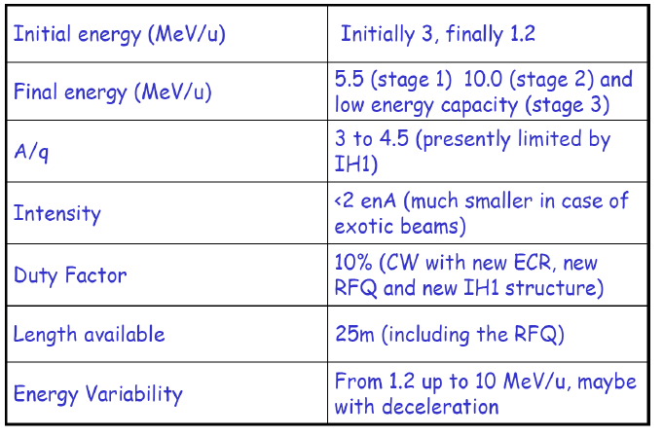
M. Huyse
at Saariselkä 2009
< 2 enA ~ < 1x10⁹ pps

Slide 6
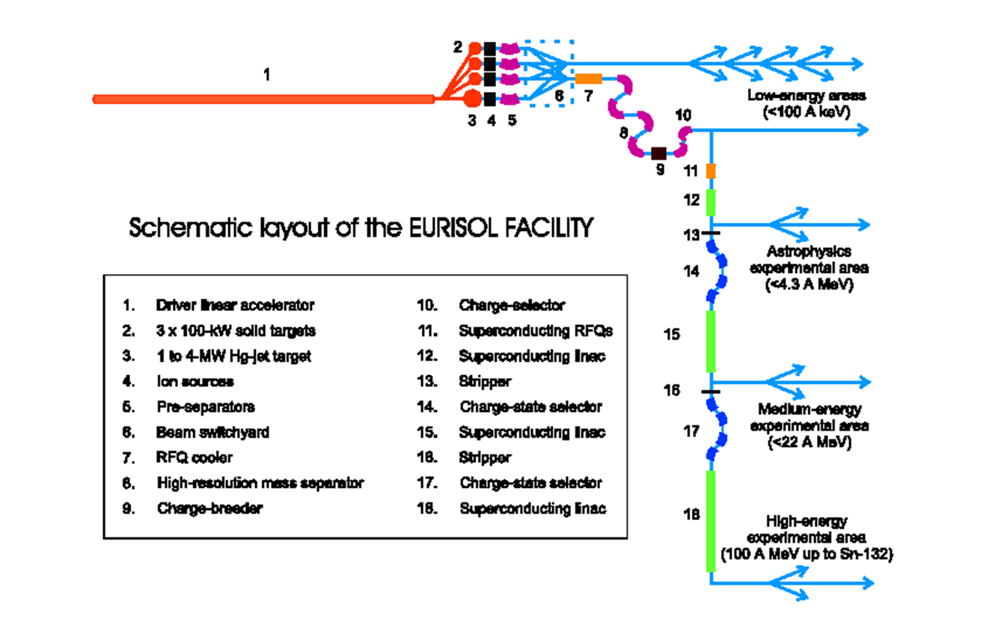

Slide 7
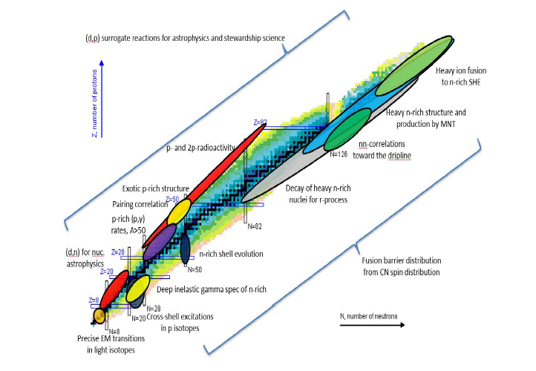
Recoil Separator for Rea12
White paper on the science case and proposed technical solution

Slide 8
Experiments:
- < 100 keV/A
- Laser spectroscopic studies, mass measurements, isobar purified spectroscopy
- COLLAP, CRIS, ISOLTRAP, IDS
- < 4 MeV/A
- (”Safe”) Coulex, MINIBALL
- Capture reactions (p, γ), (α, γ)
- < 20 MeV/n
- fusion-evaporation reactions
- Transfer reactions (n,p)……
- Deep-inelastic, multi-nucleon transfer, cluster transfer…
- 100 MeV/n
- Spallation, fragmentation, fission

Slide 9
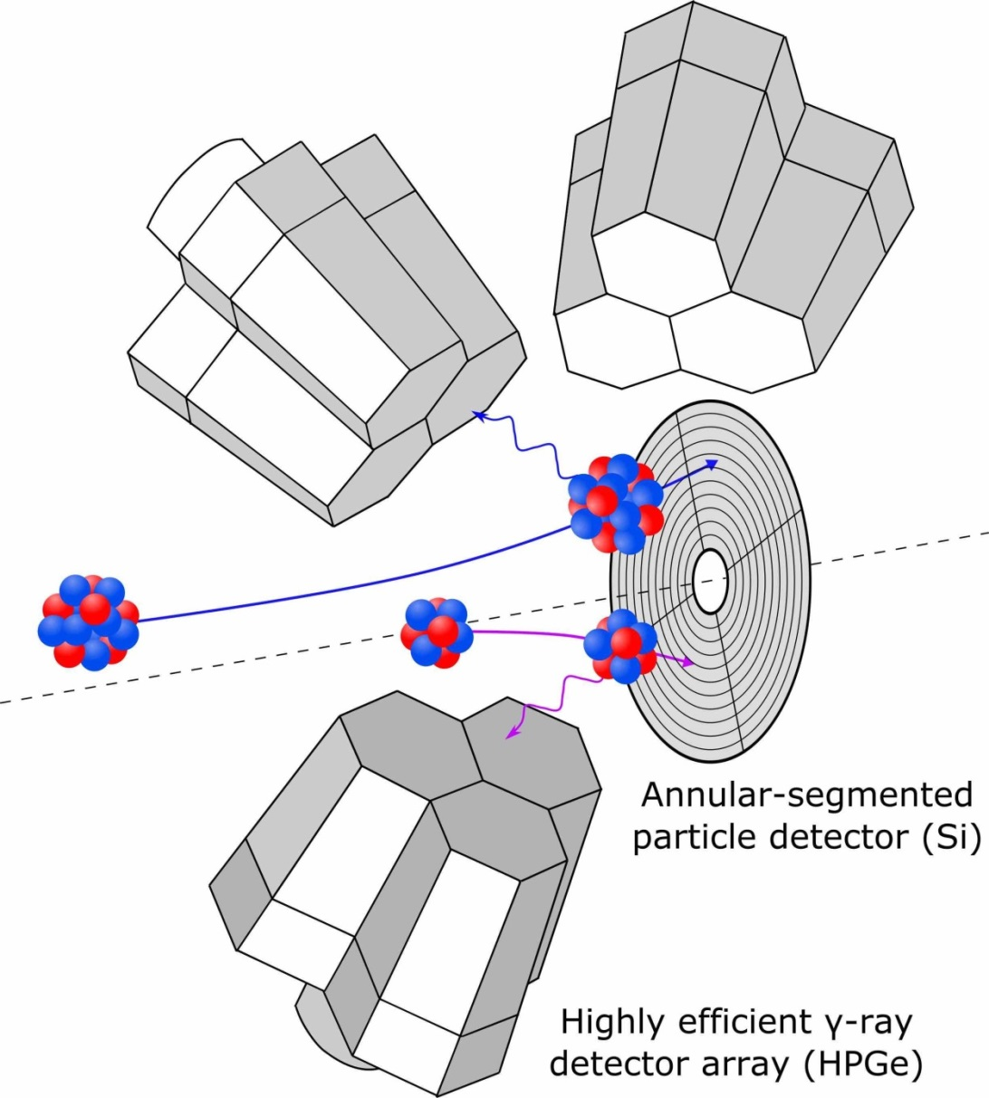
Safe Coulex experiments

Slide 10
• Spectrometer (in-flight separators) key features:
- acceptance (angular, energy, momentum, m/q), resolving power, beam suppression, image size
• Small acceptance separators
- small aberrations, image size small, physical separation
- Examples: FMA, EMMA, MARA, (SHIP)
- Transmission reasonable high in inverse kinematics or in symmetric cases
• Large acceptance separators
- large aberrations, no physical separation, identification based on using large tracking detectors
- Examples: VAMOS, PRISMA..
• Gas-filled separators
- Charge and velocity focusing, high transmission and very good beam suppression with as-symmetric cases
- TASCA, GARIS(I and II), BGS, RITU..
• Detector setups around the target position and around the focal plane

Slide 11
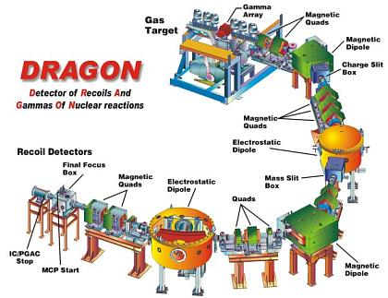
Dragon at Triumf for capture reactions
ΔE, E, ToF
→ A, Z

Slide 12
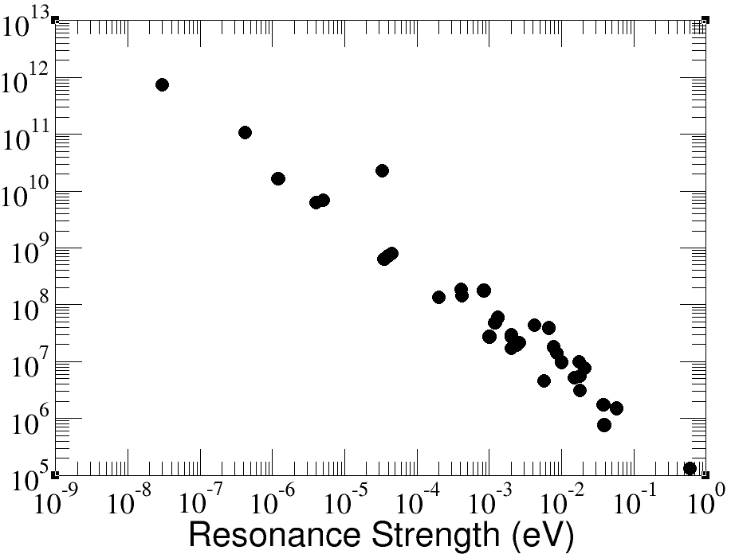
SECAR, Separator for Capture Reaction
Beam suppression
for <1 background event
Typical astrophysical resonances
Minimum beam intensity for 2 week measurement
Ultimate Performance Parameter
UPP 10⁻¹⁷
Beam Intensity (pps)
Key Performance Parameter
KPP 10⁻¹³

Slide 13
SECAR, Separator for Capture Reactions
Step 5: Focal Plane
Detectors
Gas target (H, He)
coincidence
Step 5: Gamma
Detectors, BGO-array
Step 1: Dipoles
Charge state
selection
Recoil
FP4
Step 4: Dipole
Cleanup scattered beam
FP1
Step 2: Velocity Filter
Mass resolution 510
FP3
VF1
“Scattered
Beam”
VF2
Better performance than
DRAGON required.
This is achieved through:
Higher mass resolution
“Clean up” section
Step 3: Velocity Filter
Mass resolution 770
Beam
FP2
- Maximum Bρ 0.8 Tm, maximum Eρ 16 MV
- Angular acceptance 2.5 msr
- Energy acceptance ± 3.1 %
- m/q acceptance, one charge state

Slide 14
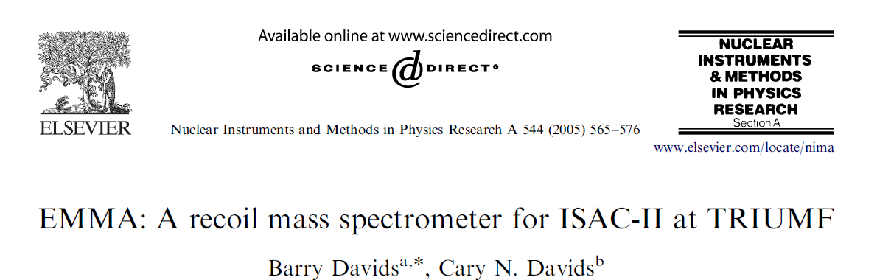
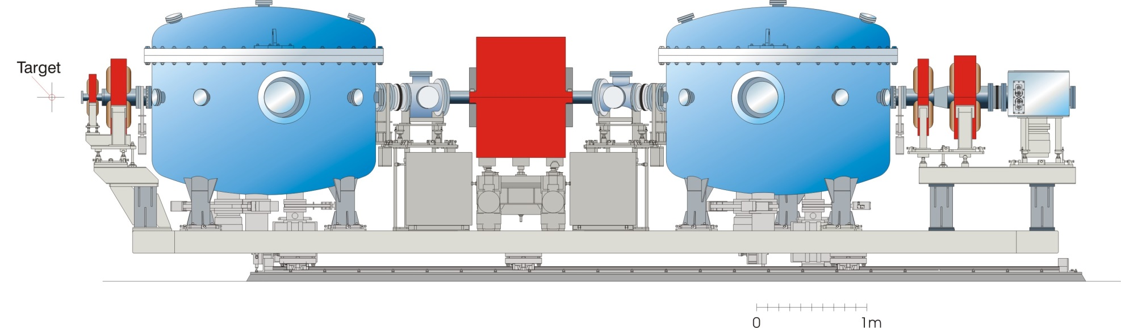
- Maximum Bρ 1 Tm, maximum Eρ 25 MV
- Angular acceptance 16 msr
- Energy acceptance ±20 %
- m/q acceptance 4 %
- Fusion evaporation studies
- Transfer studies in inverse kinematics
  d(¹³²Sn,p)¹³³Sn, Eρ = 38 MV

Slide 15
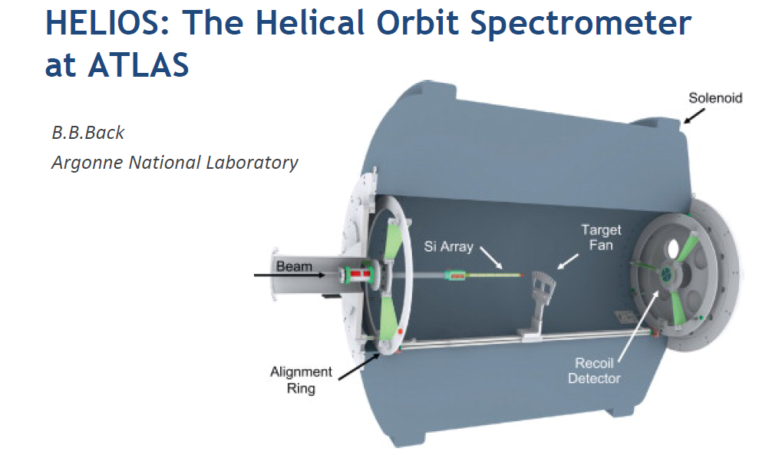
Inverse kinematics
d(^{A}X,p)^{A-1}X reactions
Gas targets to allow
(3He,p), (3He,d), (3He,α)
ISS, Isolde Solenoidal Spectrometer

Slide 16
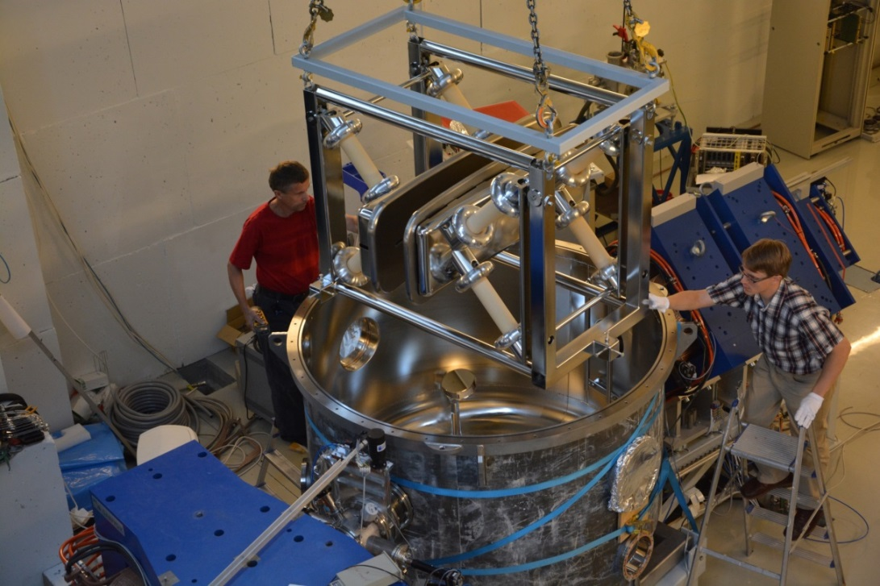
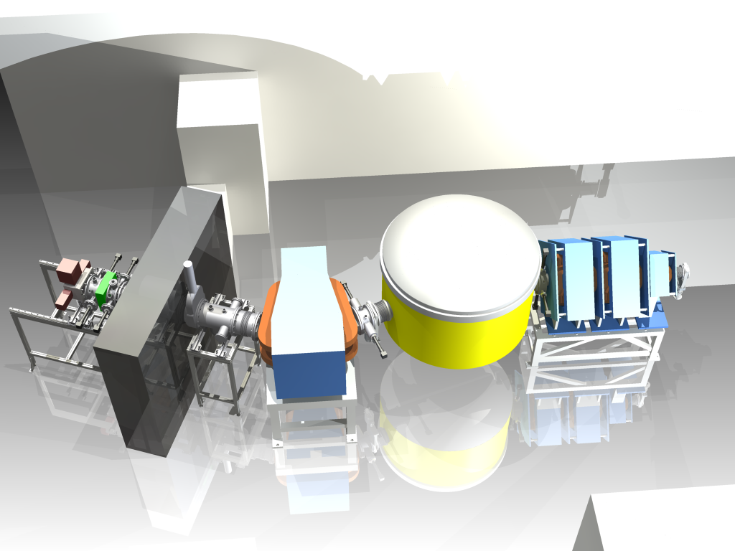
MARA at JYFL-ACCLAB
- Maximum Bρ 1 Tm, maximum Eρ 14 MV
- Angular acceptance 10 msr
- Energy acceptance +20%, -15 %
- m/q acceptance ± 7 %
- Fusion evaporation studies

Slide 17
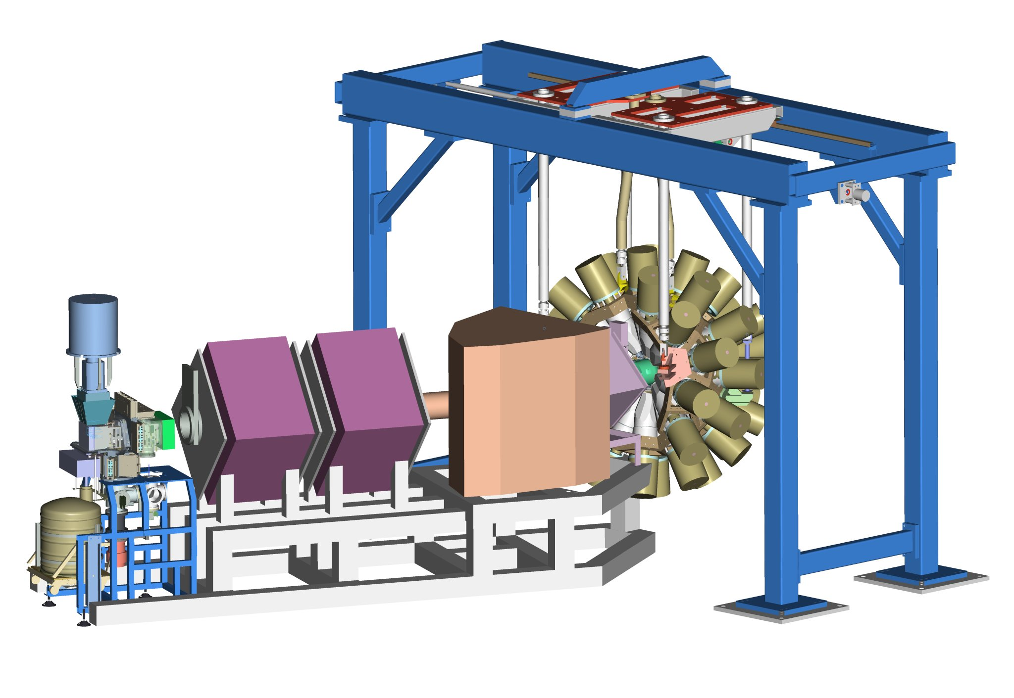
RDT Instrumentation at JYFL-ACCLAB
JUROGAM
Compton suppressed
24Ge Clovers + 15 Ge
Eff. 6%
GREAT
Focal plane spectrometer
RITU
Gas-filled recoil separator
Transmission 10-80 %
Beam
TDR
Total Data Readout
Triggerless data acquisition system
with 10 ns time stamping
+ GRAIN the Analyser

Slide 18
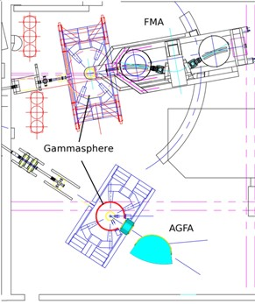
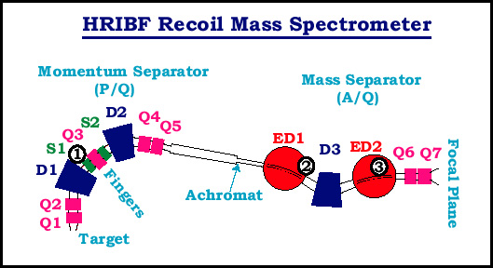
Argonne separators
ANL, USA
ORNL, USA

Slide 19
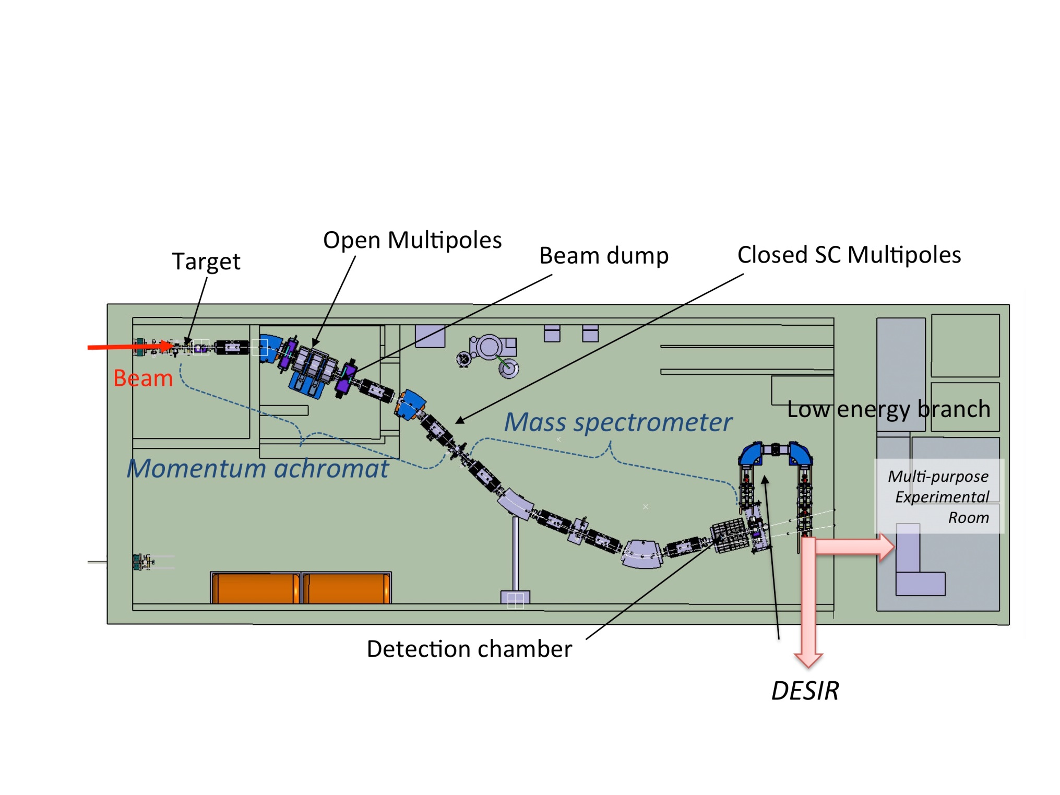
S3 separator at Ganil

Slide 20
VAMOS at GANIL

Slide 21
PRISMA at Legnaro

Slide 23
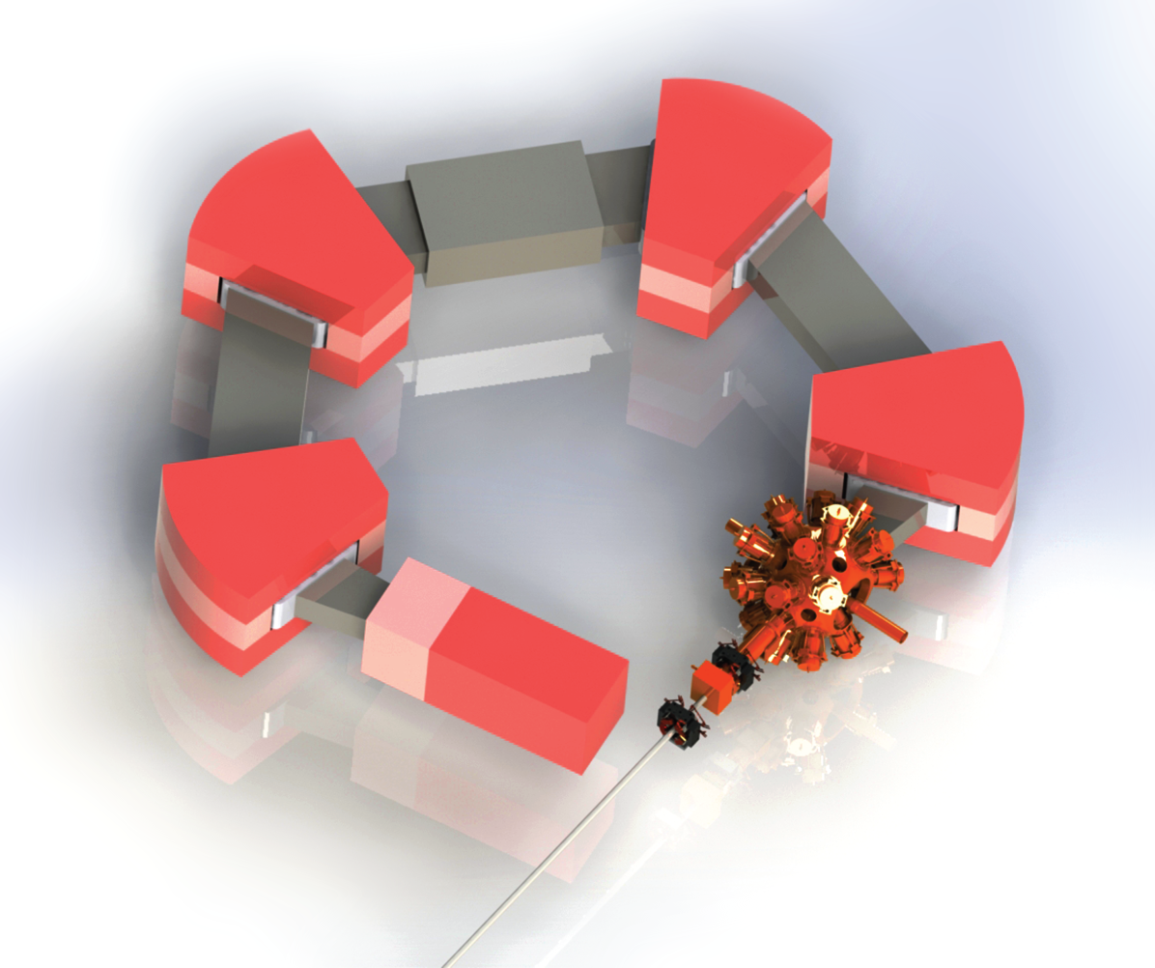
ISLA
Isochronous Separator with Large Acceptances
Recoil Separator for Rea12
White paper on the science case and proposed technical solution
Multi-purpose separator for
transfer, for deep-inelastic and
for fusion evaporation reactions
Large acceptance separator with
Relatively small image size (< 15 cm)
Vacuum-mode as well as
gas-filled mode.
Moderate beam suppression
- Maximum Bρ 2.6 Tm,
- Angular acceptance 64 msr
- Momentun acceptance ± 10 %

Slide 24
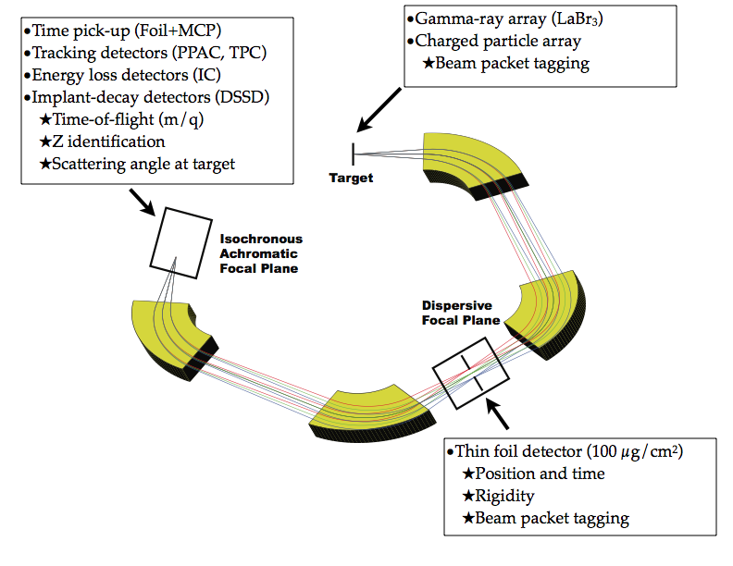
- fusion-evaporation reactions
- high spin state population
- multi-nucleon transfer reactions to regions not accessible by fragmentation
(neutron rich U isotopes, transuraniums, neutron rich nuclei below 208Pb,…)
- direct reactions such as (d,p), (d,n), (p,t)
- direct heavy ion transfer reactions such as (7Li,4He), (12C,14C), 18O,16O)

Slide 25
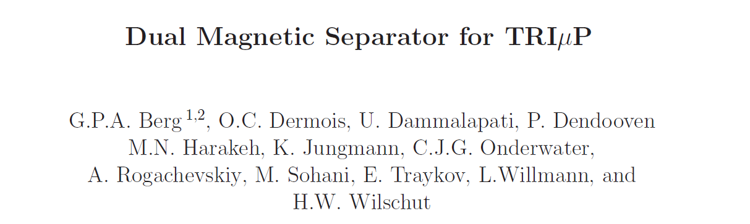
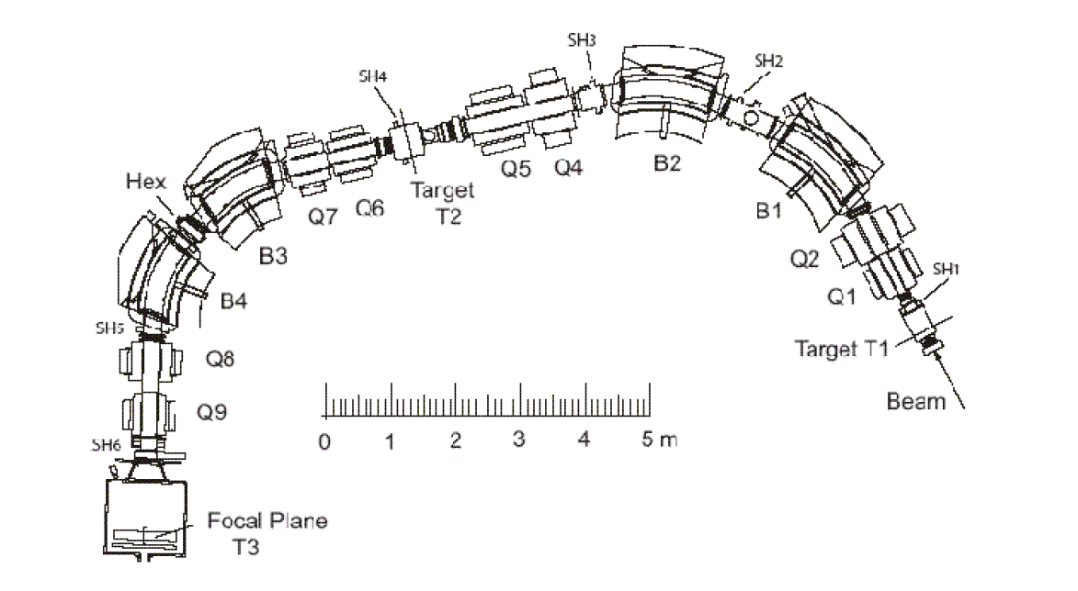
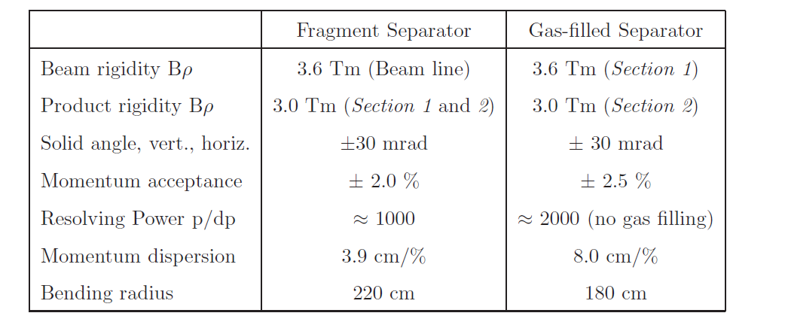
THAN YOU FOR YOUR ATTENTION !

