Slide 1
Class 0 Power Converters
Update on ADC development and testing
Nikolai Beev
High Precision Measurements Section
Electrical Power Converters Group
Technology Department
HL-LHC TCC meeting 18.04.2019

Slide 2
Presentation Outline
Significance of the ADC
HL-LHC Class 0 Requirements
ADC strategy: DS24 and HPM7177
Preliminary test results
Conclusions

Slide 3
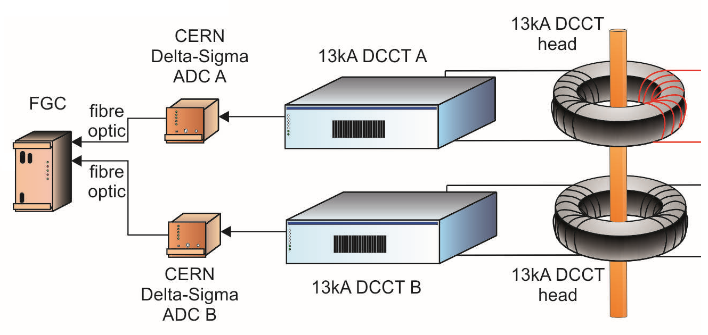
LHC High Precision Measurement System
_{V ref}
Power converter
_{V out}
I out (primary)
Magnet
(R+L)
_{I ref}
I _{secondary}
V_{ADC}
digital
control loop
DS22 [2]
[1] M. C. Bastos et al. "High accuracy current measurement in the main power converters of the large hadron collider: tutorial 53," in IEEE Instrumentation & Measurement Magazine, vol. 17, no. 1, pp. 66-73 (2014)
[2] J. Pett. A high accuracy 22 bit sigma-delta converter for digital regulation of super-conducting magnet currents. Third International Conference on Advanced A/D and D/A Conversion Techniques and their Applications, pp. 46 – 49 (1999)

Slide 4
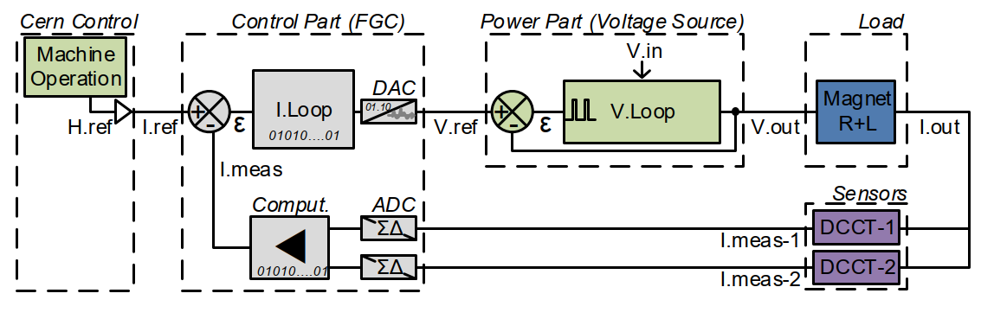
Current Regulation: Closed loop performance
V dist
I dist
I meas. noise
RPTE.UA83.RB.A78 – LHC 13 kA

Slide 5
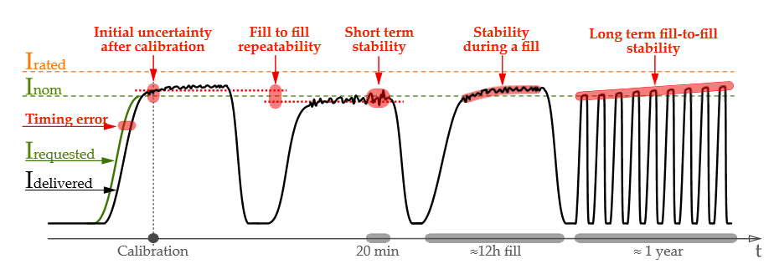
HL-LHC Class 0 Requirements
 | Class 0
 | total PC | adc
Resolution [ppm] | 0.5 | 0.2
Initial uncertainty after cal [2xrms ppm] | 2.0 | 1.0
Linearity [ppm] [max abs ppm] | 2.0 | 1.0
Stability during a fill (12h) [max abs ppm] | 0.7 | 0.3
Short term stability (20min) [2xrms ppm] | 0.2 | 0.1
Noise (<500Hz) [2xrms ppm] | 3.0 | 1.0
Fill to fill repeatability [2xrms ppm] | 0.4 | 0.1
Long term fill to fill stability [max abs ppm] | 8.0 | 4.0
Temperature coefficient [max abs ppm/C] | 1.0 | 0.2
T = const.
ΔT = 0.5 ºC
[3] M. C. Bastos. HL-LHC Power Converter Requirements. EDMS 2048827 v.2

Slide 6
DS22
Designed at CERN in the 1990s [2]
3rd order Sigma-Delta ADC built of discrete components
Temperature-stabilized with a Peltier element
Improved gradually over the years
Version 10.1 (2006) installed in LHC: Class 1 – main bends, main quads, inner triplets
Excellent reliability record so far
Not compliant with HL-LHC Class 0 requirements for noise (LF and broadband) and fill stability
Contains obsolete components
Has known and recurring problems (e.g. idle tones)

Slide 7
ADC strategy for HL-LHC Class 0
DS24 – an improved version of DS22
replacement of obsolete components
improvements in LF and broadband noise
mitigation of the idle tones with a different dithering scheme
improvements in the digital low-pass filter
new documentation - schematics and layouts in Altium Designer; new 3D models and mechanical drawings
HPM7177 - a brand new digitizer based on a commercial ADC chip

Slide 8
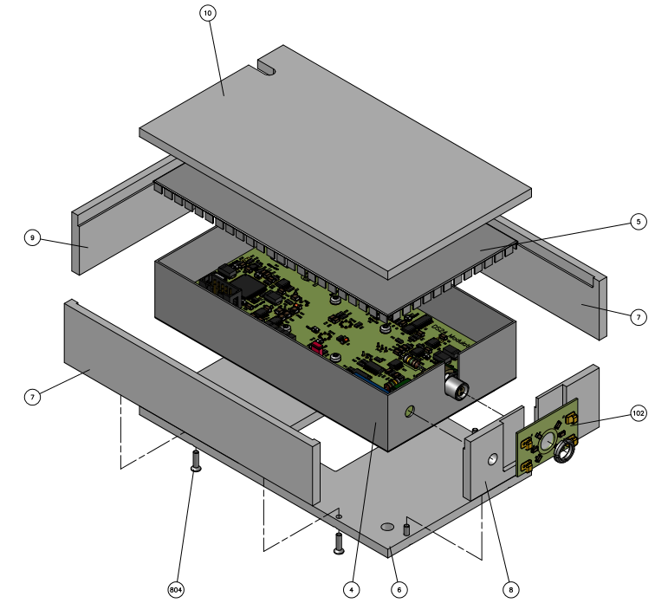
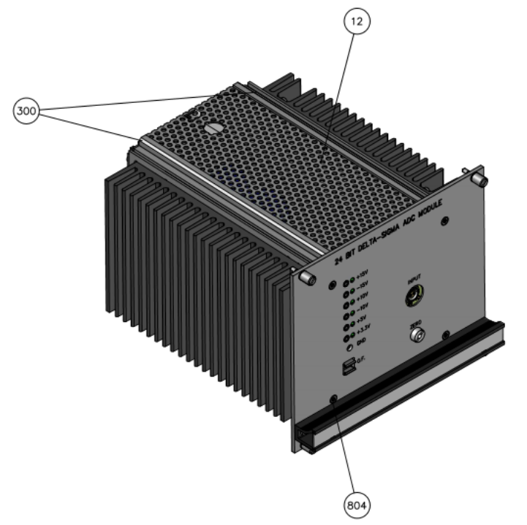
DS24
DS22 was studied in detail in the past 2 years to identify possible improvements
EDMS 2054292 V1 [4] summarizes all changes from DS22 V10.1 to DS24
Expected performance improvements:
significant decrease of LF noise
slight decrease of broadband noise
significant reduction or elimination of idle tones
Design documentation:
EDA-03978 – ADC module
EDA-03979 – Modulator
EDA-03980 – Power supply
EDA-03981 – Shielding PCB

Slide 9
DS24 Low-frequency Noise
DS22
First improvement
Further improvement -> DS24
5x lower noise
(2.3 effective bits)
HL-LHC Class 0
short-term stability requirement BW

Slide 10
Commercial ADC Survey and Pre-selection
Commercial ADCs with nominal resolution ≥24 bits were considered
Datasheet information (noise, SNR, effective resolution) was carefully studied and scaled for a fair comparison. Results were reported in [5]
best ΣΔ
best SAR
DS22
[5] N. Beev. Analog-to-digital conversion beyond 20 bits. Proceedings of I2MTC-2018, Houston, TX (2018)

Slide 11
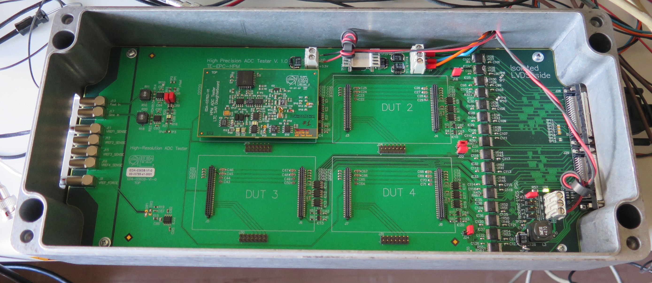
Commercial ADC testing - LF noise
A test bench based on a NI PXIe FPGA system was developed
Tested devices: LTC2380-24, AD7177-2, LTC2378-20, AD7176-2
Identical measurement conditions: shorted inputs, 20-minute acquisition buffer, FFT averaging (Welch method with Hanning window, no overlap)
AD7177-2 is the clear winner
32 nV Hz^{-1/2} white noise
15 nV_{RMS}/decade 1/f noise
f_{corner} ≈ 0.05 Hz
reproducible between devices

Slide 12
HPM7177 digitizer architecture
[6] HPM7177 Open Hardware project
https://www.ohwr.org/project/opt-adc-10k-32b-1cha/wikis/wiki

Slide 13
DS24 and HPM7177 – Low-frequency noise
HPM7177 has advantage
over DS24 above 0.1 Hz,
particularly up to 10-20 Hz
At +10 V (full scale) both
ADCs are limited by the voltage reference (LTZ1000) 1/f noise below 0.1 Hz
Safely within the HL-LHC specs

Slide 14
DS24 and HPM7177 – Broadband noise
DS24 is expected to be slightly better than DS22 (≈20%)
HPM7177 has yet lower broadband noise than DS24 up to 500 Hz (≈25% lower)
A new digital filter for DS24 will make a big difference for reducing the aliased noise after decimation

Slide 15
DS22 and HPM7177 - Linearity
DS24 is expected to be the same as DS22
LUT-based linearization could be implemented in HPM7177 to improve the figure
In both ADCs, linearity is safely within the specs
DS22
HPM7177 (prototype)

Slide 16
DS24 vs HPM7177 - Summary
Specification | Conditions | Unit | HL-LHC Class 0 requirement | DS24 | HPM7177
Noise | 0.1 – 500 Hz | ppm (rms) | 0.5 | > 0.4 | 0.3
Short-term stability | 1 – 100 mHz | ppm (rms) | 0.05 | < 0.025 | < 0.025
Fill stability | 23 μHz to 10 mHz | ppm (p-p) | 0.3 | ≈ 0.2 | ≈ 0.2
Linearity | 3-point method -FS to 0; 0 to +FS | ppm | 1 | 0.5 | 0.6 (<0.3 with digital correction)
Temperature coefficient | T_{amb} = 20°C to 40°C | ppm/°C | 0.2 | < 0.2 | < 0.05
LTZ1000
-limited
 | DS24 | HPM7177
Optical interface | Unidirectional out: bitstream | Bi-directional in: synchronization out: serial data
Built-in calibration capabilities | No | Yes
Inputs | Fully differential with floating GND | Single-ended with floating GND
Compatibility | FGC 2, FGC 3.2 | FGC 3.2

Slide 17
Status and planning
DS24 is currently in production
3 prototypes will be available in mid-2019
performance testing will finish by the end of 2019
HPM7177 is currently in the final design stages
documentation is under preparation at the CERN Design Bureau, will be ready in mid-2019
3 prototypes will be produced by the end of 2019
performance testing in early 2020
HPM7177 characterization against a Josephson Junction array – external collaboration with PTB - Braunschweig planned for 2020
Decision on which ADC to use – mid 2020
Pre-series production of 22 units for IT String – January 2021
Series production of 89 units for HL-LHC – January 2024

Slide 18
Conclusions
The ADC plays an important role in the measurement chain and ultimately in the quality of the current delivered to the magnets
Higher performance in the ADC is desirable, as it relaxes the requirements for the DCCT
We have two feasible ADC candidates for HL-LHC Class 0
Commercial integrated high-resolution ADCs have improved significantly over the years, but the discrete-component solution is still competitive
At very low frequencies (<0.1 Hz), both DS24 and HPM7177 will be limited by the LTZ1000 voltage reference

Slide 19
References
[1] M. C. Bastos et al., "High accuracy current measurement in the main power converters of the large hadron collider: tutorial 53," in IEEE Instrumentation & Measurement Magazine, vol. 17, no. 1, pp. 66-73 (2014)
[2] J. Pett. A high accuracy 22 bit sigma-delta converter for digital regulation of super-conducting magnet currents. Third International Conference on Advanced A/D and D/A Conversion Techniques and their Applications, pp. 46 – 49 (1999)
[3] M. C. Bastos. HL-LHC Power Converter Requirements. EDMS 2048827 V2
[4] N. Beev. DS24 Design Proposal. EDMS 2054292 V1
[5] N. Beev. Analog-to-digital conversion beyond 20 bits. Proceedings of I2MTC- 2018. Houston, TX (2018)
[6] HPM7177 Open Hardware project
https://www.ohwr.org/project/opt-adc-10k-32b-1cha/wikis/wiki

Slide 20

Thank you!

