Slide 1

Protection of magnet circuits for hollow e-lens (introduction)
74th HL-LHC Technical Coordination Committee (TCC) meeting - 18.04.2018
Diego Perini, Giorgia Gobbi, Adriana Rossi, Stefano Redaelli

Slide 2
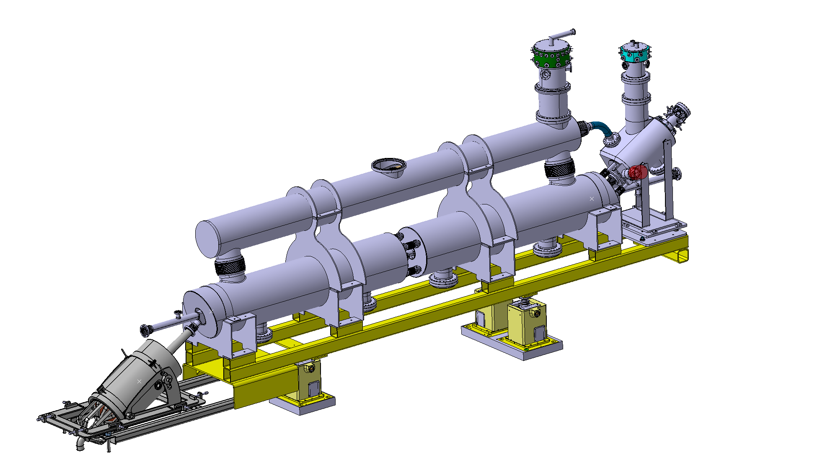
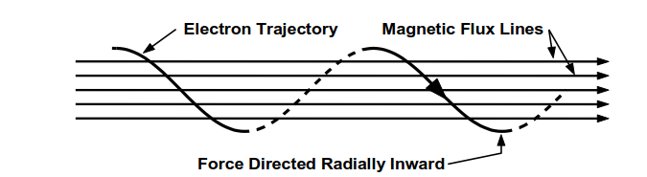
The system configuration
Electrons are produced by the cathode of an e-gun.
A system of superconducting solenoids cooled at 4.5K generates the magnetic field to tune de size and steer the trajectory of the electron ring.
E-gun solenoid
Electron ring
Space for Beam Gas Monitor
HL-LHC protons
~ 3500 mm
Main solenoids
Collector

Slide 3
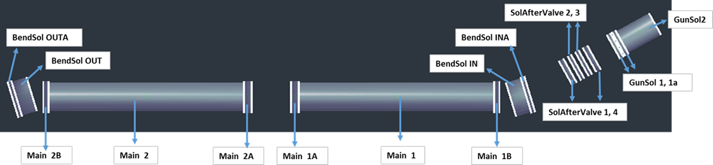
Situation today:
  System of solenoids optimized.
  Correctors under definition. Beam dynamic computation in BINP.
    Compensation of mechanical tolerances.
    Tuning of beam position from injection to flat top.
EDMS 2036694 in work. Attention: table of correctors need to be updated.

Slide 4
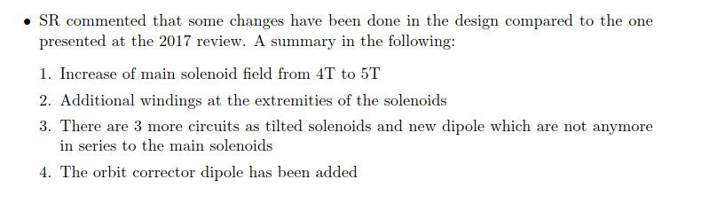
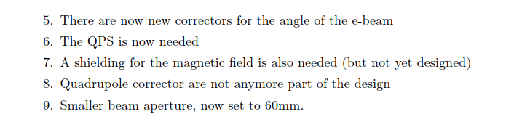
LHC Collimation Upgrade Specification Meeting (ColUSM) N114
https://indico.cern.ch/event/808362/

Slide 5
Thank you for your attention

