Slide 1
Hollow Electron Lens
Quench Protection Design and Analysis status update
TE-MPE (HEL Quench Protection):
M. Maciejewski, M. Mentink, D. Wollmann, A. Verweij
EN-MME (HEL Design):
G. Gobbi, D. Perini + G. Kirby (TE-MSC)

Slide 2
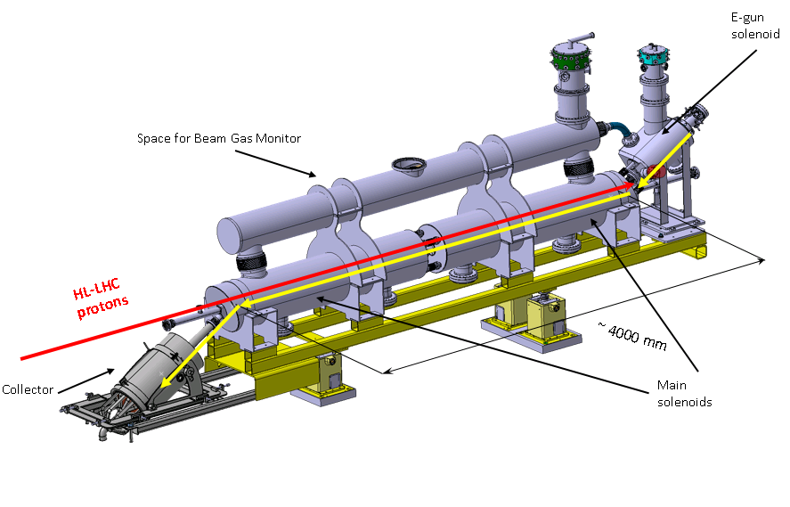
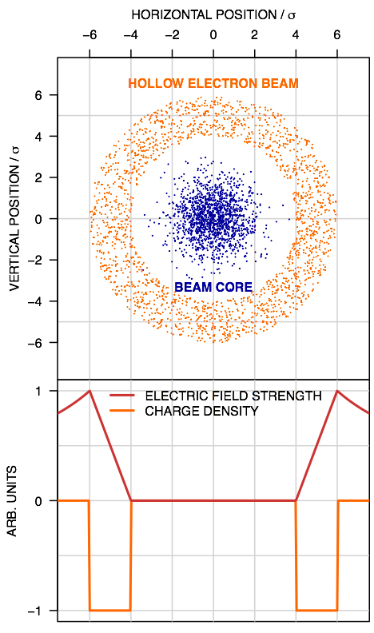
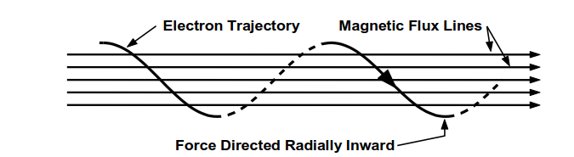
The HEL System – SC Magnets
Operating Principle (Collimator)*
-
-
-
-
+
-
-
-
-
Magnetic Flux Lines
Electron Trajectory
Force Directed Radially Inward
The Hollow Electron Lens system consists of multiple superconducting magnets for
Guiding the hollow beam of electrons:
  (main solenoid, bending solenoid, solenoid after valve, e-gun, CCT)
Correcting the field imperfections and fine tune the beam position:
  (4 for the main solenoid, 4 for the main bending, 2 for the e-gun)
The aim of this work is to study the protectability of the superconducting circuits.
HL-MCF Meeting # 46: Conceptual Design of IFS, CLIQ and K-MOD Feeders+ Quench Study for MCBXF Magnets + Status on HEL Circuits, https://indico.cern.ch/event/794680/ D. Perini: Status Report on HEL Circuits
*A. Bertarelli, et al. Hollow Electron Lens Update, Collimation Upgrade Specification Meeting #56

Slide 3
Outline
System Overview
Quench Protection Design
  E-gun cathode
  Solenoid After Valve + e-gun
  Main Bending Solenoids
  Main Solenoids
Summary
direction of electrons

Slide 4
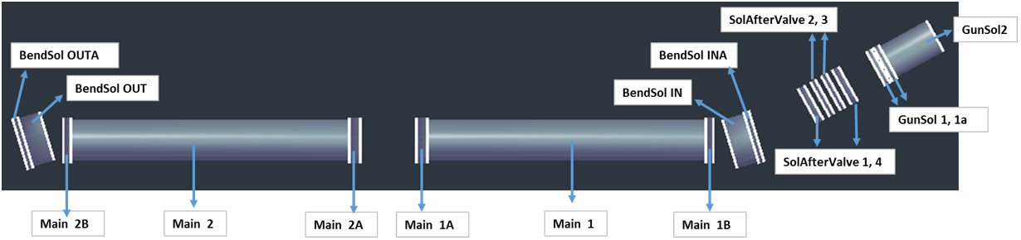
1. System Overview*
direction of electrons
- Bx
- By
- Bz
- Btot
* Bcathode
* Bvalve
*G. Gobbi, D, Perini: Main parameters of HEL electrical circuits, EDMS 2036694

Slide 5
2. Solenoids – Powering Scheme
MainSol2_tot
MainSol1_tot
BendSolGunSol_tot
GunSol
PC+EE
330 A
PC+EE
330 A
PC+EE
320 A
PC+EE
257 A
BendSol_tot
PC+EE
335 A
Differential Inductance [mH]
Stored Energy [kJ]
 | GunSol | BendSolGunSol_tot | BendSol_tot | MainSol1_tot | MainSol2_tot
GunSol | 834.18 | 100.79 | 1.63 | 1.92 | 0.19
BendSolGunSol_tot | 100.79 | 806.74 | 13.24 | 7.29 | 0.34
BendSol_tot | 1.63 | 13.24 | 2146.47 | 130.35 | 130.35
MainSol1_tot | 1.92 | 7.29 | 130.35 | 8877.46 | 49.91
MainSol2_tot | 0.19 | 0.34 | 130.35 | 49.91 | 8877.46
GunSol | 32
BendSolGunSol_tot | 47
BendSol_tot | 135
MainSol1_tot | 494
MainSol2_tot | 493
BendSolGunSol_tot = SolAftValve1…4 + GunSol1 + GunSol1a; GunSol = GunSol2
MainSol1_tot = Main1 + Main1A + Main1B; MainSol2_tot = Main2+Main2A + Main2B
BendSol_tot = BendSolIN + BendSolINA + BendSolIN + BendSolINA

Slide 6
2. Strategy for Quench Protection Analysis
We study protection of busbars, magnets, and circuits.
We assume that if one of the main circuits quenches, all circuits are discharged.
For coils, we consider 100 mV threshold for quench detection and 10 ms validation.
In order to explore the parameter space, the following strategy was applied:
Quench propagation to calculate the quench detection time – 1D STEAM-BBQ model
Calculation of the maximum hot-spot temperature
  Quench integral curves with 1D STEAM-BBQ model
Calculation of minimum quench integral for a given maximum voltage to ground – Excel
  Neglecting internal magnet resistance growth and assuming constant inductance
  Constant energy extraction resistance
Iterate 3. varying energy extraction resistance until to conditions (can be adjusted) are met
T_{hot-spot} < 200 K - to limit the thermal load on the conductor as well as the cryogenic system
V_{ground,max} < 500 V - to limit the power converter common mode voltage and the insulation testing voltage
1
2
Design
iterations
3
Notes:
We accept unreliability of the crowbar, i.e., if it doesn’t work, then circuit is not protected.

Slide 7
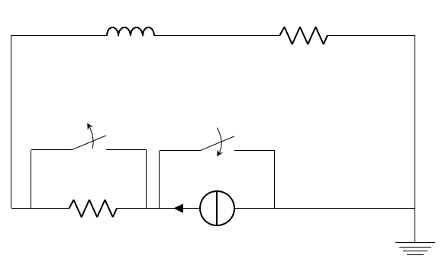
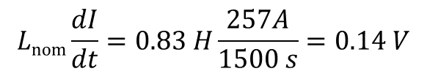
2.A. E-gun Cathode - Parameters
Magnet geometry
Parameter | Value
Cu/Nb-Ti | 4:1
I_{c}(5 T, 4.2 K) | >= 750 A
RRR | >=100*
I_{nom} | 257 A
J_{nom} | 149 A/mm²
L_{nom} | 0.83 H
B_{nom,max} | 3.7 T
V_{Rleads} @ I_{nom} | 1 V
15-20 um
1.05 mm
1.65 mm
Cable with polymide insulation
76 mm
Same conductor for all coils
109 mm
39.6 mm
Circuit topology
HEL circuits follow LHC powering cycle
L_{nom}
I [A]
R_{leads}
I_{RB} = 11850 A
t = t_{detect+validate}
I_{nom} = 257 A
1500
t [s]
R_{EE}
I_{nom}
Inductive voltage during ramp-up
$$Lnom\frac{dI}{dt}=0.83 H\frac{257A}{1500 s}=0.14 V$$

Slide 8
2.A. E-gun – Energy Extraction Resistance Sweep
Quench detection and validation time
RRR | 80 | 100 | 150 | 300
t_{detect+validate} [ms] | 160 | 190 | 220 | 270
Voltage to ground and hot-spot temperature as a function of energy extraction resistance.
Energy extraction grounded at the input terminal.
With the maximum temperature (200 K) and voltage to ground (500 V)
the permissible energy extraction resistance values span from 0.12 to 1.9 Ω.
Notes:
Results are available at \\cern.ch\dfs\Projects\STEAM\HL-LHC\Hollow Electron Lens\Th\COMSOL\9
Results are available at \\cern.ch\dfs\Projects\STEAM\HL-LHC\Hollow Electron Lens\El\Excel\2

Slide 9
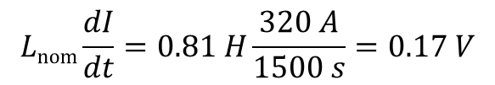
2.B. Solenoids After Valve + e-gun - Parameters
Magnet geometry
Same conductor as in the e-gun solenoid
Parameter | Value
I_{nom} | 320 A
J_{nom} | 185 A/mm²
L_{nom} | 0.81 H
B_{nom,max} | 3.1 T
39.6 mm
76 mm
109 mm
Circuit topology
Inductive voltage during ramp-up
L_{nom}
R_{leads}
$$Lnom\frac{dI}{dt}=0.81 H\frac{320 A}{1500 s}=0.17 V$$
t = t_{detect+validate}
R_{EE}
I_{nom}

Slide 10
2.B. Solenoid after Valve + e-gun – Energy Extraction Resistance Sweep
Quench detection and validation time
RRR | 80 | 100 | 150 | 300
t_{detect+validate} [ms] | 105 | 115 | 125 | 165
Voltage to ground and hot-spot temperature as a function of energy extraction resistance.
Energy extraction grounded at the input terminal.
With the maximum temperature (200 K) and voltage to ground (500 V)
the permissible energy extraction resistance values span from 0.2 to 1.56 Ω.
Notes:
Results are available at \\cern.ch\dfs\Projects\STEAM\HL-LHC\Hollow Electron Lens\Th\COMSOL\8
Results are available at \\cern.ch\dfs\Projects\STEAM\HL-LHC\Hollow Electron Lens\El\Excel\2

Slide 11
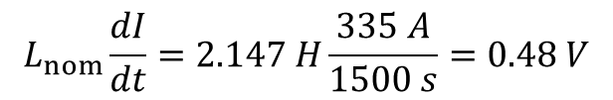
2.C. Bending Solenoids - Parameters
Magnet geometry
Same conductor as in the e-gun solenoid
150 mm
Parameter | Value
I_{nom} | 335 A
J_{nom} | 193 A/mm²
L_{nom} | 2.147 H
B_{nom,max} | 3.5 T
258 mm
321 mm
Circuit topology
Inductive voltage during ramp-up
L_{nom}
$$L_{nom}\frac{dI}{dt}=2.147 H\frac{335 A}{1500 s}=0.48 V$$
R_{leads}
t = t_{detect+validate}
R_{EE}
I_{nom}
CCT temporarily removed from the circuit.

Slide 12
2.C. Bending Solenoids - Energy Extraction Resistance Sweep
Quench detection and validation time
RRR | 80 | 100 | 150 | 300
t_{detect+validate} [ms] | 105 | 115 | 125 | 165
Voltage to ground and hot-spot temperature as a function of energy extraction resistance.
Energy extraction grounded at the input terminal.
With the maximum temperature (200 K) and voltage to ground (500 V)
the permissible energy extraction resistance values span from 0.65 to 1.5 Ω.
To stay below the limits, the maximum allowed inductance for the CCT is 8 H.
Notes:
Results are available at \\cern.ch\dfs\Projects\STEAM\HL-LHC\Hollow Electron Lens\Th\COMSOL\7
Results are available at \\cern.ch\dfs\Projects\STEAM\HL-LHC\Hollow Electron Lens\El\Excel\2

Slide 13
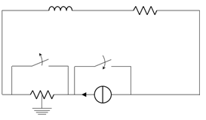
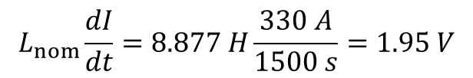
2.D. Main Solenoid - Parameters
Magnet geometry
Same conductor as in the e-gun solenoid
1599 mm
Parameter | Value
I_{nom} | 330 A
J_{nom} | 191 A/mm²
L_{nom} | 8.877 H
B_{nom,max} | 5 T
180 mm
249.3 mm
Circuit topology
Inductive voltage during ramp-up
L_{nom}
R_{leads}
$$L_{nom}\frac{dI}{dt}=8.877 H\frac{330 A}{1500 s}=1.95 V$$
t = t_{detect+validate}
R_{EE}
I_{nom}
Feasibility of application of 600 A LHC power converter with EE grounded in the middle
for this circuit (maximum voltage, stored energy, inductance) has to be studied by TE-EPC.
13

Slide 14
2.D. Main Solenoid - Energy Extraction Resistance Sweep
Quench detection and validation time
RRR | 80 | 100 | 150 | 300
t_{detect+validate} [ms] | 65 | 75 | 85 | 95
Voltage to ground and hot-spot temperature as a function of energy extraction resistance.
Energy extraction grounded in the middle.
500 V during standard operation, up to 1 kV under earth fault on current lead.
With the maximum temperature (200 K) and voltage to ground (500 V)
the permissible energy extraction resistance values span from 2.46 to 3 Ω.
Notes:
Results are available at \\cern.ch\dfs\Projects\STEAM\HL-LHC\Hollow Electron Lens\Th\COMSOL\6
Results are available at \\cern.ch\dfs\Projects\STEAMHL-LHC\Hollow Electron Lens\El\Excel\2

Slide 15
3. Conclusion
The HEL superconducting magnets and circuits are still under design work
  Very good contact with colleagues at EN-MME.
  Changes are still expected and the study will undertake iterations (mostly correctors).
We study the main superconducting circuits
  The circuits can be protected with energy extraction systems
    All circuits except the main solenoid are protectable with a regular EE system.
    To limit the voltage to ground in the main solenoid circuit, for the main solenoid we assume that the energy extractor is grounded in the middle.
    However, this option needs further study in cooperation with TE-EPC to ensure that this is compatible with the power converter.
    The choice of the final EE resistance is a trade-off between the peak voltage and temperature (the peak values might need to be adjusted).
  Design* of the corrector magnets to be confirmed with beam dynamics analysis.
*G. Gobbi, D. Perin: Main parameters of HEL electrical circuits, EDMS 2036694

