Slide 2
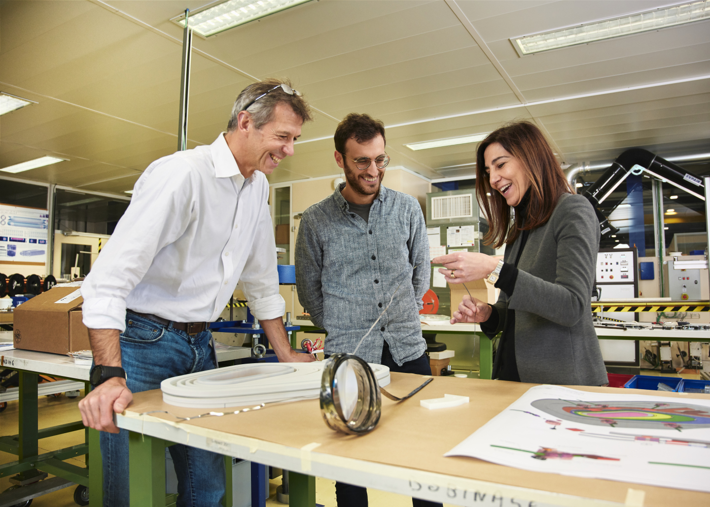
#WomenInScience Campaign 2019
5 women featured from different CERN Member States.
An article on home.cern
A social-media campaign
A photography shooting with different places at CERN.
Notes:
Trouver ce que l’on a repris chez EPPCN…rien en fait parce que personne n’a rien fait de pertinent proche du CERN ou rien fait du tout…

Slide 3
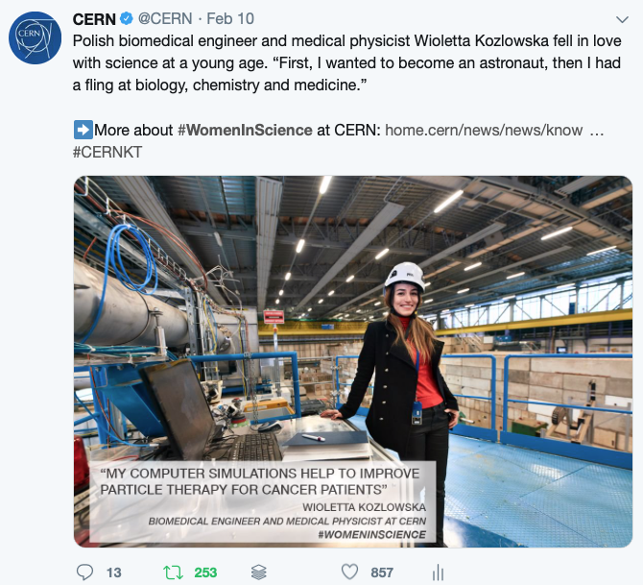
Twitter
5 dedicated tweets, retweeting our own tweets on 11 February
600,000 impressions (1.5x the average of our tweets)
Engagement rate of 1.5% (1.5x the average of our tweets)
Notes:
Engagement rate of a social-media post?
$\frac{Σ of the engagements (comments, shares, likes, clics, etc)}{Σ of the impressions (views)}×100=engagement rate$(%)
For CERN, it’s around 1.5% on average for a picture on Twitter, 2.5% on Facebook, 2.8% on LinkedIn

Slide 4
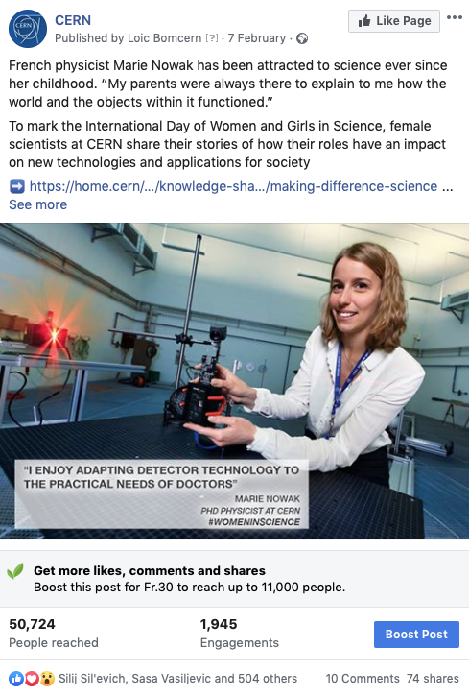
Facebook
5 dedicated posts
300,000 reach (1.2x the average of our posts)
Great engagement on those posts

Slide 5
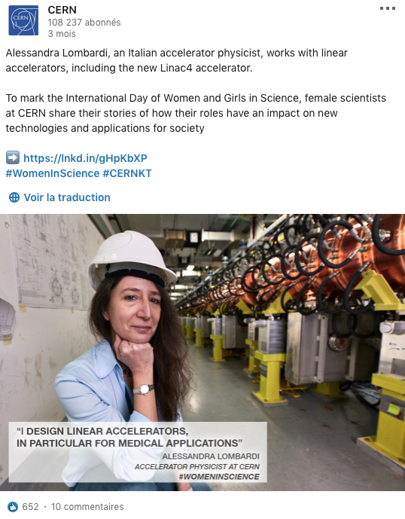
LinkedIn
5 dedicated posts
180,000 impressions (1.5x the average of our posts)
Average engagement rate

Slide 6
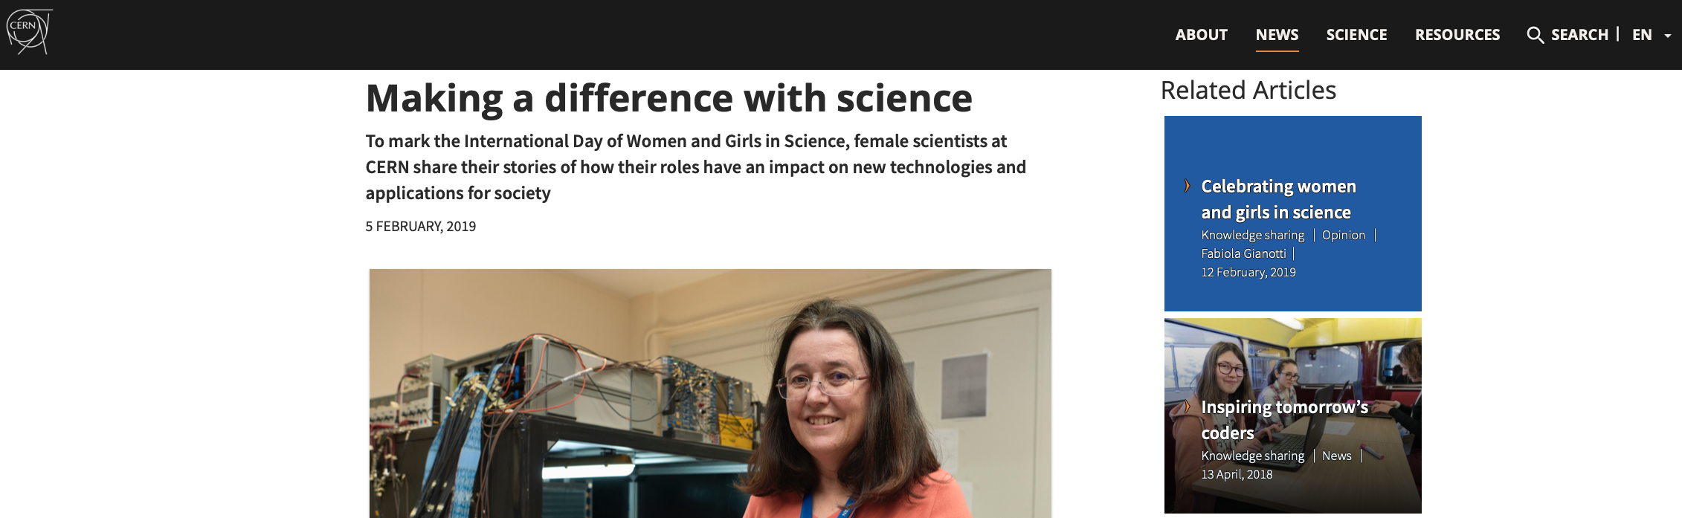
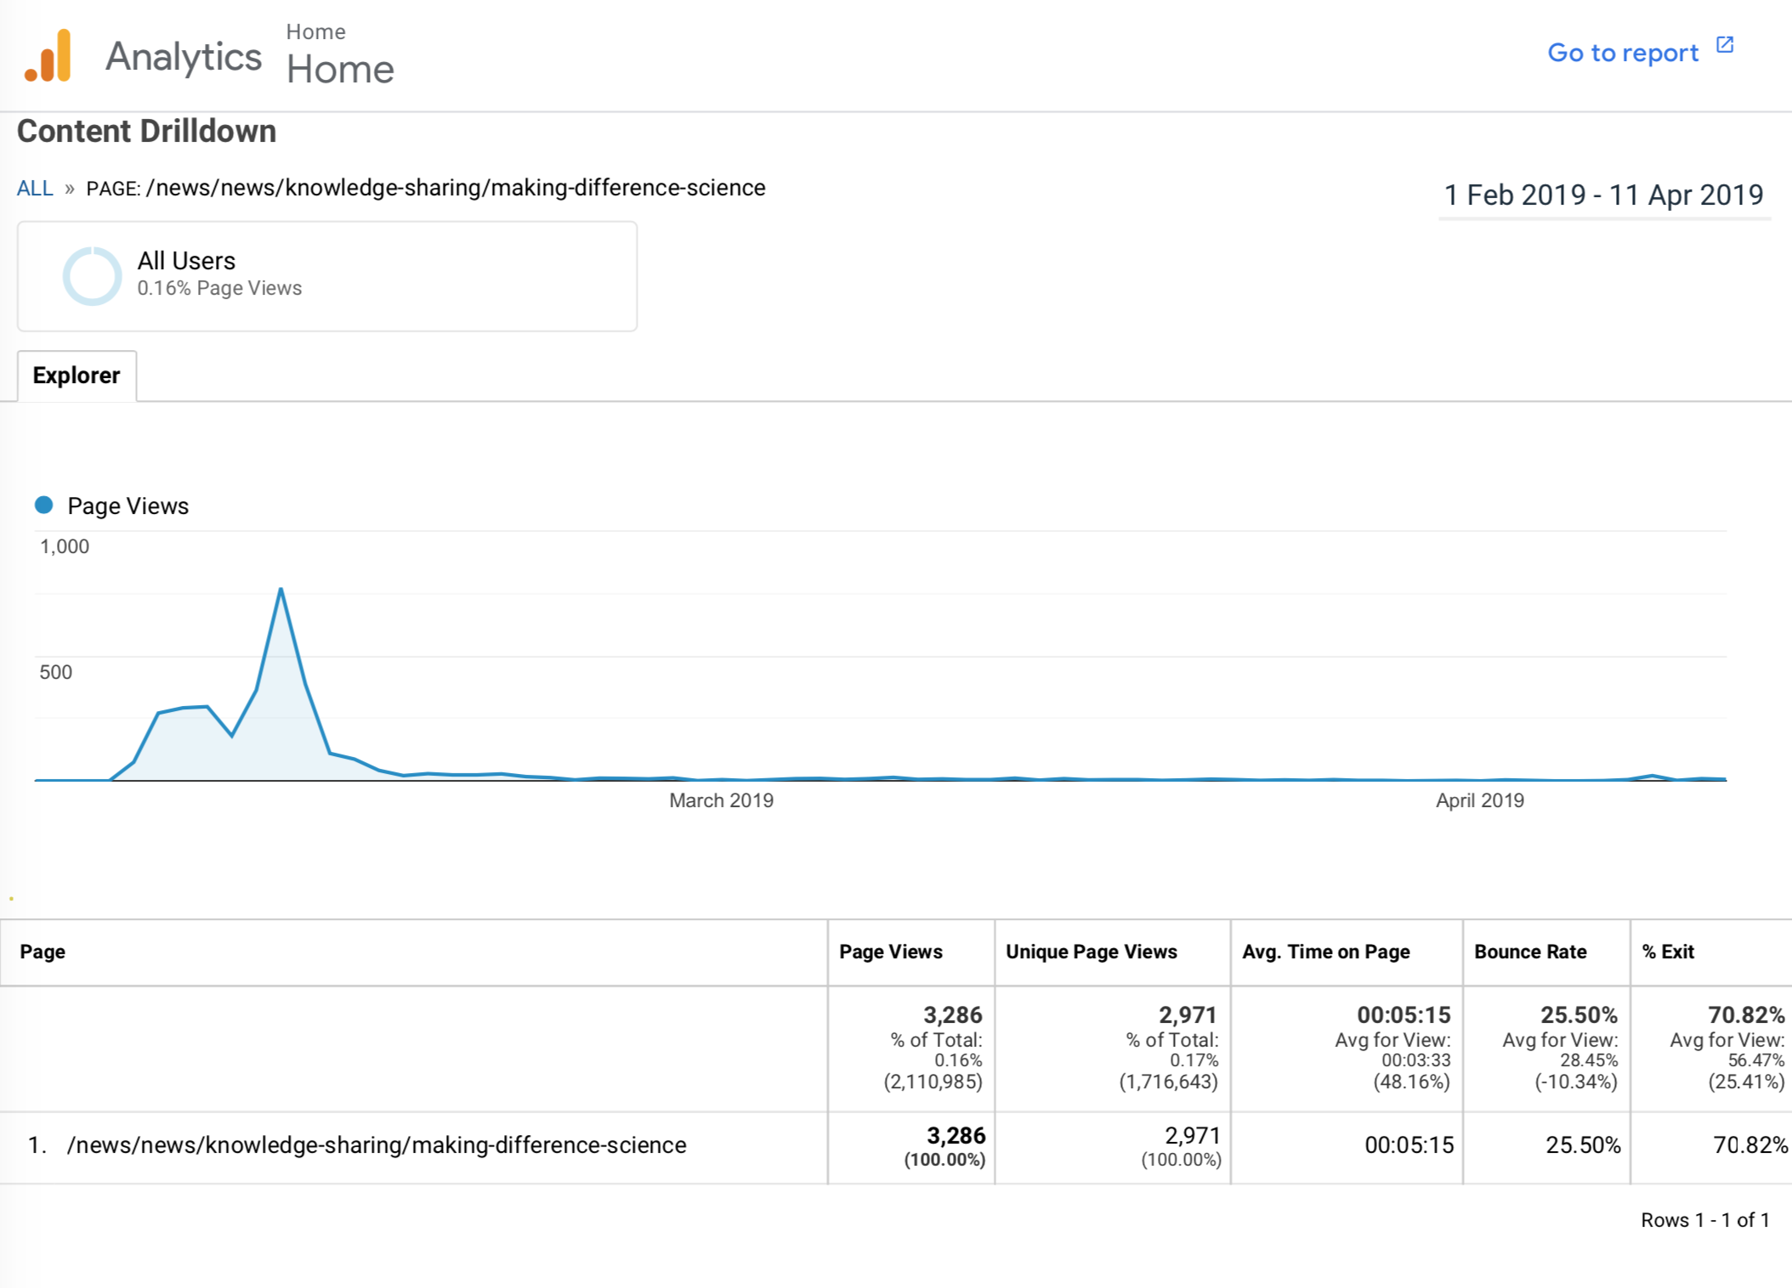
Home.cern
An article on the website grew each day with a new woman profiled: https://home.cern/news/news/knowledge-sharing/making-difference-science
…but we had limited views of the article (drove only 0.42% of the traffic)
The effort to research, write and translate the profiles in the article did not justify the limited impact.

Slide 7
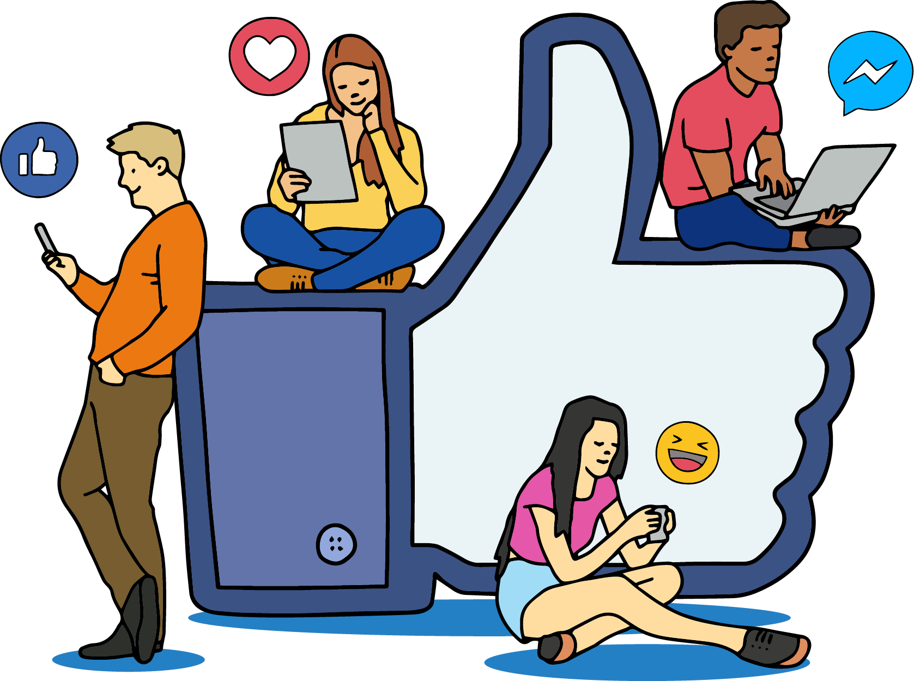
Conclusion
We had great stats on social media for this campaign.
Promoting behind-the-scenes and people who do science is still (and always) a great way to increase engagement on social media.
Keep such a campaign on social media, a web article is not so relevant.
In future have photos of people working rather than posing
Work more in advance, having everything almost prepare before the Christmas break
In the end, we didn’t work a lot together, it’s something we have to improve for next campaigns…(how?)

Slide 8
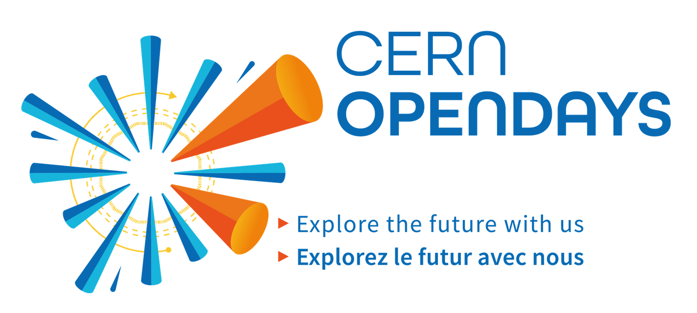
What’s next?
LS2 plan at CERN: share Facebook Live schedule
#CERNOpenDays: User-generated content on Instagram and Lives
Expectations from your side
New EPPCN campaigns to come
Best practice sharing from CERN’s Social Media team if needed.
AOB

