Slide 1

Micromegas tests
̶ Test beam 2010 plans ̶
D. Attié, P. Colas, M. Dixit, M. Riallot, W. Wang
RD51 Mini Week - CERN
Notes:
I’m here to present a TPC review

Slide 2
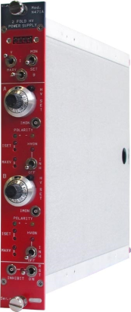
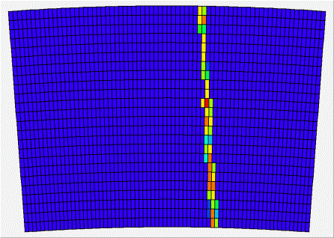
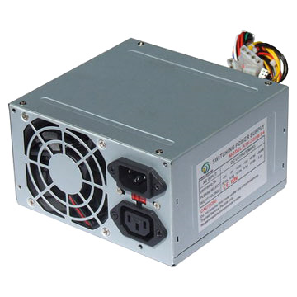
Data taking diagram
Goliath magnet
V_{drift} =1 kV
SHV cables
CAEN 471A
(NIM)
V_{mesh} = 380 V
Beam trigger
T2K electronics
1728 channels
Optical
fibre
Back-end electronic
(ML405)
Lemo
LV-TTL
TCP/IP via ethenet
LV
(+5 V)
PC
T2K DAQ on Linux
T2K gas
(5L/h)
500 Go
Standard PC
Power supply
HDD
Hall
Control room

Slide 3
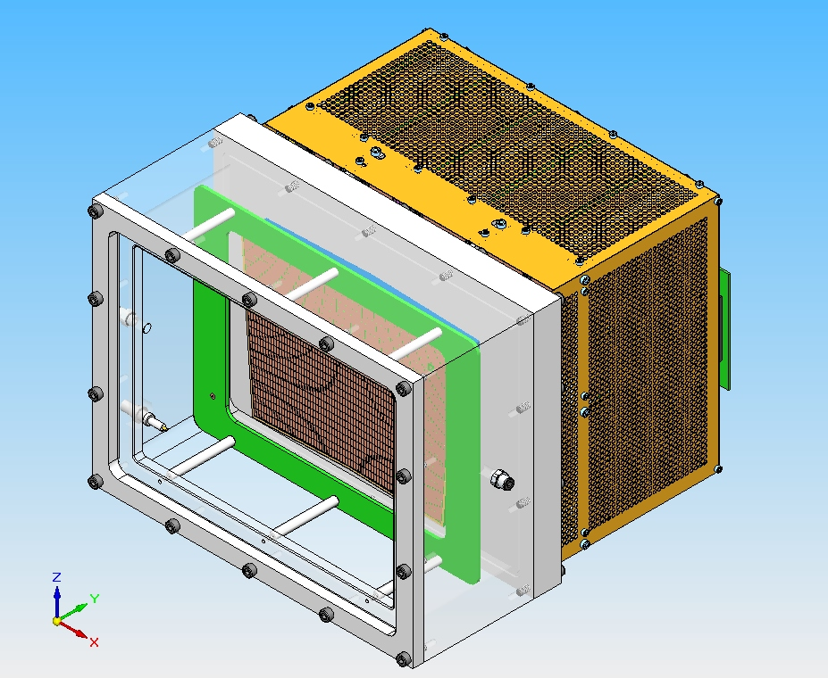
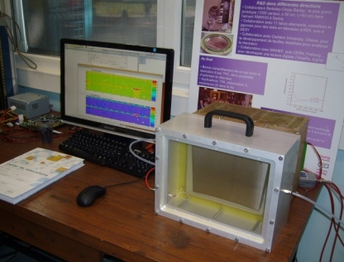
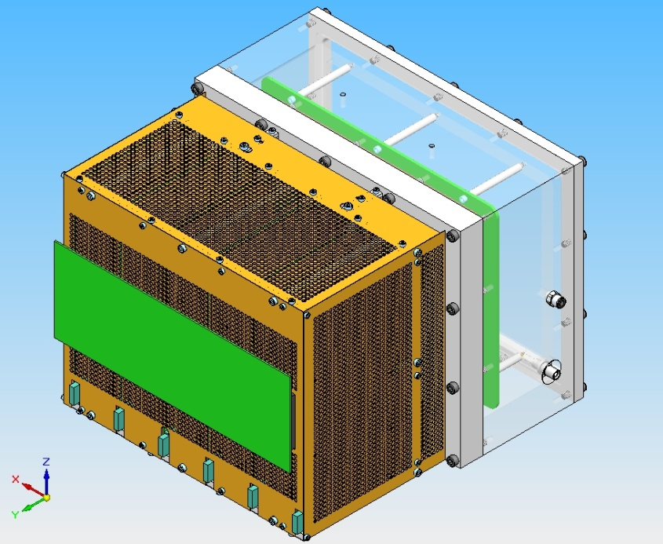
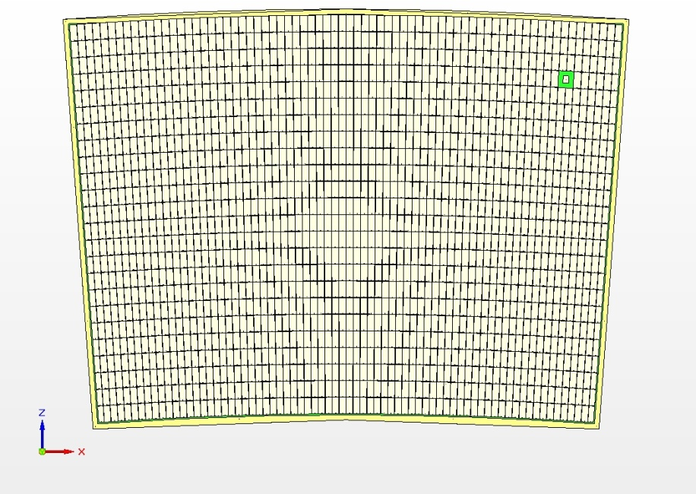
Detector description 1/2
1726 pads Micromegas resistive Kapton bulk
17 cm
23 cm
24 rows x 72 columns; <pad size> ~ 3.2x7 mm²

Slide 4
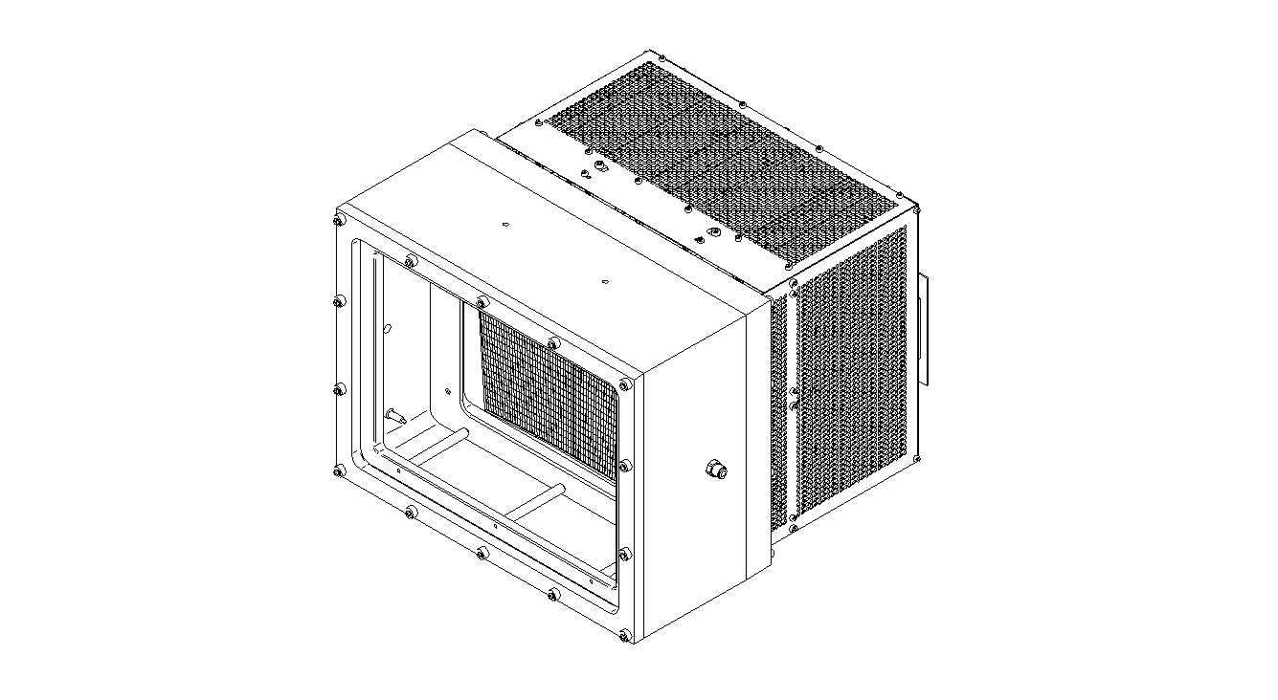
Detector description 2/2
Total weight: ~20 kg
Radiation length: 40% (2×1.8 cm of aluminium)
B field
Top
27 cm
40 cm
Bottom
35cm
11 cm

Slide 5
Requests for the beam tests
Detector placed in the centre of the magnet for homogeneous B field
Goal: precision tracking and performance measurement of the resistive Kapton coverlay with hadrons at different beam intensities in TPC mode
Duration: 3-4 days
Particles: muons preferably, the rest can be hadrons, from low to very high rates
Intensity: scan necessary.
Gas: premix bottle of T2K gas (ArCF₄Iso) at 5 L/h
Status:
  optical fiber, SHV cables, gas tube already installed
  improve the box installation: secured small lift table
  own beam trigger as close as possible to the gas box but out of the B field

