Slide 1
November test beam results
D. Attié, T. Alexopoulos, M. Boyer, P. Colas, J. Derré, F. Diblen,
E. Ferrer Ribas, T. Geralis, A. Giganon, I. Giomataris, F. Jeanneau, K. Karakostas, S. Kirch, E. Ntomari, M. Titov ,W.Wang
Within the MAMMA collaboration
Arizona, Athens(U, NTU, Demokritos), Brookhaven,
CERN, Harvard, Istanbul, Naples, CEA Saclay, Seattle, USTC Hefei, South Carolina, St. Petersburg, Shandong, Stony Brook, Thessaloniki
Shuoxing Wu / CEA Saclay, USTC Hefei

Slide 2
Outline:
Spark current-voltage monitoring.
Spark rate.
Efficiency and spatial resolution.

Slide 3
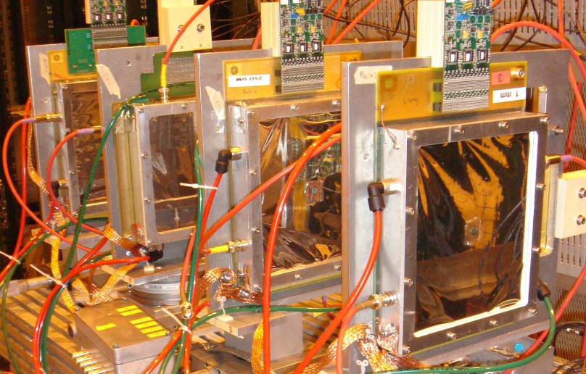
Test beam set up:
Telescope:
3 X-Y detectors(10 x 10 cm²) manufactured at Saclay
Aim: Test different resistive films detectors manufactured by Rui De Oliveira at CERN and compare behaviour to non-resistive detectors
Electronics: GASSIPLEX
DAQ: realised by Demokritos
Gas: 95%Ar + 3% CF₄ + 2% isobutane
SPS-H6
120 Gev π+
Detectors in test
Resistive
Non-Resistive
Beam
1 mm
0.25 mm
1 mm
X
Y
X
Y
X
Y
Tested detectors:
Standard bulk detectors; Resistive coating detectors; Segmented mesh detector

Slide 4
Summary of tested detectors:
Type | Name | Properties:
Standard bulk: | SLHC3 | 1mm pitch
 | SLHC2 | 2mm pitch
Resistive coating: | R3&R4 | 2mm,2MΩ/ ,kapton+insulator
 | R5 | 2mm,250MΩ/ ,resistive paste
 | R6 | 1mm,400KΩ/ , resistive strip
 | R7 | 0.5mm, tens of KΩ/ , resistive pad
Segmented mesh | S1 | 1mm pitch,8 segmentations

Slide 5
Different sparking behaviors of standard and resistive detector:
Standard SLHC2 (2mm) (@10KHz):
R6(1mm,400kΩ/ resistive strip) (@10KHz):
SLHC2: HV=400 V (Gain ~3000): current when sparking < 0.4 μA
voltage drop< 5%
R6: HV=390 V (Gain ~3000): current when sparking < 0.08 μA
voltage drop<0.5%

Slide 6
Sparking behavior of resistive detector R3:
Standard SLHC2 (2mm) (@10KHz):
Resistive R3(2mm,2MΩ/ ) (@10KHz):
SLHC2: HV=400 V (Gain ~3000): current when sparking < 0.4 μA
voltage drop< 5%
R3: HV=410 V (Gain ~3000): current when sparking < 0.2 μA
voltage drop<2%

Slide 7
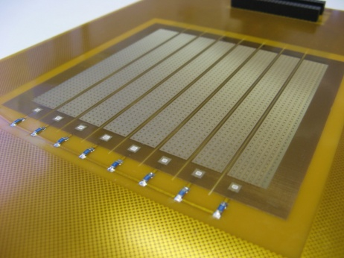
Sparking behavior of S1:
Seven,eight sparking
six sparking
five sparking
four sparking
three sparking
two sparking
one sparking
Standard bulk: SLHC2
S1:

Slide 8
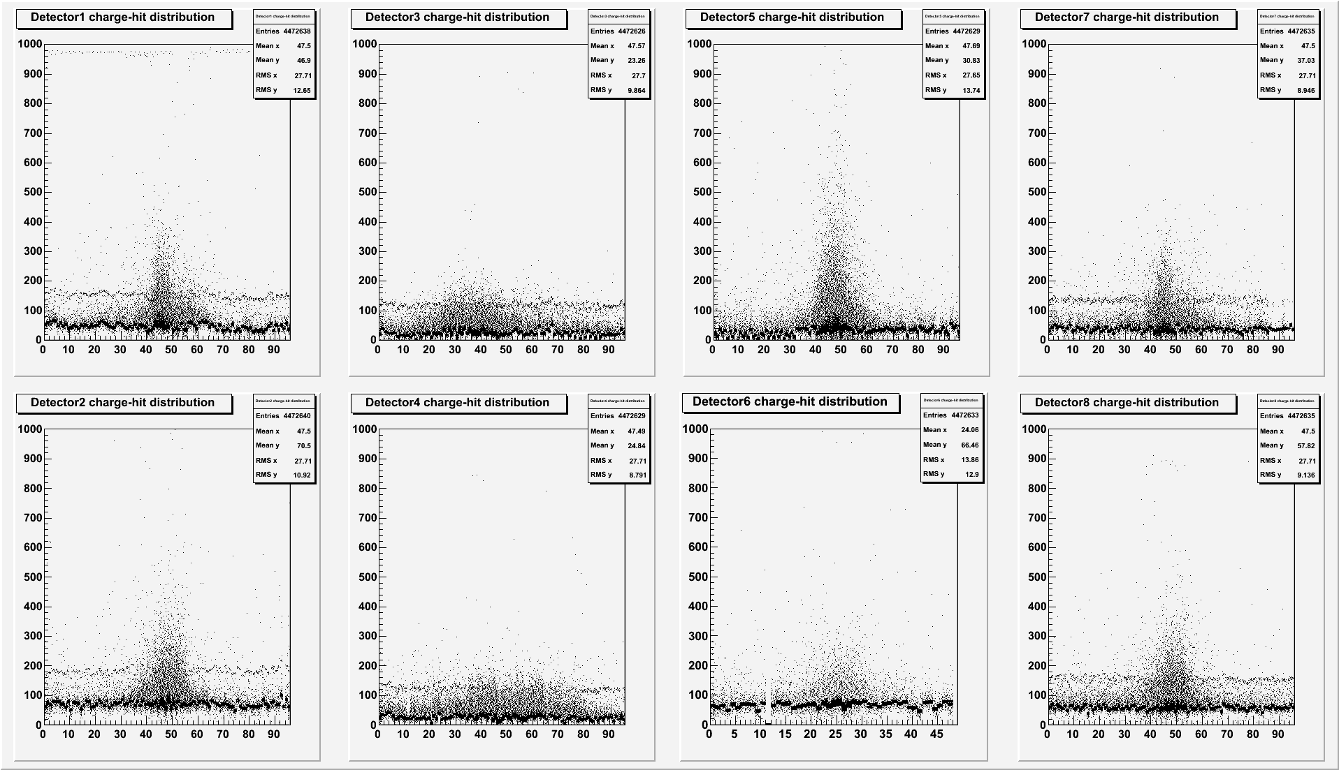
Charge vs. channel number:
1mm
250μm
R6
1mm
1mm
250μm
R3
1mm
Pedestal shift in standard MM (telescope) due to sparks.
No pedestal shift in resistive detectors (R3&R6).

Slide 9
Spark rate vs mesh voltage and beam intensity:
R3(2mm, 2MΩ/ ):

Slide 10
Detector performance at same gas gain (~3000):
Detector | type | Spark rate | Spark current /μA | Voltage drop
SLHC2 | standard | 7*E-5 | 0.4 | 5%
R3 | 2 M Ω/ resistive kapton | 9.6*E-6 | 0.2 | 2%
R6 | 400K Ω/ resistive strip | 6.4*E-6 | 0.08 | 0.5%
R5 | 250 M Ω/ resistive paste | 1.6*E-4 | 0.1 | 1.5%
R7 | tens of K Ω/ resistive pad | 5.9*E-4 | 0.35 | 4.5%

Slide 11
R6 (1mm, 400KΩ/ ) efficiency :
@beam intensity of 11kHz/cm2:
@voltage of 400V:
>98%
drop<3%

Slide 12
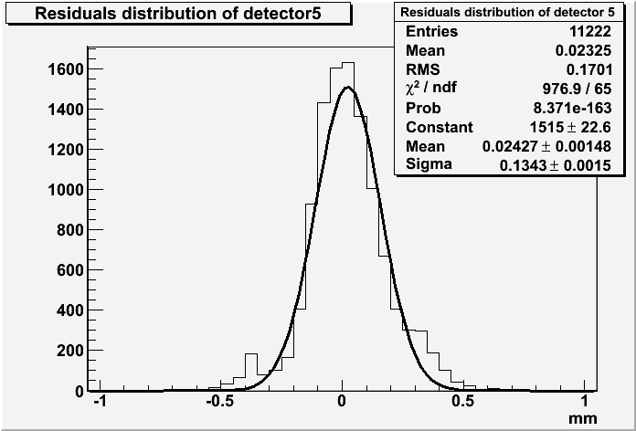
Resolution:
MM
MM
MM
•Residuals of MM cluster position and extrapolated track from MM telescope:
•Convolution of:
- Intrinsic MM resolution
- Track resolution (extrapolated)
- Multiple scattering
beam
1mm
0.25 mm
MM under test
1mm
~98μm
R6(1mm pitch, 400kΩ/ )
δ=134μm
δmm= 91±2.2μm

Slide 13
R6(1mm 400kΩ/ resistive strip) resolution vs mesh voltage and beam intensity:
Mesh voltage:
Beam intensity:

Slide 14
Cluster size (mean of distribution) :
R3 : 2mm , 2 M Ω/ Resistive kapton +insulator
R6 : 1mm , 400 k Ω/ Resistive strip
SLHC2: 2mm standard bulk

Slide 15
Conclusion and outlook:
Resistive coating is a successful method to reduce the micromegas spark rate and limit the change in mesh voltage and current.
Good spatial resolution<100μm can be reached with a resistive strip coating detector of 1mm pitch.
High efficiency (>98%) can be achieved with resistive strip coating micromegas detector, and efficiency drops less than 3% when increasing the beam intensity from 5KHz to 40KHz . R6 can operate at high gain up to 30000 without loosing efficiency.
R&D and studies will continue inside the MAMMA collaboration

Slide 16
Back up slides

Slide 17
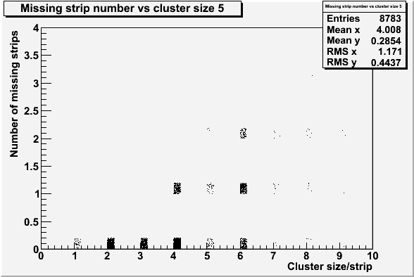
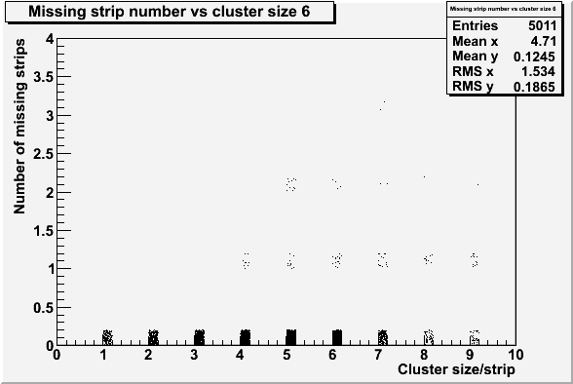
Number of missing strips in cluster:
R6( 1mm, 400 KΩ/ ):
R3( 2mm, 2 mΩ/ ):
17

Slide 18
Probability to have missing strips in cluster and number of missing strips:
18

Slide 19
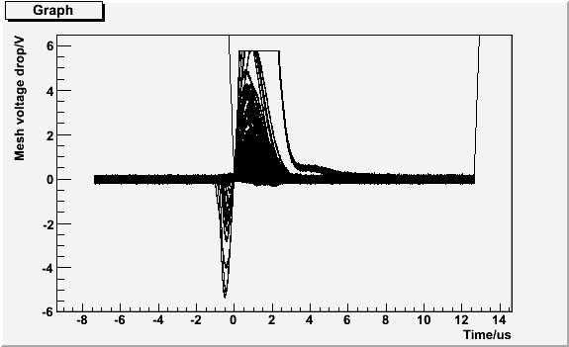
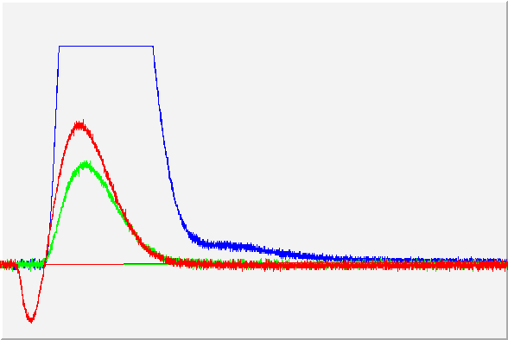
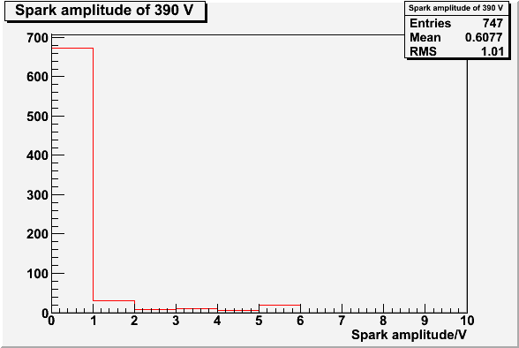
Sparks in R7(few tens of kΩ/ Resistive pads):
All the ‘sparks’ in R7:
Three ‘spark’ type:
‘Spark’ amplitude distribution:

Slide 20
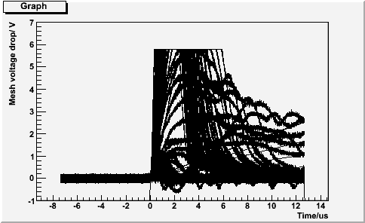
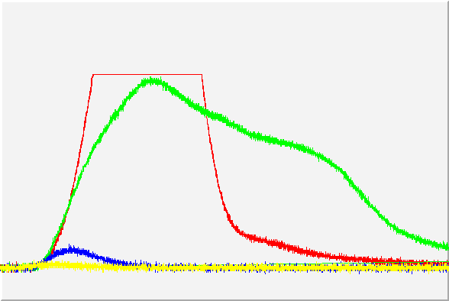
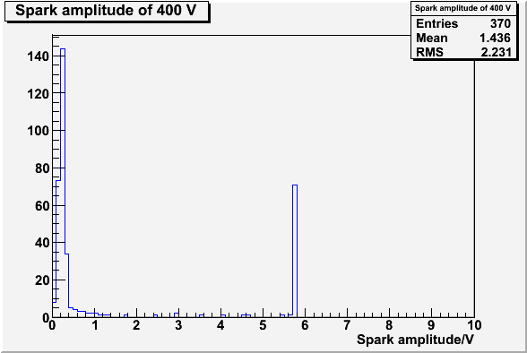
Sparks in R5(250 MΩ/ Resistive kapton):
All the ‘sparks’ in R5:
Four ‘spark’ type:
‘Spark’ amplitude distribution:

Slide 21
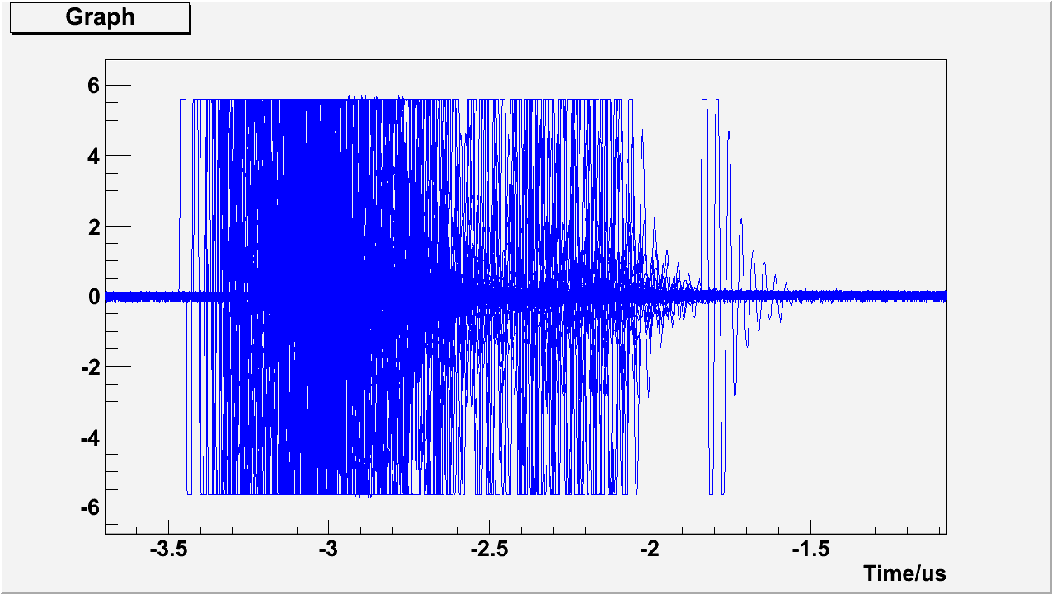
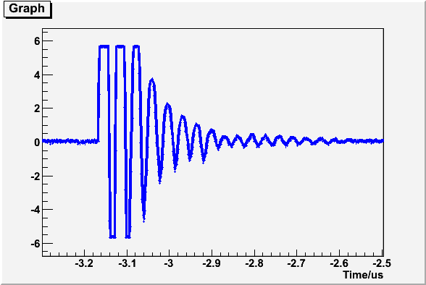
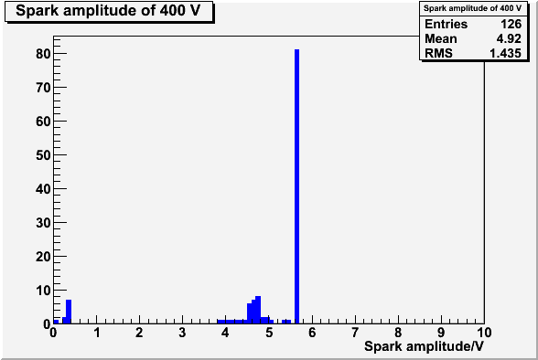
Sparks in SLHC2(standard bulk):
All the ‘sparks’ in SLHC2:
One ‘spark’ type:
‘Sparks’ amplitude distribution:

Slide 22
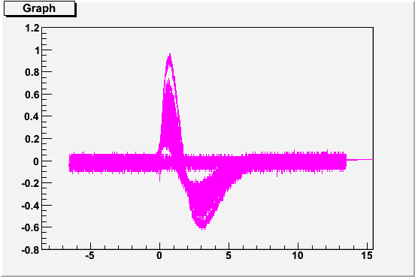
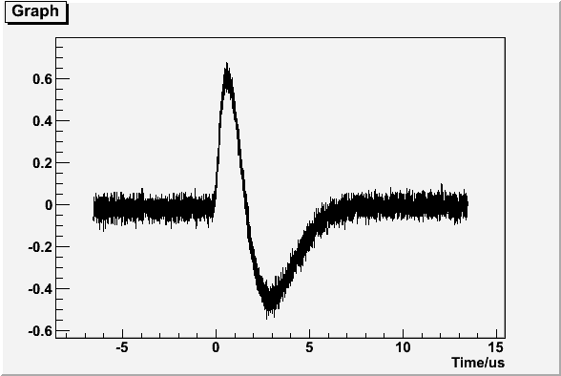
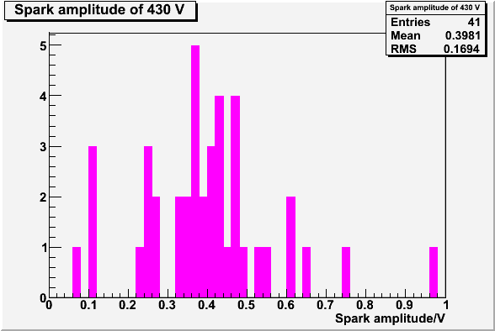
Sparks in R3(2 MΩ/ resistive kapton):
All ‘sparks’ in R3:
One ‘spark’ type:
‘sparks’ amplitude distribution:

Slide 23
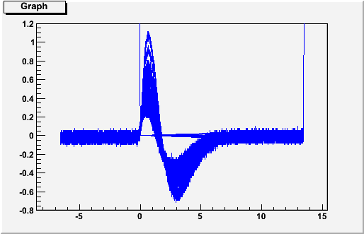
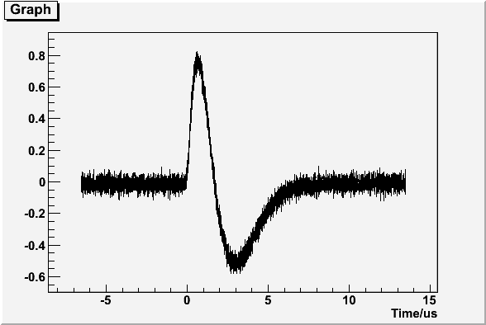
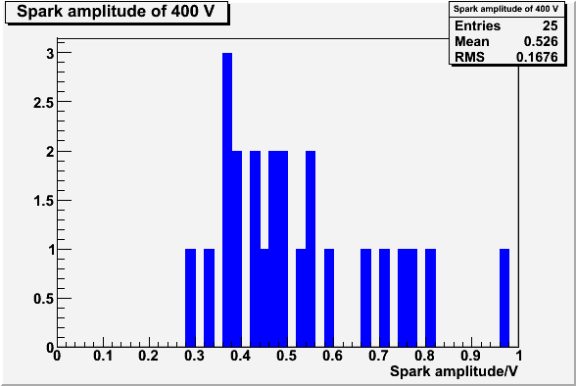
Sparks in R6(400 kΩ/ resistive strip):
All ‘sparks’ in R6:
One ‘spark’ type:
‘sparks’ amplitude distribution:

Slide 24
Spark amplitude vs voltage and beam intensity:
R5 vs voltage:
R7 vs voltage:
SLHC2 vs voltage:
R3 vs voltage:
R5 vs voltage:
R3 vs intensity:

