Slide 1


Open Market Consultation Session 2
07.05.2019 – Barcelona
ARCHIVER – Archiving and Preservation for Research Environments Project has received funding from the European Union’s Horizon 2020 research and innovation programme under grant agreement No 824516.

Slide 2
A set of 43 use cases has been defined
Preparation sessions with Buyers resulted in 43 use cases
Use cases have been written in atomic format:
“As a <actor>, I can <do something> so that <achieve value>
Use cases have be grouped in 7 categories:
Category | #
1. OAIS Conformance | 10
2. Hybrid Archives | 8
3. Business & Deployment Model | 7
4. Scalability | 6
5. Federation & Integration | 6
6. Network & Federated AAI | 2
7. Multidisciplinary Science | 4

Slide 3
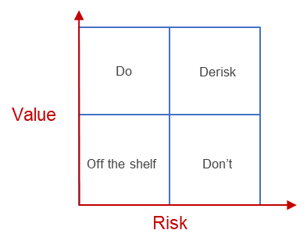
All use cases will be mapped on a value-risk matrix
This requires your input regarding use case feasibility & perceived risks

Slide 4
These use cases have been prioritized with the Buyers
Value & innovation potential of each use cases has been assessed together with all Buyers
No value
for the user
Nice to have
If time or budget left
Must have
We need this
WOW!!!
I’d give my house for this

Slide 5

Feasibility will be assessed using planning poker
Each participant has a set of planning poker cards
When asked, please show your cards, everybody at the same time
We will discuss the votes to land on a common agreement & feasibility assessment
Off the shelf
No risk
Can be done
& has been done before
Not standard
Might be possible with sufficient time & effort
Mission Impossible
Defies laws of physics

