Slide 2

Ideas for REX/HIE-ISOLDE Upgrade
Jose Alberto Rodriguez
on behalf of the ISOLDE Operations team

Slide 3
Outline:
REX/HIE-ISOLDE before LS2
REX/HIE-ISOLDE after LS2
Ideas for long-term upgrades
Summary
J.A. Rodriguez – Group for the Upgrade of the ISOLDE Facility – 2019/06/03

Slide 4
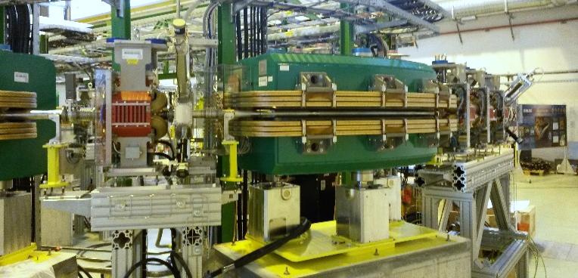
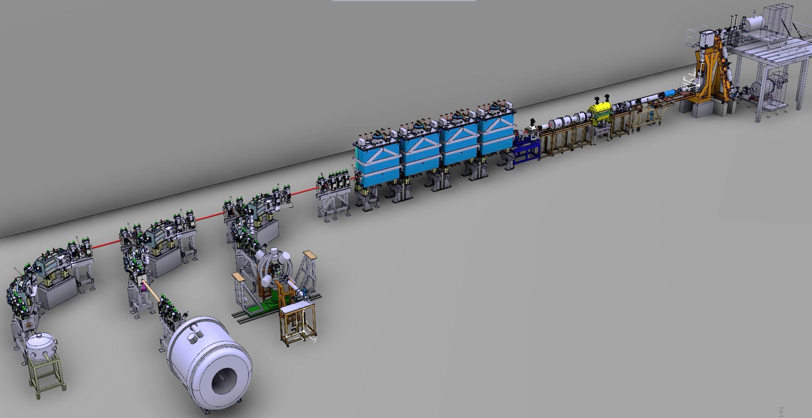
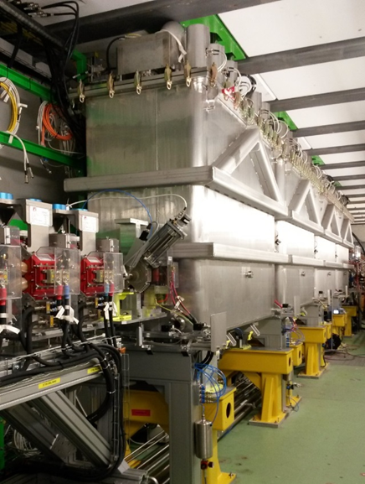
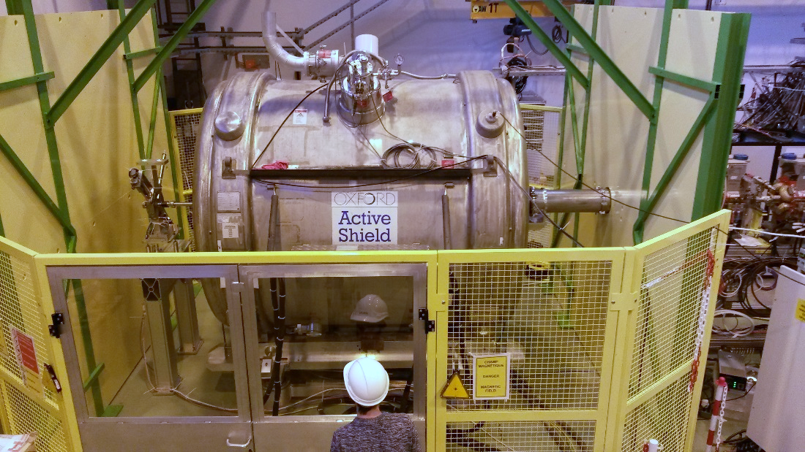
REX/HIE-ISOLDE before LS2
Phase 2B of HIE-ISOLDE completed and operational since 2018:
Four cryomodules
Three High Energy Transfer Beamlines (HEBT)
ISS experimental station
Miniball
SEC
ISS
J.A. Rodriguez – Group for the Upgrade of the ISOLDE Facility – 2019/06/03

Slide 5
REX/HIE-ISOLDE before LS2
Highlights 2018 Physics campaign:
First radioactive ion beam (RIB) delivered on July 11th
Campaign ended in Nov. 21st (pre-irradiated target)
Thirteen experiments conducted
  First beams to the ISS (²⁸Mg and ²⁰⁶Hg)
  Light isotopes (⁷Be, ⁸B, ⁹Li…)
  Heavy isotopes (²²⁸Ra, ²²⁶Rn, ²⁰⁶Hg…)
  Slow extraction used during most of the experiments
  Stripping foils to clean contaminants (⁹Li, ^{7,11}Be , ⁸B)
  Molecular beams (⁸B¹⁹F₂, ¹³⁴Sn³⁴S)
Multiple stable beams to the three experimental stations
Experiment number | Isotope(s) | Energy [MeV/u] | Experimental station | Time [hours]
IS644 | ⁹⁶Kr | 4.7, 5.3 | Miniball | 178.2
IS506 | ²¹²Rn | 3.8, 4.4 | Miniball | 49.0
IS552 | ^{222, 228}Ra, ^{222, 224, 226}Rn | 4.3, 4.2, 5.1 | Miniball | 31.3, 82.9
IS553 | ¹⁴²Ba | 4.2 | Miniball | 38.5
IS562 | ¹⁰⁶Sn | 4.4 | Miniball | 91.4
IS616 | ⁸B | 4.9 | SEC | 97.2
IS655 | ¹¹Be | 7.5 | OTPC | 117.5
IS654 | ^{134, 132}Sn | 7.4, 7.2 | Miniball | 67.5
IS651 | ²⁸Mg | 9.5 | Miniball | 116.0
IS621 | ²⁸Mg | 9.5 | ISS | 116.8
IS631 | ²⁰⁶Hg | 7.4 | ISS | 98.0
IS561 | ⁹Li | 8.0 | SEC | 103.0
IS554 | ⁷Be | 5.0 | SEC | 135.0
 |  |  | Total | 1322.3
REX
REX/HIE-ISOLDE
Beam(s) | Energy [MeV/u] | Experimental station | Time [hours]
²²Ne⁷⁺ | 6.2, 4.6, 9.5 | Miniball | 110.5
²²Ne⁷⁺ | 9.5 | ISS | 126.8
¹²⁹Xe³¹⁺ | 4.8 | Miniball | 4.0
¹²C⁴⁺ | 2.8, 4.9, 8.0 | SEC | 89.8
¹³²Xe³¹⁺ | 7.2 | Miniball | 21.0
¹³⁰Xe²⁹⁺ | 7.4 | ISS | 14.5
¹⁸¹Ta⁴²⁺ | 7.4 | Miniball | 2.0
 |  | Total | 368.6
Number of High Energy Experiments at ISOLDE
J.A. Rodriguez – Group for the Upgrade of the ISOLDE Facility – 2019/06/03

Slide 6
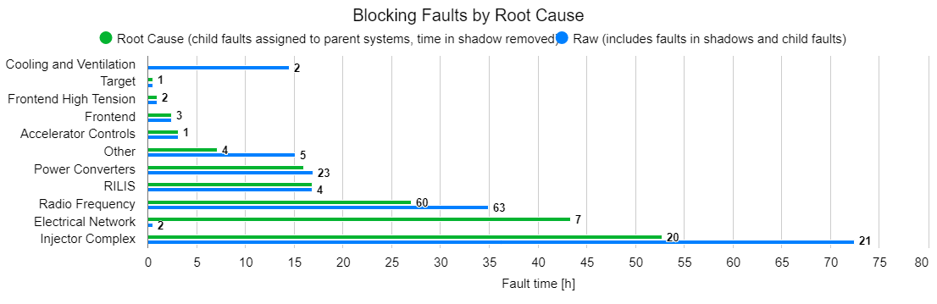
REX/HIE-ISOLDE before LS2
Availability of the ISOLDE facility by week number
Low energy Physics
Installation & commissioning CM4
Initial block of high energy Physics
Parallel low and high energy Physics
Alternating low and high energy Physics
Wk. 30: CERN wide power cut
Wk. 38, 32: Problems in Linac2
Wk. 33: SRF controls / Timing problem with request
J.A. Rodriguez – Group for the Upgrade of the ISOLDE Facility – 2019/06/03

Slide 7
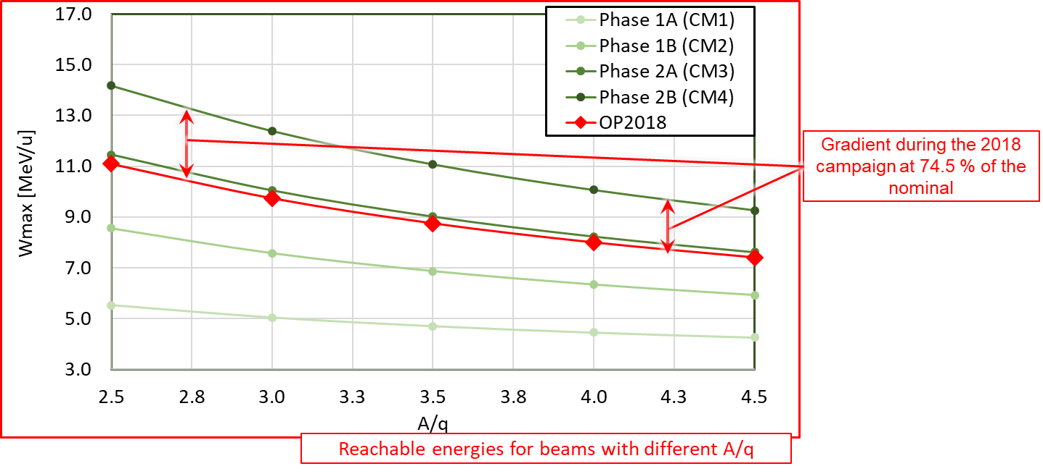
REX/HIE-ISOLDE before LS2
Main issues/worries:
SRF cavities operating at 74.5 % of nominal gradient
  Three of the 13 experiments conducted last year would have benefited from higher energies
Around 15-20 % not understood beam losses
  Linac transmission better during the REX years. Not explained by beam dynamics simulations
REX-EBIS electron gun cathode degradation faster than anticipated
  No impact on the Physics in 2018. However, it had to be replaced once during the campaign and the second one also degraded towards the end of the year.
Trips of SRF cavities after instability of the cryo system
  Main source of downtime in the post-accelerator. Additional set-up time required to re-phase the linac
J.A. Rodriguez – Group for the Upgrade of the ISOLDE Facility – 2019/06/03

Slide 8
Outline:
REX/HIE-ISOLDE before LS2
REX/HIE-ISOLDE after LS2
Ideas for long-term upgrades
Summary
J.A. Rodriguez – Group for the Upgrade of the ISOLDE Facility – 2019/06/03

Slide 9
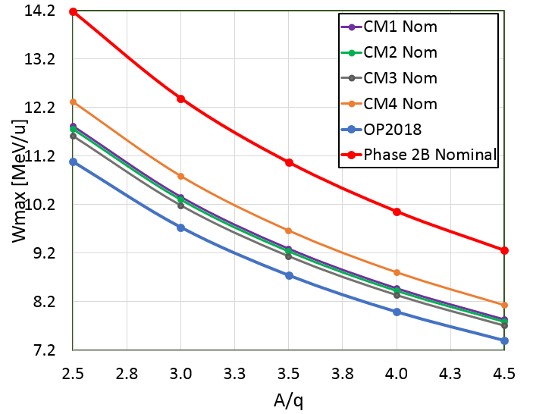
REX/HIE-ISOLDE after LS2
Main issues/worries:
SRF cavities operating at 74.5 % of nominal gradient
  CM4 uninstalled and sent back to SM18 (E. Siesling)
  Cavity SRF18 repair (W. Venturini)
  Replacement of the two worse performing cavities
  by the best two spares (W. Venturini)
  Testing in bunker of SM18 (W. Venturini)
  Transport back to ISOLDE and installation (E. Siesling)
→ Done
→ Done
Decided not to exchange
→ Waiting for bunker to be available
→ Scheduled for Jan. 2020
Operational gradient for each SRF cavity during the 2018 campaign [MV/m]
 | CM1 | CM2 | CM3 | CM4
CAV. 1 | 5.0 | 4.0 | 5.5 | 4.2
CAV. 2 | 5.0 | 4.5 | 5.5 | 4.2
CAV. 3 | 5.0 | 5.5 | 5.5 | 0.0
CAV. 4 | 5.0 | 4.0 | 5.5 | 4.5
CAV. 5 | 2.0 | 5.0 | 5.5 | 4.0
Average | 4.4 | 4.6 | 5.5 | 3.4
After LS2 (with SRF18 and the rest of the couplers in CM4 repaired and with additional conditioning of some of the other cavities), we hope we will be able to reach 7.8 MeV/u for beams with A/q = 4.5 or 10.4 MeV/u for A/q = 3.0 (~ 80 % nominal gradient)
J.A. Rodriguez – Group for the Upgrade of the ISOLDE Facility – 2019/06/03

Slide 10
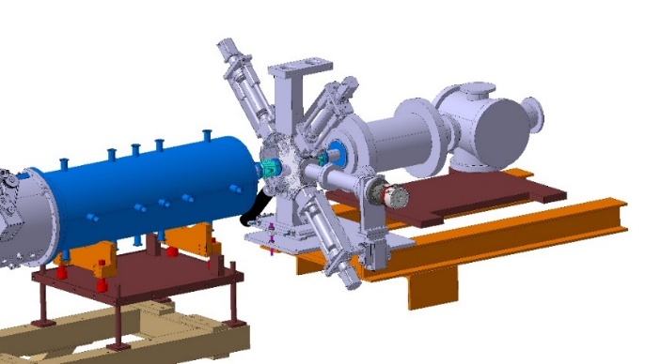
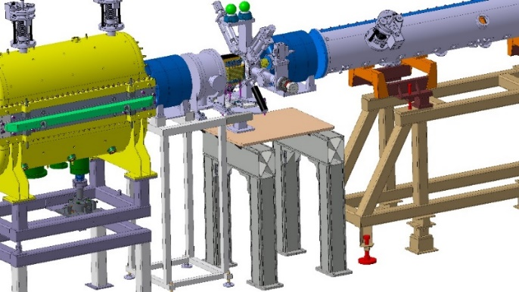
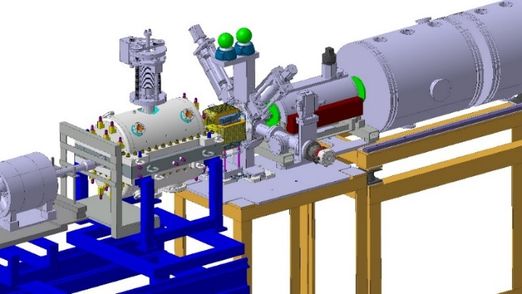
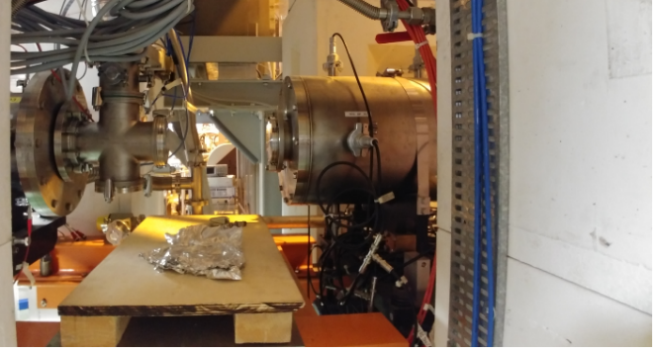
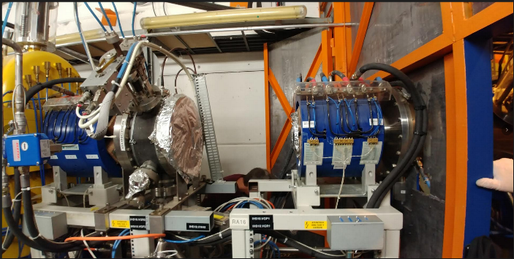
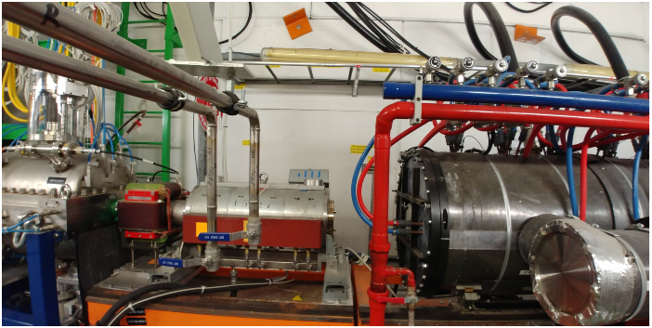
REX/HIE-ISOLDE after LS2
Main issues/worries:
Around 15-20 % not understood beam losses
  Aperture check between REX separator and CM1 (E. Siesling)
  Additional diagnostics and steerers in the REX linac (S. Mataguez)
  Additional beam commissioning time 2020 requested (E. Siesling)
  Additional (automatic) machine checkout tests (J.A. Rodriguez)
  Automatic beam optimizer (E. Piselli)
→ Done
→ Scheduled for the beginning of 2020
Waiting for formal approval by LS2 committee
→ Prototype software under development
→ Software ready
Mechanical drawings courtesy of C. Capelli EN-MME
J.A. Rodriguez – Group for the Upgrade of the ISOLDE Facility – 2019/06/03

Slide 11
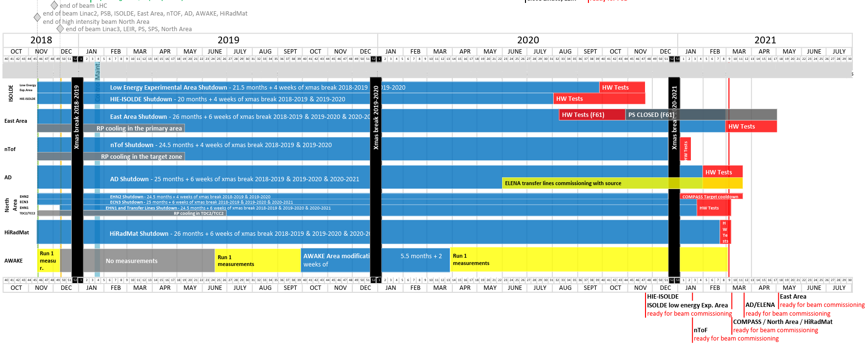
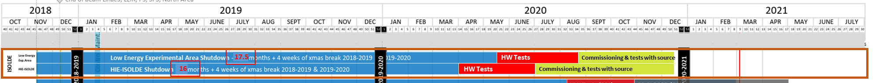
REX/HIE-ISOLDE after LS2
Main issues/worries:
Around 15-20 % not understood beam losses
  Aperture check between REX separator and CM1 (E. Siesling)
  Additional diagnostics and steerers in the REX linac (S. Mataguez)
  Additional beam commissioning time 2020 requested (E. Siesling)
  Additional (automatic) machine checkout tests (J.A. Rodriguez)
  Automatic beam optimizer (E. Piselli)
→ Done
→ Scheduled for the beginning of 2020
Waiting for formal approval by LS2 committee
→ Prototype software under development
→ Software ready
Request for schedule change made to the LS2 committee (E. Siesling)
J.A. Rodriguez – Group for the Upgrade of the ISOLDE Facility – 2019/06/03

Slide 12
REX/HIE-ISOLDE after LS2
Main issues/worries:
REX-EBIS electron gun cathode degradation faster than anticipated
  Three approaches being pursued in parallel to address this problem (F. Wenander):
  Understanding and solving or mitigating the problem with the present cathode
    Less risky option since there would be no major design changes
    Spare cathodes available. Cathode replacement could potentially be scheduled
    Discussions with the manufacturer on-going
  New immersed gun solution
    New cathode provider identified
    Electron beam gun simulations on-going
    Technical design will follow and it take 2-3 months
    Manufacturing of the pieces will need to be outsourced (CERN main workshop busy with LS2) and will take several months
  New MEDeGUN Brillouin gun solution
    Currently being tested at the TwinEBIS
    Working well but very complex design and no long-term performance data available
    (most risky option)
    Current design will need to be adapted for REX-EBIS
    Discussions with the manufacturer on-going
J.A. Rodriguez – Group for the Upgrade of the ISOLDE Facility – 2019/06/03

Slide 13
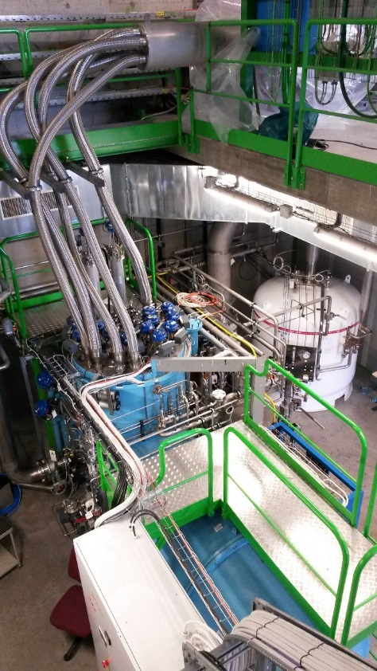
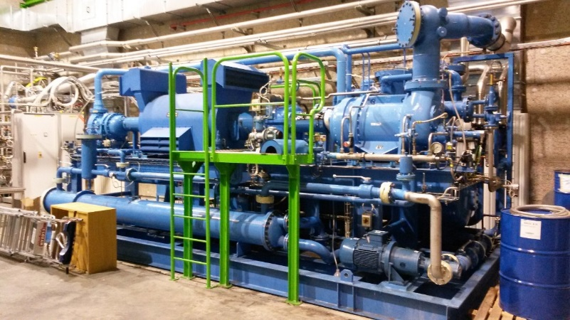
REX/HIE-ISOLDE after LS2
Main issues/worries:
Trips of SRF cavities after instability of the cryo system
  Maintenance of the cryo-plant on-going (O. Pirotte)
  Setup of automatic controls for transient modes on-going
  Additional time for restart and recommissioning of cryo available
  (cost of early restart ~ 15 kCHF/month)
  Additional time for recommissioning of SRF systems available
→ Scheduled to be completed before end of 2019
→ Scheduled to be completed before end of 2019
Waiting for formal approval by LS2 committee
Waiting for formal approval by LS2 committee
J.A. Rodriguez – Group for the Upgrade of the ISOLDE Facility – 2019/06/03

Slide 14
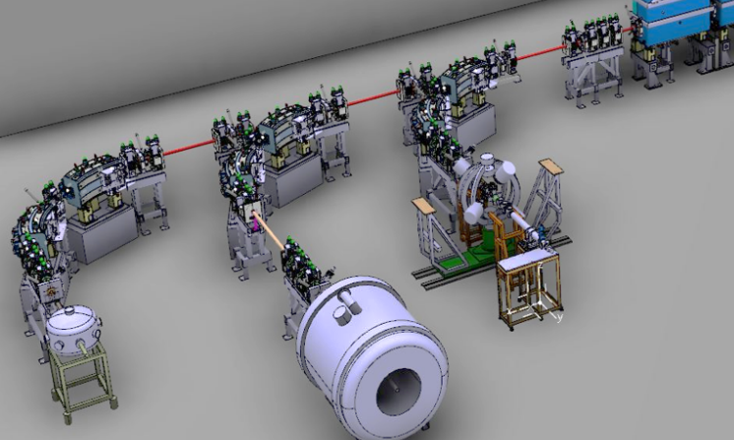
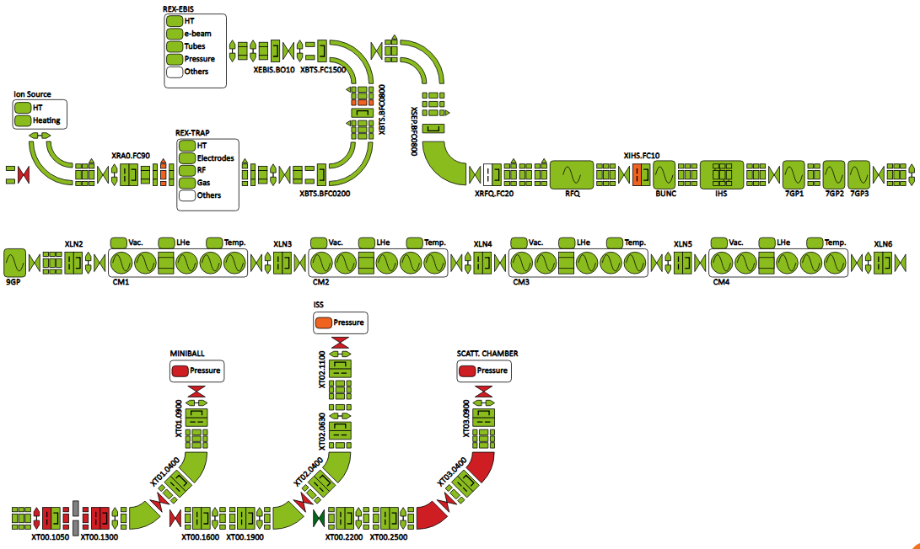
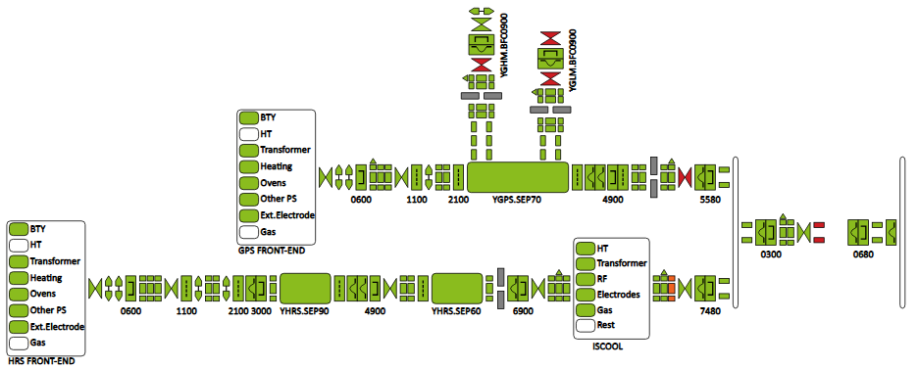
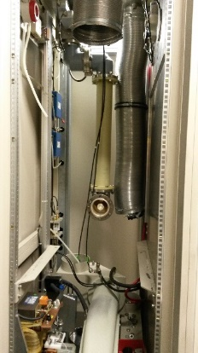
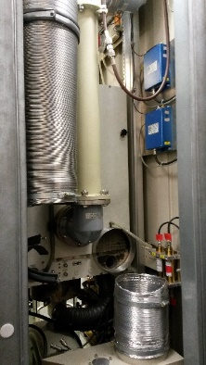
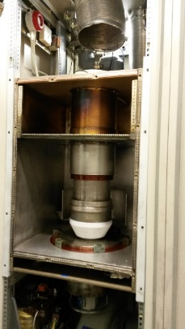
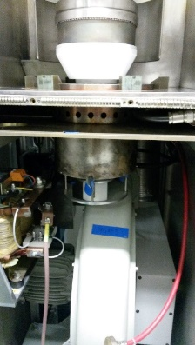
REX/HIE-ISOLDE after LS2
After LS2
Additional planned improvements:
New silicon detectors will be installed between the two
dipoles in XT02 and XT03
  Beam energy measurements possible in the three HEBT lines
  Reduction in set-up time for beams to ISS and Scattering Chamber
  Energy loss measurements after stripping foils possible
  Redundancy in case one of them fails
Semi-automatic phasing of SRF cavities (E. Piselli)
  Additional reference set-ups at the beginning of the Physics campaign
  Less set-up time needed if problems with one SRF cavity appear
Improvements in beam diagnostics applications (E. Piselli)
New version of the Fast Beam Investigation (FBI) (E. Fadakis)
  Full integration of C2MON and Grafana
  More functionalities and additional views will be available
X-ray monitors for each of the cryomodules
  Better diagnostics on the field emission of the SRF cavities
  Potential gains in cavity gradients
Major refurbishment of REX RF amplifiers (C. Gagliardi, L. Timeo)
  Remote and automatic re-start after trip on-going
  Several sources of problems identified and fixed
  Better power and gradient calibrations
  Higher peak powers available (90 kW)
  New cooling for the IH structure
  Potential more reliable operations and less down time
Validation of beam optics models (J.A. Rodriguez, N. Bidault)
  Important time investment during the recommissioning in 2020
Before LS2
J.A. Rodriguez – Group for the Upgrade of the ISOLDE Facility – 2019/06/03

Slide 15
Outline:
REX/HIE-ISOLDE before LS2
REX/HIE-ISOLDE after LS2
Ideas for long-term upgrades
Summary
J.A. Rodriguez – Group for the Upgrade of the ISOLDE Facility – 2019/06/03

Slide 16
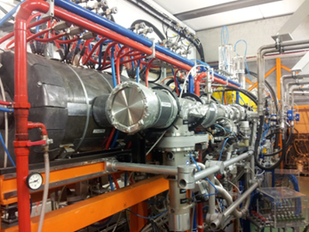
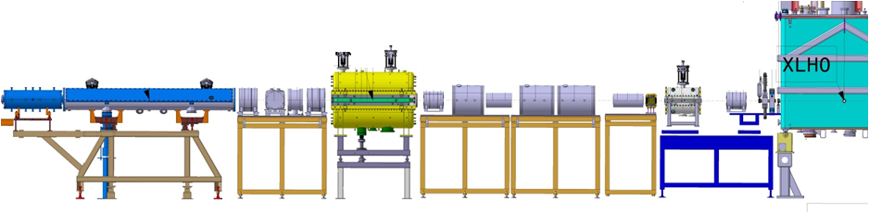
REX linac
The REX normal conducting linac:
Beam from the charge breeder with 5 keV/u energy is accelerated to 2.85 MeV/u
Seven RF structures: f = 101.28 MHz (except for 9gap at 202.56 MHz) up to 10% duty cycle
Charge state dynamic acceptance: 2.5 < A/q < 4.5
RF Systems:
RF structure | E_{f} [MeV/u] | β_{f} [%] | P [kW] for A/q=4.0 | A/q acceptance
RFQ | 0.3 | 2.5 | 29 | < 5.5
Buncher | 0.3 | 2.5 | 1.3 | > 2.5
IHS | 1.2 | 5.1 | 40 | < 4.5
7gap1 | 1.55 | 5.7 | 60 | > 2.5
7gap2 | 1.88 | 6.3 | 60 | > 2.5
7gap3 | 2.2 | 6.8 | 60 | > 2.5
9gap | 2.85 | 7.8 | 71 | > 2.5
Magnets:
Triplets | 6
Doublets | 1
Steerers | 2H, 2V
Beam from EBIS
5 keV/u
Beam to HIE-ISOLDE
2.8 MeV/u
RFQ
Triplet
Triplet
IHS
Triplet
Triplet
Doublet
7gap 2
7gap 3
Triplet
9gap
Triplet
Buncher
7gap 1
Diagnostics
Diagnostics
Diagnostics
HV Steerer
HV Steerer
Diagnostics
J.A. Rodriguez – Group for the Upgrade of the ISOLDE Facility – 2019/06/03

Slide 17
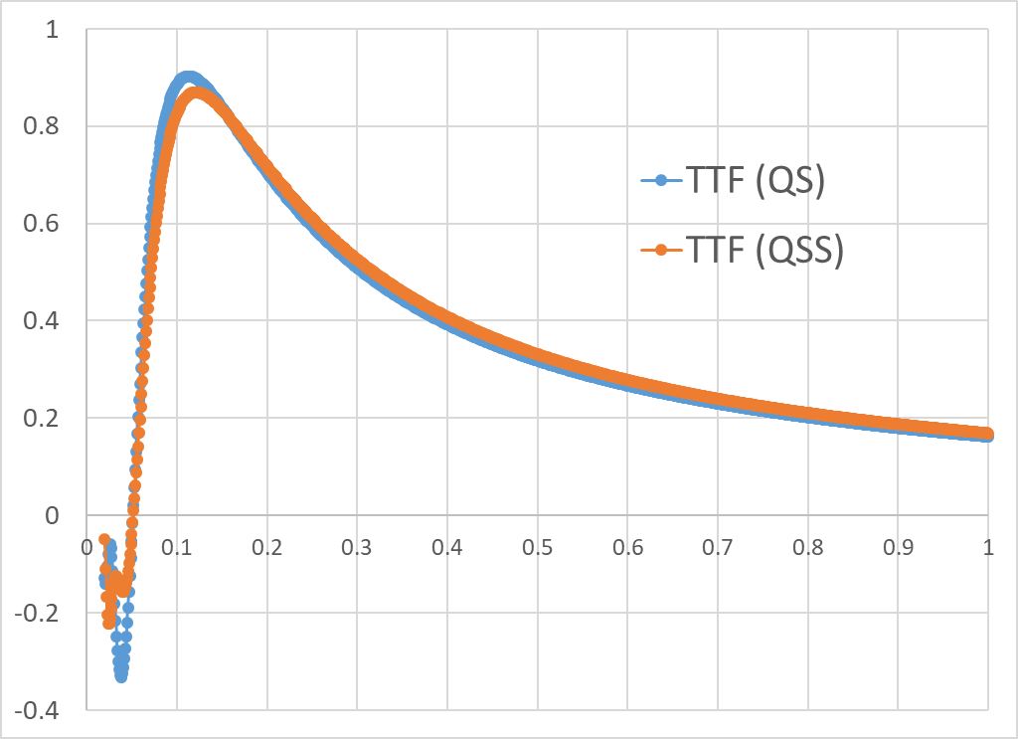
HIE Phase 3
Replacement of the 9gap and the 3x7gap structures by two low-beta cryomodules
First high-beta cryomodule moved to the end of the tunnel
Energy: 10 MeV/u for A/q = 4.5, 16.5 MeV/u for A/q = 2.5
Possible pre-buncher and chopper to increase bunch spacing
 | Phase 1-2 | Phase 3
# of cavities | 20 | 12
# of solenoids | 4 | 4
f [MHz] | 101.28 | 101.28
Geometrical beta (β_{g}) | 10.3 | 6.3
E_{acc} [MV/m] | 6.0 | 6.0
Quality factor (Q_{o}) | > 5∙10⁸ | > 3.2∙10⁸
P [W] at 4.2 K for E_{acc} | < 10 | < 7
Length [m] | 0.3 | 0.195
Beam aperture diameter [cm] | 2.0 | 2.0
Maximum Transit Time Factor (TTF) | 0.9 | 0.85
E_{peak} / E_{acc} | 5.6 | 5.4
RF structure | E_{f} [MeV/u] | β_{f} [%] | P [kW] for A/q=4.0 | A/q acceptance
RFQ | 0.3 | 2.5 | 29 | < 5.5
Buncher | 0.3 | 2.5 | 1.3 | > 2.5
IHS | 1.2 | 5.1 | 40 | < 4.5
Replacement by 2 low-beta cryomodules
RFQ
Triplet
Triplet
IHS
Buncher
Triplet
7gap 1
7gap 2
7gap 3
9gap
Diagnostics
Diagnostics
Diagnostics
Diagnostics
J.A. Rodriguez – Group for the Upgrade of the ISOLDE Facility – 2019/06/03

Slide 18
Normal conducting upgrade
Replacement of the 9gap, the 3x7gap and the IH structures by 5-6 new normal conducting structures
Possible pre-buncher and chopper to increase bunch spacing
This is only a possibility worth studying. At this point, only qualitative analysis. Full study is needed
Replacement by 5-6 structures
RFQ
Triplet
Triplet
IHS
Buncher
Triplet
7gap 1
7gap 2
7gap 3
9gap
Diagnostics
Diagnostics
Diagnostics
Diagnostics
J.A. Rodriguez – Group for the Upgrade of the ISOLDE Facility – 2019/06/03

Slide 19
HIE-ISOLDE Phase 3 vs. Normal Conducting
Beam intensity and time structure considerations:
HIE-ISOLDE Phase 3:
Improved beam dynamics resulting in lower beam losses
Maximum A/q still at 4.5 (limited by the IH structure)
Normal conducting upgrade:
Improved beam dynamics resulting in lower beam losses
Maximum A/q could be pushed to 5.5 (limited by the RFQ and REX-EBIS high tension)
  Lower charge states could be accelerated.
  For example: ²⁰⁶Hg³⁸⁺ (A/q = 5.421) instead of ²⁰⁶Hg⁴⁶⁺ (A/q = 4.478)
  Very significant increase in beam intensity (i.e. higher REX-EBIS efficiency)
  Higher repetition rates and better time structure (i.e. reduction in the optimum breeding time)
J.A. Rodriguez – Group for the Upgrade of the ISOLDE Facility – 2019/06/03

Slide 20
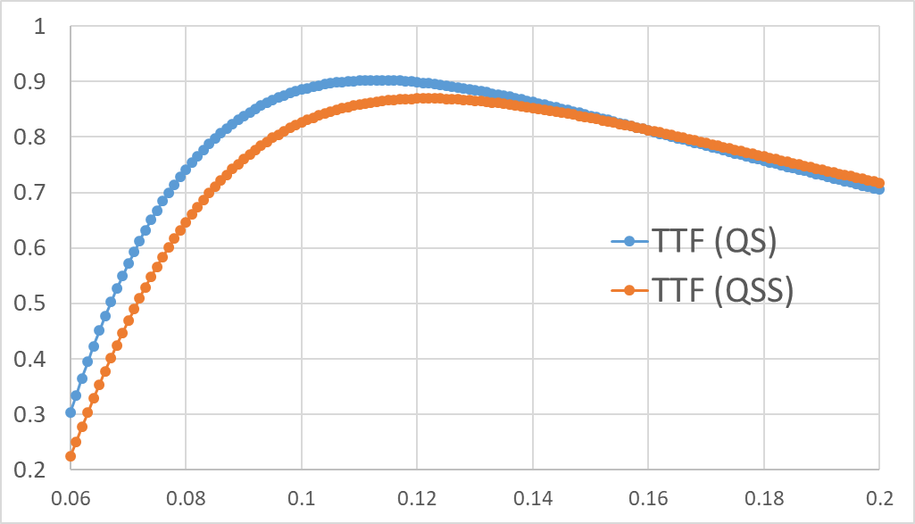
HIE-ISOLDE Phase 3 vs. Normal Conducting
Beam energy considerations:
HIE-ISOLDE Phase 3:
Continuous energy changes above 1.2 MeV/u
Possible beam deceleration down to ~ 0.6 MeV/u
 | E_{o} [MeV/u] | β_{o} [%] | E_{f} [MeV/u] | β_{f} [%]
Nominal – A/q = 4.5 | 3.5 | 8.6 | 10.0 | 14.3
Nominal – A/q = 2.5 | 5.4 | 10.7 | 16.5 | 18.6
80% nominal – A/q = 4.5 | 3.0 | 8.1 | 8.2 | 13.0
80% nominal – A/q = 2.5 | 4.8 | 10.1 | 13.7 | 16.7
Normal conducting upgrade:
These estimates are based on a rough initial analysis
Final number depend on the design and the number of cavities as well as on the amplifiers peak powers
Only discrete energy steps between 0.3 and 3.5 MeV/u
 | E_{o} [MeV/u] | β_{o} [%] | E_{f} [MeV/u] | β_{f} [%]
Nominal – A/q = 5.5 | 3.5 | 8.6 | 8.6 | 13.2
Nominal – A/q = 4.5 | 3.5 | 8.6 | 10.0 | 14.3
Nominal – A/q = 2.5 | 3.5 | 8.6 | 14.6 | 17.0
80% nominal – A/q = 5.5 | 3.5 | 8.6 | 7.5 | 12.5
80% nominal – A/q = 4.5 | 3.5 | 8.6 | 8.5 | 13.0
80% nominal – A/q = 2.5 | 3.5 | 8.6 | 12.5 | 16.0
J.A. Rodriguez – Group for the Upgrade of the ISOLDE Facility – 2019/06/03

Slide 21
HIE-ISOLDE Phase 3 vs. Normal Conducting
Cost and other considerations:
HIE-ISOLDE Phase 3:
Upgrade of the cryoplant necessary
R&D for new low-beta cavity required
Low beta cryomodule design needed
Cryoline and other ancillary equipment already in place
Longer set-up times than for the normal conducting option (i.e. higher operational cost)
Possibly less AC power consumption (i.e. lower operational cost)
In-vacuum triplet in the IH structure will remain a very weak point
Normal conducting upgrade:
Possible spreading of the cost over a longer period of time
  RF cavities and 2-3 amplifiers initially
  Four REX amplifiers could be used for a few years and replaced later
Shorter set-up times than for the superconducting option (i.e. lower operational cost)
Possibly more AC power consumption (i.e. higher operational cost)
Possibly lower maintenance cost
J.A. Rodriguez – Group for the Upgrade of the ISOLDE Facility – 2019/06/03

Slide 22
Outline:
REX/HIE-ISOLDE before LS2
REX/HIE-ISOLDE after LS2
Ideas for long-term upgrades
Summary
J.A. Rodriguez – Group for the Upgrade of the ISOLDE Facility – 2019/06/03

Slide 23
Summary:
Main improvements after LS2:
  CM4 partially repaired
  Additional beam diagnostics and steerers in REX
  Additional time to restart and recommission the cryoplant and the SRF systems
  Thorough beam commissioning. Validation of beam optics models
  Semi-automatic phasing application
  Improved controls for the beam diagnostics
Long-term upgrade of REX:
  Normal conducting option should be evaluated. Potentially:
    Lower cost
    A/q as high as 5.5 (i.e. higher beam intensities specially for heavier beams)
  Both normal conducting and superconducting upgrades will require years. In my opinion, we should start working on them very soon
J.A. Rodriguez – Group for the Upgrade of the ISOLDE Facility – 2019/06/03

