Slide 1
The EPIC Project
Richard Catherall
EN-STI-RBS

Slide 2
Gaining momentum
Part of the ESPP paper presented at Granada early May
  Mentioned at least 5 times throughout the week
Presented (and published) at IPAC 19 last week.
  Discussion with STFC representative during poster session
To be presented (ISOLDE V) by Tim in INPC 29th July 2019

Slide 3
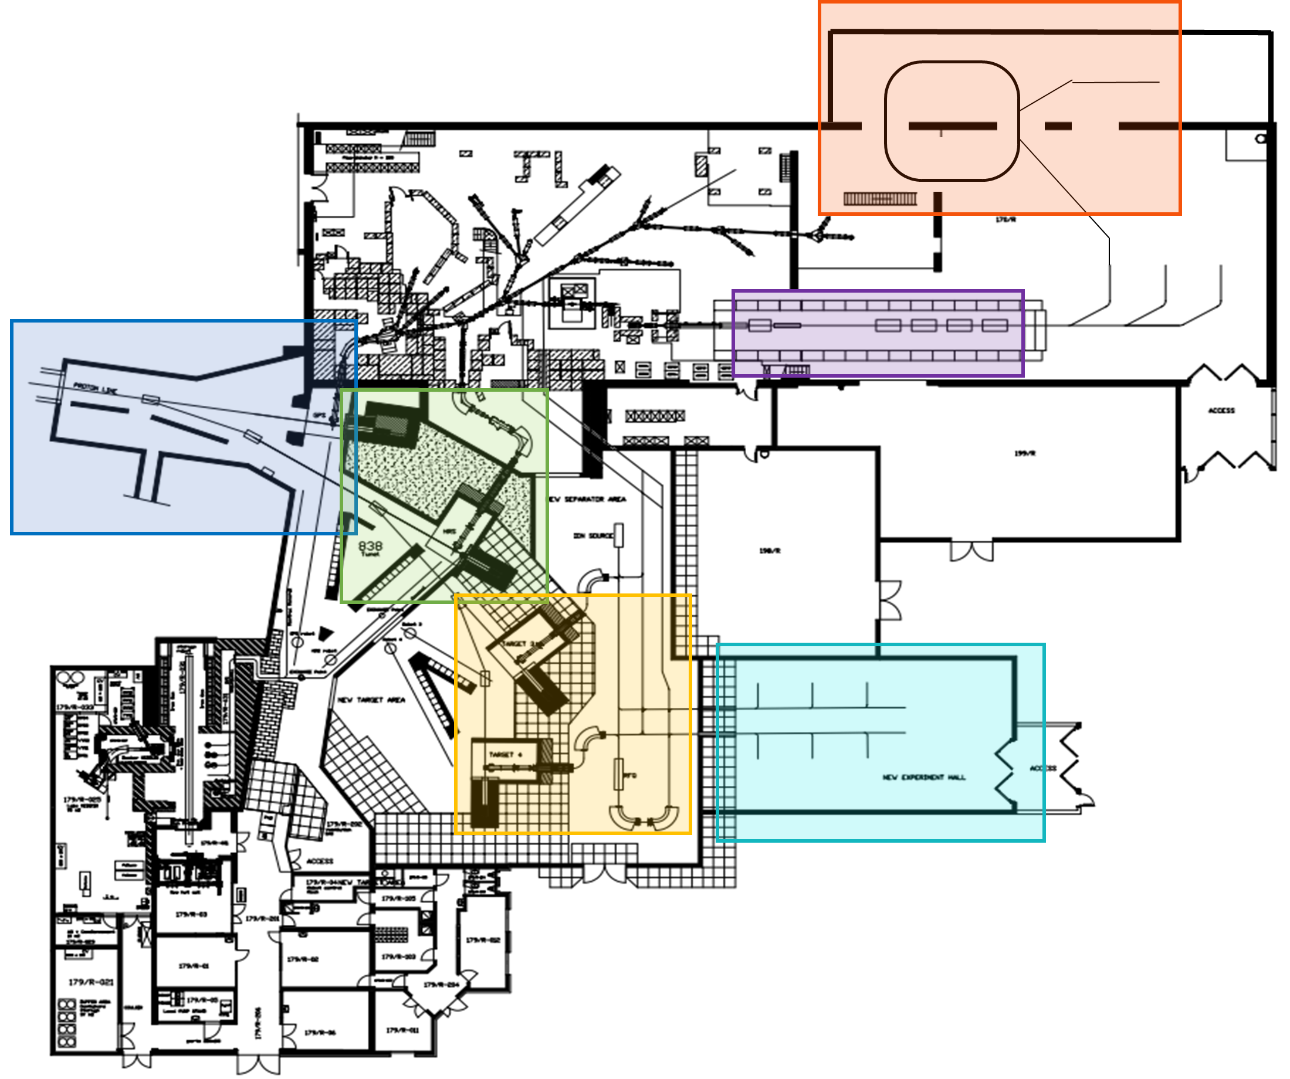
The EPIC project comprises of 6 key upgrades:
The addition of two new target stations and high resolution mass separator
Improvement of the existing beam dumps
Provide 2 GeV protons to ISOLDE
The addition of a second experimental hall
Installation of a storage ring beyond the HIE-ISOLDE post accelerator
An upgrade of the non-superconducting part of HIE-ISOLDE

Slide 4
Priorities – possible scenario
Beam dumps
Infrastructure for new target stations and HRMS
Frontend and HRMS installation
2 GeV upgrade
LSx
HIE upgrade
TSR
New experimental hall
LSx+1

Slide 5
Funding
UK pre-project budget of 120kGBP (150kCHF) via Manchester University
  1 Fellow for 1.5 years
  Could be complemented by CONS budget
  =1 Fellow for 3 years
Requirements
  1 full TDR for leverage for further funding
  Beam dump integration
  New FE and HRMS integration
  New 2 GeV beam line should be taken on by CERN support groups

