Slide 1
LIU-PS Planning report

Slide 2
New demineralized water circuit
Pipes installation in the Central ring, Gallery 1, Gallery 3 and Gallery 7 have been completed last Saturday (1 week delay)
Integration discussions are still ongoing for the connection between the end of the galleries and the outer side of the ring
Delay to start the connection between end of gallery 1 and the gallery that goes to B.355 (integration concluded late – the works were suppose to start the 25/03 but the integration was completed last week)
Planning shuffling discussions are ongoing with the following priority list defined last Friday (Serge is checking with the company how many works they can perform in parallel):
  End of gallery 1 up to the ring (part between the ring and the connection to the gallery that goes to B.355 will be performed after) – to be completed by the 13/05/2019
  PS SWY to TT2 (finish the work started in January and that could not be finished due to some integration issues) – 6 to 10th May 2019
  Connection gallery 7 to the outer side of the ring – 8th May – 7th June/2019
  Connection gallery 5 to the outer side of the ring
  Connection between TT2 and B.269
  Connection between inner side of the ring and the gallery that goes to B.355

Slide 3
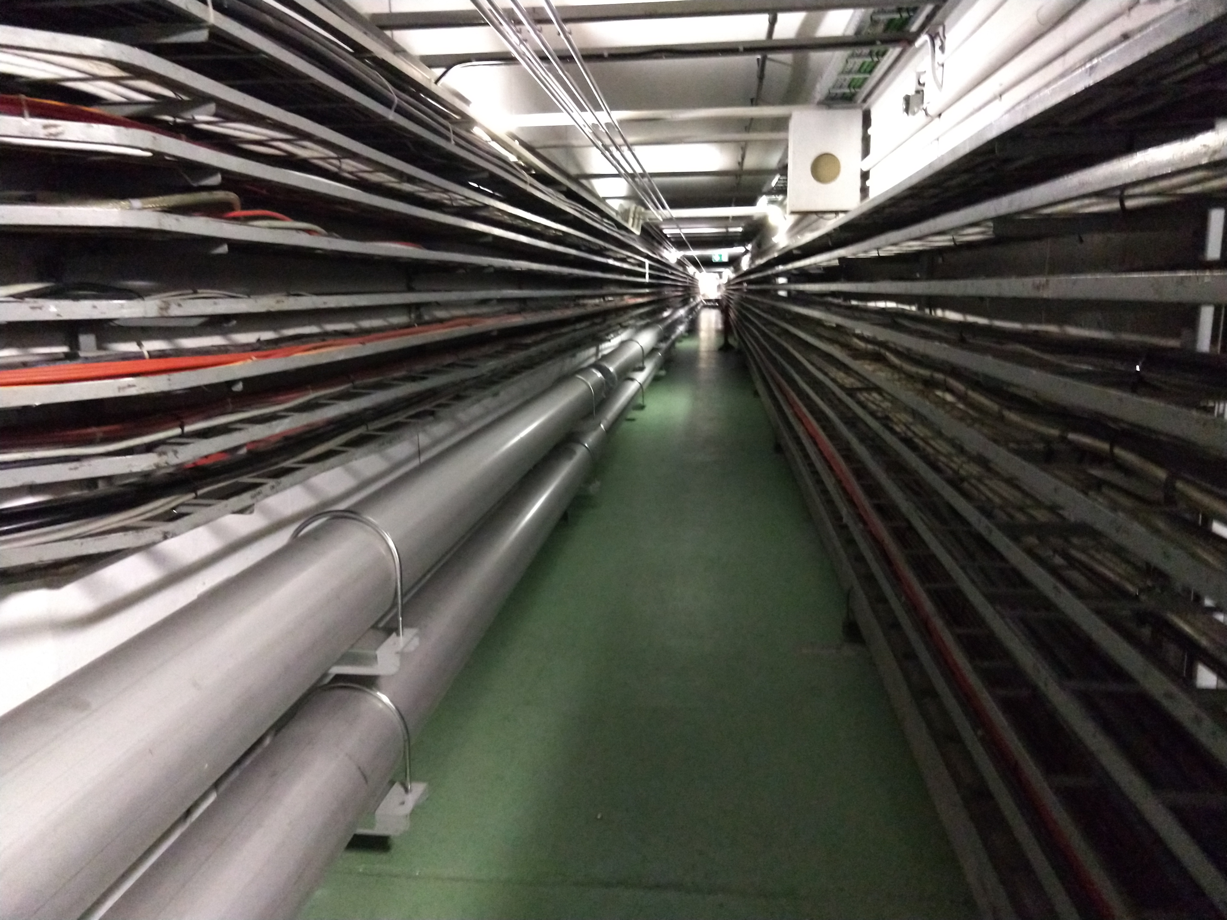
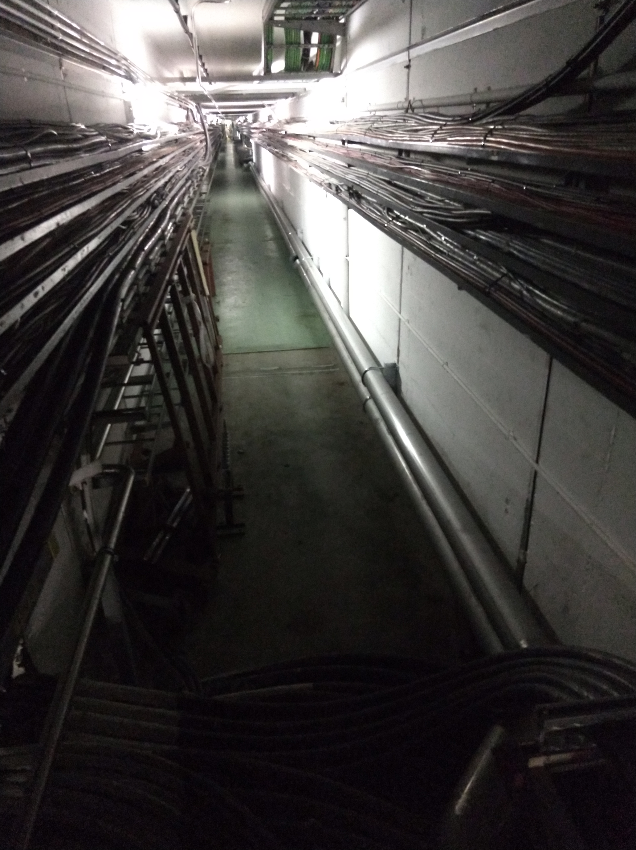
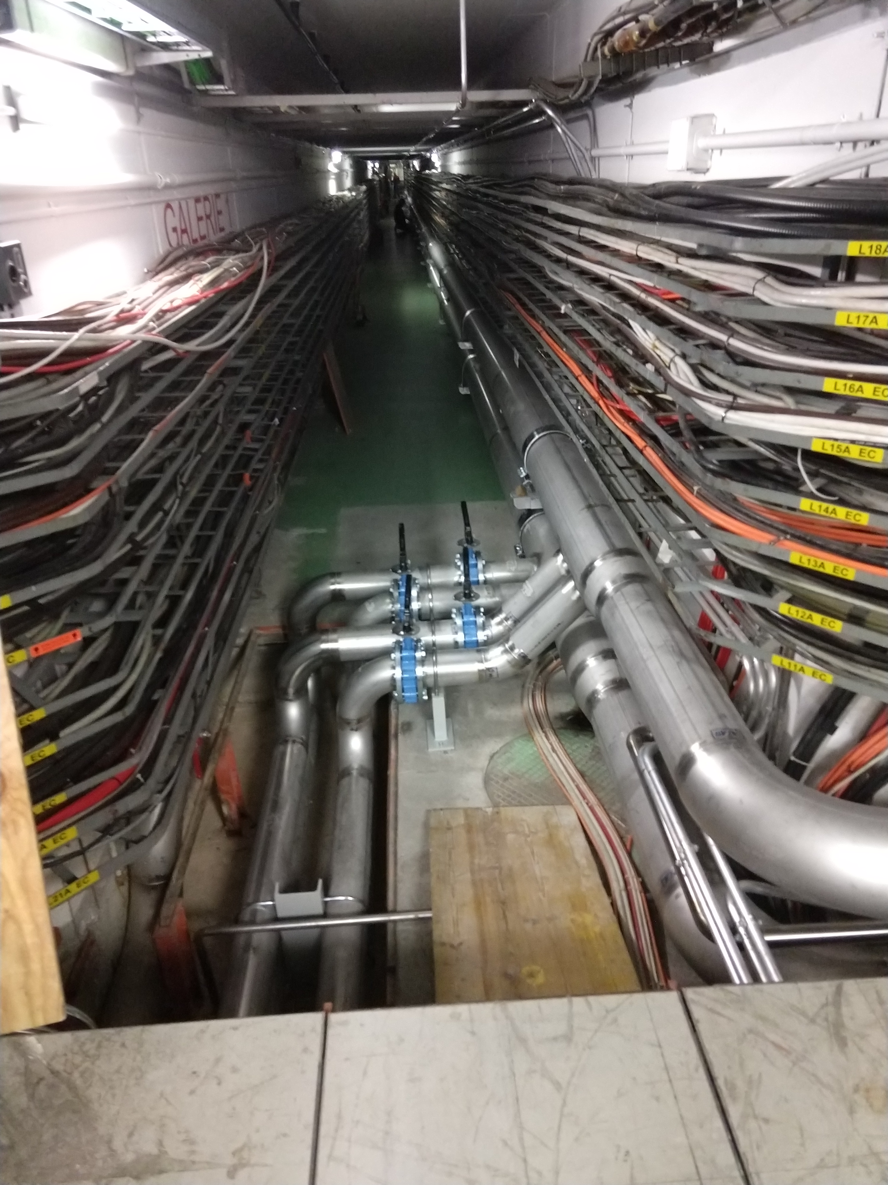
New demineralized water circuit

Slide 4
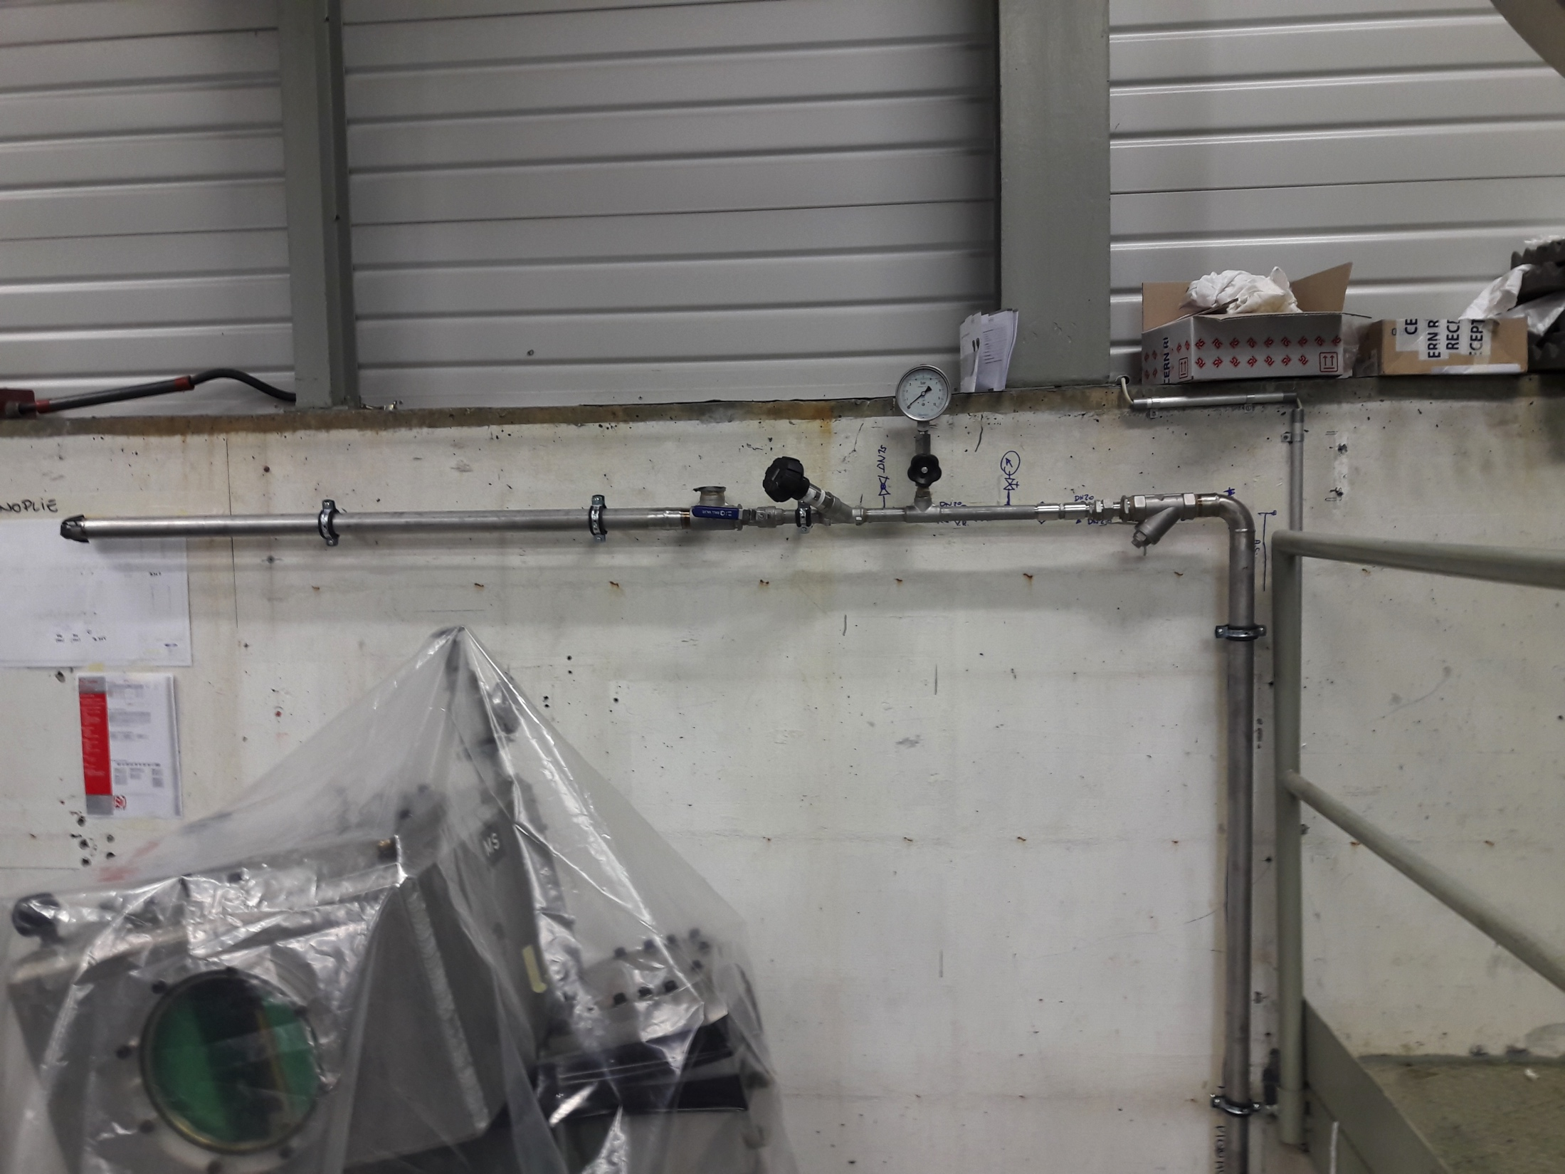
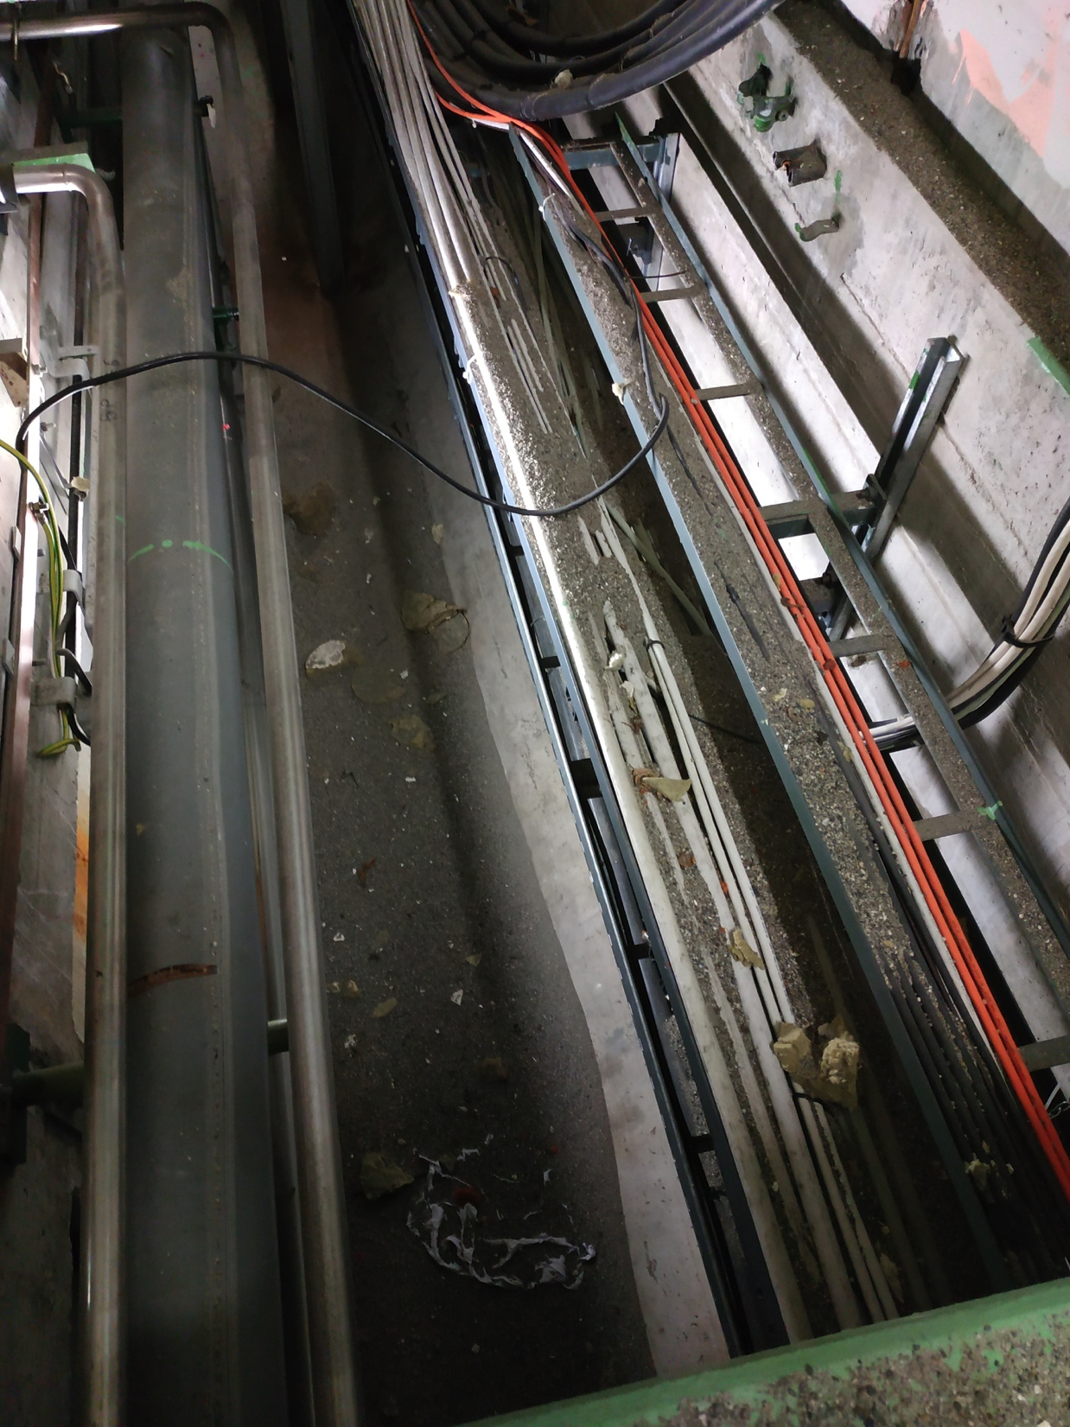
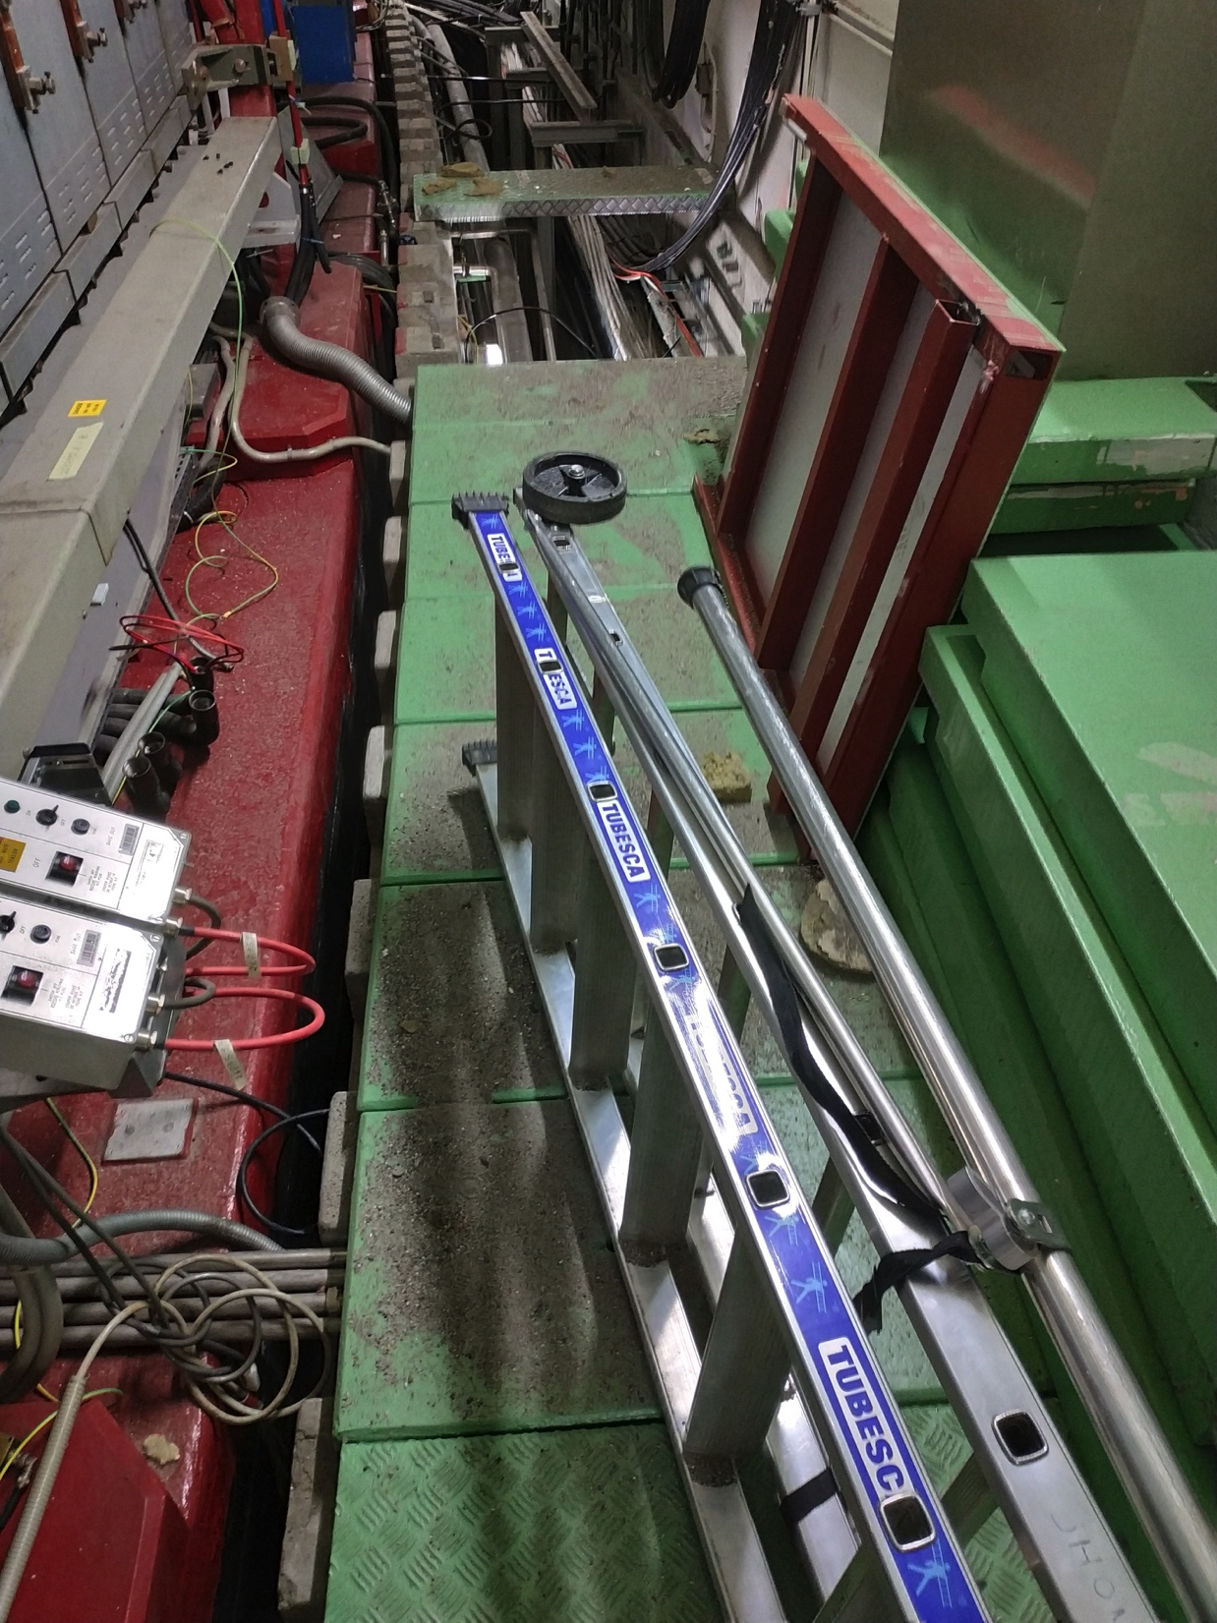
B.365 – KFA45 area
  SMB modifications performed in the new structure after the CV pipes installation
  Additional rack not included in the integration study
    SMB performed the already the modifications and agreed to provide the study after
    Rack installed
  Cabling campaign ongoing with some difficulties, incidents and delays
  EN-EL LV consolidation works ongoing – Anticipated on request of TE-ABT and EN-EL (co-activity managed internally in EN-EL)

Slide 5
B.365 – PCs area
Last minute integration modification following the issue detected with the overhead crane
  No need for SMB modifications
Issue with the SMB works on the roof not declared, and anticipated by one year without informing anyone (on-site meeting foreseen this Friday at 9:00, but I will also report it in the LS2C presentation)

Slide 6
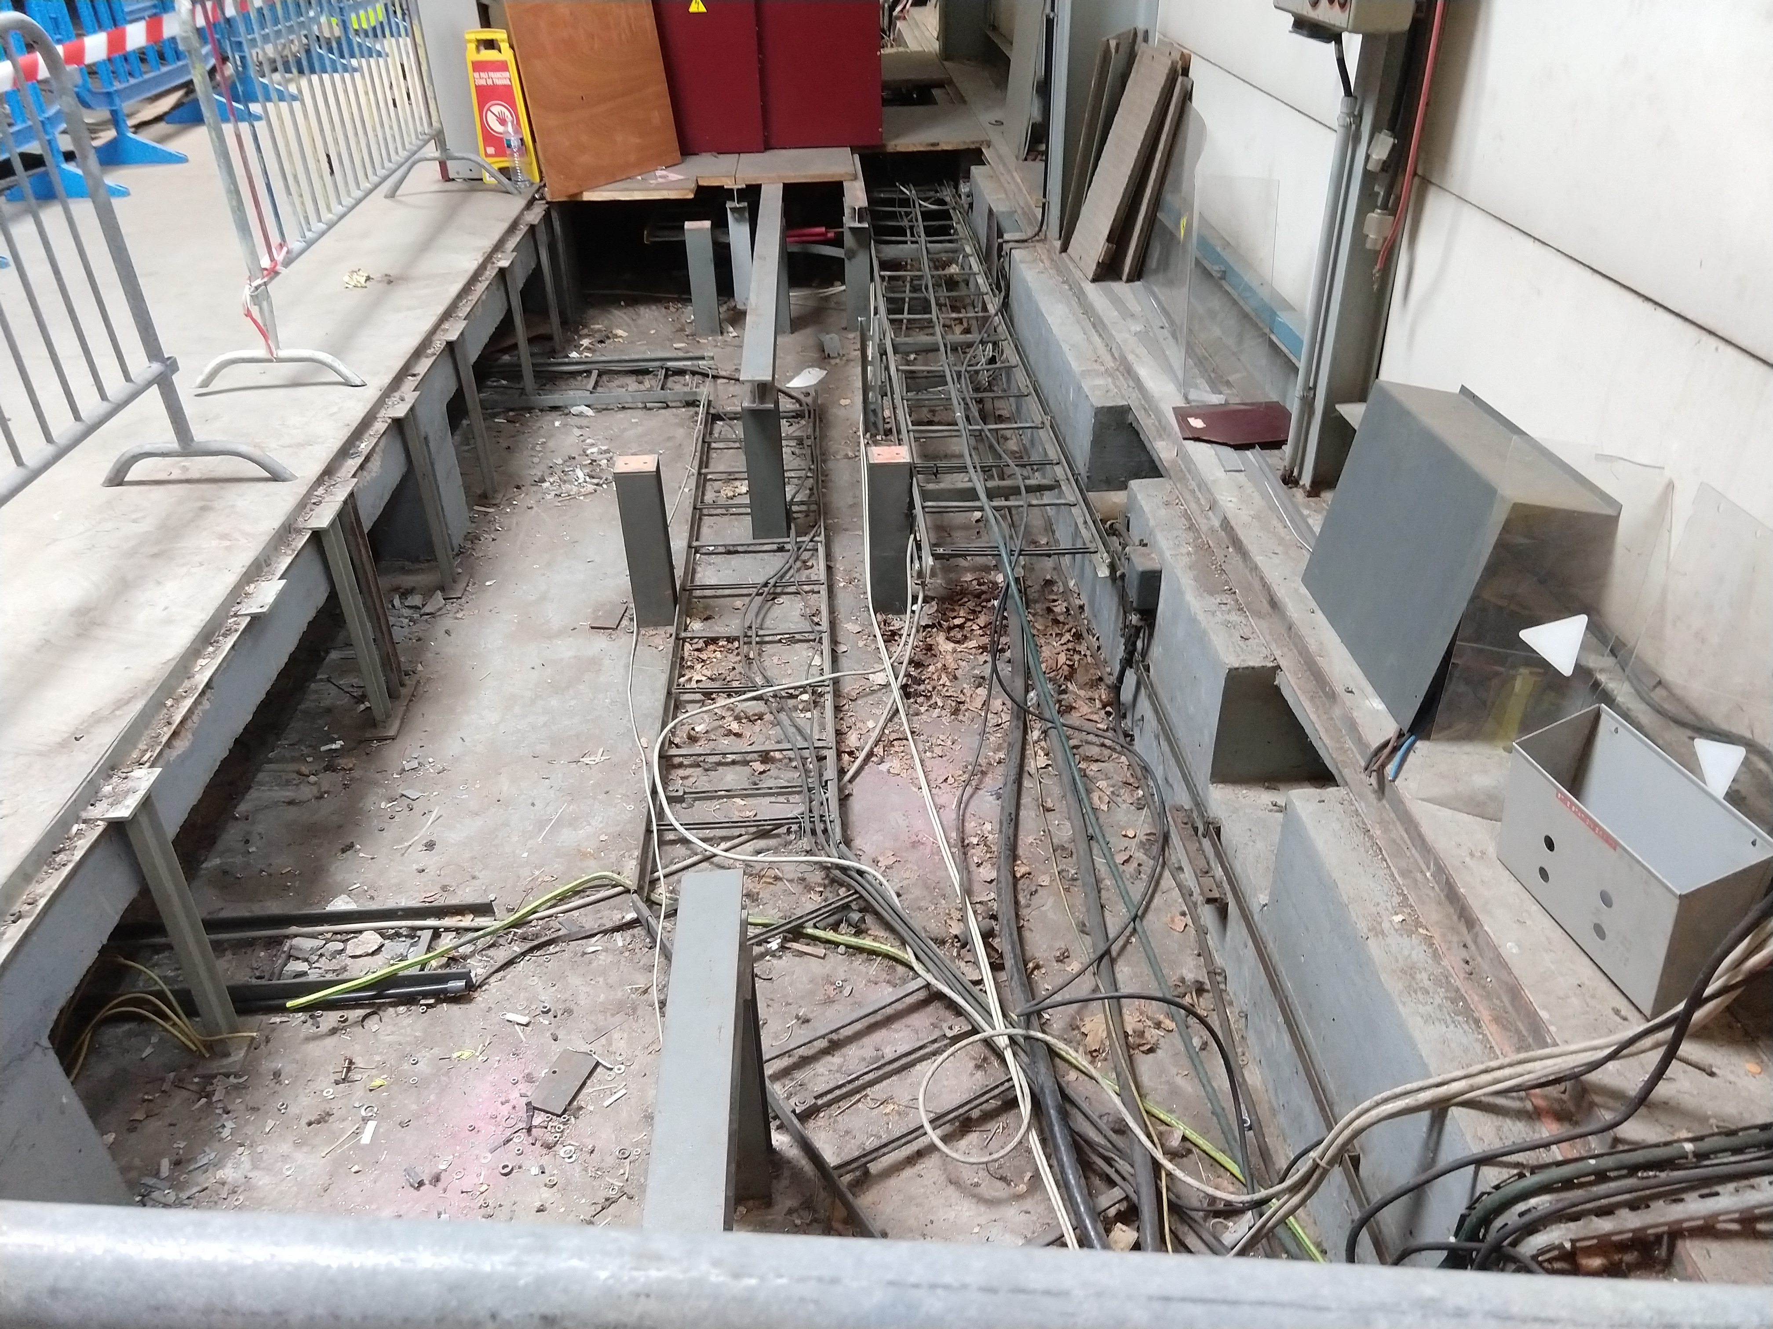
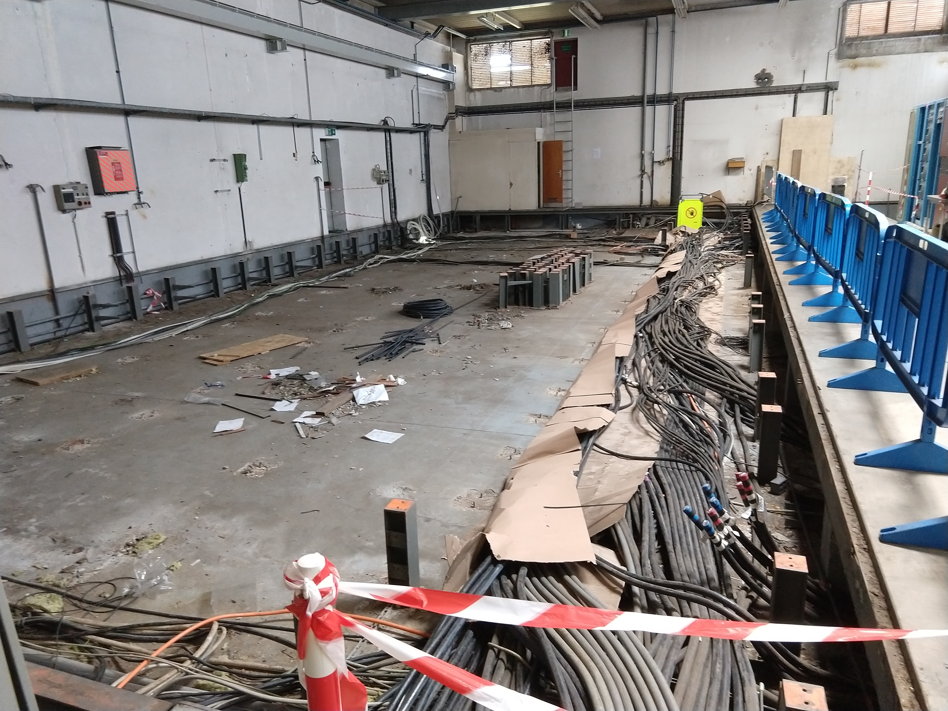
B.269
De-cabling progressing well, and maybe finished in advance
Integration modifications is blocking part of the SMB installation
  Information on the new Switchboard known only since 2 weeks ago
  Racks in R-003
  Connection between the ventilation unit and the external wall
  I’m discussing with SMB to find a way to move forward on the different points and unblock the situation
Contract for the PCB decontamination went out last Friday (the slot to perform this job starts the 10th of June and will last 2 weeks
Transformer installation issues

Slide 7
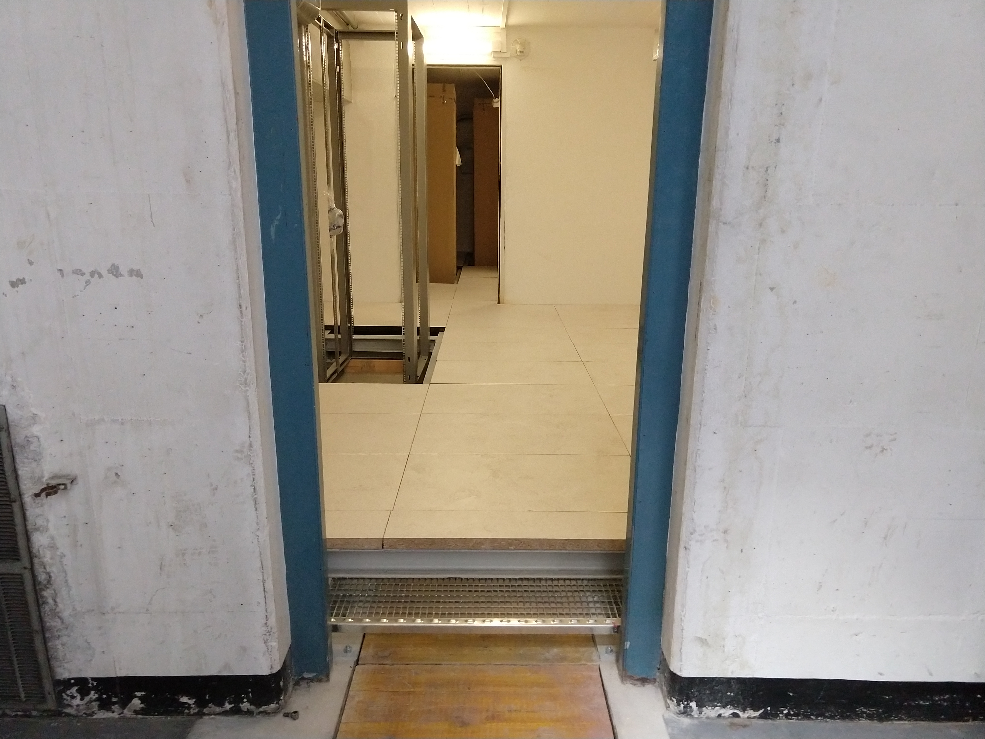
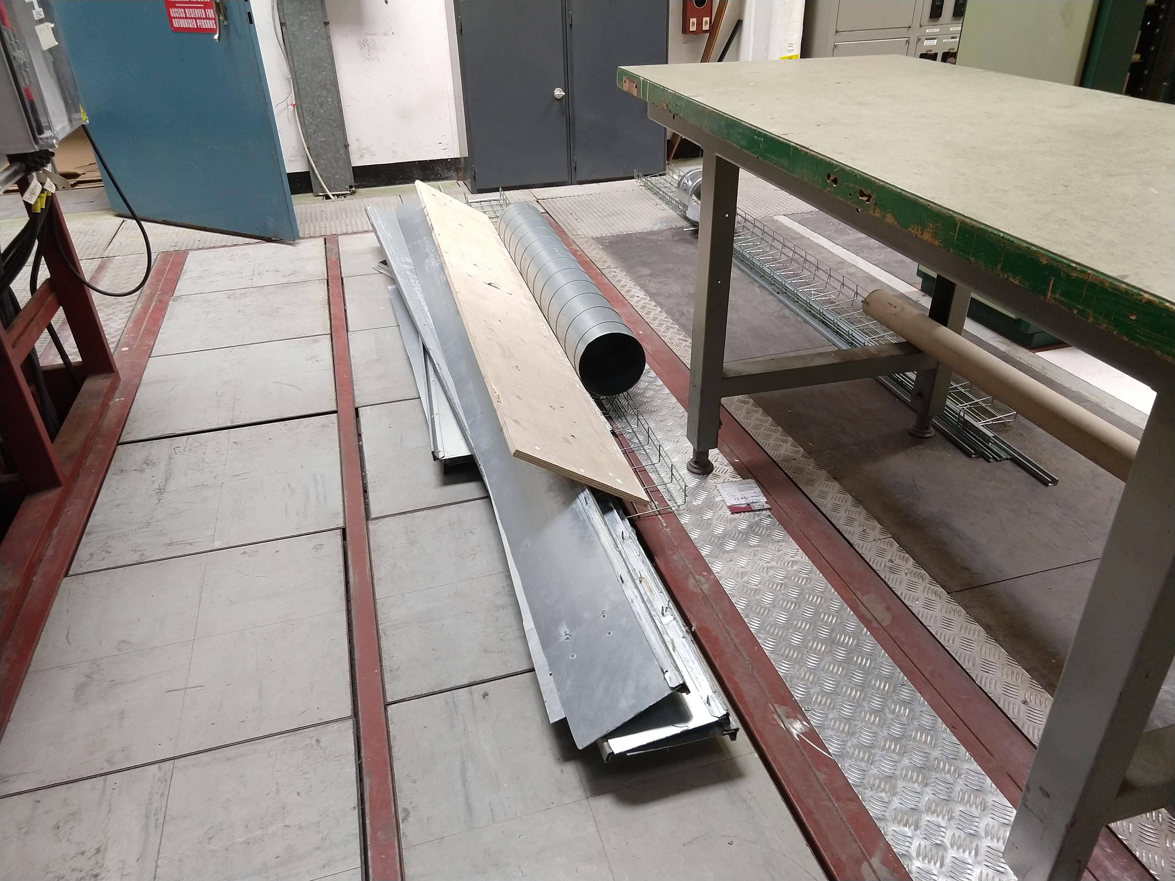
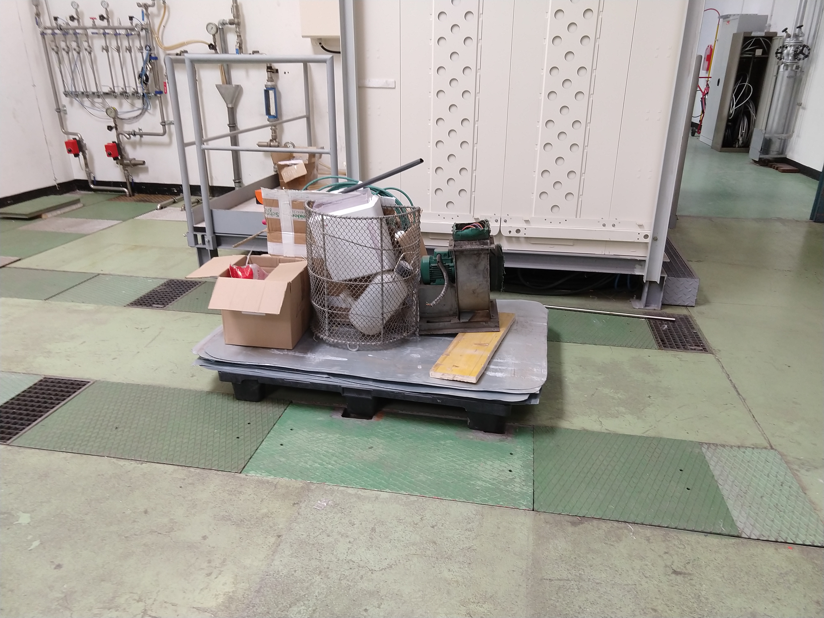
B.355
Due to the unavailability of the new power converters (new readiness date), not much activity is ongoing
BE-CO hardware installation – with the new estimations the time required for installation is quite reduced compared to the baseline
ME6 switch room installation is ongoing and we will have a new cabling campaign (not declared initially) starting next week for 2 weeks
Issue: Waste transferred from the ME6 room to the R-009

Slide 8
Main Units renovation (cons.)
15/43
  already renovated
2/15
  kept in B.150 (MU27 and MU39) for the LINAC4 and BTP works
13/15
  already re-installed and re-aligned in the machine (MU73, MU24, MU22, MU29, MU32, MU13, MU11, MU4, MU30, MU6, MU40, MU12, and MU21)
  MU12 and MU21 alignment to be performed this Thursday

Slide 9
Dashboard
  https://lhcdashboard.web.cern.ch/lhcdashboard/ls2/#page%3D12_image%3D0

Slide 10
Question?

