Slide 1
PS Complex – LS2 progress report
LS2 Committee Meeting 03-May-2019
Julie Coupard, David Hay and Fernando Pedrosa

Slide 2
Table of Contents
Master schedule
PSB activities
LINAC4 connection activities
PS activities

Slide 3
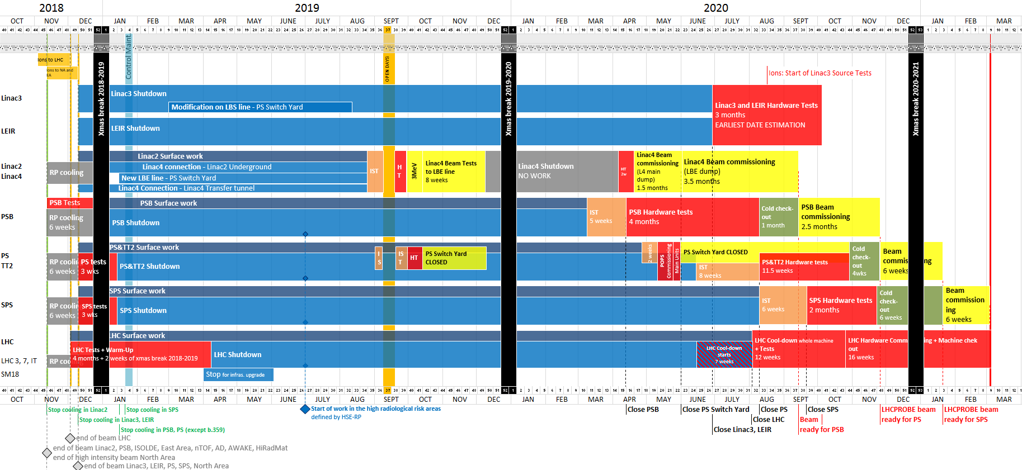
Master Schedule
Today

Slide 4
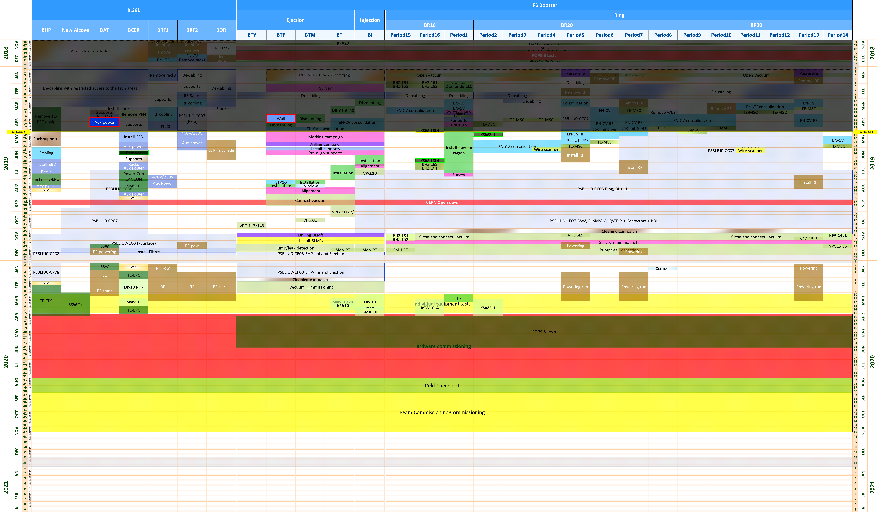
PSB LS2 Progress Dashboard (broken line)

Slide 5
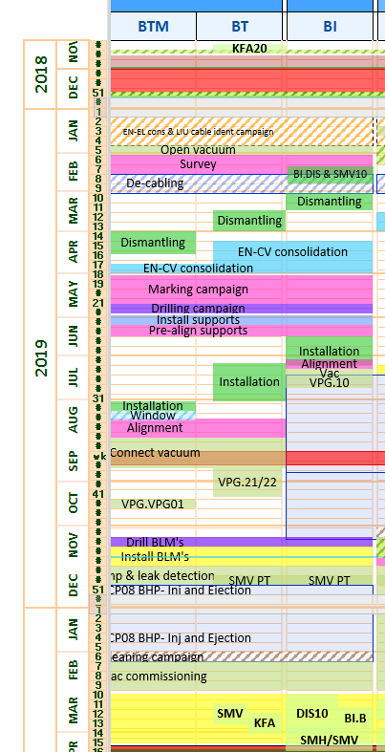
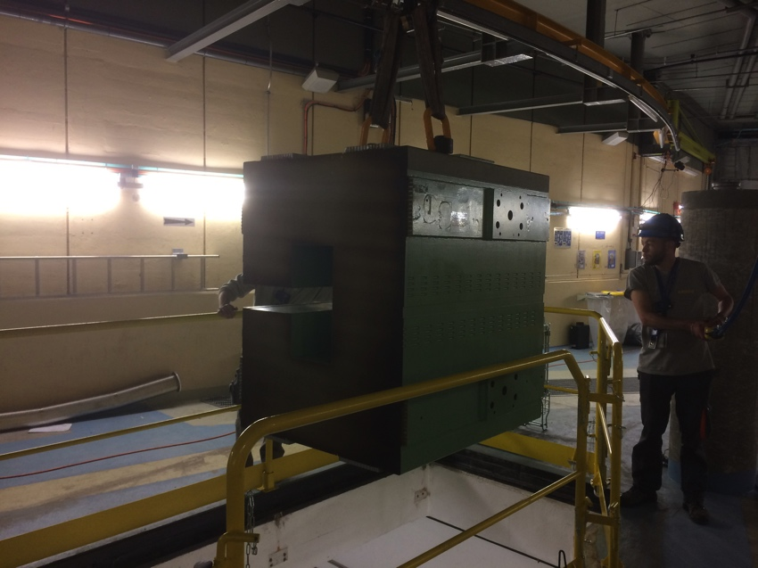
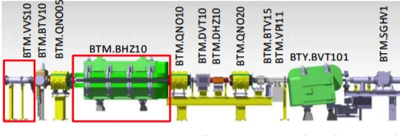
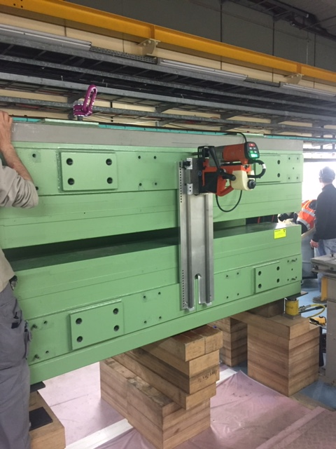
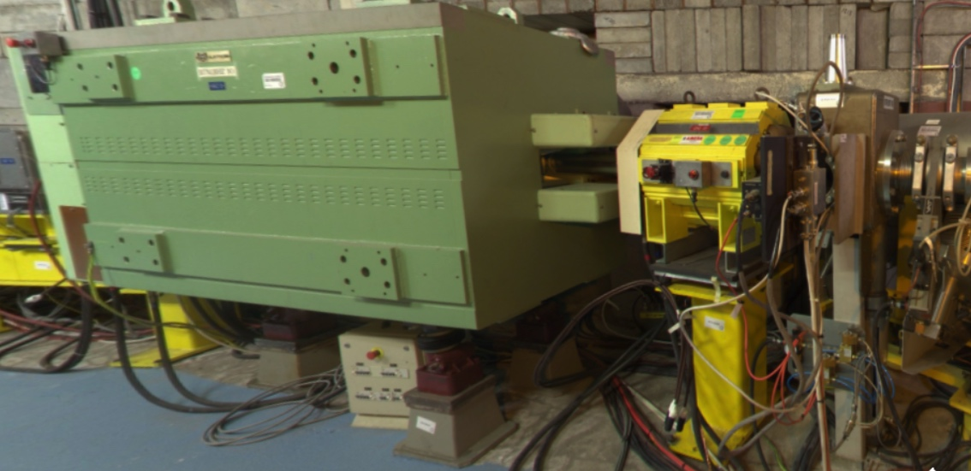
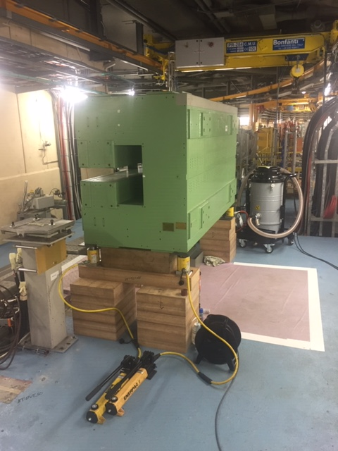
Remove the BTM.BHZ10 magnet assembly

Slide 6
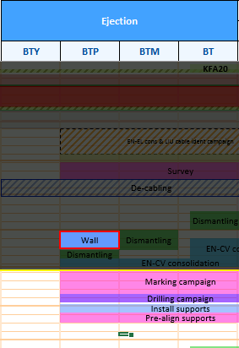
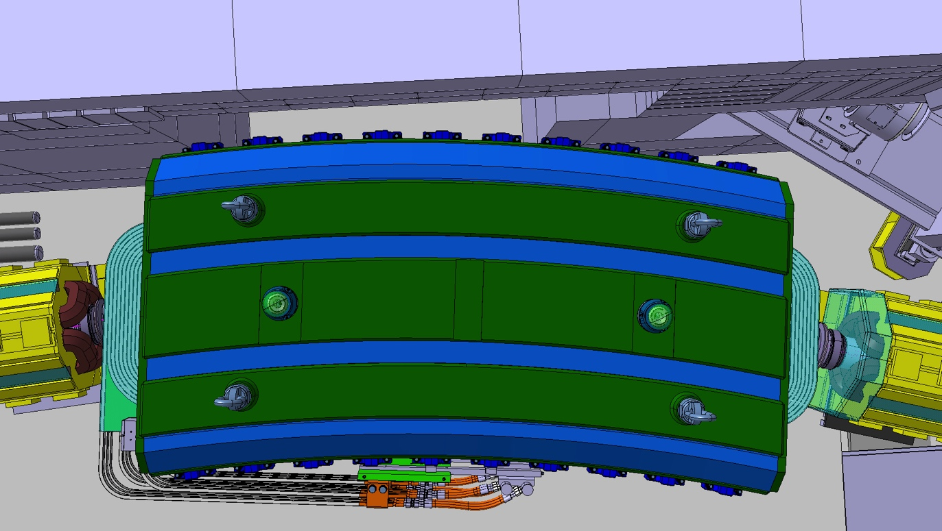
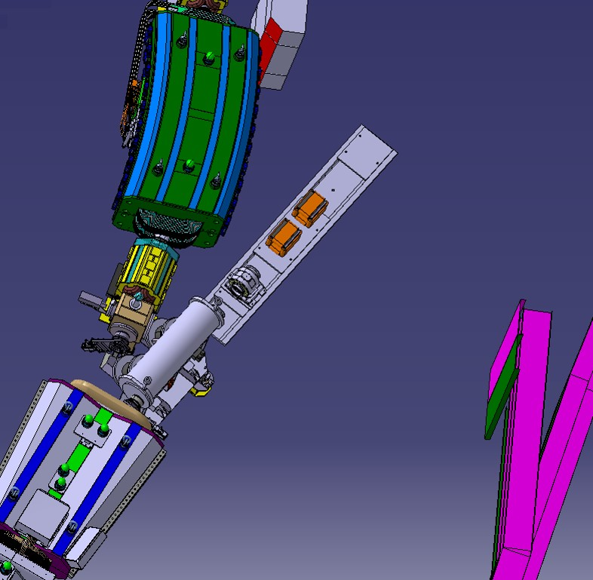
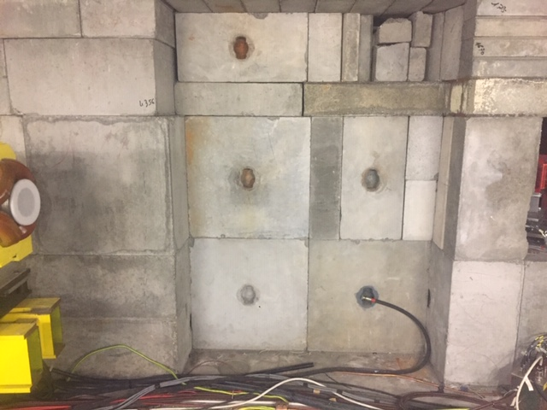
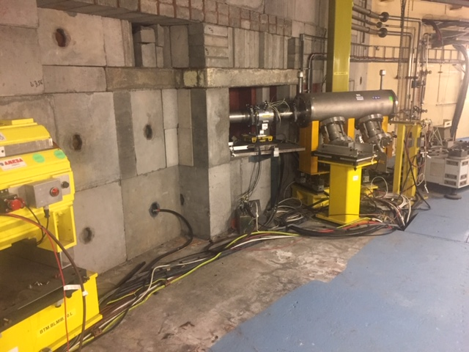
BTM.BHZ10 magnet assembly installation
SMB Study
SMB Civil Engineering works will take place week 22

Slide 7
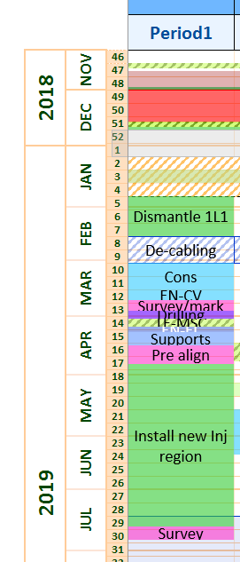
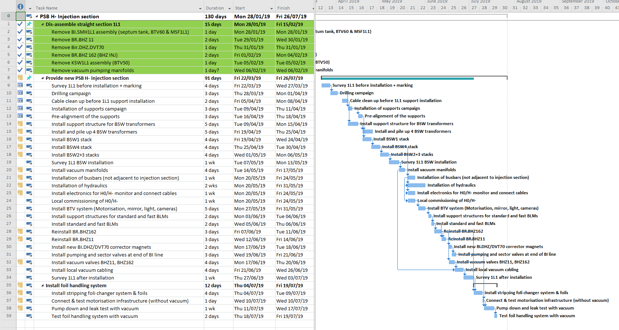
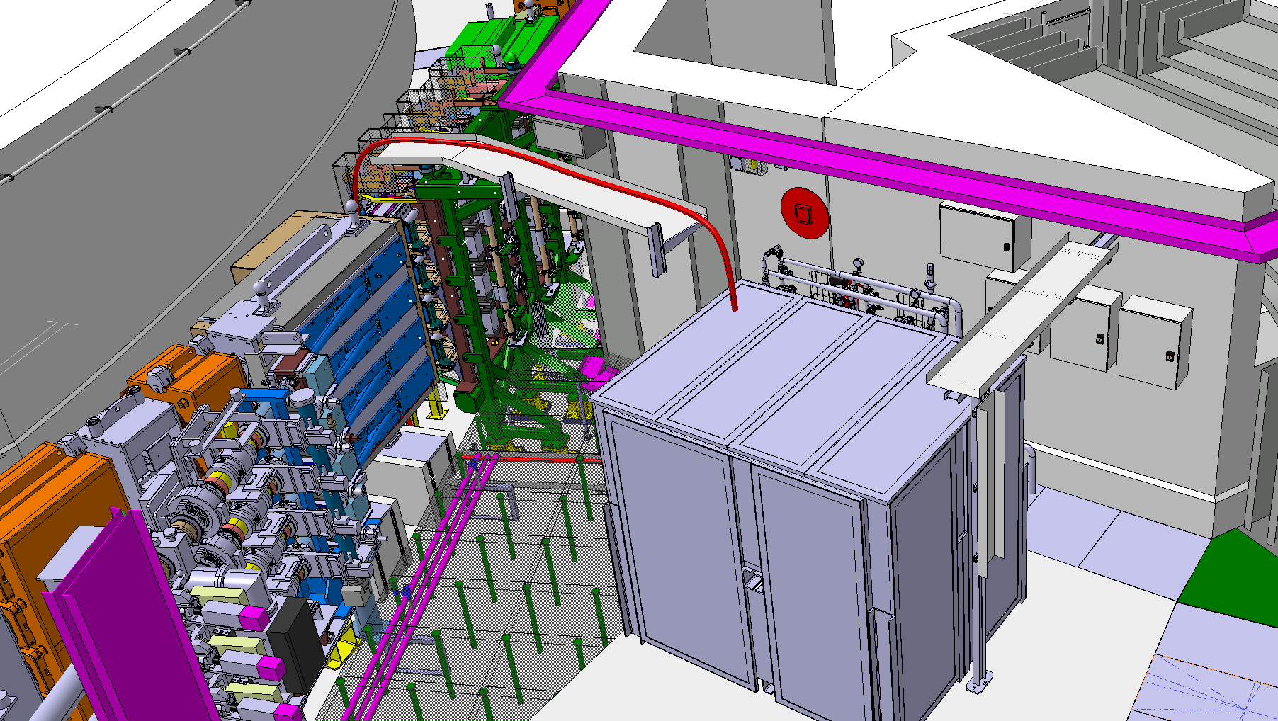
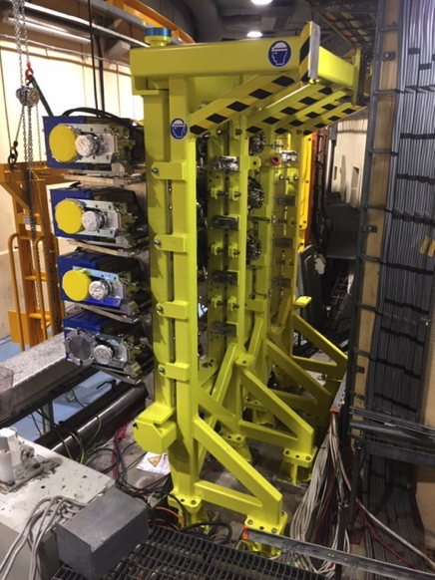
Install new PSB H- Injection system (TE-ABT)
Forecast for the next 4 weeks ATC W. Weterings WSS R. Noulibos, M. Atanasov
Work TBD next 4 weeks
Install the BSW magnets
TE-EPC announced a 2 month delay with the installation of the BSW transformers support structures due to technical issues.
No schedule impact expected
BSW Stack

Slide 8
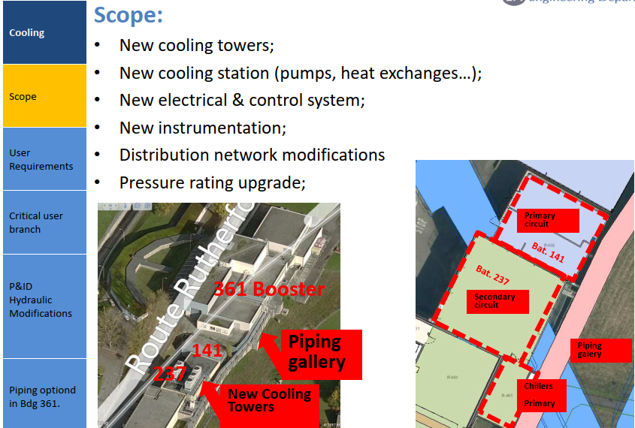
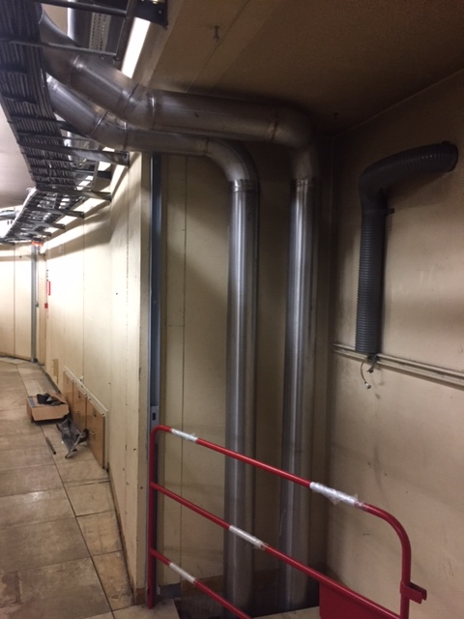
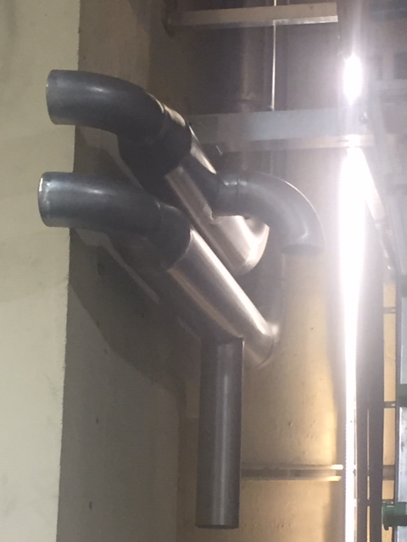
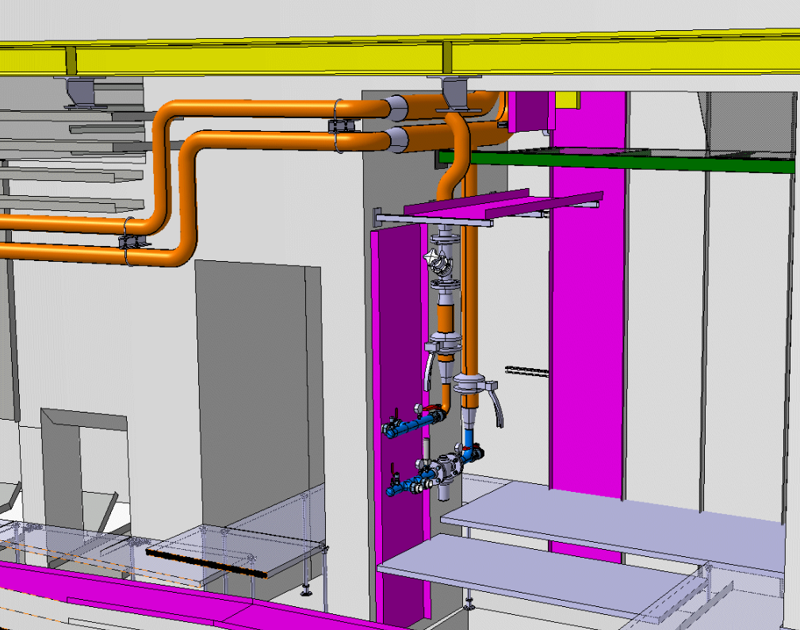
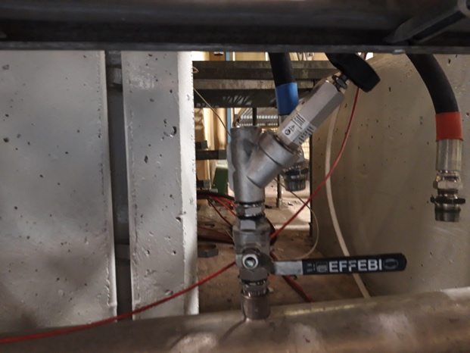
Renovation of the PSB cooling system (EN-CV)
ATC G. Petrika
Ongoing
Installation of the remaining RF cooling pipes pit 5 & 13 delayed.
Critical path; High Impact to the RF cabling campaigns. Must be terminated week 18 (this week).
Completed
PIT 5
PIT 5

Slide 9
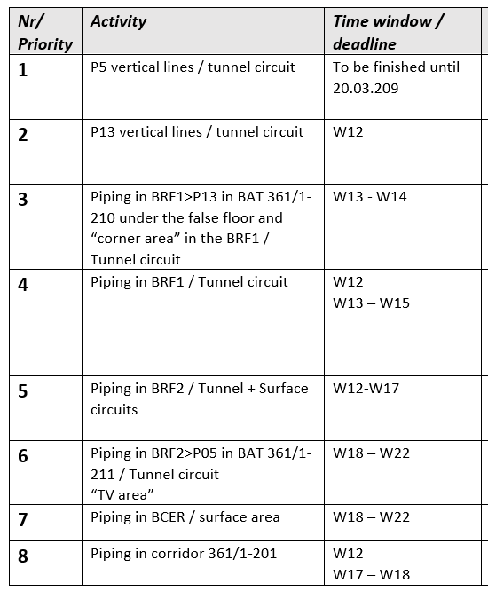
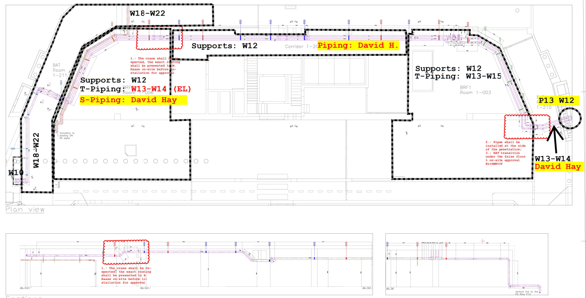


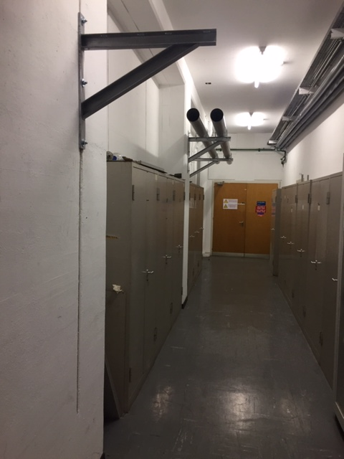
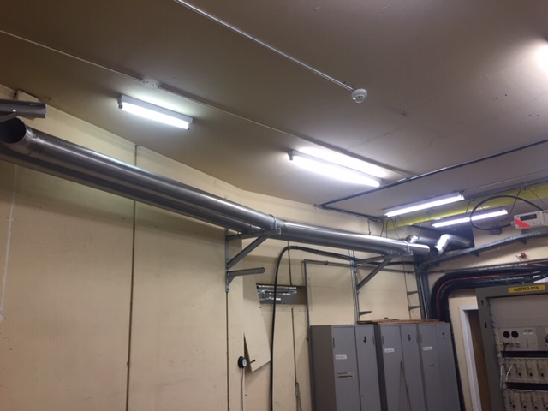
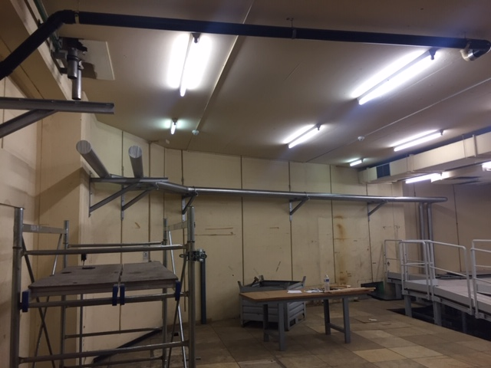
Renovation of the PSB cooling system (EN-CV)
ATC G. Petrika WSS E. Garcia
Ongoing
Surface delays not critical path
BRF2
Corridor BCER
BRF1

Slide 10
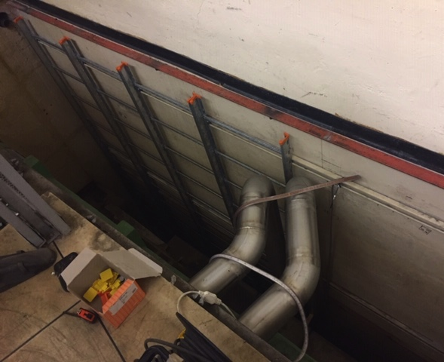
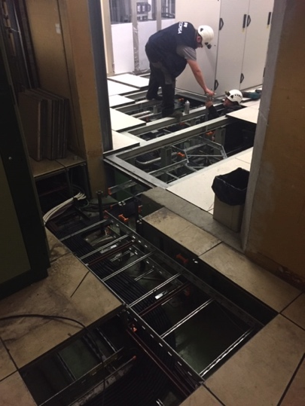
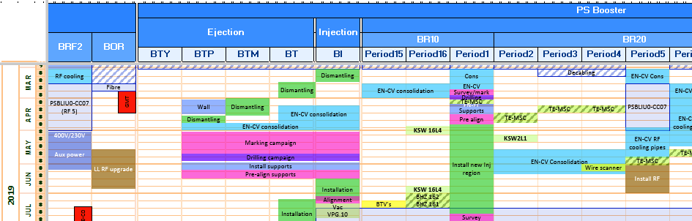
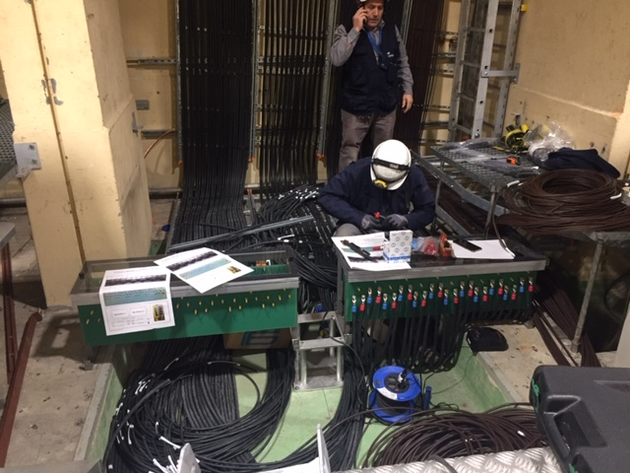
De-cabling, Cabling & Consolidation (EN-EL)
ATC Georgi Minchev Georgiev WSS T. Turk
Ongoing
March 2019
BRF1 BE-RF cable trays Completed.
Installation of the pit 5 cable trays completed
Installation of the pit 13 cable trays completed
Cabling campaign PSBLIU0-CC07 BRF2 -> RF period 5 signal cables ongoing but linked to the EN-CV problem slide 8.
Work TBD next 4 weeks
Connection of the RF-5 cavity patch panels
Installation of the RF-13 power cables
Installation of cable trays period 10 for future cabling of RF-7

Slide 11
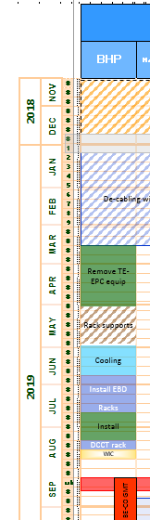
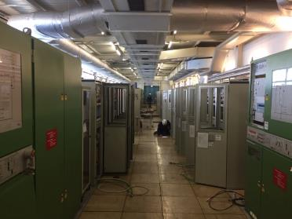
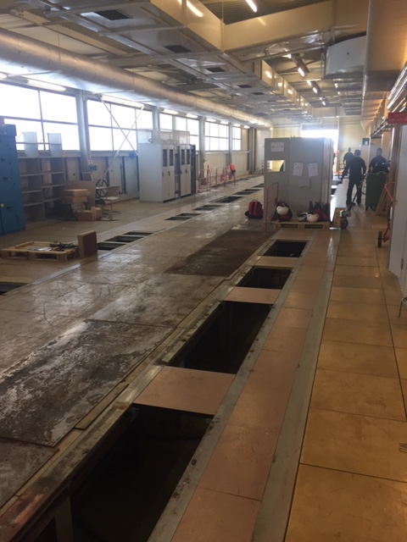
B.361 BHP (transfer lines) Power Converters Refurbishment (TE-EPC)
ATC Maxime Sardano
Ongoing
Removed
Removal of the power converters Completed Modifications to the rack structures postponed

Slide 12
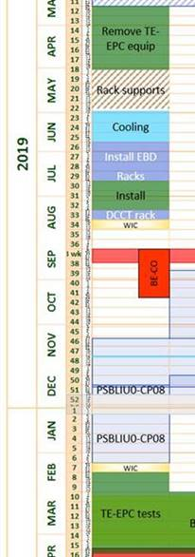
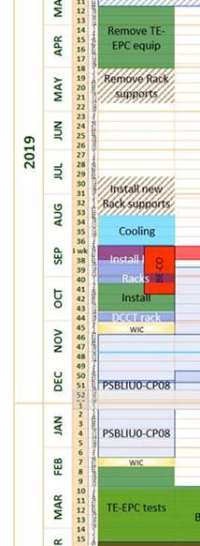
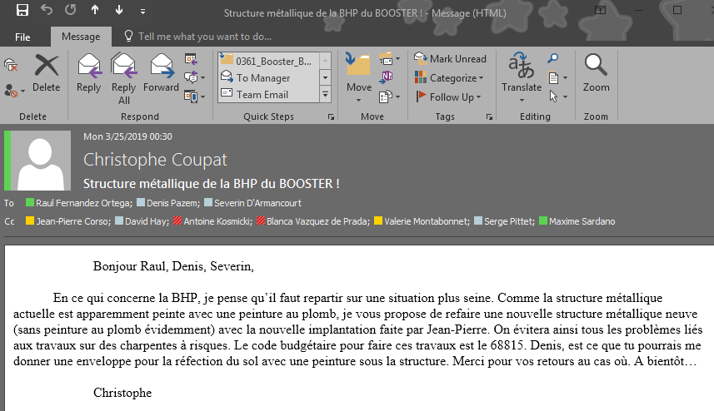
B.361 BHP (transfer lines) Power Converters Refurbishment (TE-EPC)
ATC Maxime Sardano
Ongoing
Important shift in the planning due to lead paint with the existing metallic structures and traces of asbestos in the floor tiles
Awaiting a technical and financial offer from SMB to renew the false floor in their entirety.
Integration and SMB studies

Slide 13
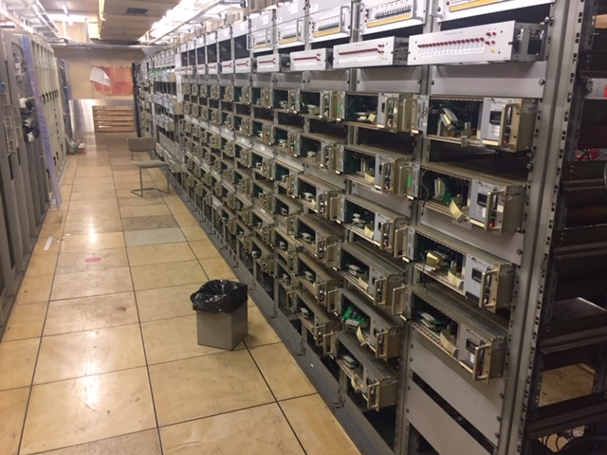
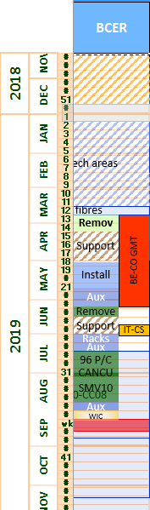
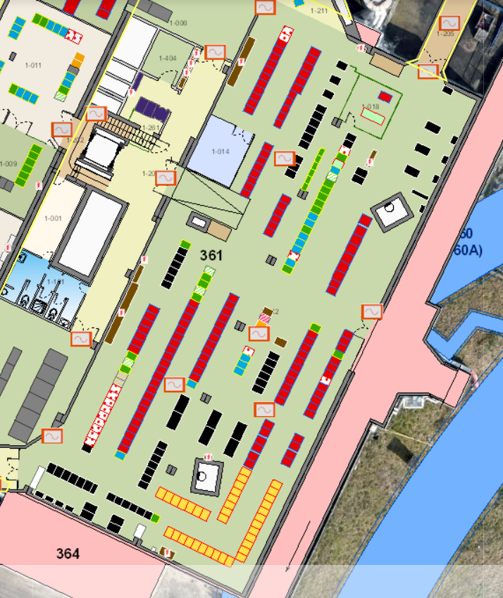
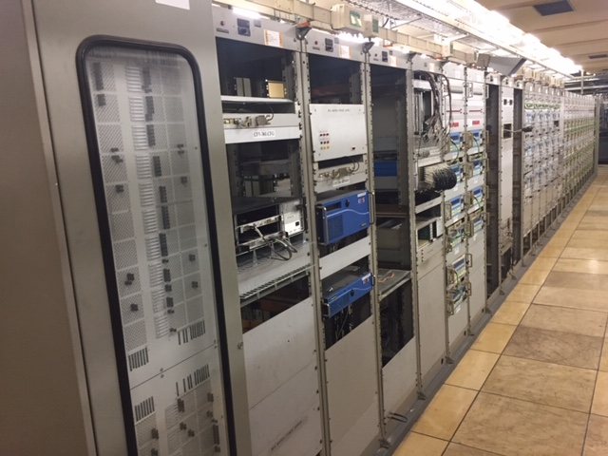
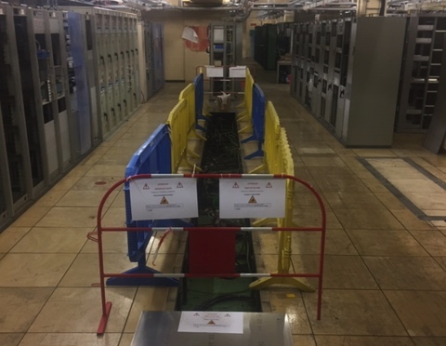
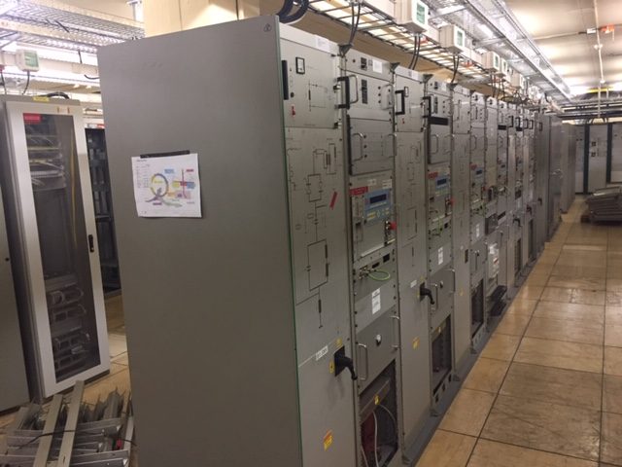
B.361 BCER Power Converters Refurbishment (TE-EPC)
ATC Maxime Sardano
Ongoing
Racks removed
Work TBD next 4 weeks
SMB to install new rack supports
Removed
534-556
447-459
SMV & SMH

Slide 14
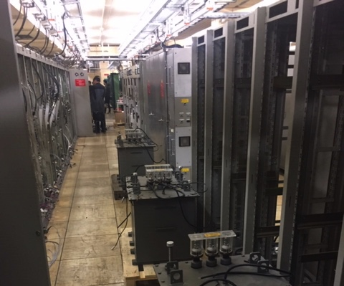
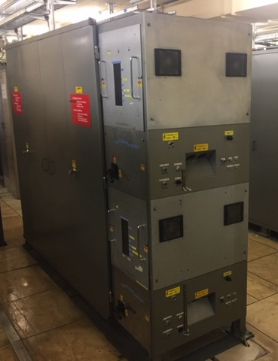
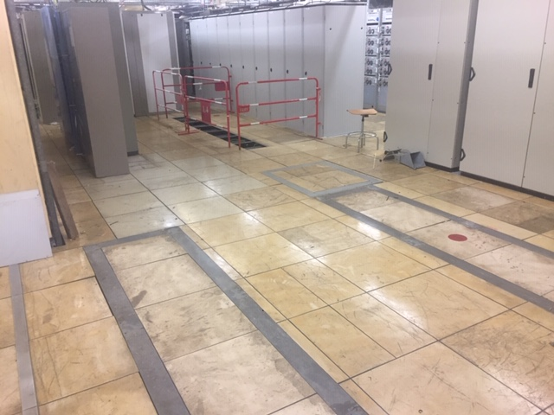
B.361 BCER BI.DIS10 PFN’s Refurbishment (TE-ABT)
ATC W. Weterings WSS P. Burkel
Ongoing
Removed
PFN’s removed
Work TBD next 4 weeks
SMB to install new rack supports
Install New PFN’s and control racks week 20

Slide 15
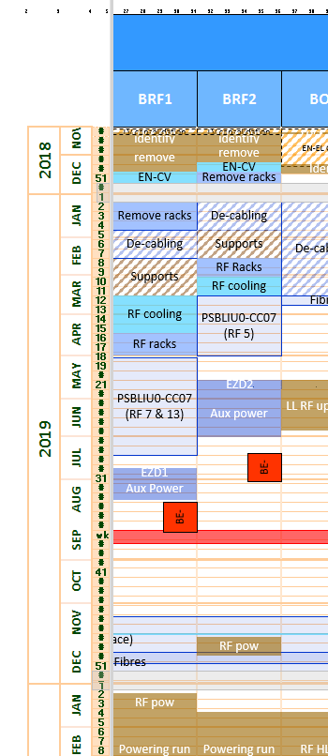
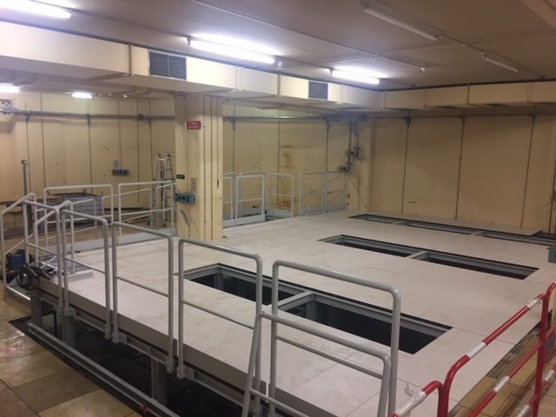
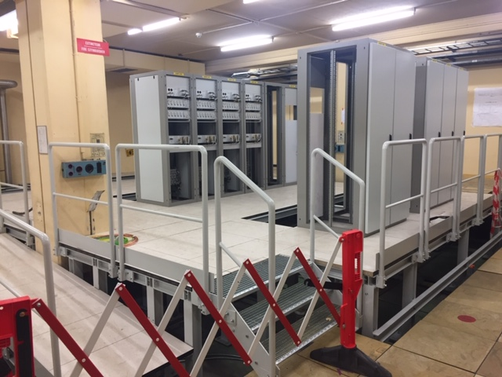
Finemet Cavity Installation (BE-RF)
ATC Matthias Haase
Ongoing
Installation of the BAT & BRF1 rack support structures Completed
Platform cable tray installations completed.
Signal cabling from BRF2 to Period 5 ongoing but linked to the EN-CV problem slide 8.
Work TBD next 4 weeks
Complete the BRF1 rack installation
Cabling campaign BRF1 to periods 7 & 13

Slide 16
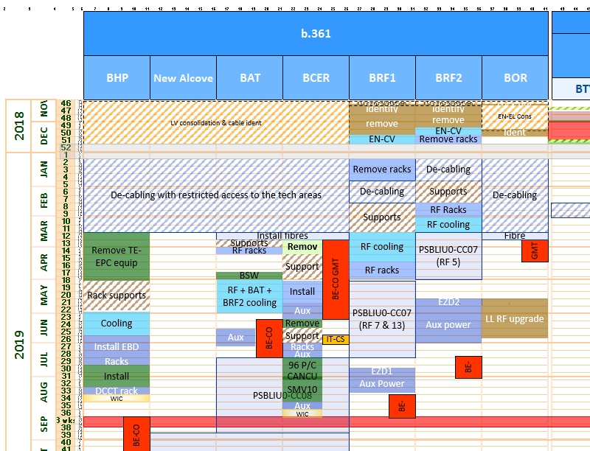
Major surface activities for the next 4 weeks
4 weeks
BHP
Remove rack supports
BAT
RF 7 Cooling & cabling
BCER
Install rack supports and PFN racks
BE CO consolidation
BRF1
RF 13 cabling
BHP
Remove rack supports

Slide 17

Major machine activities for the next 4 weeks
Ejection and Injection marking campaign.
Install the BSW magnet stacks
Terminate RF- cooling circuits
RF cabling campaigns

Slide 18

Linac4 Connection
Broken Line 20/03/19 (presented in coordination meeting)
Switchboard installed one week earlier
EL works started
Two days of delay due to equipment left on-site too long → aim to complete on time
Dates mistake 13-14th → 23-24th

Slide 19

Linac4 Connection
Broken Line 10/04/19 (presented in coordination meeting)
Civil Engineering: shielding built before the holes, 2 additional days to complete the holes
EL works: 2 additional weeks to complete the work

Slide 20

Linac4 Connection
Broken Line 30/04/19
SEMGrids installation delayed to mid-July
MINOR IMPACT on the schedule
Rescheduling of the installation of the LT.QFW70 in June/July after civil engineering intervention on the wall close to LT.QDN65
NO IMPACT on the schedule
Schedule sequence of activities reviewed
NO IMPACT on the schedule
EL works: 4 additional weeks to complete the work
MINOR IMPACT on the schedule

Slide 21





Linac4
Linac4 closed for Low Energy beam tests → Activities resumed last week (23rd April)
  Drilling holes for cabling path redone (24cm wrong)
  Cable trays installed
  BLMs being installed
  Completion of the beam line sectors 5 and 6 in progress
  Alignment next week
  Cabling campaign starts in two weeks (16th May)
  Survey measurement of the overall Linac4 and transfer line will start next month (3rd June)
Issue of dust → cleaning being organized
On schedule
Sector 5
Sector 6

Slide 22




Linac2 – racks room
Reconfiguration of the racks room
  False floor reinforced
  New racks and power converters installed
  New holes for cabling path done
  Power supply activities in progress (4 weeks later than previously announced)
  Cabling campaign in progress
General services cables cut during drilling holes for CV new DN125 pipe (could not be avoided) → safety measures put in place to ensure to keep the electrical supply locked-out
→ A2: https://edh.cern.ch/Document/General/Accident2/7739090
Cabling on schedule, but co-activities generated by power supply activity delays
→ on-site follow-up by EN-EL, priority defined on the cabling if necessary

Slide 23





Linac2 – machine
Reconfiguration of the Linac2
  Opening in the wall done (new emergency exit)
  Beam line shielding built
  Cabling campaign from 363 1st floor in progress
  The construction of the new wall starts in two weeks (13th May)
  The re-installation of the beam line (including new LT.BHZ20) has been anticipated by 2 weeks and will start next month (4th June)
On schedule

Slide 24




PS Switch Yard
ECR
New LBE
approved by IEFC
CPS-LJ-EC-0005
2019 beam
test procedure
Under approval
CPS-OP-PRD-0001
Reconfiguration of the beam lines
  De-cabling campaign completed
  Removal of 2 meters long of shielding wall in progress (removal of 3x80cm and reinstallation of 40cm)
  Re-installation of beam line equipment on LT and LTB in progress
  Reinstallation of the demineralized water and compressed air pipes next week (late request for EN-CV)
  Cabling campaign starts in two weeks (13th May)
Test assembly of the LBE line in Linac4 surface building starts next week (dedicated meeting foreseen with group involved)
On schedule

Slide 25

PS LS2 Progress Dashboard (broken line)

Slide 26





PS LS2 – EN-EL LV consolidation
365-1-404
Works on building 365-1-404 have been anticipated on EN-EL and TE-ABT request (the generated co-activity was managed internally in EN-EL between the two sections)
Works are followed closely with the EN-EL due to the delay accumulated since the beginning (None of the sectors done up to now is fully completed)
An action plan has been discussed yesterday morning with EN-EL to recover the delay

Slide 27




PS LS2 – New PS demineralised water cooling system
Central ring and the 3 galleries pipes installation – completed with one week of delay
Works on the connection between gallery 1 and B.355 could not start due to the unavailability of resources and the integration not finalized, so the works started this Monday (baseline 25/Mar/2019)
A slot of 5 days (next week) has been agreed with CV to finalize the connection between the PS SWY and TT2
Discussions are ongoing with CV, and CV with the company, to evaluate how much planning reshuffling we will need to do for the coming sectors

Slide 28



PS LS2 – Main Units
Renovation works progressing quite well, 15/43 have been already renovated. Thirteen have been already re-installed and 2 are in the storage in B.150 (MU27 and MU39)
The delay and the advance shown in the broken line are real, but the delay is due to the planning reshuffling of the straight sections re-installation requested by TE-MSC
Some planning reshuffling, mainly sequence of Main Units, is needed due to good progress on this activity and the delay on the warm water and ventilation duct works between SS89 and SS02 (planning reshuffling proposal sent last Tuesday to all the groups involved + RP)
Issue with the MU12 since yesterday

Slide 29




PS LS2 – BTP
Shielding block cut was performed last week
New wall configuration has been completed this week
Issues with the information needed by the survey team to trace line is preventing us to start the installation (situation has been followed closely and next week the survey team should be able to trace de line)
Information is still needed from the transport team concerning the new rail installation

Slide 30



PS LS2 – F61
The shielding blocks have all been removed and transported out from the PS
All beam elements have been dismantled with the exception of 2 magnets
Some logistic problems to evacuate some dismantled beam elements (we did not observe ths problem during the shielding dismantling even regards of the quantity)
Some works have been anticipated following the good progress and the different teams availability

Slide 31



PS LS2 – Warm water and ventilation duct renovation
The problems with the scaffolding installation introduced 15 days of delay in the start date of this project
Five extra days of delay have been introduced on the start of the warm water pipes installation due to some welders validation problems
Asbestos removal went very well and much faster than planned (methodology used can be adopted for next sectors in the future)
Ventilation duct installation went also faster than planned (few improvements have been identified, but methodology can be used for next sectors in the future)
The delay in this project is triggering a major reshuffling in the PS planning

Slide 32






PS LS2 – Ring + TT2
Issue with the cabling campaign for the KFA45
Drilling between TT2 and PS SWY for the passage of the CV pipes has been performed
Maintenance of the TT2 and PS ventilation Units
TT2 drilling

Slide 33









PS LS2 – Surface building
B.269 – De-cabling started in advance and will probably finish in advance
B.355 – CV pipes installation for the TFB and PCs is done, ME45 works and CV works are ongoing
B.365 – KFA45 equipment partially re-installed, de-cabling done, EN-LV renovation on the first floor has been anticipated and is ongoing together with cabling campaign – Issue with the roof renovation
B.362 – Asbestos removed, floor resin applied, and roof replaced
B.355
B.365
B.362
B.269

