Slide 1
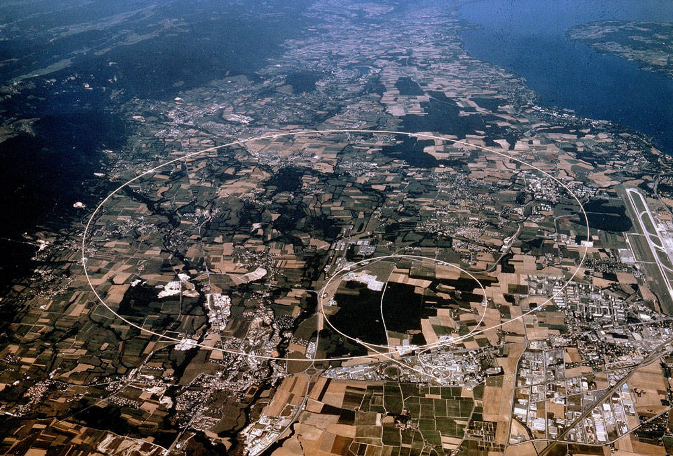
James Gillies, CERN Heritage Committee, first meeting, 10 May 2019

Slide 2
Background
CERN history project initiated in 1980
  Published three volumes between 1987 and 1996
    Cover the period from the 1940s to the end of the 1970s
      Third-party funded (Member States and Foundations)
        Pioneering initiative in institutional science history
        Today, the time is ripe to resume
        Expand to include all aspects of heritage preservation and management

Slide 3
The CERN History Days
Two days:
  Day 1 – open session
  Day 2 – closed working groups
Steering committee:
  Theodor Arabaizis – Athens
  Luisa Bonolis – MPI Munich
  Afroditi Anastasaki – CERN
  Panos Charitos – CERN
  James Gillies – CERN
  Emmanuel Tsesmelis – CERN
Objective: develop proposal for CERN management

Slide 4
Day 1: Open Session
Talks from historians, philosophers, sociologists and communicators of science to prepare the ground for day 2, opened by Charlotte Warakaulle
Jürgen Renn – Director MPI for the History of Science
Theodore Arabatzis – National and Kapodistrian University of Athens
Kostas Gavroglu –
Univeristy of Athens
“be more ambitious, covering political, cultural and economic contexts”
“it is time to relaunch the CERN history project”
“a history of CERN is a history of Europe”

Slide 5
Day 1: Institutional histories
John Krige, Herwig Schopper, Charlotte Warakaulle, Arturo Russo, Lillian Hoddeson

Slide 6
Day 1: Panels 2 and 3
History and Philosophy: Chaired by Jan Lacki, University of Geneva
Allan Franklin, University of Colorado, Arianna Borrelli, TU Berlin, Kent Staley, St Louis University
History in Motion: Chaired by Graham Farmelo, University of Cambridge
Sharon Traweek, UCLA, Jon Butterworth, UCL, Helge Kragh, NBI

Slide 7
Day 2
Workshops on the themes of:
Archives and Digital Humanities, Jens Vigen
Collaboration and Diversity, Geneviève Guinot, Ioanna Koutava
History and Philosophy, Emmanuel Tsesmelis
Fundraising, Matteo Castoldi
Oral History, James Gillies
Written History, Matthew Chalmers
Two iterations, one obligatory, the second by choice

Slide 8
Day 2: Archives and Digital Humanities
The project cannot limit itself to the resources of CERN; one has to reach out both to national archives and companies.
The CERN History project should develop tools to let historians explore the available material. CERN should invest resources to seek pathways through the complex structures discussed.
CERN is a European platform and should also consider playing a role in the field of digital humanities – at least in relation to the history of science.
The next anniversary will always be close in time when you start thinking of how to best mark it. We have to start now!

Slide 9
Day 2: Collaboration and Diversity
The influence of the socio-political landscape on CERN and its evolution.
The inter-disciplinary nature of CERN; appropriate emphasis should be given to each discipline, including humanities.
Historical information related to Collaboration and Diversity should be embedded in CERN’s history instead of consisting of a chapter apart.
The various vectors of diversity. The gender vector should remain central.
The causes of low representation of women in CERN’s history.
Personal experience of women in the early days of CERN.
The hidden aspects and the non-conventional elements of the decision-making and discovery history.
Epistemology of diversity as well as the impact of diversity on knowledge production and the Organization’s progress.
People working at CERN express the sentiment of contributing to a greater aim and often use “we” instead of “I”. The correlation of this phenomenon to normalising processes.
Negative aspects of CERN’s history; the following examples were brought forward: “we are too smart to be biased” and “CERN as an old-white-boys-network”.
CERN is a cultural icon and example of successful international collaboration; the criteria of this success, and the manner those apply, from a diversity perspective.
The causes of the fact that different under-represented groups present a pattern of representation growth from 3% to 10%.
Moreover, the belief that sex (biological characteristics) and gender (cultural attitudes and behaviours) do not influence the manner in which individuals carry out scientific work should be examined. Finally, the project should provide a short and fully accessible version of CERN’s history.

Slide 10
Day 2: History and Philosophy
Discuss the theory of knowledge in particle physics, especially with regard to its methods, validity, and scope, and the distinction between justified belief and opinion. In particular, discuss the criteria for claiming a scientific discovery / breakthrough and the validation of the acquired knowledge.
Discuss sets of concepts and categories in particle physics that show their properties and the relations between them. A primary example is the interplay and dialogue between theory and experiment in particle physics.
Discuss the practice of analysing and describing a complex phenomenon in terms of its simple or fundamental constituents.
Discuss how discoveries make the field of particle physics go forward in uncharted territory. Underline that particle physics does not only depend on major discoveries, but other breakthroughs in technologies and methodologies also have a substantive and long-lasting impact. discuss the process of how the particle physics community decides on what project to follow and how the community develops to realise the agreed project.

Slide 11
Day 2: Fundraising
Implement a CERN project structure in order to facilitate fundraising
Fundraising drivers: philanthropy, research, political, marketing
Target groups: High net-worth individuals, research organisations and universities, CERN Member States and other countries, corporates
Segmentation and matching: Central budget for project planning and management, individual activities matched to target groups
Recognition aligned to level and scope of contribution

Slide 12
Day 2: Oral history
CERN could set the standard, but CERN should be careful not to be perceived as arrogant
The CERN archivist should be involved in every aspect of history, including oral histories
Archives and IT need close collaboration
ORAL histories are complementary to the written record
Oral histories can bring history to life
The large experiments are sufficiently complex ecosystems to merit their own oral history projects
15-point check list for creating oral histories

Slide 13
Day 2: Written history
CERN’s history during the past four decades presents historians, philosophers and sociologists of science with an embarrassment of riches. There are dozens of books that you could write about CERN
There was strong interest in contextualizing the science stories
Avoid a hagiographic approach and also discuss antagonisms, conflicts, tensions, blind alleys
A history of CERN has to “capture the essence of the place” no matter what the technical details
Defining the audience for a written history is a priority, and many of the topics identified could easily have several audiences
The new CERN history project would have to be more than just a set of hardback tomes.

Slide 14
Conclusions
Considerable enthusiasm from the history of science community
It is timely to relaunch the written history project
  Must be third party funded to ensure impartiality
Tangible offers of help from individuals and institutions
“CERN could play a leading role in the discipline”
Revisit the History Days here: https://indico.cern.ch/event/666086/

