Slide 1
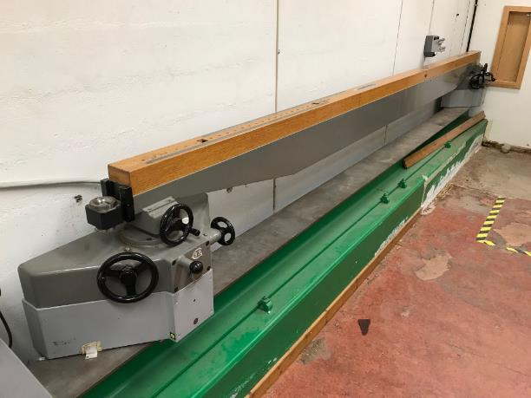
Distance Calibration Bench
Precision 4 m Standard

Slide 2
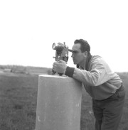
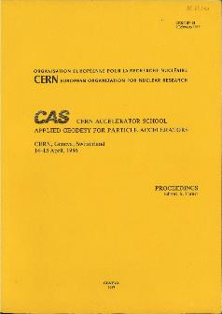
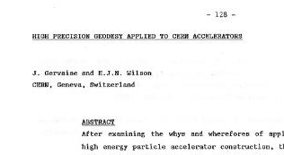
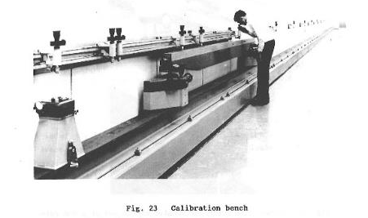
Provenance

Slide 3
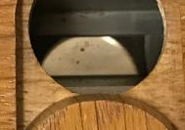
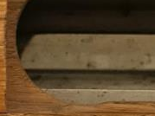
Precision 4 m
Distance Standard
Precision ~5 μm?
Principal part of a distance calibration bench
  64 m long, constructed by Société Genevoise d’Instrument de Physique
  Located in one of the PS radial tunnels between 1959 and 1969
  Bench relocated to building 839 in 1969
    This distance standard was the only part retained
Eventually replaced by an interferometer in 1980s

Slide 4
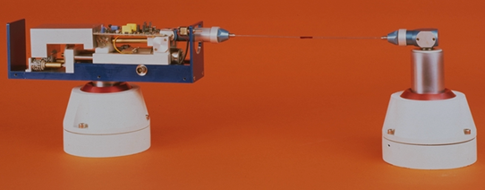
Distance Calibration
Calibration of invar wires
  Lengths from 0.4 m to 64 m
  Unique facility in the world at the time
Identified elongation of invar wires over time
    Some tenths of a millimetre
    A phenomenon subsequently confirmed by BIPM

Slide 5

Synopsis
Essential and unique tool
  Used at CERN for 25 years from 1959
Assured a common distance standard for the alignment CERN’s first accelerators
  Enabled the precision alignment of the
  PS, ISR and SPS accelerators
An amazing part of our heritage!

Slide 6
