Slide 1
Bus Tapes
Yield on final prototype 14 module bus tapes much lower than on previous batches
Yield 13/18 cf ~ 100% on previous tapes from Altaflex.
Failures
Open circuits: micro-cracks
Short circuits: contamination
Very high resistance: very bad Ni/Au plating.
Carl trying to find alternative vendor
Tweak layout to improve reliability.

Slide 2
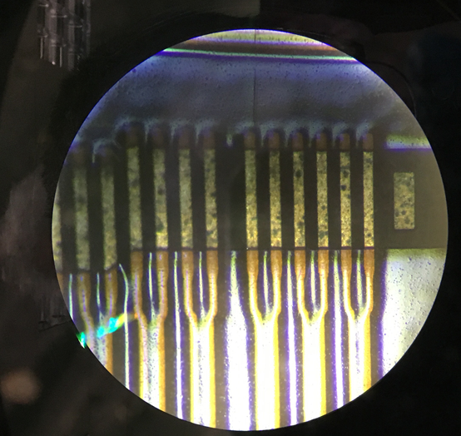
Contamination
Ni/Au pads should look shiny!
Contamination on tape?
Green could be copper oxide?
Cleaned with IPA: most of the contamination could be removed but the pads still don’t look as shiny as for a good tape.
Something went wrong on the plating …

Slide 3
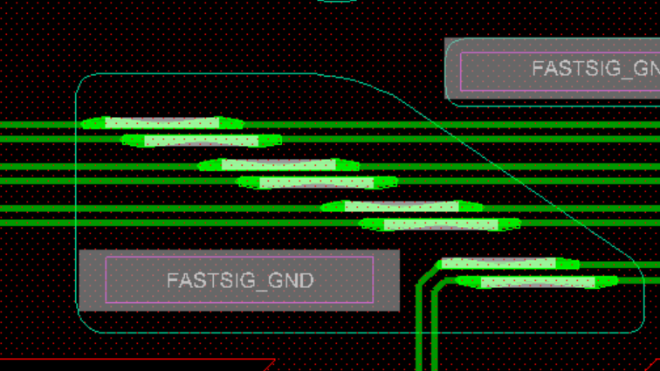
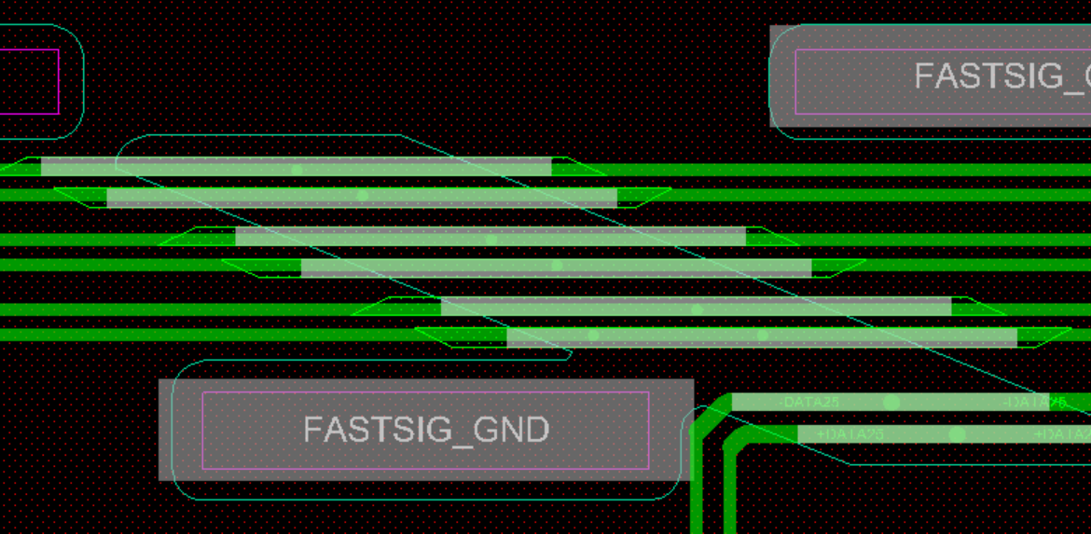
Layout Tweaks
Opening for pads in top cover layer to allow Ni/Au plating
100 um tracks widened out to 150 um pads for wire bonding.
Increase length of pads to cover the entire opening.
Make another small batch at Altaflex with these tweaks.

