Slide 1
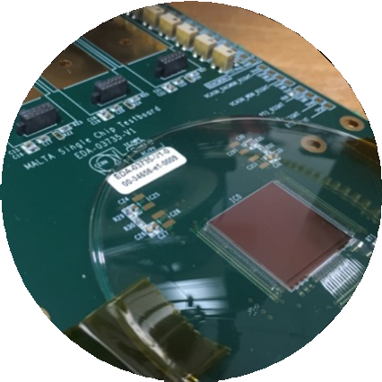
MALTA Telescope System I-V Measurements
Shiyu Wang (Boston University), Enrico Schioppa (CERN), Carlos Solans(University of Oxford)
CERN, Project Update 5

Slide 2
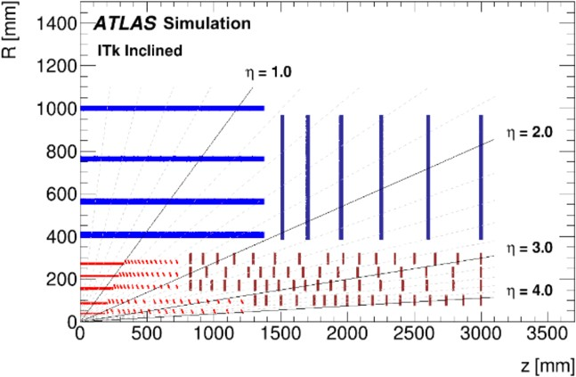
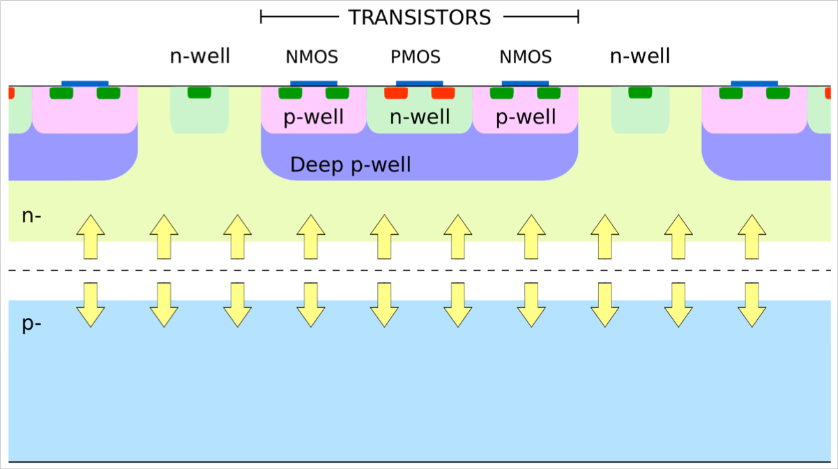
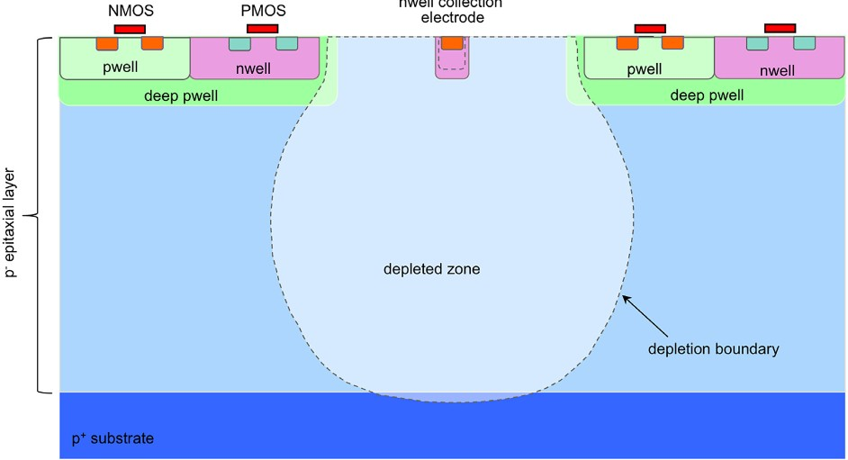
ATLAS ITk upgrade Reminder
HL-LHC Pixel detector upgrade (2024-2026): 5 pixel layers, inclined layout
Targeting the outermost Layer 4:
HL-LHC Requirements for Pixel Layer 4:
  Radiation tolerance
  (TOP Priority):
    Need a modified process to obtain full radiation depletion based on different type of implants and ITK layers for a high radiation environment like the ATLAS ITK
    Required NIEL tolerance 10¹⁵ n_{eq}/cm²
    Equivalent to 60 Mrad
Modified Process
Notes:
A brief reminder for the ATLAS ITK upgrade. As I showed you earlier, the requirements for outmost layer 4 is radiation tolerance with up to 10^15 NIEL or 60 Mrad. Our standard process is not enough to support this amount of tolerance, so we need…
At present, both the two processes have their own special benefits and problems. Therefore, every perspective sensor like the MALTA I am working on are based on either the standard or the modified process, for today I will only show you one case for the modified process.
The case here is the IV relation between each parts of the sensor, because we have so many separate parts like the SUB, PWELL, NWELL and different layer, each parts will therefore interfere each other with their own IV relation. Then this effect will breaks the radiation depleted condition inside the substrate area. If this is valid, then we cannot reach the target radiation tolerance for HL-LHC.

Slide 3
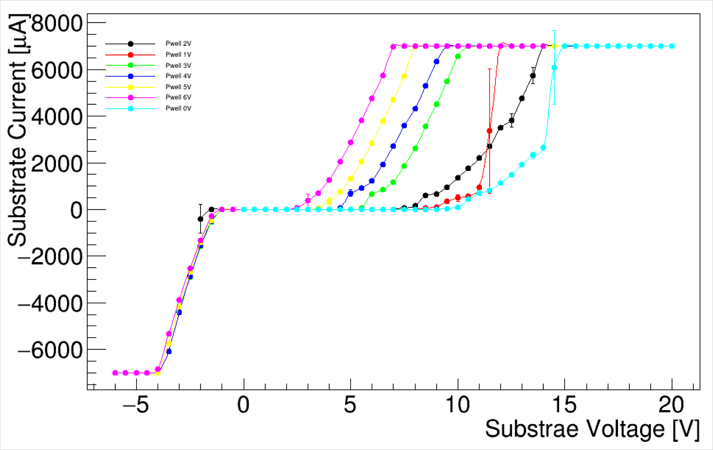
Results Reminder – IV Measurements
Malta Readout Meeting
W12 – E
(Sub-Pwell) Δ [V]
Currents observed by ΔV PSU. Breakdown voltage occurring following similar pattern to previous measurements (inversely proportional to pwell voltage). Negative currents between substrate and pwell in negative Δ regions.
Punch-through defined by difference in currents observed between pwell PSU and Δ PSU.
Notes:
To prove this effect, we start by doing the IV measurement for only the SUB area with a various amount of pwell. We start by setting the SUB voltage to a certain degree, then keeping changing the pwell voltage from 6 to 0 volts.
Then we find out that there is one break down voltage for pwell 1 volt and from SUB to be -5 to 20 volts. We call it the punch through voltage because the IV curve will going to break it’s own voltage compliance limits and starts to intersect and interfere with the others curves.

Slide 4
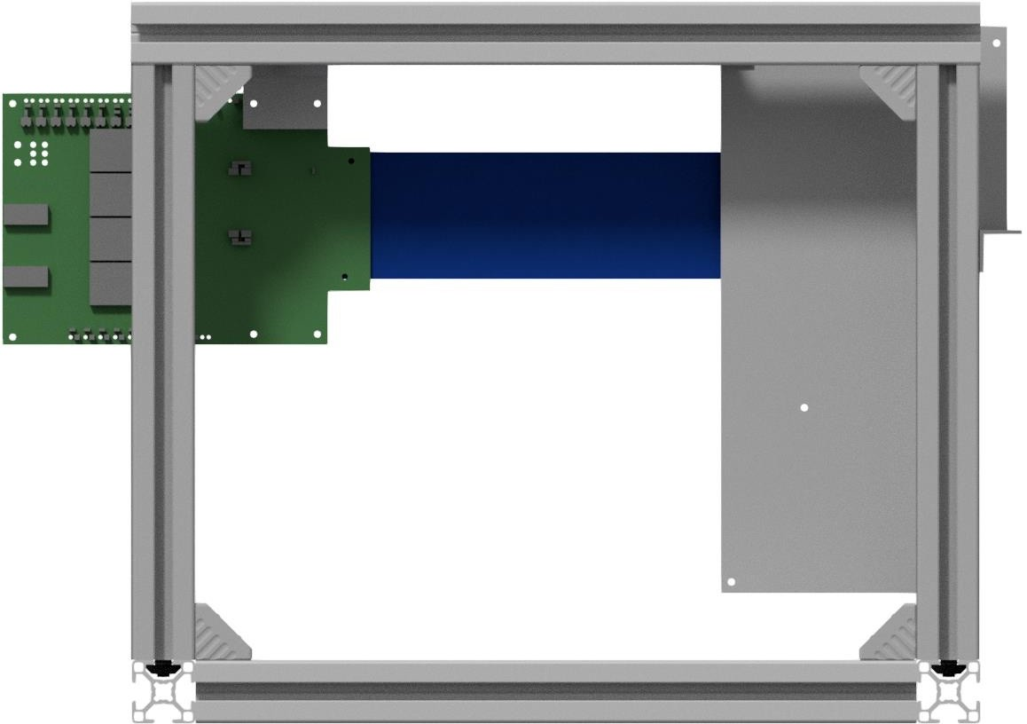
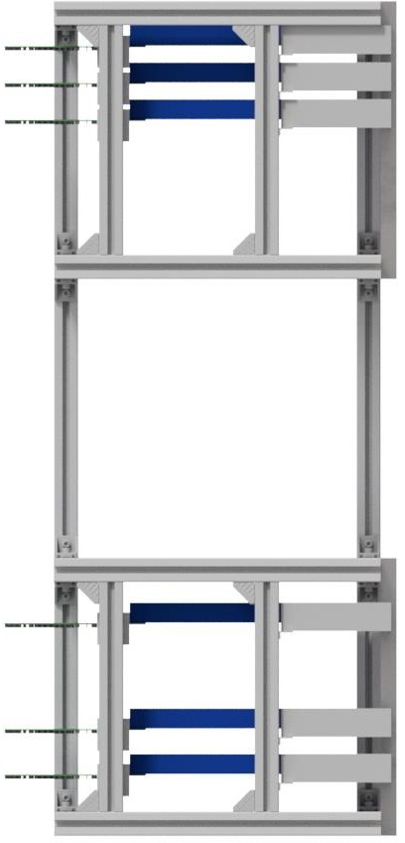

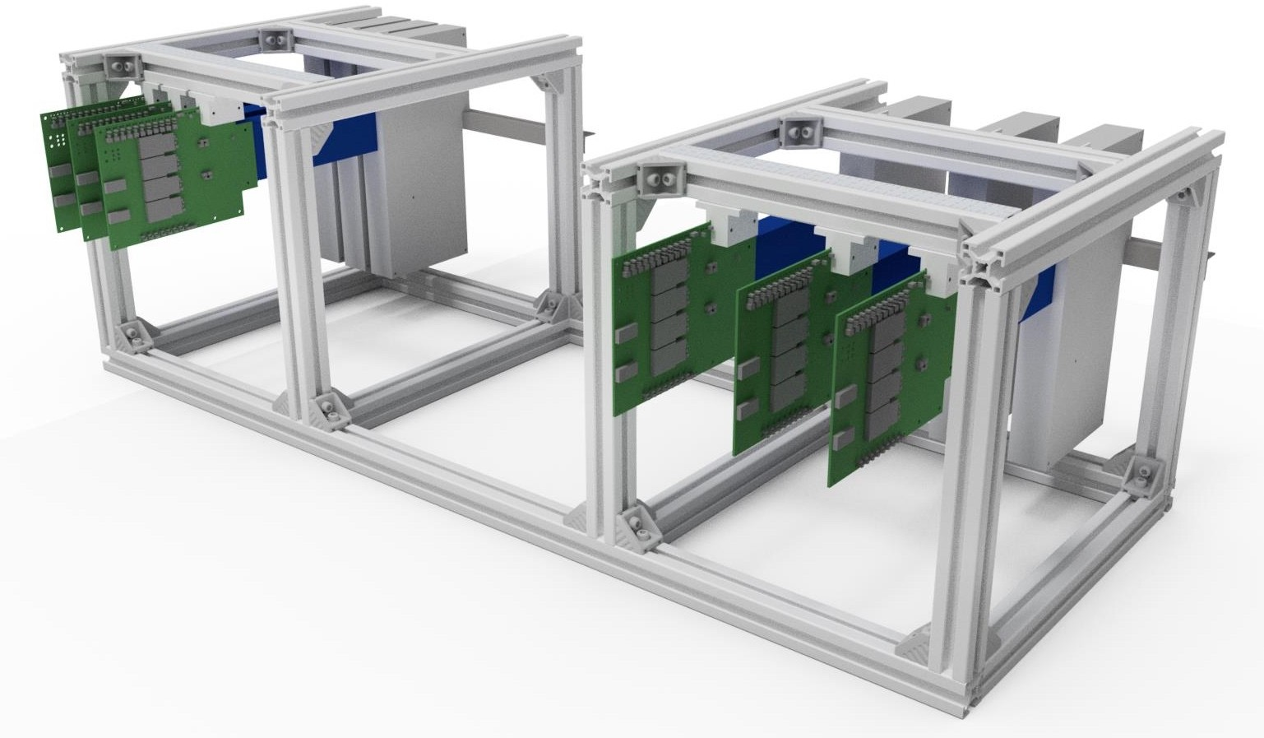
MALTA Telescope System Optimized
6 MALTA and Monopix sensor-based planes connected to 6 FPGAS
Centralized powering
Simulation estimates yield
3.9 um resolution (much efficient than 6 single MALTA combined with 6 Monopix sensors)
Combined benefits from both the standard process (no IV disturbance) and the modified process (High radiation tolerance)
Expected Beam Location
Notes:
So we found this effect and we are trying to understand why this effect happens, then it turns out that the current spike due to nothing but the nature of the modified process. That being said, in the modified process we have every parts separated from each other and therefore each parts will have their own voltage and currents. That’s why the current can starts to spike different areas. The standard process don’t have this problem, but it cannot provide us enough radiation tolerances.
One way to solve this is to develop a system that can support both the standard and the modified process, this system is called the MALTA Telescope…..

Slide 5
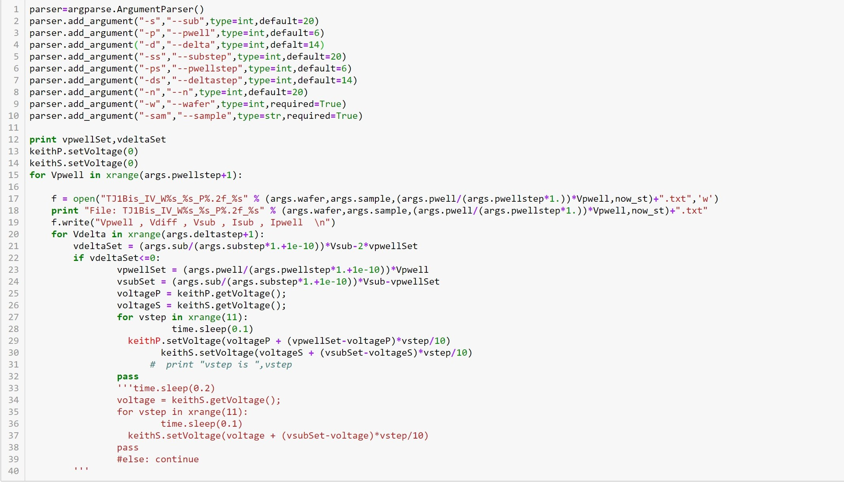
Part of MALTA Telescope Scripts
This script can let us change almost every setup for the IV measurements without do them manually in the lab (Currently Only compatible with MALTA sensor)
Notes:
As you can see, the MALTA Telescope is a huge system, then it is a hard job for me to change every setup manually. Therefore, I spent my Easter working wrote this script

Slide 6
IV Scans for Telescope System
MALTA sensor W1R10:
at pwell 0V, scan SUB from -2 to 4 V with 40 steps (1)
at pwell -2V, scan SUB from -2 to 4 V with 60 steps (2)
at pwell -3V, scan SUB from -4 to 10 V with 10 steps (3)
at pwell -4V, scan SUB from -4 to -10 V with 10 steps (4)
(1)
(2)
(3)
(4)
Notes:
And these are some simple IV scans for the MALTA Telescope systems using the scripts I wrote. As you can see I only have the plots for MALTA sensor. One of my future task is to update the script for it to support the other sensor.

Slide 7
Possible Problems encountered
W2R10, W1R10
at pwell 0V, scan SUB from 0 to -10 V with 30 steps (1, 2)
at pwell 0V, scan SUB from 0 to -10 V with 30 steps (repeat the first scan)
Could because the specific input values reaches the general compliance limit in the script, which could be a possible bug. Anyway we’ll test them and make it compatible. (Future plan)

