Slide 1
Project Update 7
By: Ryan McCarthy

Slide 2
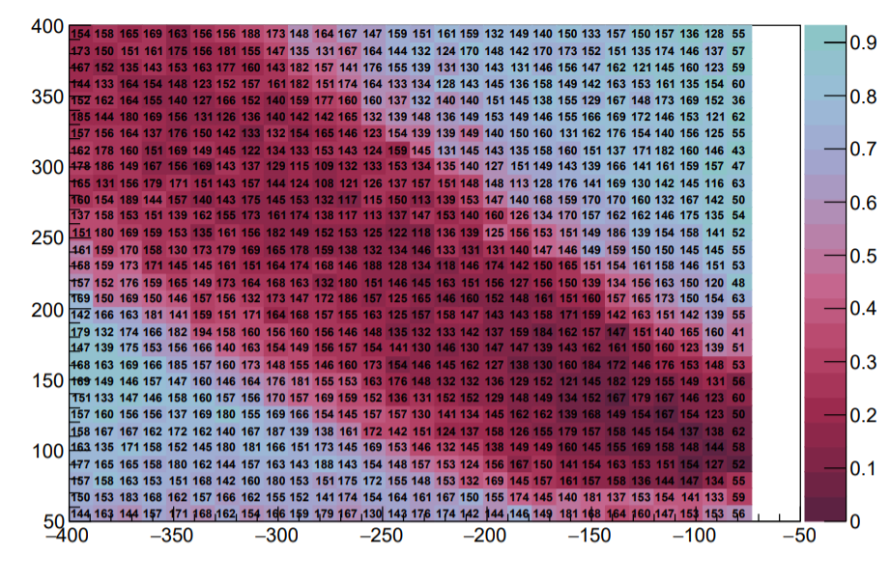
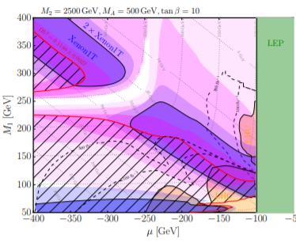
“Not-So-Well Tempered Neutralino” Plots
Ratio of surviving models after XENON exclusion
M1 [Bino Mass Parameter ] (GeV)
Mu [Bilinear Higgs mass parameter](GeV)

Slide 3
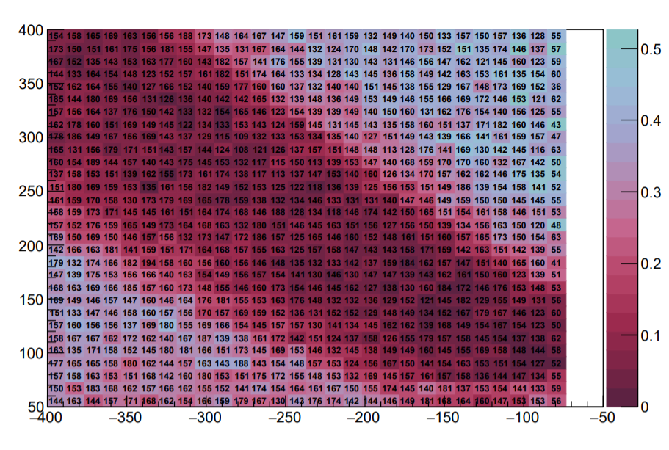
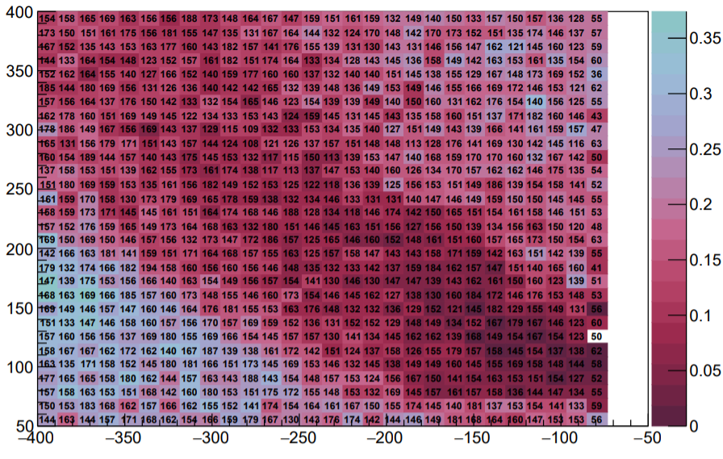
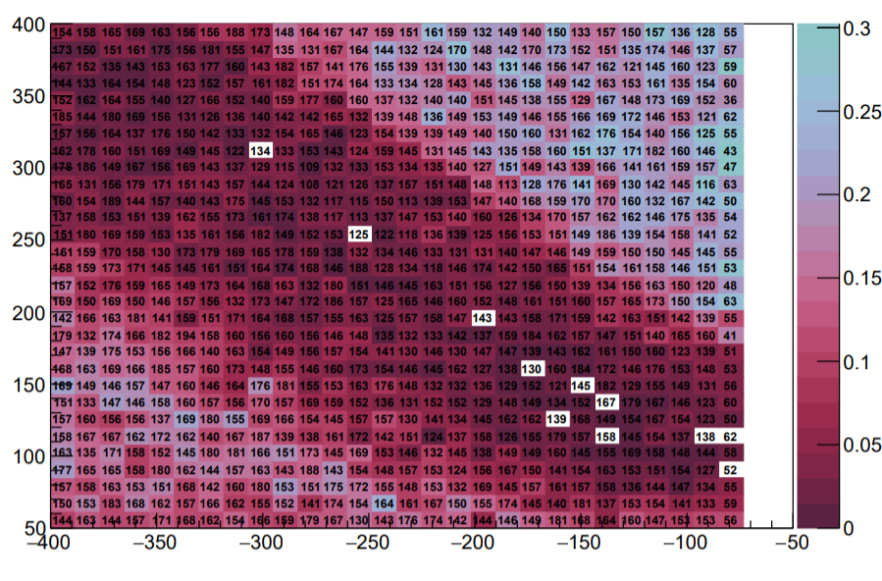
Additional Plots to Analyze Our Plot
800<Abs(M2)<1600
Wanted to see effect of M2 on cut efficiency. “Not-So-Well Tempered Neutralino” plots fixed other parameters so we also wanted to see if our plots matched when we required our parameters to be near theirs
Abs(M2) < 800GeV
Abs(M2)>1600

Slide 4
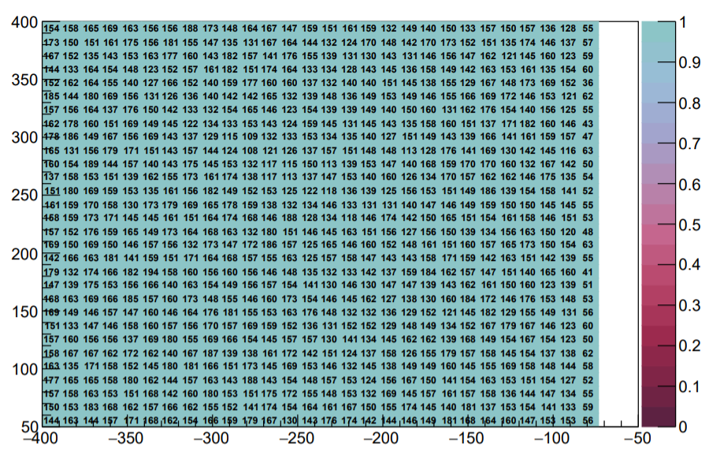
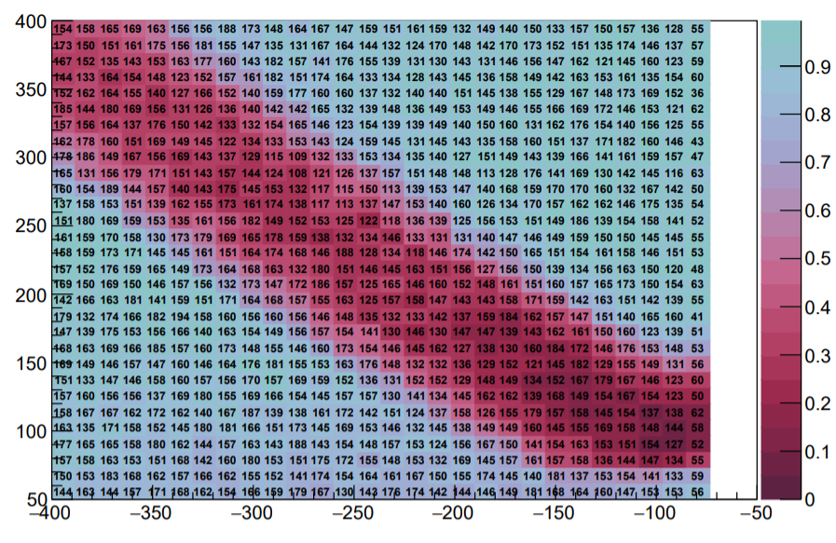

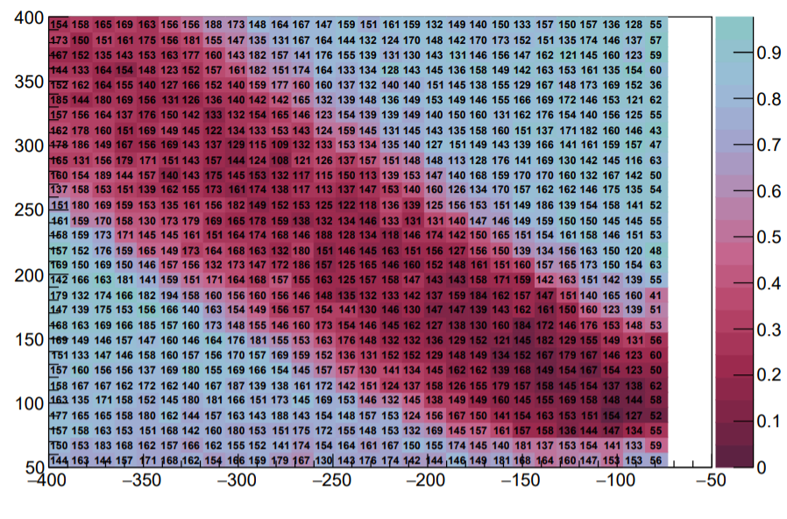
Additional Plots to Compare to Other Plots
cr3
PANDA
cdms
LUX

Slide 5
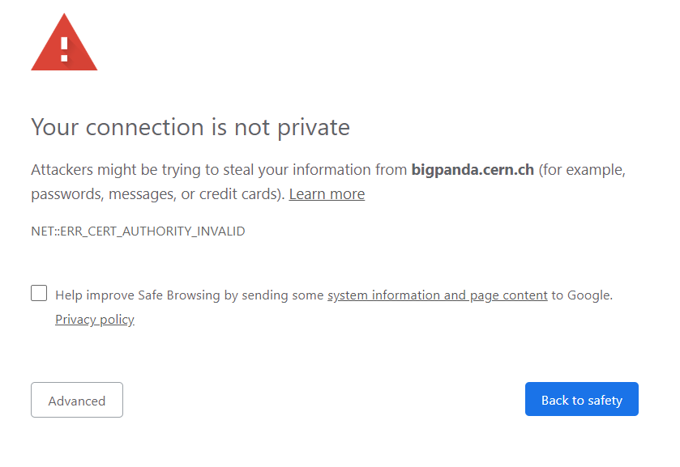
Submitting Jobs to Grid
Want to now do intense calculations and event simulations on our model points
This would take too long to do locally or on condor so we use the CERN computing grid
Thanks CERN!

Slide 6
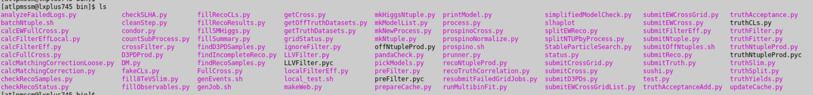
What’s next?
Understand the new code I’m running on the grid
Make more histograms, of course!
Amount of code I have to go through, trivial

