Slide 1
‘Tornado’ Plots for Front-End Testing
Michael McGinnis
May 6, 2019

Slide 2
The Tornado Plot
Measures the Front-End response time
  Low charges
  Due to actual performance vs ideal
  Also due to physics and area of detector
  SYNC is fastest, though LIN is simulated to approach it in RD53B
If the delay is too long, hits are assigned to the wrong bunch crossing
  Missing hit in one bunch and spurious hit in another

Slide 3
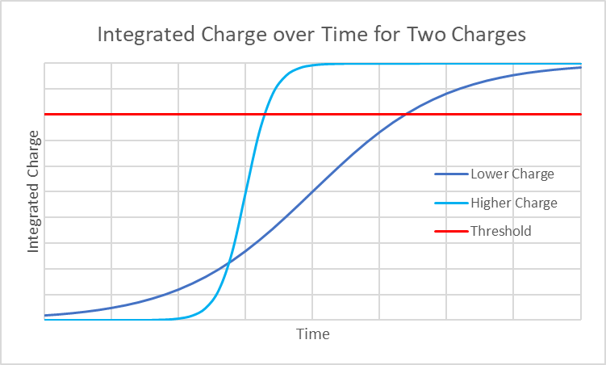
Integrated Charge is Read by Sensor
Since charge signal is a gaussian, the integrated charge is an s-curve.
Higher charge crosses threshold first
The tornado plot essentially shows this

Slide 4
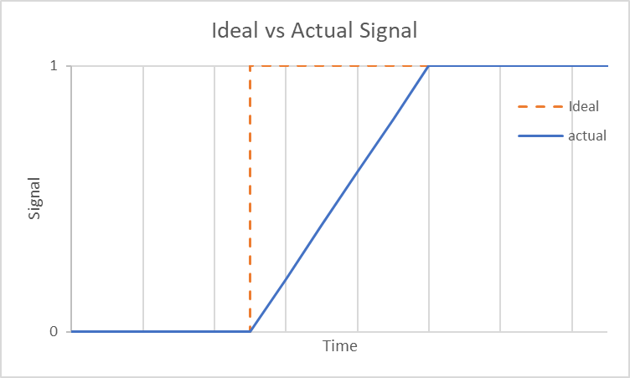
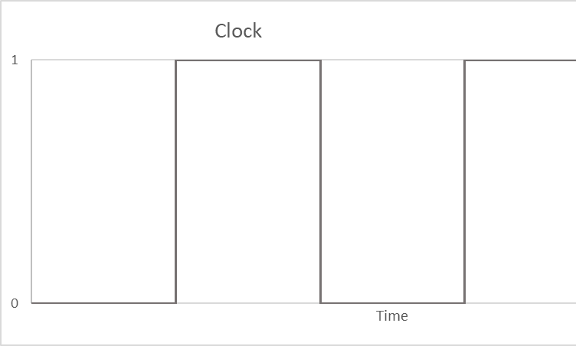
Delay in Chip Response
After the integrated charge crosses the threshold, the chip sends a signal
Requires time to send signals

Slide 5
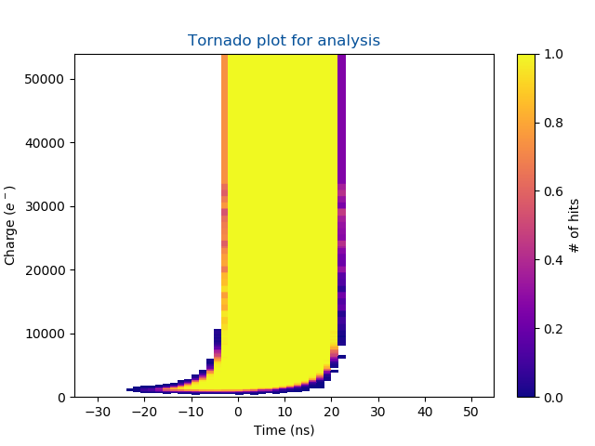
The Tornado Plot
The ideal tornado plot is a vertical rectangle above threshold of width 25ns
High charges are read correctly
Tail shows hits that are read in wrong bunch crossing
  Low charge, shallow s-curve
Charges below threshold are undetected

Slide 6
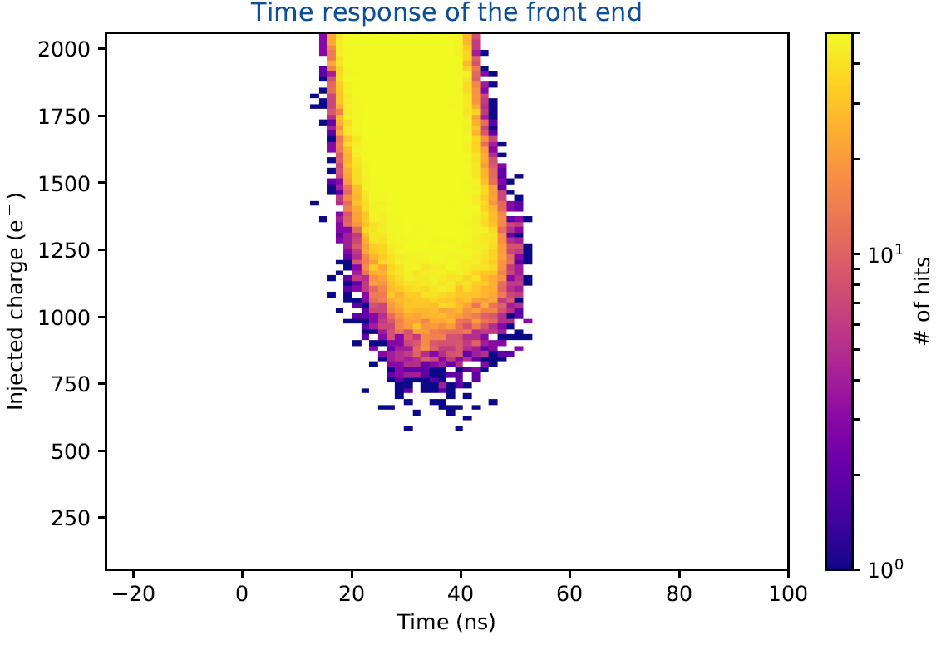
Zoom of Bottom of Tornado
Time inverted and not zeroed
Threshold in red
  Below this are undetected hits
One bunch crossing in black
  Outside of this are late hits

