Slide 1
HGCal & Neural Nets
05/06/2019
Slides By Toluwase Afolayan

Slide 2
Where did we leave off?
Finished with Simple Machine Learning testing comparing neural networks trained on different combinations of the clothing dataset
  Short Summary
    Higher accuracy w/ less epochs; networks over-train quickly
    Discerning images with vague color contrasts in B&W was difficult
    The non-convolutional models performed better, likely due to better suited activation functions and parameters
    Models maintained accuracy across flipped and regularly oriented sets.
Tasked with reformatting the clothing dataset to be input into the layers that other members of my group had developed and were testing; The Graph NN Layers called GarNet and GravNet.

Slide 3
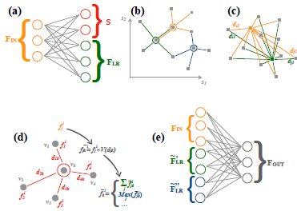
Quick GarNet & GravNet Summary
These Layers are designed to improve performance on particle reconstruction tasks in comparison to more basic layer architectures that might be used like CNNS.
Normally, convolutional layers are used for patter recognition. These rely on a regular pixel grid. The HGCal has hexagonal sensors with different sizes and is therefore not a regular pixel grid. Because of this convolutional NNs are not suitable.
Graph NNs allow for far improved quantization of relation and dependence between different parts of a complicated system like reconstructed track data.
They receive an Input with dimension B x V x F_in where B is batch size or the number of samples in the dataset, V is the set of detector hits, that are embedded in the data set through F_in which are the features.
They require this input shape because the way they will analyze the information from the data set will be by taking each sensors information one by one and processing it through filters rather than looking over the whole detector at once as though it were an image

Slide 4
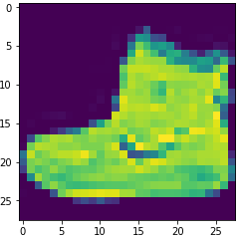
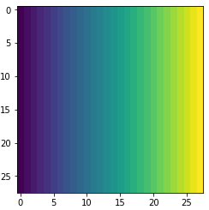
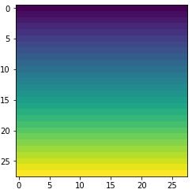
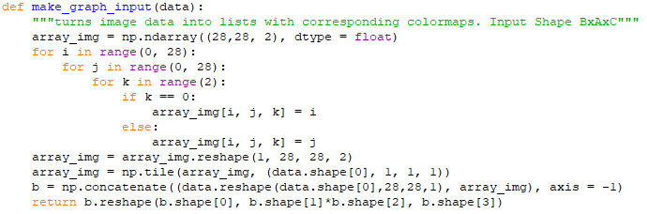
Making Input Format for GarNet/GravNet
Next Task was to take the Fashion MNIST clothing data set and convert it from B X Length X Width X channel to B X (L*W) X 2 Color Maps
This will change the input from
  60,000 X 28 X 28 X 1
  to
  60,000 X 784 X 3
The last dimension is the channel and is the color that makes up each pixel that we see, each pixel as 2 colors each stacked on top of each other in the ‘eyes’ of a neural network
Each picture is made into a 1 dimensional list of all 784 of its pixels to which corresponded a color taken from a color map gradient of that pixel in accordance to what channel colors that pixel in the initial array was valued as.
Original Image
0th index color map
1st index color map

Slide 5
Current Status
Transported all my code from Jupyter Notebooks, to python scripts on the on a CC7 Virtual Machine.
Begun doing tests with GarNet layers, and playing around with parameters.
Currently encountering an issue where my accuracies from epoch to epoch will be stagnated at exactly .1000 or 10.00% without changing.
  Problem appears to be caused in part by the weighted_sum_layer function
  GNNs are sensitive to parameter changes which likely contributes to the low accuracies
  Trying to figure out which characteristics affect this issue the most
Improving Network performance analysis methods, w/ Early-Stopping mechanics, validation datasets, and MatPlotLib loss and accuracies Graphs.
Plan to have a GarNet model training using GPUs by later this week.
The intention here is to get a better for how these particular GNN Layers work and why they are most effective for the problem of HGCAL data analysis

Slide 6
Questions?

